Slide 1

Chapter 8
Aggregate Demand and Economic Fluctuations

Slide 2
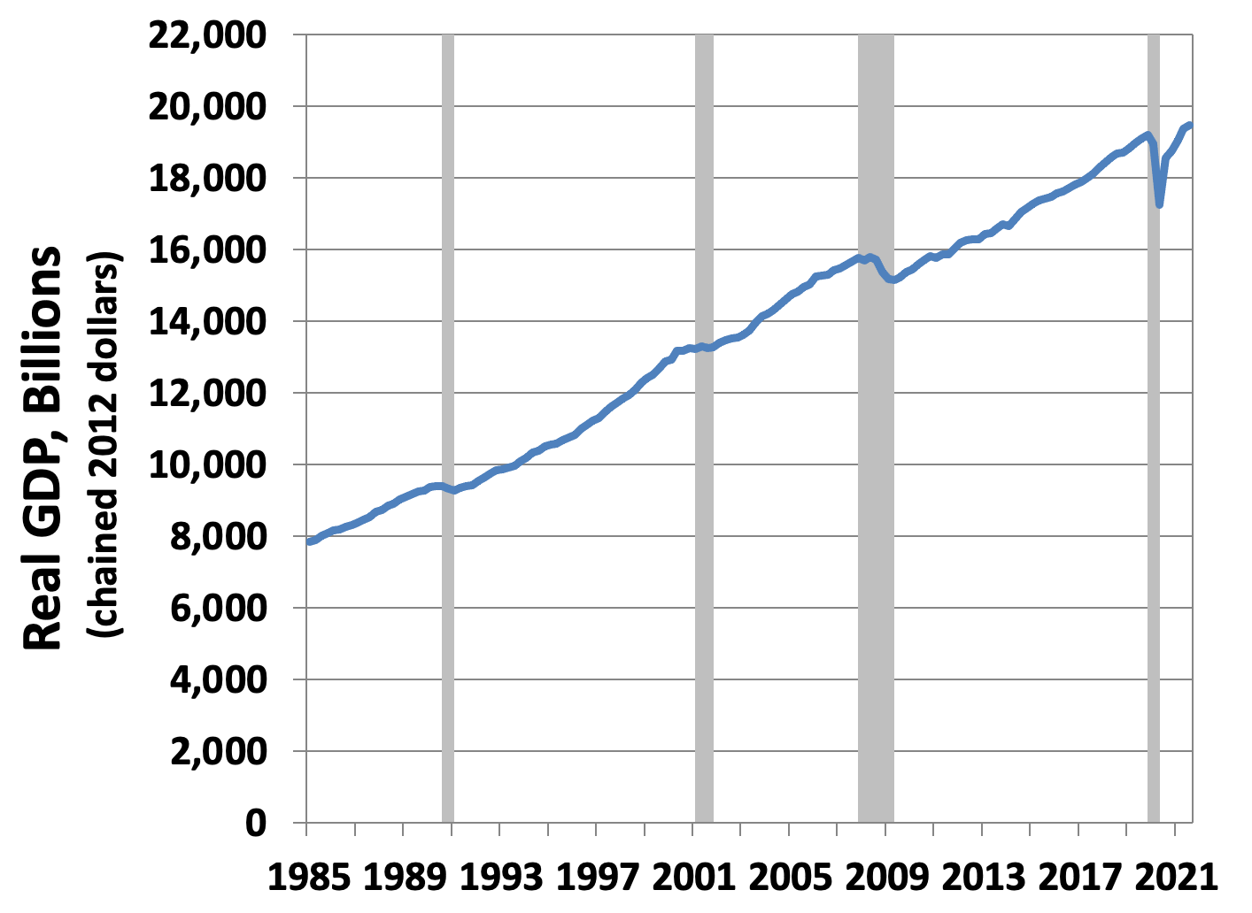
Figure 8.1: U.S. Real GDP and Recessions, 1985–2021
Source: BEA quarterly data 1985–2021, and NBER.

Slide 3
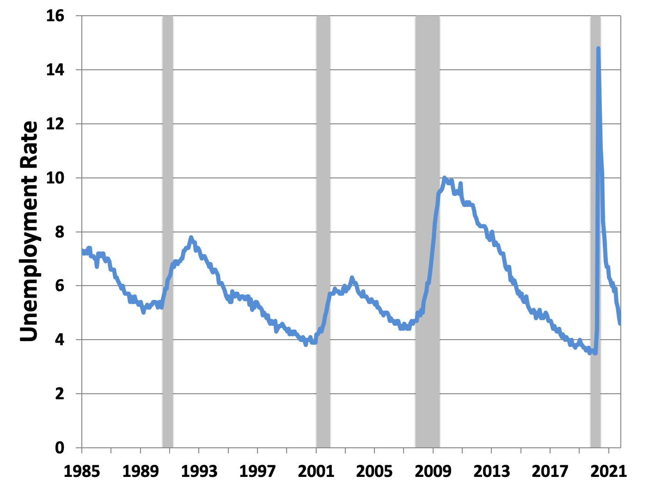
Figure 8.2: U.S. Unemployment Rate and Recessions, 1985–2017
Source: BLS monthly data 1985–2021, and NBER.

Slide 4
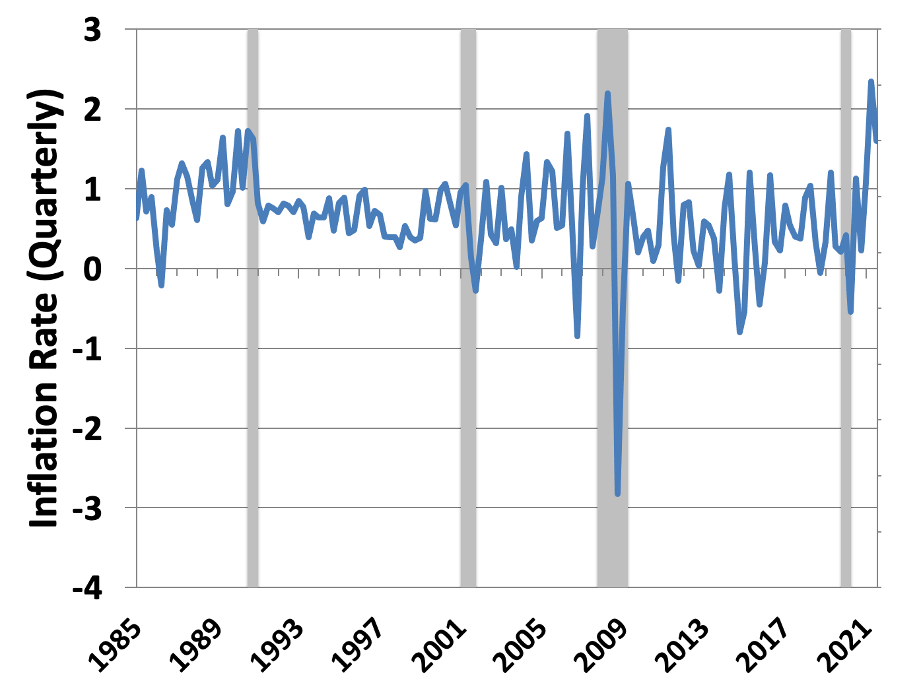
Figure 8.3: U.S. Inflation Rate and Recessions, 1985–2017
Source: “Economic Report of the President” 1985–2021; rate is calculated as a three-month moving average of the CPI; NBER.

Slide 5
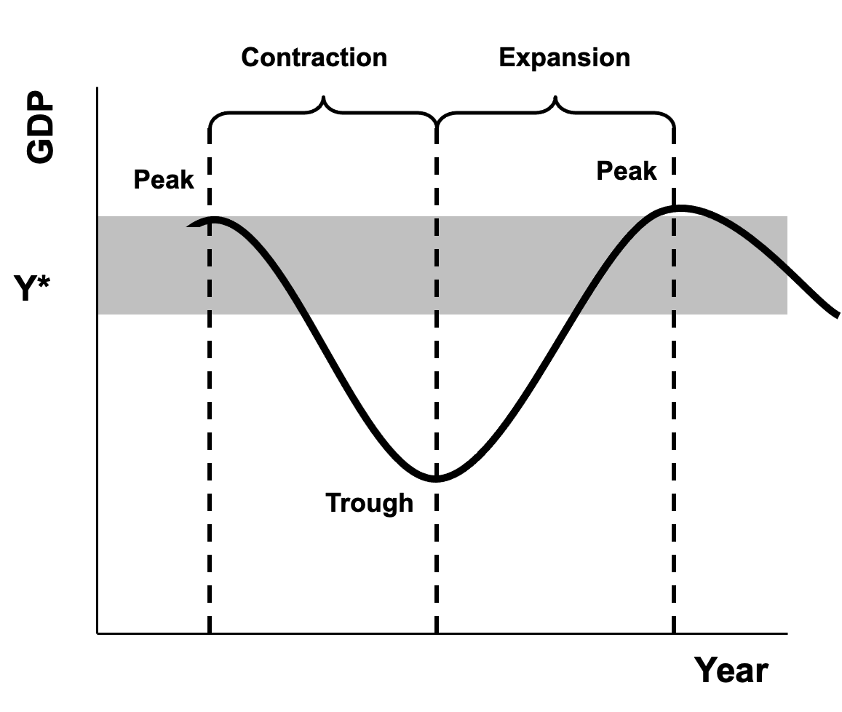
Figure 8.4: A Stylized Business Cycle

Slide 6
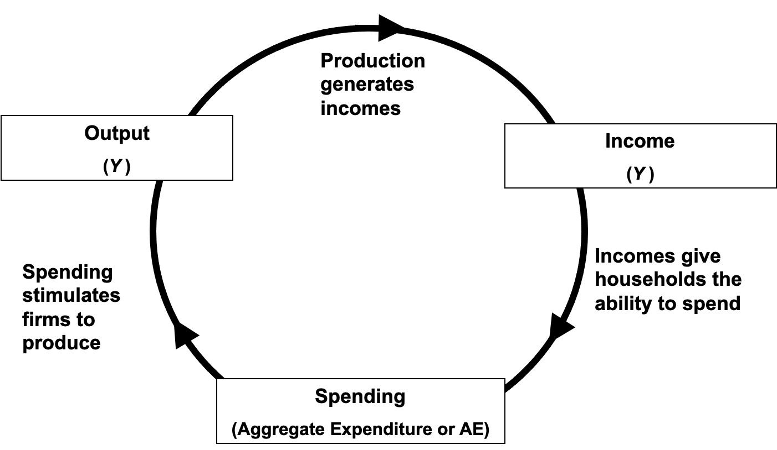
Figure 8.5: The Output-Income-Spending Flow of an Economy in Equilibrium

Slide 7
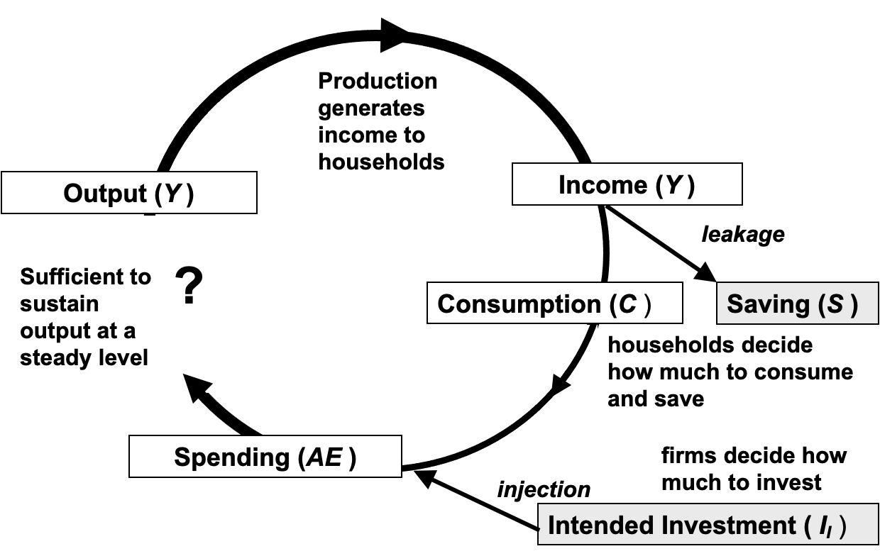
Figure 8.6: The Output-Income-Spending Flow with Leakages and Injections

Slide 8
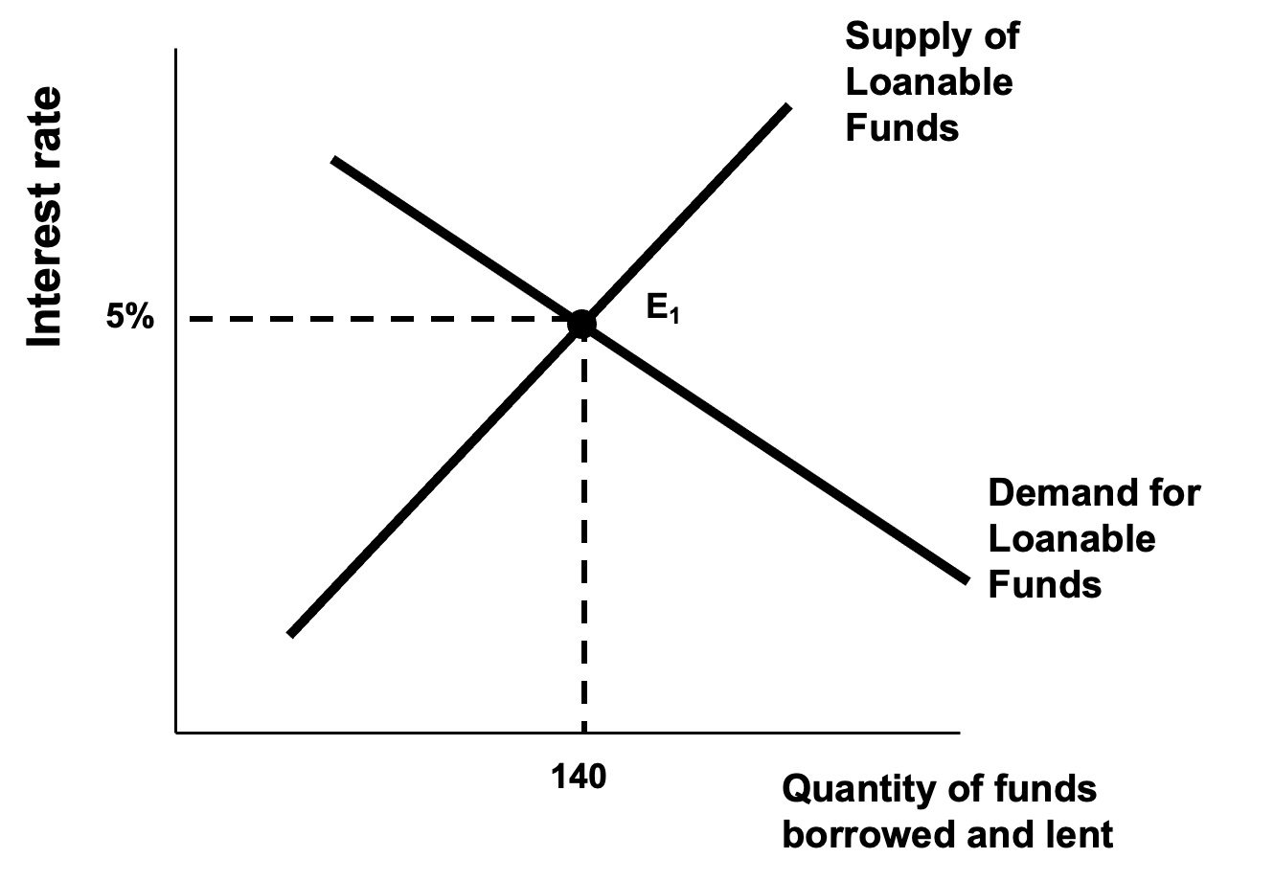
Figure 8.7: The Classical Model of the Market for Loanable Funds

Slide 9
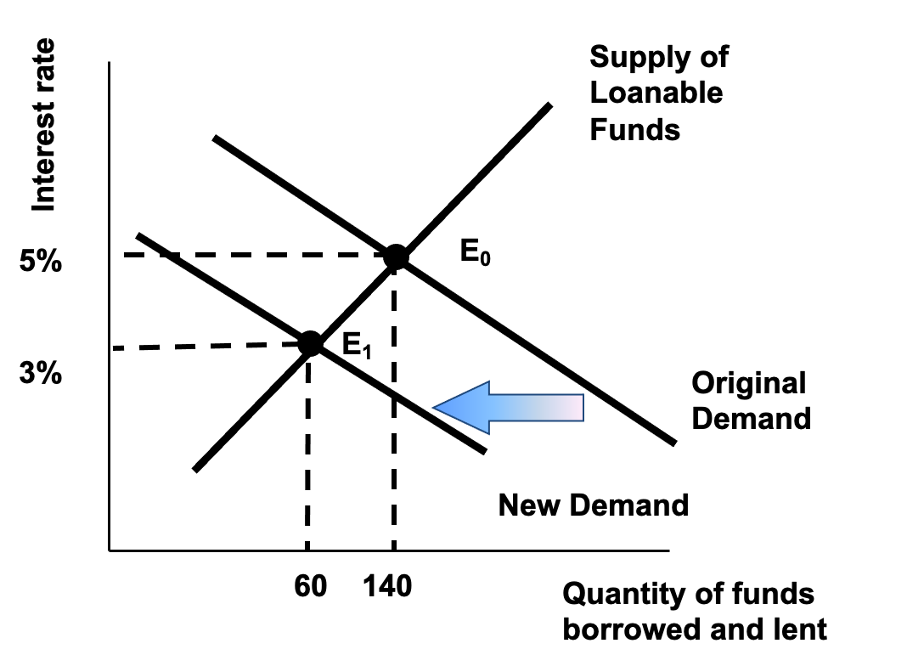
Figure 8.8: Adjustment to a Reduction in Intended Investment in the Classical Model

Slide 10
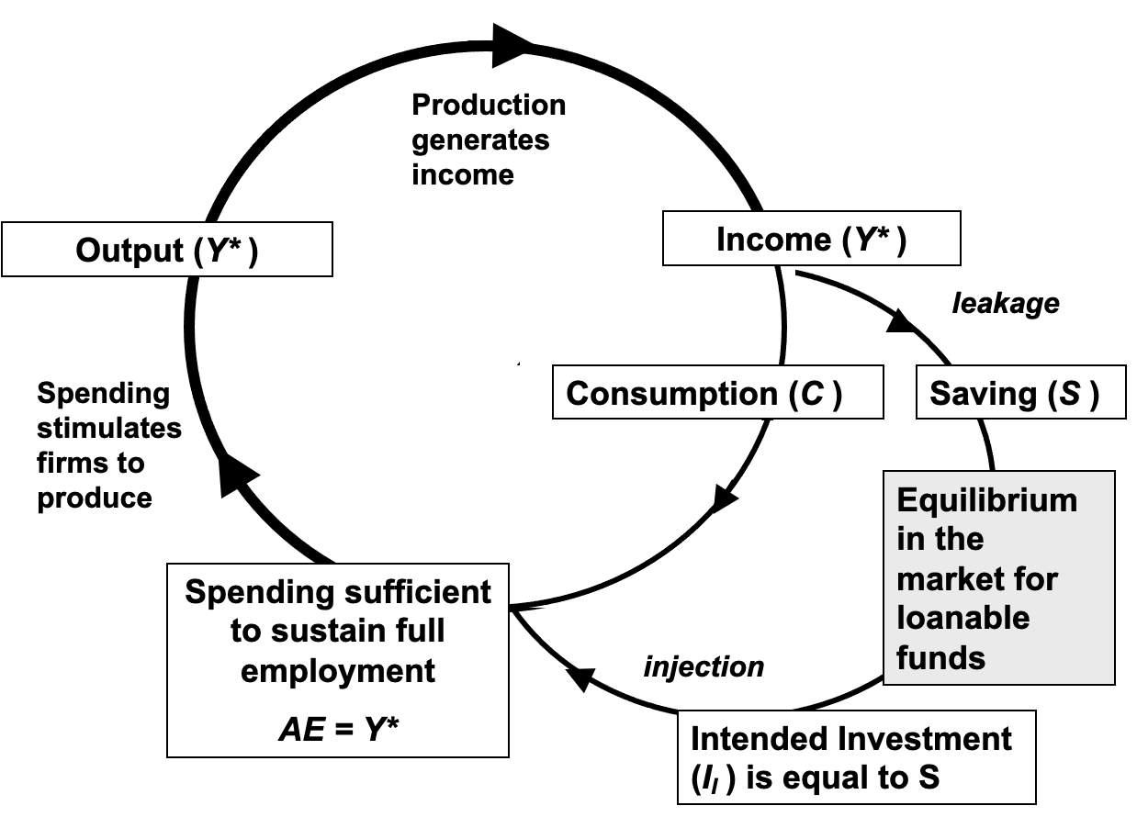
Figure 8.9: Macroeconomic Equilibrium at Full Employment in the Classical Model

Slide 11
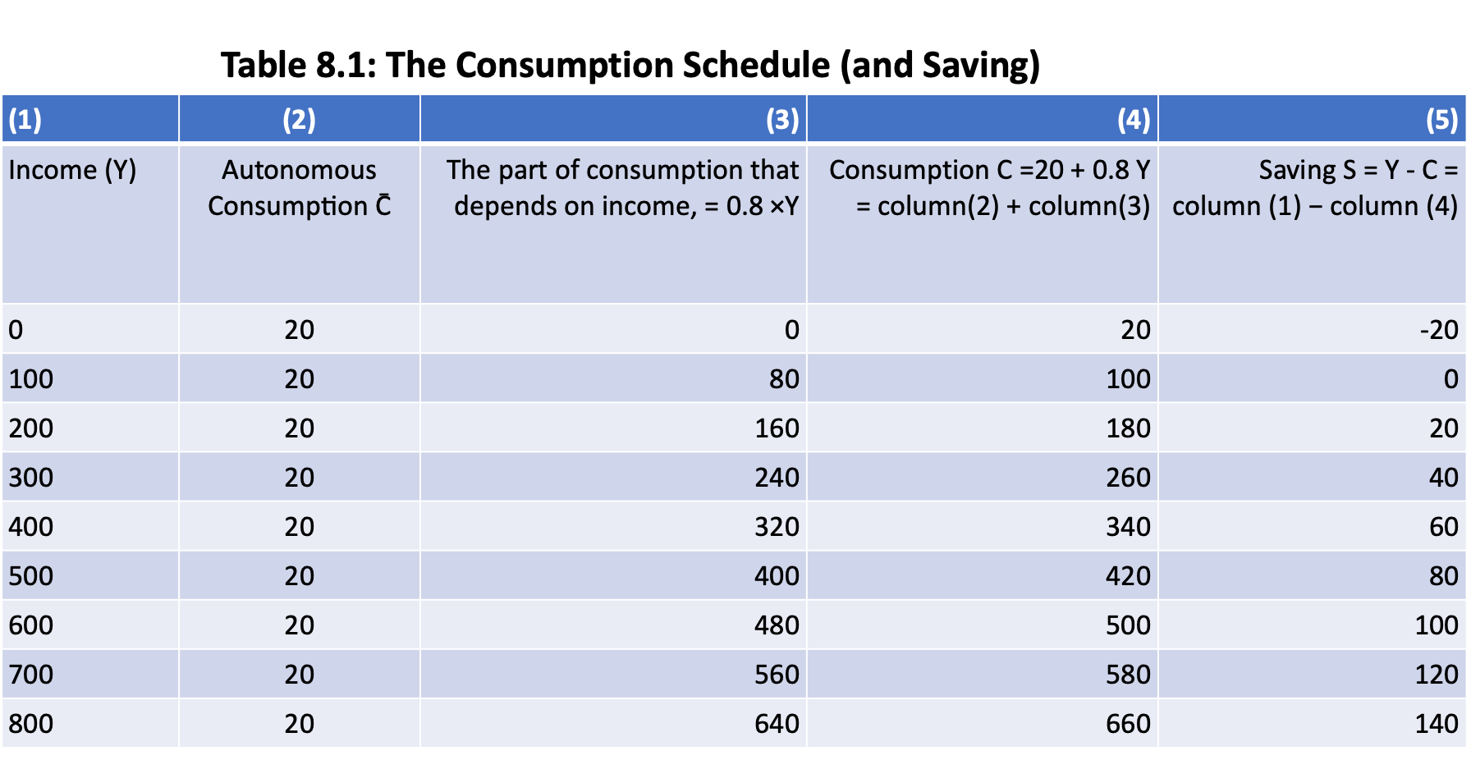

Slide 12
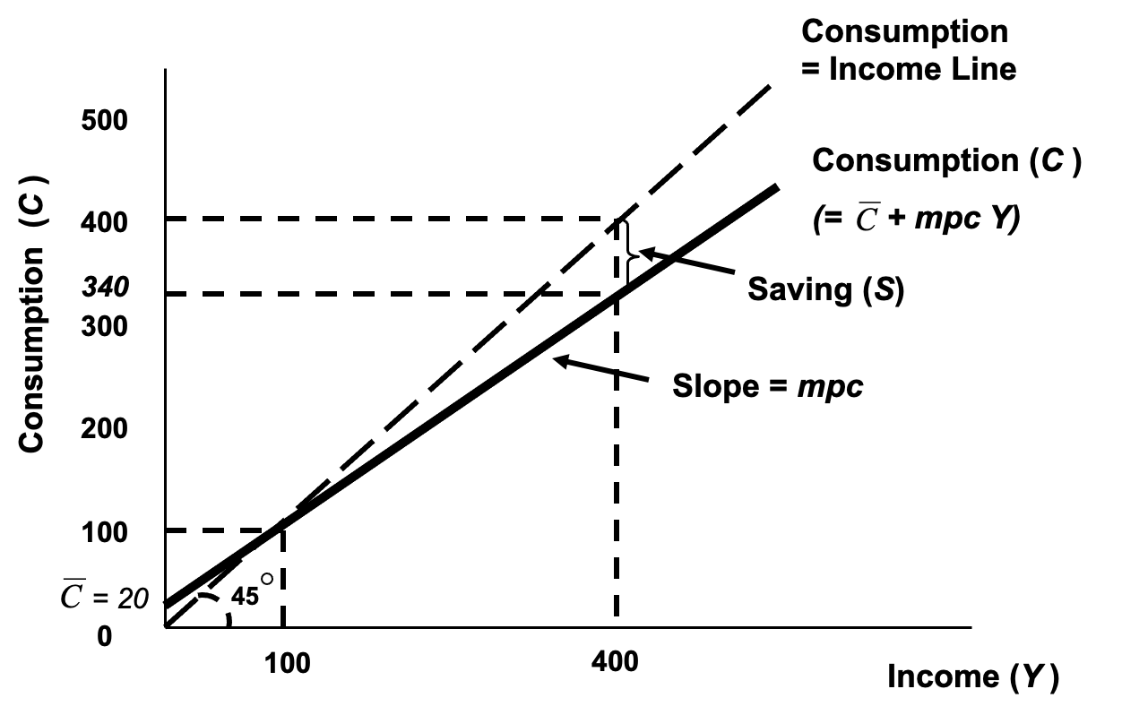
Figure 8.10: The Keynesian Consumption Function

Slide 13
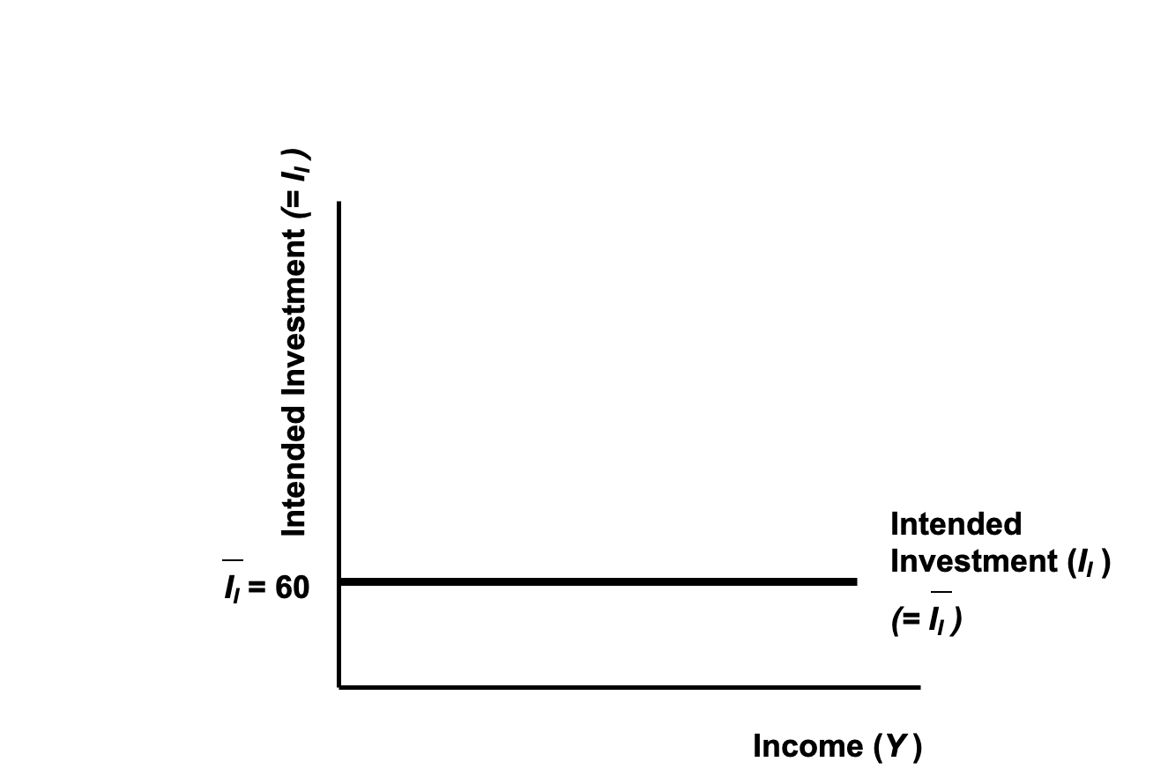
Figure 8.11: The Keynesian Investment Function

Slide 14
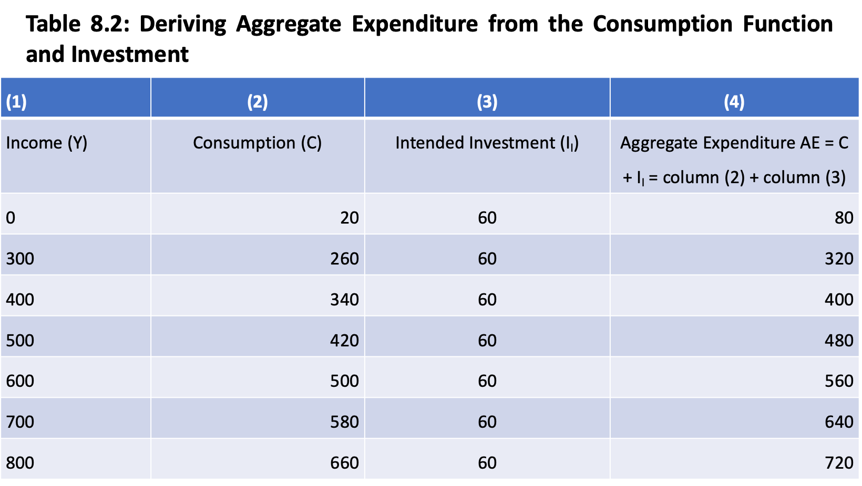

Slide 15
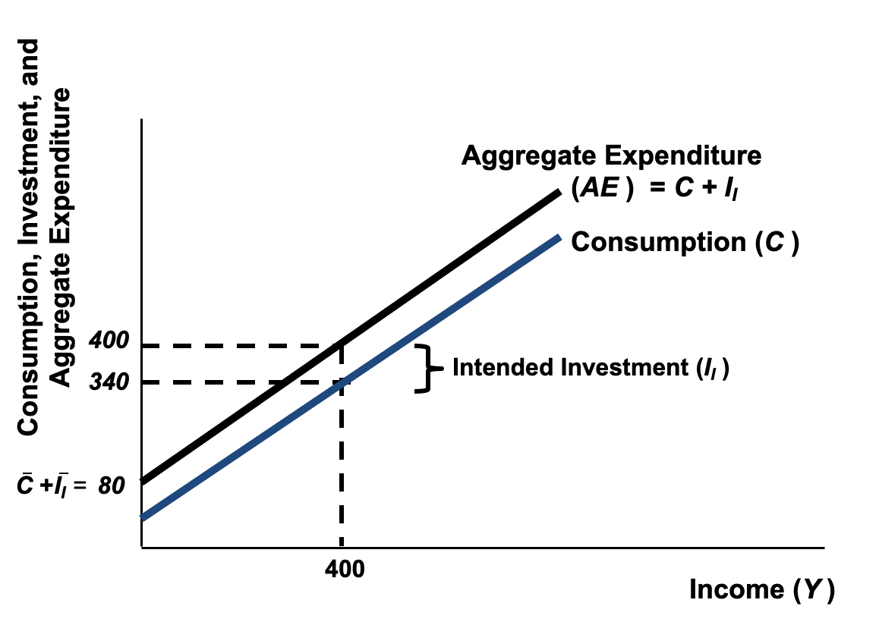
Figure 8.12: Aggregate Expenditure

Slide 16
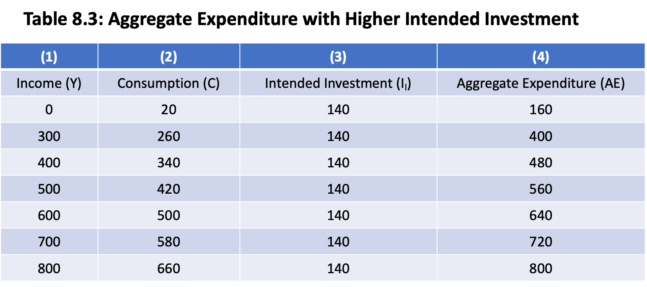

Slide 17
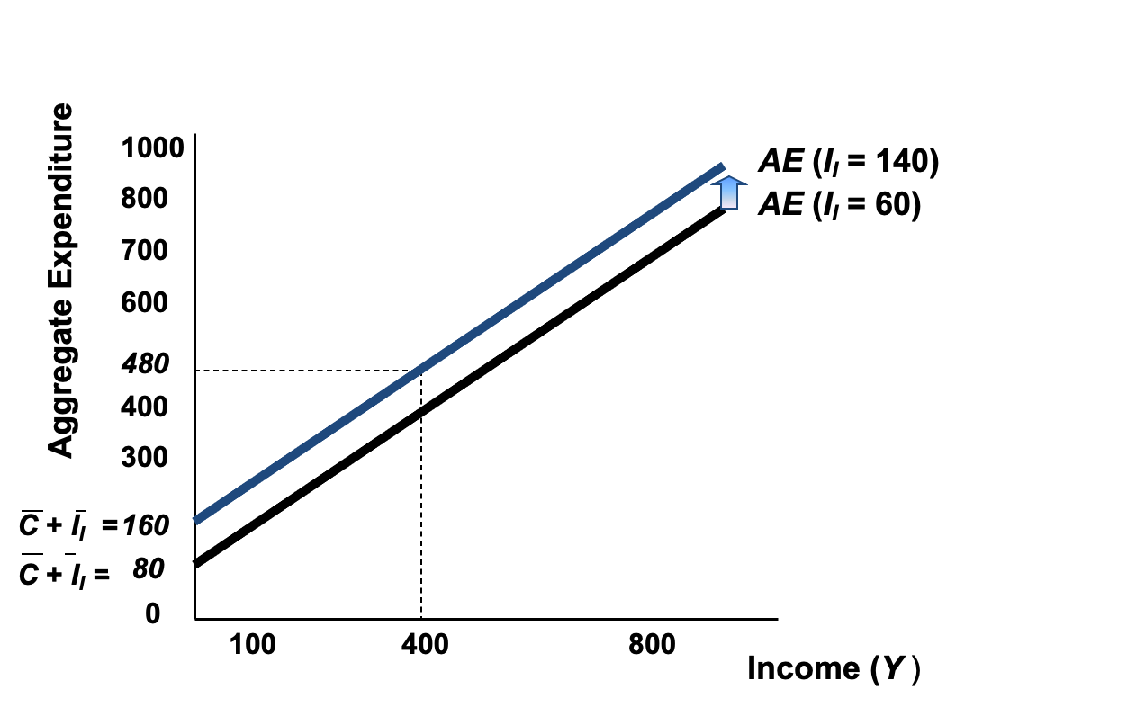
Figure 8.13: Aggregate Expenditure with Higher Intended Investment

Slide 18
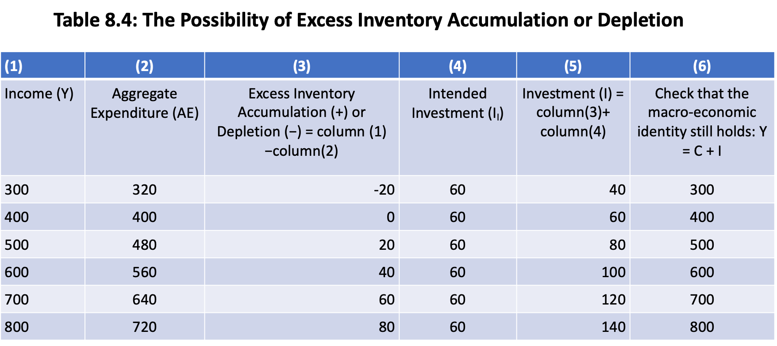

Slide 19
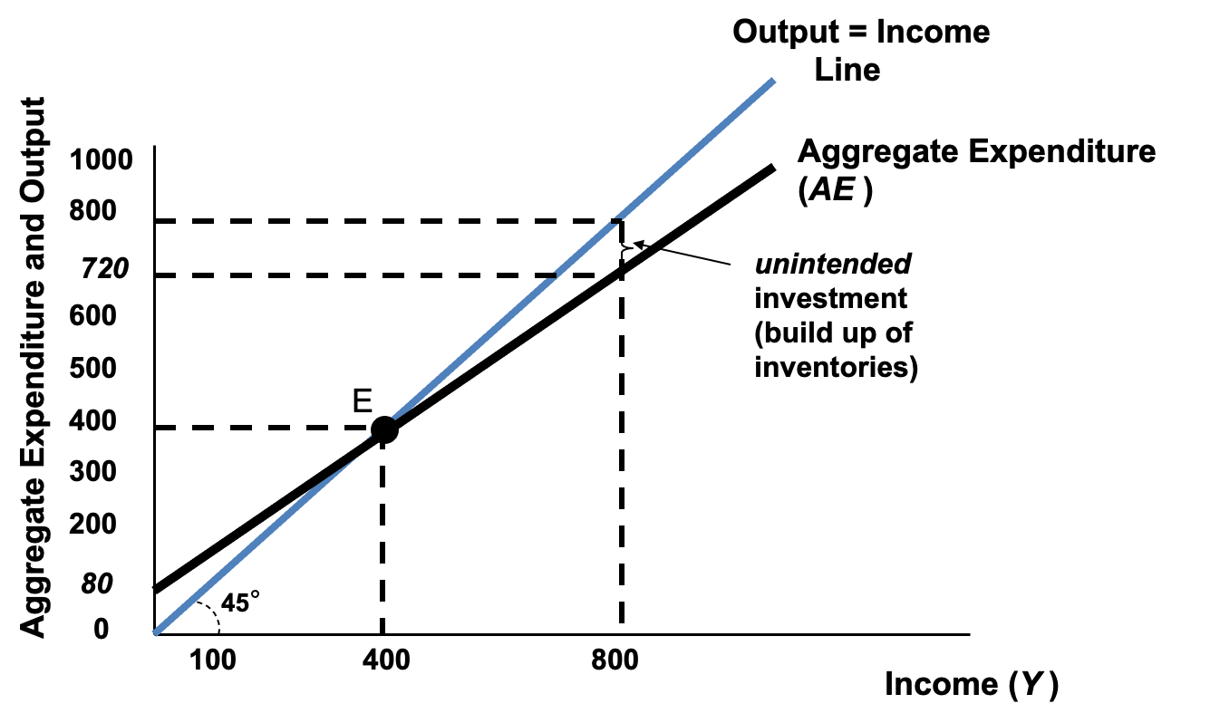
Figure 8.14: Unintended Investment in the Keynesian Model

Slide 20
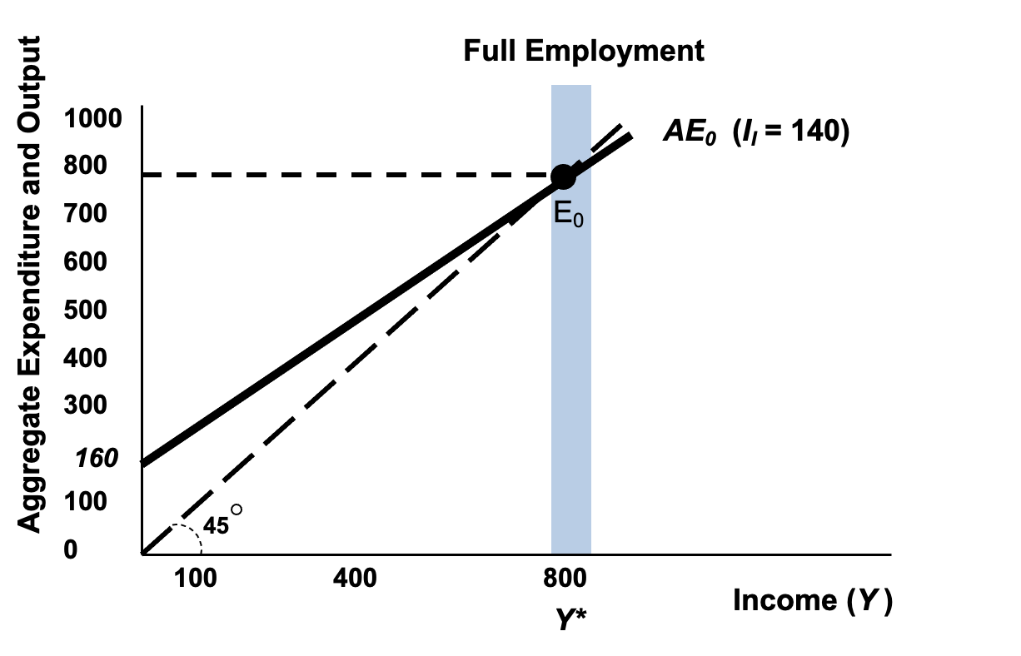
Figure 8.15: Full Employment Equilibrium with High Intended Investment

Slide 21
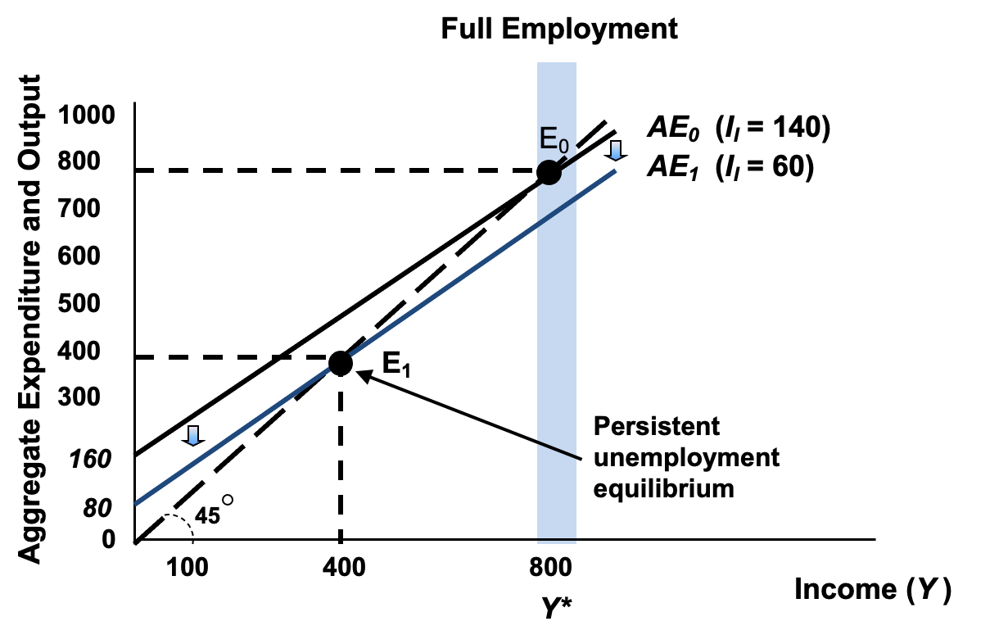
Figure 8.16: A Keynesian Unemployment Equilibrium

Slide 22
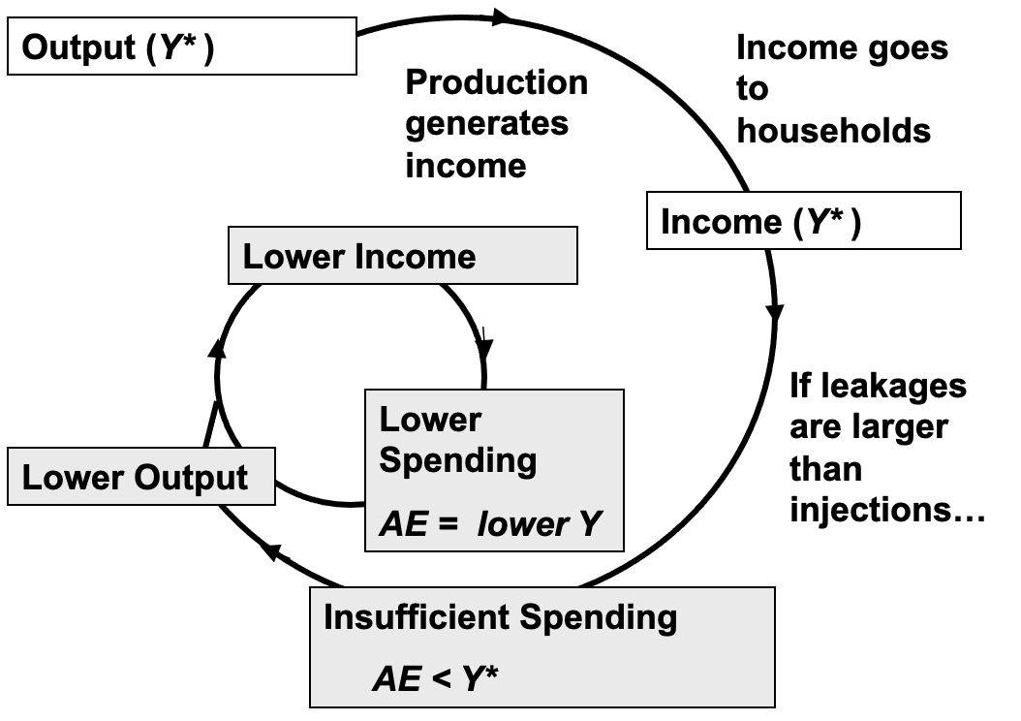
Figure 8.17: Movement to an Unemployment Equilibrium

Slide 23
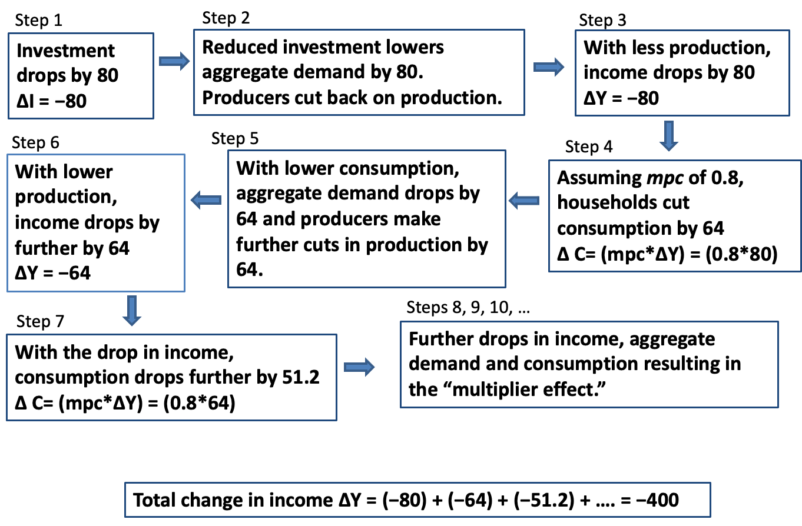
Figure 8.18: The Multiplier at Work

