Slide 1

Chapter 7
Employment, Unemployment, and Wages

Slide 2
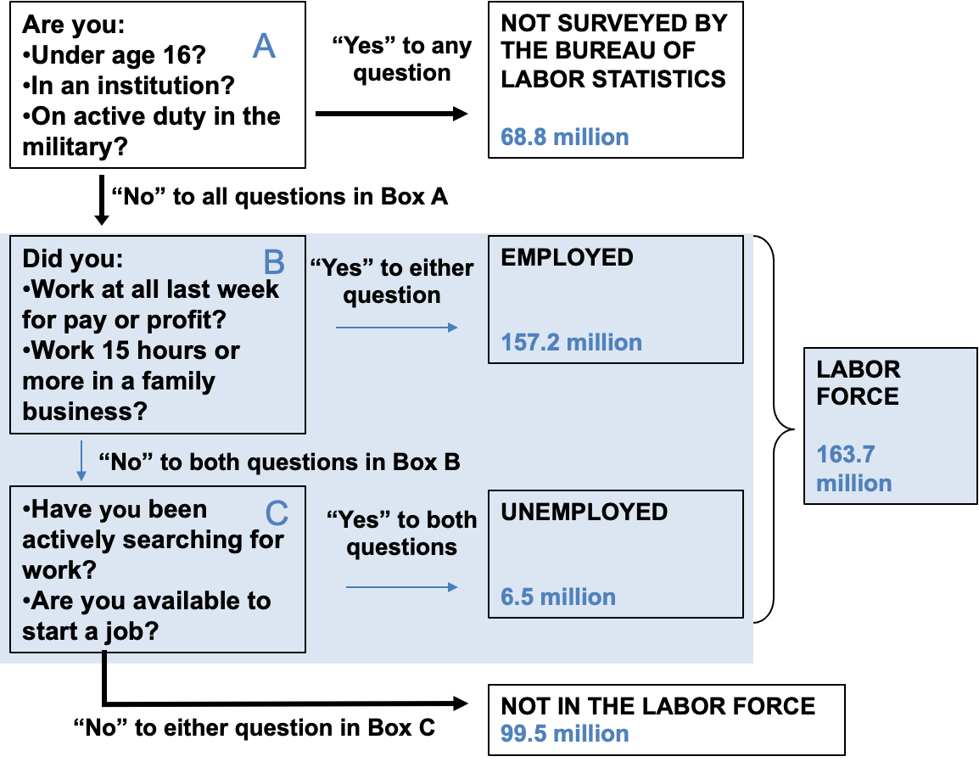
Figure 7.1: Who Is In the Labor Force?
Source: BLS News Release, “The Employment Situation—January 2022,” February 2022; U.S. Census Bureau Current Population Clock.

Slide 3
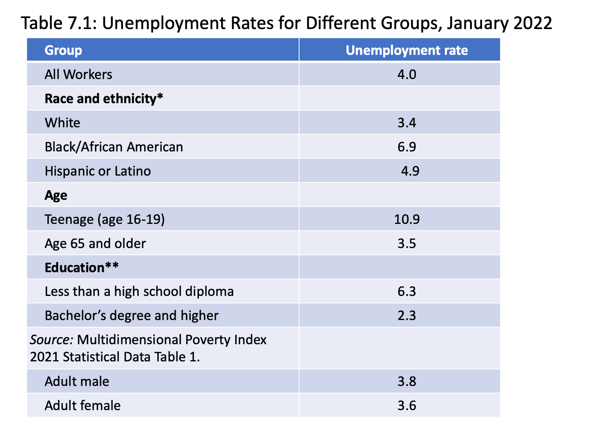
Source: BLS News Release, “The Employment Situation—January 2022,” February 4, 2022.
*People are allowed to indicate more than one racial group.
** Data on unemployment by education is for the age-group 25 years and over.

Slide 4
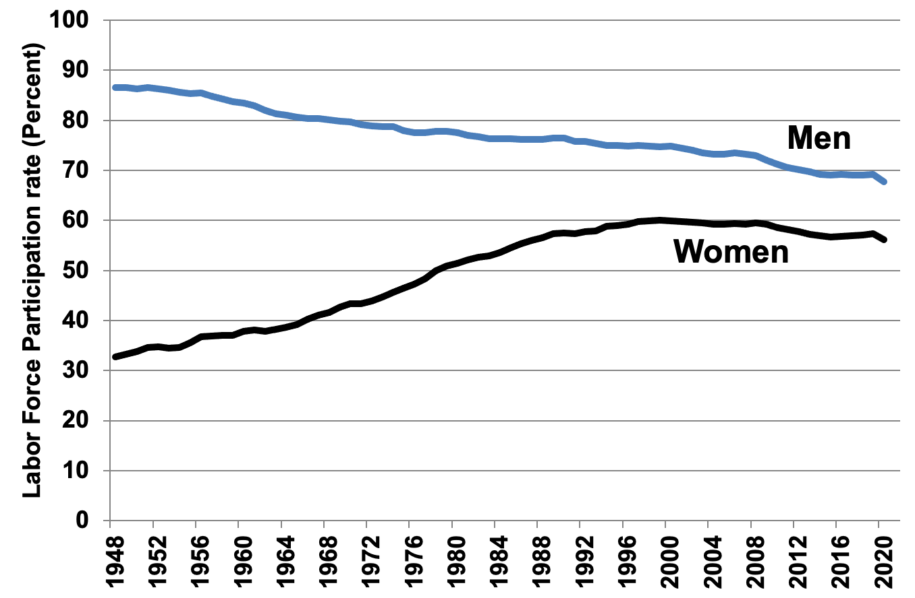
Figure 7.2: Male and Female Labor Force Participation Rates, 1948–2020
Source: Bureau of Labor Statistics, Labor Force Participation Rate, retrieved from FRED, Federal Reserve Bank of St. Louis

Slide 5
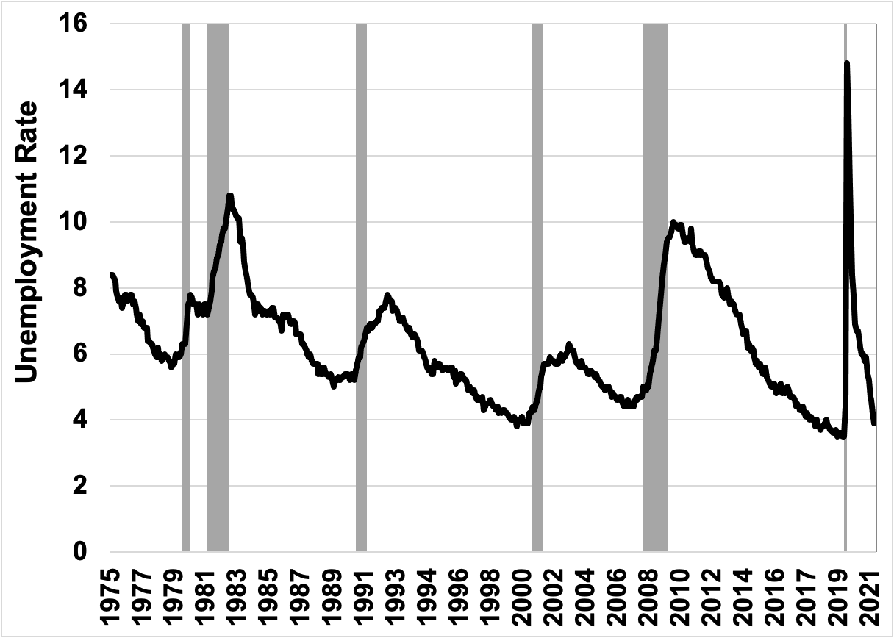
Figure 7.3: The Monthly Unemployment Rate in the United States, 1975–2021
Source: U.S. Bureau of Labor Statistics online database.
Notes: Recessionary periods shaded.

Slide 6
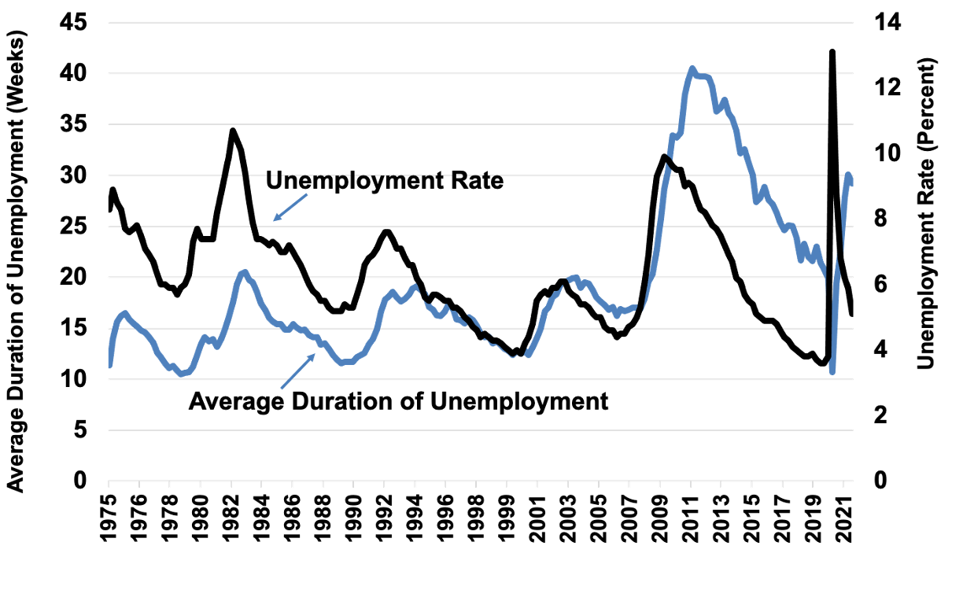
Figure 7.4: Average Duration of Unemployment and Unemployment Rate, 1975–2021
Source: U.S. Bureau of Labor Statistics online database.

Slide 7
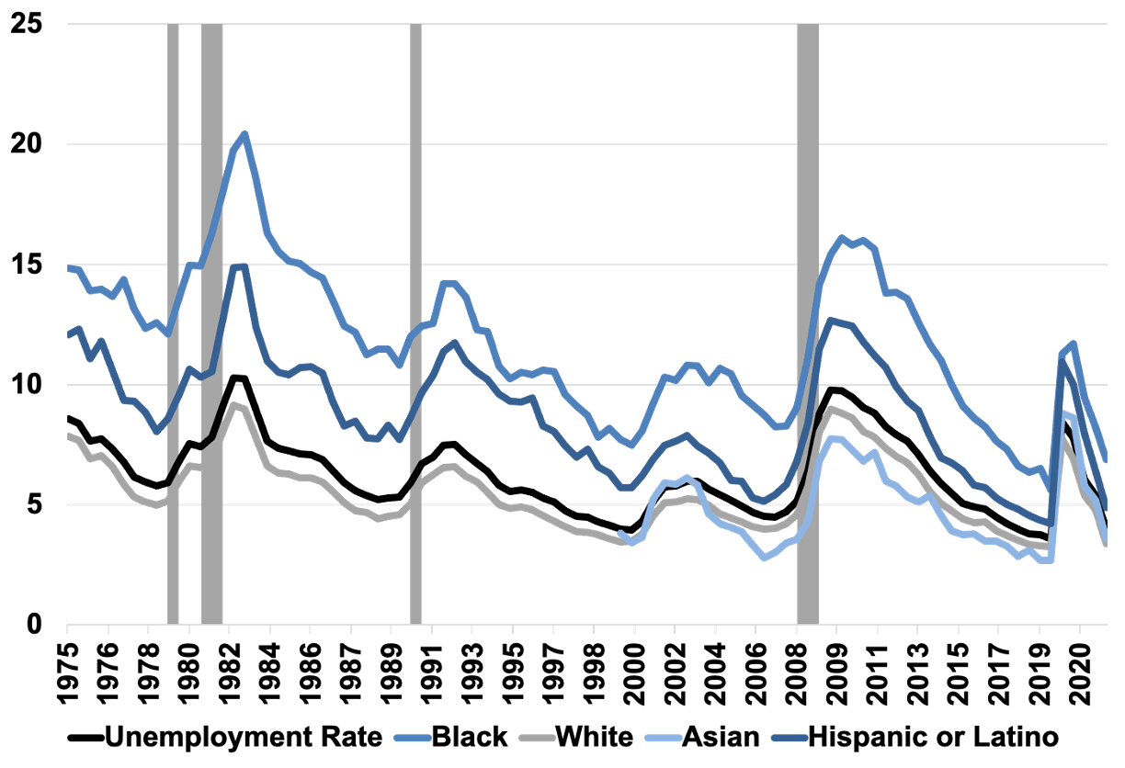
Figure 7.5: Unemployment Rate by Race, 1975–2021
Source: U.S. Bureau of Labor Statistics online database.

Slide 8
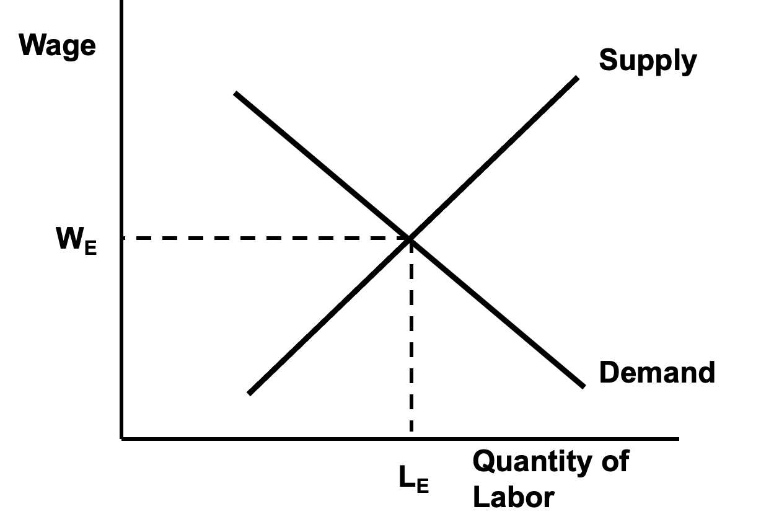
Figure 7.6a: The Classical Labor Market Model

Slide 9
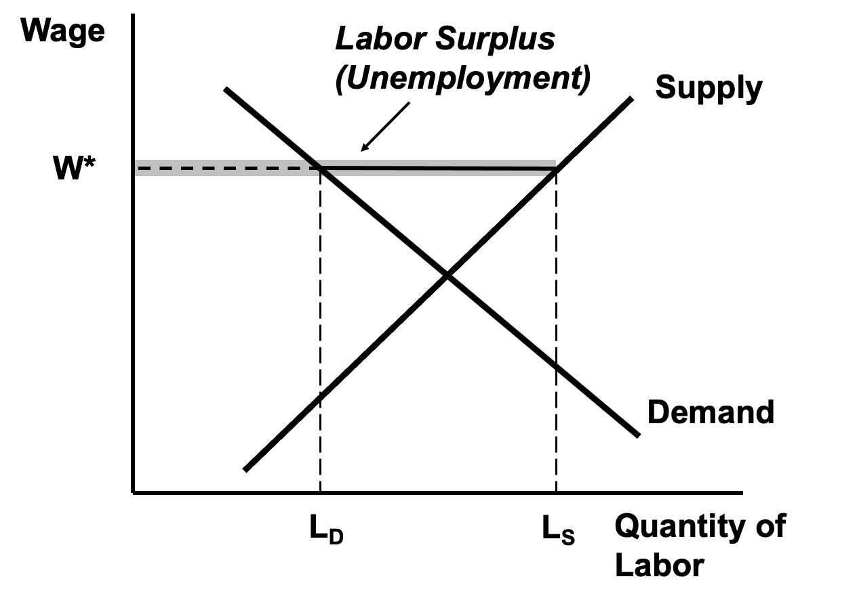
Figure 7.6b: Unemployment in the Classical Labor Market Model

Slide 10
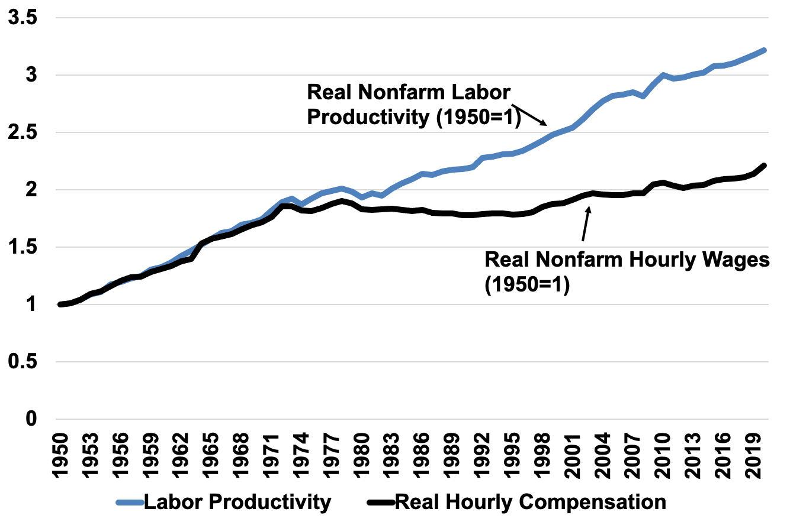
Figure 7.7: Real Nonfarm Median Wages and Labor Productivity, 1947–2016
Source: U.S. Bureau of Labor Statistics, Labor Productivity and Costs online database.

