Slide 1

Chapter 6
The Structure of the United States Economy

Slide 2
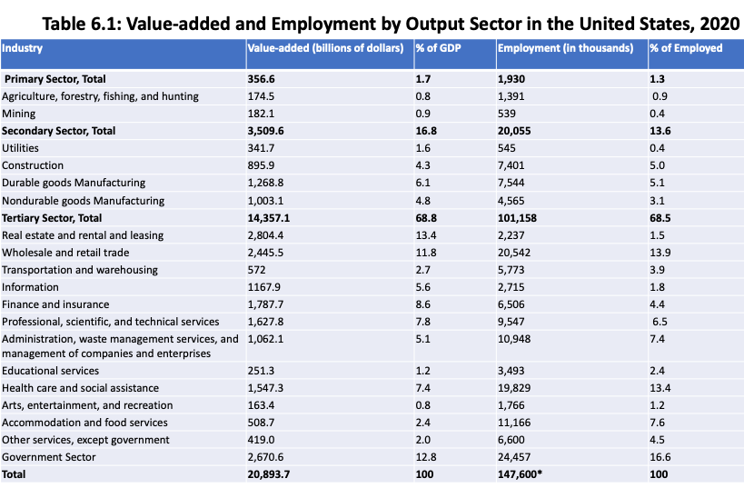
Source: Bureau of Economic Analysis

Slide 3
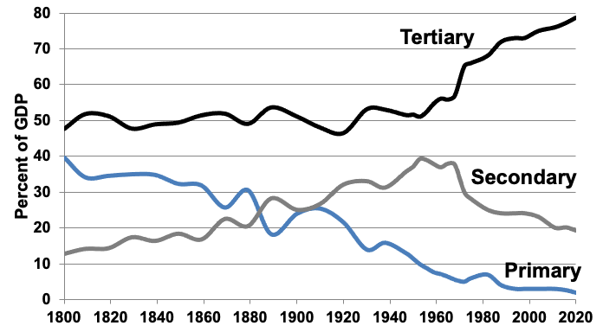
Figure 6.1: Relative Shares of United States Economic Production, by Output Sector, 1800–2020
Sources: Historical Statistics of the United States, 1789–1945, U.S. Census Bureau, 1949 (1800– 1938); Historical Statistics of the United States, Bicentennial Edition, Colonial Times to 1970, U.S. Census Bureau, 1975 (1947–1968); various annual editions of the Statistical Abstract of the United States, U.S. Census Bureau (1969–2020).
Note: This graph shows relative, not absolute, magnitudes.

Slide 4
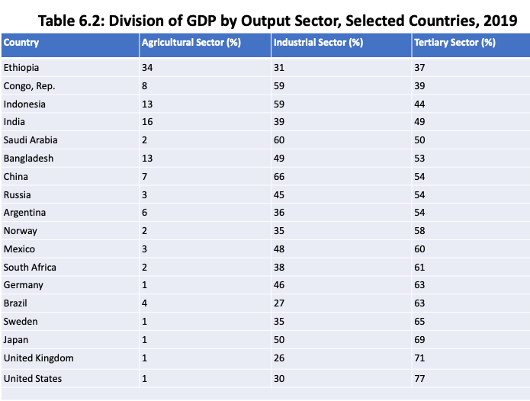
Source: World Bank, World Development Indicators database, 2019.

Slide 5
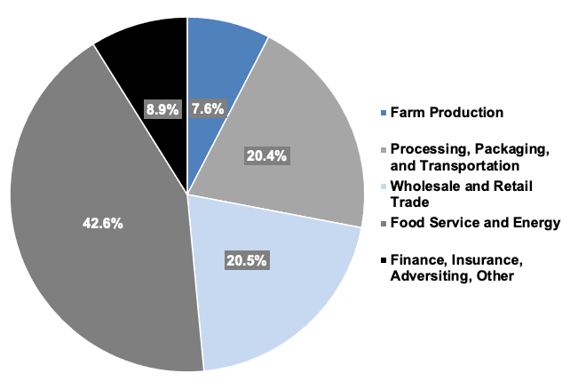
Figure 6.2: The Allocation of a Dollar Spent on Food in the United States, 2019
Source: U.S. Department of Agriculture (USDA), Food Dollar Series, 2019.
Note: “Other” includes two industry groups, Agribusiness plus Legal and Accounting.

Slide 6
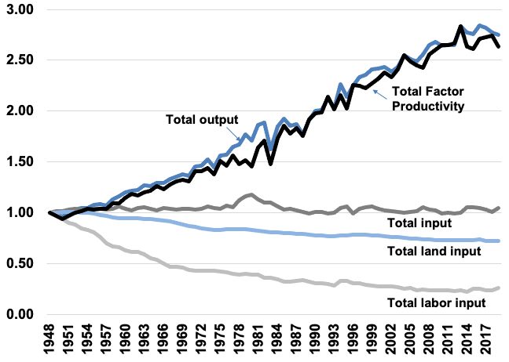
Figure 6.3: U.S. Total Factor Productivity Growth, 1948-2017
Source: USDA, Economic Research Services data, Table 1. Indices of farm output, input, and total factor productivity for the United States, 1948-2017.

Slide 7
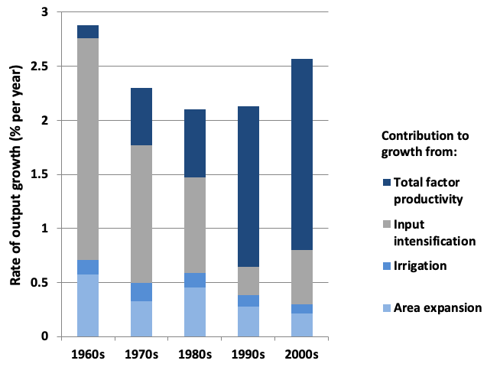
Figure 6.4: Average Annual Growth Rate in Gross Global Agricultural Output (1960s–2000s)
Source: Fuglie and Wang, 2012.

Slide 8
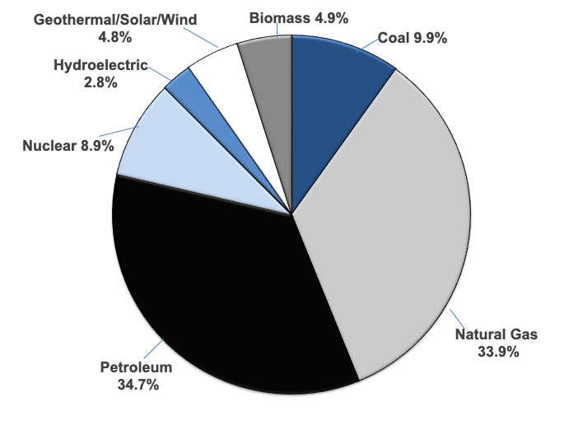
Figure 6.5: Energy Consumption in the United States, by Energy Source, 2020
Source: Monthly Energy Review, United States Energy Information Administration, 2020.

Slide 9
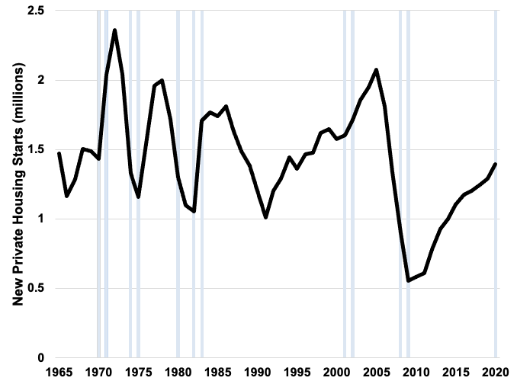
Figure 6.6: Annual Number of Private Housing Starts in the United States, 1965–2020
Sources: U.S. Census Bureau, Department of Housing and Urban Development.

Slide 10
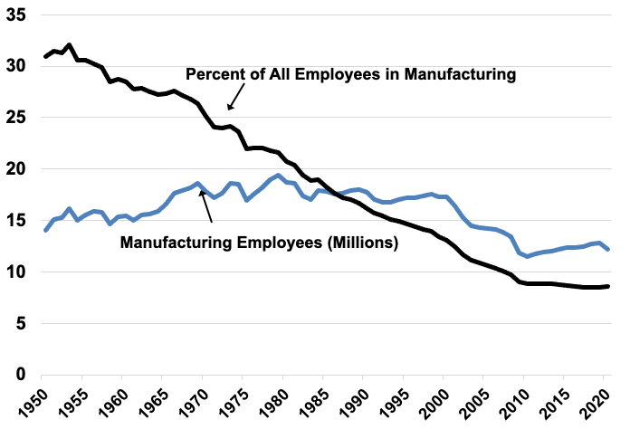
Figure 6.7: Total U.S. Manufacturing Employment and Manufacturing Employment as a Percentage of Total Employment, 1950–2020
Source: Various editions of the Statistical Abstract of the United States.

Slide 11
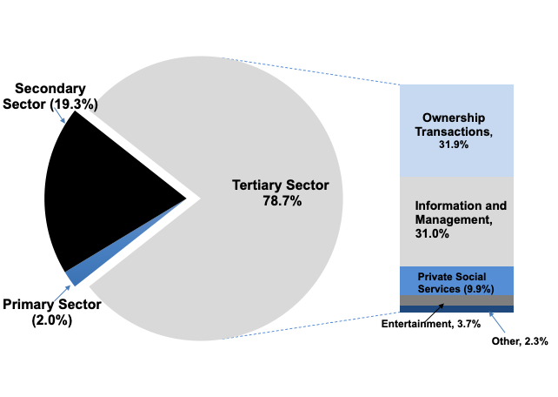
Figure 6.8: Classification of Private GDP in the United States, 2020

Slide 12
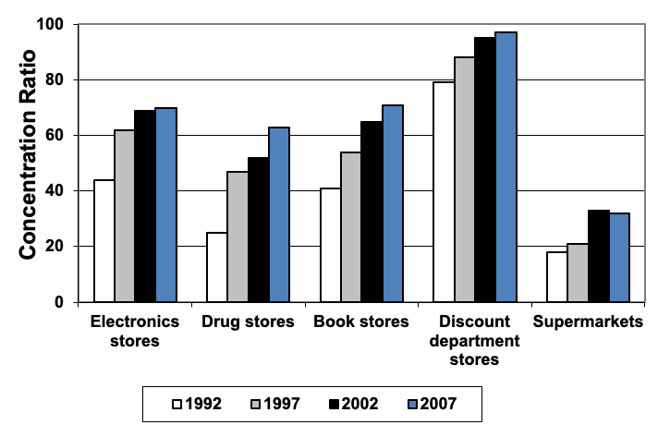
Figure 6.9: Four-Firm Concentration Ratios in Retail Industries, 1992–2007
Source: Economic Census publications, United States Census Bureau.

Slide 13
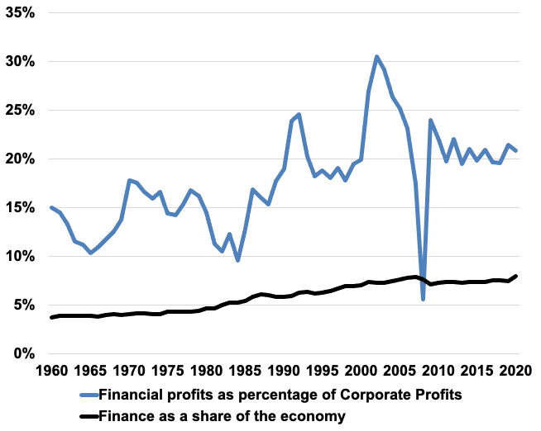
Figure 6.10: Finance as a Share of the Economy and Financial Profits as a Percentage of Corporate Profits, 1960-2020
Source: NIPA Tables 6.2A-6.2D, and Piketty, Saez, and Zucman’s Distributional National Accounts, Appendix tables II: Distributional series.

Slide 14
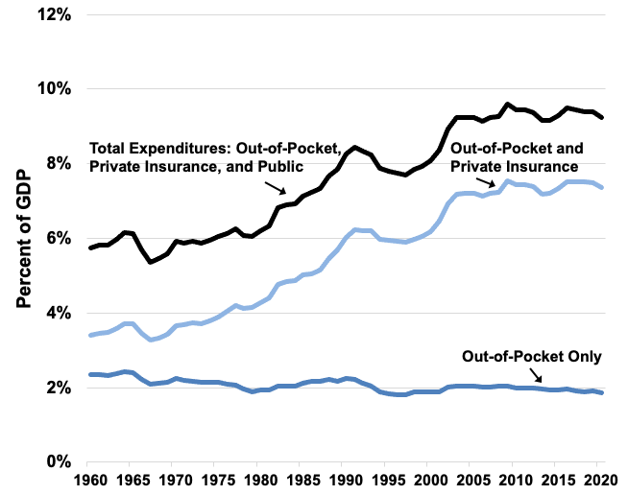
Figure 6.11: Health Care Expenditures in the United States as a Percentage of GDP, 1960–2019
Source: Various editions of the Statistical Abstract of the United States.

