Slide 1

Chapter 5
Macroeconomic Measurement: Environmental and Social Dimensions

Slide 2
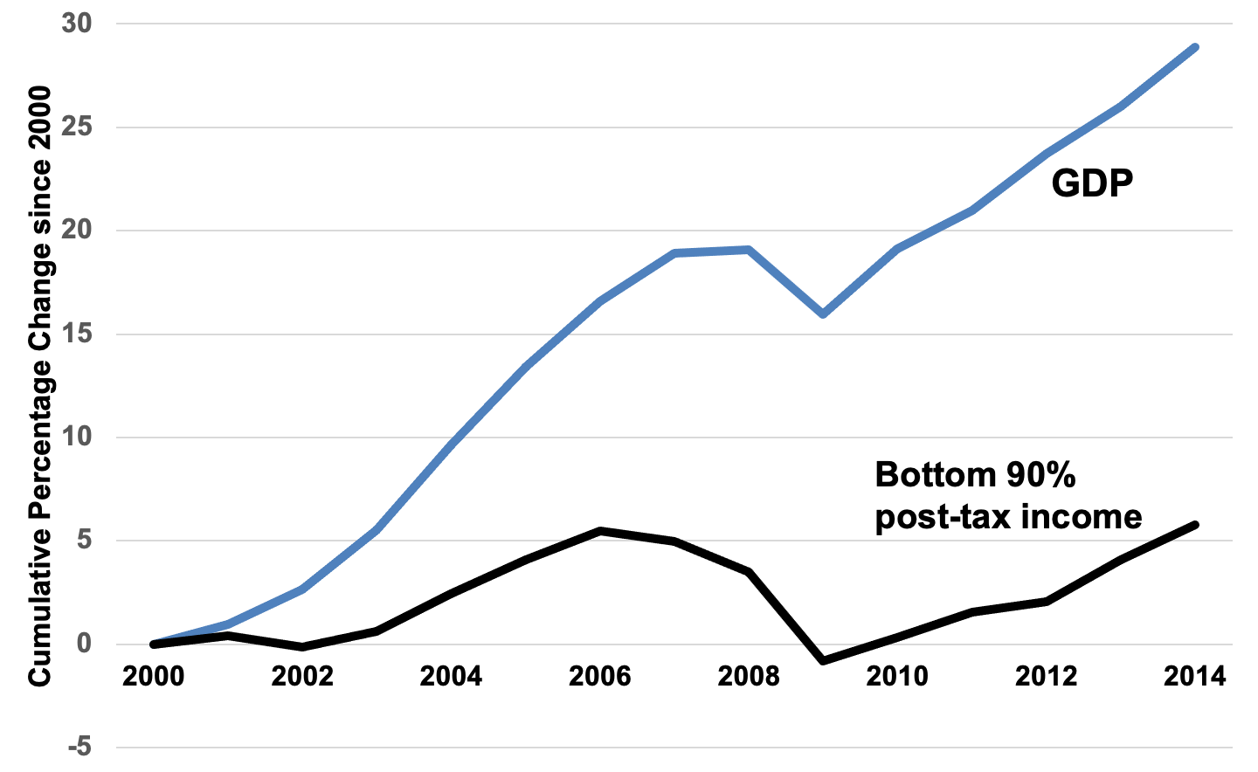
Figure 5.1 Cumulative changes in GDP and average incomes of the bottom 90 percent of earners, since 2000.
Sources: Piketty, Saez and Zucman, 2016; Bureau of Economic Analysis; Leonhardt, 2018.

Slide 3
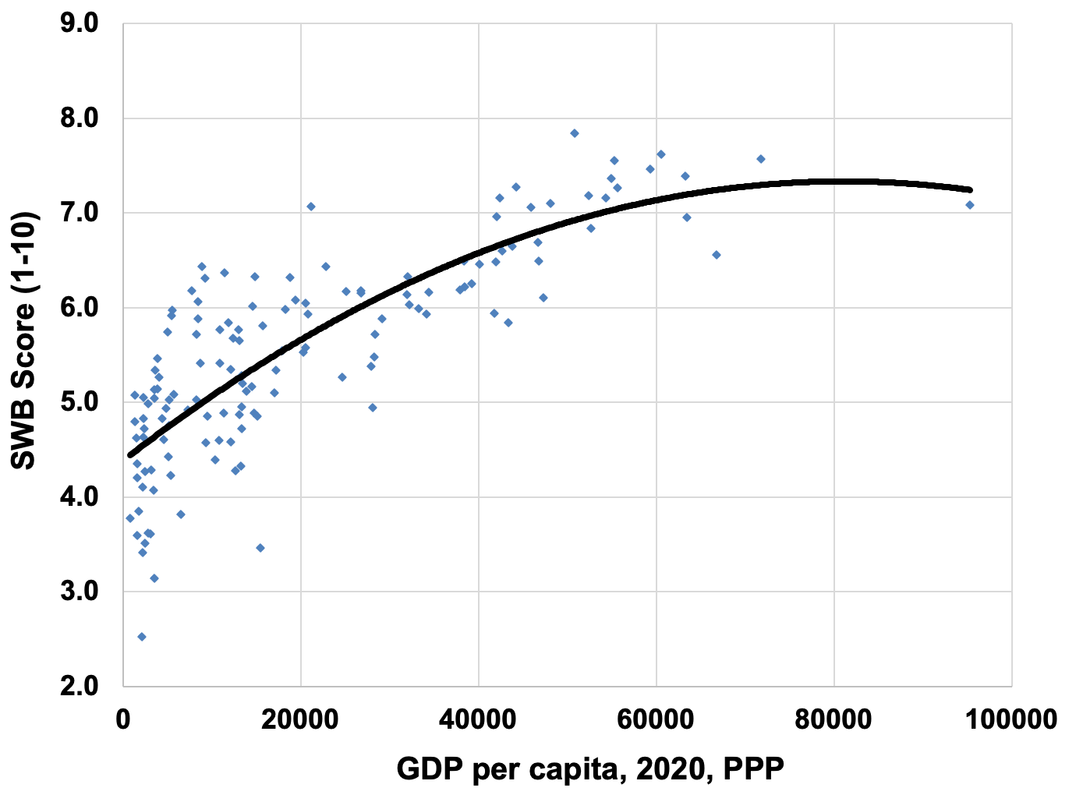
Figure 5.2 Average Subjective Well-Being 2018-2020 and GDP per Capita 2020, PPP
Sources: SWB from Helliwell et al., World Happiness Report 2021; GDP per capita data is from World Development Indicators online database.
Note: The trendline is a statistically fitted line showing a “best fit” estimate of the relationship between GDP per capita and SWB. “PPP” is Purchasing Power Parity.

Slide 4
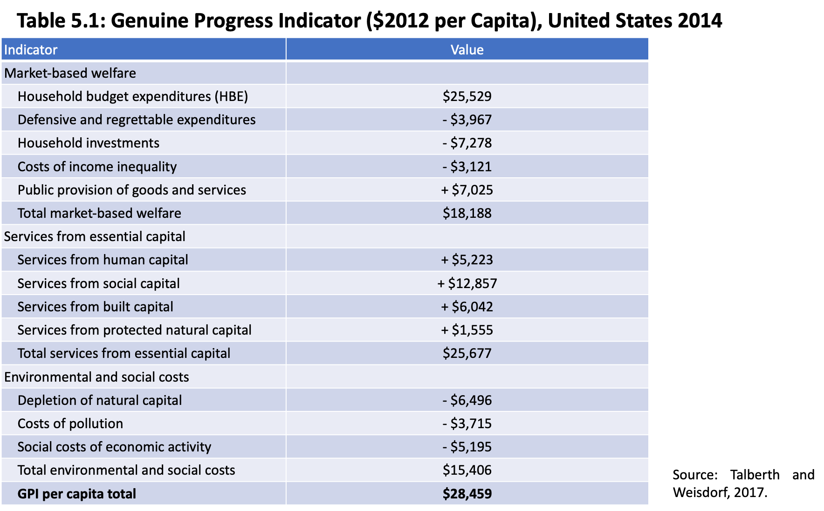

Slide 5
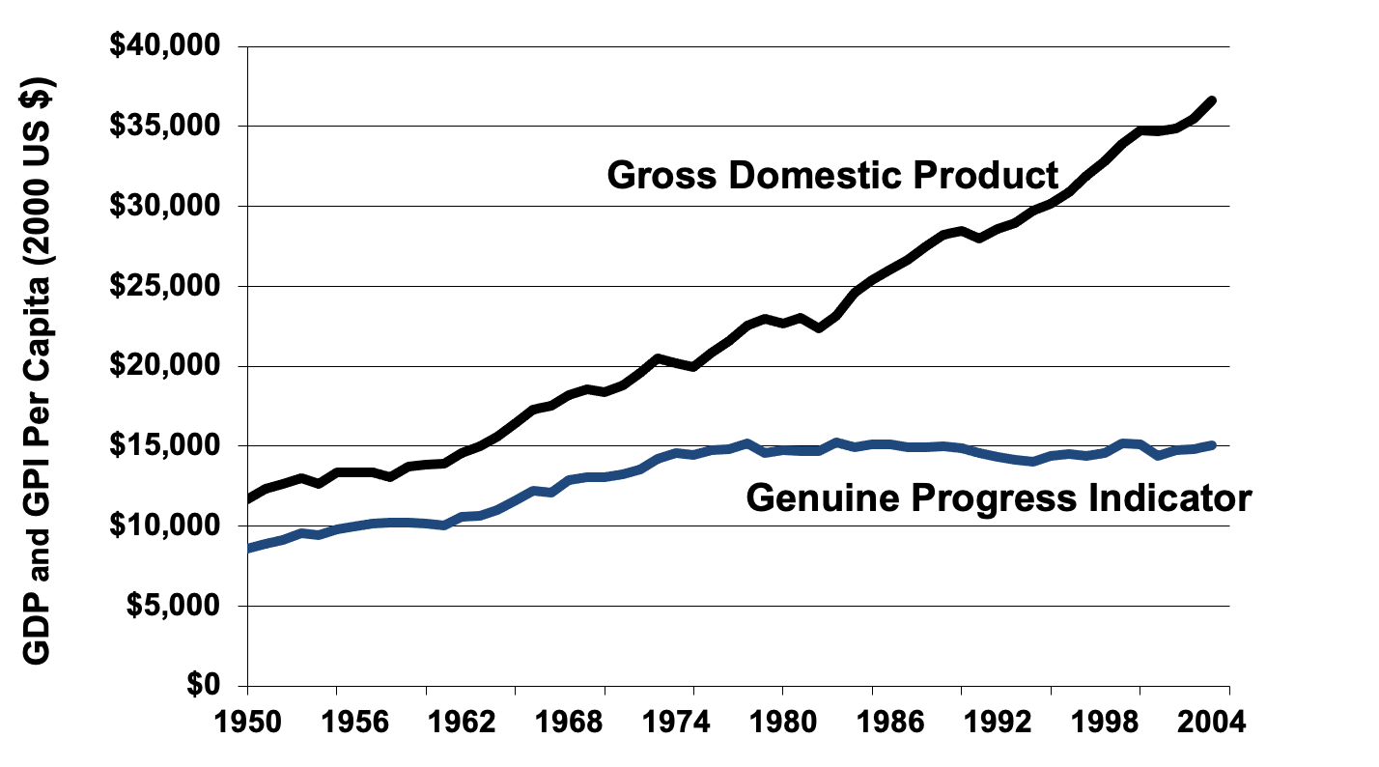
Figure 5.3: GPI vs. GDP per Capita for the United States, 1950–2004
Source: Talberth et al., 2007.

Slide 6
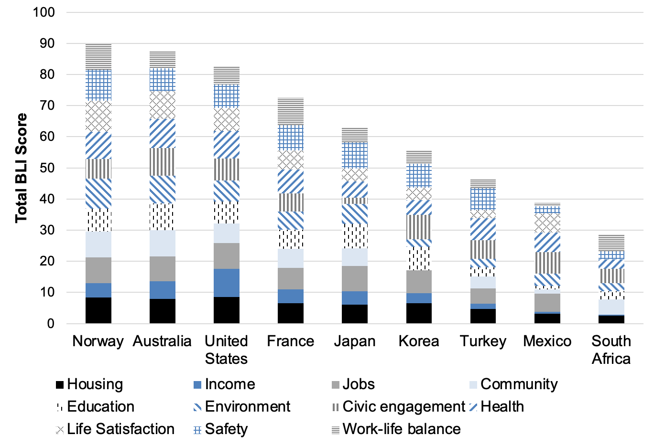
Figure 5.4: BLI for Selected Countries, 2020
Source: OECD, 2020.

Slide 7
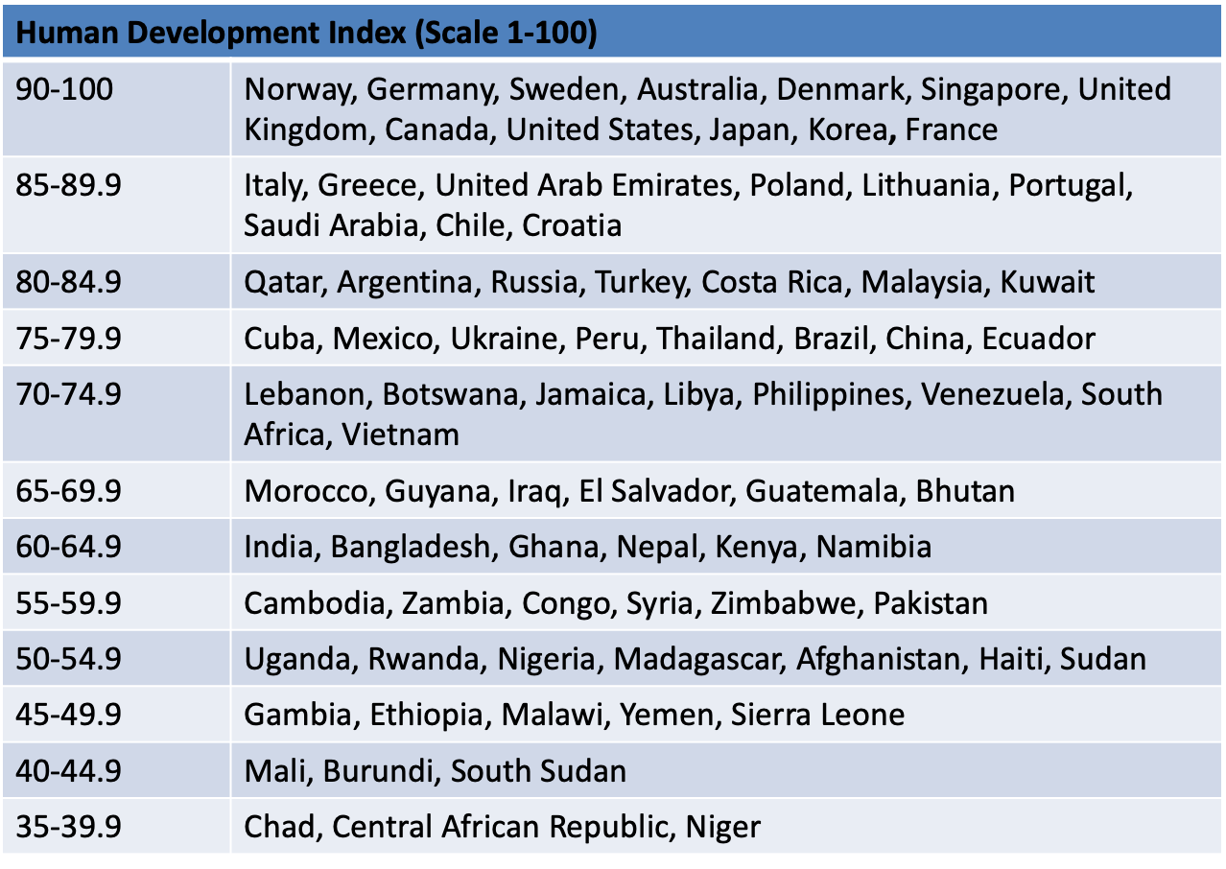
Figure 5.5: Selected Countries as Ranked in the Human Development Index, 2019
Source: UNDP, Human Development Report, 2019 data.

Slide 8
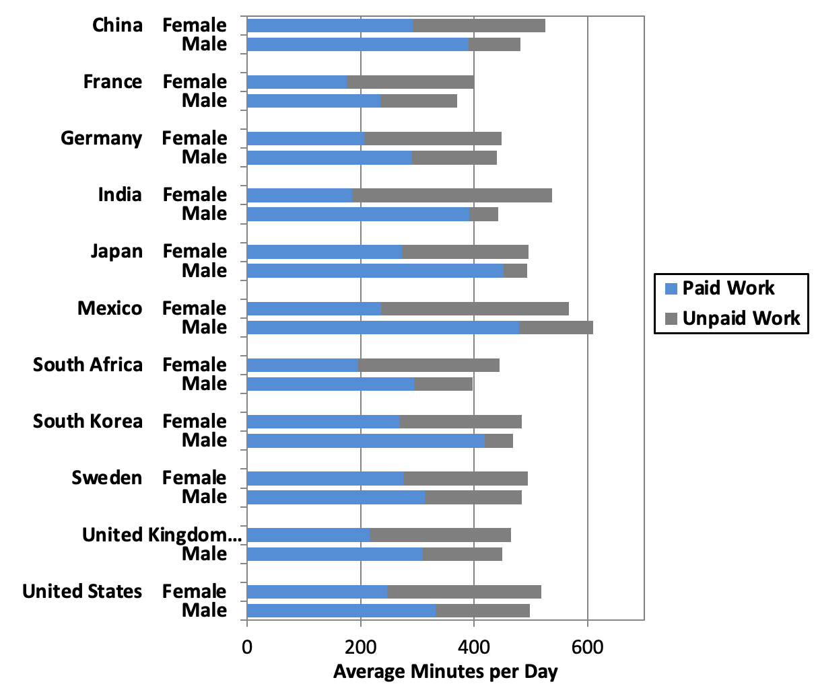
Figure 5.6: Paid and Unpaid Work by Gender, Selected Countries
Source: OECD, OECD Stat, Time Spent in Paid and Unpaid Work, by Gender.

Slide 9
