Slide 1
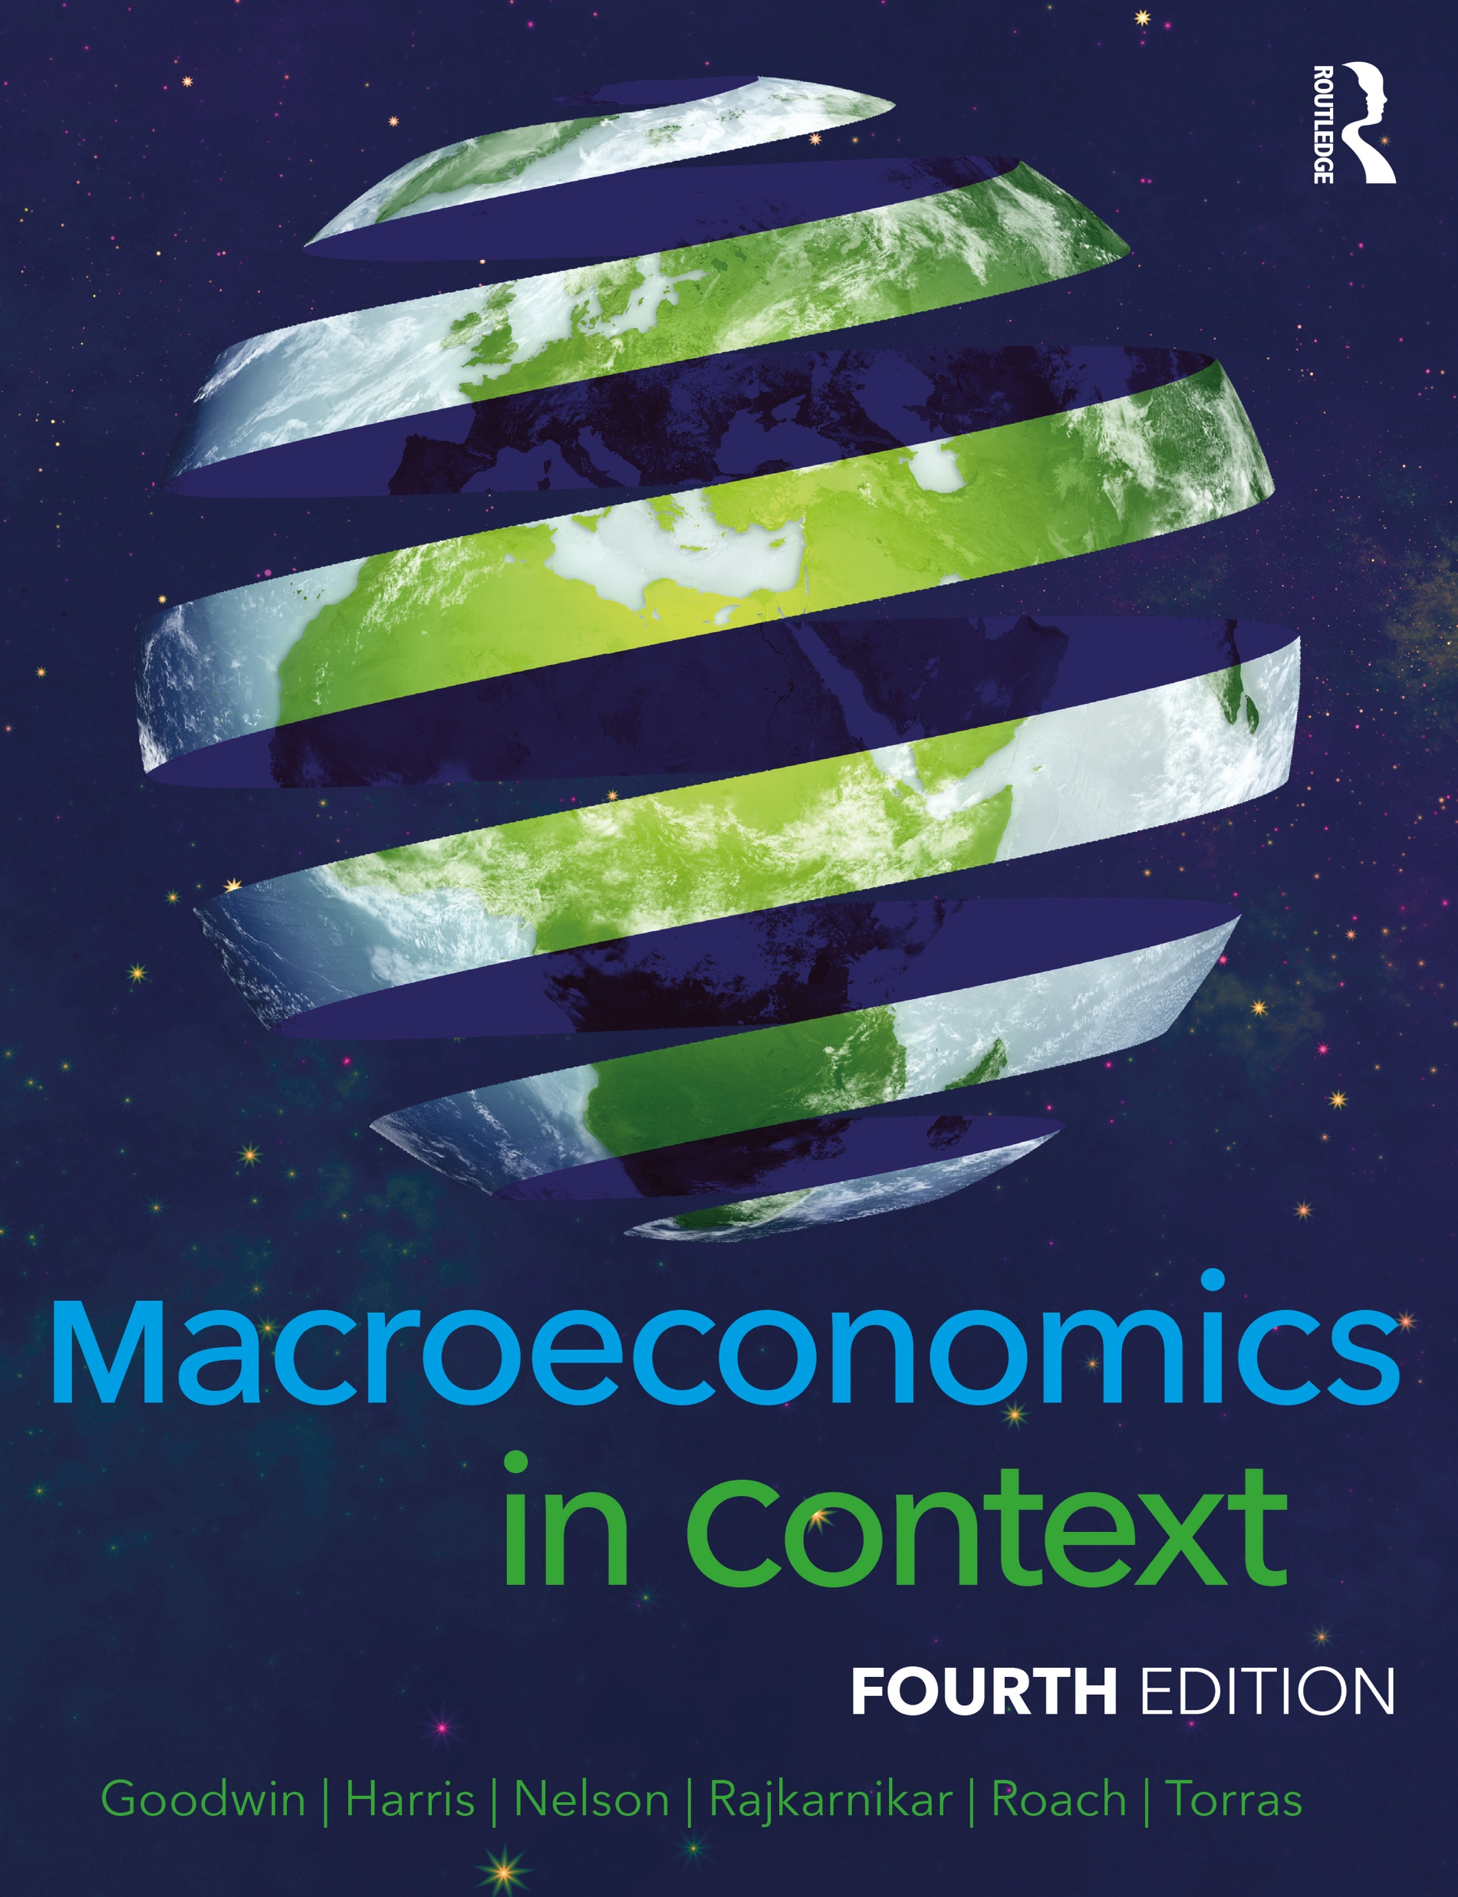
Chapter 17
Growth and Sustainability in the Twenty-First Century

Slide 2
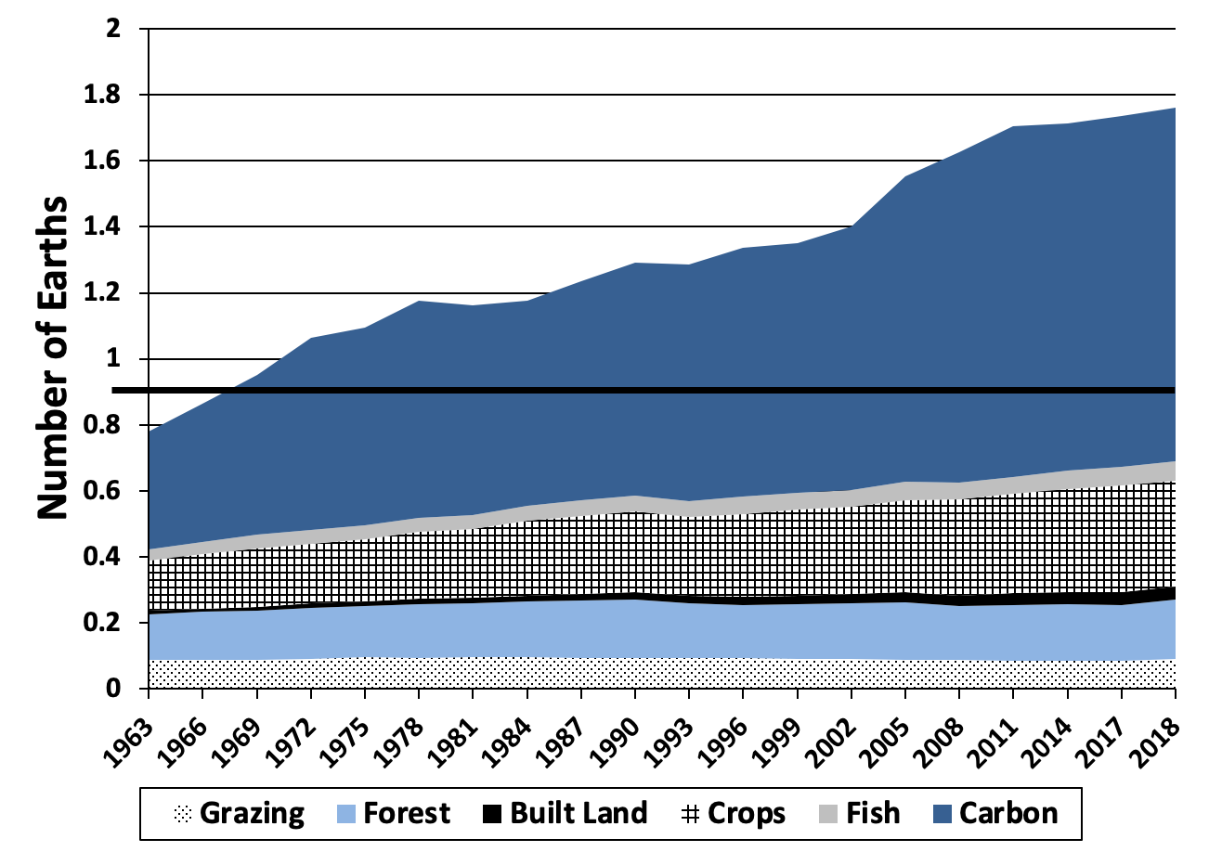
Figure 17.1: Global Ecological Footprint, by Impact Type, 1965–2018
Source: Global Footprint Network Public Data Set, https://www.footprintnetwork.org/resources/data/

Slide 3
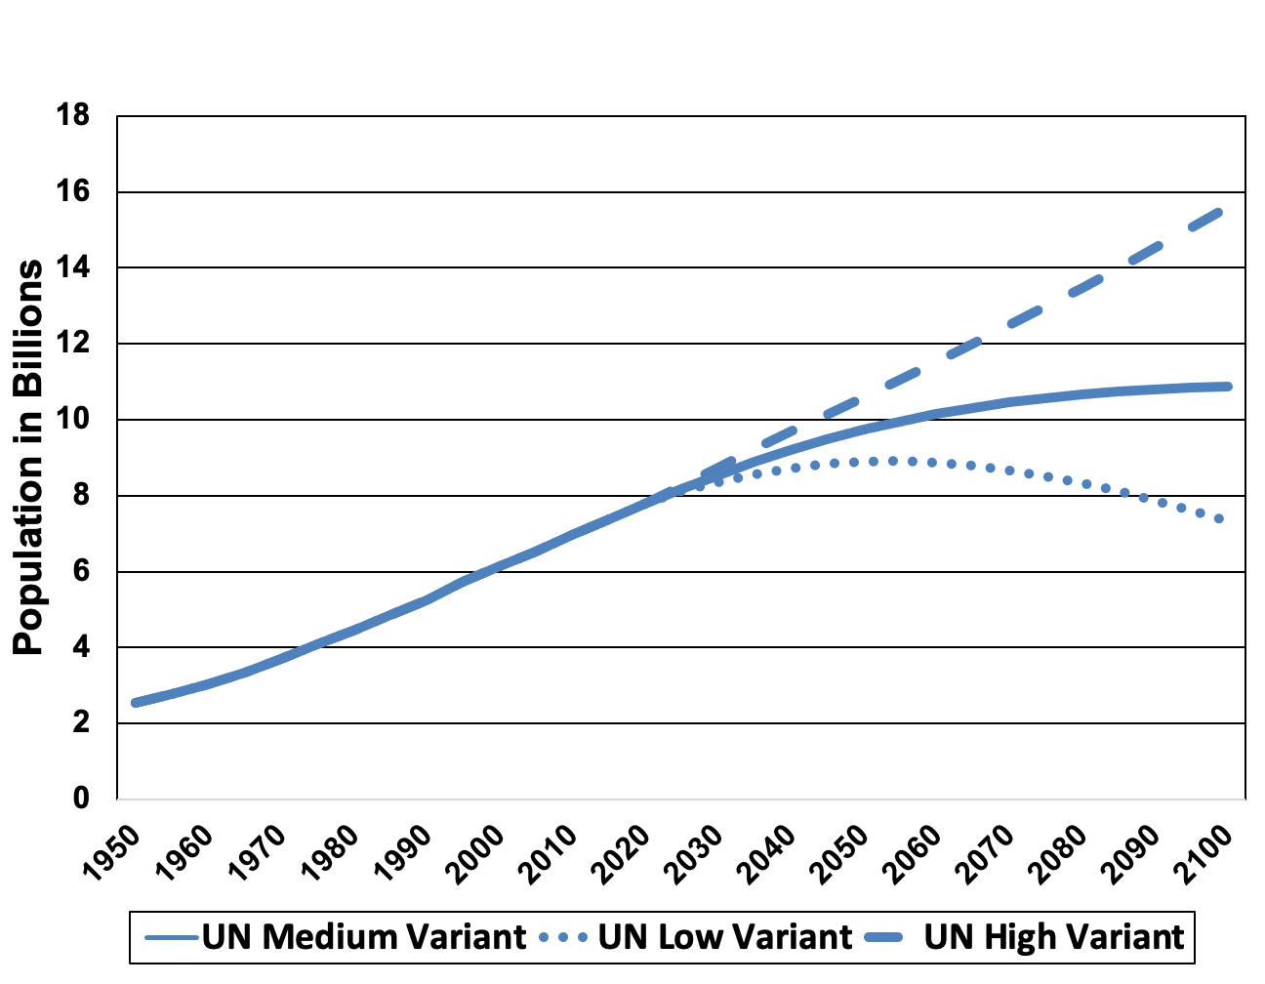
Figure 17.2: United Nations Global Population Projections, 2020–2100
Source: United Nations, World Population Prospects 2019.

Slide 4
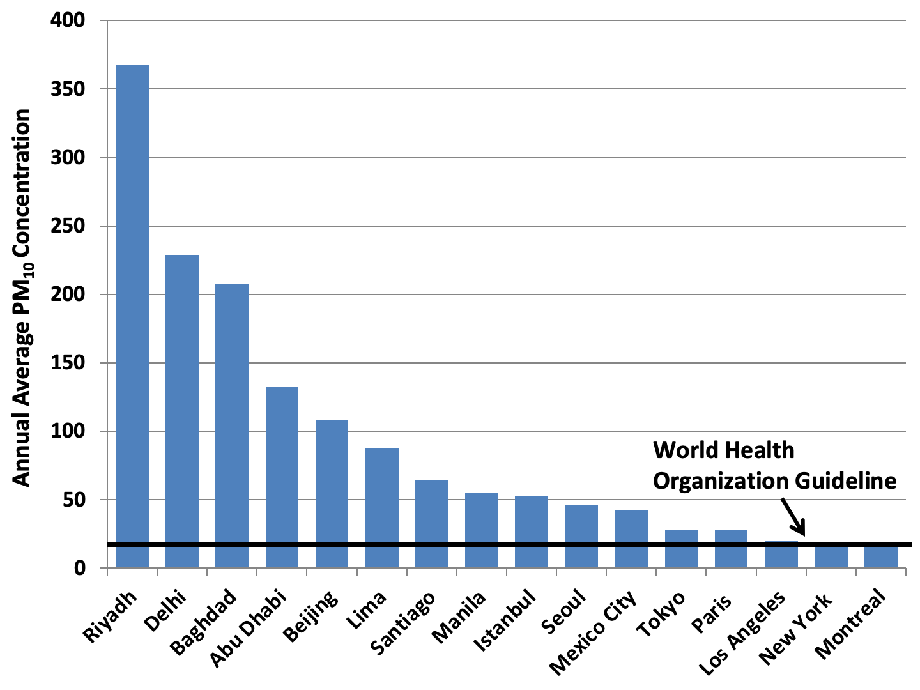
Figure 17.3: Average Particulate Matter Concentration, Selected Major Cities
Source: World Health Organization, Ambient Air Quality Database.
Notes: Particulate matter concentrations in μg/m3; data vary by city, between 2012 and 2015.

Slide 5
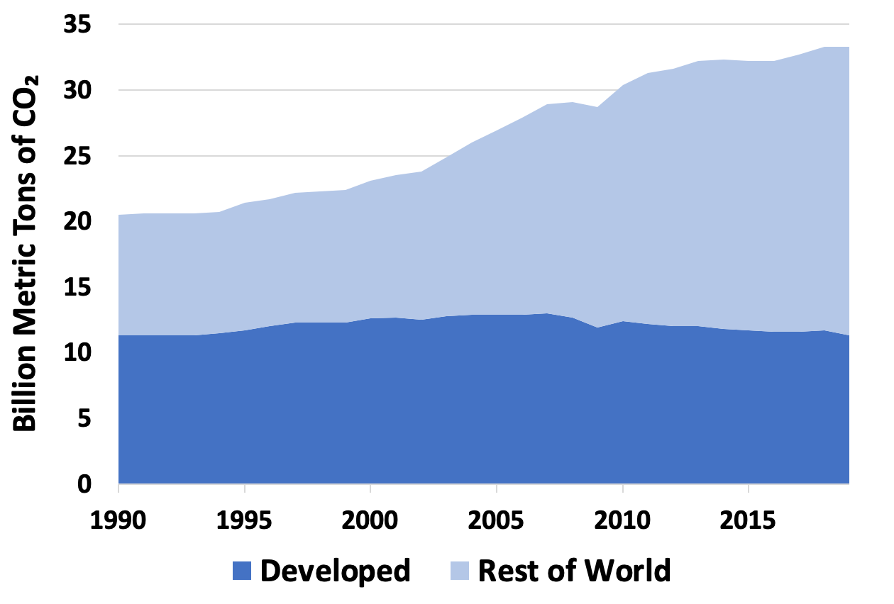
Figure 17.4 Global Carbon Dioxide Emissions, 1965–2019, Developed and Developing Countries
Source: International Energy Agency, https://www.iea.org/articles/global-co2-emissions-in-2019

Slide 6
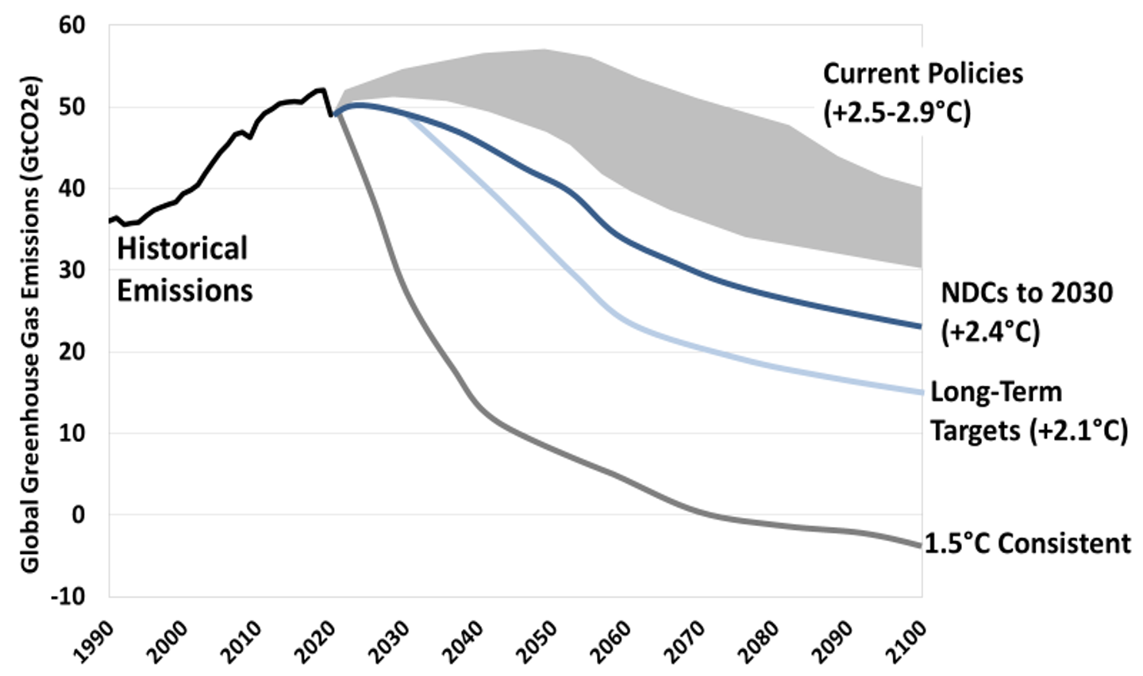
Figure 17.5: Global Greenhouse Gas Emissions Under Alternative Scenarios
Source: Climate Action Tracker, http://climateactiontracker.org/global.html.
Note: Emissions data include carbon dioxide and other greenhouse gases converted to carbon dioxide equivalents.

Slide 7
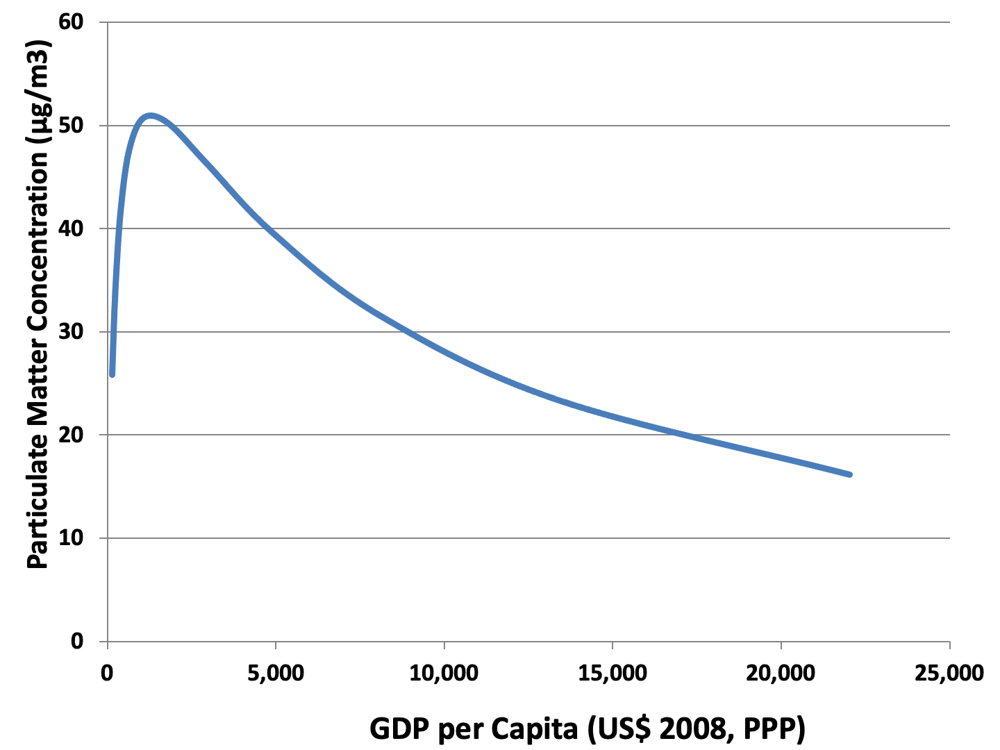
Figure 17.6: Environmental Kuznets Curve for Particulate Matter
Source: Mazurek, 2011.

Slide 8
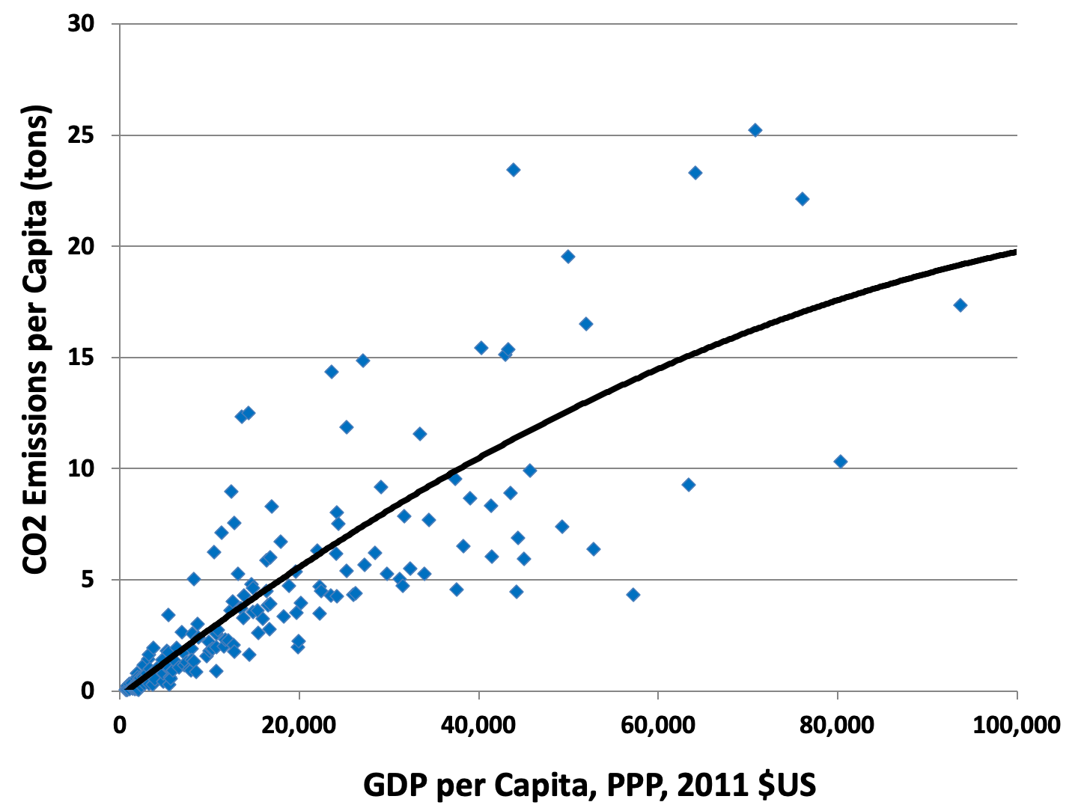
Figure 17.7: Relationship between Carbon Dioxide Emissions and GDP per Capita
Source: World Bank, World Development Indicators database.

Slide 9
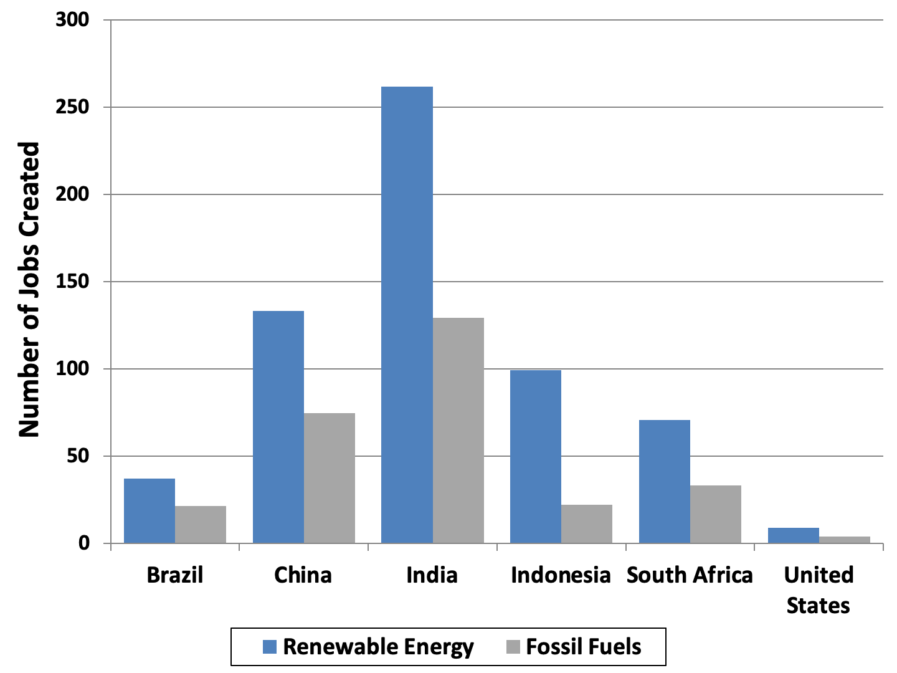
Figure 17.8 Jobs Generated by Investing One Million Dollars in Clean Energy versus Fossil Fuel Production, Selected Countries
Source: Pollin, 2015.

Slide 10
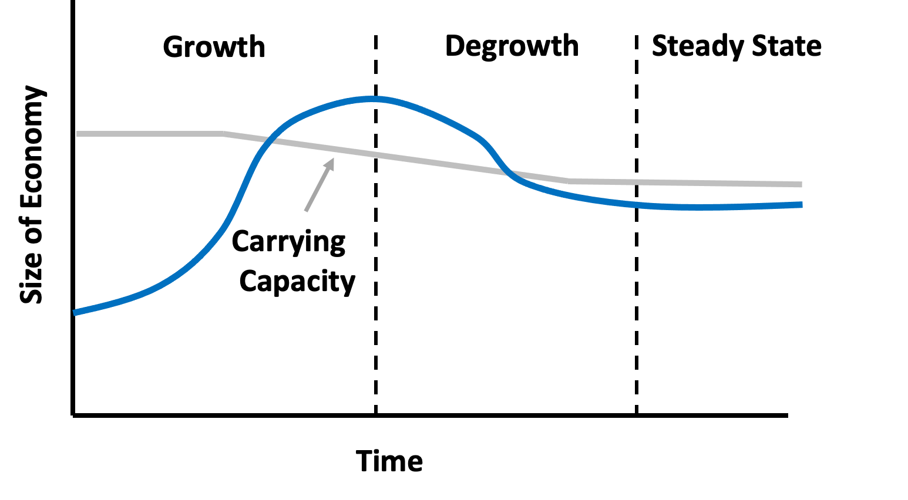
Figure 17.9: The Degrowth Transition to a Steady-State Economy
Source: Adapted from O’Neill, 2012.

Slide 11
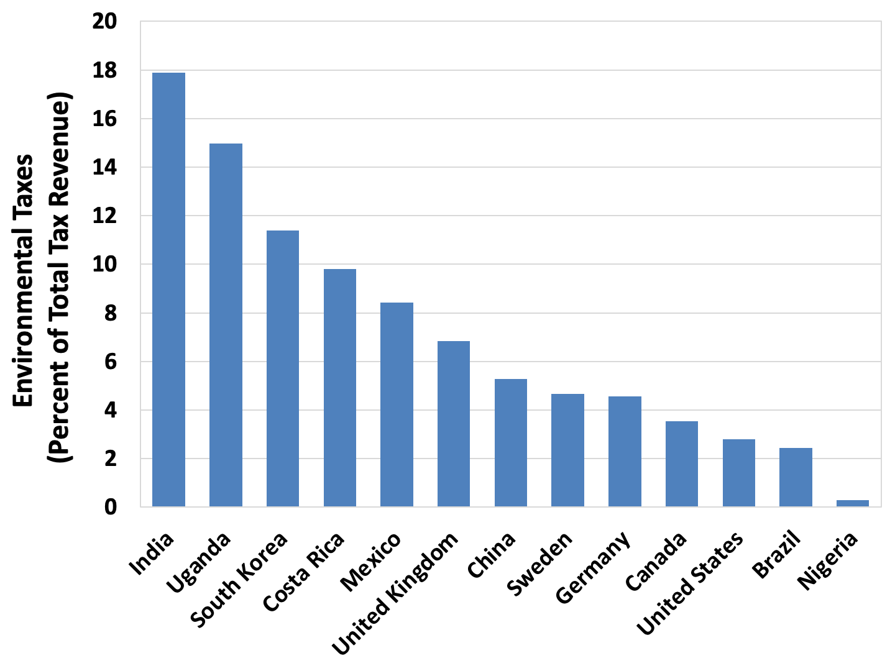
Figure 17.10 Environmental Taxes, as a Percent of Total Tax Revenues, Selected Countries
Source: OECD, OECD.Stat, “Environmentally related tax revenue,” 2019.

