Slide 1
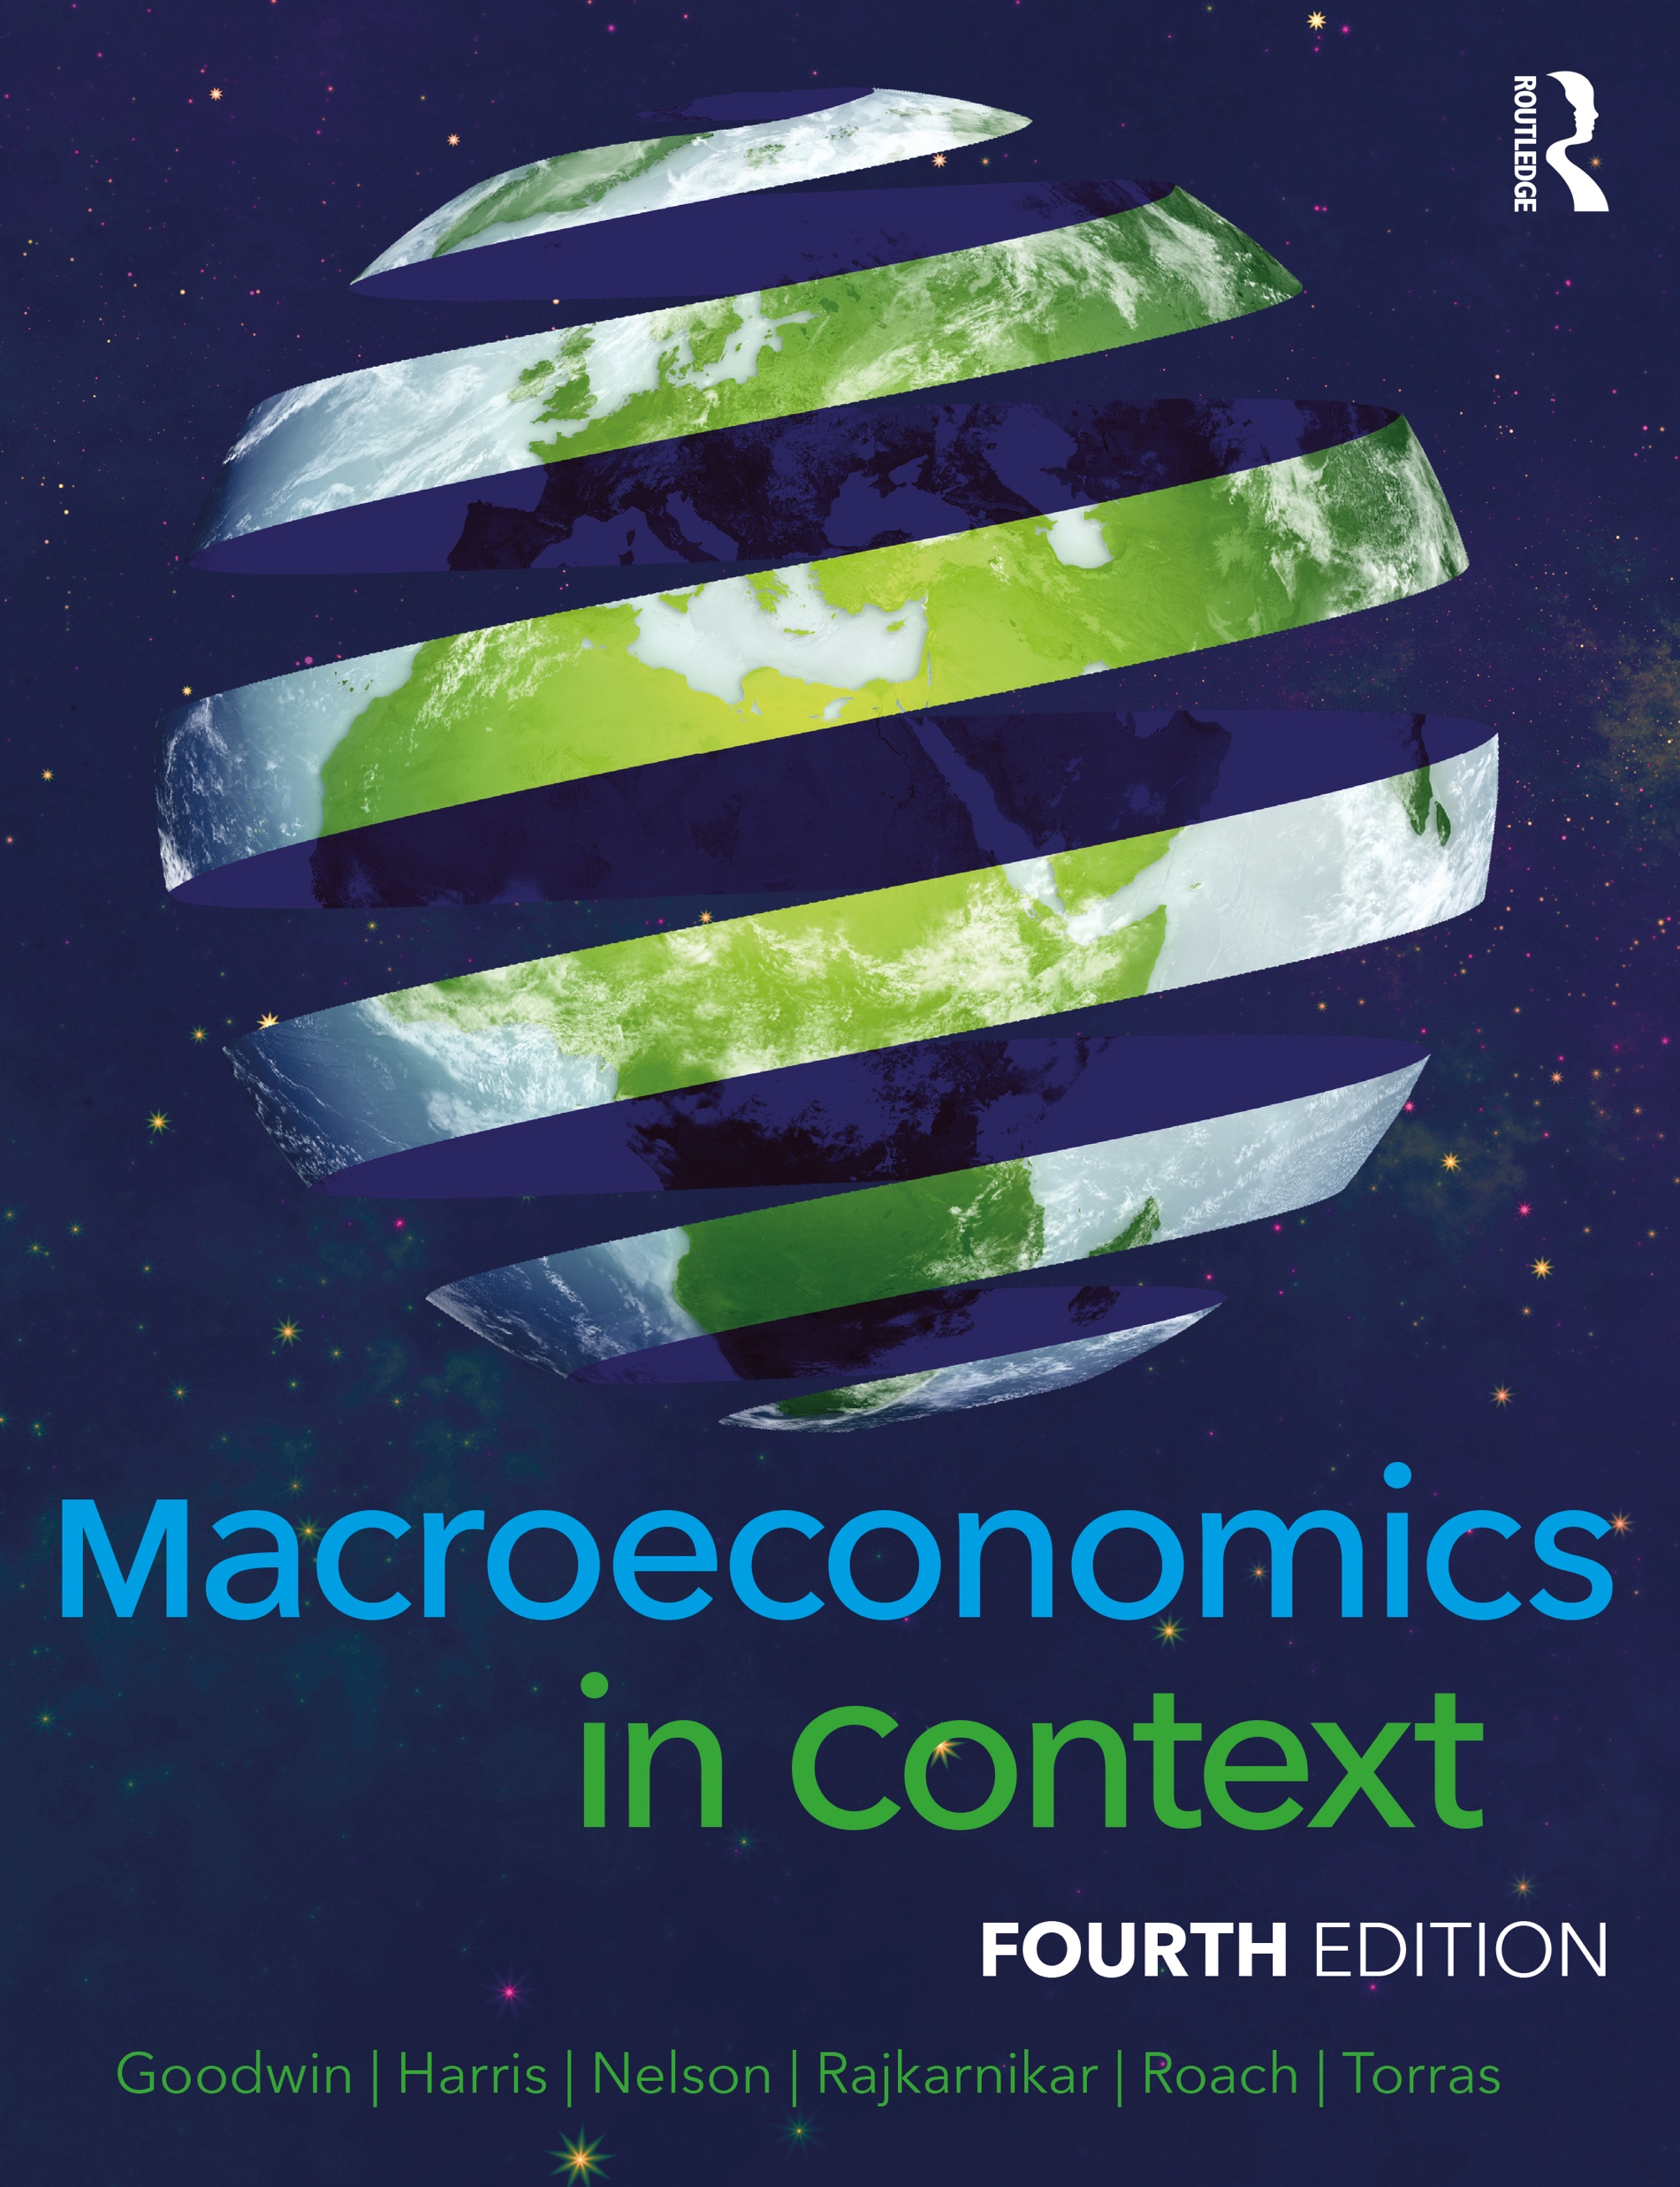
Chapter 16
How Economics Grow and Develop

Slide 2
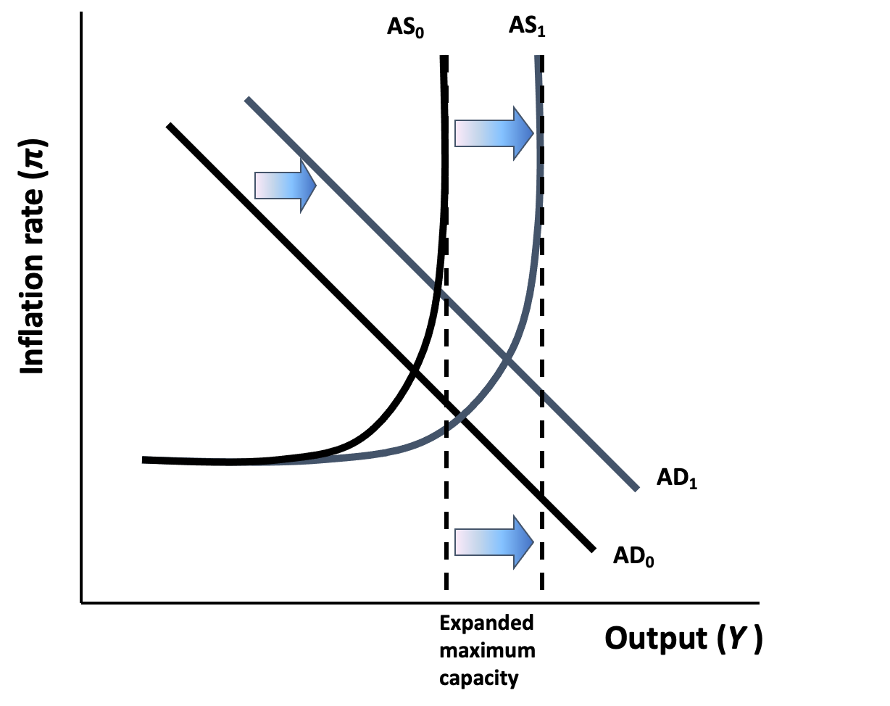
Figure 16.1 Economic Growth in the AS/AD Model
Notes:
2

Slide 3
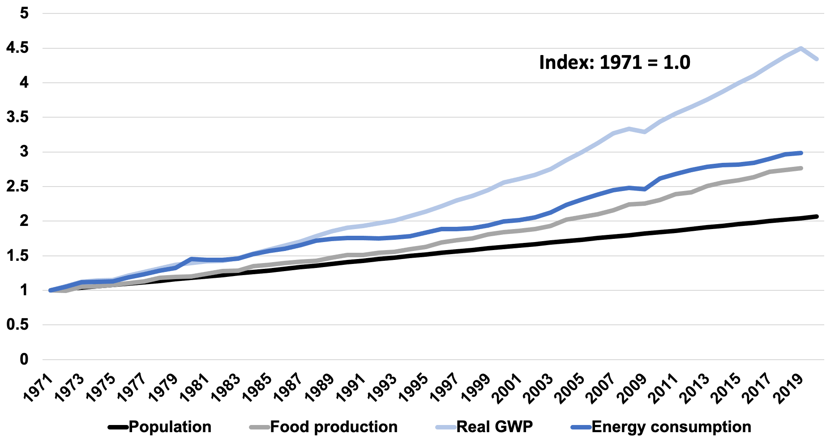
Figure 16.2: Global Growth in Population, Food Production, Economic Production, and Energy Consumption, 1971-2020
Sources: World Bank, World Development Indicators; BP, 2017; FAO, 2022.
Note: GWP is gross world product. All variables are indexed, with 1971 = 1.0

Slide 4
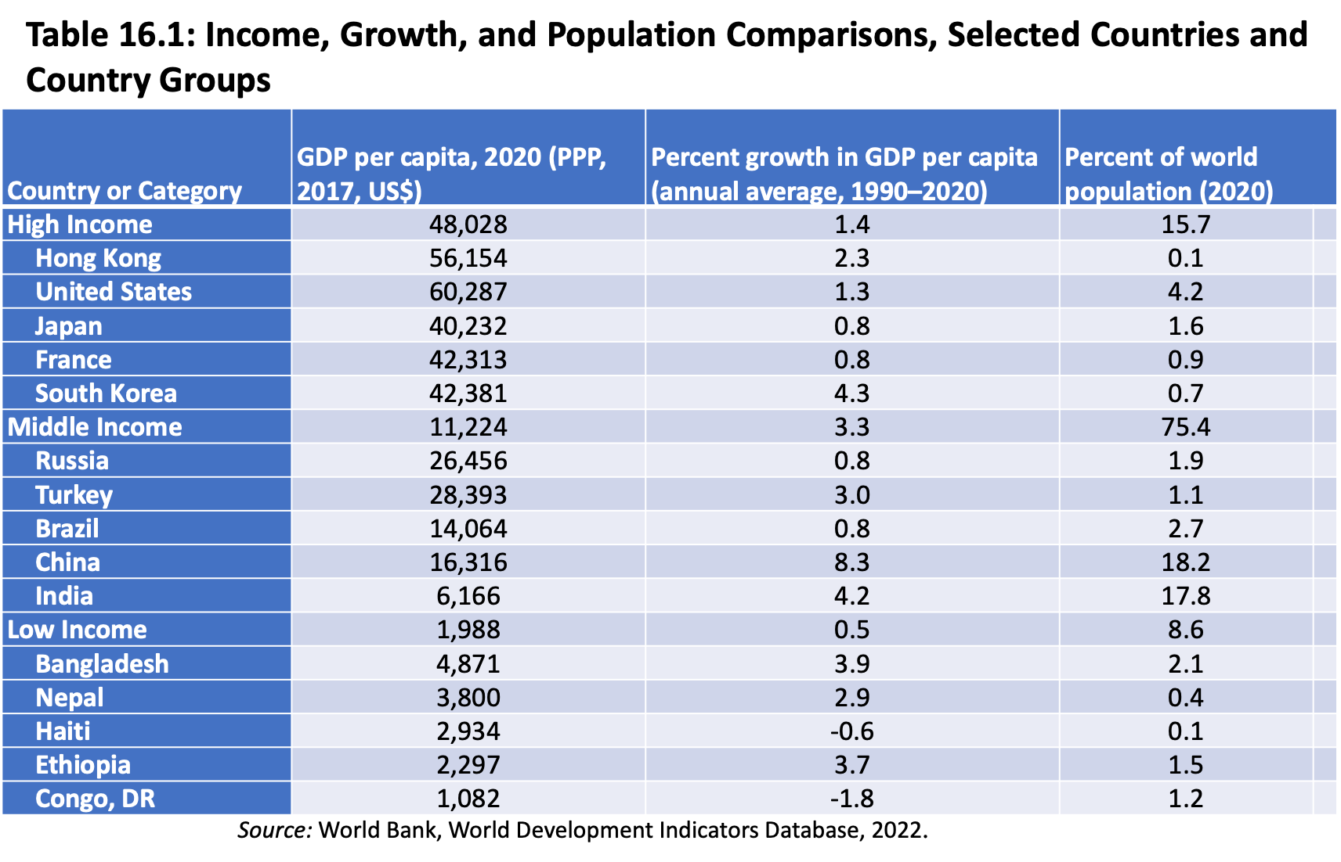

Slide 5
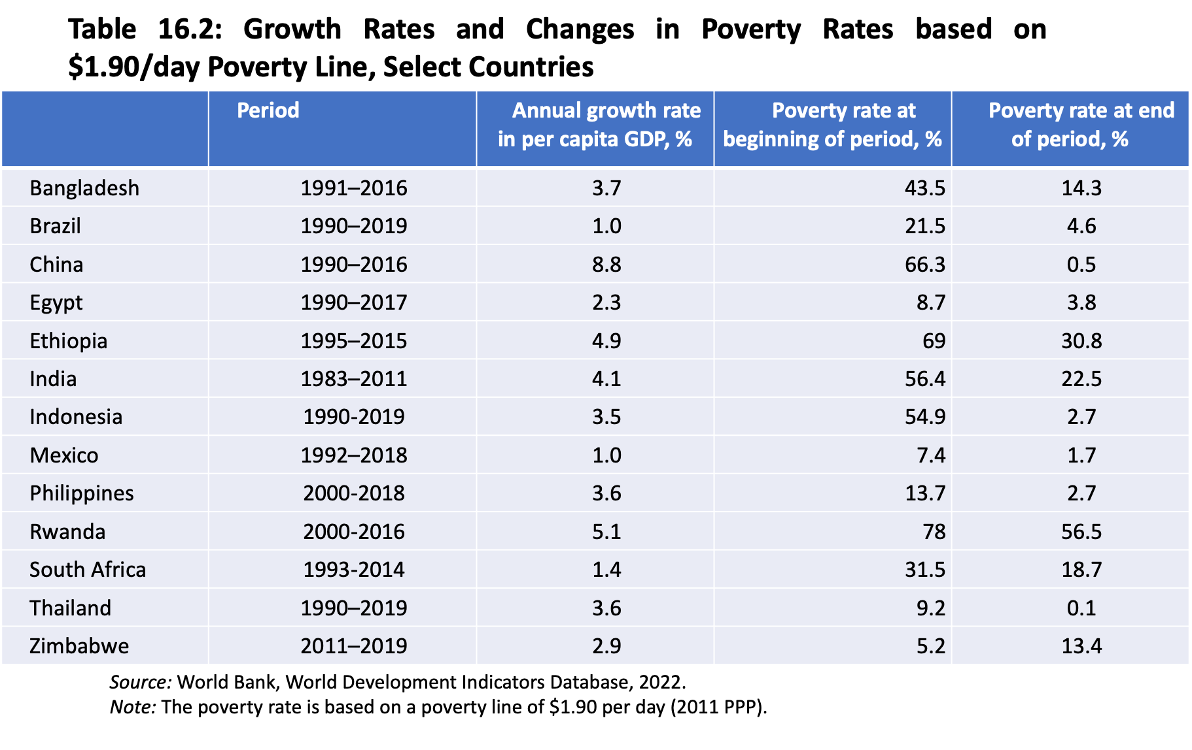

Slide 6
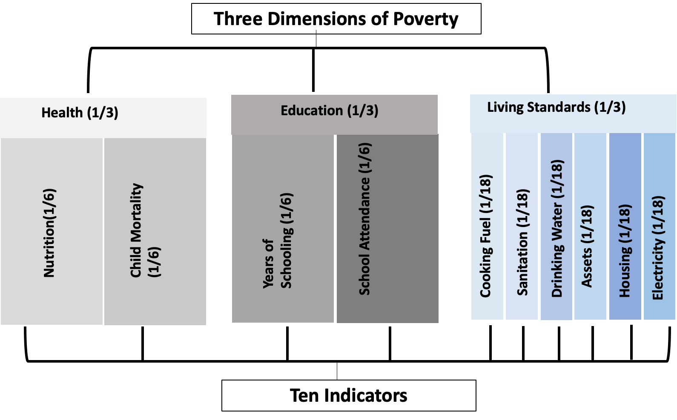
Figure 16.3: The Multidimensional Poverty Index
Source: Oxford Poverty and Human Development Initiative

Slide 7
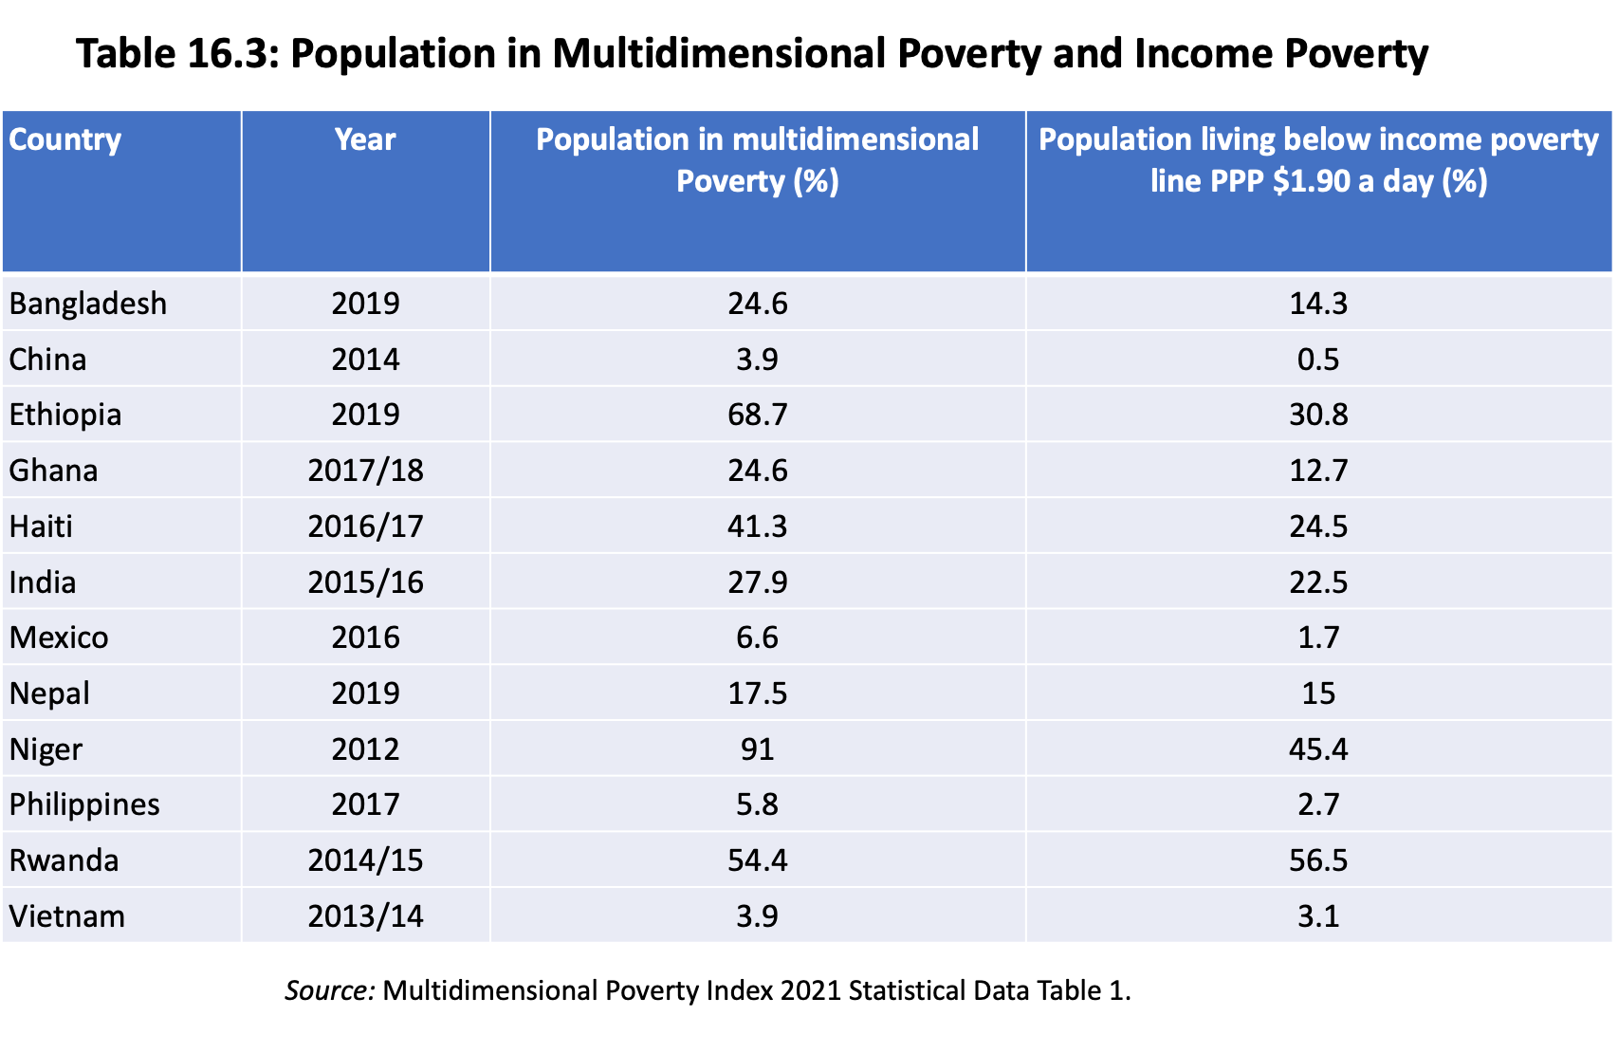

Slide 8
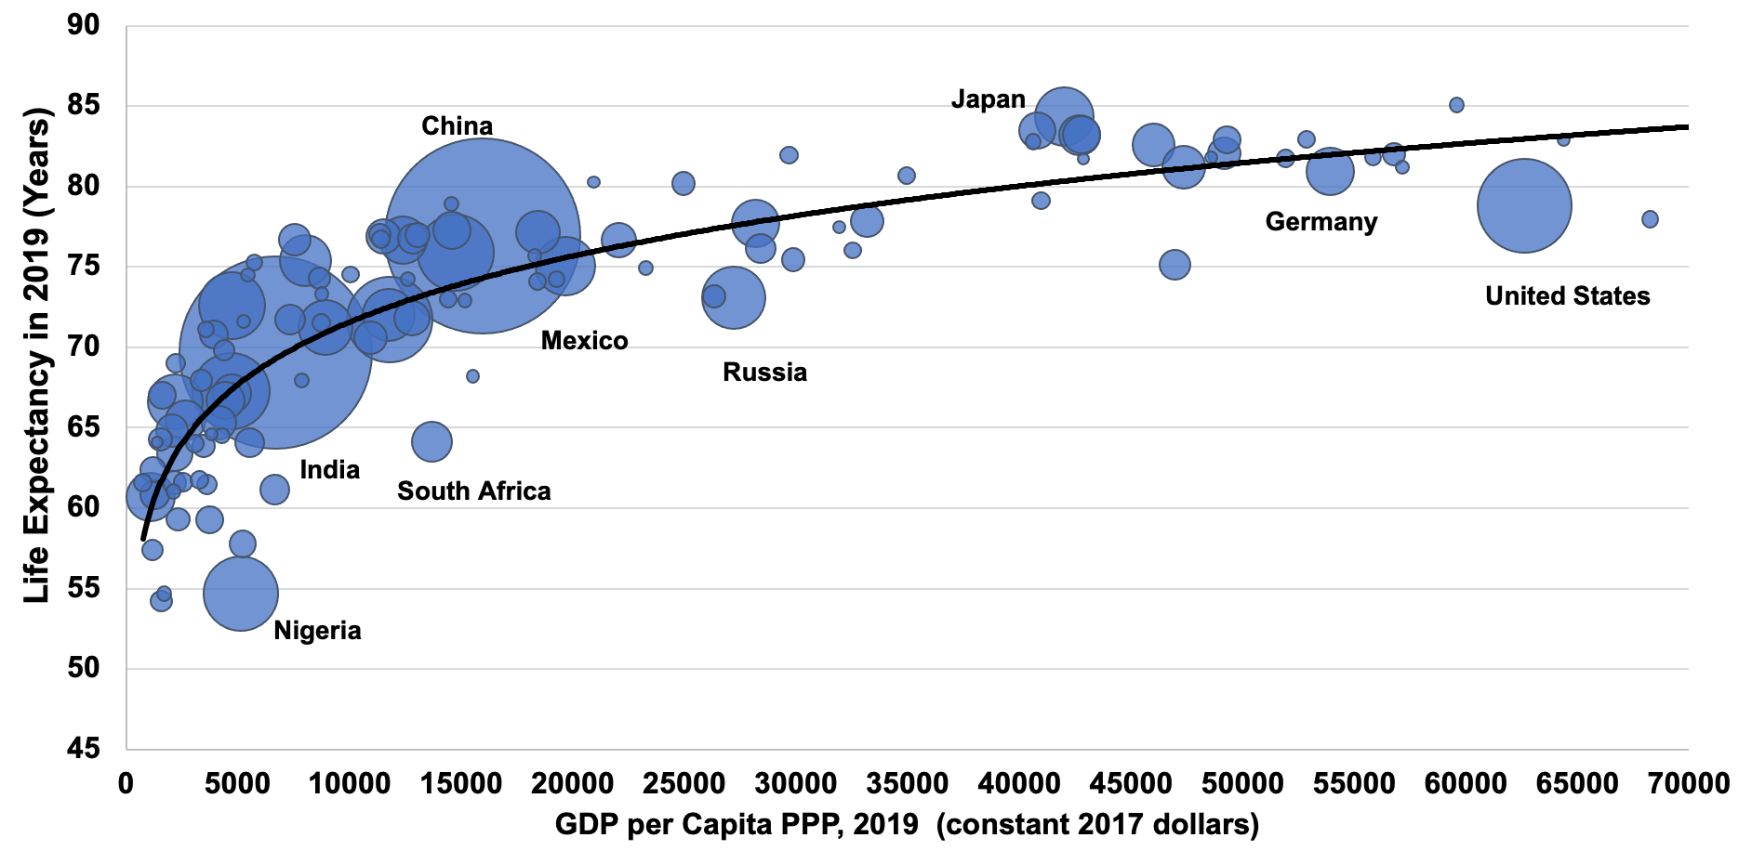
Figure 16.4: The Relation Between Life Expectancy and Income, with Area Proportional to Population, 2019
Source: World Bank, World Development Indicators Database, 2022.

Slide 9
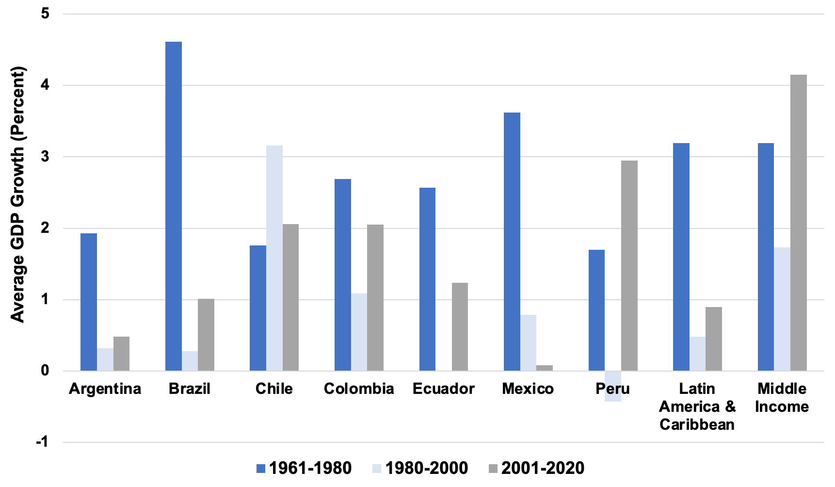
Figure 16.5 Average Per Capita Annual Real GDP Growth, Selected Latin American Countries, 1961–2020 (%)
Source: World Bank; World Development Indicators Database, 2022.

Slide 10
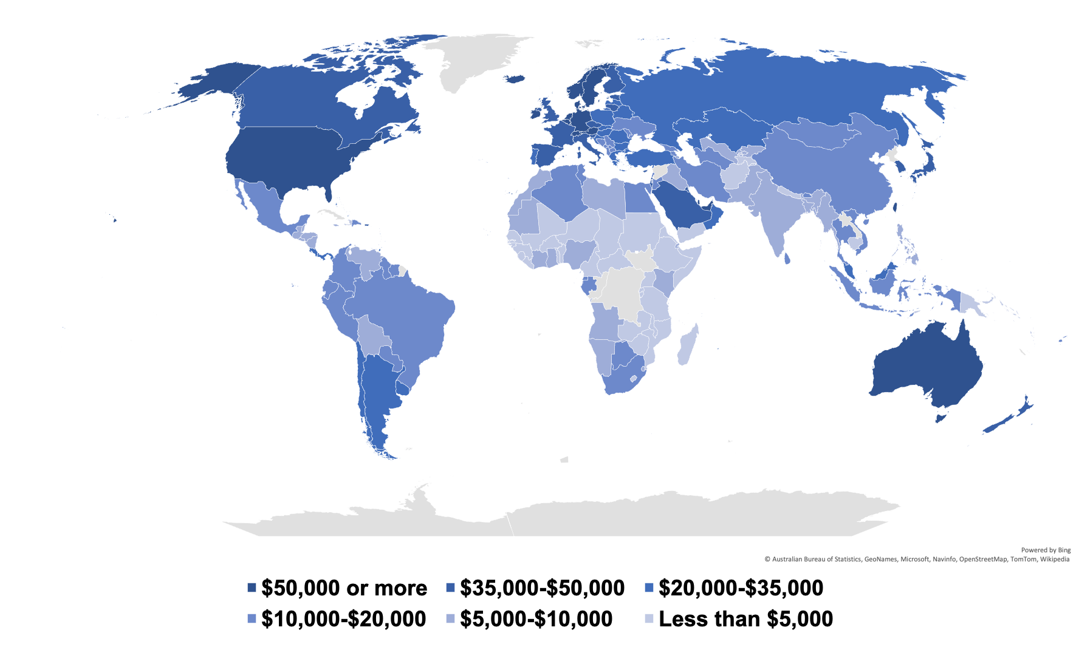
Figure 16.6: GDP per Capita in 2020 (PPP International Dollars per capita)
Source: World Economic Outlook Database 2021, IMF.

