Slide 1

Chapter 15
Deficits and Debt

Slide 2
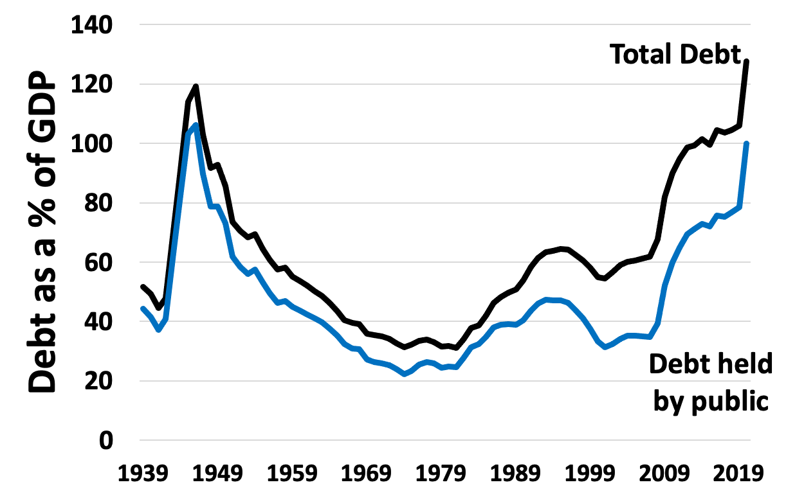
Figure 15.1 U.S. National Debt as a Percentage of GDP, 1939–2020
Source: Federal Reserve Bank of St. Louis. FRED Economic Database.

Slide 3
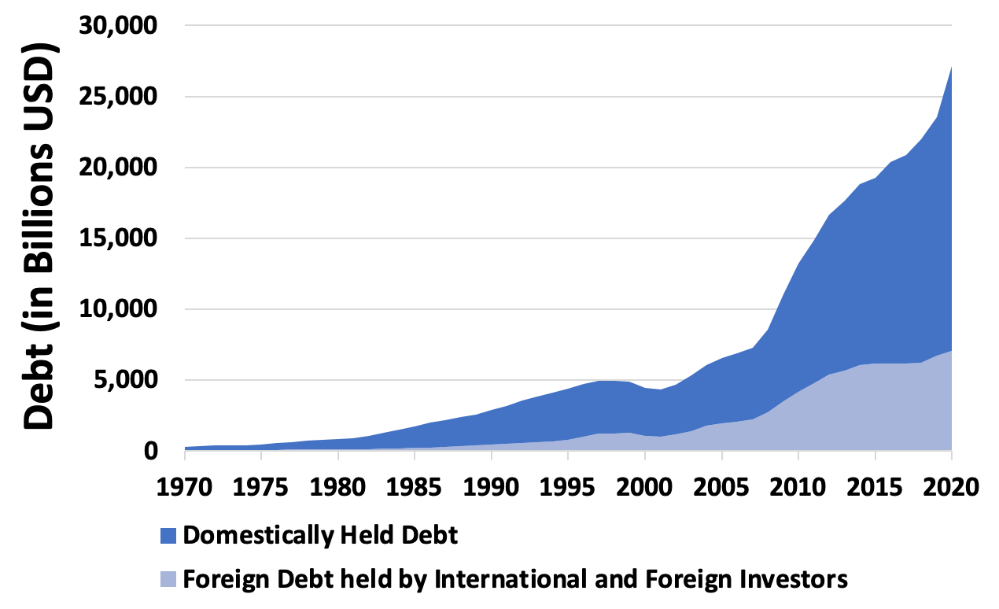
Figure 15.2 Domestic and Foreign Holdings of U.S. Debt (billions of dollars), 1970–2020
Source: Federal Reserve Bank of St. Louis. FRED Economic Database.

Slide 4
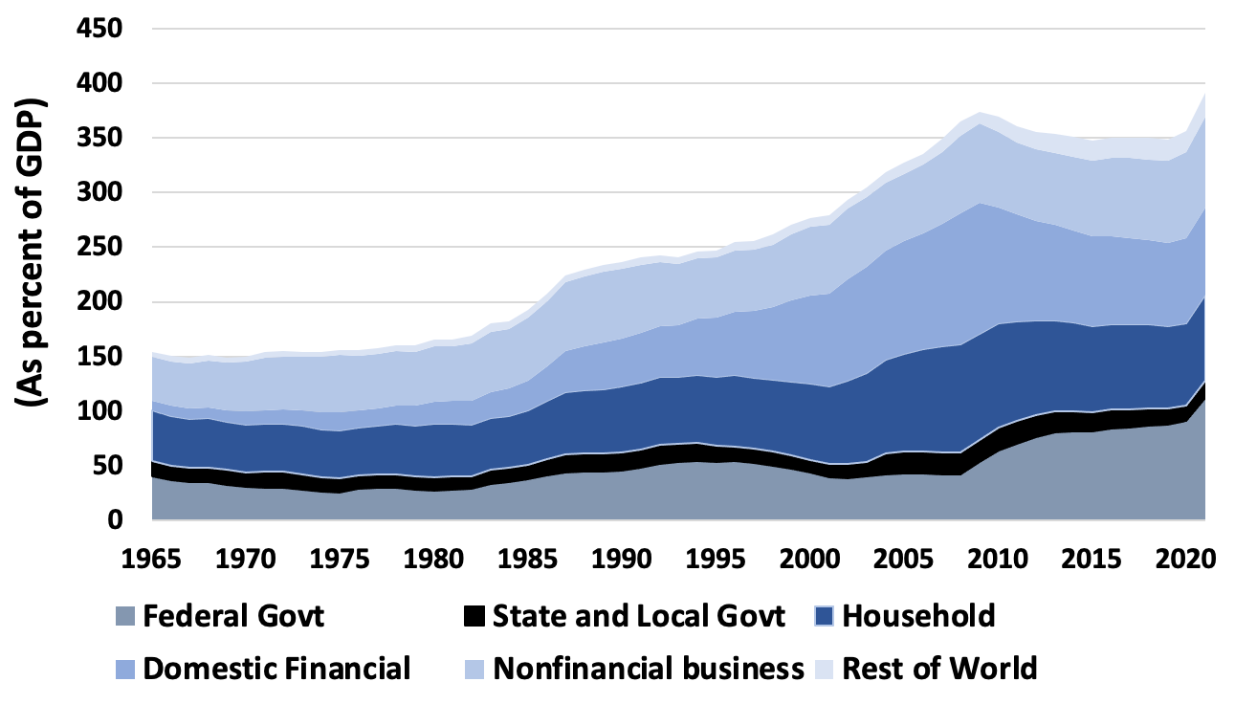
Figure 15.3 Total U.S. Indebtedness as a Percentage of GDP, 1965–2021
Source: Federal Reserve Bank of St. Louis, FRED Economic Database.

Slide 5
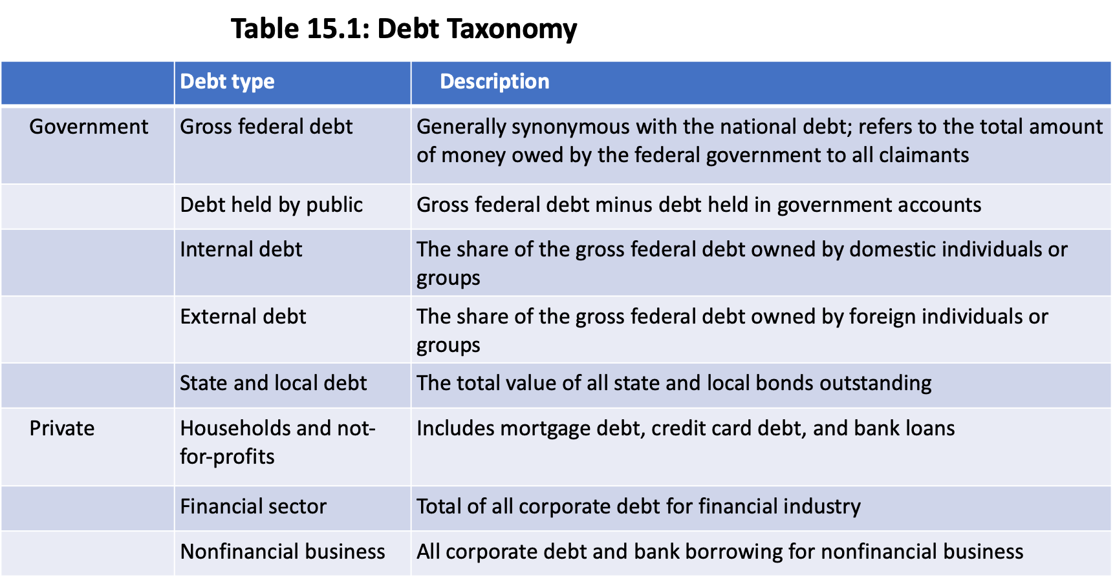

Slide 6
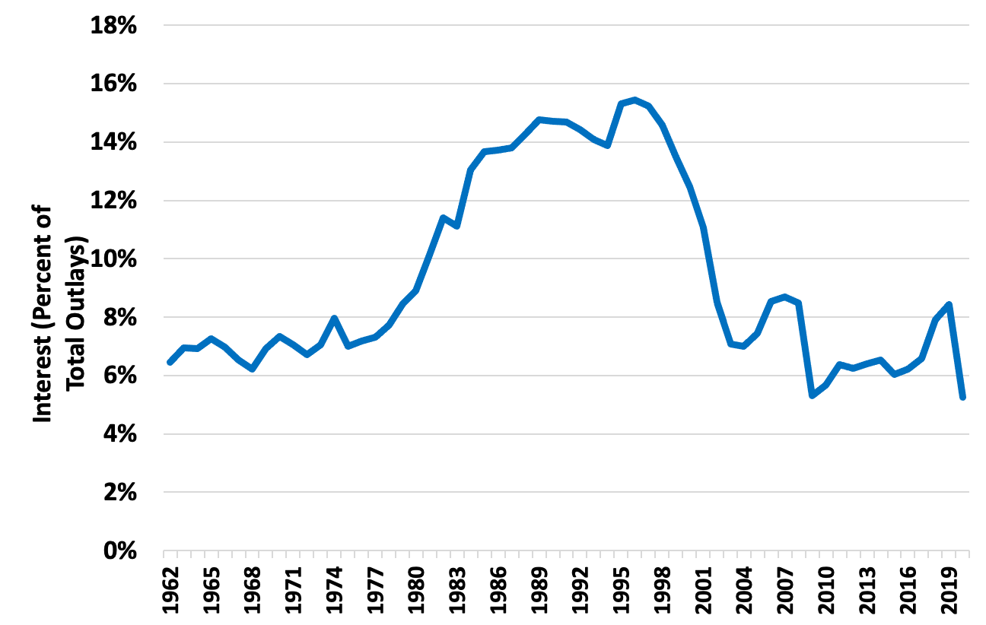
Figure 15.4 Interest Payments as Percentage of Total Federal Outlays, 1962–2020
Source: Federal Reserve Bank of St. Louis, FRED Economic Database.

Slide 7
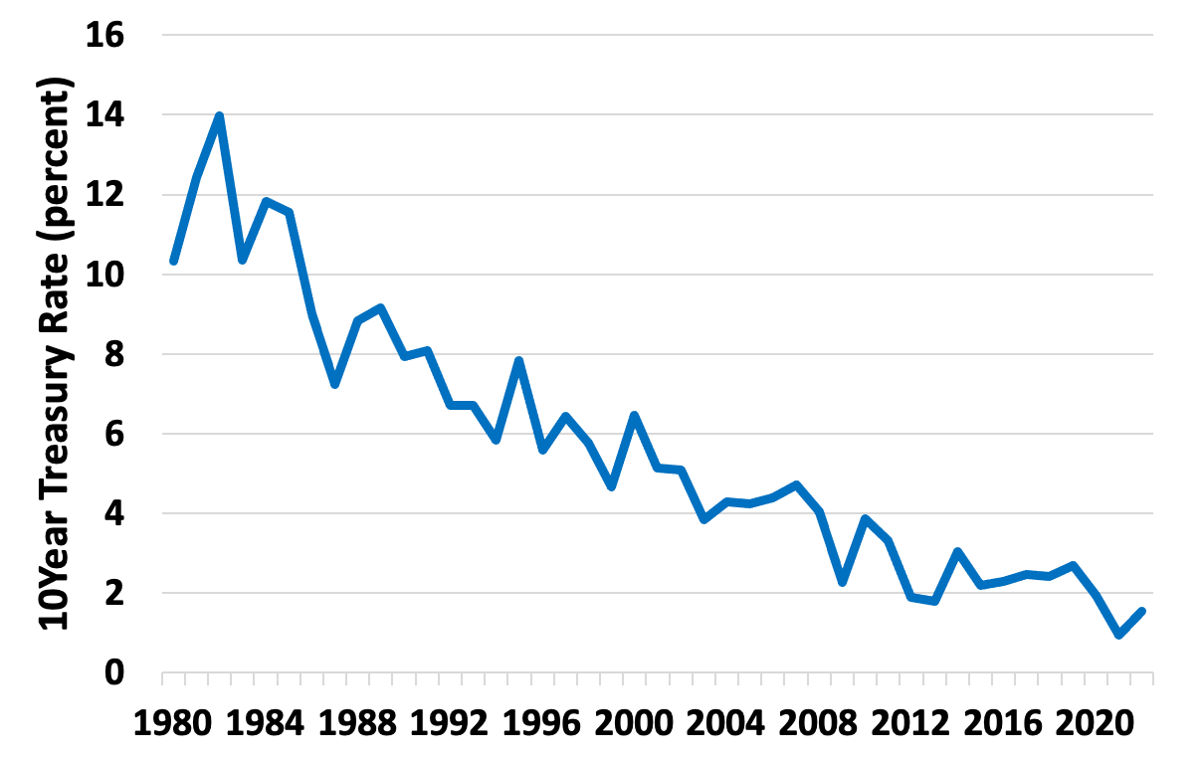
Figure 15.5 The Interest Rate on 10-Year Treasury Bonds, 1980–2022
Source: Federal Reserve Bank of St. Louis, FRED Economic Database.

Slide 8
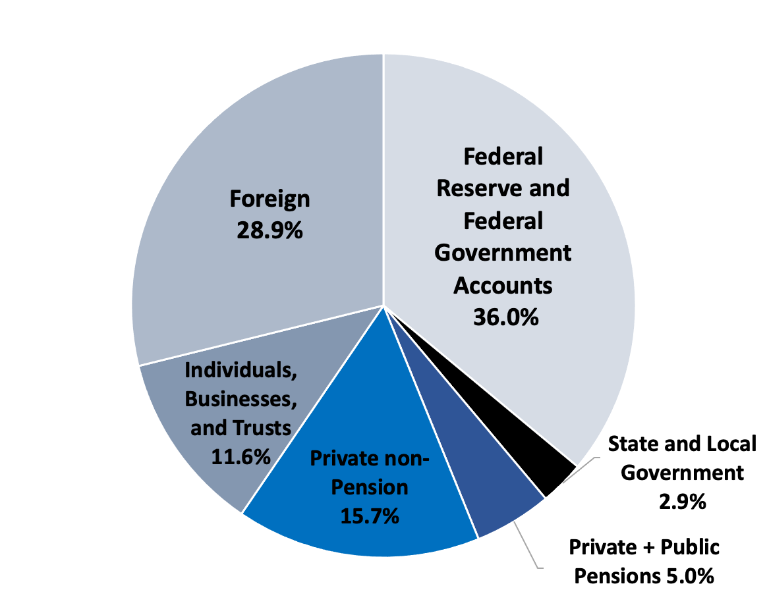
Figure 15.6 Ownership of Gross Federal Debt, 2019
Source: Treasury Department, 2021, Tables OFS-1; Distribution of Federal Securities by Class of Investors and Type of Issues, Table OFS-2; Estimated Ownership of US Treasury Securities and Table.

Slide 9
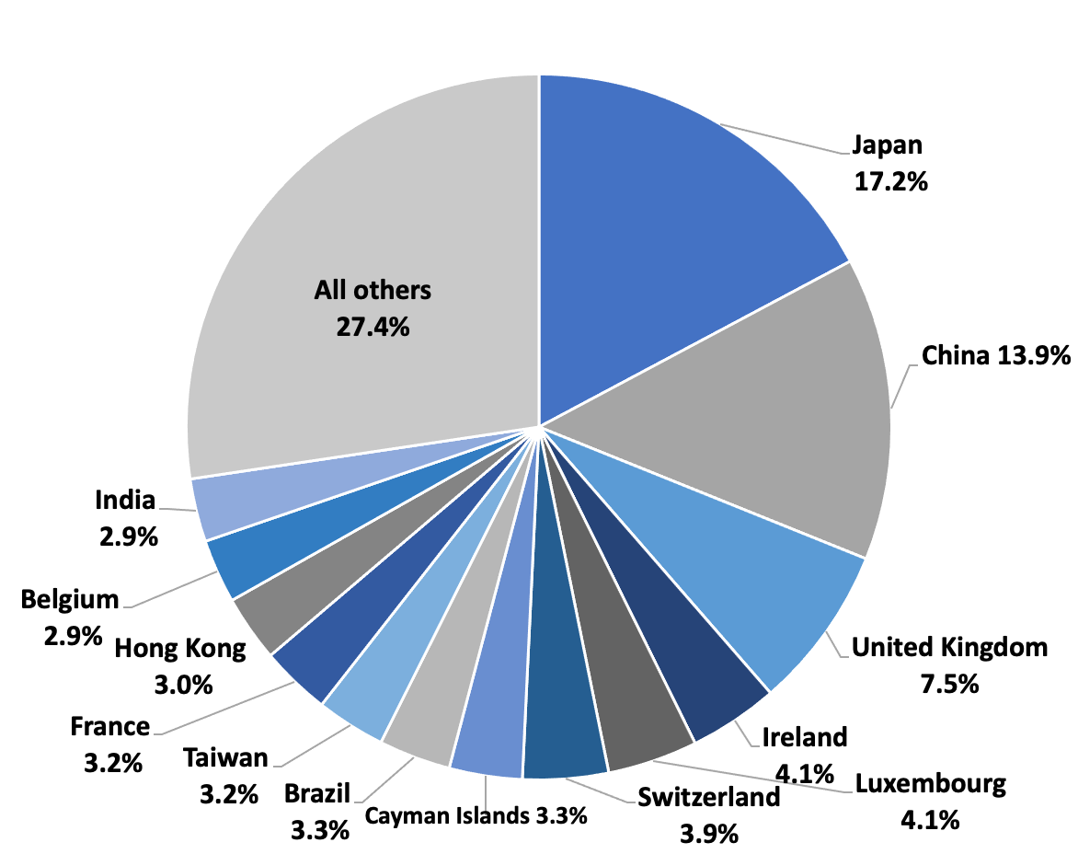
Figure 15.7 Foreign Holders of Gross Federal Debt, 2021
Source: Treasury Department, 2021, Major Foreign Holders of Treasury Securities.

Slide 10
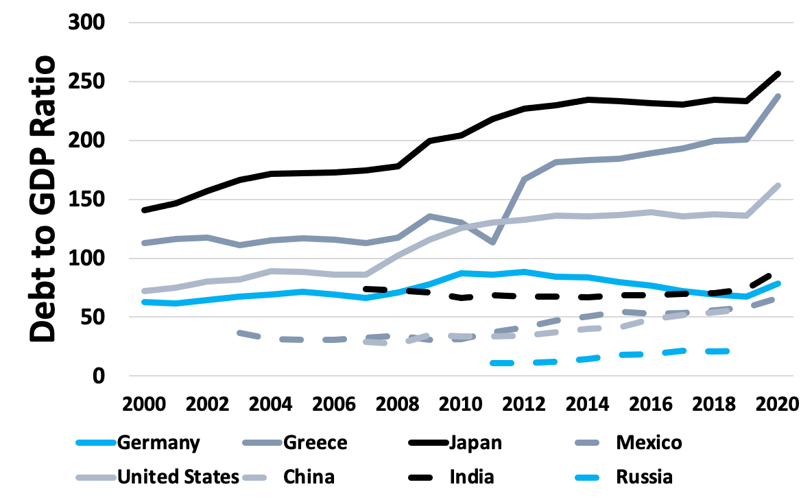
Figure 15.8 Debt-GDP Ratios, an International Comparison, 2000–2020
Source: OECD, General Government Debt, www.oecd.org
Note: U.S. debt figures include Federal, state, and local debt.

Slide 11
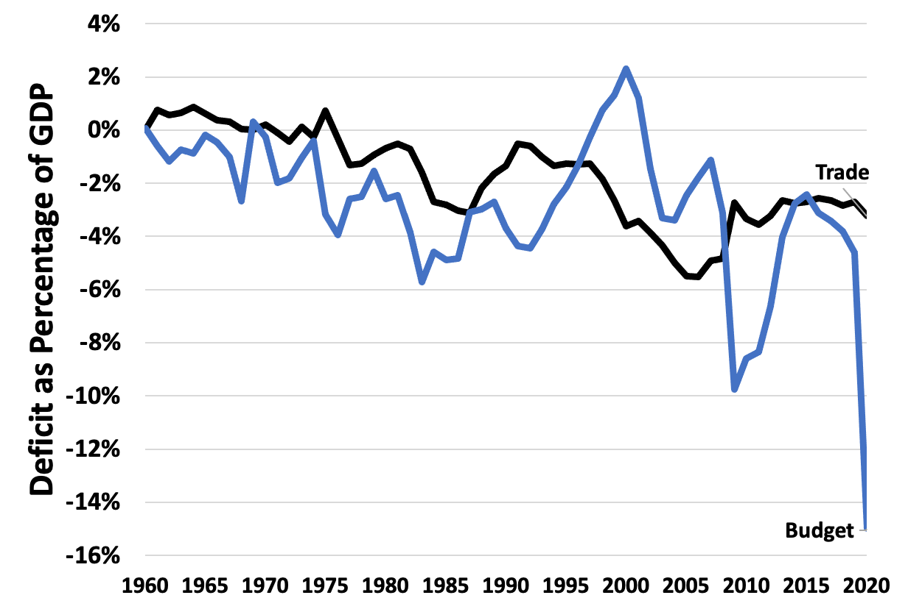
Figure 15.9 United States Twin Deficits as Percent of GDP, 1960–2020
Sources: CBO and U.S. Census Bureau.

Slide 12
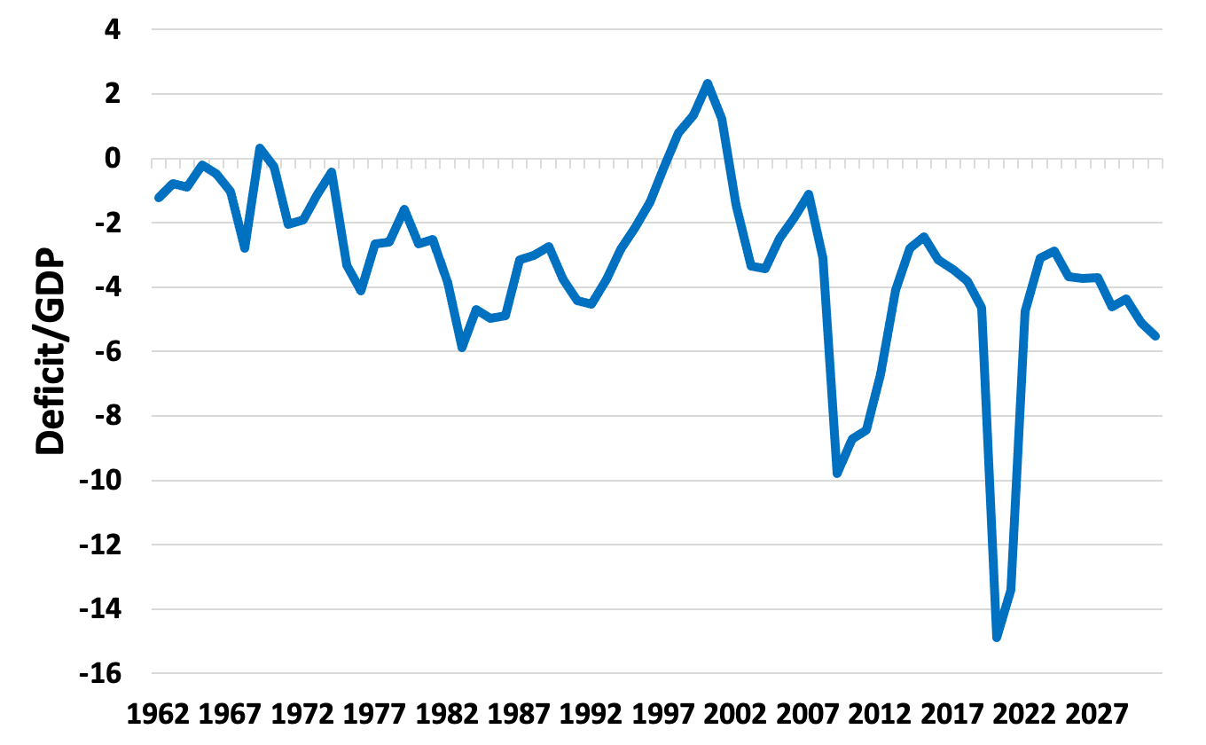
Figure 15.10 Annual Deficit as a Percent of GDP, Actual and Projected 1962–2031
Source: Congressional Budget Office, 2021.
Note: Data from 2020 to 2031 are projected

Slide 13
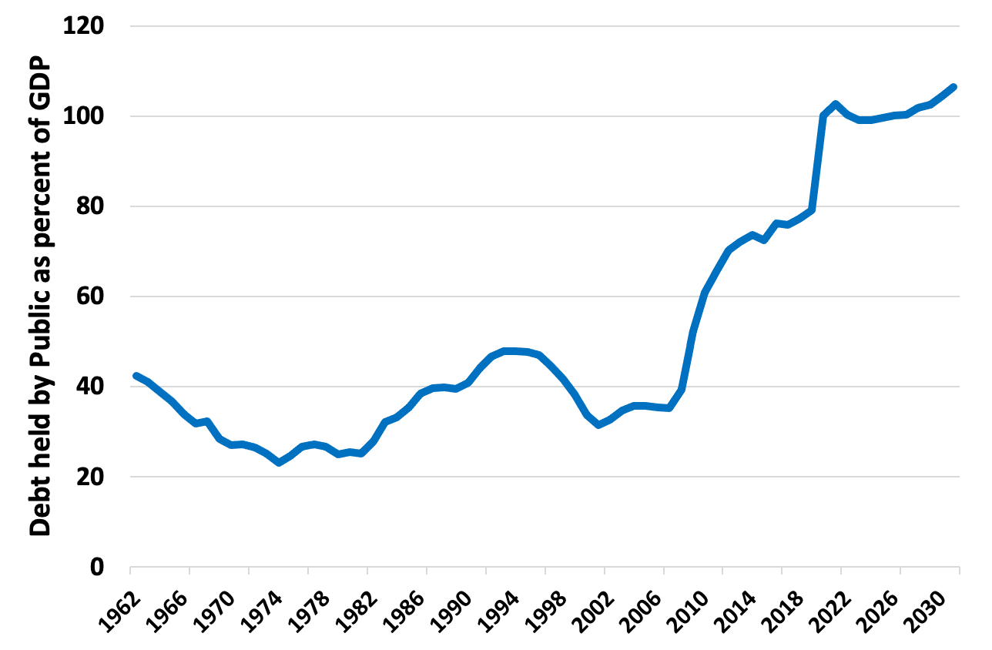
Figure 15.11 Federal Debt Held by the Public as a Percent of GDP, Actual and Projected 1962–2031
Source: Congressional Budget Office, 2021.
Note: Data from 2020 to 2031 are projected.

Slide 14
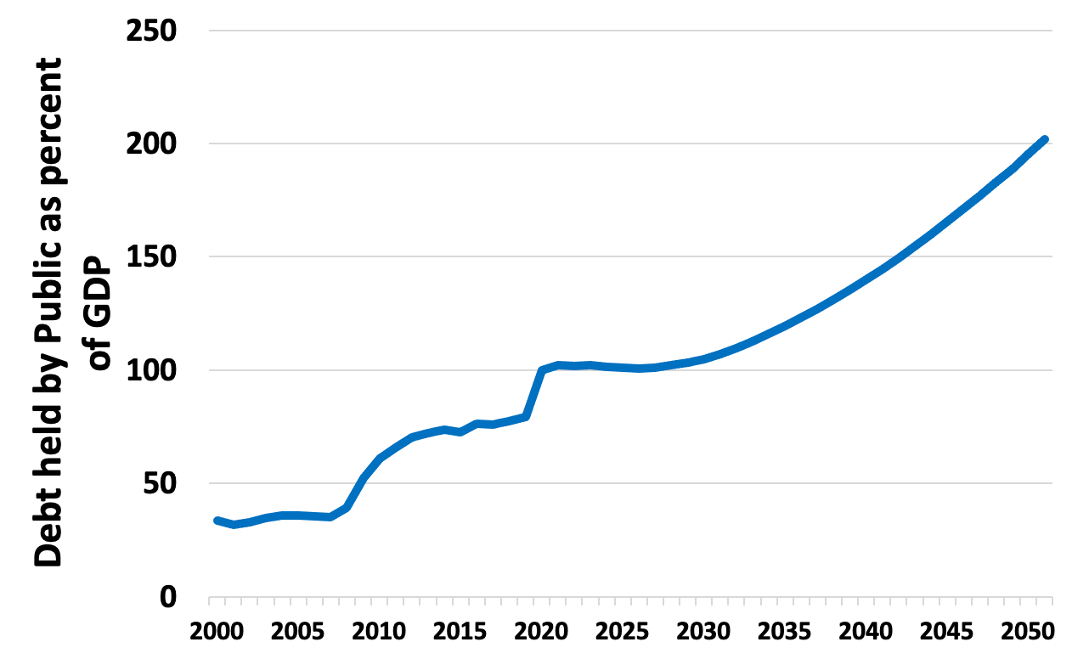
Figure 15.12 Federal Debt Held by the Public a Percent of GDP, Long-Term Projection 2000–2051
Source: Congressional Budget Office, 2021.
Note: Data from 2020 to 2050 are projected.

