Slide 1

Chapter 14
Inequality: Economic and Social Perspectives

Slide 2
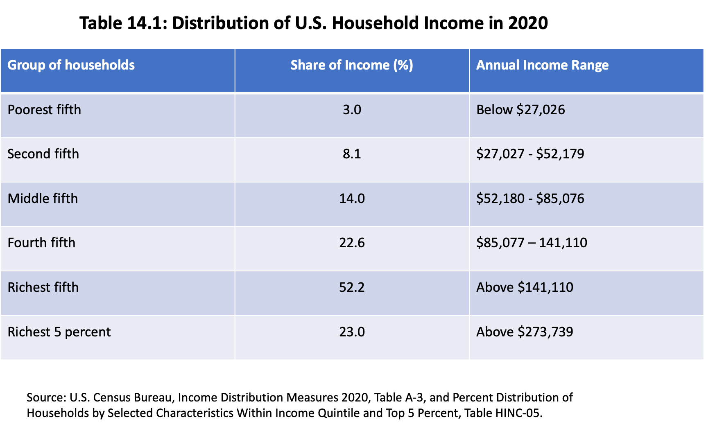

Slide 3
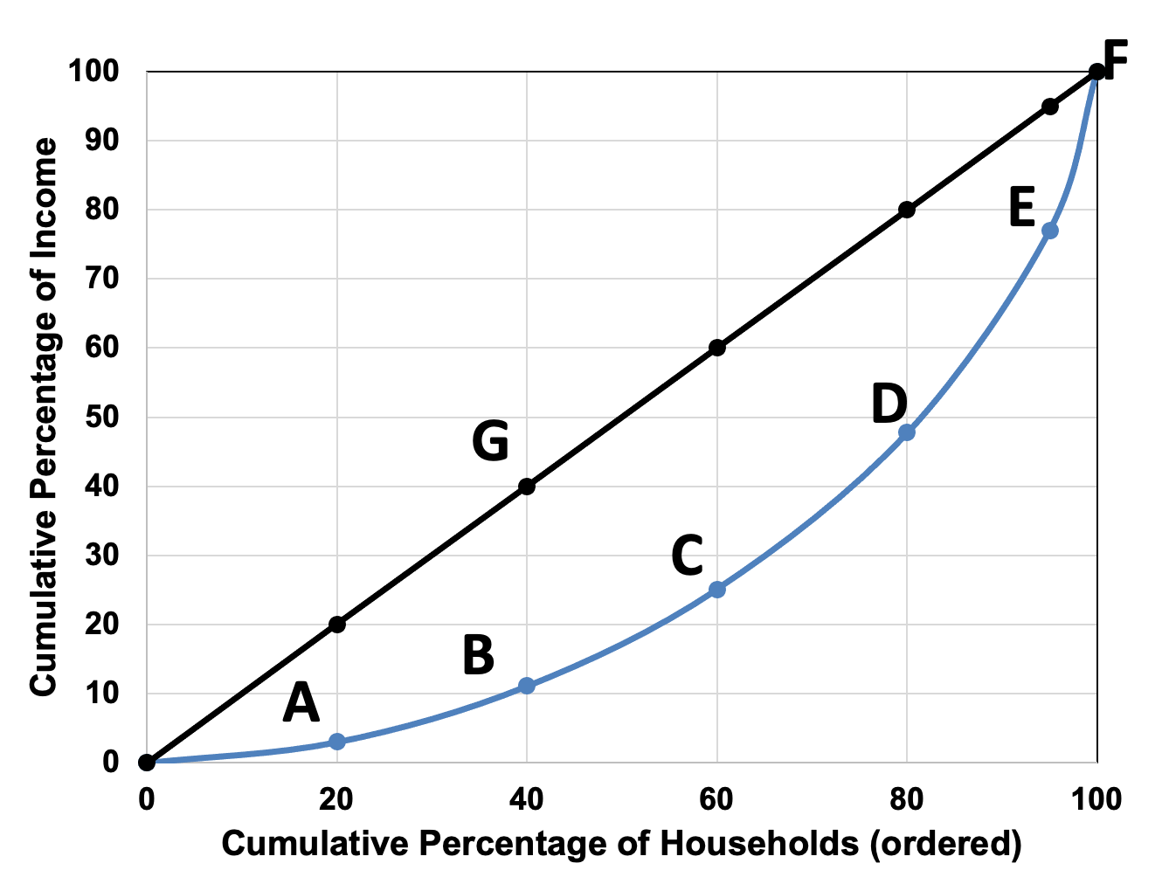
Figure 14.1 Lorenz Curve for U.S. Household Income, 2020
Source: U.S. Census Bureau, Historical Income Tables: Income Inequality, Table A-2.

Slide 4
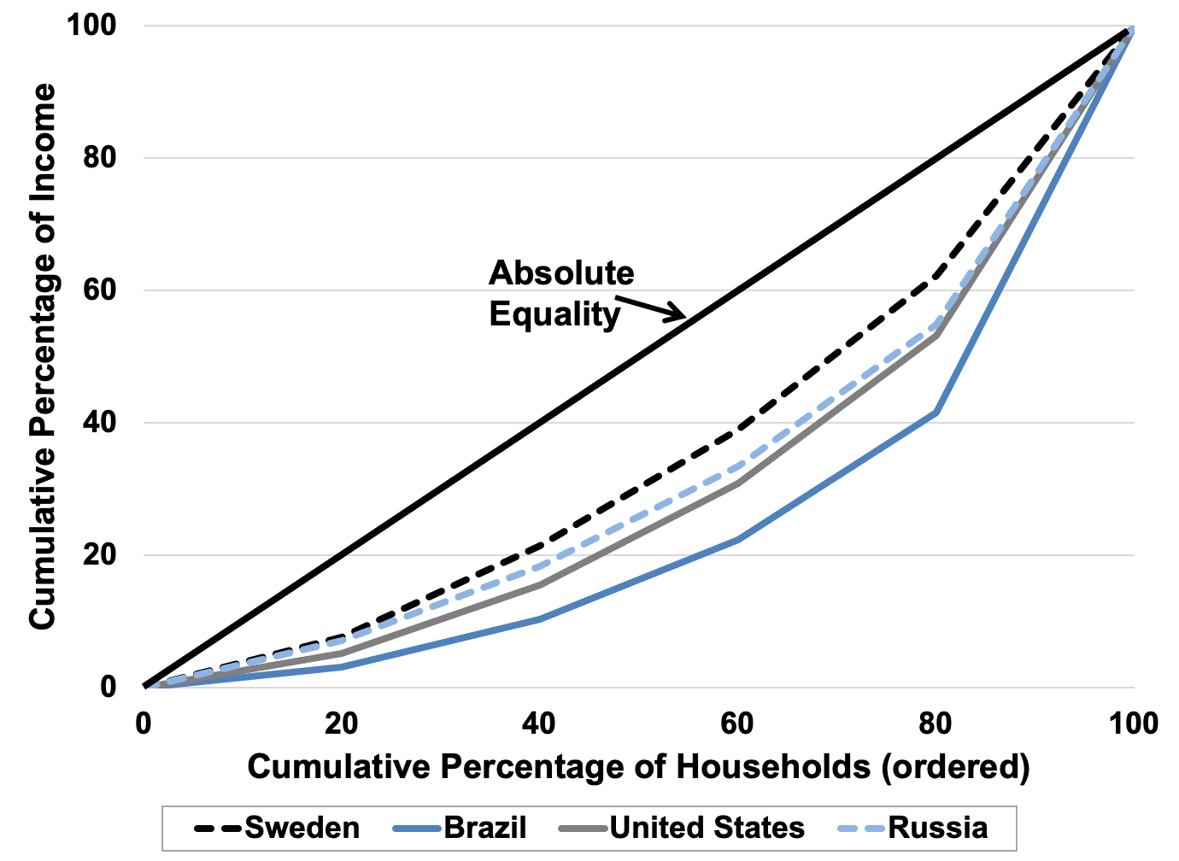
Figure 14.2: Lorenz Curves for Sweden, Brazil, Russia, and the United States, 2018.
Source: World Bank, World Development Indicators database.

Slide 5
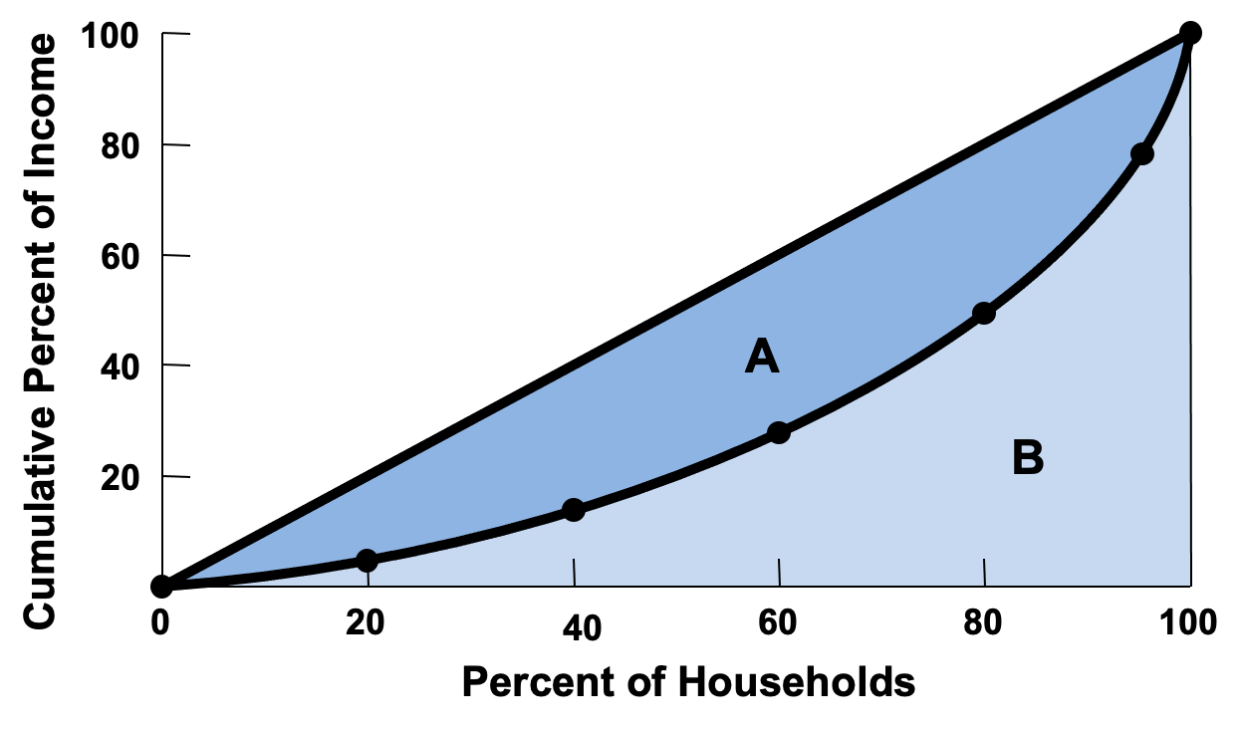
Figure 14.3 The Gini Ratio, A/(A + B)

Slide 6
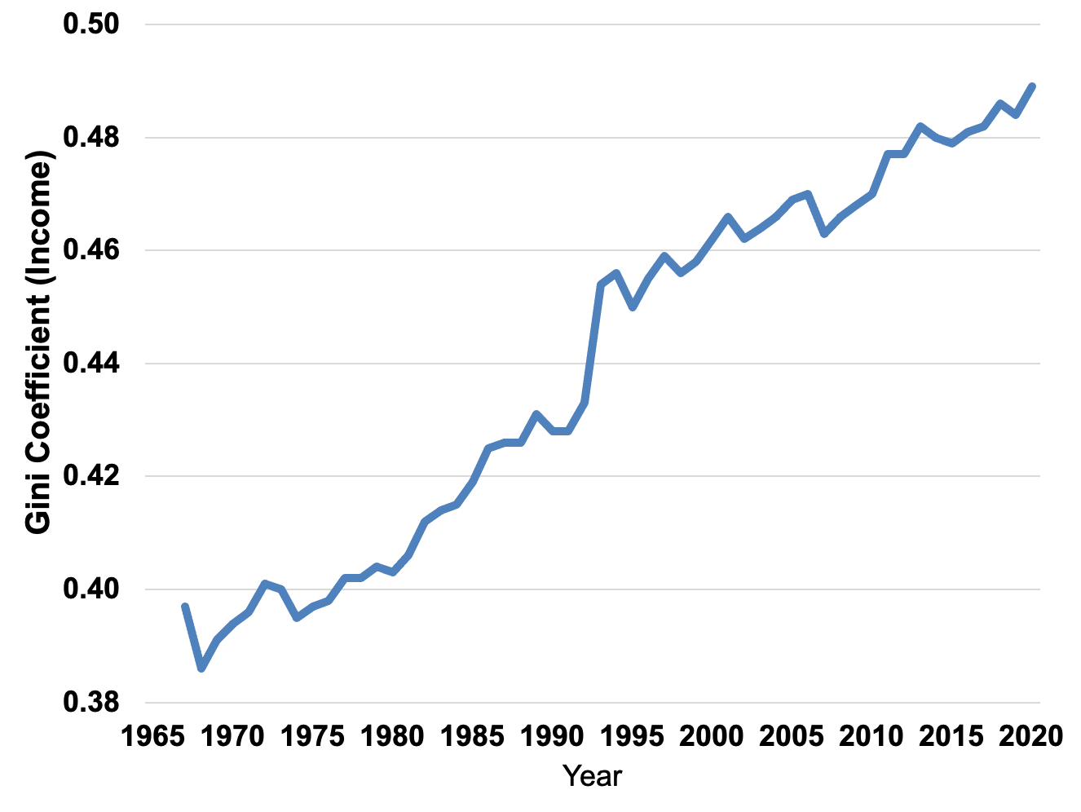
Figure 14.4 Gini Coefficient in the United States, 1968–2020
Source: U.S. Census Bureau, Historical Income Tables: Income Inequality, Table A-2.

Slide 7
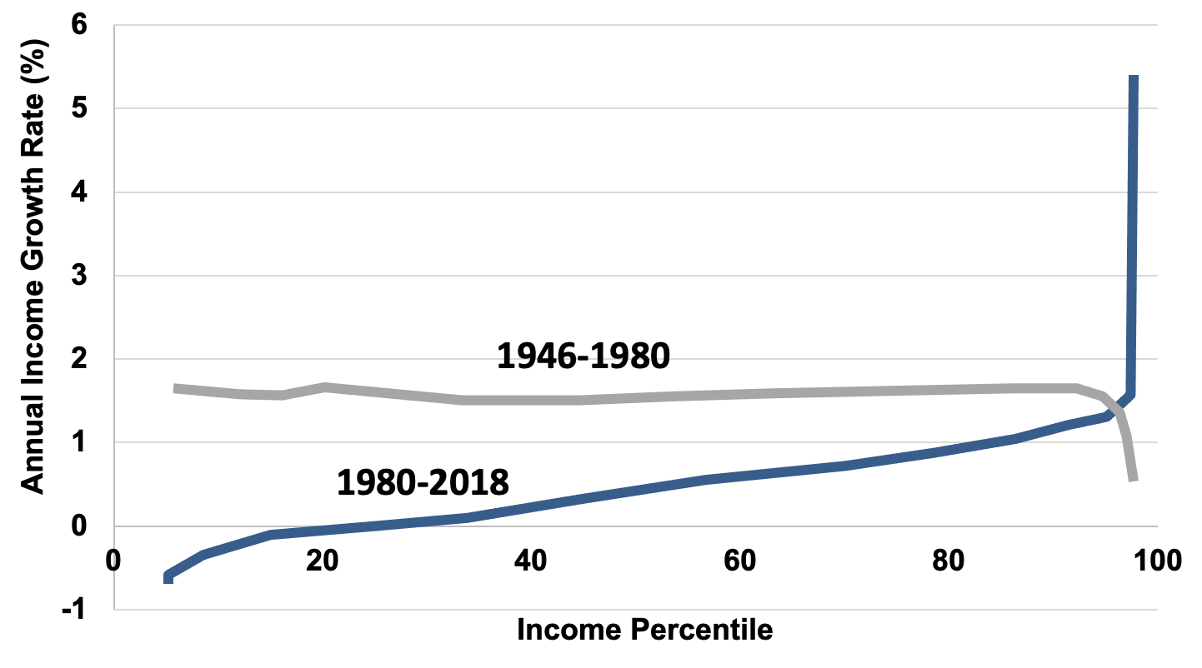
Figure 14.5 Growth in Income by Percentile
Source: Saez and Zucman, 2020.

Slide 8
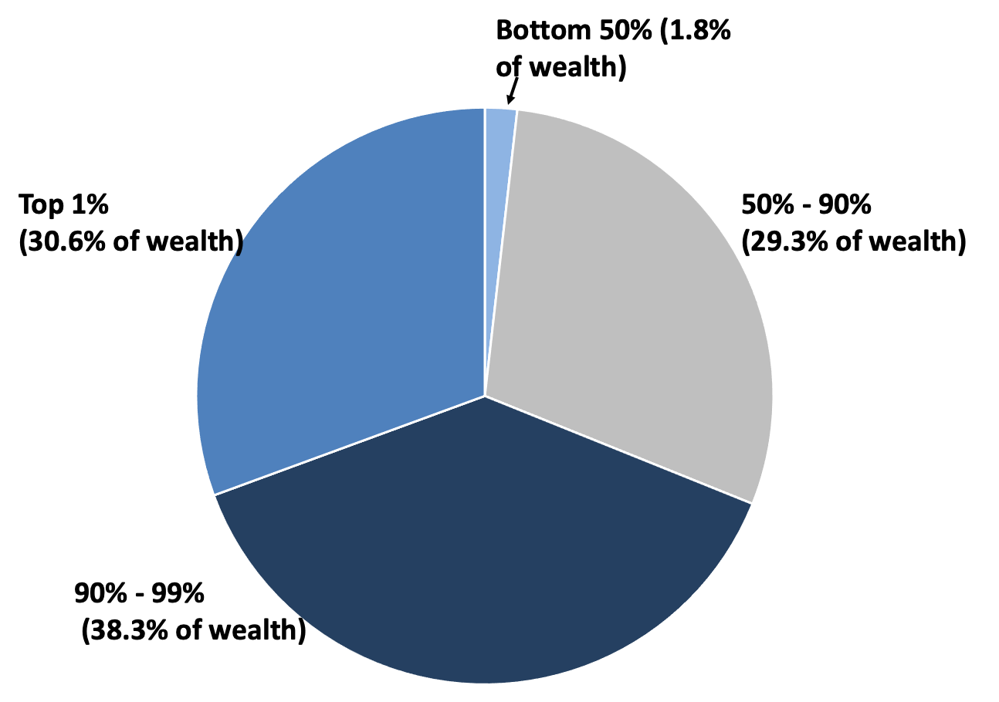
Figure 14.6 The Distribution of Wealth in the United States, 2020
Source: United States Federal Reserve, 2021.

Slide 9
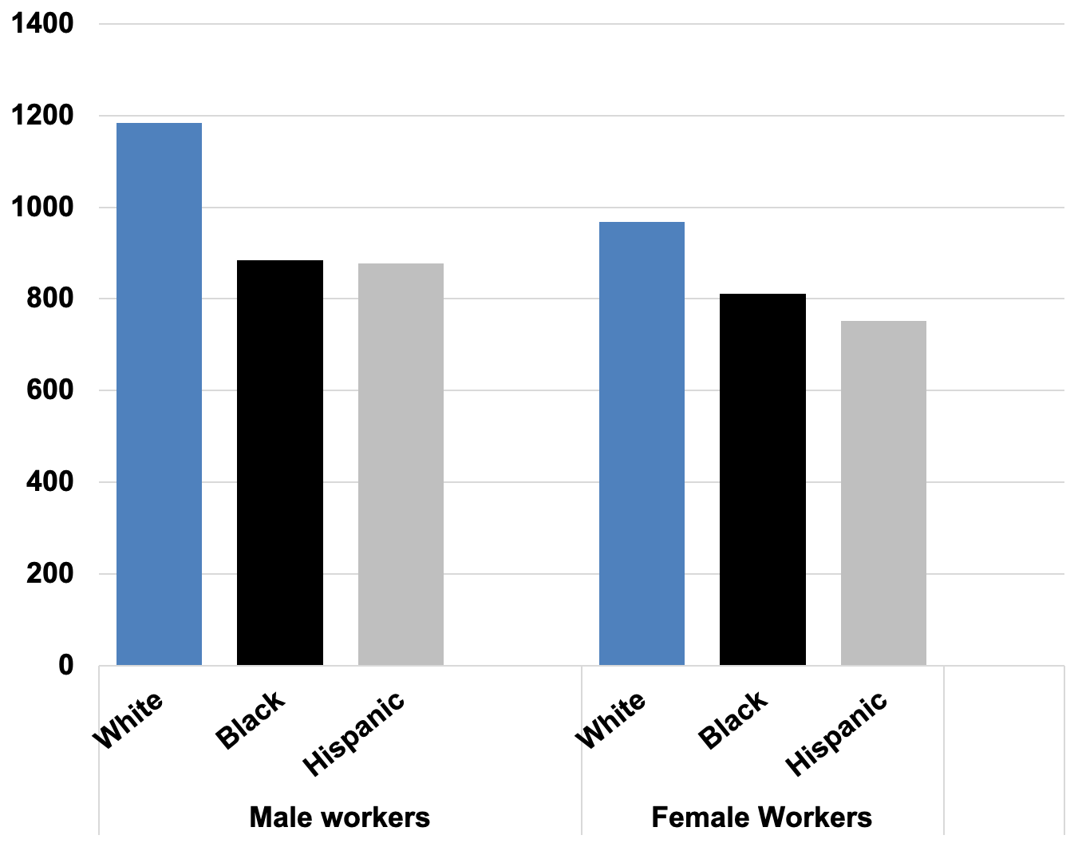
Figure 14.7 Median Weekly Earnings, Select Groups of U.S. Workers, Age 25 and Over, 2021
Source: U.S. Bureau of Labor Statistics, 2021.

Slide 10
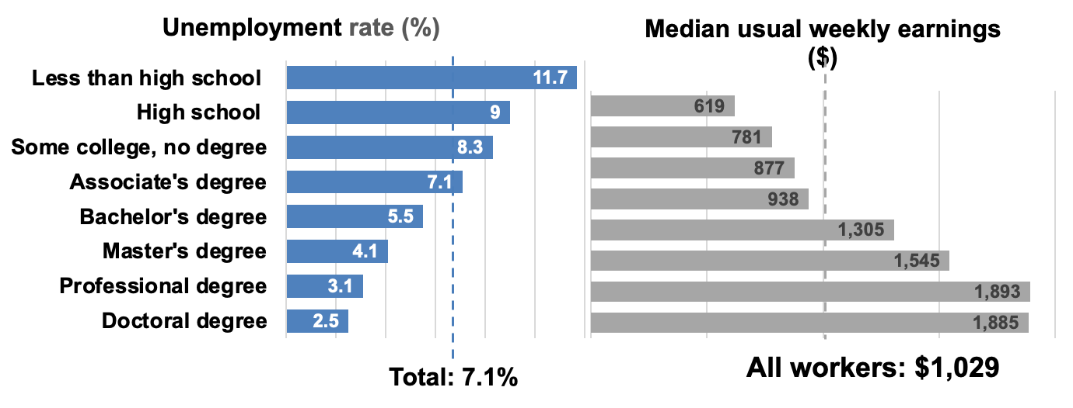
Figure 14.8 Earnings and Unemployment Rates by Educational Attainment, 2020
Source: U.S. Bureau of Labor Statistics, Current Population Survey.

Slide 11
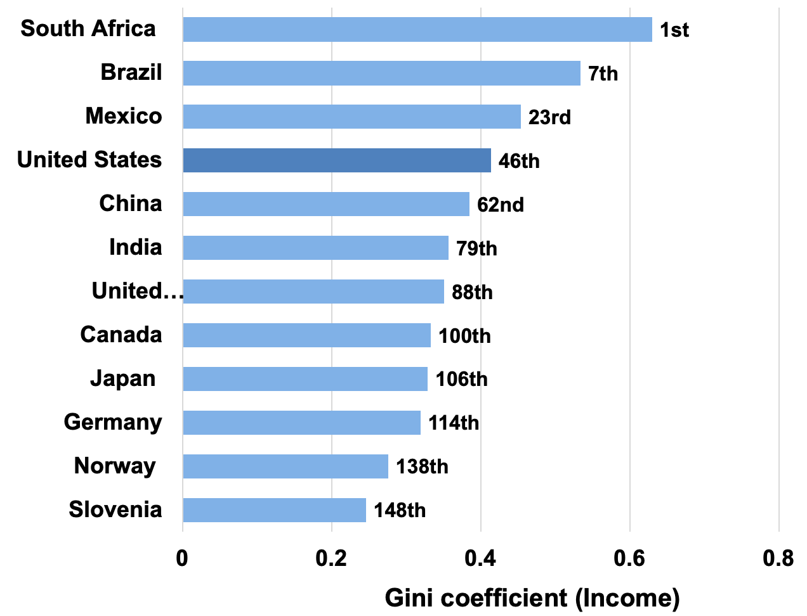
Figure 14.9 Income Gini Coefficient for Select Countries
Source: World Bank, World Development Indicators database. Data for the most recent year available, between 2011 and 2019.

Slide 12
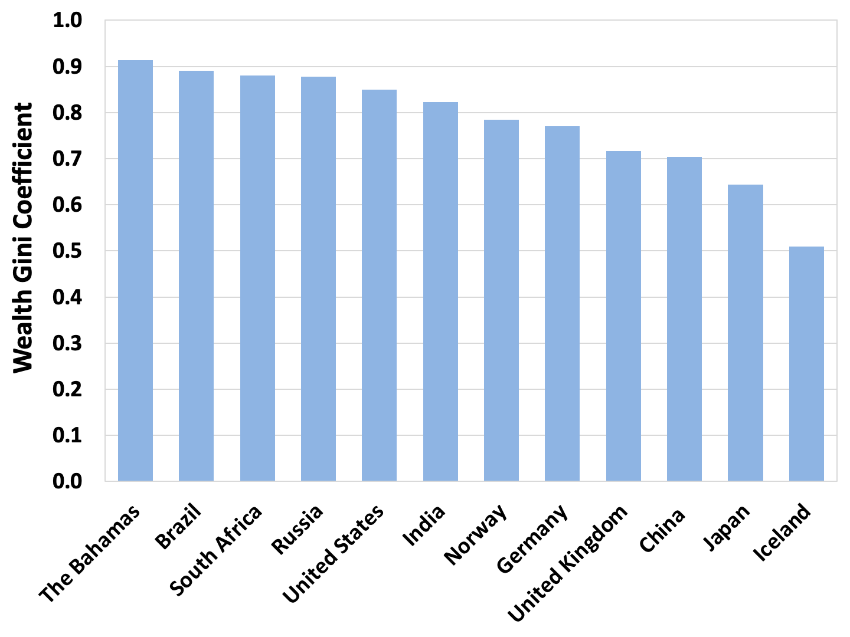
Figure 14.10. Wealth Gini Coefficient for Select Countries
Source: Credit Suisse, 2021.

Slide 13
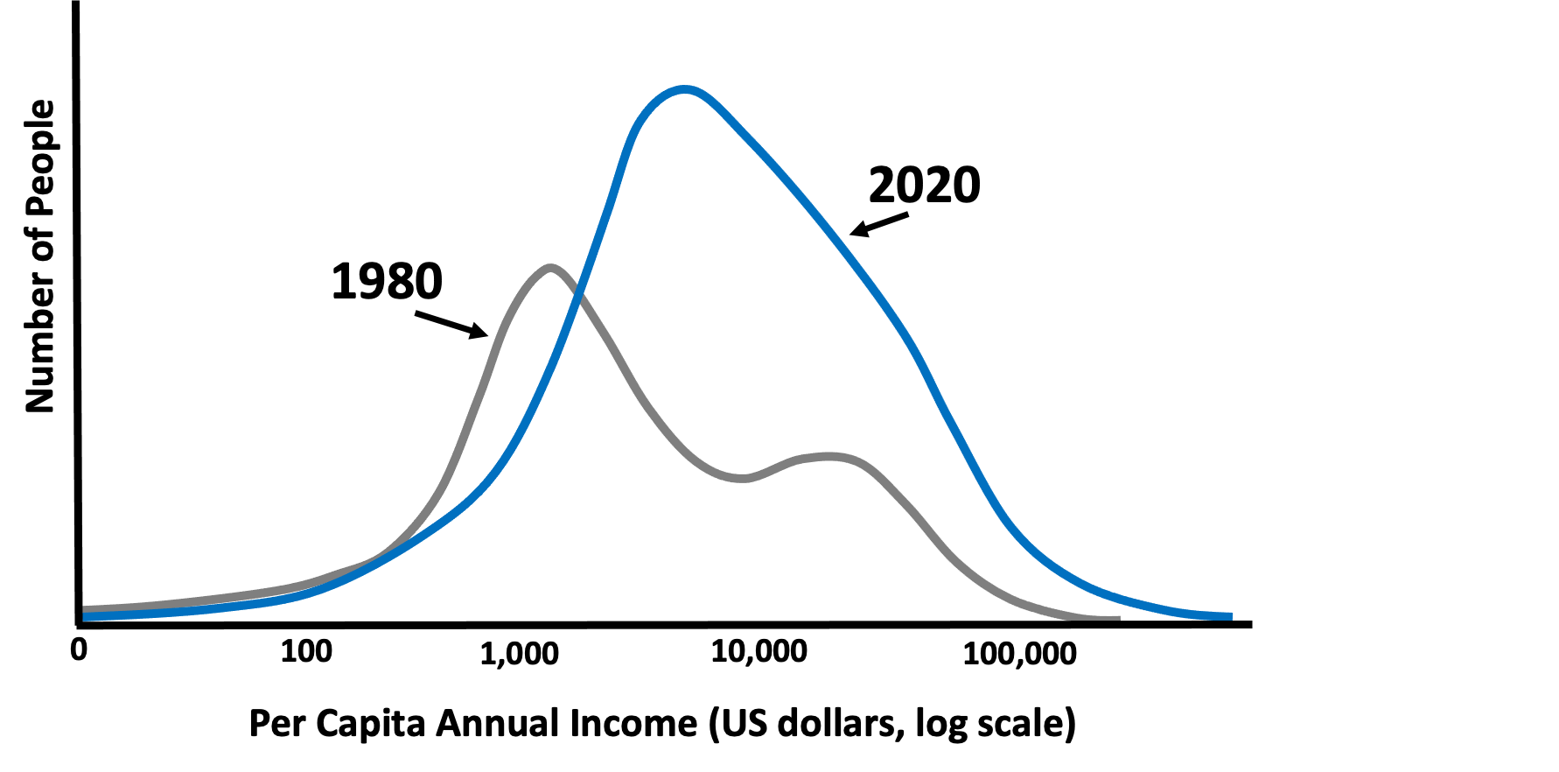
Figure 14.11. Global Income Distribution, 1980 and 2020
Source: Chancel et al., 2021.
Note: Income adjusted for inflation and purchasing power.

Slide 14
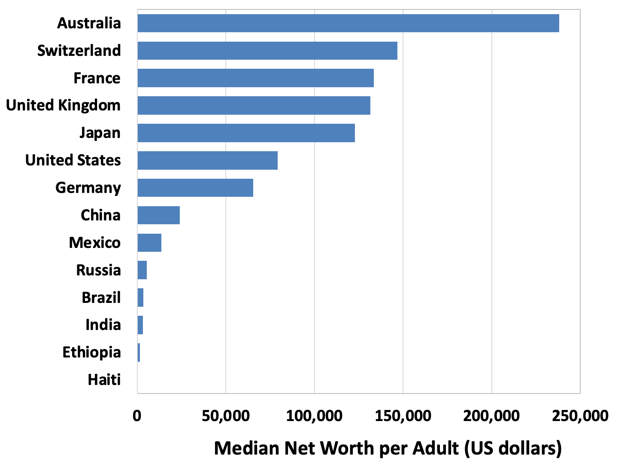
Figure 14.12 Median Net Worth per Adult, Select Countries, 2020
Source: Credit Suisse, 2021.

Slide 15
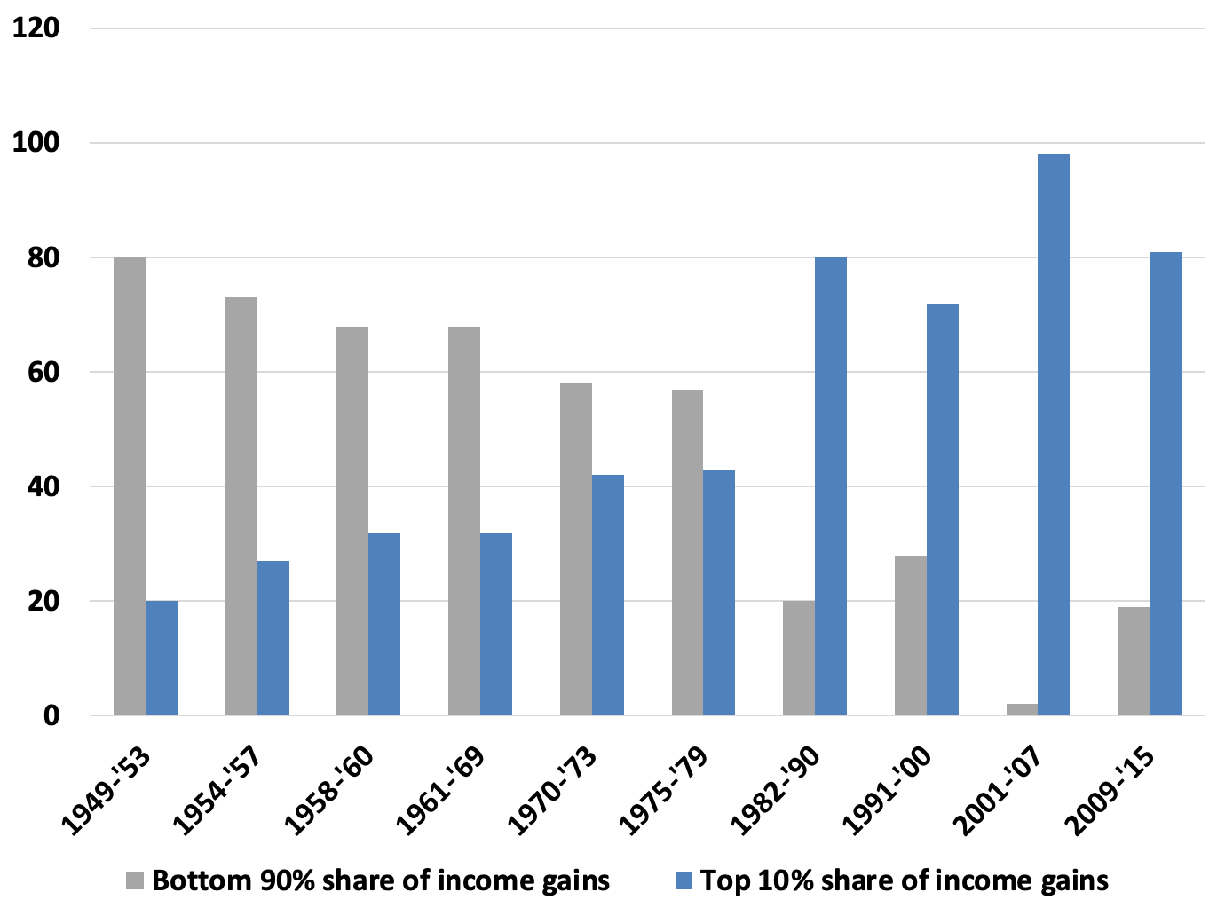
Figure 14.13 Income Gains during U.S. Expansions for the Richest 10% and the Bottom 90%
Source: Tcherneva, 2017, based on data from Thomas Piketty, Emmanuel Saez, and the National Bureau of Economic Research (NBER).

Slide 16
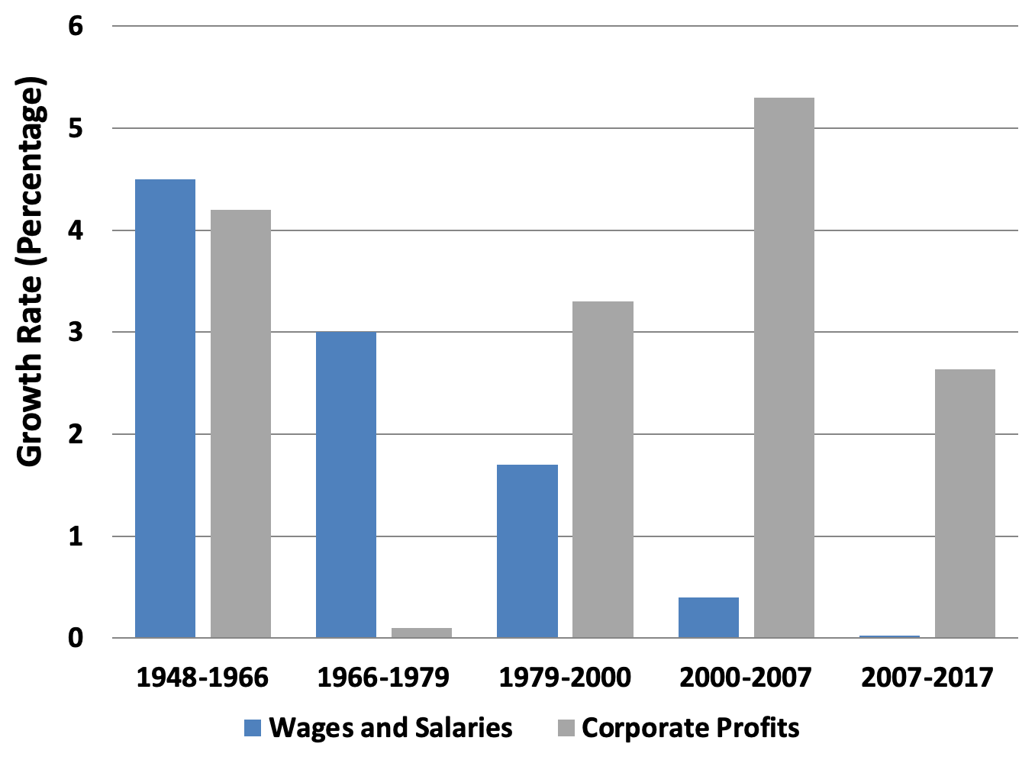
Figure 14.14 Annual Growth Rates of Wages and Salaries and Corporate Profit, 1948–2017
Source: U.S. Bureau of Economic Analysis (2017), NIPA Table 1.14, 1.1.4; Bureau of Labor Statistics (2017).

Slide 17
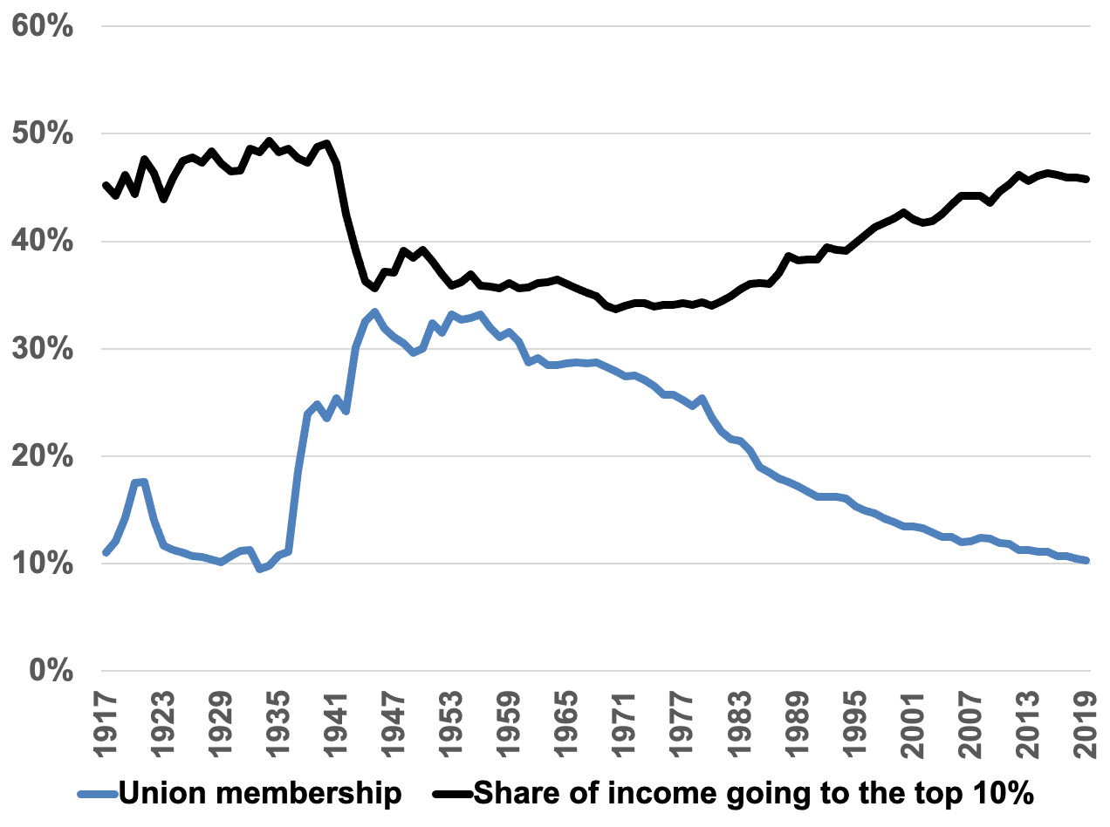
Figure 14.15 Union Membership and Income Inequality, 1917–2019
Source: Shierholz, 2019.

Slide 18
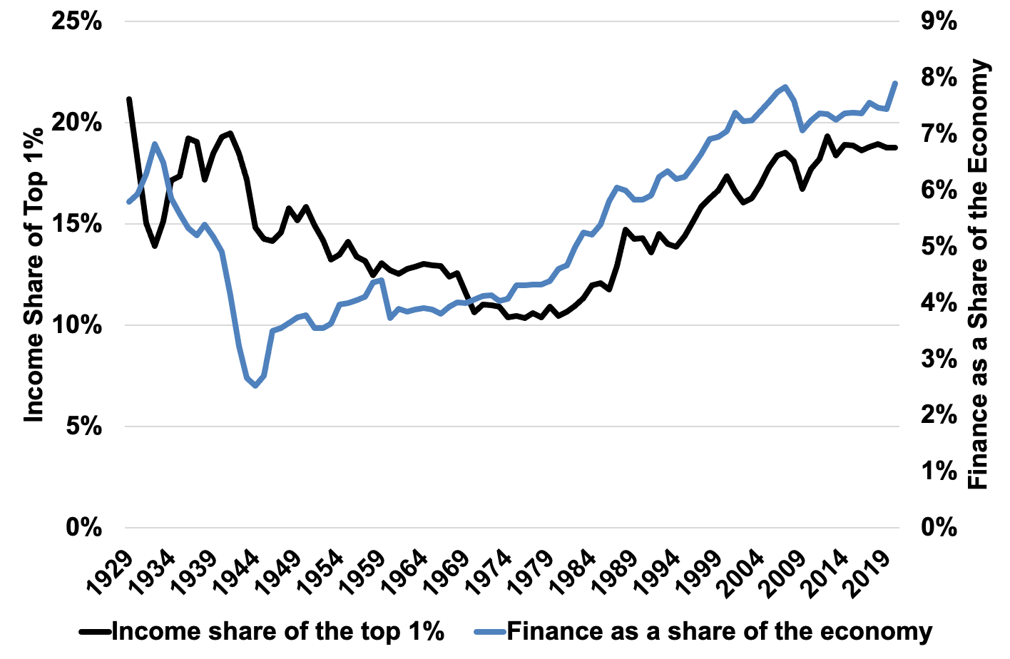
Figure 14.16 Financialization and Inequality, 1929–2020
Source: NIPA Tables 6.2A-6.2D, BEA; Saez and Zucman, 2020.

Slide 19
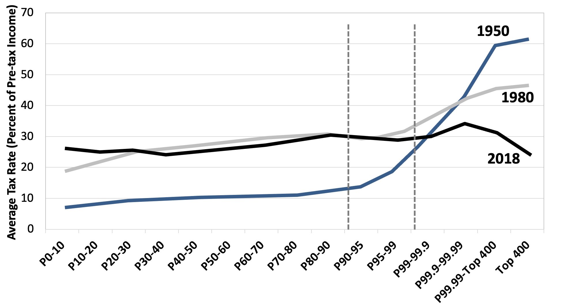
Figure 14.17: Average Tax Rates by Income Group, Select Years
Source: Piketty, Saez and Zucman, 2020.
Note: P0-10 denotes the bottom 10 percent of the population, P10-20 the next 10 percent, etc. Figure depicts US average tax rates, including all federal, state, and local taxes.

