Slide 1
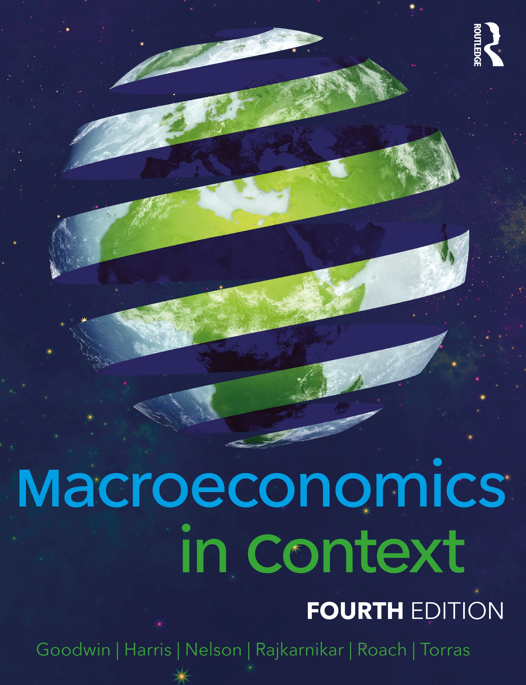
Chapter 13
The Global Economy and Policy

Slide 2
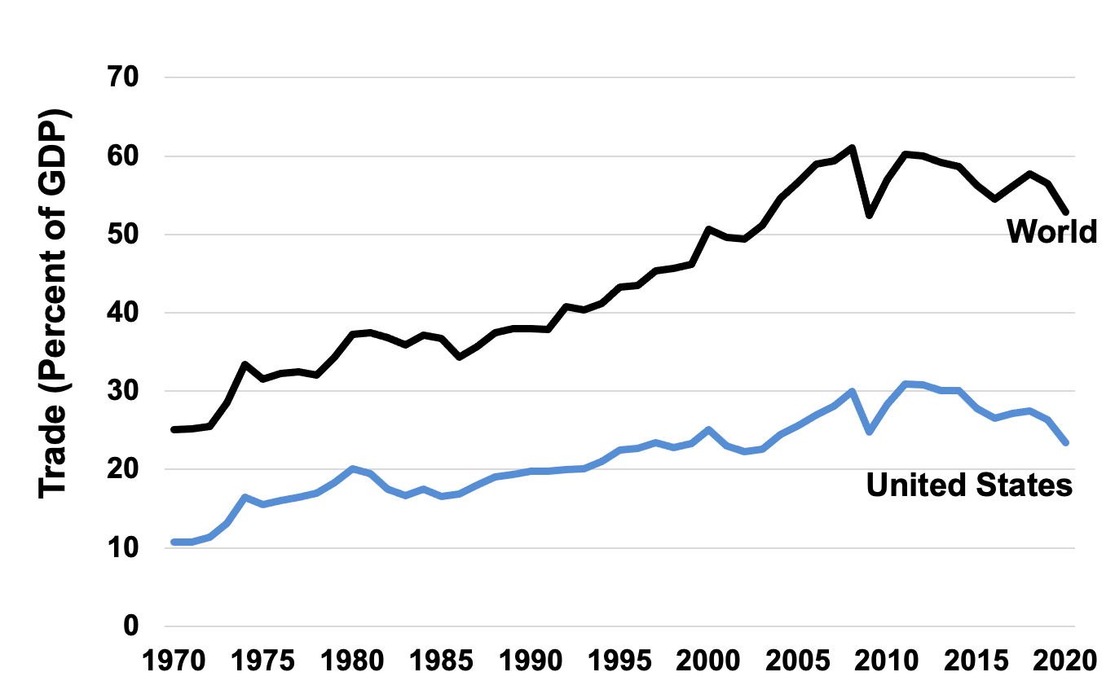
Figure 13.1 Trade Expressed as a Percentage of Production, World and United States, 1970–2020
Source: World Development Indicators, World Bank, 2021.

Slide 3
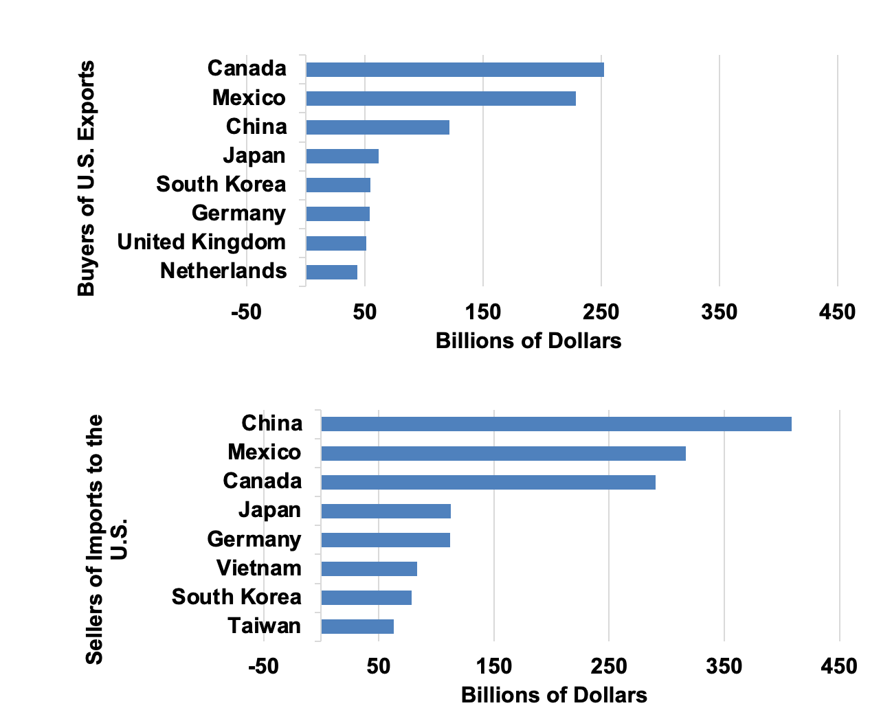
Figure 13.2 Top Purchasers of Goods from the United States and Suppliers of Goods to the United States, 2021
Source: U.S. Census Bureau, Foreign Trade Statistics, Top Trading Partners, 2021.

Slide 4
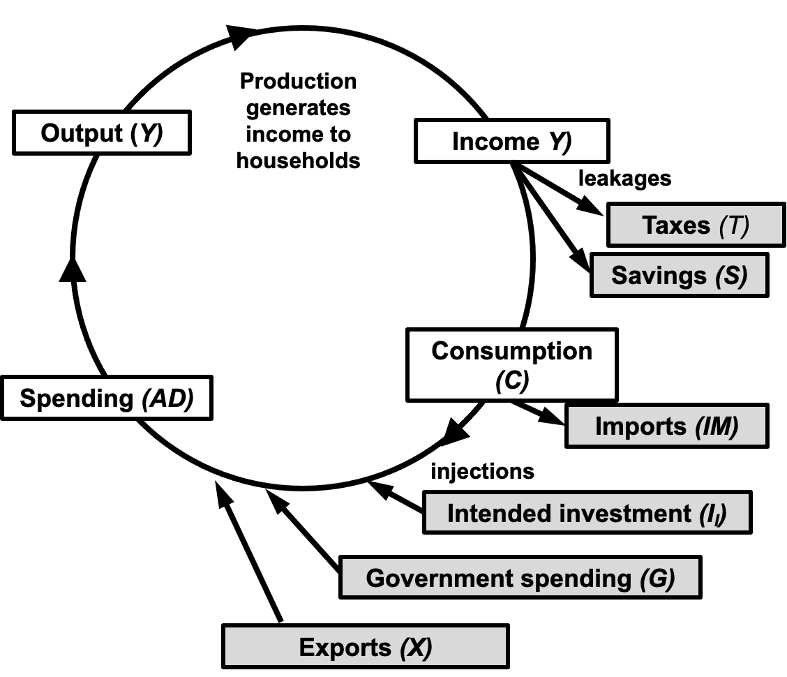
Figure 13.3 Leakages and Injections in a Complete Macroeconomic Model

Slide 5
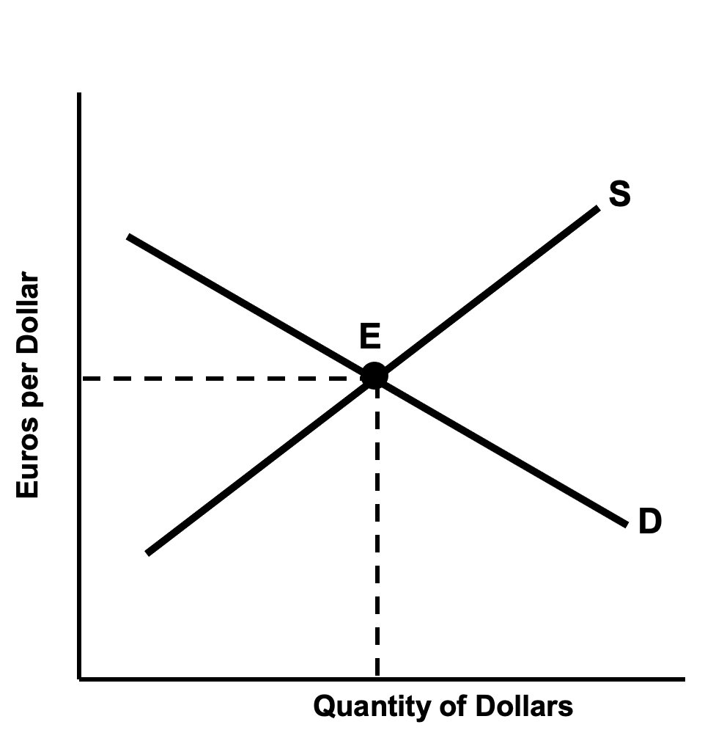
Figure 13.4 A Foreign Exchange Market for Dollars

Slide 6
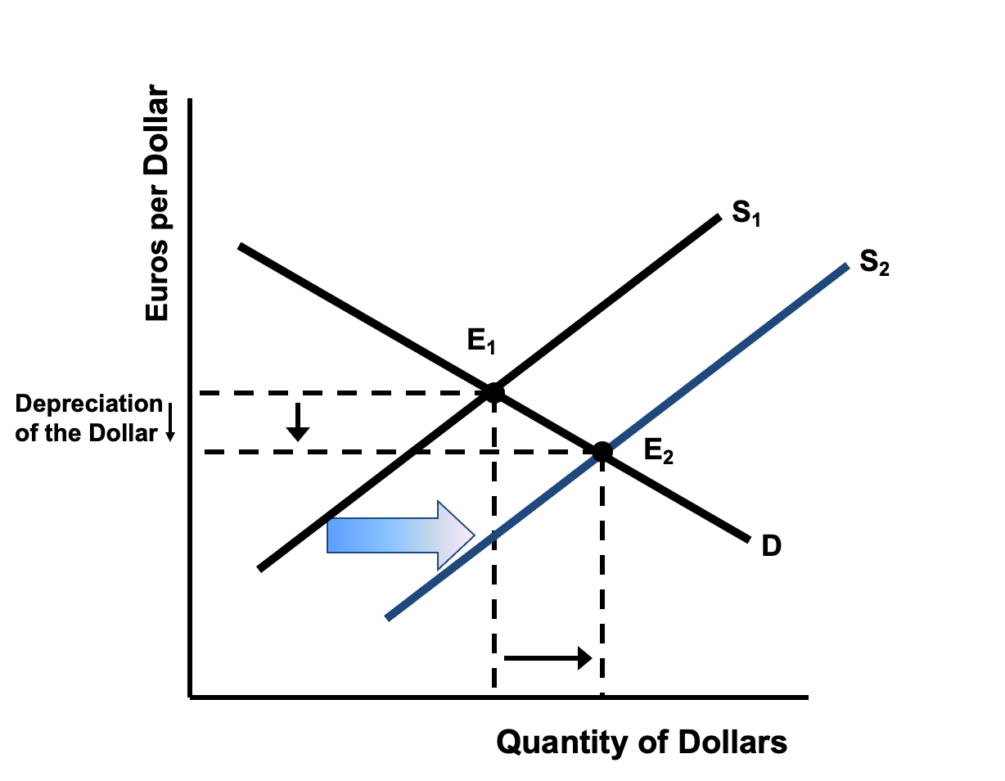
Figure 13.5 A Supply Shift in a Foreign Exchange Market

Slide 7
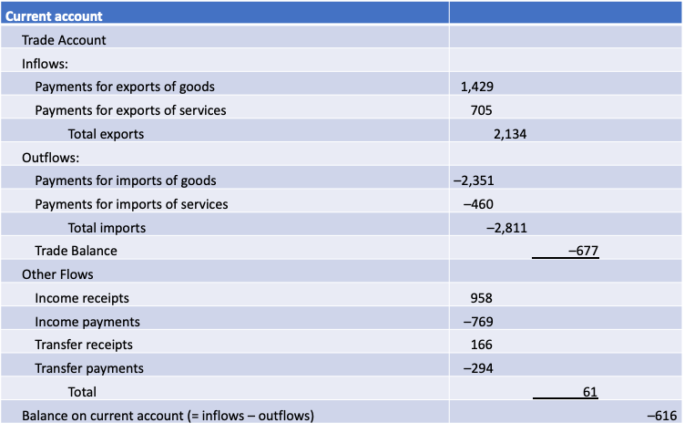
Table 13.1:U.S. Balance of Payments Account, 2020 (billions of dollars)
Source: U.S. Bureau of Economic Analysis, U.S. International Transactions Accounts Data, Table 1, with rearrangements and simplifications by authors.

Slide 8
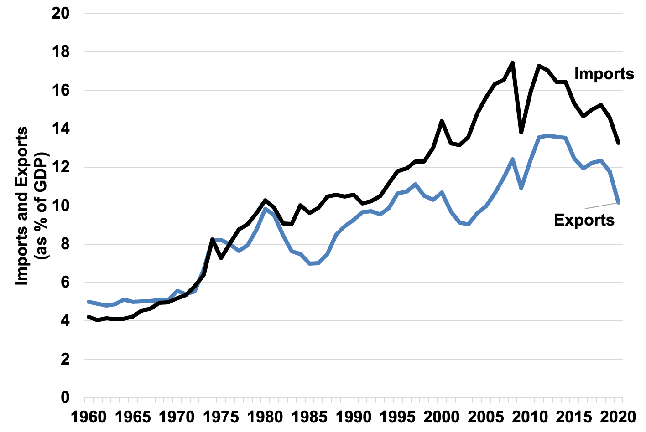
Figure 13.6 U.S. Imports and Exports of Goods and Services, 1960–2020
Source: BEA NIPA Tables 4.1 and 1.1.5, 2021

Slide 9
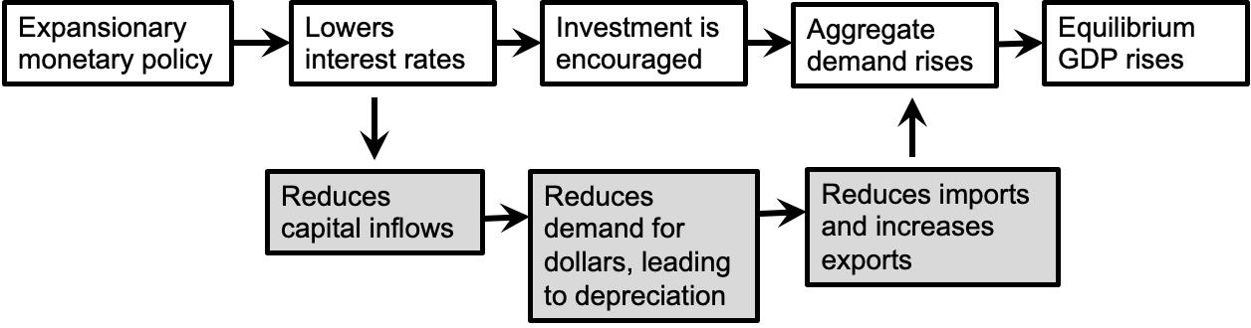
Diagram 13.1: The Impact of Expansionary Monetary Policy on GDP in an Open Economy

Slide 10
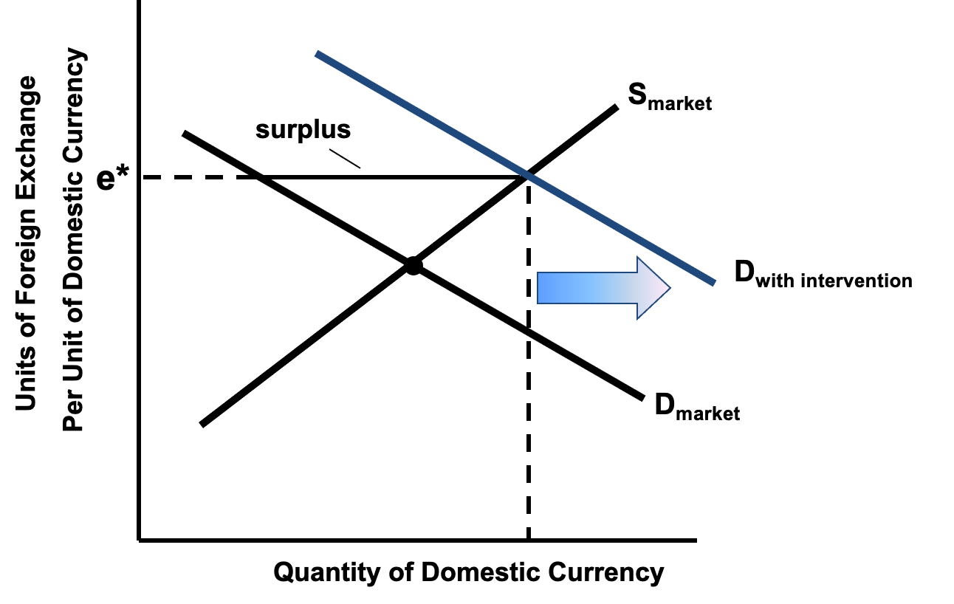
Figure 13.7 Foreign Exchange Intervention

