Slide 1

Chapter 12
Aggregate Supply, Aggregate Demand, and Inflation: Putting it All Together

Slide 2
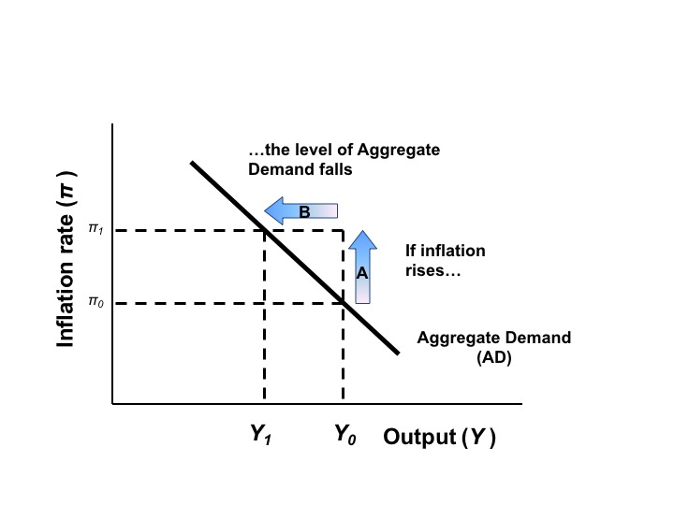
Figure 12.1 The Aggregate Demand Curve

Slide 3
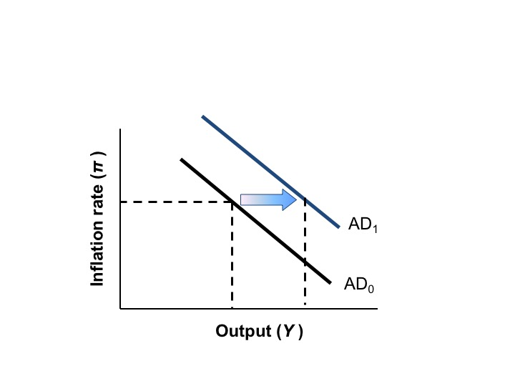
Figure 12.2 The Effect of Expansionary Fiscal Policy or Increase Confidence on the AD Curve

Slide 4
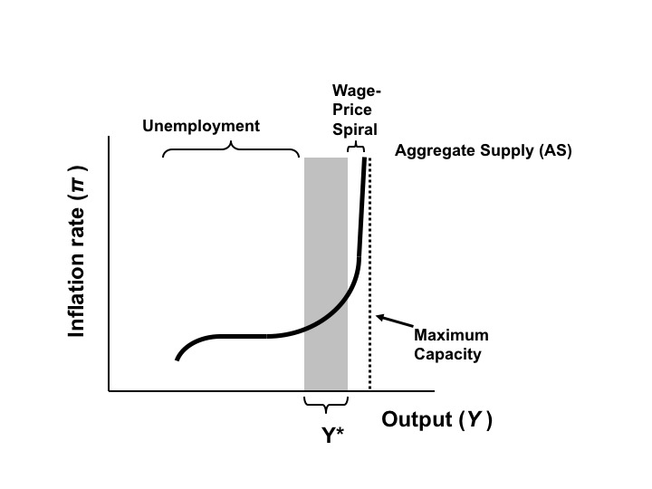
Figure 12.3 The Aggregate Supply Curve

Slide 5
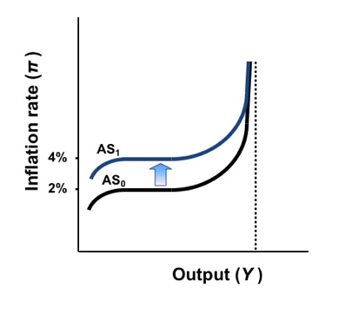
Figure 12.4 The Effect of an Increase in Inflationary Expectations on the Aggregate Supply Curve

Slide 6
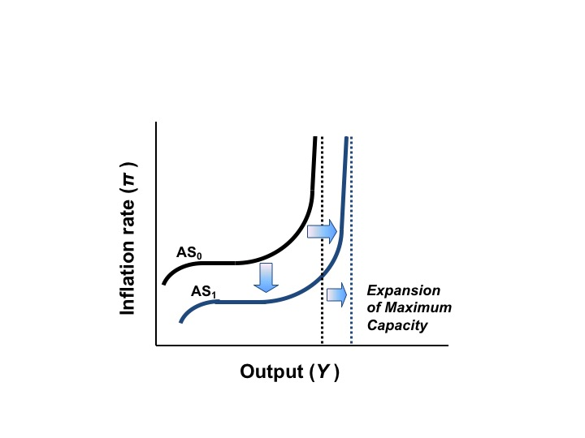
Figure 12.5: A Beneficial Supply Shock: Expansion of Output Capacity

Slide 7
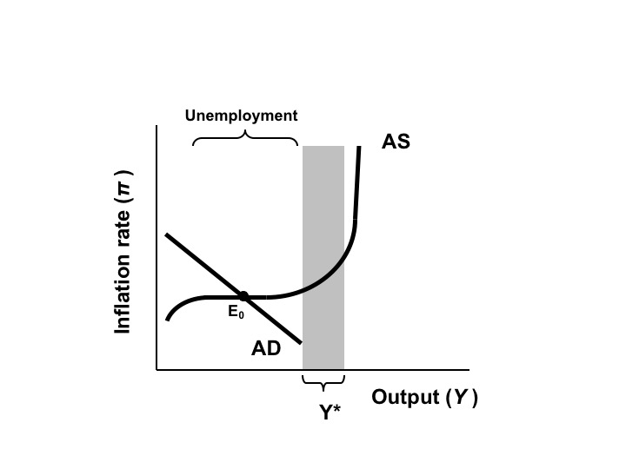
Figure 12.6 Aggregate Demand and Supply Equilibrium in Recession

Slide 8
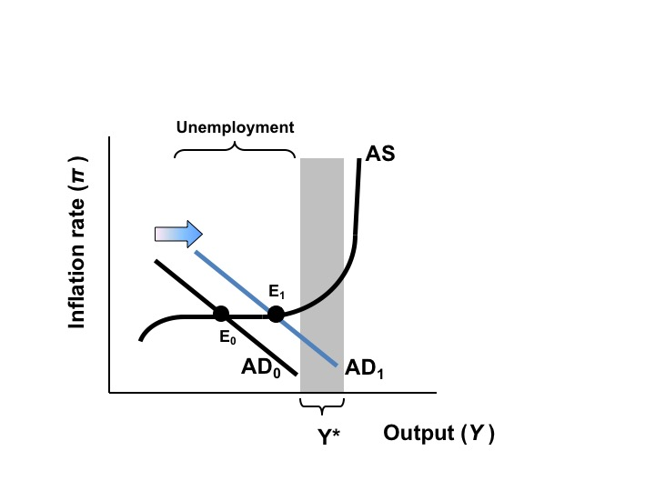
Figure 12.7 Expansionary Fiscal Policy in Response to a Recession

Slide 9
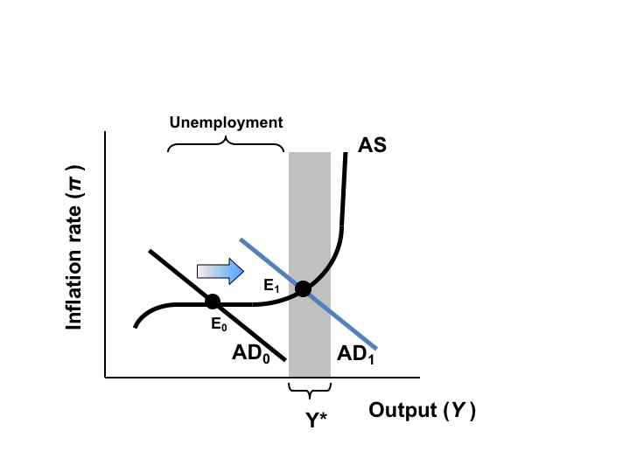
Figure 12.8 A Greater Expansion of Aggregate Demand

Slide 10
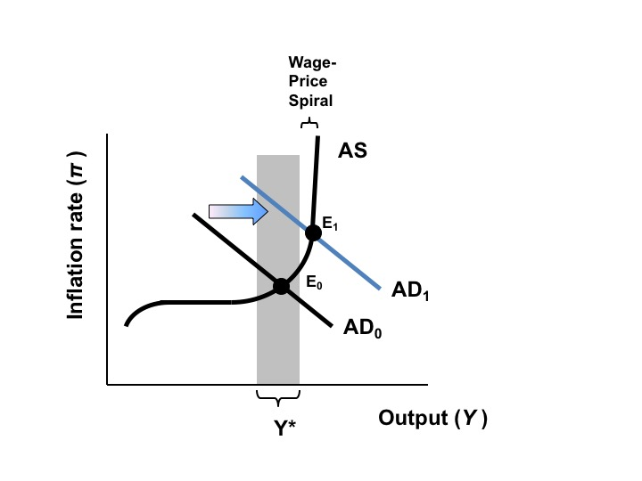
Figure 12.9 Excessively High Aggregate Demand Causes Inflation

Slide 11
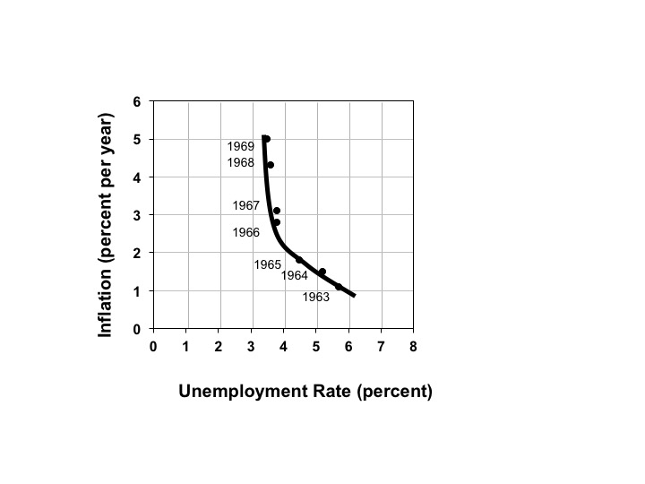
Figure 12.10 The Phillips Curve in the 1960s

Slide 12
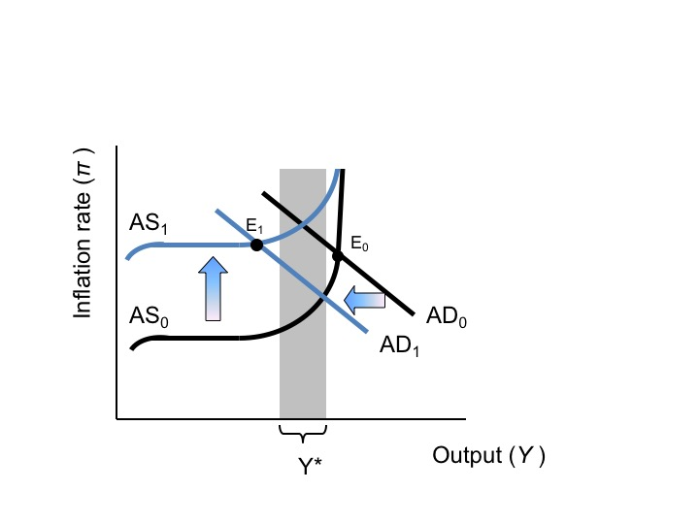
Figure 12.11: “Stagflation”- A Combination of Unemployment and Inflation

Slide 13
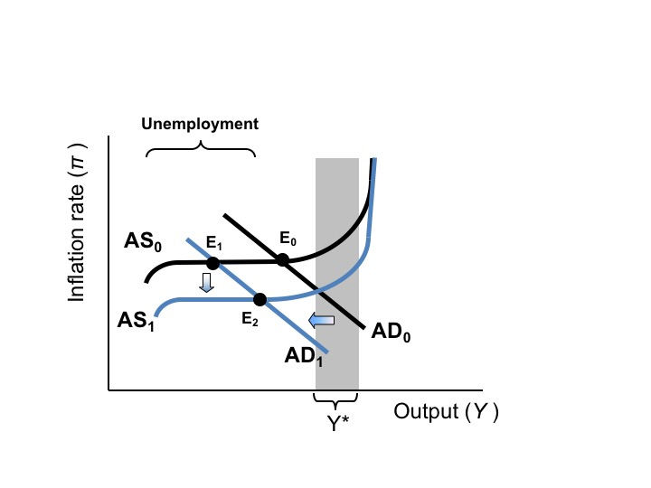
Figure 12.12 The Effects of the Fed’s “Tight Money” Policy in the 1980s

Slide 14
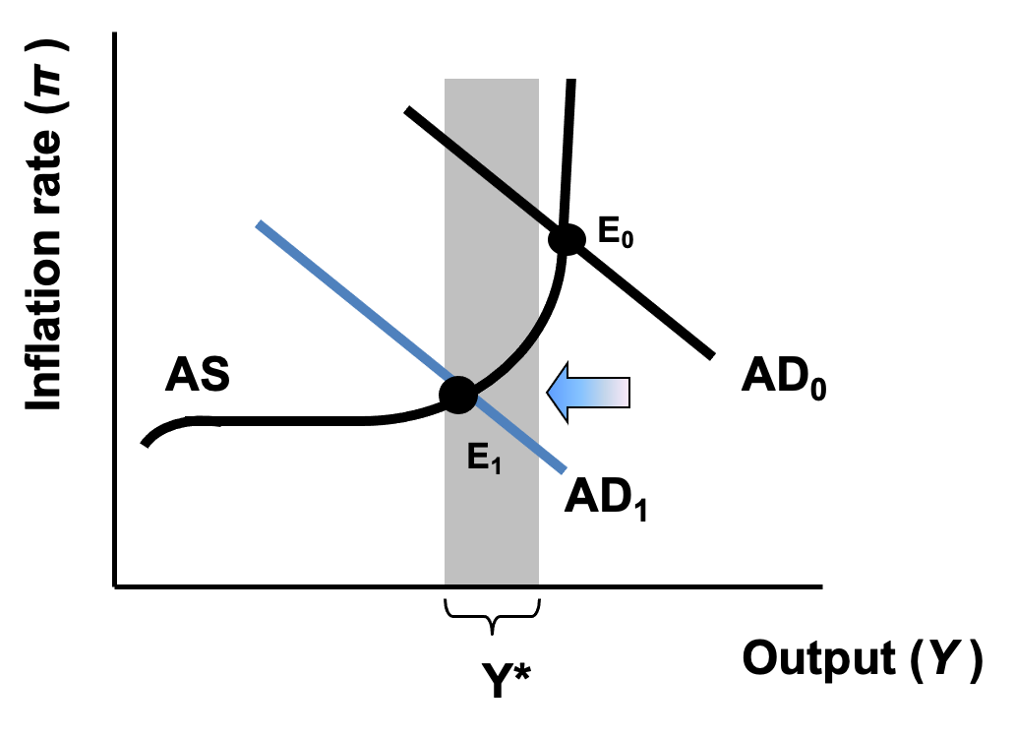
Figure 12.13: A Policy Response to Inflation

Slide 15
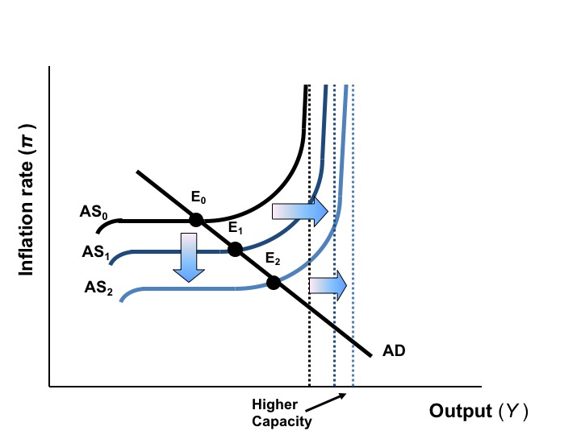
Figure 12.14 The Effects of Technological Innovation and Increased Efficiency

Slide 16
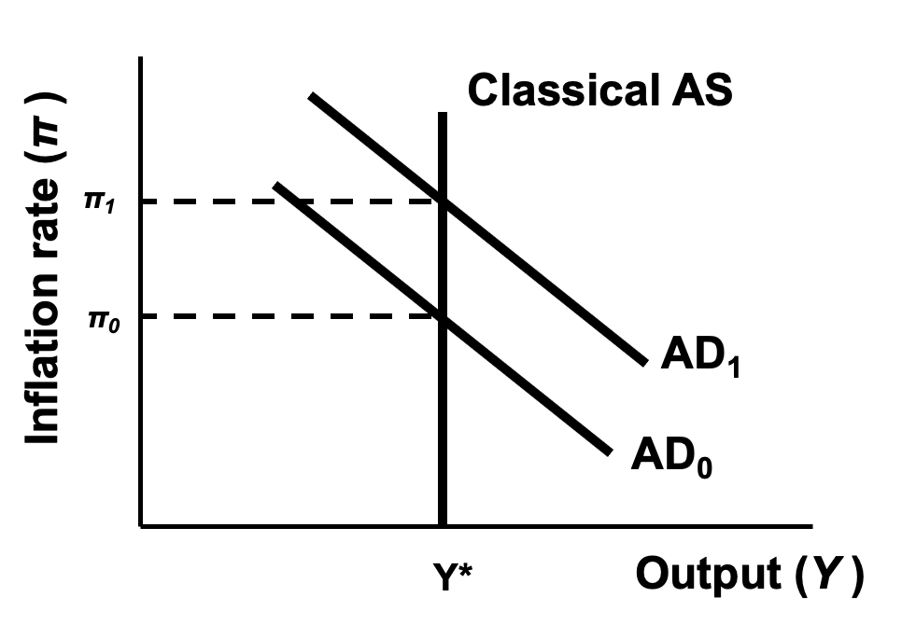
Figure 12.15 The Classical View of AS/AD

