Slide 1
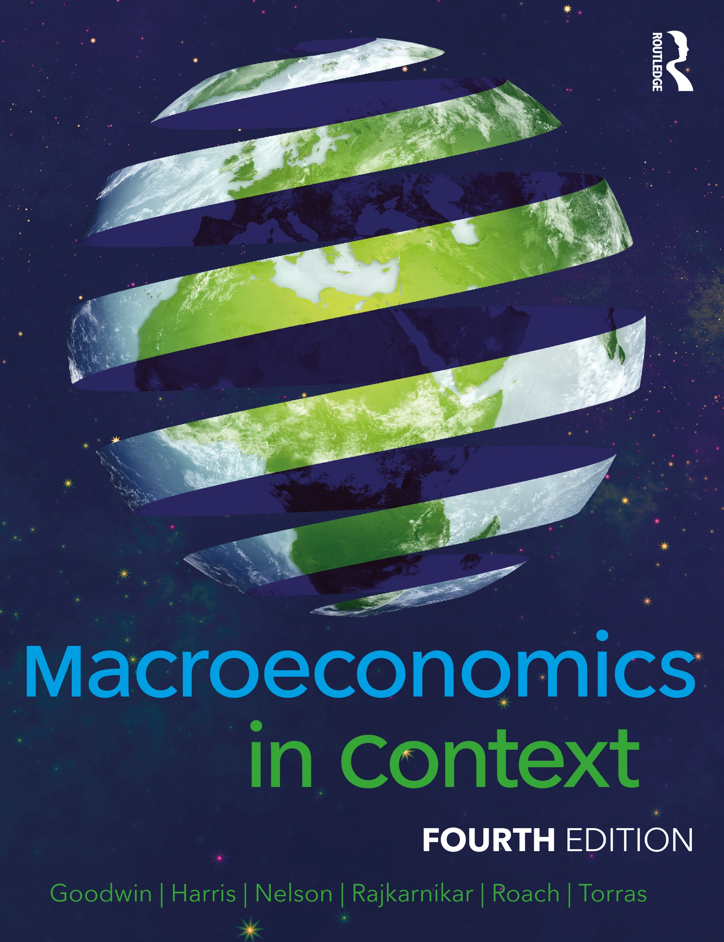
Chapter 11
The Federal Reserve and Monetary Policy

Slide 2
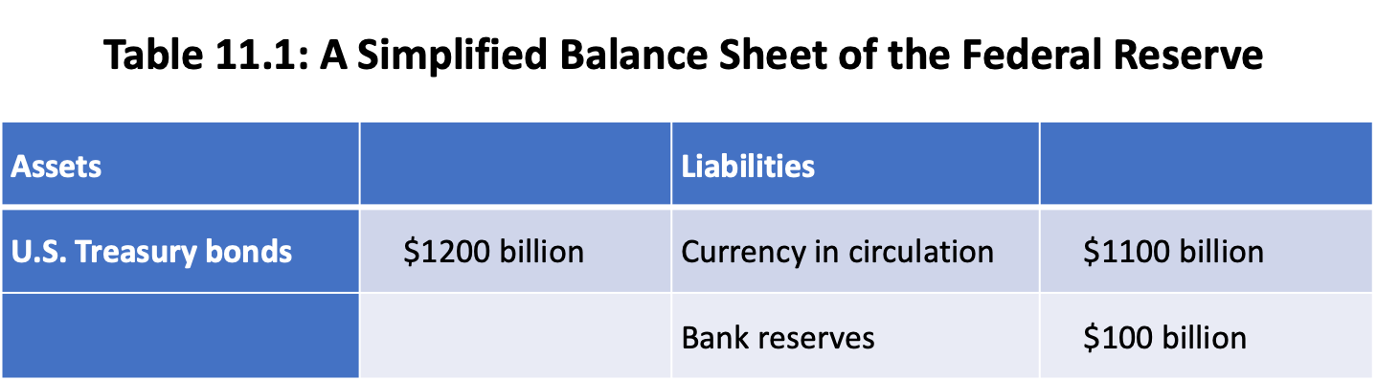

Slide 3
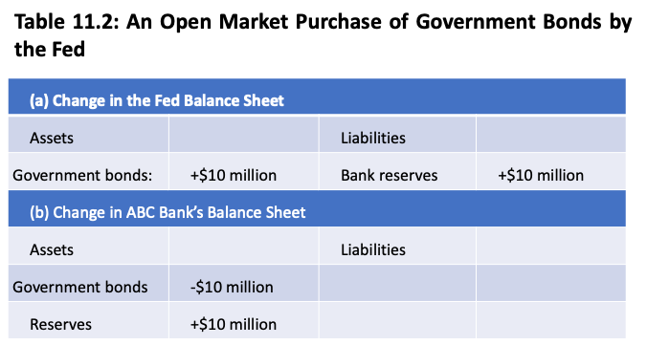

Slide 4
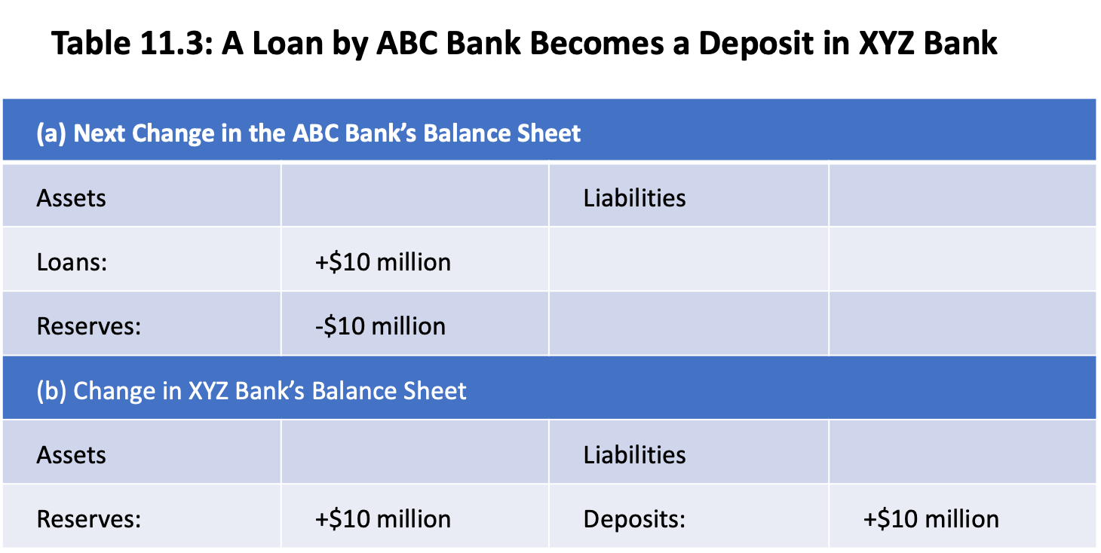

Slide 5
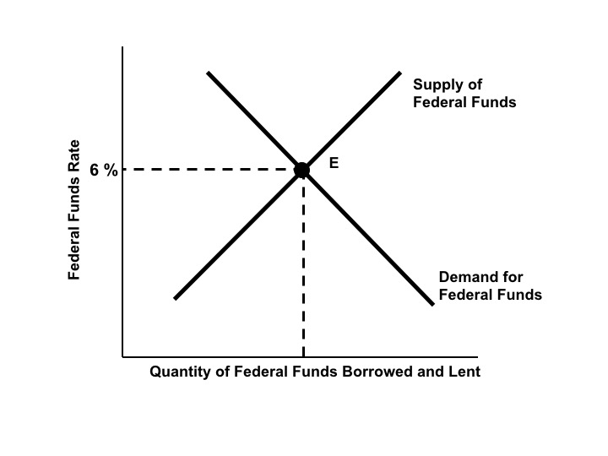
Figure 11.1a: The Market for Federal Funds

Slide 6
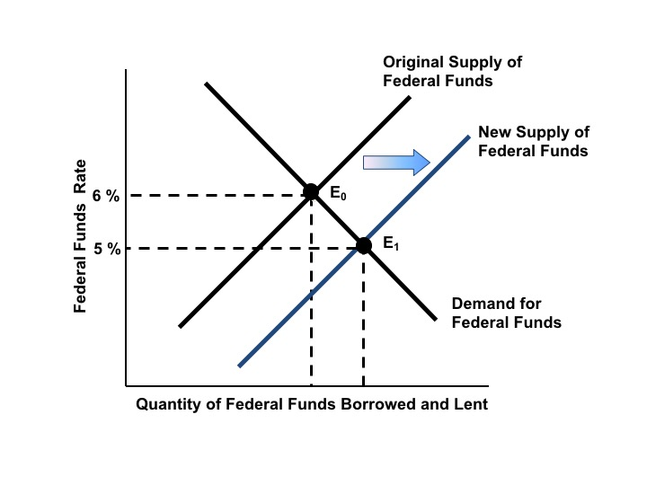
Figure 11.1b: An Open Market Purchase Lowers the Federal Funds Rate

Slide 7
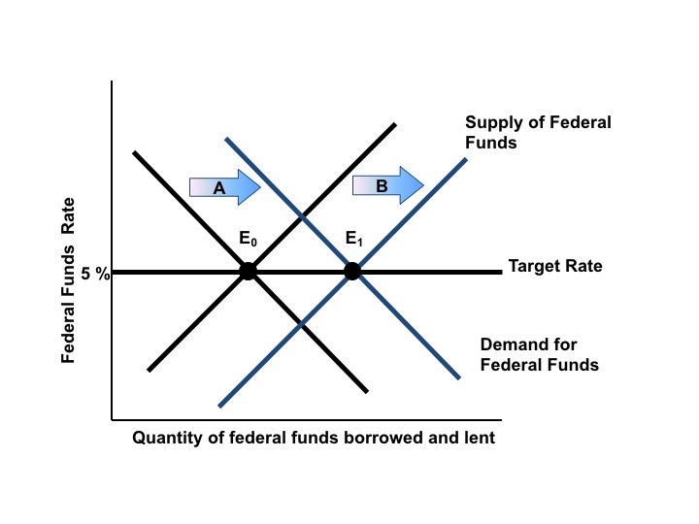
Figure 11.2 Maintaining the Federal Funds Target Rate

Slide 8
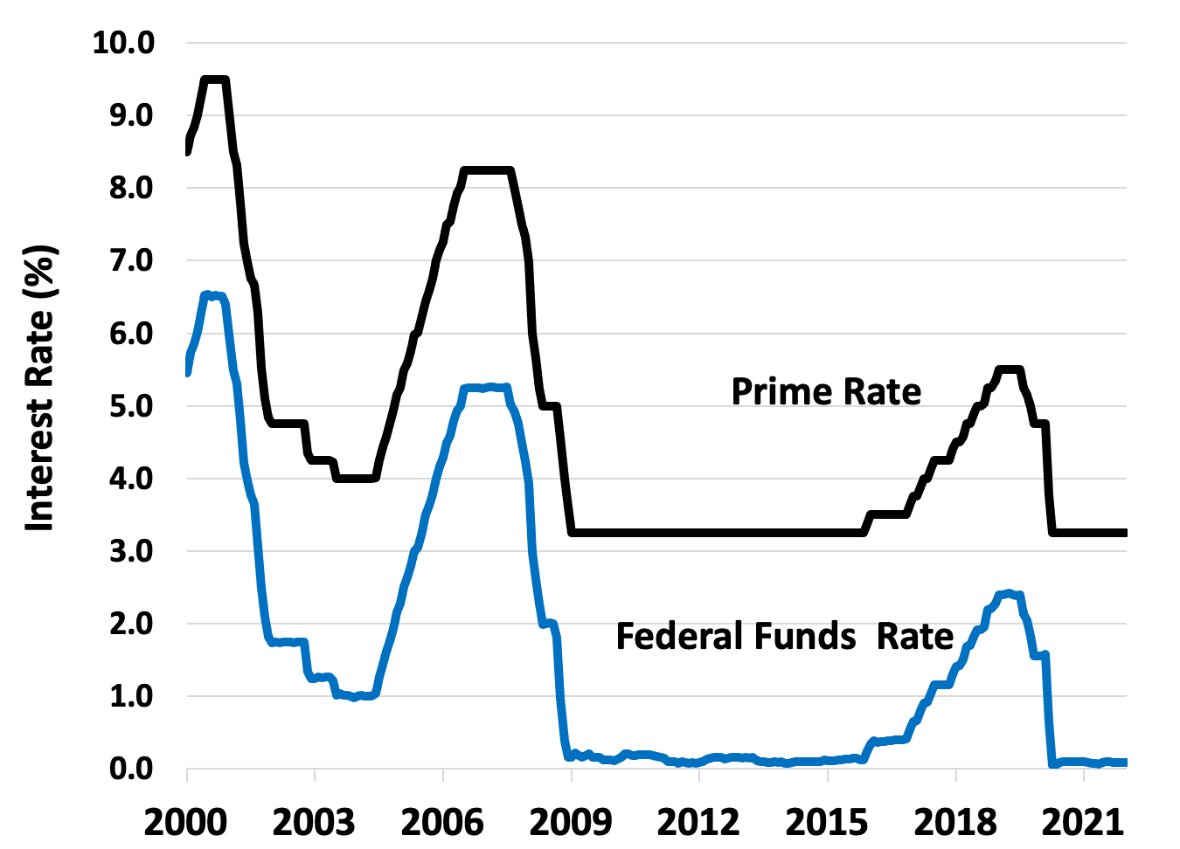
Figure 11.3 The Federal Fund and Prime Rates, 2000-2021
Source: Federal Reserve Board, Monthly data.

Slide 9
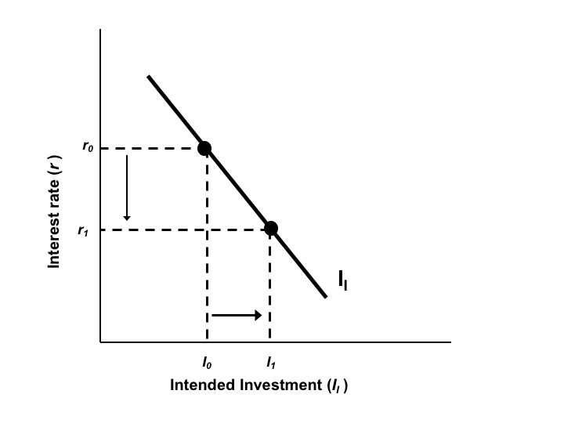
Figure 11.4 The Intended Investment Schedule

Slide 10
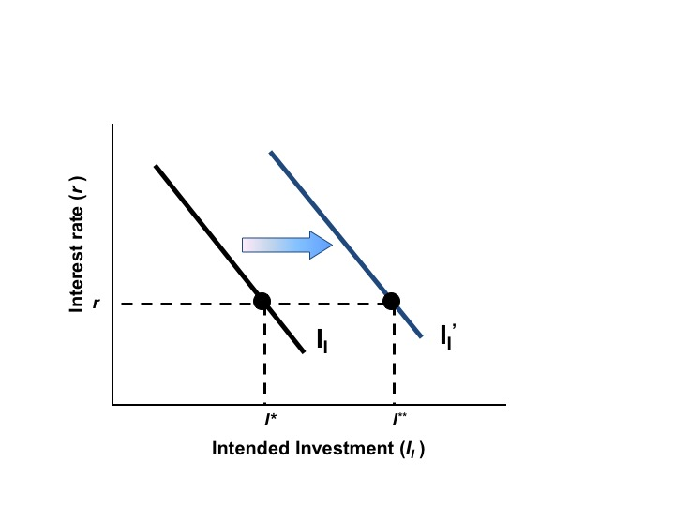
Figure 11.5 An Increase in Investor Confidence

Slide 11
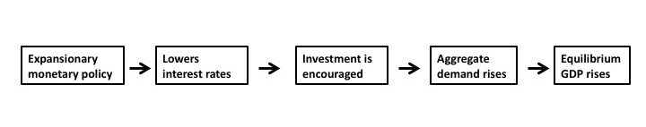
Diagram 11.1

Slide 12
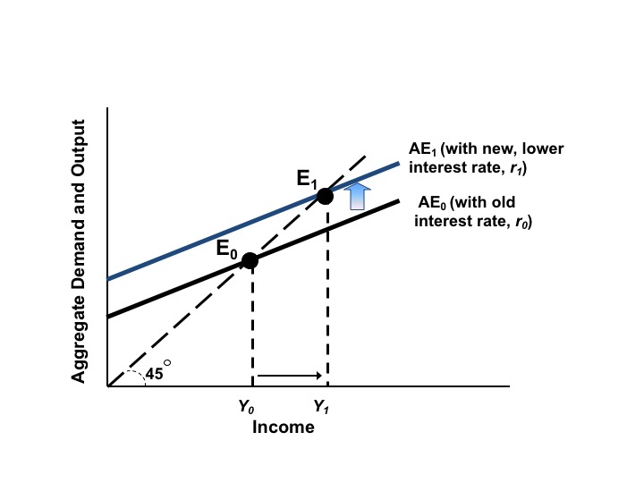
Figure 11.6 Expansionary Monetary Policy and the AE Curve

Slide 13
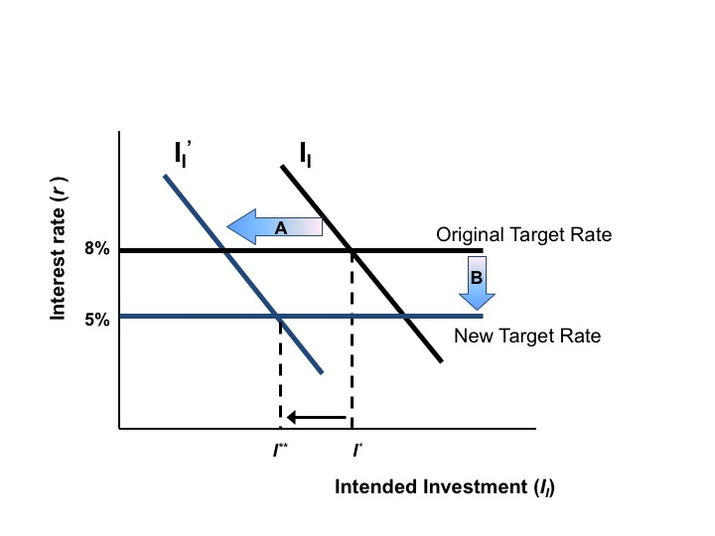
Figure 11.7 Expansionary Monetary Policy in an Environment of Pessimism

Slide 14
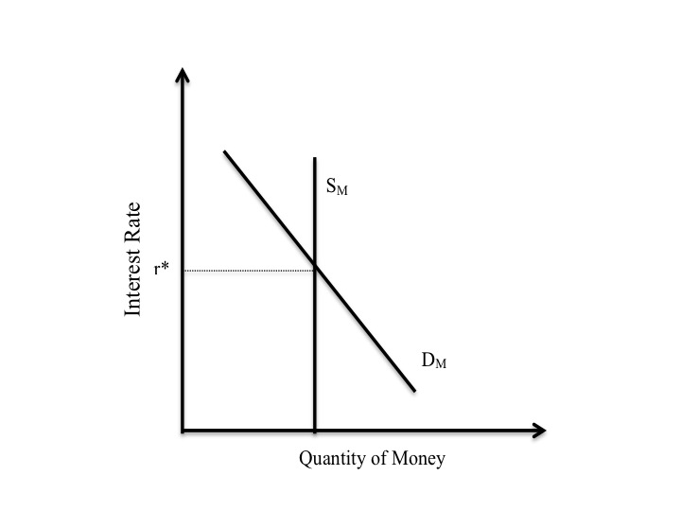
Figure 11.8 Demand and Supply for Money

Slide 15
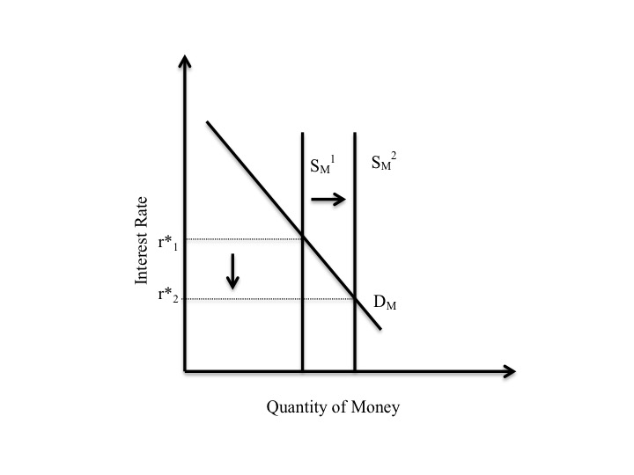
Figure 11.9 An Increase in the Supply of Money

Slide 16
Figure 11.10 The Liquidity Trap
Money
Supply (1)
Money
Supply (2)
Money
Supply (3)
Money
Supply (4)
Interest rate
Money
Demand
Money in Circulation
Notes:
Figure 11.10 (New)

Slide 17
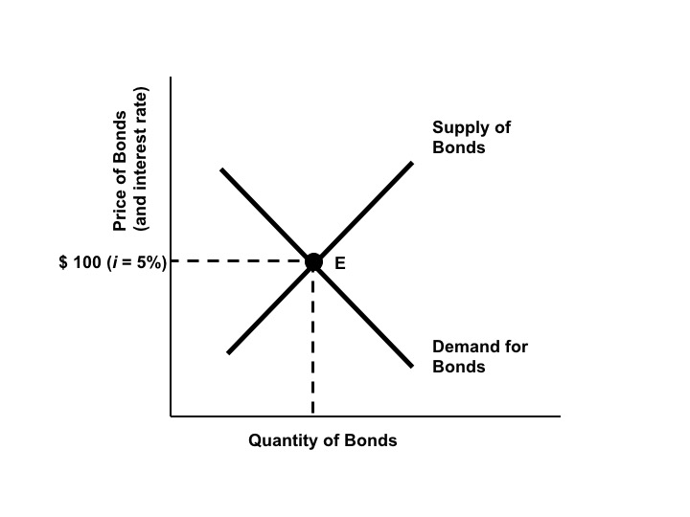
Figure 11.11a The Market for Government Bonds

Slide 18
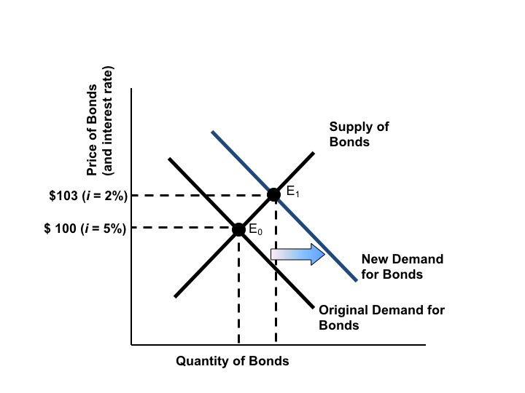
Figure 11.11b The Market for Government Bonds

Slide 19
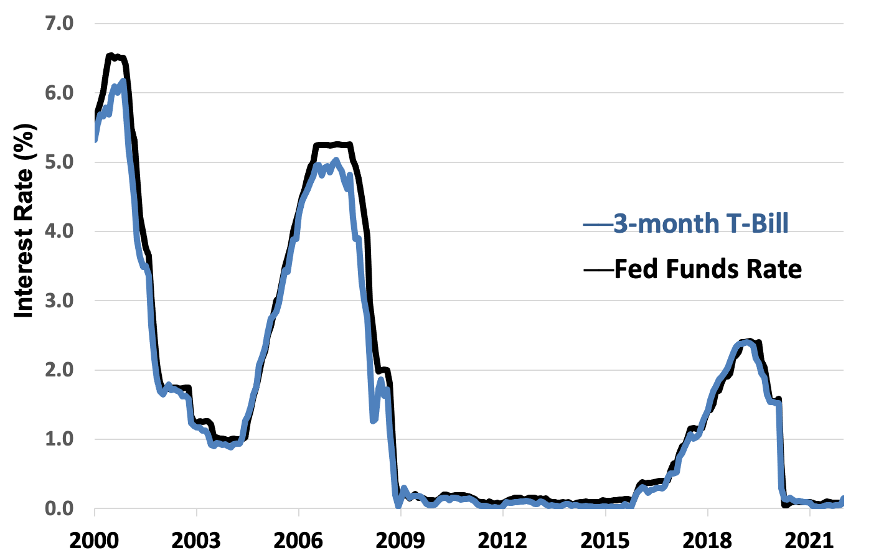
Figure 11.12 The Federal Funds and Three-Month Treasury Bill Rates, 2000–2021
Source: Federal Reserve, monthly data.

