Slide 1

Chapter 0
Macroeconomics And Well-Being

Slide 2
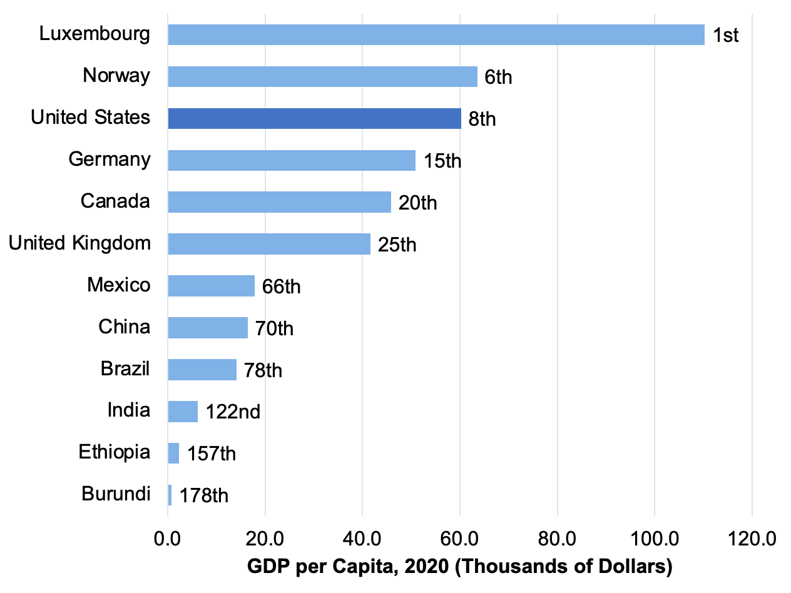
Figure 0.1: GDP per Capita (Thousands of Dollars), 2020
Source: World Bank, World Development Indicators database.
Notes:
Figure 0.1 (New)

Slide 3
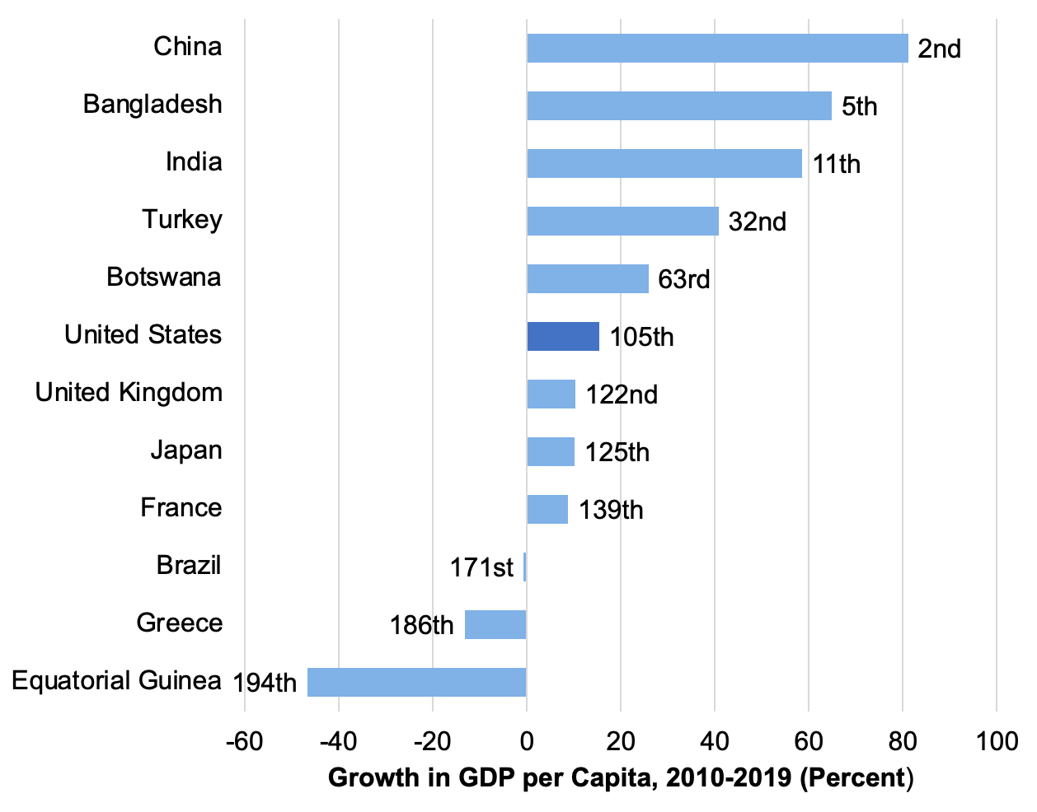
Figure 0.2: Growth in GDP per Capita (Percent), 2010-2019
Data are adjusted for purchasing power differences.
Source: World Bank, World Development Indicators database.
Notes:
Figure 0.2 (New)

Slide 4
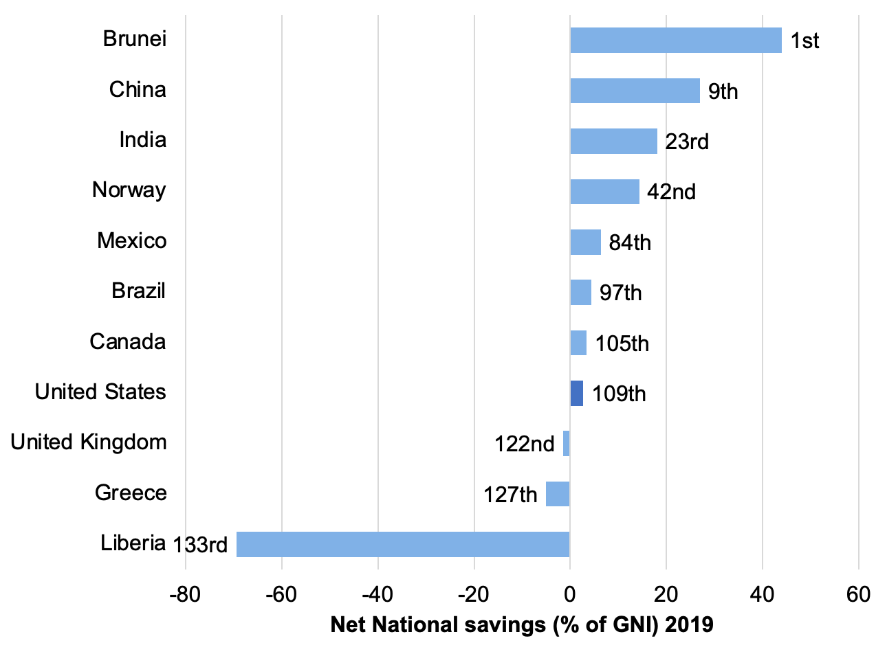
Figure 0.3: Net National Savings Rate (Percent of GNI), 2019
GNI is gross national income, a measure similar to gross domestic product, but including income from residents abroad and excluding income earned by foreigners within the country. GNI is also sometimes referred to as Gross National Product (GNP).
Source: World Bank, World Development Indicators database.
Notes:
Figure 0.3 (New)

Slide 5
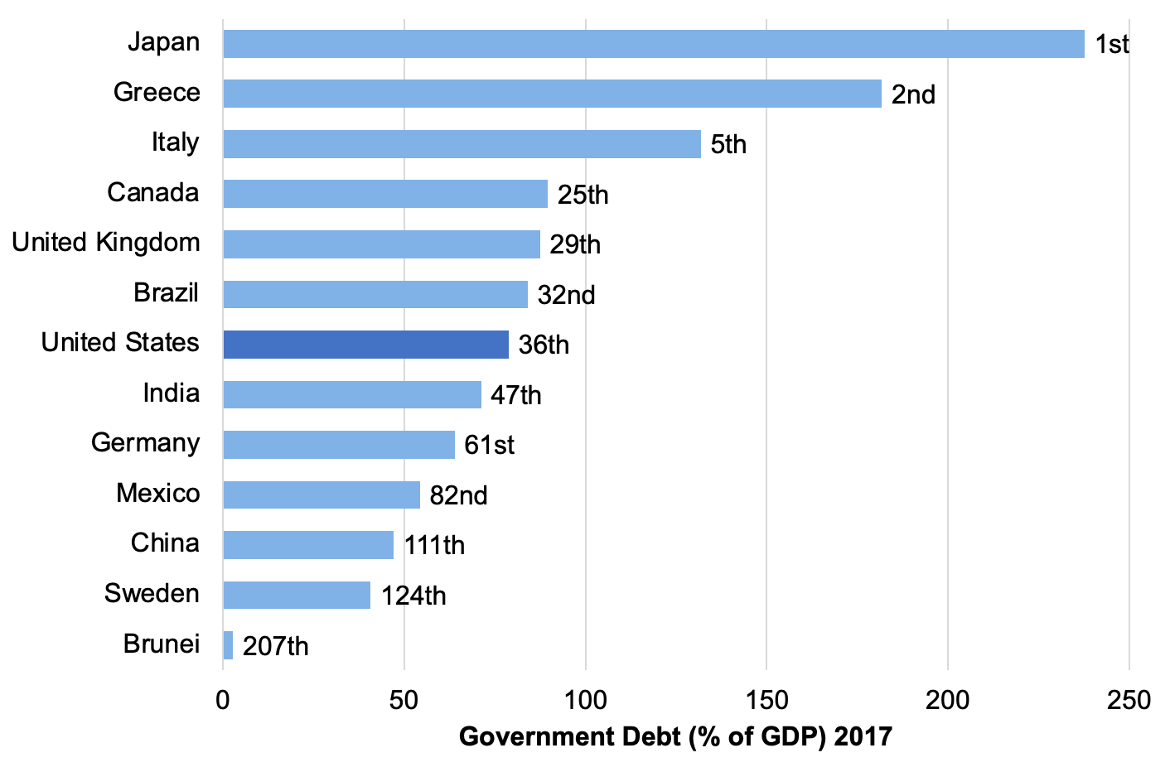
Figure 0.4: Government Debt (Percent of GDP), 2017
Source: United States Central Intelligence Agency, CIA World Factbook.
Notes:
Figure 0.4 (New)

Slide 6
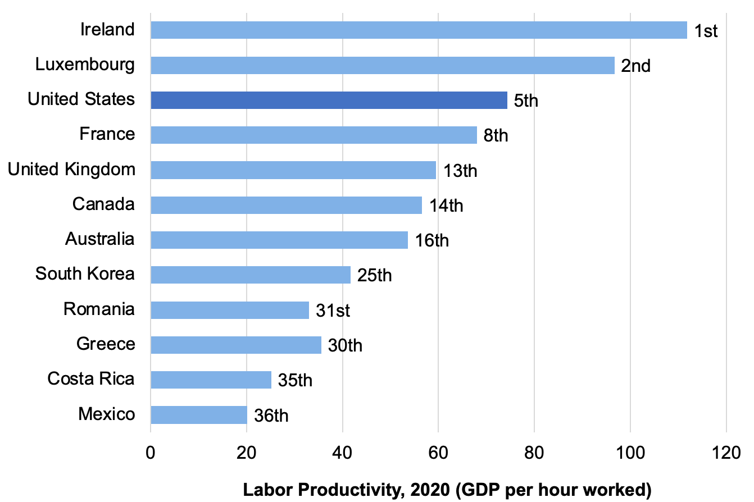
Figure 0.5: Labor Productivity (GDP per hour worked), 2020
Source: Organisation for Economic Co-operation and Development, OECD online statistical database.
Notes:
Figure 0.5 (New)

Slide 7
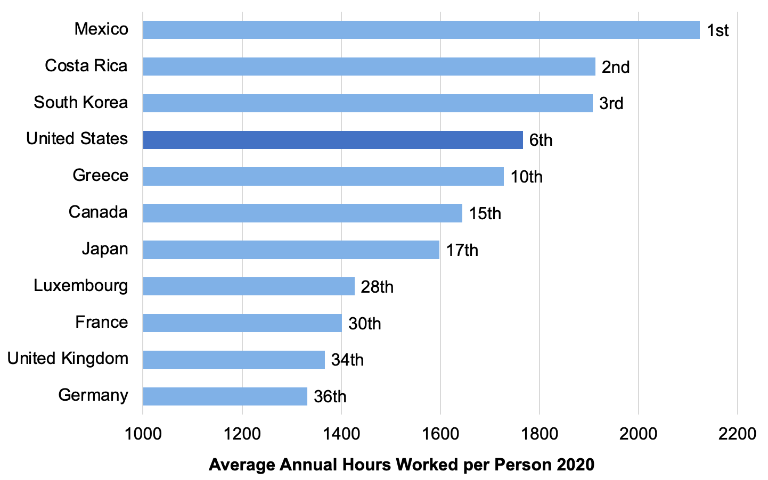
Figure 0.6: Average Annual Hours Worked Per Person, 2020
Source: Organisation for Economic Co-operation and Development. OECD online statistical database.
Notes:
Figure 0.6 (New)

Slide 8
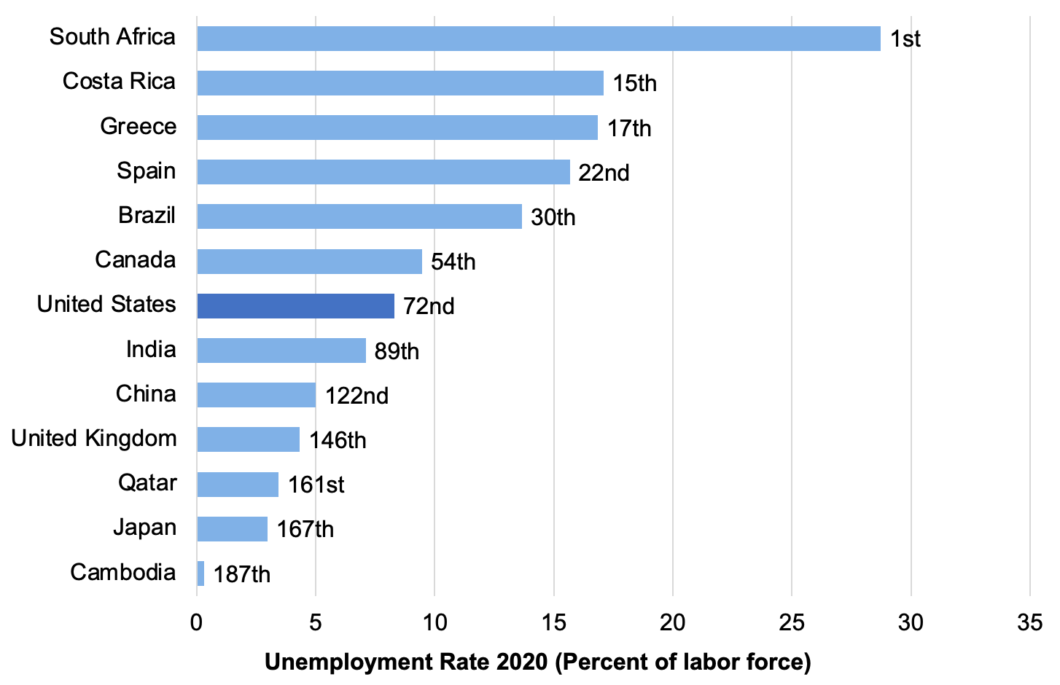
Figure 0.7: Unemployment Rate (Percent of Labor Force), 2020
Source: World Bank, World Development Indicators database.
Notes:
Figure 0.7 (New)

Slide 9
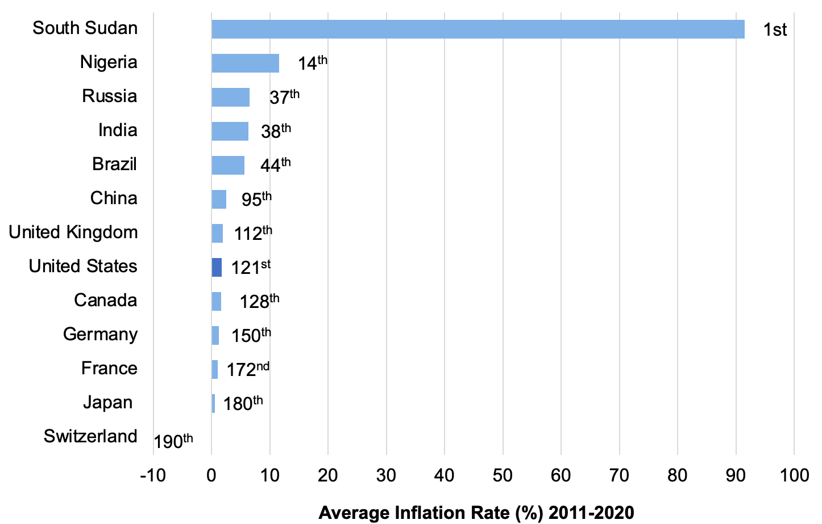
Figure 0.8: Average Inflation Rate (Percent), 2011-2020
The average inflation rate is calculated as the average of the inflation rate for each year from 2011 to 2020.
Source: World Bank, World Development Indicators database.
Notes:
Figure 0.8 (New)

Slide 10
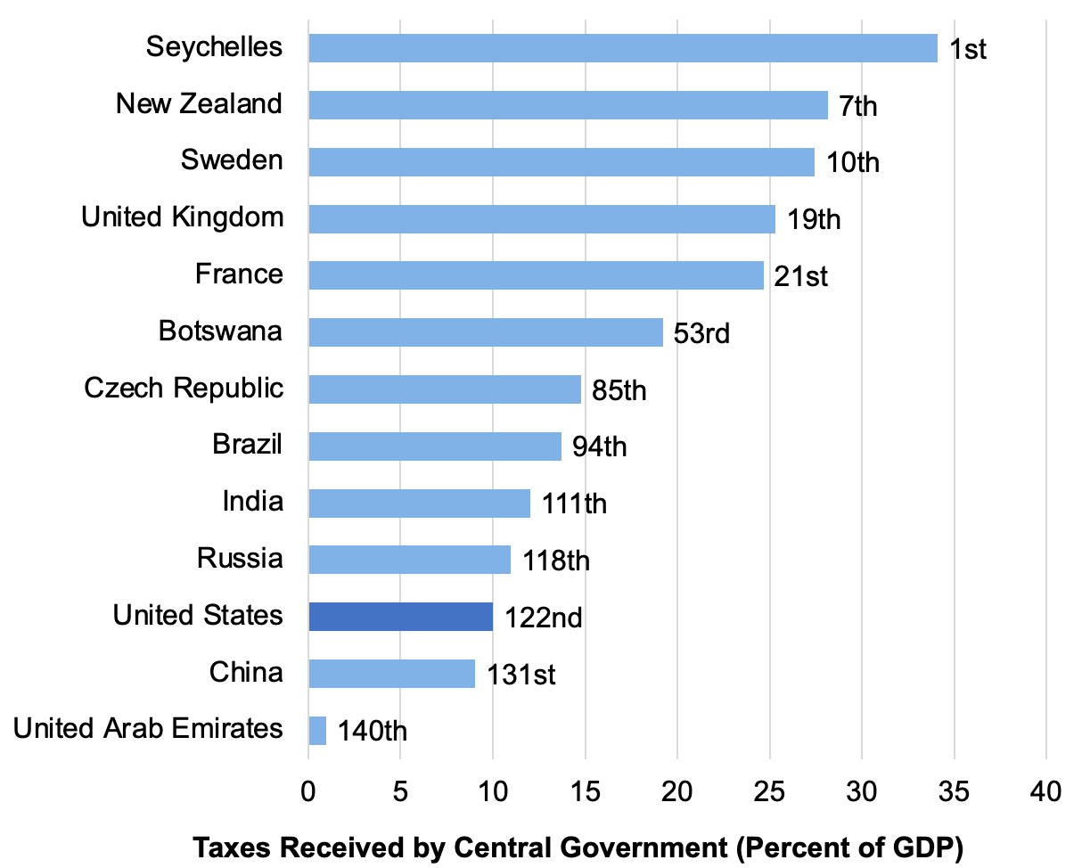
Figure 0.9: Taxes Received by Central Government (Percent of GDP)
Data are mostly 2019 estimates.
Source: World Bank, World Development Indicators database.
Notes:
Figure 0.9 (New)

Slide 11
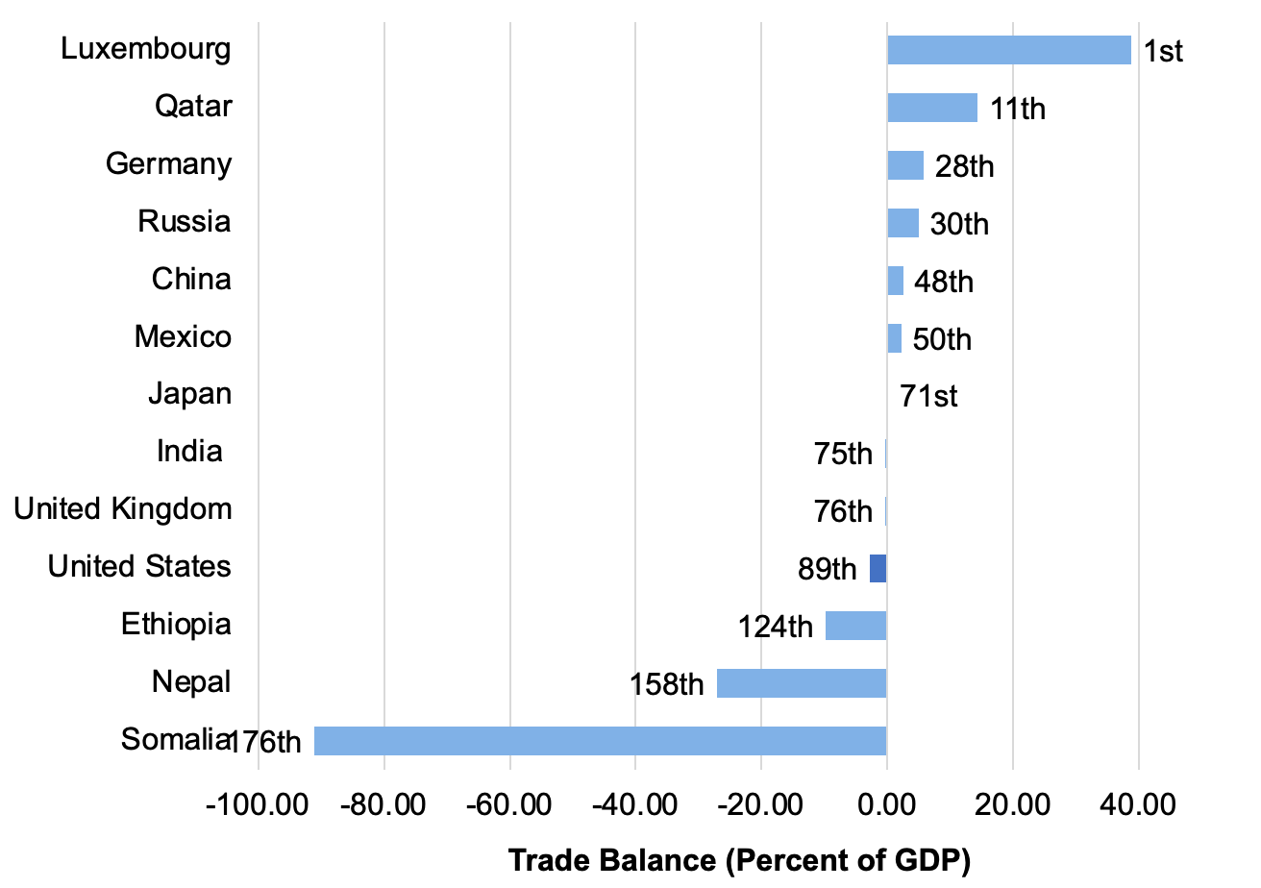
Figure 0.10: Trade Balance (Percent of GDP)
Data are mostly 2019 estimates.
Source: World Bank, World Development Indicators database, and authors’ calculations.
Notes:
Figure 0.10 (New)

Slide 12
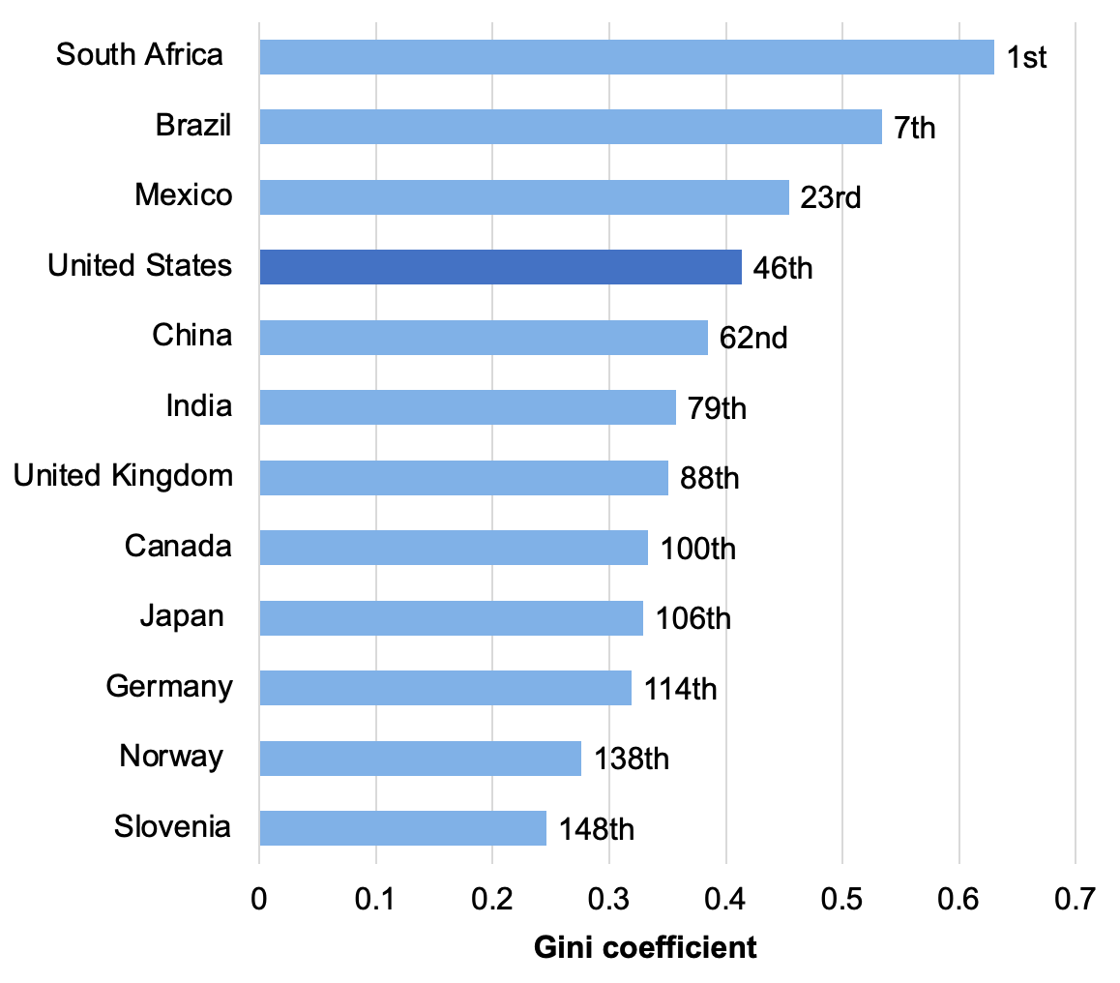
Figure 0.11: Gini Coefficient
Source: World Bank, World Development Indicators database.
Data for the most recent year available, between 2011 and 2019.
Notes:
Figure 0.11 (New)

Slide 13
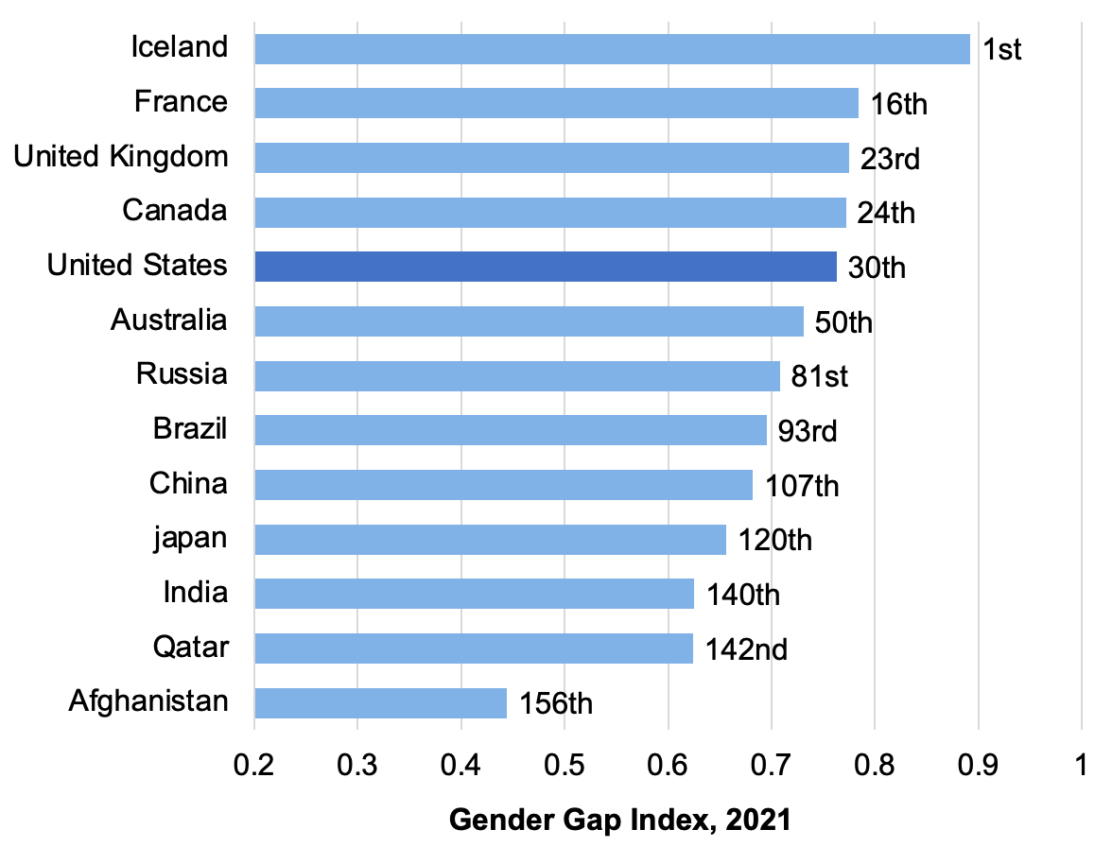
Figure 0.12: Global Gender Gap Index, 2021
Source: Global Gender Gap Report 2021, World Economic Forum.
Notes:
Figure 0.12 (New)

Slide 14
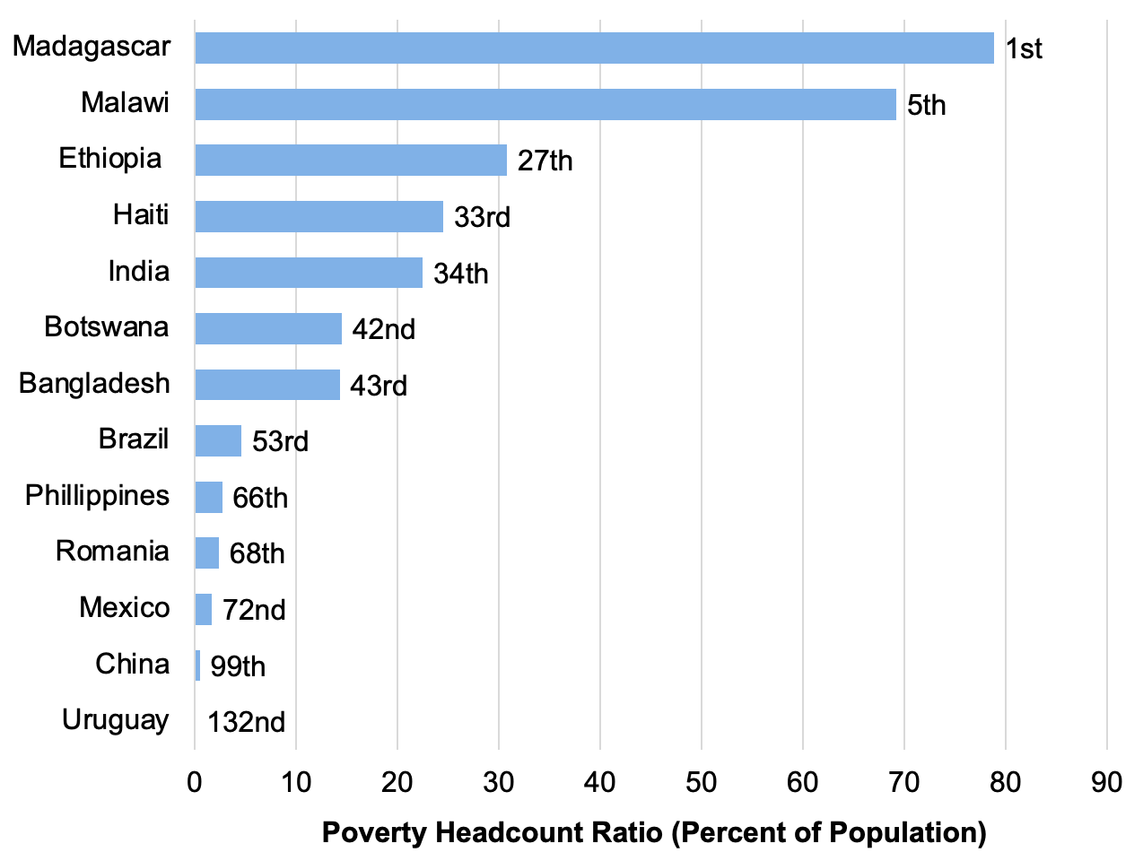
Figure 0.13: Percent of Population Living Below $1.90/day Poverty Line
Source: World Bank, World Development Indicators database.
Data are for the most recent year available, between 2011 and 2019.
Notes:
Figure 0.13 (New)

Slide 15
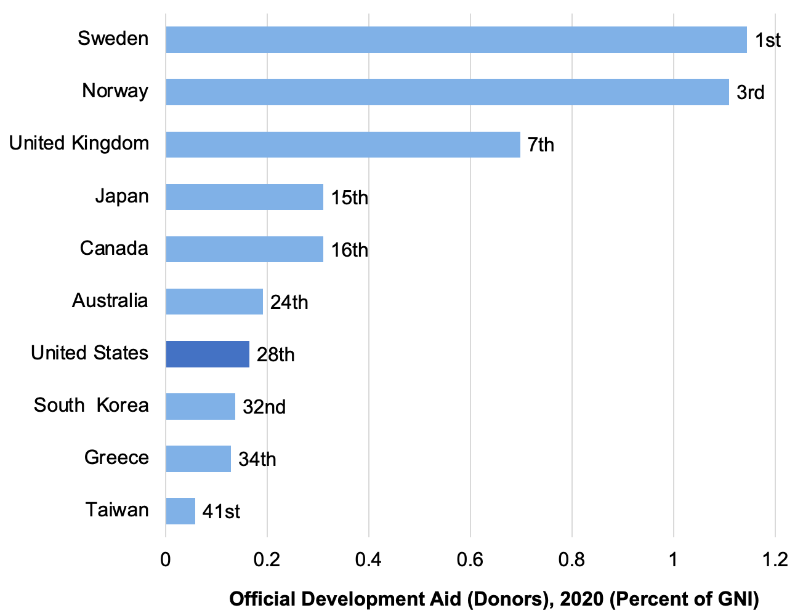
Figure 0.14: Official Development Aid (Percent of GNI), 2020
Source: Organisation for Economic Co-operation and Development, Official Development Assistance—2020 Update.
Notes:
Figure 0.14 (New)

Slide 16
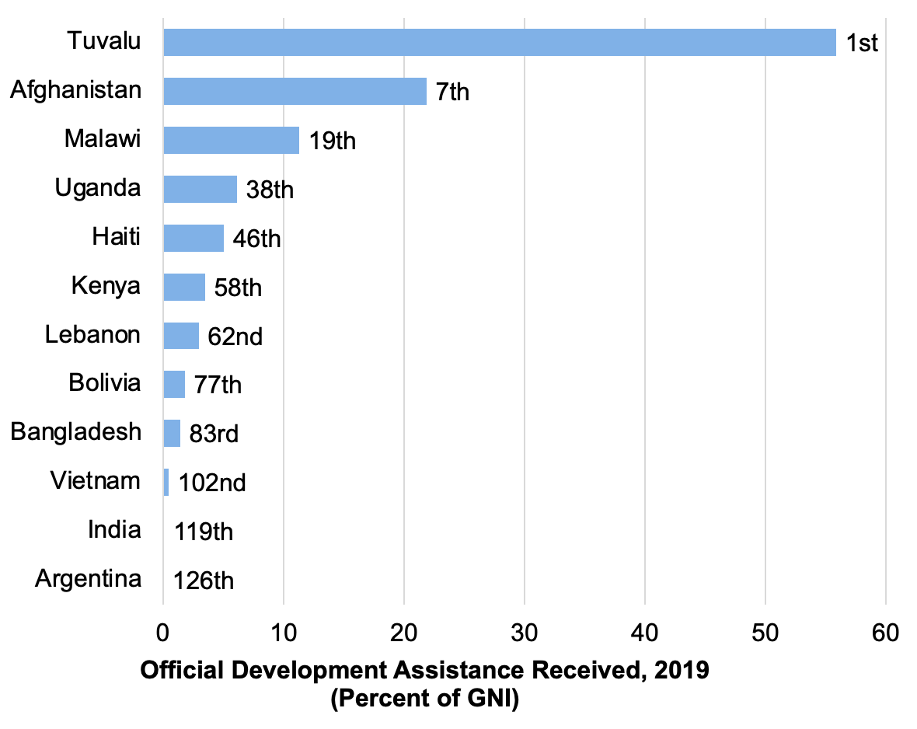
Figure 0.15: Official Development Assistance Received (Percent of GNI), 2019
Source: World Bank, World Development Indicators database.
Notes:
Figure 0.15 (New)

Slide 17
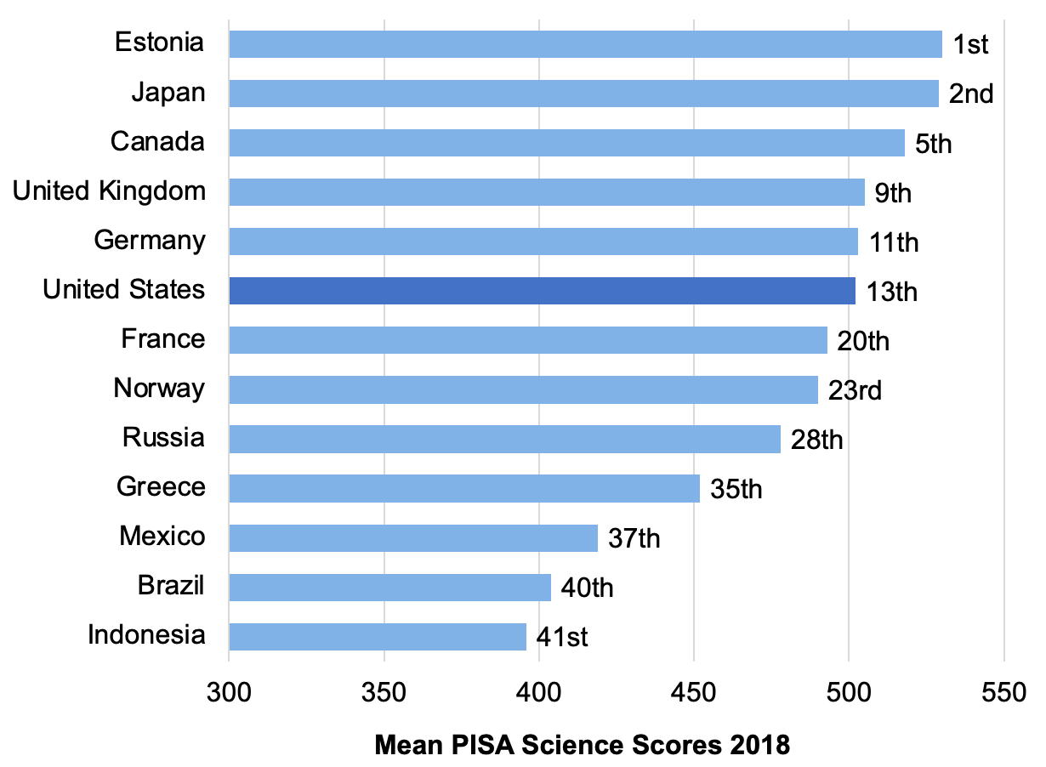
Figure 0.16: Average PISA Science Test Score (15-year-olds), 2018
Source: Organisation for Economic Co-operation and Development, Programme for International Student Assessment, PISA 2018 Key Findings.
Notes:
Figure 0.16 (New)

Slide 18
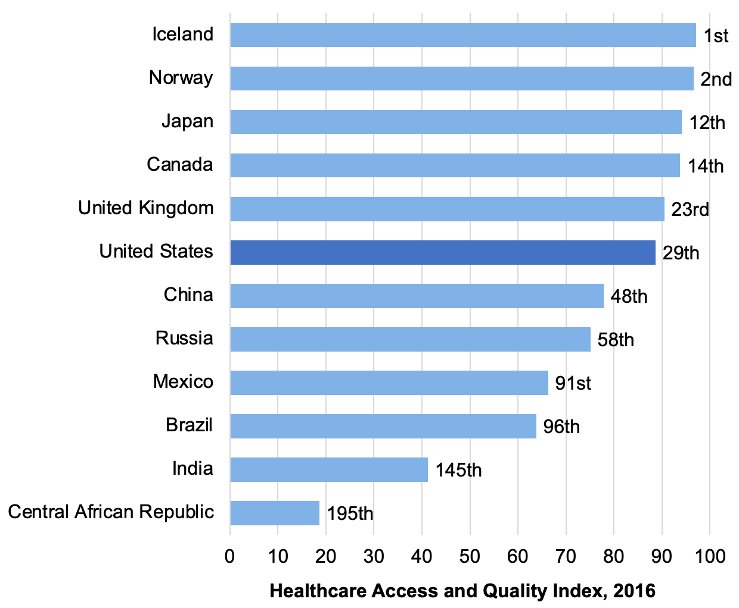
Figure 0.17: Healthcare Access and Quality Index, 2016
Source: Institute for Health metrics and Evaluation, Global Burden of Disease Study 2016.
Notes:
Figure 0.17 (New)

Slide 19
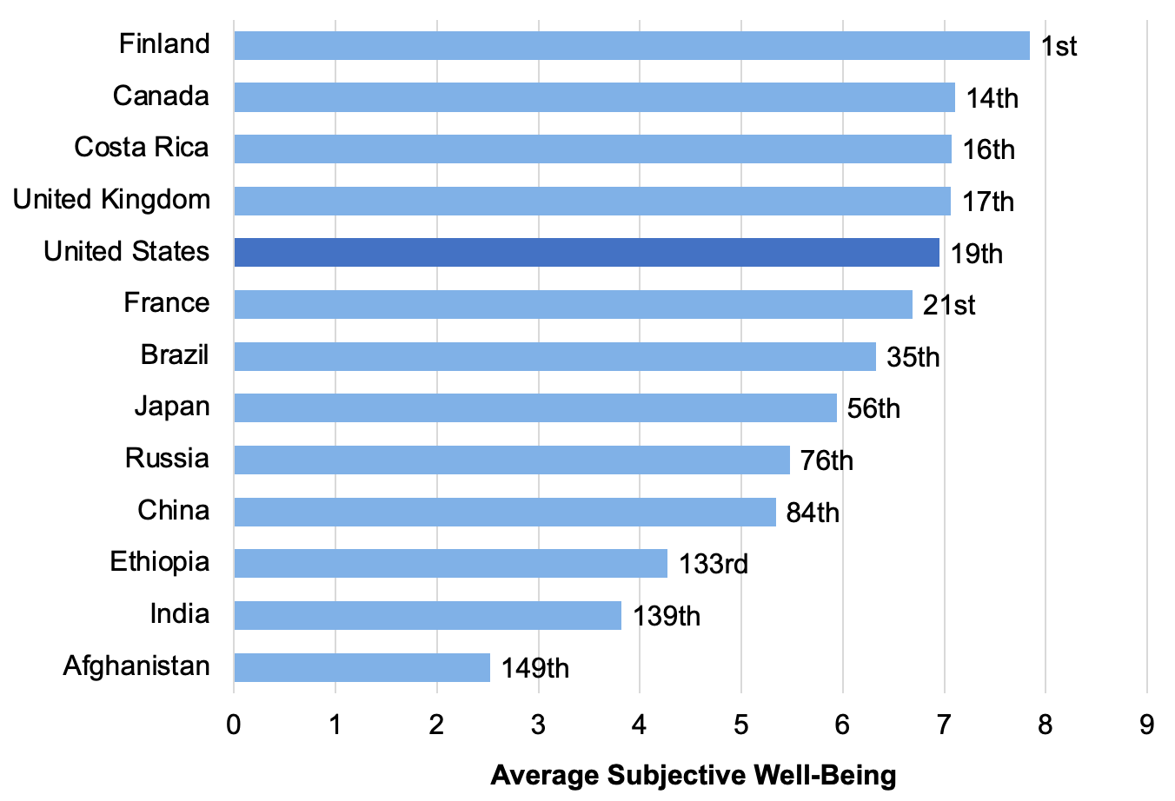
Figure 0.18: Average Subjective Well-Being Index
Source: World Happiness Report 2021.
Notes:
Figure 0.18 (New)

Slide 20
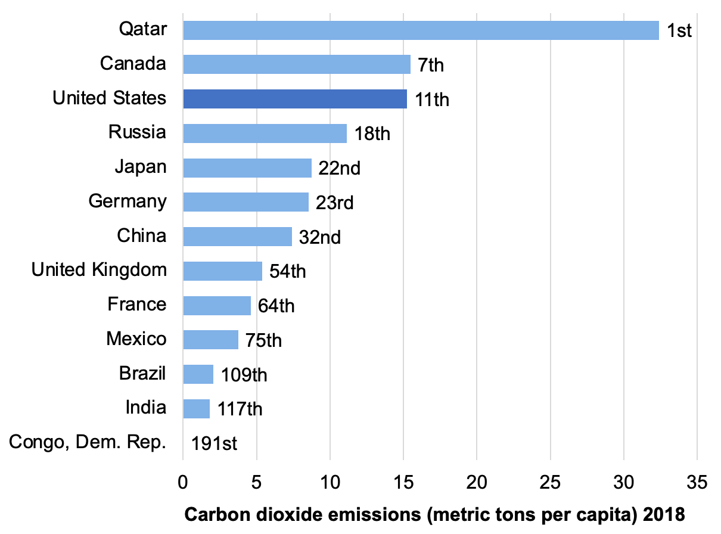
Figure 0.19: Carbon Dioxide Emissions per Capita (Metric Tons per year), 2018
Source: World Bank, World Development Indicators database.
Notes:
Figure 0.19 (New)

Slide 21
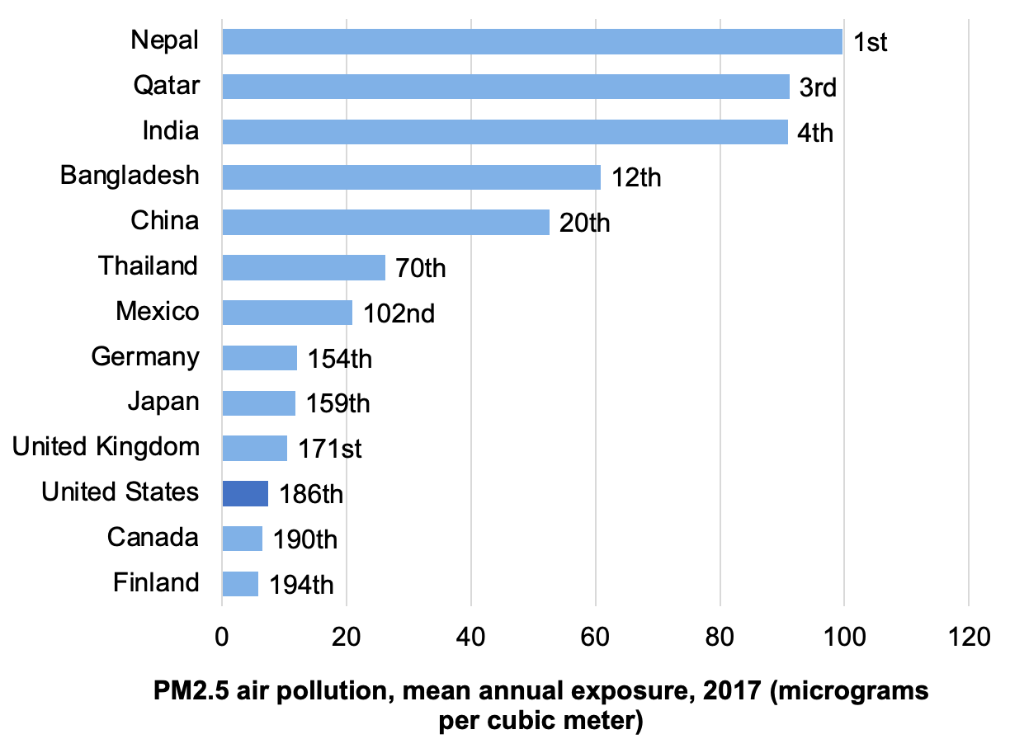
Figure 0.20 Average National Particulate Matter Concentration (Micrograms per Cubic Meter), 2017
Data are for particulate matter smaller than 2.5 micrometers, referred to as PM2.5. For reference, the European Union pollution standard for average PM2.5 is 25 micrograms/cubic meter (µg/m3); California has a stricter standard of 12 µg/m3.
Source: World Bank, World Development Indicators database.
Notes:
Figure 0.20 (New)

