Slide 1
Climate Challenges after the Glasgow Conference: the roles of Forests and Soils
Jonathan Harris and Anne-Marie Codur
Tufts University Global Development and Environment Institute,
https://sites.tufts.edu/gdae
Boston University Global Development Policy Center
Economics in Context Initiative https://www.bu.edu/eci/
Notes:
This presentation is based on a policy brief available on our website, and teaching modules on forests, soils, and climate, forthcoming this summer. Sign up for our mailing list at https://sites.tufts.edu/gdae for updates.

Slide 2
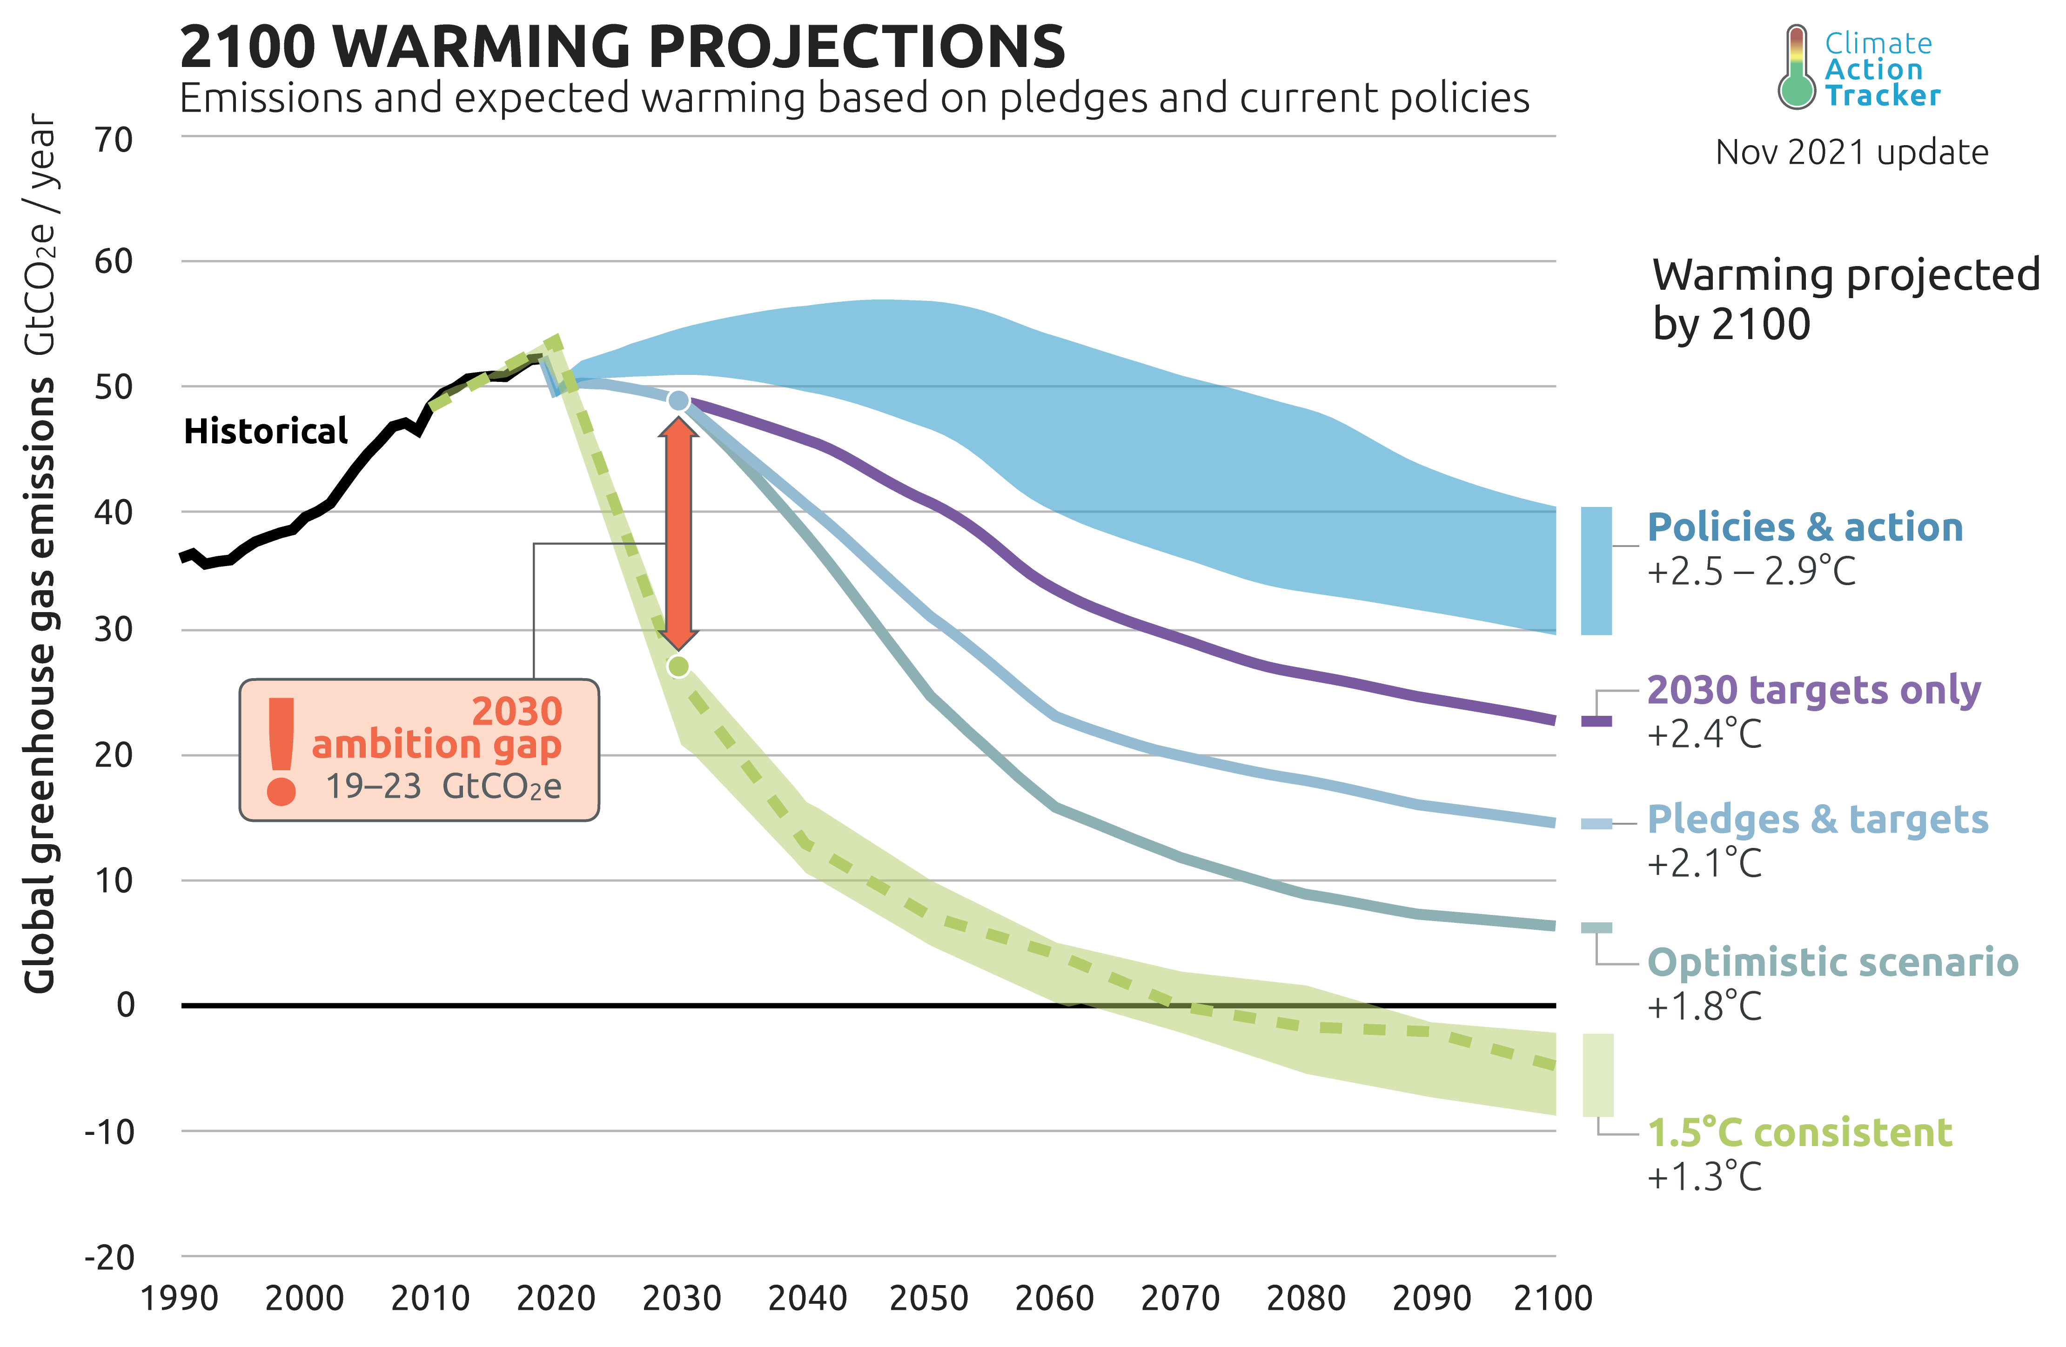
Source: Climate Action Tracker , November 2021 update
Notes:
It has been widely discussed that the carbon emissions reduction pledges by countries at the Glasgow COP26 conference fall well short of what is needed to hold warming to 1.5 or even 2.0 degrees C.

Slide 3
Keeping 1.5 °C Alive?
“We have kept 1.5 °C within reach but its pulse is weak, and it will only survive if we keep our promises, if we translate commitments into rapid action, and if we deliver on the expectations set out in this Glasgow Climate Pact to increase ambitions to 2030 and beyond, and if we close the vast gap that remains, as we must.”
- Alok Sharma, President of COP26
Notes:
The President of the conference, Alok Sharma, acknowledged this “vast gap” between commitments and requirements.

Slide 4
Glasgow’s COP26 Major Milestones
Specific commitment to “phase down” fossil fuels made for the first time
Requirement for countries to update NDCs annually
Reaffirm the obligation for developed nations to mobilize $100 billion a year for climate mitigation efforts in developing countries
Double funding for climate adaptation to reach $40 billion a year in 2025.
Global Methane Pledge: 109 countries, to cut down methane by 30% by 2030
Glasgow Declaration on Forests and Land Use: 100 countries, representing 85% of forested land, pledge to end deforestation by 2030.
Notes:
The conference did commit to reduce fossil fuel use, update commitments annually, mobilize $100 billion a year for mitigation and $40 billion for adaptation,
reduce methane emissions by 30% by 2030, and end deforestation by 2030. But how realistic are these commitments?

Slide 5
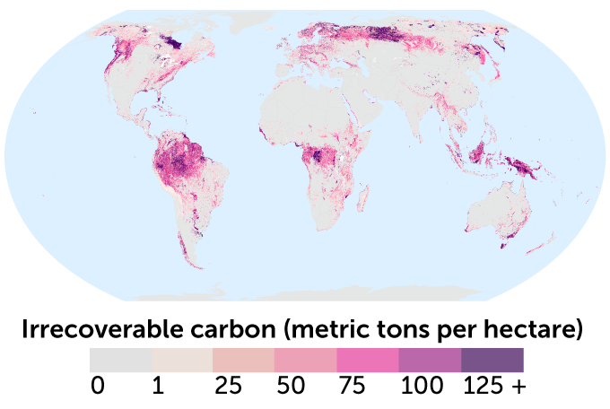
Natural Solutions to Climate Change:
Forests, Wetlands, and Soils
These areas store 139 Gigatons (Gt) of “irrecoverable” carbon in trees, plants, and soils: natural regeneration could not compensate for their loss by 2050.
4 Gt of this irrecoverable carbon has been released into the atmosphere through wildfire, logging, and farming in the past decade.
Source: Noon, Monica L. et al. 2021. “Mapping the Irrecoverable Carbon in Earth’s Ecosystems,” Nature Sustainability
Notes:
Crucial to any chance of meeting the commitments and filling the gap is maximizing carbon storage in forests, wetlands, and soils.
At a minimum, this means protecting current essential carbon storage in areas that are vulnerable and, if compromised, will be difficult or impossible to recover.

Slide 6
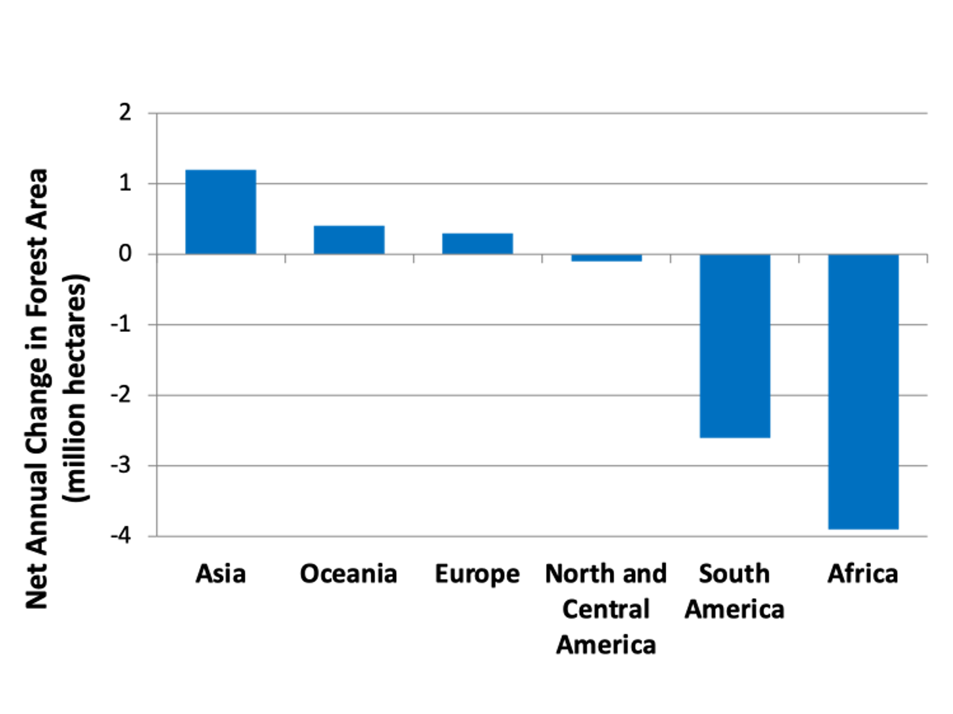
Net change in Forest area, 2010-2020
Source: FAO, Global Forest Resources Assessment 2020.
Notes:
But currently critical tropical forest areas in South America and Africa are being rapidly depleted.
Asian forest loss is masked by afforestation and reforestation gains, but many of these are of poor ecological quality compared to the primary forest that is being lost.

Slide 7
Percent Decrease in Intact Forests, 2000-2013
Region | % Intact Forest Loss
South America, tropical | 7.3%
Eurasia, southern boreal and temperate | 9.1%
Africa | 10.1%
North America, northern boreal | 3.3%
Southeast Asia | 13.9%
South America, southern boreal and temperate | 15.5%
Eurasia, northern boreal | 4.4%
Australia | 21.9%
South America, temperate | 1.3%
Source: Potapov et al., 2017
Notes:
Intact forests are declining everywhere, often at rapid rates.

Slide 8
Deforestation in Amazonia
Source: Codur and Harris, Forests and Climate: Economics and Policy Issues Teaching Module forthcoming 2022.
Notes:
Deforestation in the Amazon declined from 2006 to about 2014 as a result of government policy,
but has since increased with the Bolsonaro government committed to extensive forest exploitation.

Slide 9
Ending Deforestation: Financial Pledges
BY COUNTRIES:
12 countries including the United States and the EU will provide $12 billion for forest-related climate finance between 2021 and 2025.
This includes $1.7 billion specifically dedicated to support Indigenous Peoples and Local Communities, to advance their forest tenure rights and recognize their role as guardians for forests and nature.
BY PRIVATE FINANCIAL INSTITUTIONS:
30 leading financial institutions (collectively with over $8.7 trillion in assets under management) pledged $7.2 billion to the Global Forest Finance Pledge, and also pledged to eliminate agricultural commodity-driven deforestation from their portfolios by 2025.
Notes:
Public and private pledges to end deforestation amount to about $20 billion over the four years between 2021 and 2025.

Slide 10
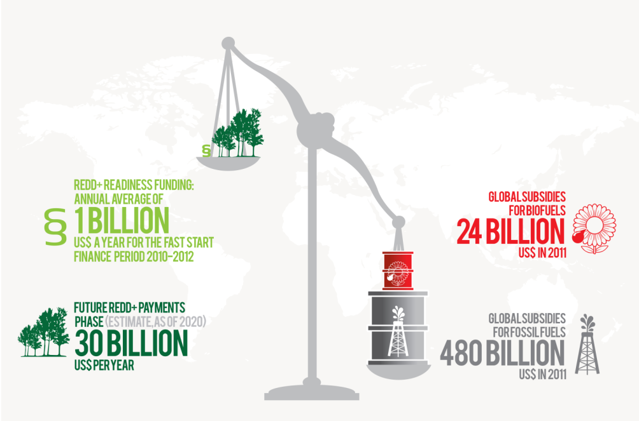
Funding for REDD+ compared with
Global Subsidies for Fossil Fuels and Biofuels
Mulder, Ivo. 2014. “The Economics of REDD+.” in REDD+ Academy Asia Pacific.
Notes:
But these pledged amounts, even if fulfilled, are dwarfed by the scale of global subsidies for fossil fuels and destructive biofuels

Slide 11
Afforestation, Reforestation, Proforestation: not all solutions are ecologically equal
Countries with net gain in their forested area: Europe 0.3 million ha, Oceania 0.4 million ha, and Asia 1.2 million ha, mainly due to afforestation programs in China.
These gains are made primarily with plantation forests and do not compensate for the losses of intact primary forests. Reforestation in the form of planted monoculture (eucalyptus, pines, etc.) does NOT count as new FORESTS in the ecological sense of diverse ecosystems.
PROFORESTATION: DON’T DISTURB TREES – KEEP PRIMARY FORESTS INTACTS: LARGEST 1% of ALL TREES make up 50% of Mature Forest Biomass Worldwide
Notes:
Pledging to plant trees in popular, but far less effective than preserving and expanding existing forests, called “proforestation” by GDAE Co-Director William Moomaw.

Slide 12
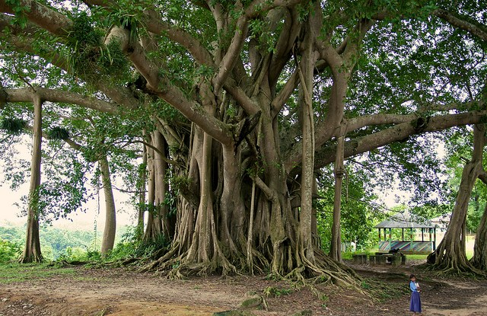
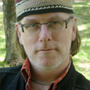
LARGEST 1% of ALL TREES make up 50%
of Mature Forest Biomass Worldwide
Notes:
The largest trees are the best at storing carbon, but also potentially the most vulnerable, and their loss cannot be compensated for by tree planting programs.

Slide 13
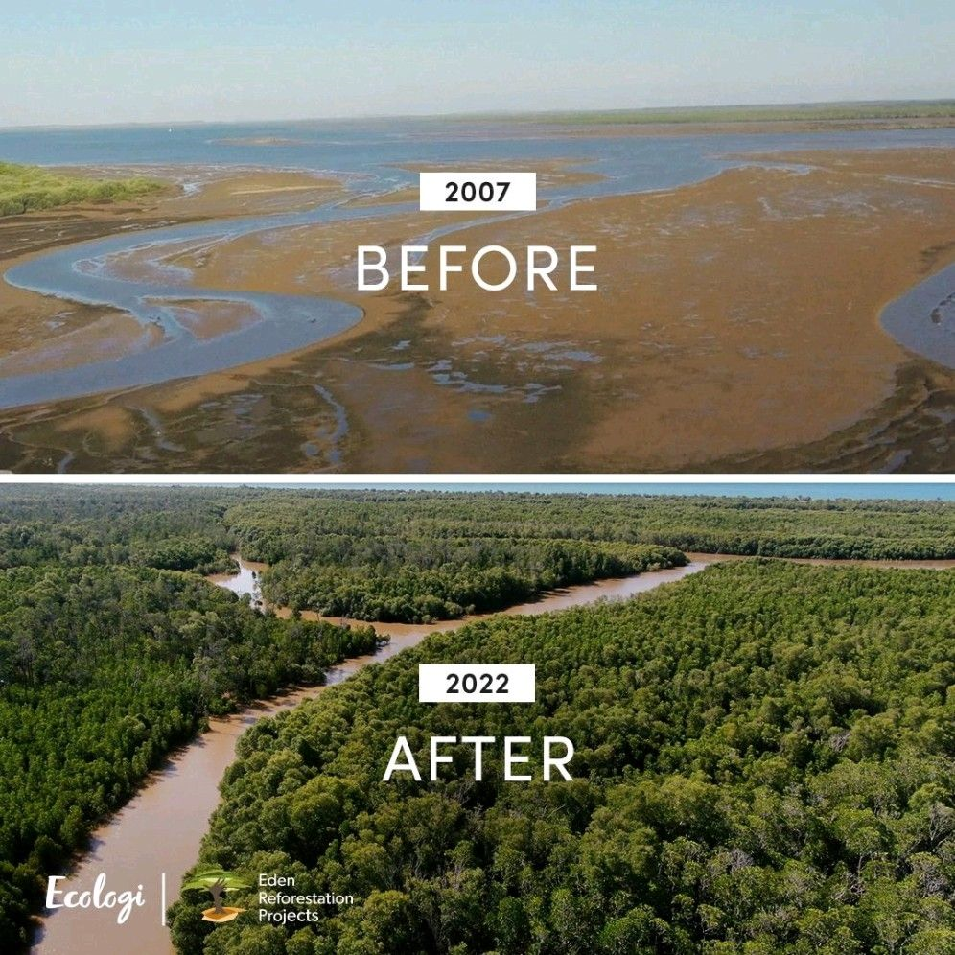
Successful reforestation, monitored and verified long-term
Notes:
Some reforestation programs promoting natural forest, not plantations, are effective but must be properly monitored and verified for the long term.

Slide 14
Wetlands
Approximately 20–30% of the world’s soil carbon is stored in wetlands.
Wetlands support many species populations, as well as providing ecological, hydrological, physiographical, and cultural functions and services. They cool surrounding areas, store flood waters, store and provide water and buffer both coastal and inland storms, providing climate resilience.
Draining or disturbing wetlands can release soil carbon very rapidly. In some types of wetlands, it can take decades to millennia to develop soil conditions that support net carbon accumulation
Leading scientists have proposed including the rights of wetlands to be protected as key natural sanctuaries in international law, through a Universal Declaration of the Rights of Wetlands.
Notes:
Wetlands provide the most effective carbon storage per acre but are also highly vulnerable and need national and international protection.

Slide 15
Soils: The Greatest Carbon Sink
2,300 Gt Total Soil Organic Carbon
680 Gt Carbon in top layer (0-30cm)
10 countries hold more than 60% of SOC stock
Russia: 22.1%
Canada: 12%
USA: 8.7%
China: 6.7%
Brazil: 5.3%
Indonesia: 3.4%
Australia: 3.4%
Argentina: 1.9%
Kazakhstan: 1.8%
Democratic Republic of Congo: 1.4%
(Note: 6 of these countries are autocracies/dictatorships or failing democracies: what impact will this have on climate negotiations on agriculture solutions to CC?)
Source: FAO https://www.fao.org/3/I8195EN/i8195en.pdf
Notes:
The world’s soils store more carbon than the atmosphere and plants combined, with over half of the soil organic carbon stock in just five countries.

Slide 16
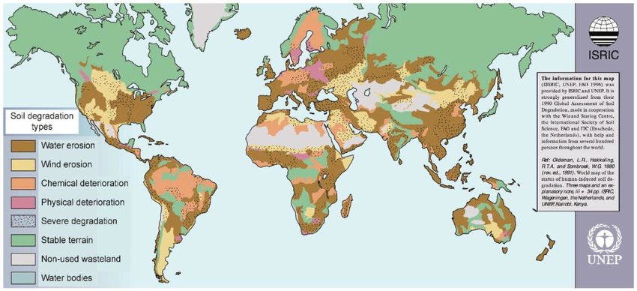
Global Soil Degradation: More Potential to Increase SOC in Degraded Soils
Notes:
Soil degradation is widespread, but with good policies the soil organic carbon stock in degraded soils can be rebuilt.

Slide 17
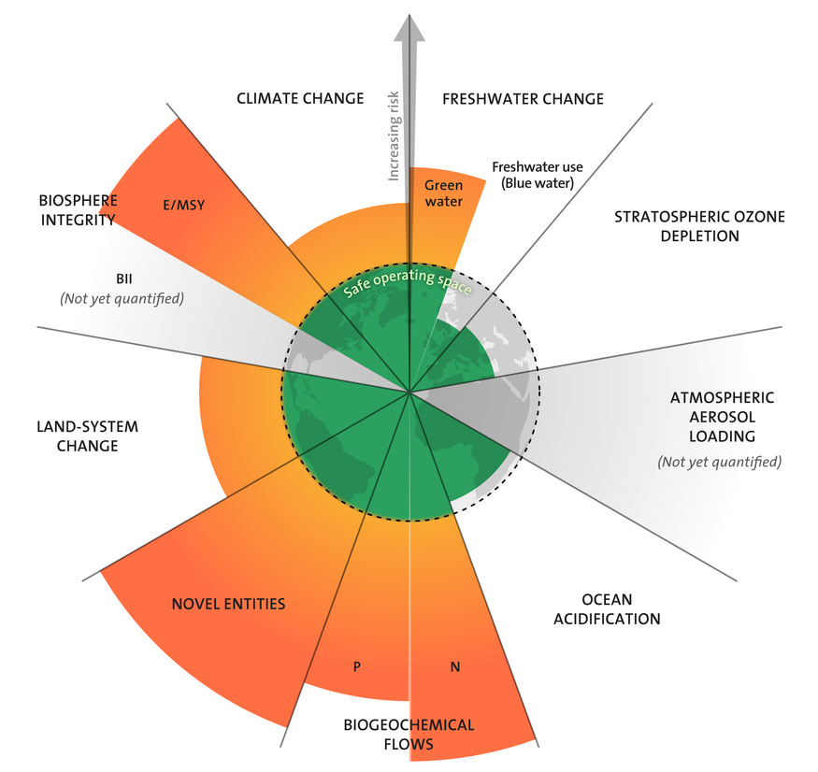
Agriculture, a culprit in crossing 5 Planetary boundaries: Climate Change, Land-System Change, Potassium Cycle, Nitrogen Cycle, Green Water
Source: Potsdam Institute for Climate Impact Research, Planetary Boundaries Update
Notes:
Good policies can also reverse the many other ways that current intensive agriculture is leading to climate and ecological damage,
including land use change, water, potassium, and nitrogen cycles.

Slide 18
Rebuilding healthy soils
“Soil health is defined as soil’s capacity, as a dynamic and biologically active entity, within natural and managed landscapes, to sustain multiple ecosystems services including net primary productivity, food and nutritional security, biodiversity, water purification and renewability, carbon sequestration, air quality and atmospheric chemistry and elemental cycling for human wellbeing and nature conservancy”
- Prof. Rattan Lal, Ohio State University
Notes:
Properly managed, the ecological services of healthy soils include food and nutritional security, biodiversity, water purification and renewability, carbon sequestration, and air quality.

Slide 19
Technical Potential of Carbon Sequestration
SOILS: between 1.45 and 3.44 Gt Carbon per year
Horizon 2100:
SOILS: 178 Gt Carbon
VEGETATION: 155 Gt Carbon
TOTAL 333Gt Carbon = 156 ppm CO₂
Source: Rattan Lal, PowerPoint presentation Glasgow, COP26 November 2021
Note: current atmospheric CO2 concentration = 420 ppm CO2
Notes:
Soils and vegetation have a theoretical potential to absorb up to 333 Gigatons of carbon, the equivalent of 156 parts per million CO₂ between now and 2100.

Slide 20
Crop yield increase with increase in SOC by
1 ton of Carbon per hectare
CROP YIELD INCREASE (Kg/Ha)
Maize 100 – 300
Soybean 20-50
Wheat 20-70
Rice 10-50
Sorghum 80-140
Millet 30-70
Beans 30-60
Source: Rattan Lal, November 2021
Notes:
Crucially, healthy soils policies would also increase crop yields, helping to avert global food crisis.

Slide 21
Soils at COP26 : the 4per1000 initiative
The name “4 per 1000” derives from a potential rate of increase of 0.4% per year in Soil Organic Carbon, on average, on all croplands, grasslands, and degraded lands, to fulfill the global potential of Carbon sequestration.
700 members, from local to national to global:
39 nation-states
11 sub-national regions (including the state of California) and counties
18 International organizations (such as the FAO)
240 NGOs (local, national, and global)
100+ research institutions
63 Farmers and Foresters organizations
195 private companies
12 public and private funding bodies
Notes:
Organizations working to promote healthy soils policies include the international 4 per 1000 initiative,
deriving its name from the goal of increasing social carbon by 0.4% per year to fill the carbon sequestration gap

Slide 22
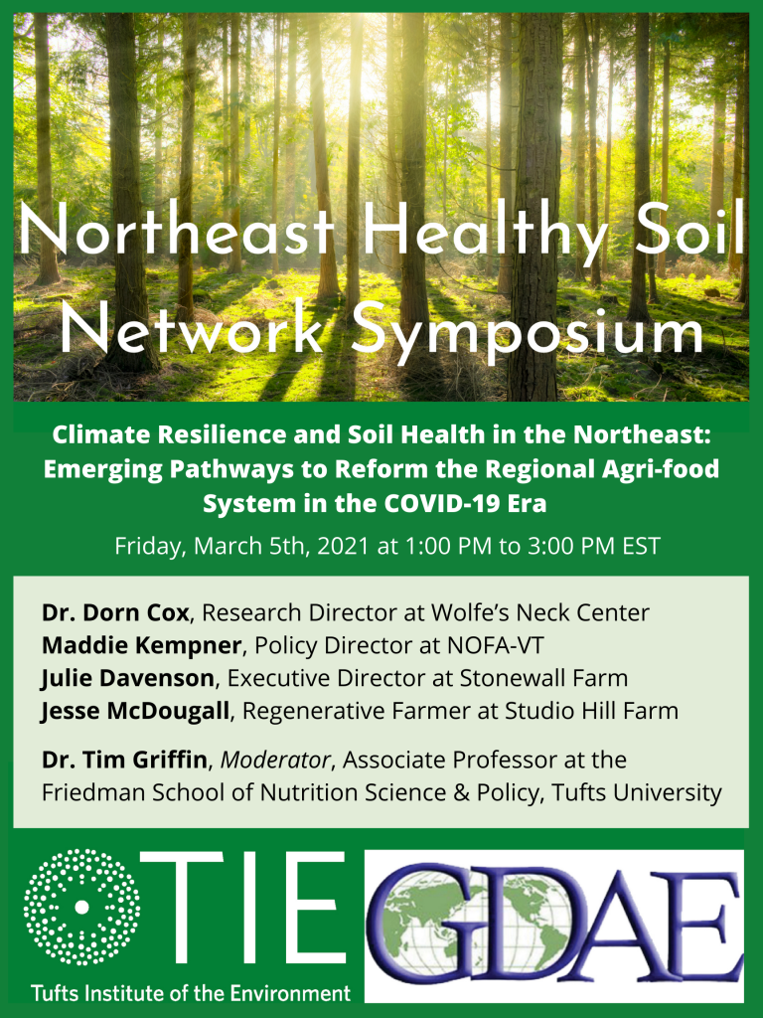
Network of multi-stakeholders at the regional level: The Northeast Healthy Soil Network
Healthy Soils legislation has now been passed in 22 US states,
and is pending in 10 more.
Notes:
Local organizations such as the Northeast Healthy Soil Network (check our website Northeast Healthy Soil Network Conferences – Global Development And Environment Institute (tufts.edu) for recent activities).

Slide 23
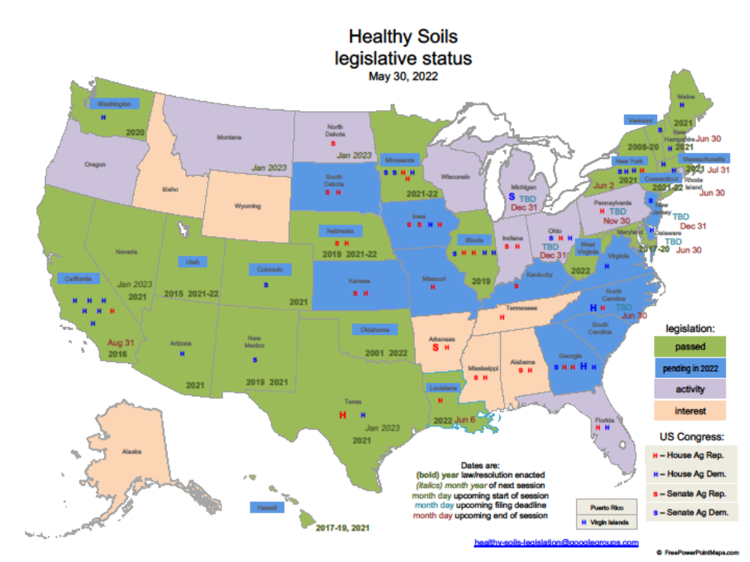
Notes:
Healthy Soils legislation has now been passed in 22 US states and is pending in 10 more.

Slide 24
CA4SH: Coalition of Action for Soil Health
Established at the UN Food Systems Summit 2021
multi-stakeholder coalition to facilitate the adoption and scaling of soil health restoration practices
champions the business case for private investment in soil as a capital asset
aligns multiple public and private stakeholders to address the nature investment gap, and incentivize and reward farmers
co-benefits to agricultural production, the environment and climate change including adaptation and mitigation
Notes:
The Coalition of Action for Soil Health, a multi-stakeholder coalition promotes public and private investment in healthy soils.

Slide 25
REGEN10 Global Network
An initiative of the World Business Council
Works with over 500 million farmers to apply regenerative production methods and transform agricultural systems,
Aims to deploy USD$60 billion per year to finance the transition.
Halting and reversing nature loss, building resilience, and enabling farmers to earn decent incomes for the vital role they play as stewards of the land.
Notes:
The REGEN10 Global Network works with farmers worldwide to promote regenerative practices and farm financial sustainability.

Slide 26
Funding the Regenerative Revolution in Agriculture?
Big Ag/Big food: Danone, Unilever, Nestlé, etc… make financial promises to help hundreds of millions of farmers adopt regenerative practices. But….
Warning! Need for a strict framework, in particular in the definition of what “regenerative production methods” mean
For instance, would increased pesticide use, GMO production, and proprietary seeds qualify as “climate-smart” in the definition of Big Agrobusiness?
Need for strict social and environmental safeguards that protect small-scale farmers and don’t sacrifice them on the altar of “regenerative” large-scale production driven by Big Agribusiness.
Notes:
Funding pledges have come from “Big Ag” corporations, but these are suspect, since Big Ag’s definition of “climate-smart” agriculture includes GMOs, pesticides, and proprietary seeds.

Slide 27
Partnerships and Crowdsourcing:
A financial alternative?
The 4per1000 initiative proposes the “Twin Regions” initiative:
A Northern community with a high level of carbon emissions but a low capacity to sequester carbon in its soils and ecosystems is paired with:
A rural community in the South with low carbon emissions, and a high potential to sequester biological carbon in its ecosystems, through forestation and regenerative practices.
→ A joint civil societal engagement of the two partners towards carbon neutrality
The Northern partner directly funds its Southern partner’s regenerative practices, monitored by a joint community of engaged citizens, farmers, NGO advocates, researchers and students, members of both twin-communities.
→ This model could be combined with urban crowdsourcing for local regenerative farming
Notes:
The 4 per 1000 group proposes a matching system for community funding of regenerative agricultural practices in the Global South.

Slide 28
THANK YOU! CONTACT US:
https://sites.tufts.edu/gdae
jonathan.harris@tufts.edu
amcodur@ume.org
https://www.bu.edu/eci/
Notes:
See ongoing work on regenerative agriculture, forests, and wetlands at https://sites.tufts.edu/gdae and sign up for our mailing list for updates.

