Slide 1
Forests and Climate:
Economics and Policy Issues
Figures and Tables
By Anne-Marie Codur,
Jonathan M. Harris,
and Maliheh Birjandi-Feriz
Copyright © 2022 Economics in Context Initiative,
Global Development Policy Center, Boston University

Slide 2
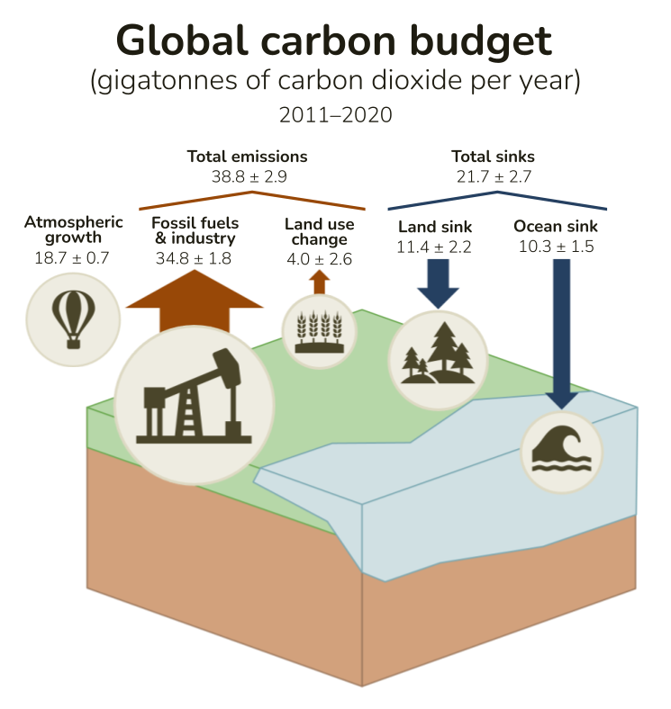
Figure 1. Global carbon budget
Source: Figure adapted from Global Carbon Budget, Global Carbon Atlas 2021. Consulted at http://www.globalcarbonatlas.org/en/content/global-carbon-budget

Slide 3
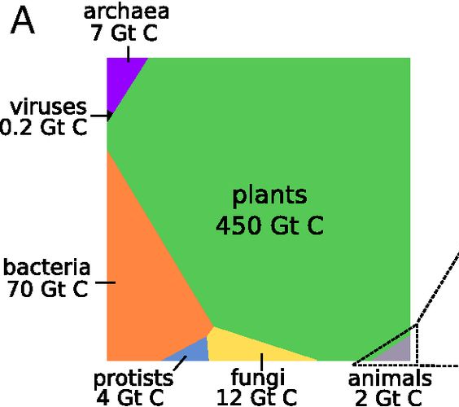
Figure 2. The distribution of biomass on earth
(in gigatons of carbon)
Source: Bar-On et al., 2018

Slide 4
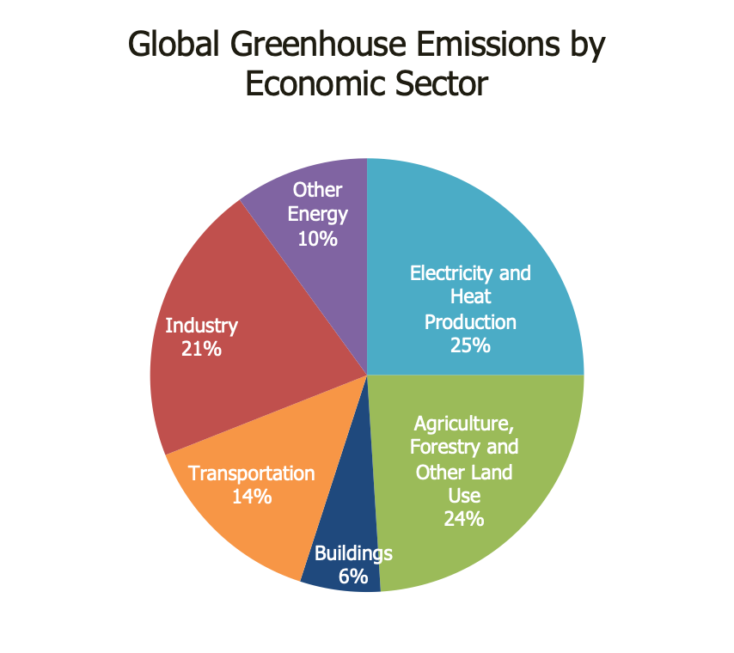
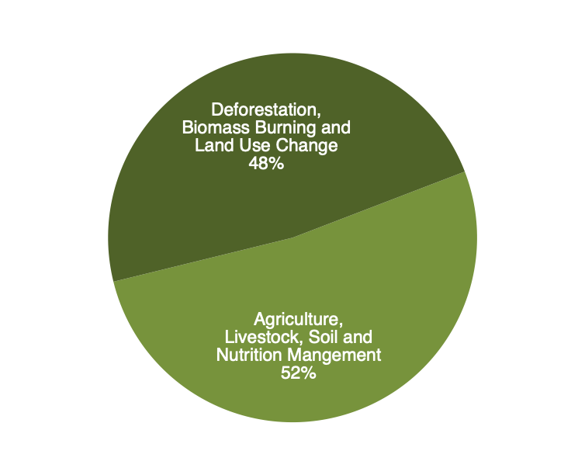
Figure 3. AFOLU greenhouse gases emissions
Source: IPCC 5th assessment (2014). consulted at https://www.ipcc.ch/report/ar5/wg3/

Slide 5
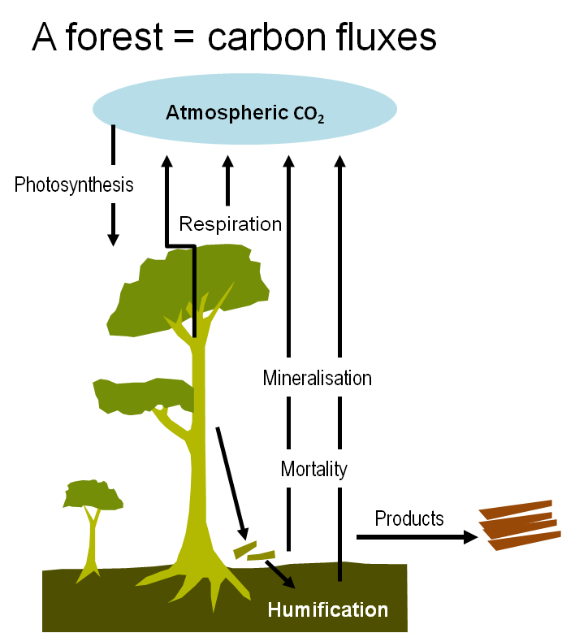
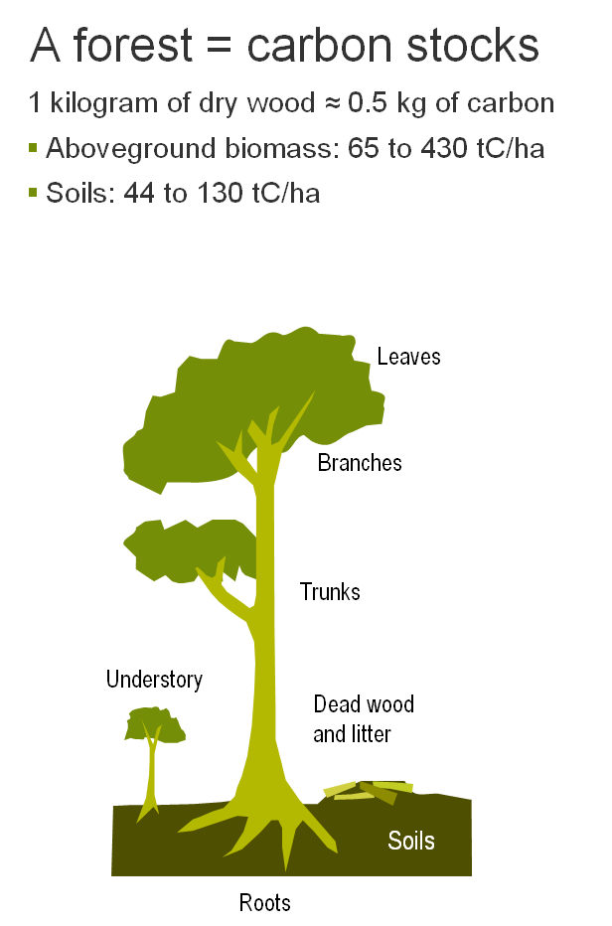
Figure 4. Forests as carbon stocks and Carbon Fluxes
Source: CIFOR, World Agroforestry Centre and USAID 2009 Forest and climate change toolbox [PowerPoint presentation]. Available fromhttp://www.cifor.cgiar.org/fctoolbox/.

Slide 6
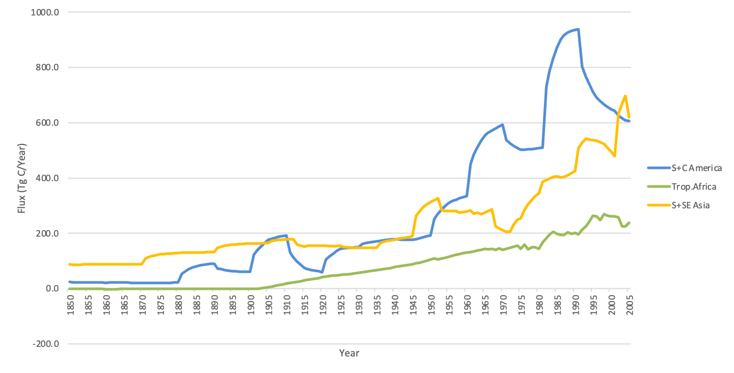
Figure 5a. Annual net flux of carbon to the atmosphere from land use change,
South America, Africa, and Asia: 1850–2005
Source: Houghton, R. A. 2008. “Carbon flux to the atmosphere from land-use changes: 1850-2005”. Oak Ridge National Laboratory http://cdiac.ornl.gov/trends/landuse/houghton/houghton.html

Slide 7
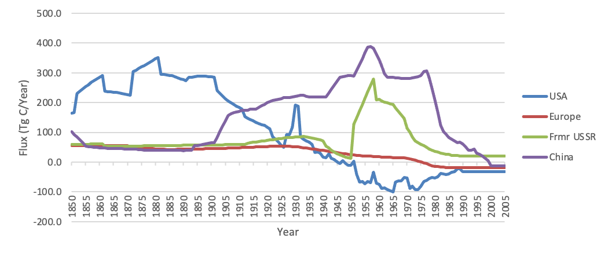
Figure 5b. Annual Net Flux of Carbon to the Atmosphere from Land Use Change,
Europe, China, Former USSR, and USA: 1850–2005
Source: Houghton, R. A. 2008. “Carbon flux to the atmosphere from land-use changes: 1850-2005”. Oak Ridge National Laborator http://cdiac.ornl.gov/trends/landuse/houghton/houghton.html

Slide 8
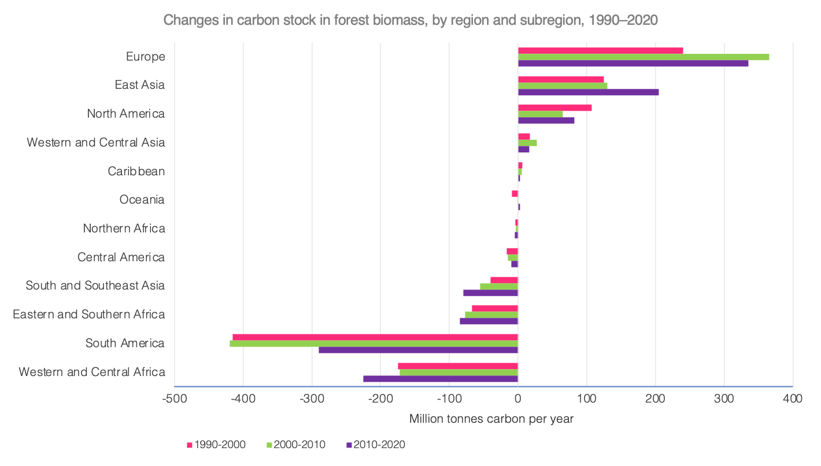
Figure 6. Changes in carbon stock in forest biomass
Source: FAO 2020 Global Forests Resources Assessment, Figure 24 (p. 53), https://www.fao.org/3/ca9825en/ca9825en.pdf

Slide 9
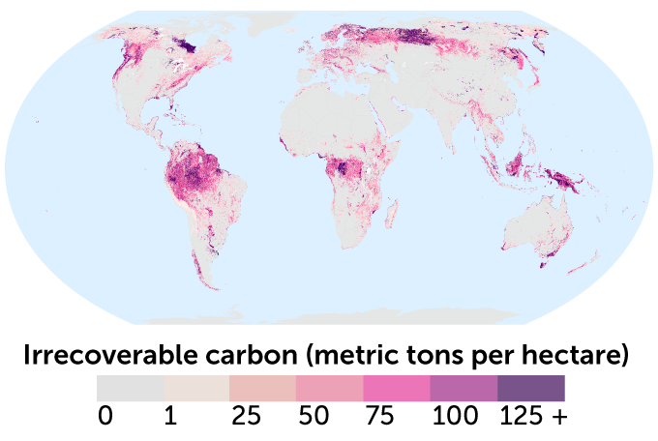
Figure 7. Irrecoverable carbon stores across the planet
Source: “The carbon most crucial to avoiding climate disaster has been mapped,” Science News https://www.sciencenews.org/article/climate-change-natural-carbon-stores-new-map;
Noon et al, “Mapping the Irrecoverable Carbon in Earth’s Ecosystems,” Nature Sustainability https://www.nature.com/articles/s41893-021-00803-6

Slide 10
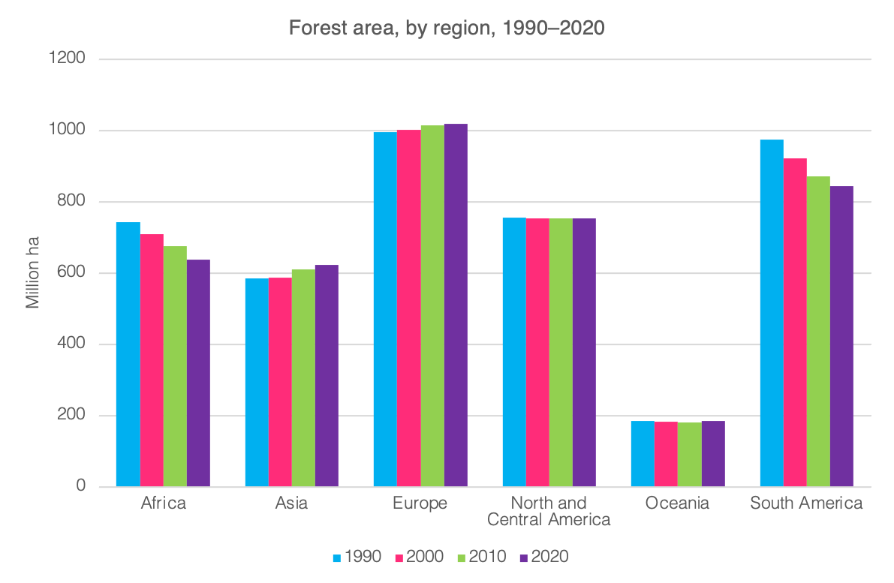
Figure 8. Annual net forest area by region in millions of ha between 1990 and 2020
Source: FAO 2020 assessment, Figure 7 (p. 17), https://www.fao.org/3/ca9825en/ca9825en.pdf

Slide 11
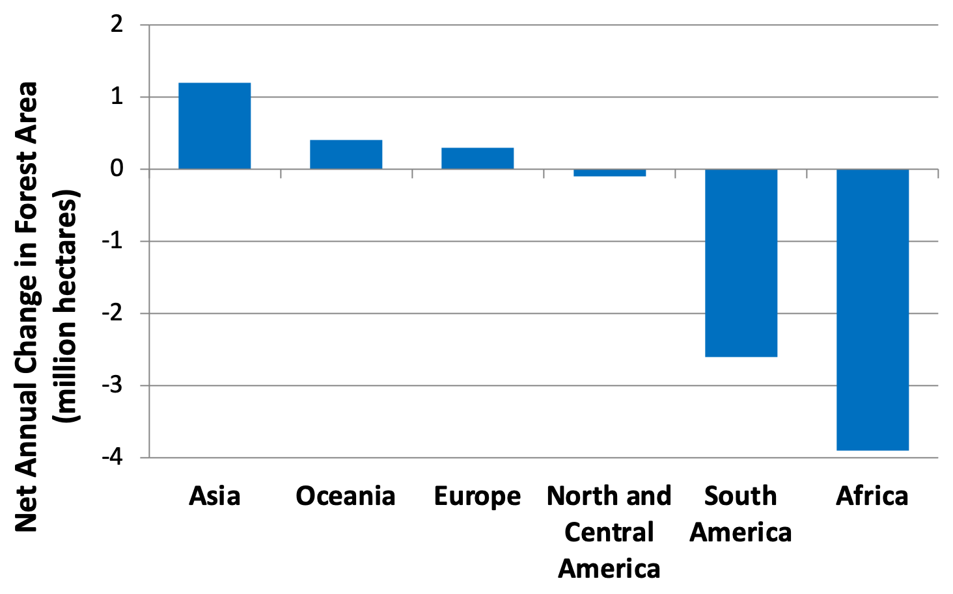
Figure 9. Net annual change in forest area
Source: Food and Agriculture Organization (FAO). 2020. Global Forest Resources Assessment 2020.

Slide 12
Figure 10. Causes of forest decline
CAUSES OF FOREST DECLINE
Direct
Indirect
Natural Causes
Hurricanes
Natural fires
Pests
Flood
Human Causes
Agricultural Expansion
Cattle Ranching
Logging
Mining & oil Extraction
Dam Construction
Roads
Biomass/biofuel production
Market Failure
Unpriced forest goods & services
Monopolistic forces
Mistaken Policy Interventions
Wrong incentives & regulatory mechanisms
Government investment
Governance Weaknesses
Concentration of land ownership
Weak/nonexistent land ownership & tenure requirements
Illegal activities
Corruption
Socio-economic & Political Causes
Population growth & increased density
Economic growth
Power distribution
Excessive consumption
Toxification
Global climate change
War
Agents
Slash & burn farmers
Agribusiness
Cattle Ranchers
Miners
Oil corporations
Loggers
Non-timber commercial corporations
Source: Adapted from Contreras- Hermosilla, 2000. The underlying causes of forest decline, Citeseer

Slide 13
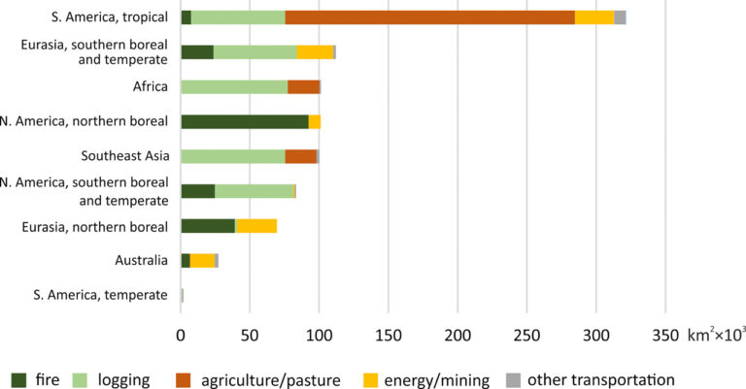
Figure 11. Regional reduction of intact forest land area and causes of change, 2000–2013
Source: Potapov et al., 2017.

Slide 14
Table 1. Percent decrease in intact forests, 2000–2013
Region | % Intact Forest Loss
South America, tropical | 7.3%
Eurasia, southern boreal and temperate | 9.1%
Africa | 10.1%
North America, northern boreal | 3.3%
Southeast Asia | 13.9%
South America, southern boreal and temperate | 15.5%
Eurasia, northern boreal | 4.4%
Australia | 21.9%
South America, temperate | 1.3%
Source: Potapov et al., 2017.

Slide 15
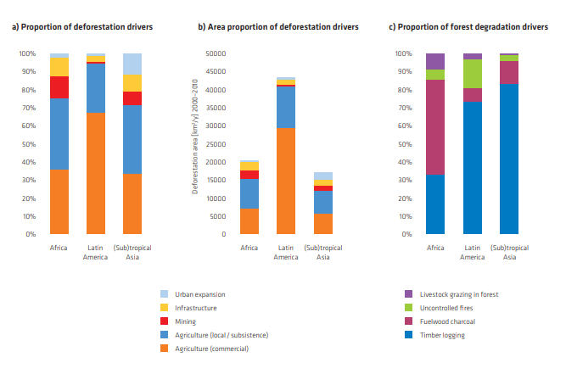
Figure 12. Drivers of deforestation and forest degradation
Source: Kissinger et al., 2012.

Slide 16
Figure 13. Deforestation in Brazil
Source: Adapted from Brazil’s national space research institute INPE, quoted in Mongabay, https://news.mongabay.com/2021/11/amazon-deforestation-unexpectedly-surges-22-to-highest-level-since-2006/

Slide 17
Figure 14. REDD+ supply curve
Price
$ per tCO₂
MMtCO₂ per year
Quantity
Source: Adapted from Estimating the Costs of Reducing Forest Emissions (Wertz-Kanounnikoff 2008.)

Slide 18
Figure 15. Illustration of baseline credit system
Historical level carried forward
Forest emissions
Baseline
Credits awarded based on difference between baseline and actual emissions
Actual
Time
Source: Adapted from Eliasch, Climate change: Financing global forests,2008.

Slide 19
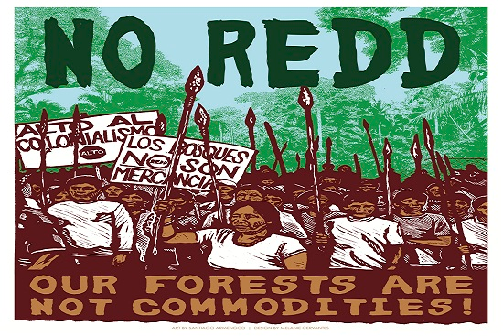
Figure 16. Posters of Indigenous peoples’ protests against REDD schemes
Source: http://ggjalliance.org/posters

Slide 20
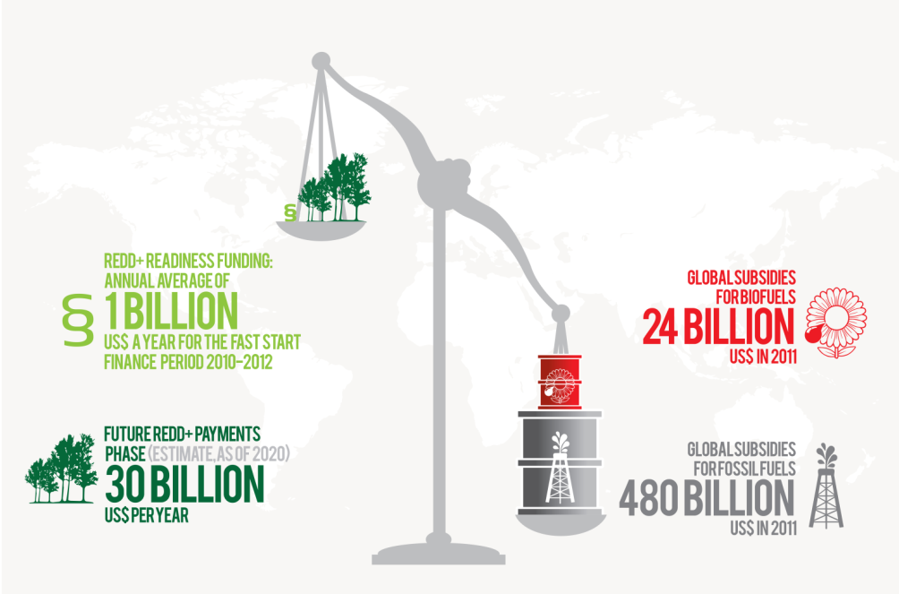
Figure 17. REDD+ funding vs. global subsidies for biofuels and fossil fuels
Source: UN REDD+ Programme, 2014. https://www.unredd.net/index.php?option=com_docman&view=list&slug=redd-academy-asia-pacific-presentations-3616&Itemid=134

