Slide 1

Chapter 9
Economic Fluctuations and Macroeconomic Theory

Slide 2
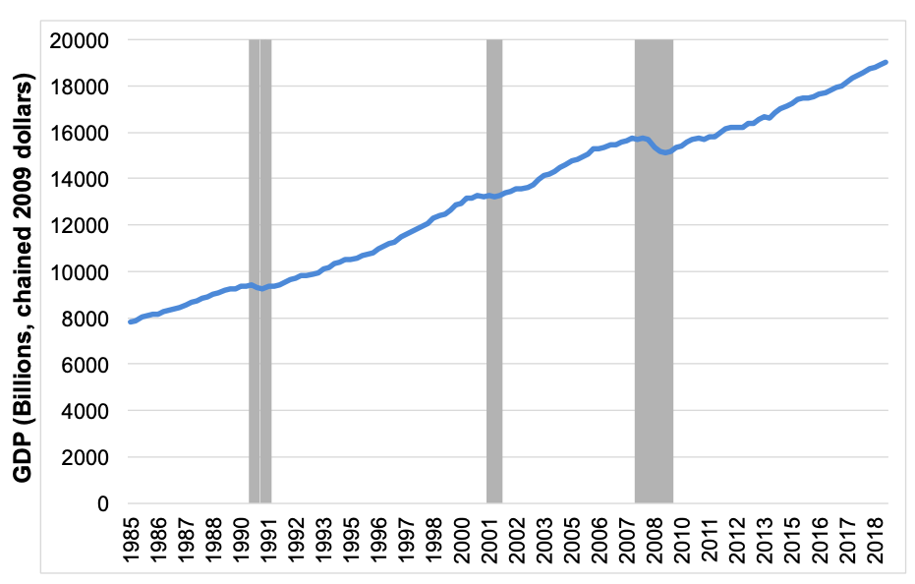
Figure 9.1 U.S. Real GDP and Recessions
Source: Bureau of Economic Analysis quarterly data 1985–2019, and National Bureau of Economic Research.

Slide 3
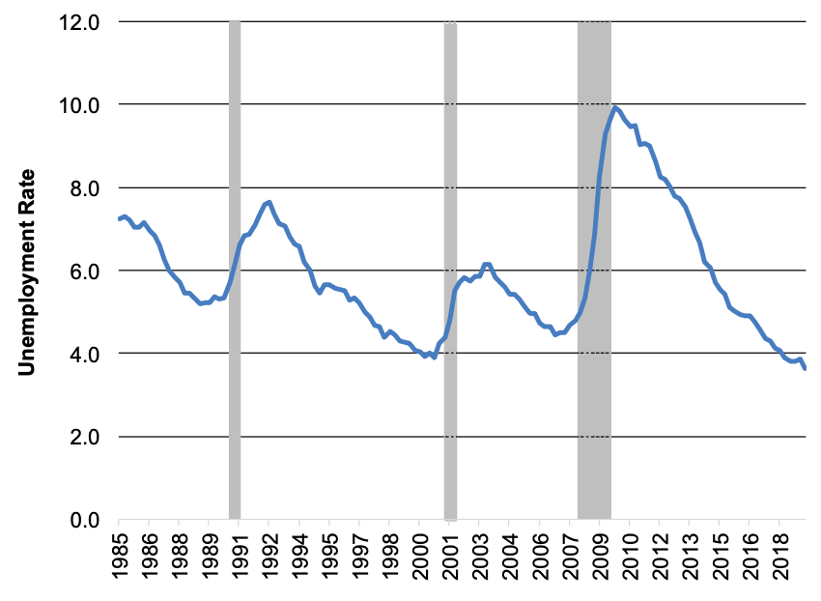
Figure 9.2 U.S. Unemployment Rate and Recessions
Source: Bureau of Labor Statistics monthly data 1985–2019, and National Bureau of Economic Research.

Slide 4
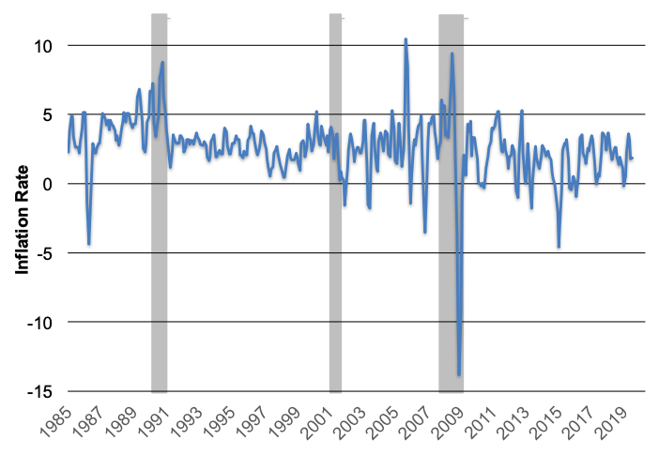
Figure 9.3 U.S. Inflation Rate and Recessions
Source: “Economic Report of the President” 1985–2019; rate is calculated as a three-month moving average of the Consumer Price Index (CPI); National Bureau of Economic Research.

Slide 5
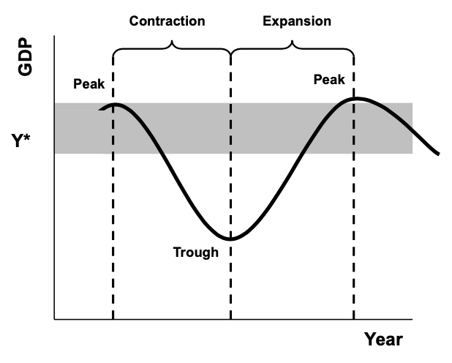
Figure 9.4 A Stylized Business Cycle

Slide 6
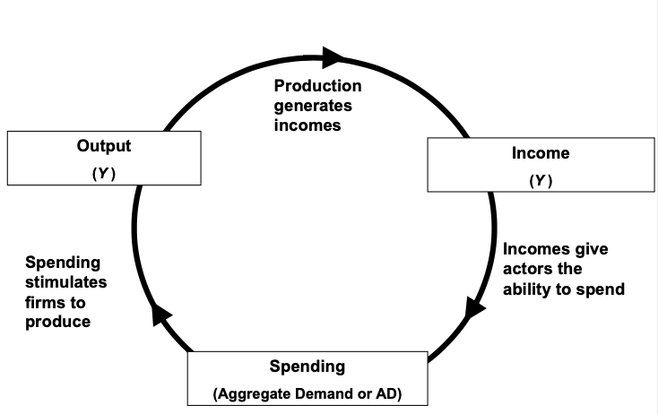
Figure 9.5 The Output-Income-Spending Flow of an Economy in Equilibrium

Slide 7
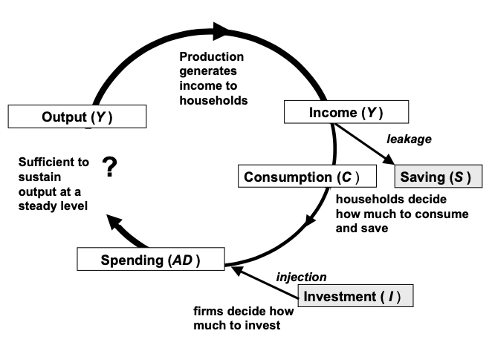
Figure 9.6 The Output-Income-Spending Flow with Leakages and Injections

Slide 8
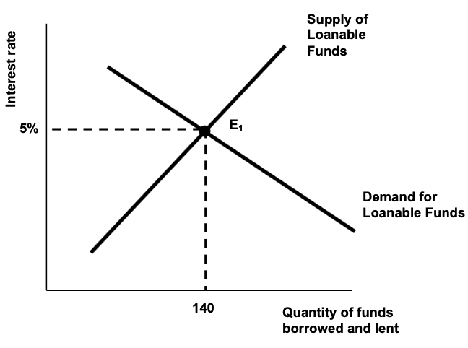
Figure 9.7 The Classical Model of the Market for Loanable Funds

Slide 9
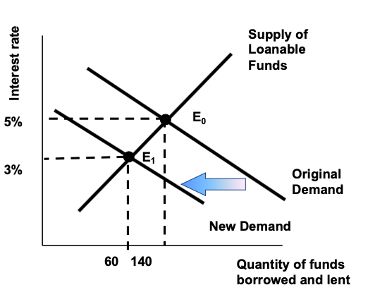
Figure 9.8 Adjustment to a Reduction in Intended Investment in the Classical Model

Slide 10
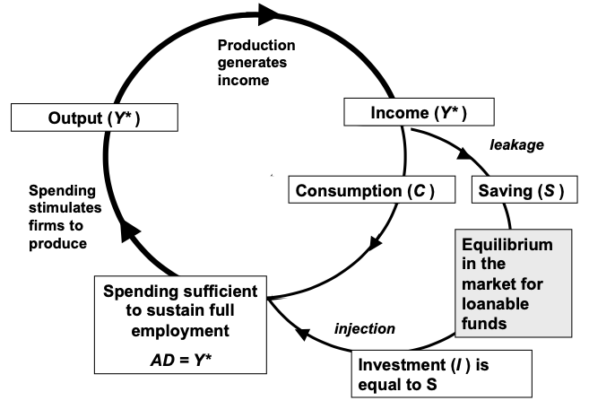
Figure 9.9 Macroeconomic Equilibrium at Full Employment in the Classical Model

Slide 11
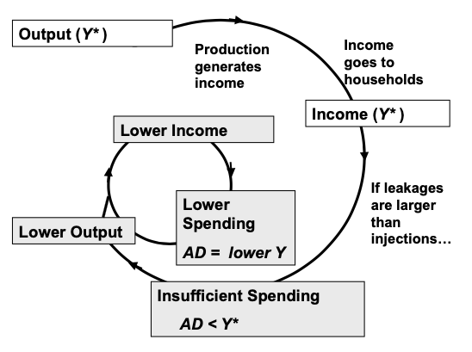
Figure 9.10 A Keynesian Unemployment Equilibrium

Slide 12
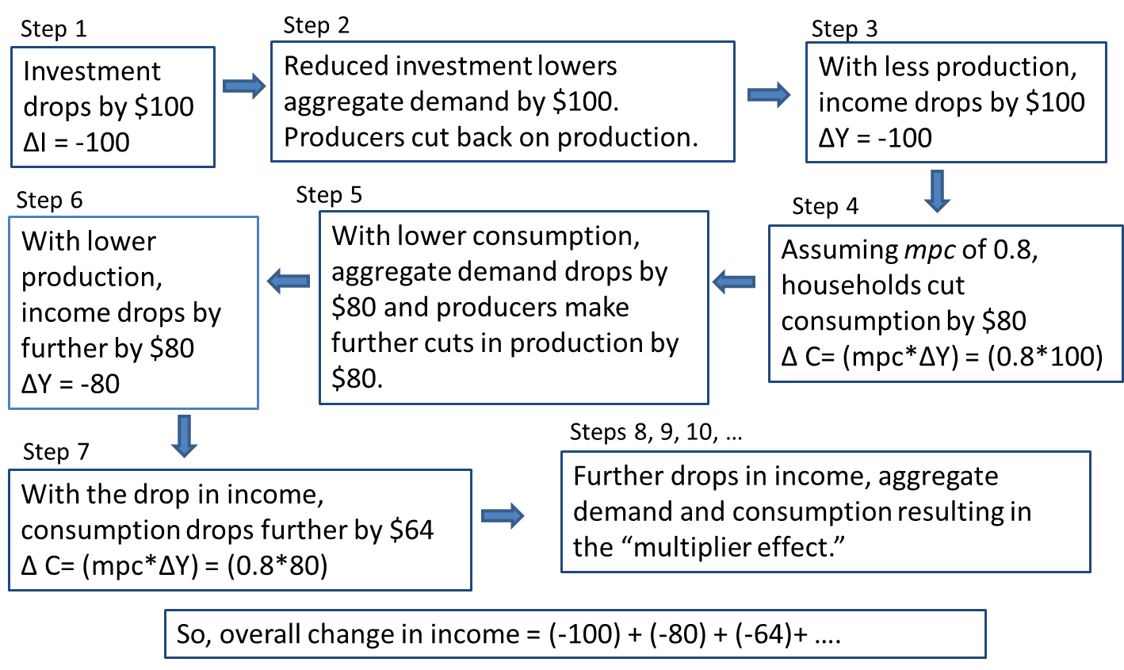
Figure 9.11 The Multiplier at Work

