Slide 1

Chapter 8
Macroeconomic Measurement

Slide 2
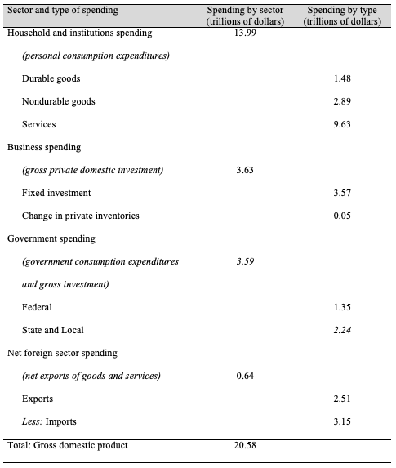
Table 8.1 Gross Domestic Product, Spending Approach, 2018
Source: U.S. Bureau of Economic Analysis, National Income and Products Account, Table 1.1.5, October 4, 2019.
Note: Totals may not add up exactly due to rounding.

Slide 3
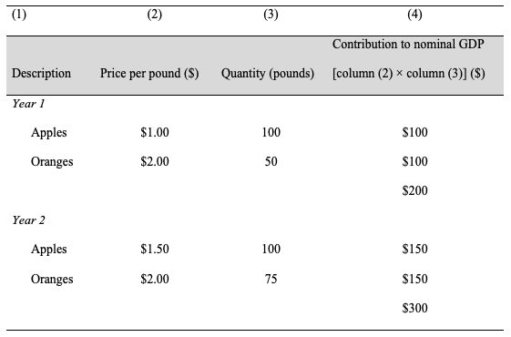
Table 8.2 Calculation of Nominal GDP in an “Apples-and-Oranges” Economy

Slide 4
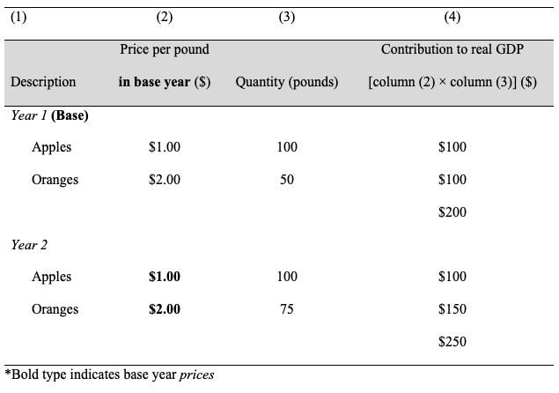
Table 8.3 Calculation of Constant-Dollar Real GDP

Slide 5
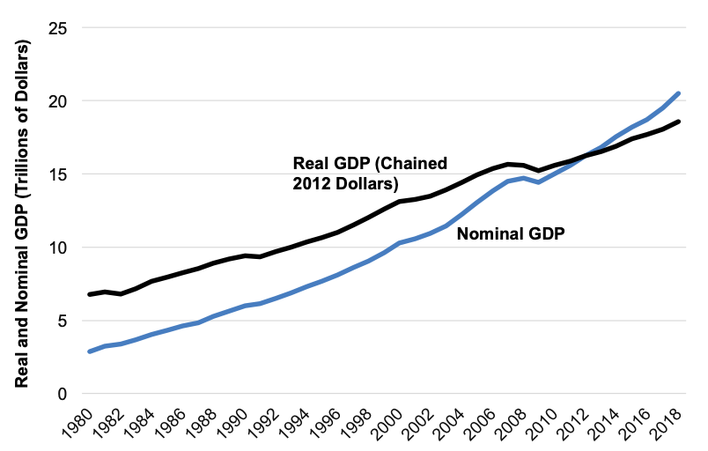
Figure 8.1 Real versus Nominal GDP, Chained 2009 Dollars, 1980–2018
Source: U.S. Bureau of Economic Analysis National Income and Product Accounts, Tables 1.1.5 and 1.1.6.

Slide 6
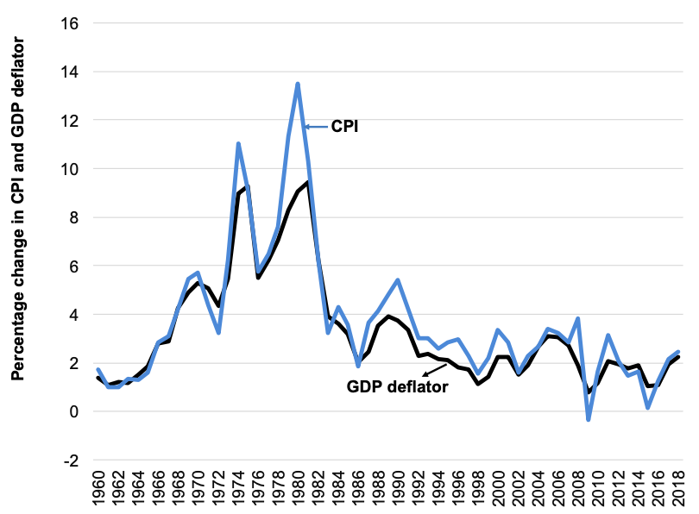
Figure 8.2 Rate of change in GDP deflator vs. CPI, 1960-2018
Source: U.S. Bureau of Economic Analysis, National Income and Product Accounts Tables 1.1.4 and U.S. Bureau of Labor Statistics, Table on CPI-All urban consumers.

Slide 7
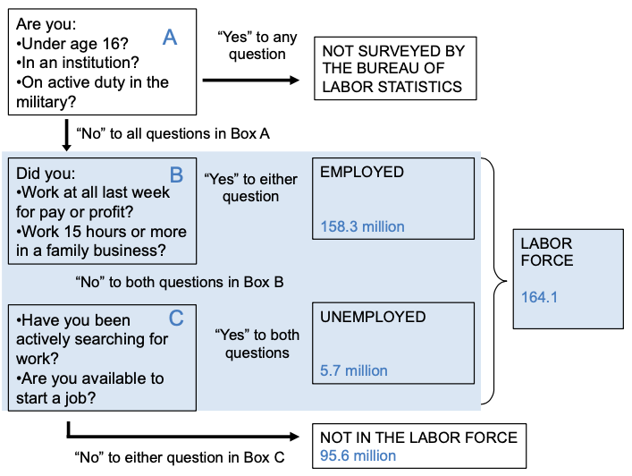
Figure 8.3 Who is in the Labor Force?
Source: U.S. Bureau of Labor Statistics, The Employment Situation – September 2019, News Release.

Slide 8
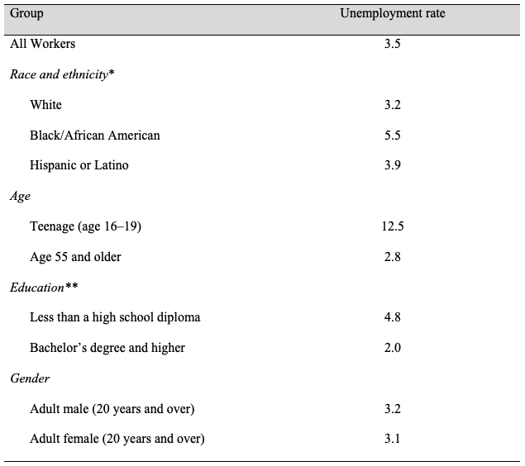
Table 8.4 Unemployment Rates for Different Groups
Source: BLS News Release, “The Employment Situation—September 2019,” October 8, 2019.
* People are allowed to indicate more than one racial group. However, data from people who indicated more than one race are not included in these statistics.
**Data on unemployment by education is for the age-group 25 years and over.

Slide 9
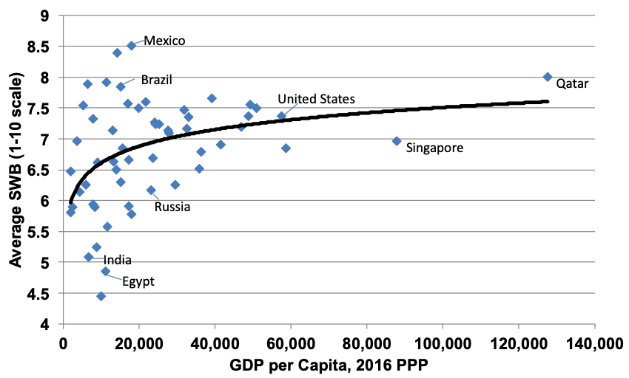
Figure 8.4 Average Subjective Well-Being and GDP per Capita
Sources: SWB from World Values Survey online data analysis, 2005–2008 survey wave; GDP from World Development Indicators online database.
Note: The trend line is a statistically fitted line showing a “best fit” estimate of the relationship between the two variables on the graph, GDP per capita and SWB.

Slide 10
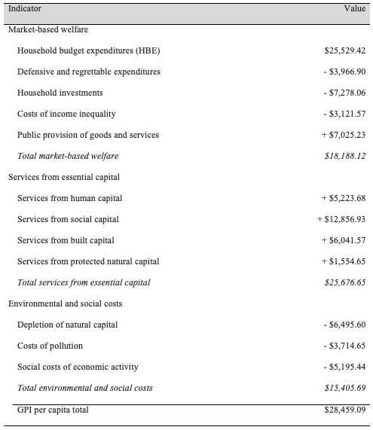
Table 8.5 Genuine Progress Indicator ($2012 per Capita), United States 2014
Source: Talberth and Weisdorf, 2017.

Slide 11
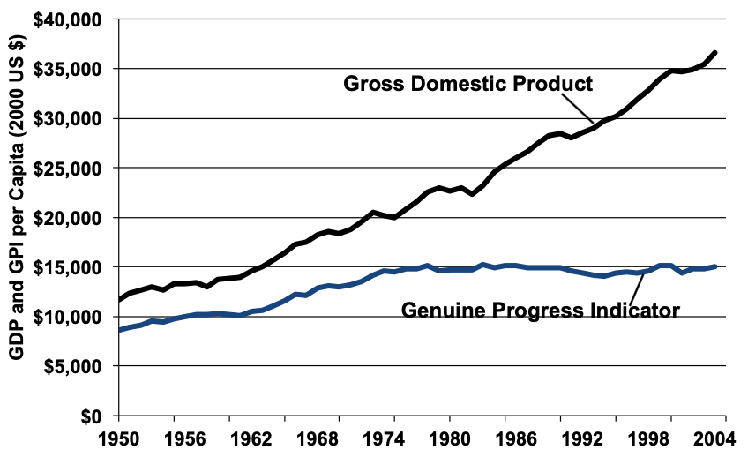
Figure 8.5 GPI vs. GDP per Capita, 1950-2004
Source: Talberth, John, Clifford Cobb, and Noah Slattery. 2007. “The Genuine Progress Indicator 2006: A Tool For Sustainable Development.” Redefining Progress. February, 2007.

Slide 12
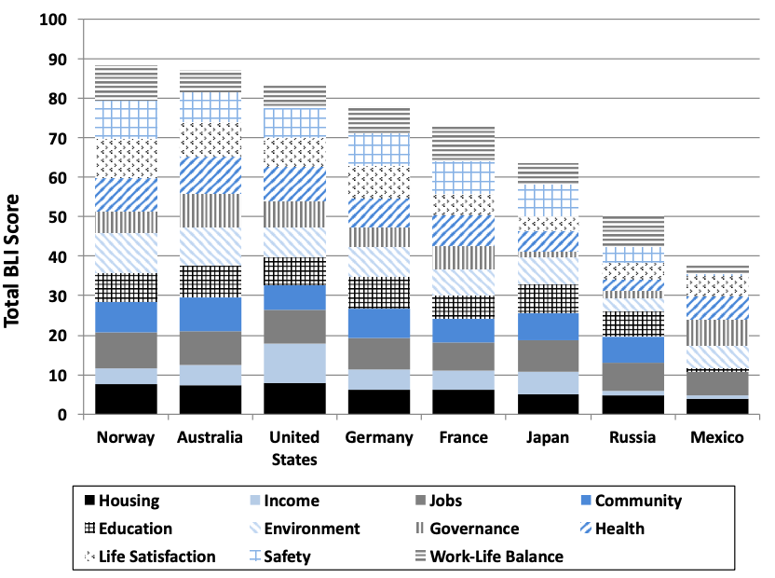
Figure 8.6 BLI for Selected Countries, 2015
Source: OECD, 2015.

Slide 13
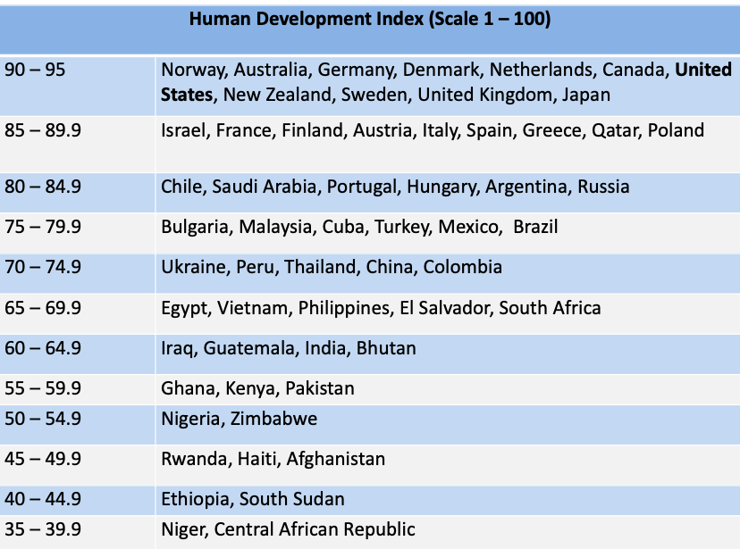
Figure 8.7 Selected Countries as Ranked in the Human Development Index
Source: UNDP, Human Development Report, 2016 data.

