Slide 1

Chapter 7
Markets for Labor

Slide 2
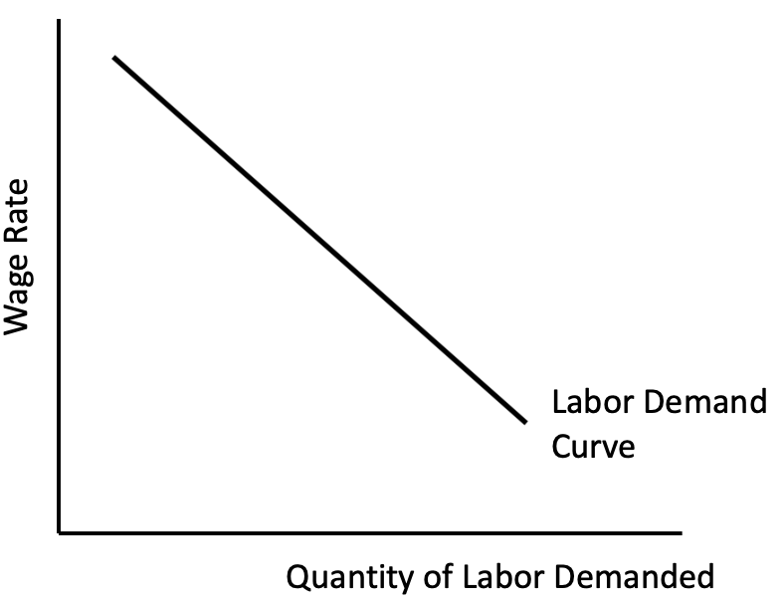
Figure 7.1 An Individual Firm’s Labor Demand Curve

Slide 3
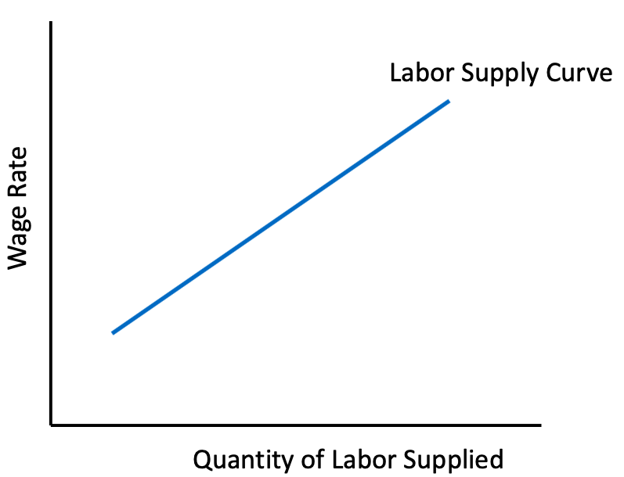
Figure 7.2 Upward-Sloping Labor Supply Curve

Slide 4
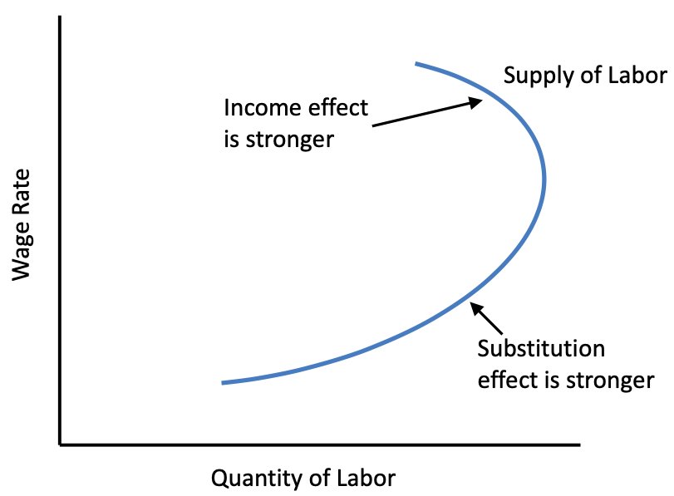
Figure 7.3 Backward-bending Individual Labor Supply Curve

Slide 5
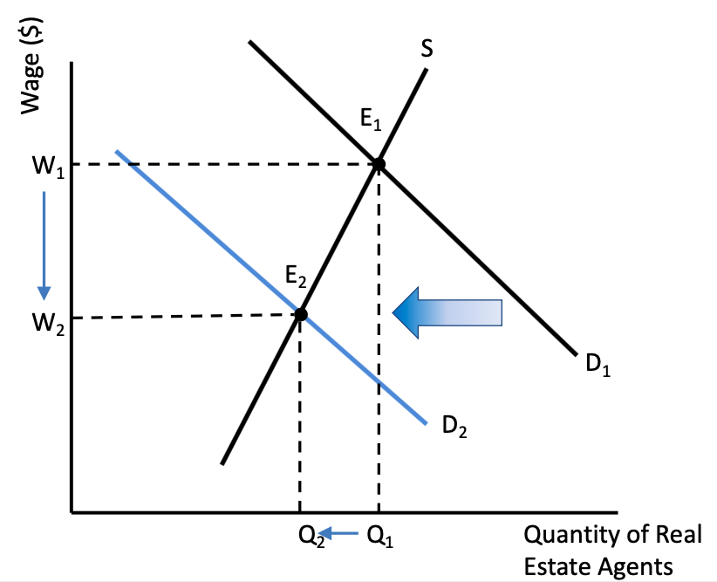
Figure 7.4 The Labor Market for Real Estate Agents

Slide 6
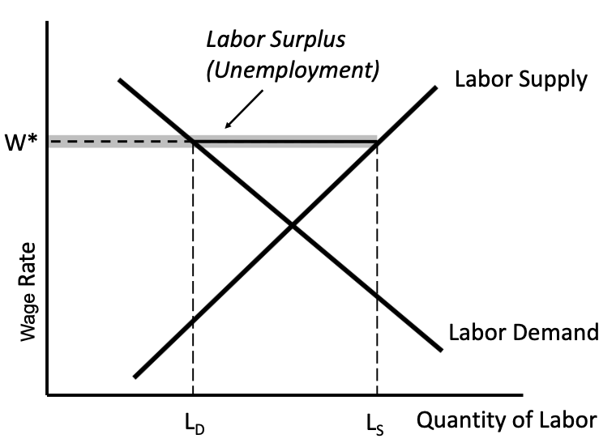
Figure 7.5 Unemployment due to Minimum Wage Regulations

Slide 7
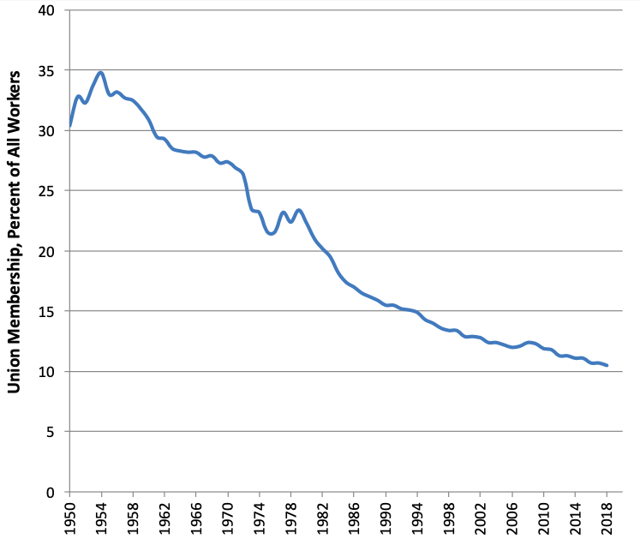
Figure 7.6 Union Membership in the United States, 1950–2018
Sources: Mayer, Gerald. 2004. “Union Membership Trends in the United States.” Congressional Research Service, Washington, DC. U.S. Bureau of Labor Statistics, 2019.

Slide 8
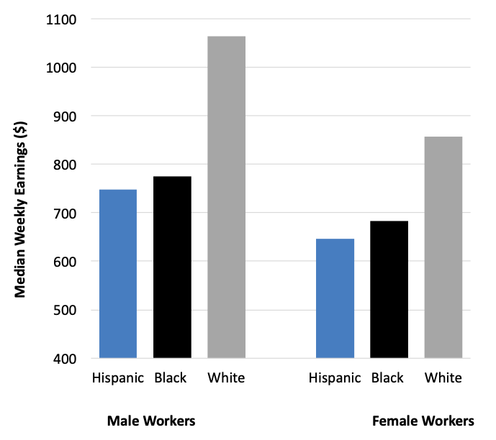
Figure 7.7 Median Weekly Earnings, Select Groups of U.S. Workers, Age 25 and Over, 2018
Source: U.S. Bureau of Labor Statistics, 2019.

Slide 9
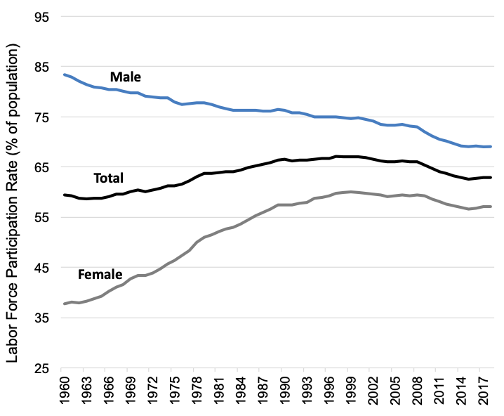
Figure 7.8 Labor Force Participation Rates, 1960-2018
Source: U.S. Bureau of Labor Statistics, 2019.

Slide 10
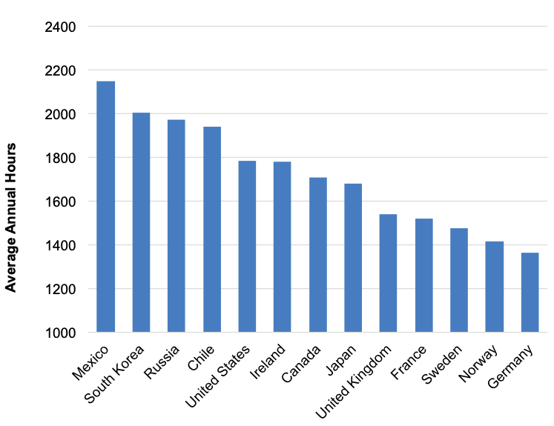
Figure 7.9 Average Annual Hours Worked, Select Countries, 2018
Source: OECD, OECD. Stat, “Average Annual Hours Actually Worked per Worker.”

Slide 11
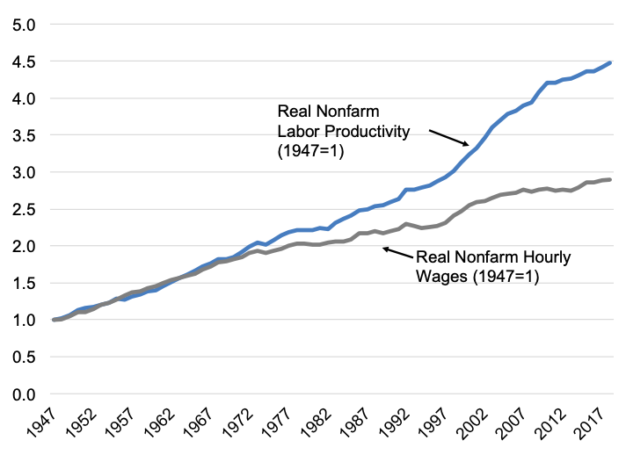
Figure 7.10 Real Nonfarm Median Wages and Labor Productivity, 1947-2018
Source: OECD, OECD. Stat, “Average Annual Hours Actually Worked per Worker.”

Slide 12
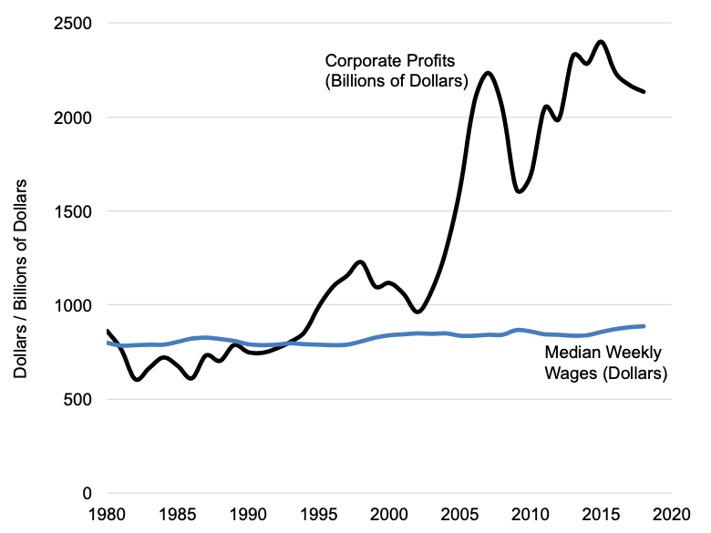
Figure 7.11 Real Median Weekly Wages Versus Real Corporate Profits, United States, 1980-2018
Sources: U.S. Bureau of Economic Analysis, National Income and Products Accounts, Corporate Profits before Tax, Table 6.17; U.S. Bureau of Labor Statistics, Weekly and Hourly Earnings Data from the Current Population Survey.

