Slide 1

Chapter 6
Market Structure

Slide 2
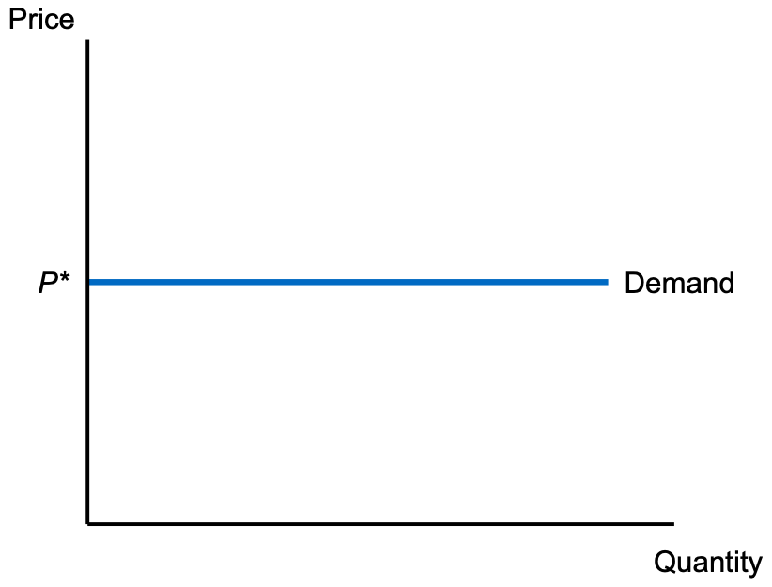
Figure 6.1 The Demand Curve for a Perfectly Competitive Seller

Slide 3
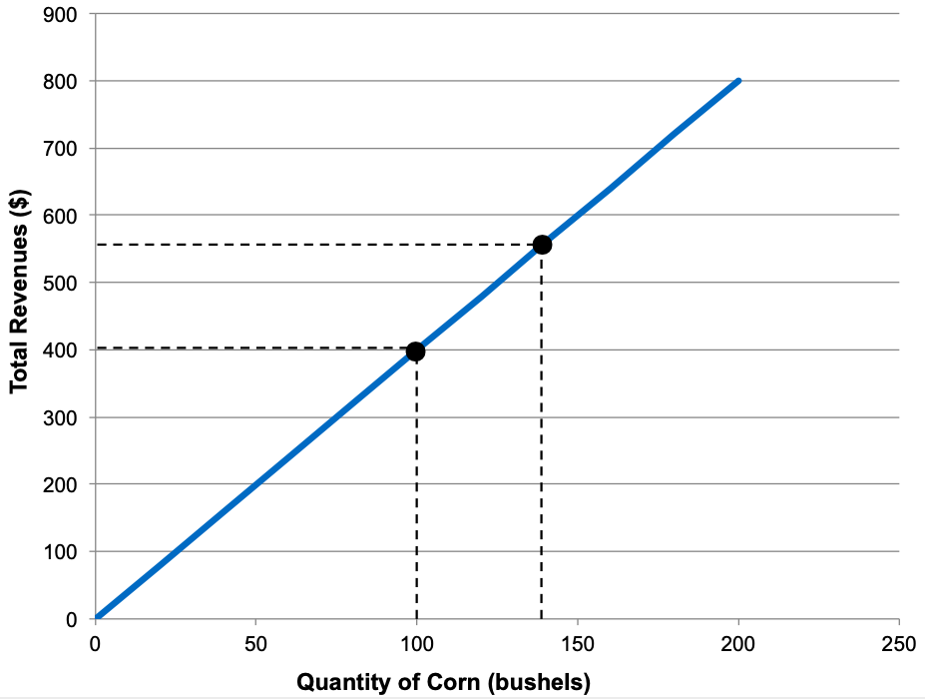
Figure 6.2 Total Revenues

Slide 4
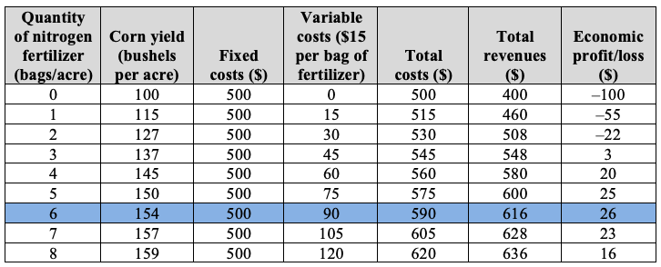
Table 6.1 Profit Maximization, Based on Analysis of Total Costs and Total Revenues

Slide 5
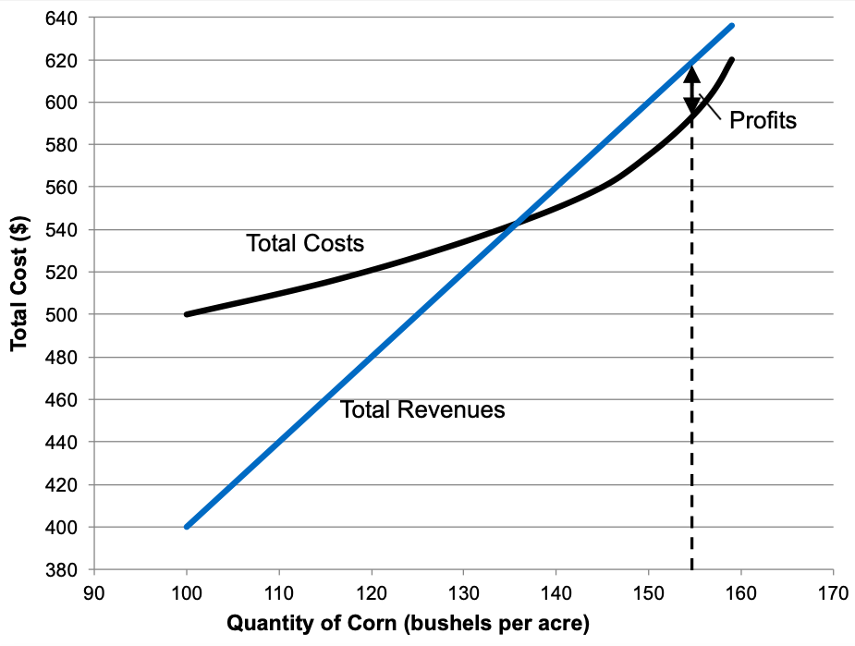
Figure 6.3 Profit Maximization, Based on Analysis of Total Costs and Total Revenues

Slide 6
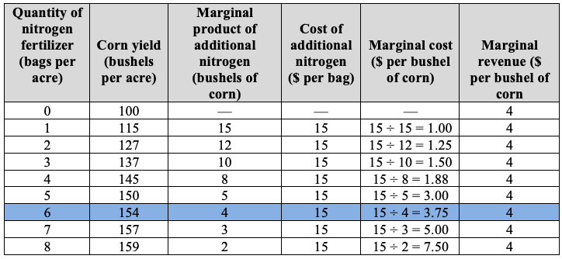
Table 6.2 Profit Maximization, Based on Analysis of Marginal Costs and Marginal Revenues

Slide 7
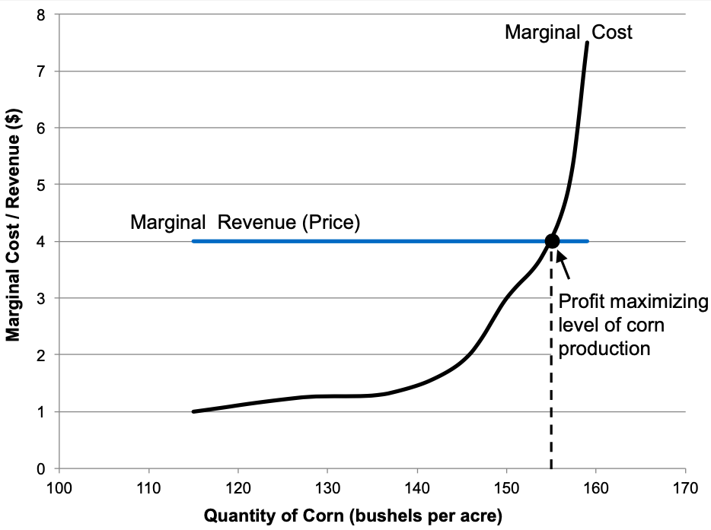
Figure 6.4 Profit Maximization Based on Marginal Analysis

Slide 8
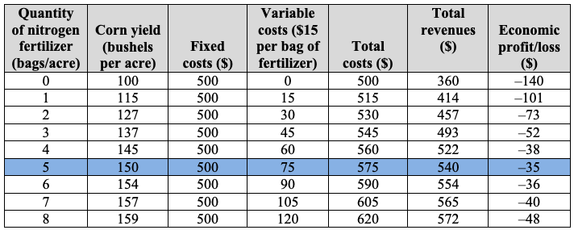
Table 6.3 Impact of a Decrease in Corn Prices

Slide 9
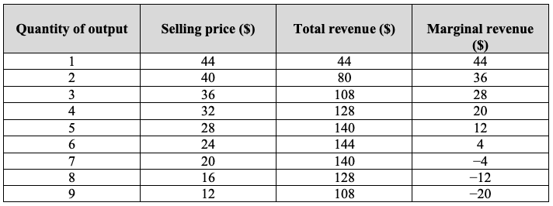
Table 6.4 Total and Marginal Revenue for a Monopolist

Slide 10
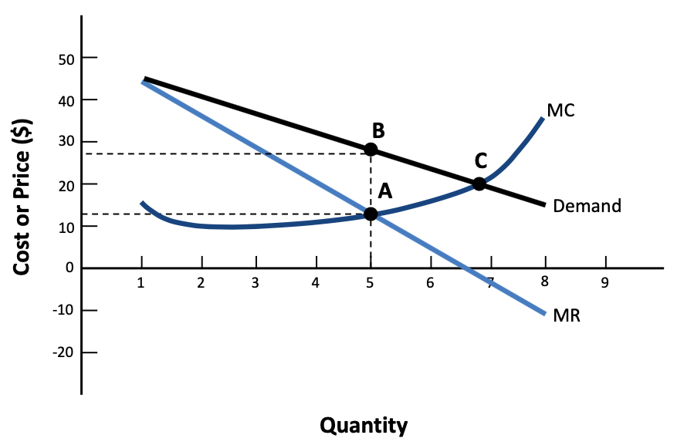
Figure 6.5 Profit Maximization for a Monopoly Firm

Slide 11
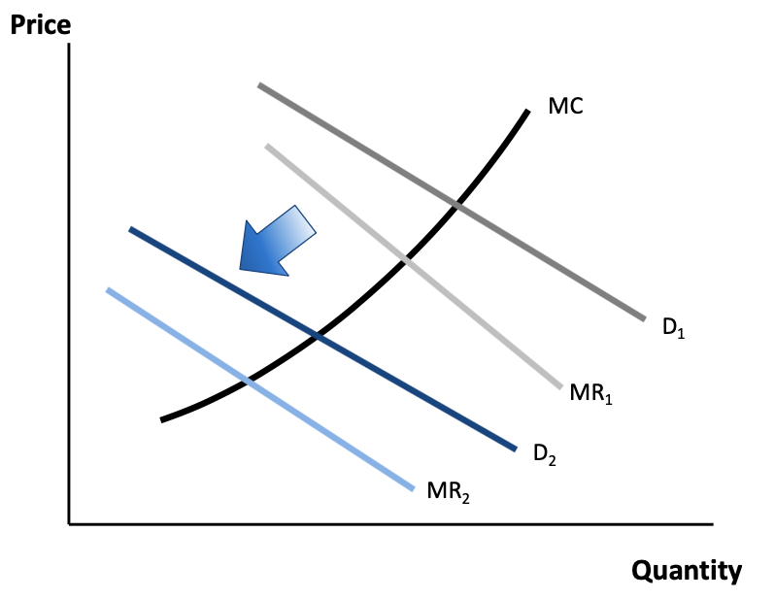
Figure 6.6 The Effect of Firm Entry on the Demand Curve for a Monopolistically
Competitive Firm

Slide 12
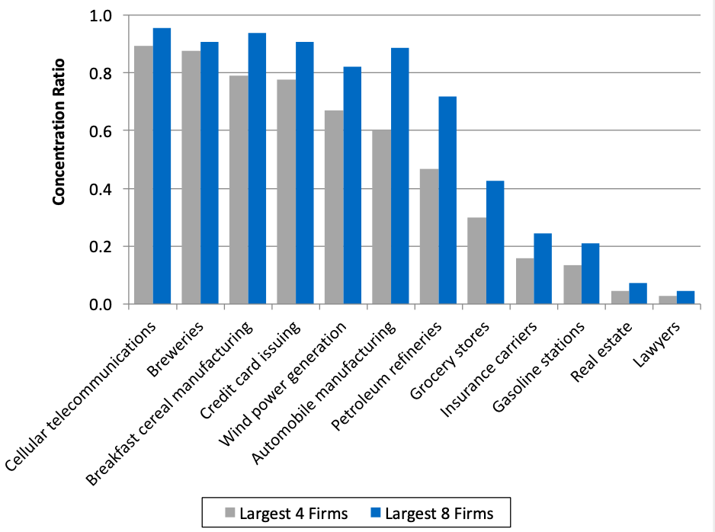
Figure 6.7 Concentration Ratios for Select Industries, United States, 2012

