Slide 1
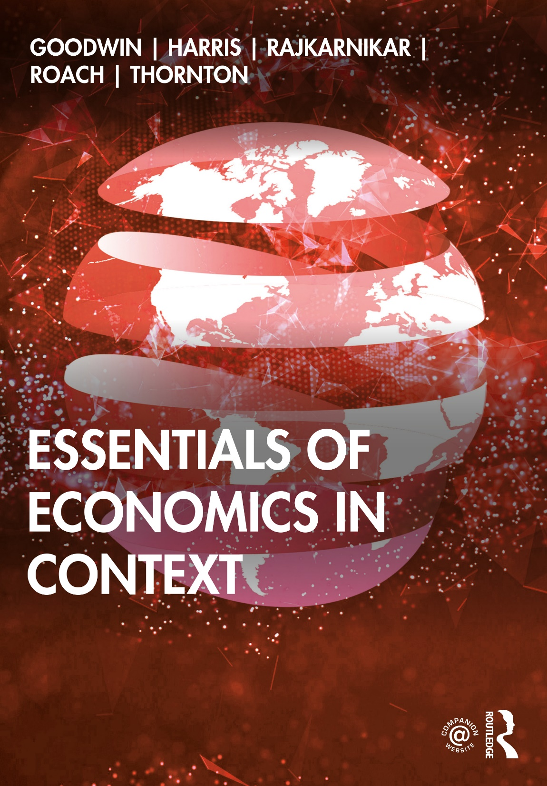
Chapter 5
Production

Slide 2
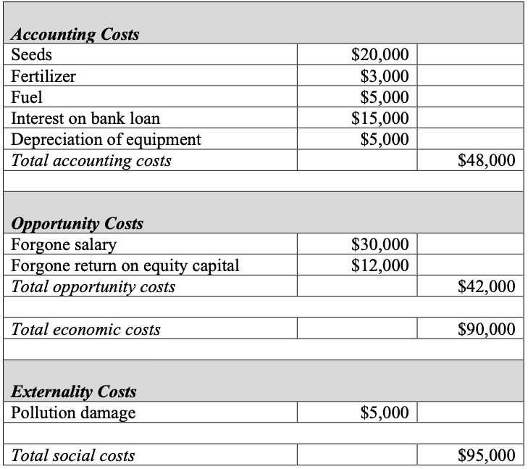
Table 5.1 Gail’s Cost of Farming

Slide 3
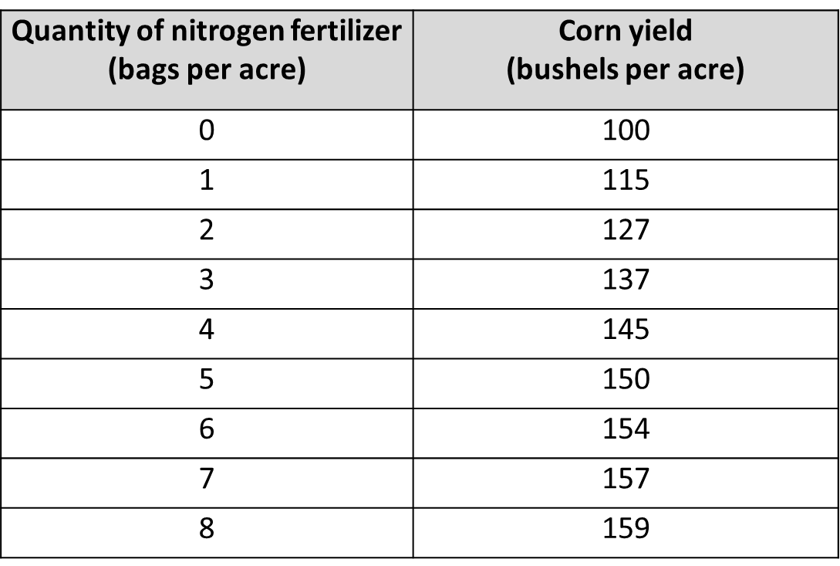
Table 5.2 Corn Production Function

Slide 4
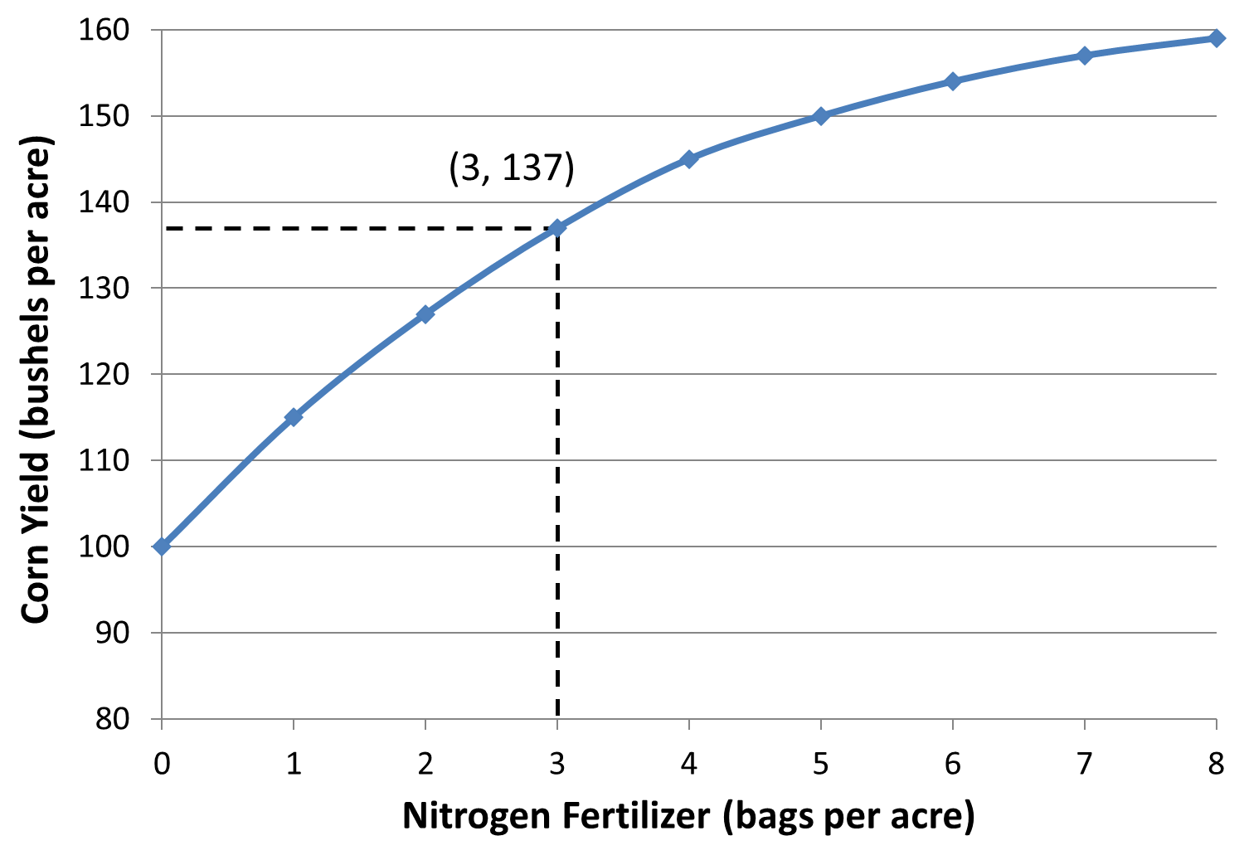
Figure 5.1 Corn Production Function

Slide 5
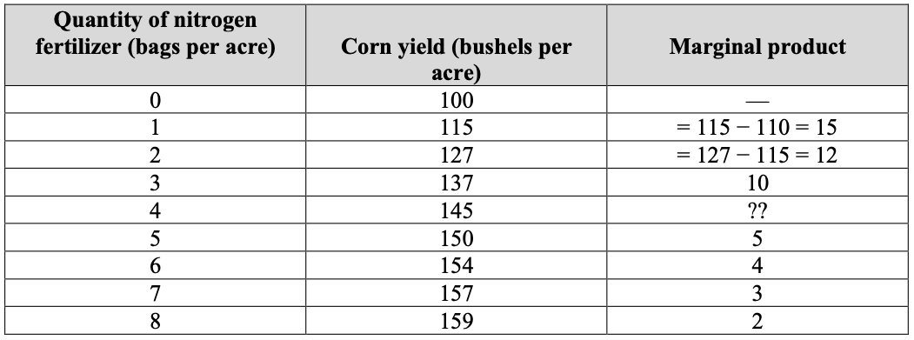
Table 5.3 Calculating Marginal Product

Slide 6
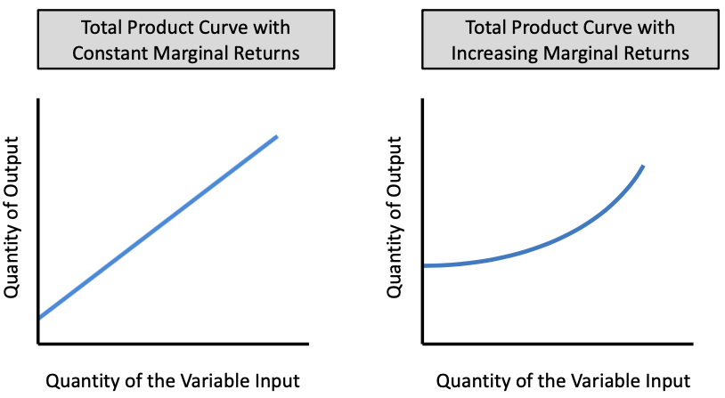
Figure 5.2 Total Product Curves with Constant and Increasing Marginal Returns

Slide 7
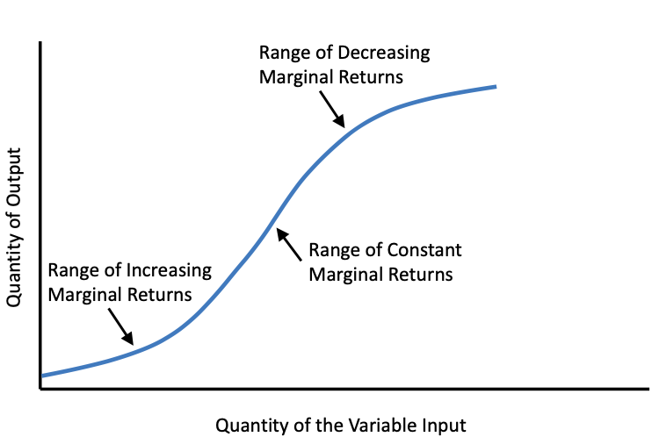
Figure 5.3 A Total Product Curve with Increasing, Constant, and Decreasing Marginal Returns

Slide 8
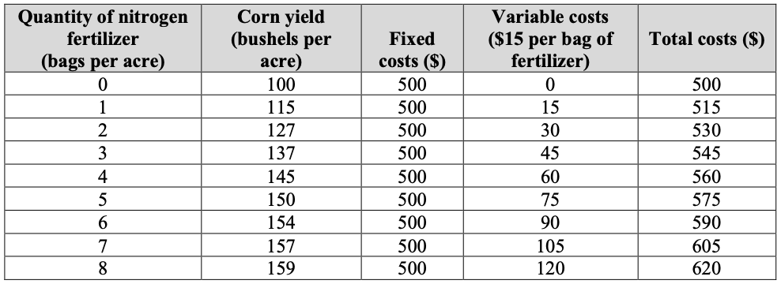
Table 5.4 Cost of Corn Production

Slide 9
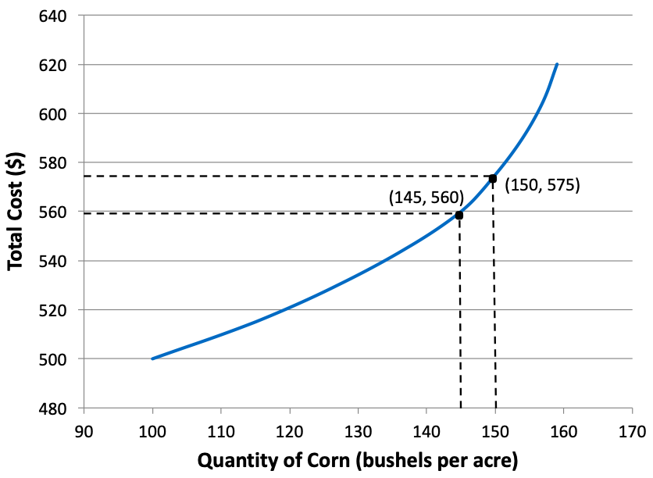
Figure 5.4 Total Cost Curve for Corn Production

Slide 10
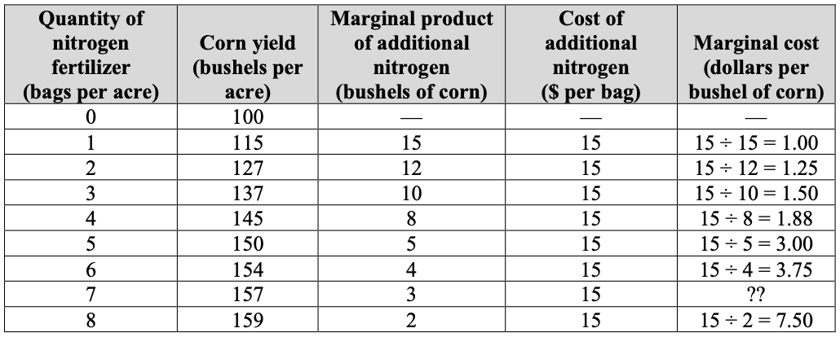
Table 5.5 Marginal Cost of Corn Production

Slide 11
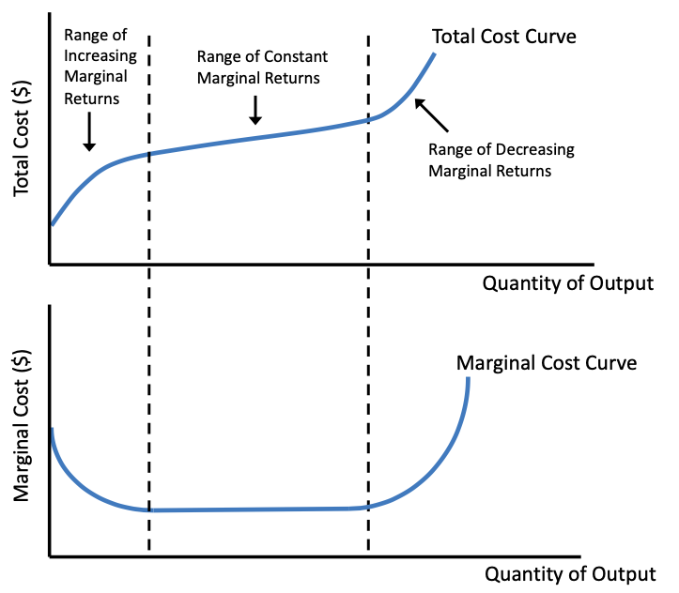
Figure 5.5 Relationship Between Total and Marginal Costs

Slide 12
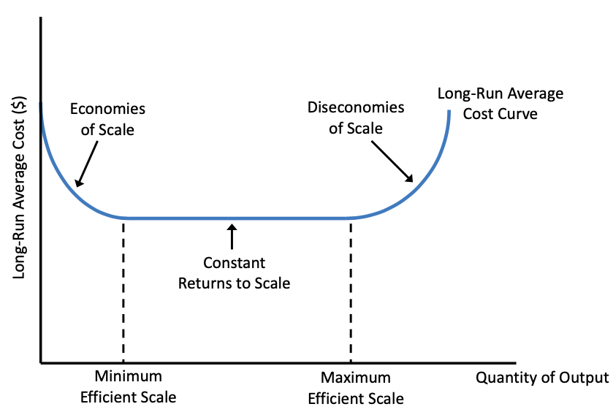
Figure 5.6 Long-Run Average Costs

