Slide 1

Chapter 16
Economics of the Environment

Slide 2
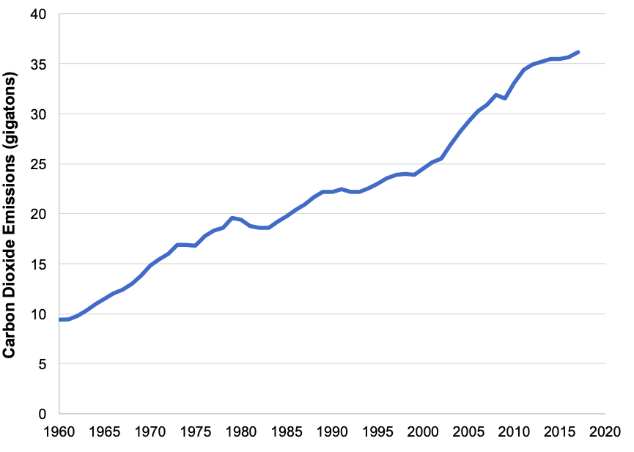
Figure 16.1 Key Global Trends, 1961-2017
Sources: World Bank, World Development Indicators; U.S. Energy Information Administration, International Energy Statistics; U.N. Food and Agriculture Organization, FAOSTAT; International Energy Agency, World Energy Balances; Organization of the Petroleum Exporting Countries, Annual Statistical Bulletin, 2018; BP, Statistical Review of World Energy, 2019.

Slide 3
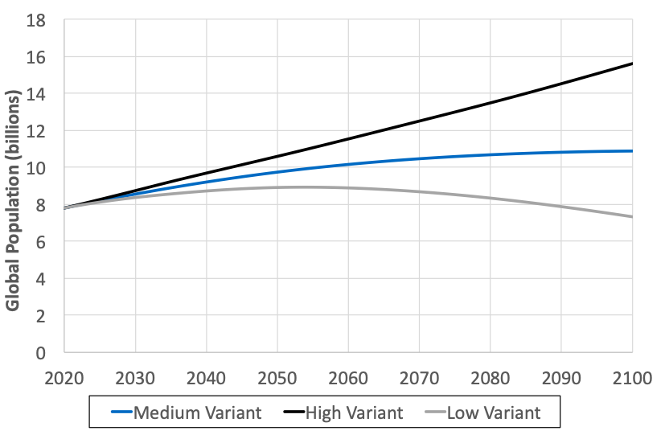
Figure 16.2 United Nations Global Population Projections, 2020-2100
Source: United Nations, World Population Prospects 2019.

Slide 4
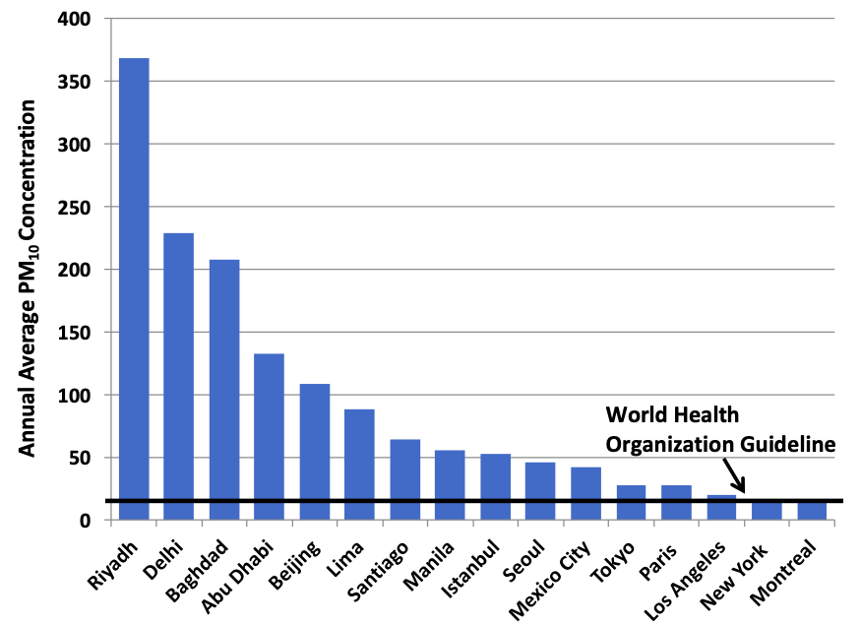
Figure 16.3 Average Particulate Matter Concentration, Selected Major Cities
Source: World Health Organization, Ambient Air Quality Database
Notes: Particulate matter concentrations in µg/m³; data year varies by city, from 2012 to 2015.

Slide 5
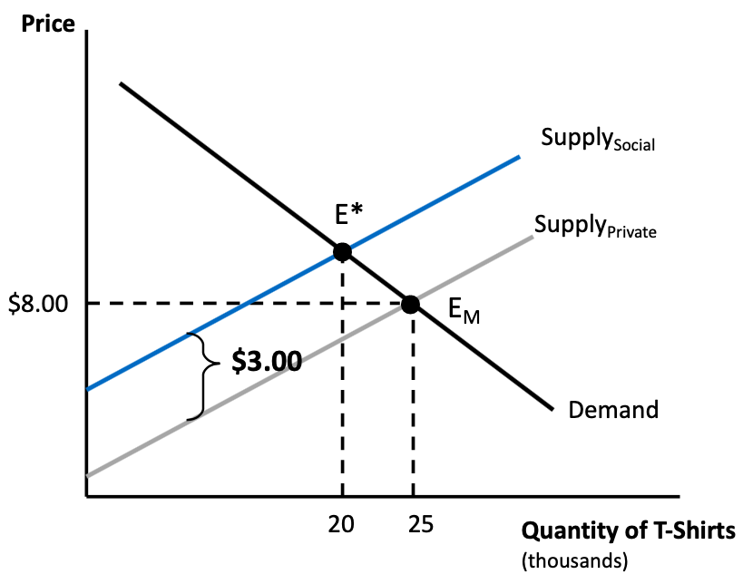
Figure 16.4 Analysis of Negative Externality

Slide 6
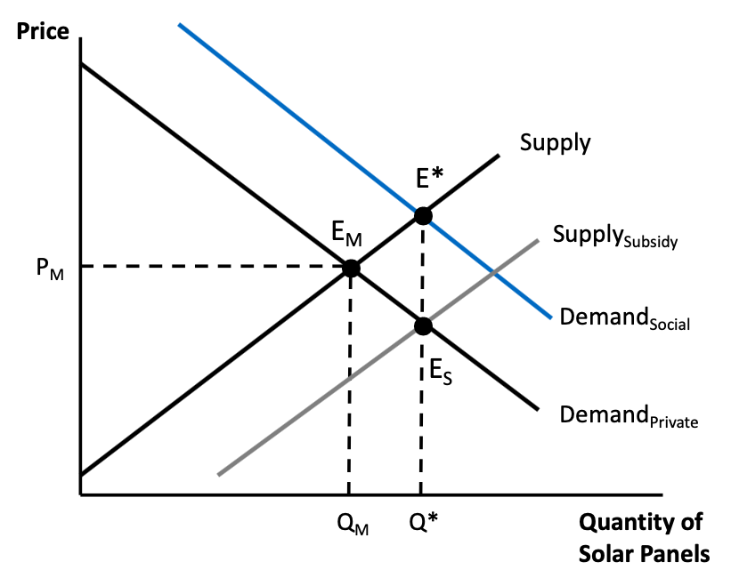
Figure 16.5 Analysis of a Positive Externality

Slide 7
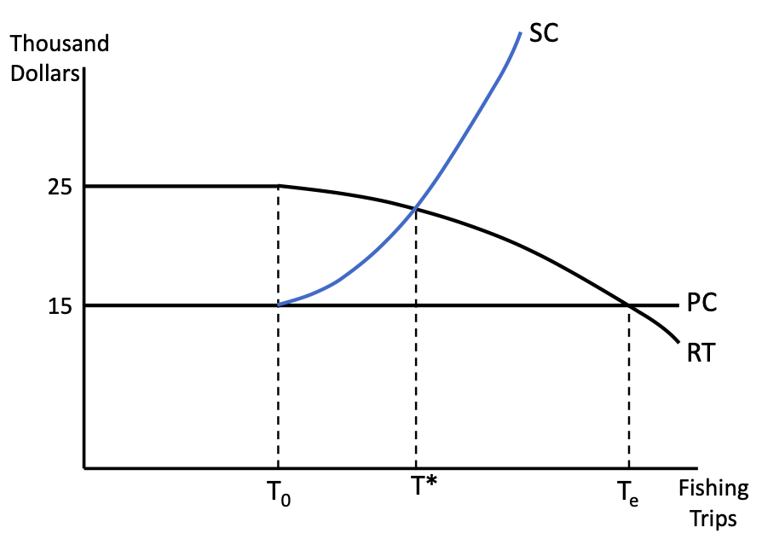
Figure 16.6 Common Property Model of a Fishery

Slide 8
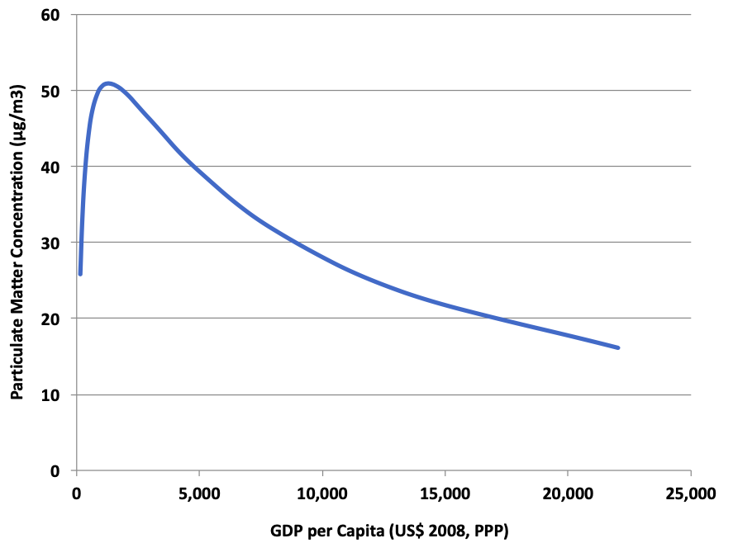
Figure 16.7 Environmental Kuznets Curve for Particulate Matter
Source: Mazurek, Jiří. 2011. “Environmental Kuznets Curve – A Tie between Environmental Quality and Economic Propsperity.” Ekonomie a Management, 14(4):22-31.

Slide 9
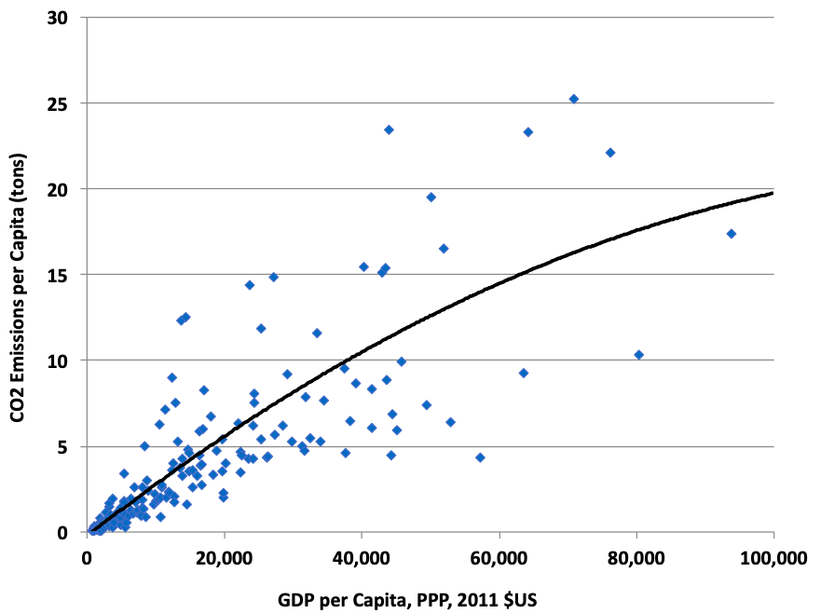
Figure 16.8 Relationship between Carbon Dioxide Emissions and GDP per Capita, 2014
Source: World Bank, World Development Indicators database

Slide 10
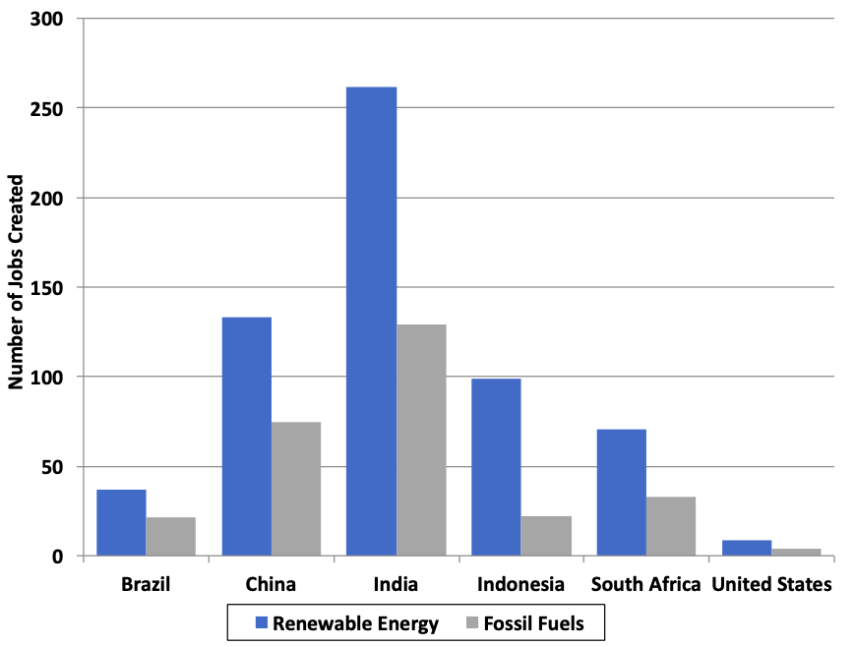
Figure 16.9 Jobs Created by Investing $1 Million in Clean Energy versus Fossil Fuels
Source: Pollin, Robert. 2015. Greening the Global Economy. MIT Press, Cambridge, MA.

Slide 11
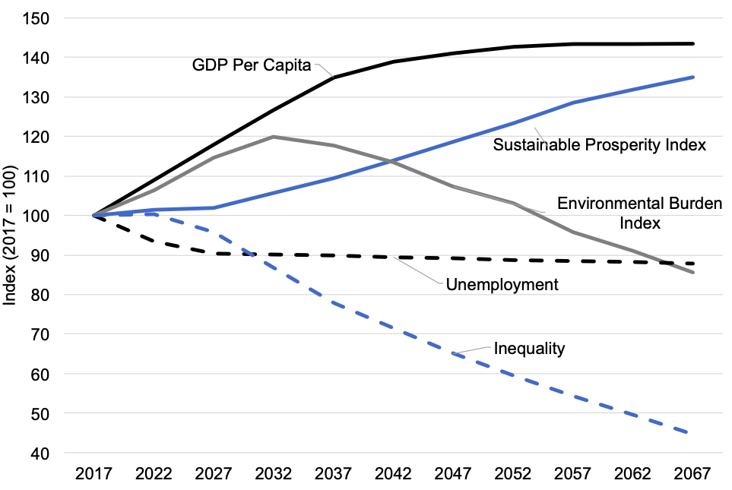
Figure 16.10 A No-Growth Scenario for the Canadian Economy
Source: Victor, Peter. 2019. Managing Without Growth, Slower by Design, not Disaster. Edward Elgar: Northampton, MA.

Slide 12
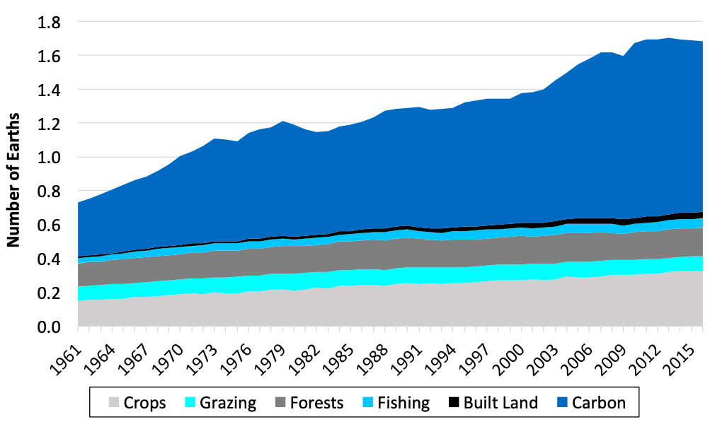
Figure 16.11 Global Ecological Footprint, by Impact Type, 1961-2016
Source: Global Footprint Network, NFA 2019 National Footprint and Biocapacity Accounts dataset

Slide 13
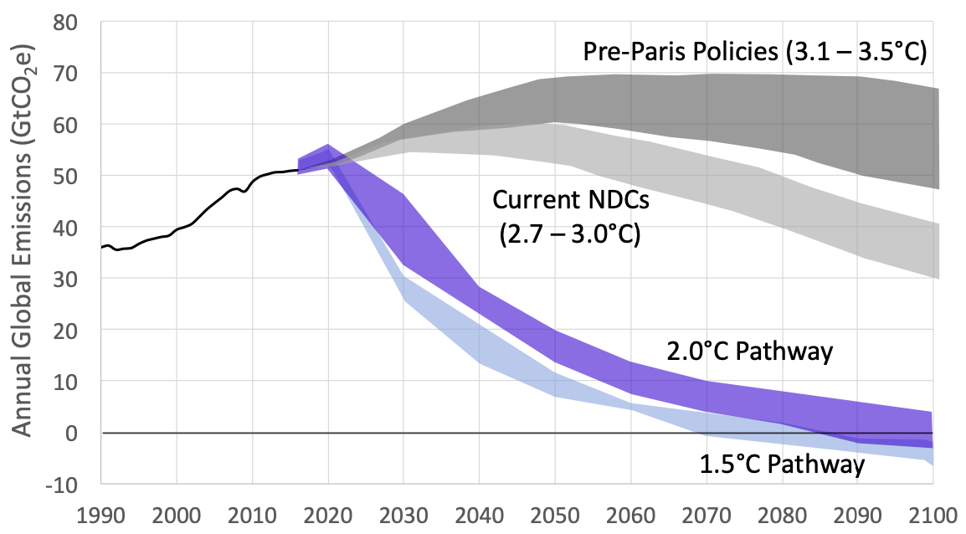
Figure 16.12 Global Greenhouse Gas Emissions under Alternative Scenarios
Source: Climate Action Tracker, https://climateactiontracker.org/global/temperatures/.
Note: GtCO₂e is gigatons of CO₂ equivalent, with all non-CO₂ greenhouse gases converted to an equivalent amount of CO₂ warming.

