Slide 1
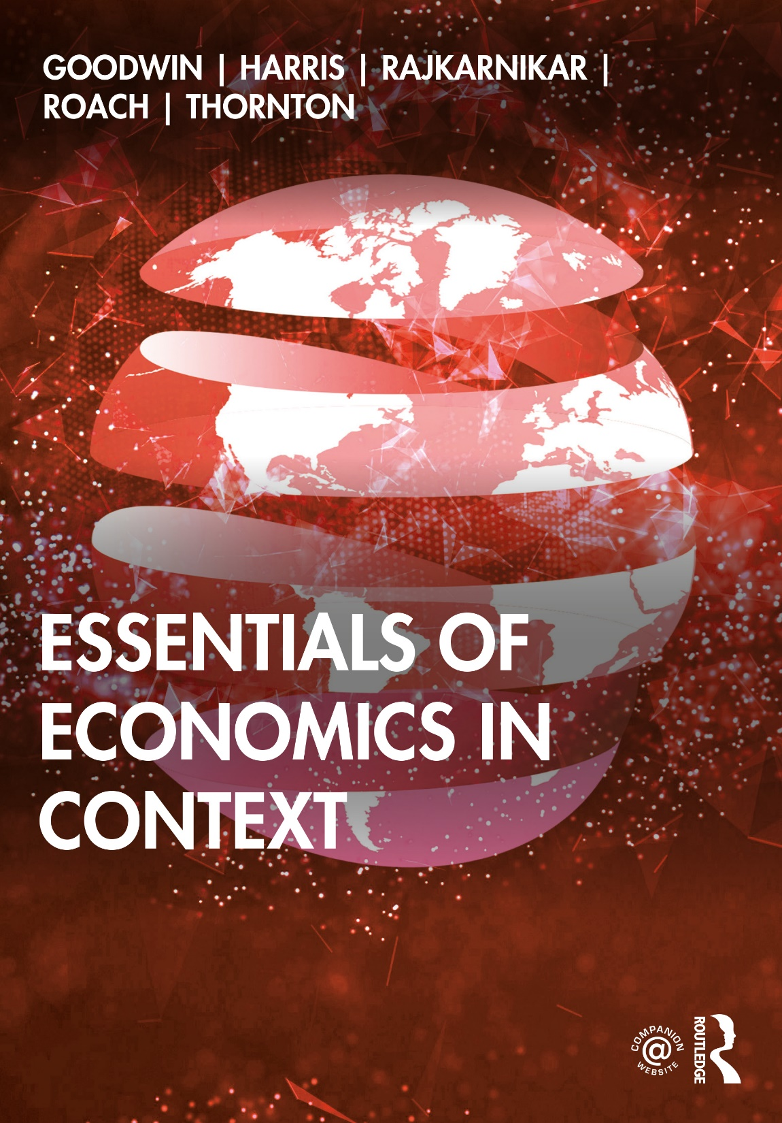
Chapter 15
How Economies Grow and Develop

Slide 2
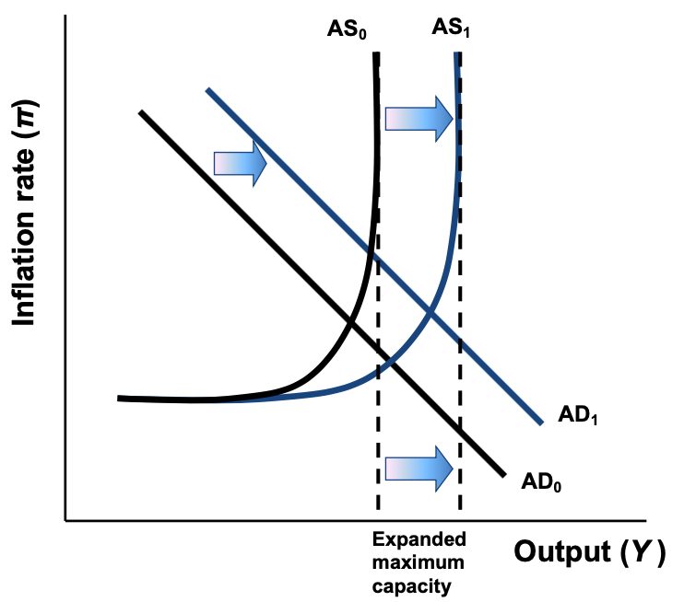
Figure 15.1 Economic Growth in the AS/AD Model

Slide 3
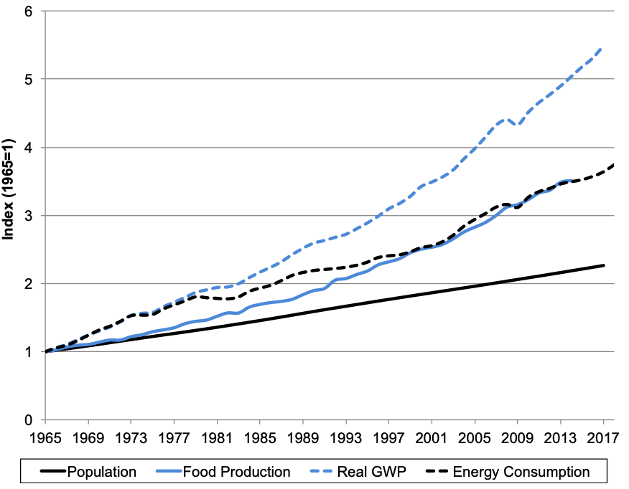
Figure 15.2 Global Growth in Population, Food Production, Economic Production, and Energy Consumption, 1965-2017
Sources: World Bank, World Development Indicators; BP, Statistical Review of World Energy 2018.
Notes: GWP is gross world product. Global food production index not available from 2015 to 2017.

Slide 4
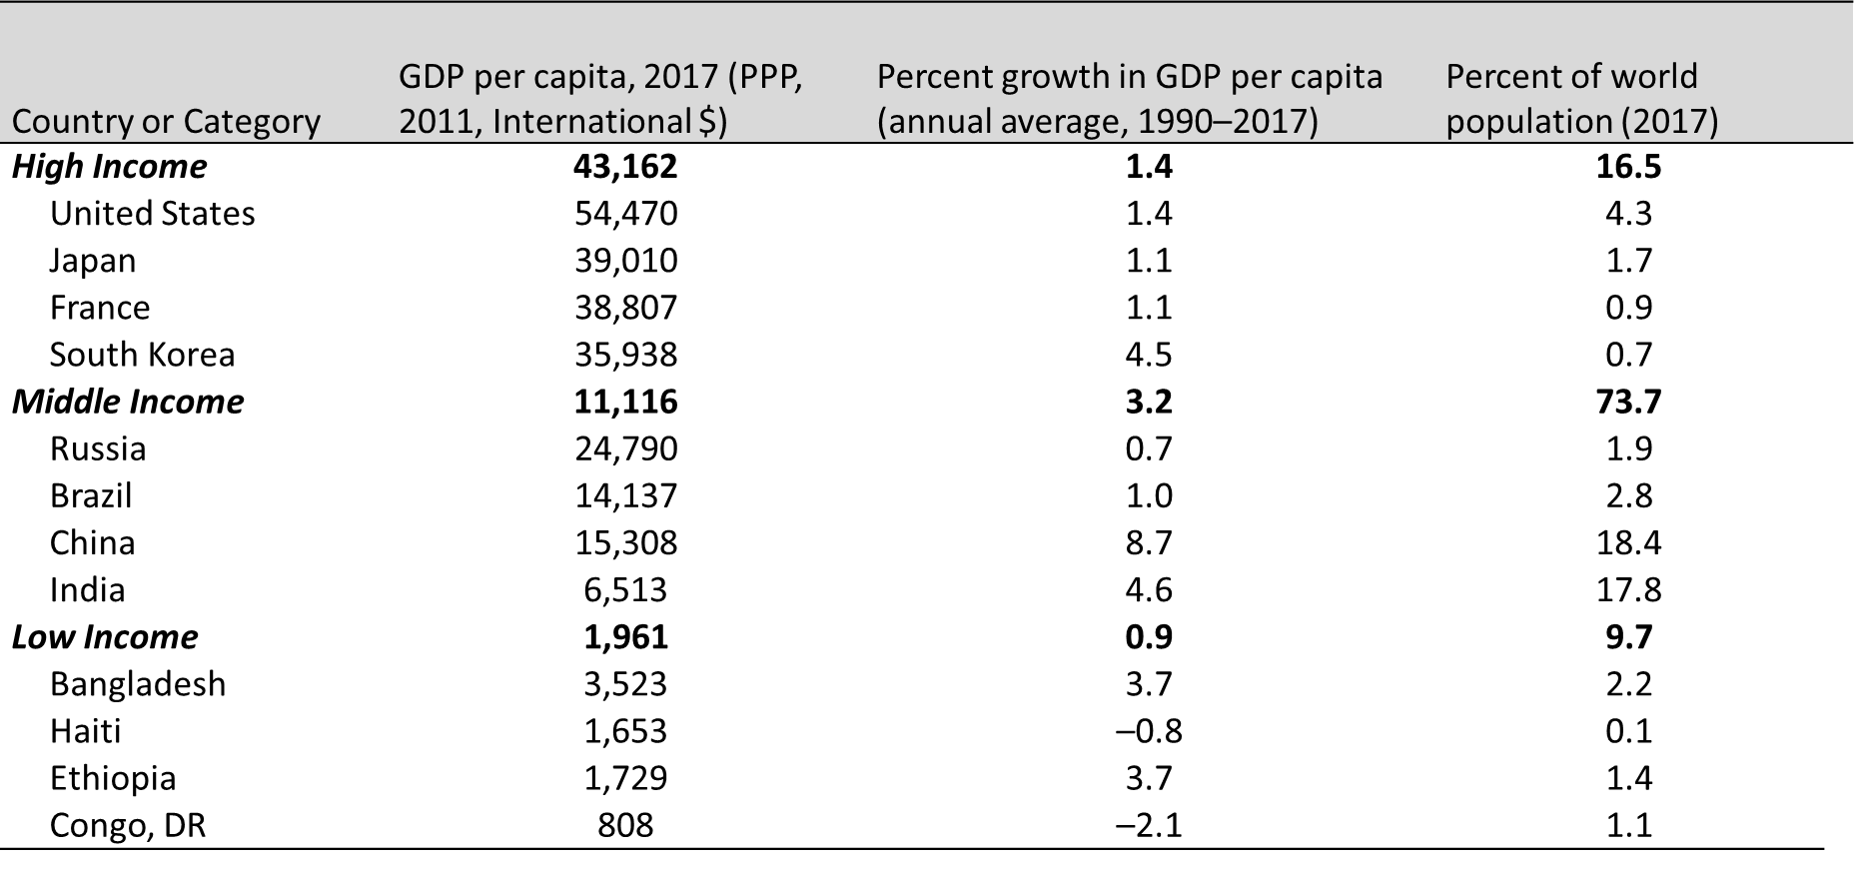
Table 15.1 Income, Growth, and Population Comparisons, Selected Countries and Country Groups
Source: World Bank, World Development Indicators Database, 2019.

Slide 5
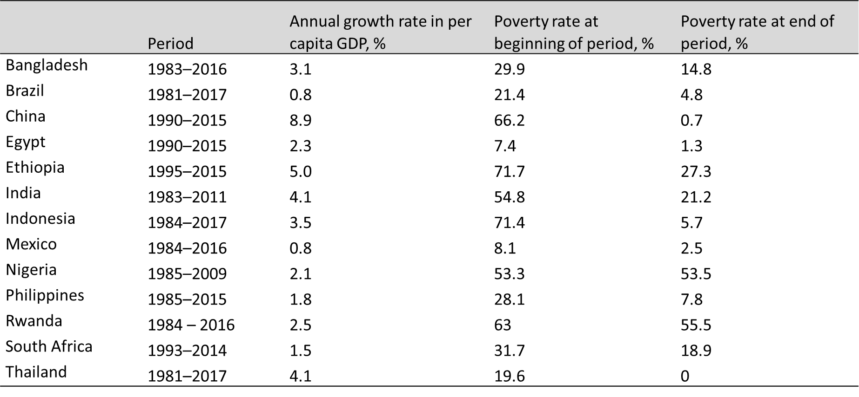
Table 15.2 Growth Rates and Changes in Poverty Rates, Select Countries
Source: World Bank, World Development Indicators Database, 2019.
Note: The poverty rate is based on a poverty line of $1.90 per day (2011 PPP).

Slide 6
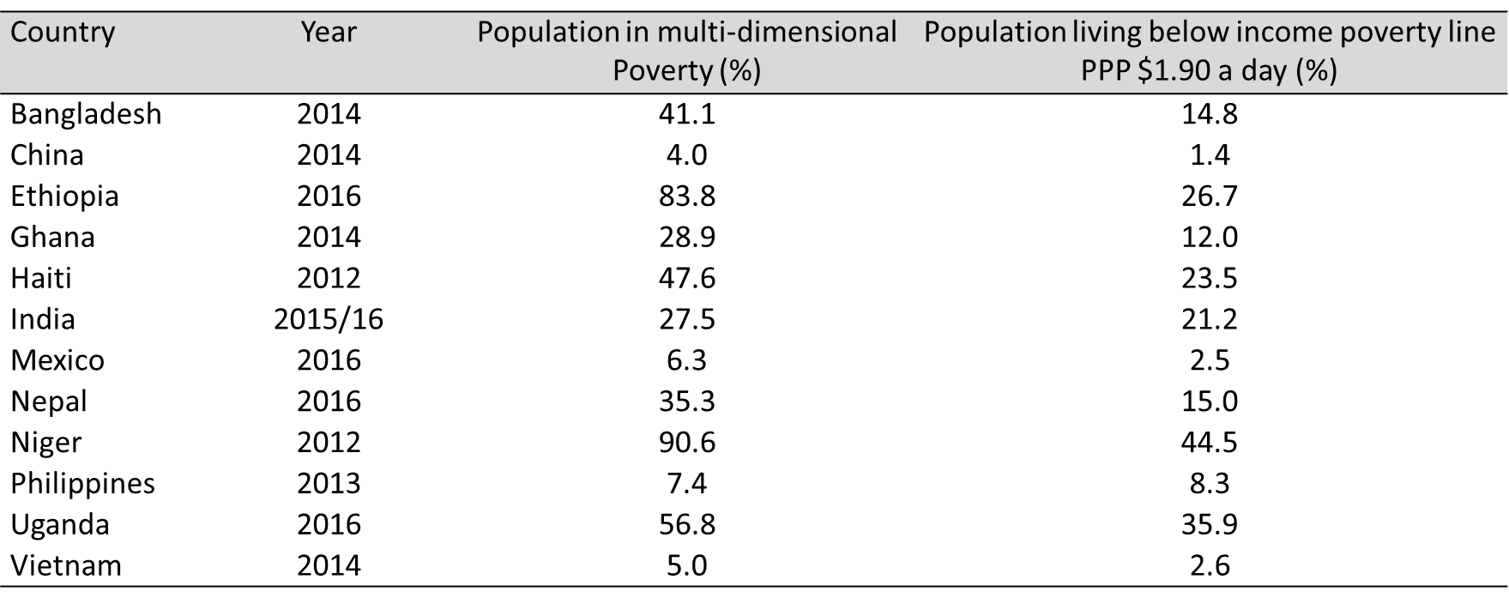
Table 15.3 Population in Multidimensional Poverty and Income Poverty
Source: Human Development Report, 2018.

Slide 7
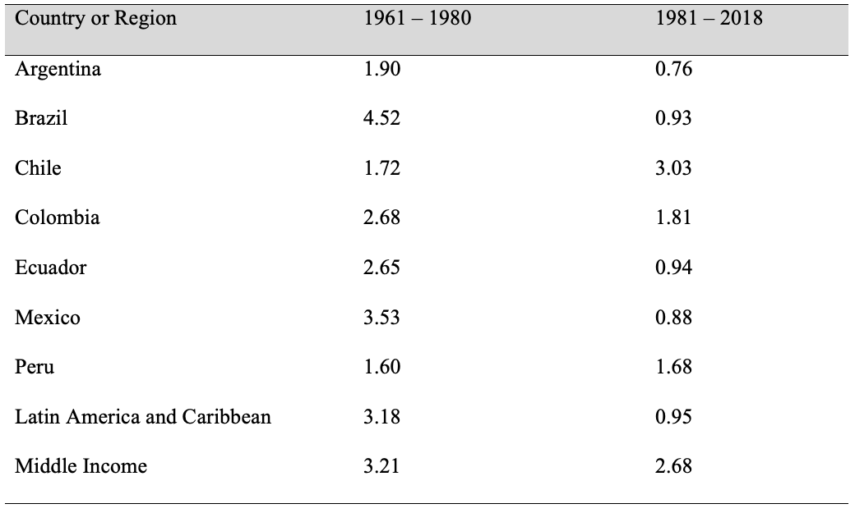
Table 15.4 Average Per Capita Annual Real GDP Growth, Select Latin American Countries, 1961-2018 (%)
Source: World Bank, World Development Indicators Database, 2019.

Slide 8
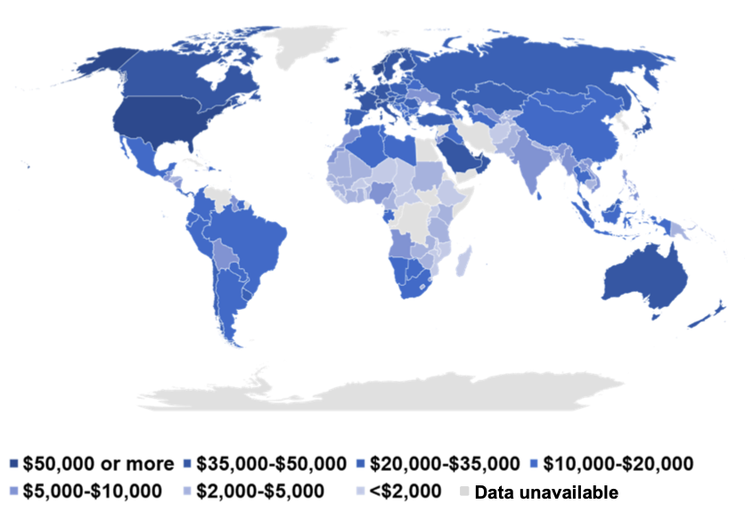
Figure 15.3 GDP per Capita in 2017 (in constant 2011 PPP $)
Source: World Bank, World Development Indicators Database, 2019.

Slide 9
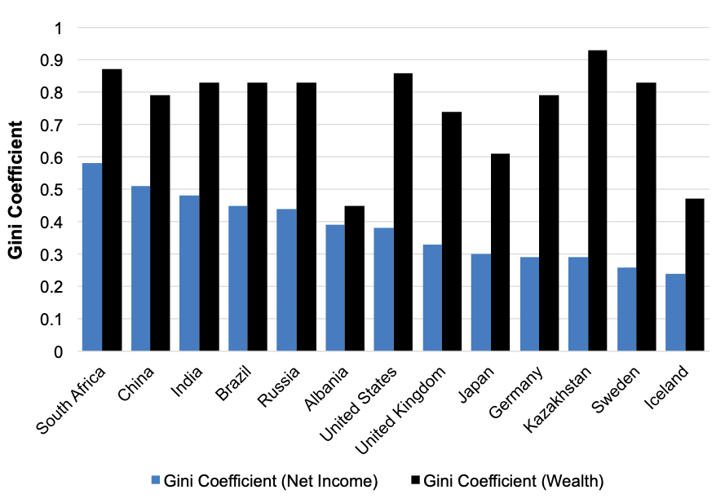
Figure 15.4 Gini Coefficient for Income and Wealth, Select Countries, 2018.
Source: The World Economic Forum’s Inclusive Development Index 2018.

Slide 10
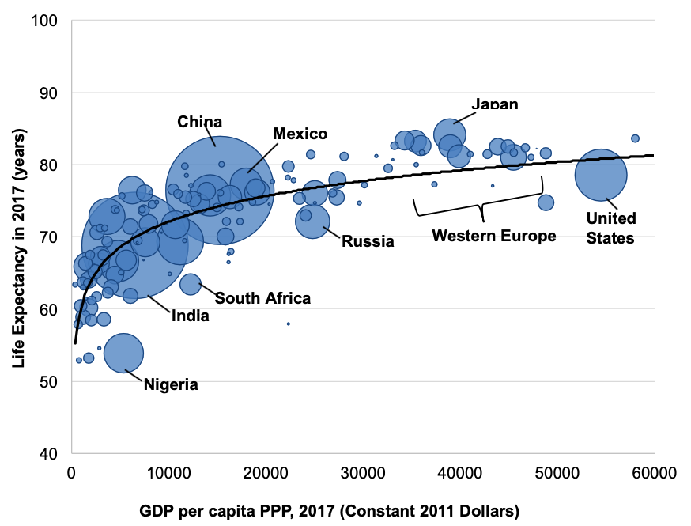
Figure 15.5 The Relation Between Life Expectancy and Income, with Area Proportional to Population, 2017
Source: World Bank, World Development Indicators Database, 2019.

