Slide 1

Chapter 13
Financial Instability and Economic Inequality

Slide 2
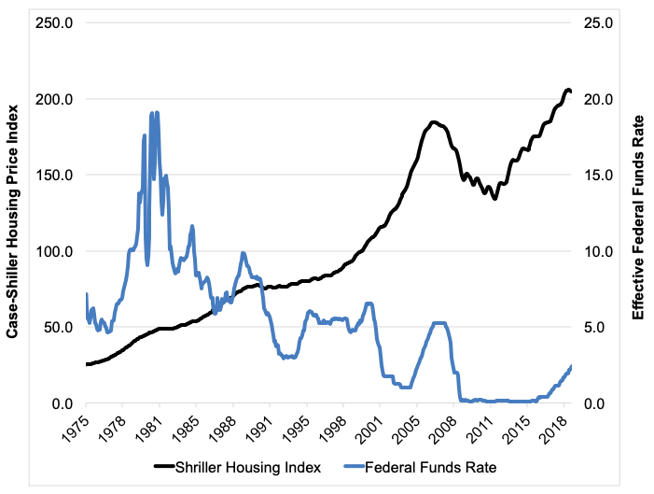
Figure 13.1 Housing Bubble and Credit Access, 1975 – 2019
Sources: Federal Reserve; Shiller dataset www.econ.yale.edu/~shiller/data.htm.

Slide 3
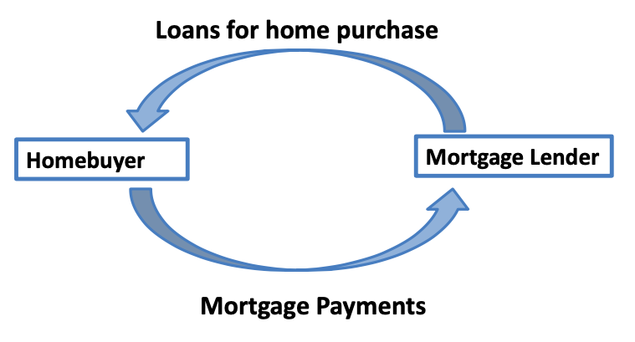
Figure 13.2 (a) Traditional Mortgage Lending Structure

Slide 4
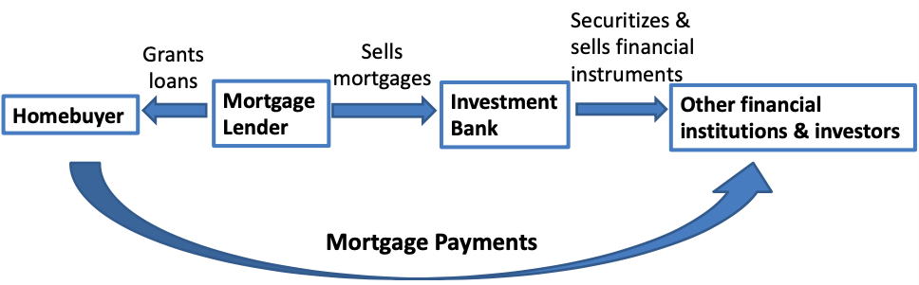
Figure 13.2 (b) Basic Structure of Securitized Mortgage Lending System

Slide 5
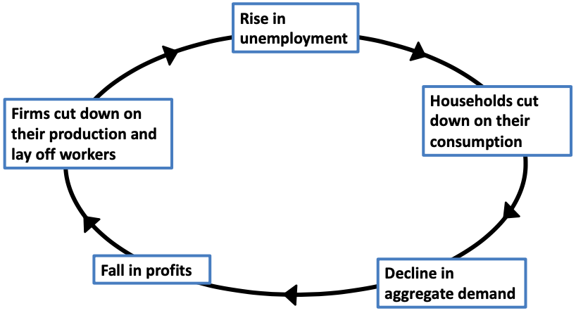
Figure 13.3 Vicious Cycle of Unemployment

Slide 6
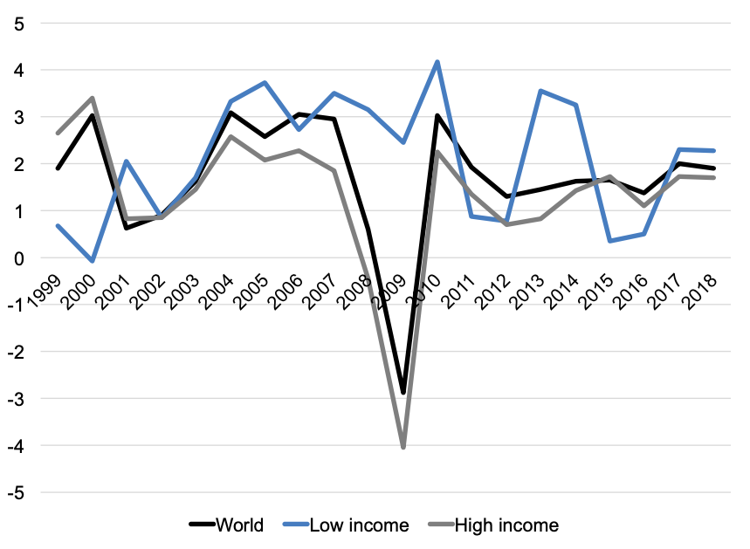
Figure 13.4 GDP per capita Growth Rates, 1999-2018
Source: World Development Indicators, World Bank

Slide 7
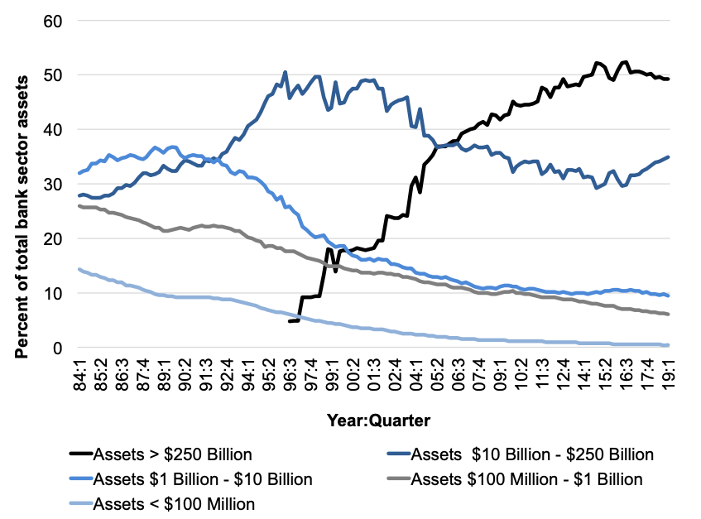
Figure 13.5 Increasing Bank Size
Source: Federal Deposit Insurance Corporation

Slide 8
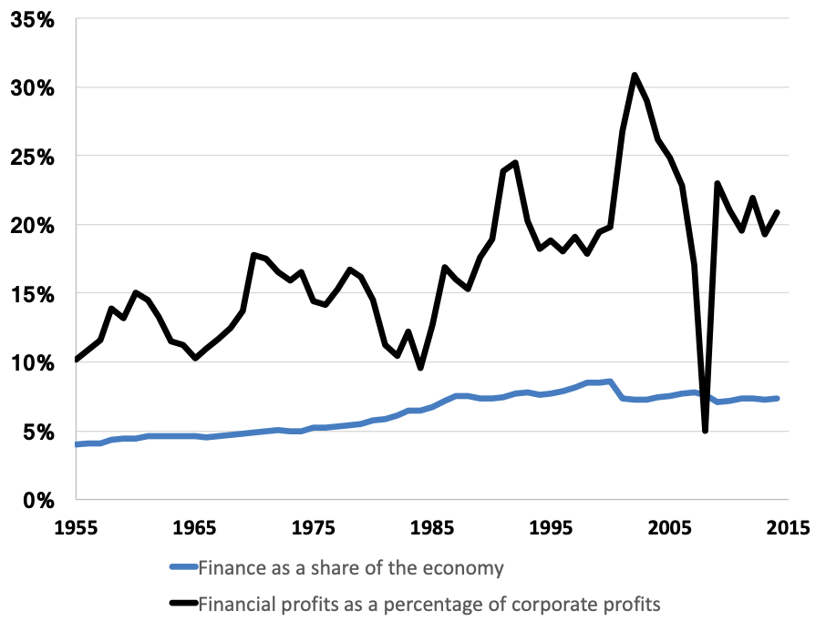
Figure 13.6 Finance as a Share of the Economy and Financial Profits as a Percentage of Corporate Profits
Source: U.S. Bureau of Economic Analysis, National Income and Product Accounts, Tables 6.2A-6.2D, and Thomas Piketty, Emmanuel Saez, and Gabriel Zucman. “Distributional National Accounts: Methods and Estimates for the United States,” Appendix tables II: Distributional series, National Bureau of Economic Research Working Paper Series, Working Paper 22945, December 2016.

Slide 9
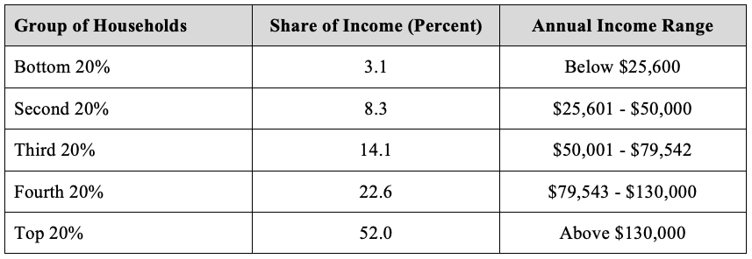
Table 13.1 Household Income Distribution in the United States, 2018
Source: U.S. Census Bureau, Historical Income Tables: Households, Tables H-1 and H-2.

Slide 10
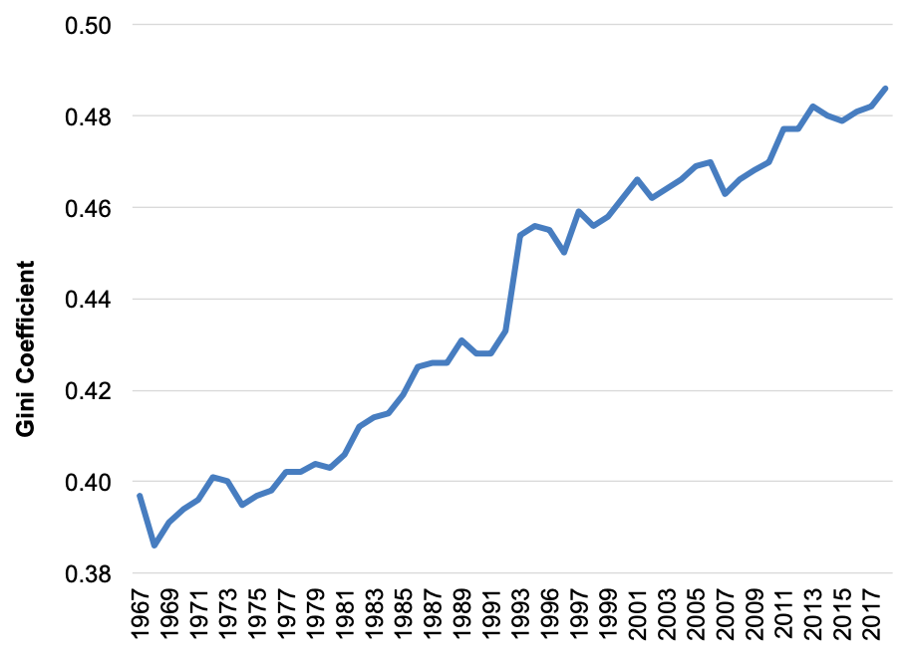
Figure 13.7 Gini Coefficient in the United States, 1967-2018
Source: U.S. Census Bureau, Historical Income Tables: Households, Table H-4.

Slide 11
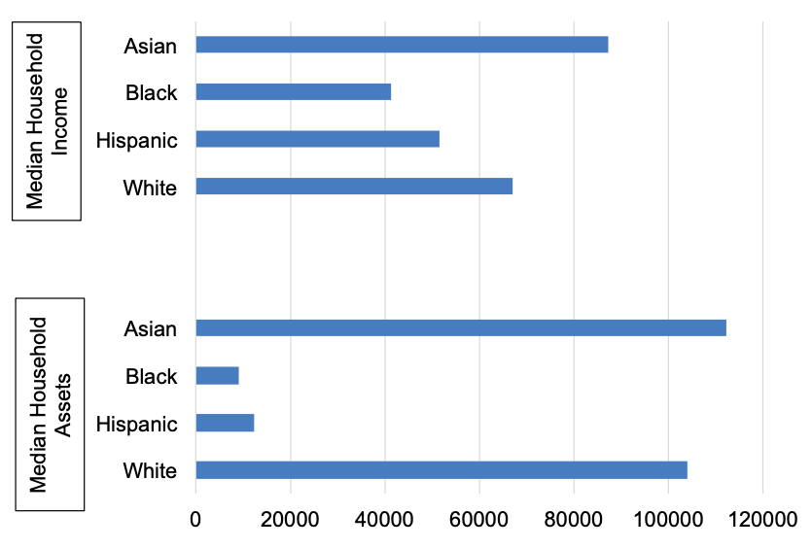
Figure 13.8 Median Household Income (2018) and Median Value of Household Assets (2016) in the United States by Race
Source: Bernadette D. Proctor, Jessica L. Semega, and Melissa A. Kollar. 2016, “Income and Poverty in the United States: 2015.” Current Population Reports, U.S. Census Bureau, September 2016. Table 1; U.S. Census Bureau, 2019.

Slide 12
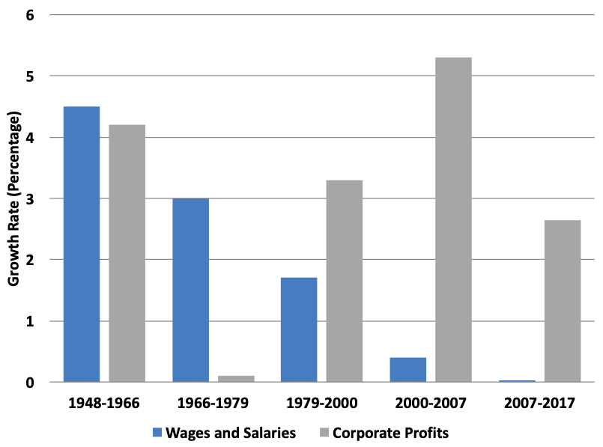
Figure 13.9 Annual Growth Rates of Wages and Salaries and Corporate Profit
Source: U.S. Bureau of Economic Analysis (2017) National Income and Product Accounts, Table 1.14, 1.1.4; Bureau of Labor Statistics (2017).

Slide 13
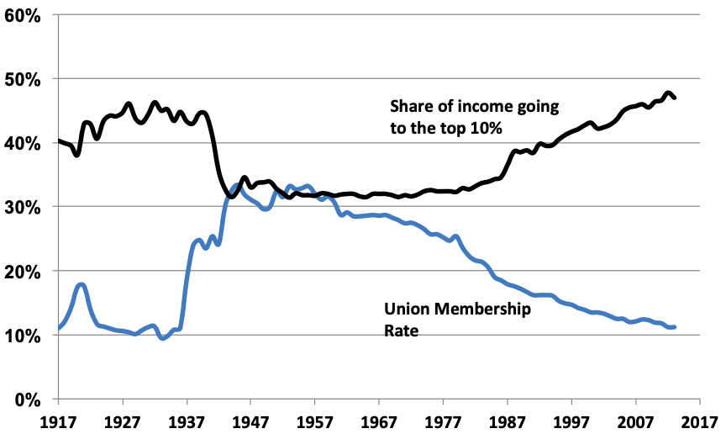
Figure 13.10 Union Membership and Income Inequality, 1917 – 2017

Slide 14
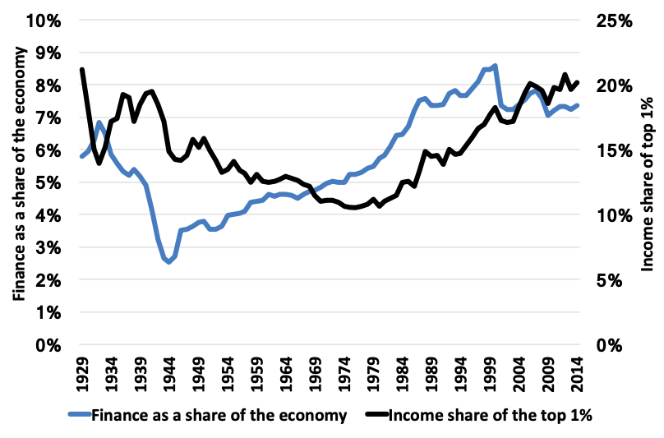
Figure 13.11 Financialization and Inequality, 1929-2014
Source: U.S. Bureau of Economic Analysis, National Income and Product Accounts, Tables 6.2A-6.2D, BEA; Thomas Piketty, Emmanuel Saez, and Gabriel Zucman. 2016. “Distributional National Accounts: Methods and Estimates for the United States.” National Bureau of Economic Research Working Paper Series, Working Paper 22945, December 2016.

Slide 15
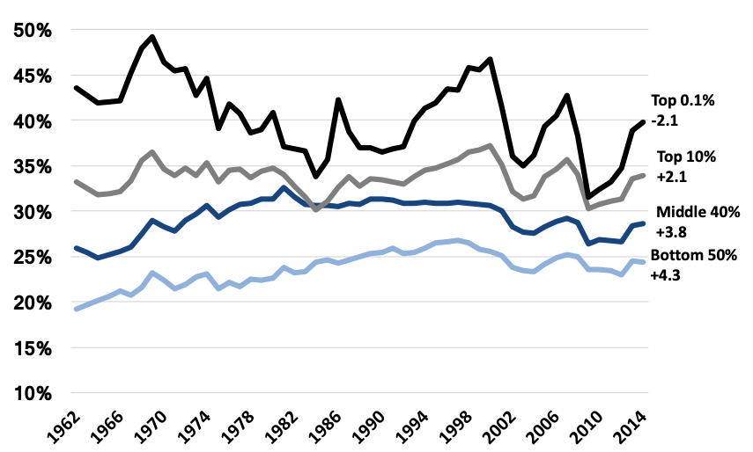
Figure 13.12 Change in Tax Rates by Income Group
Source: Thomas, Piketty, Emmanuel Saez, and Gabriel Zucman. 2016. “Distributional National Accounts: Methods and Estimates for the United States.” National Bureau of Economic Research Working Paper Series, Working Paper 22945, December 2016.

