Slide 1

Chapter 11
Money and Monetary Policy

Slide 2
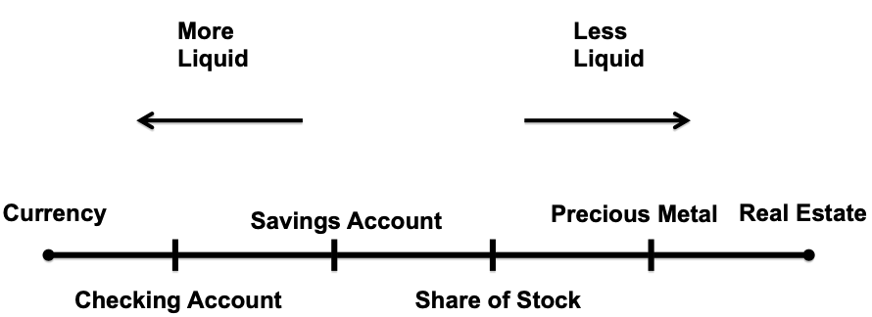
Figure 11.1 The Liquidity Continuum

Slide 3
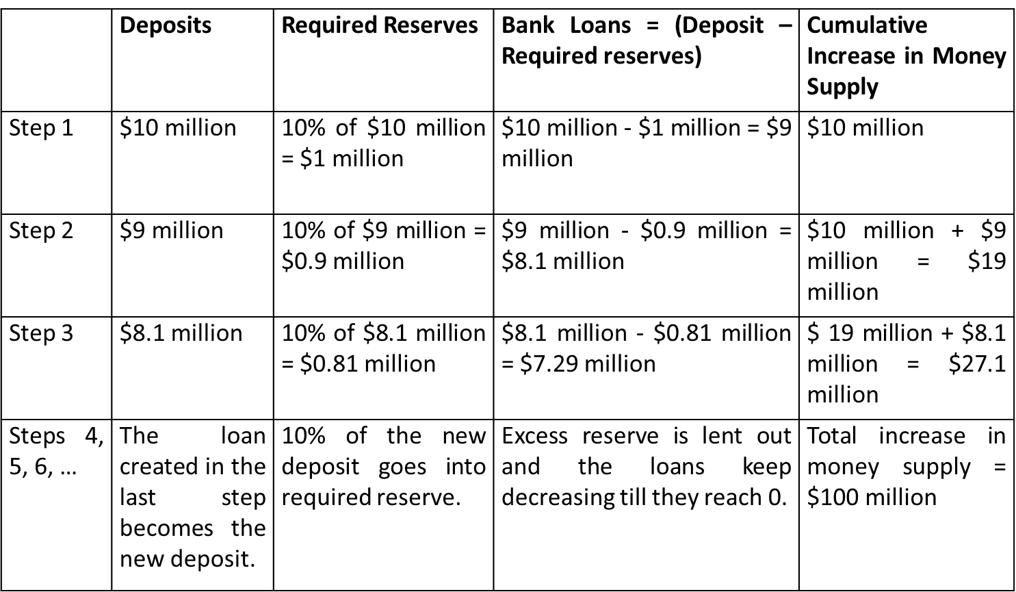
Table 11.1 Money Multiplier Effect

Slide 4
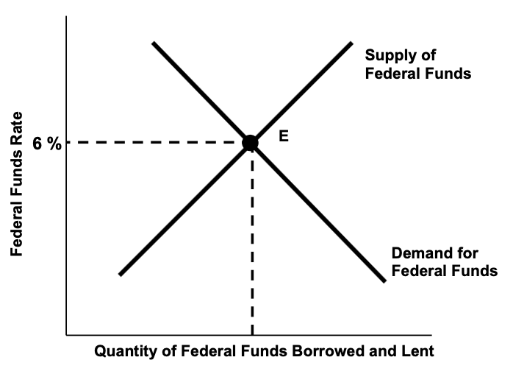
Figure 11.2a The Market for Federal Funds

Slide 5
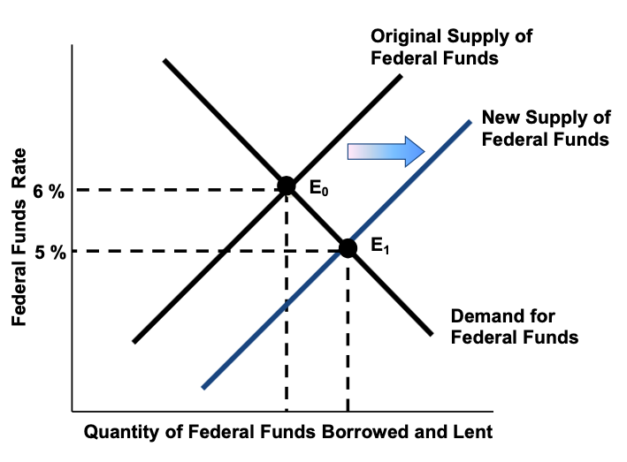
Figure 11.2b An Open Market Purchase Lowers the Federal Funds Rate

Slide 6
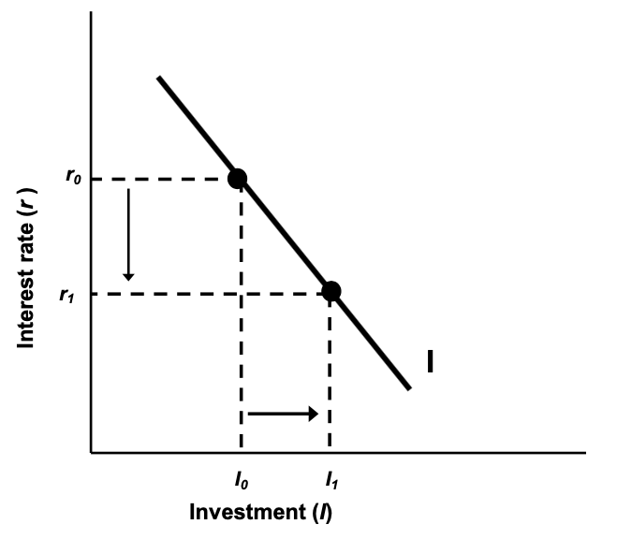
Figure 11.3 The Investment Schedule

Slide 7
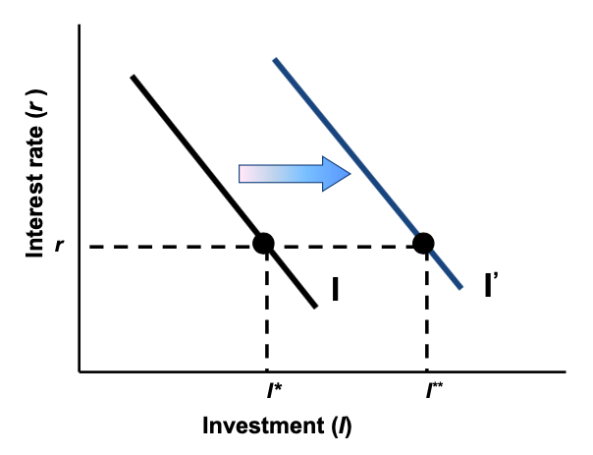
Figure 11.4 An Increase in Investor Confidence

Slide 8
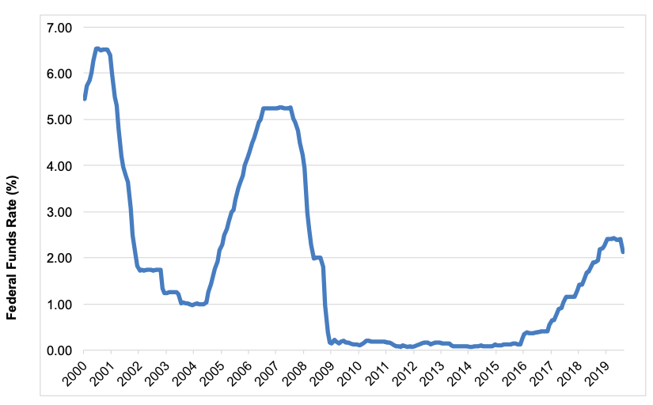
Figure 11.5 Monetary Policy, 2000–2019
Source: Federal Reserve and Bureau of Economic Analysis, 2019.

