Slide 1

Chapter 10
Fiscal Policy

Slide 2
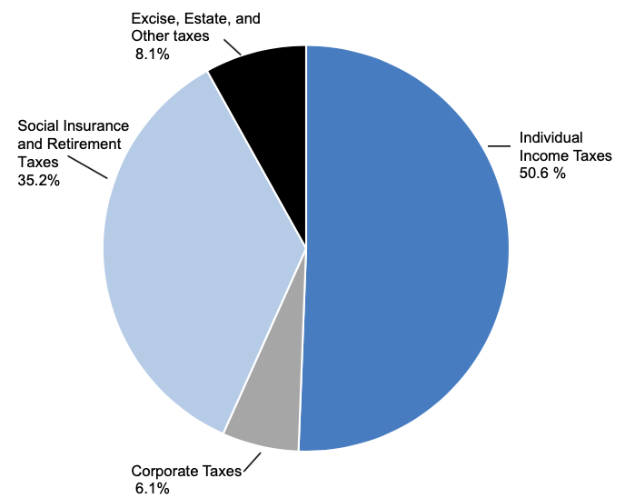
Figure 10.1 (a) United States Government Source of Funds, Fiscal Year 2018
Source: Economic Report of the President, 2019. Table 2.2.

Slide 3
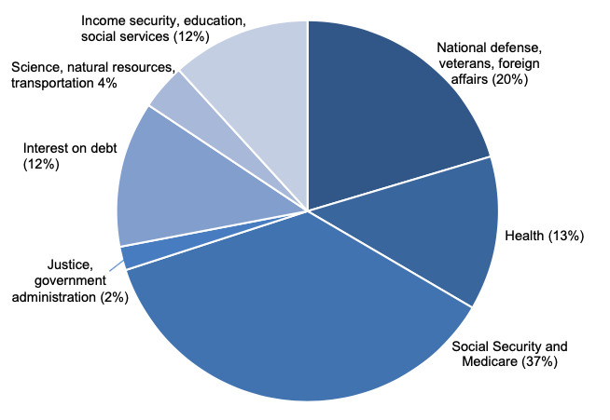
Figure 10.1 (b) United States Government Source of Outlays, Fiscal Year 2018
Source: Economic Report of the President, 2019. Table 3.2.

Slide 4
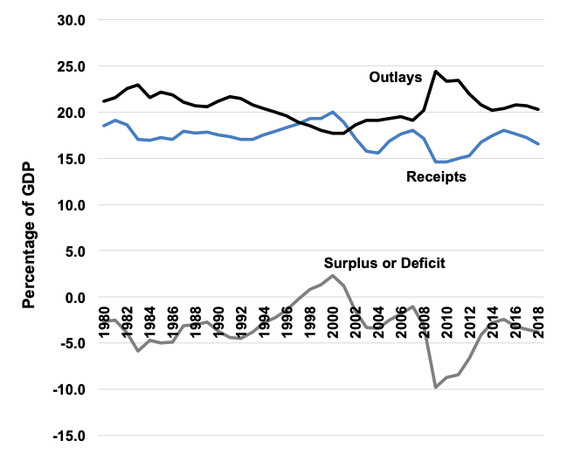
Figure 10.2 Federal Outlays, Receipts, and Surplus/Deficit, as a Percent of GDP, 1980–2018
Source: Economic Report of the President, 2019.

Slide 5
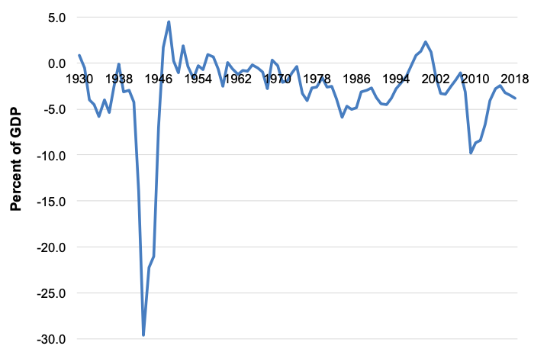
Figure 10.3 Federal Surplus or Deficit as a Percent of GDP, 1930-2018.

Slide 6
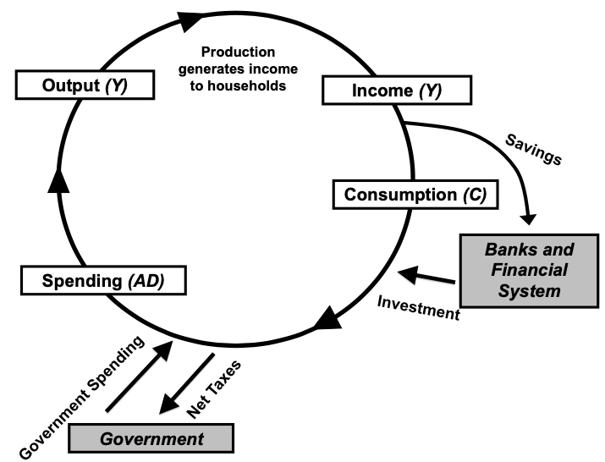
Figure 10.4 A Macroeconomic Model with Government Spending and Taxes

Slide 7
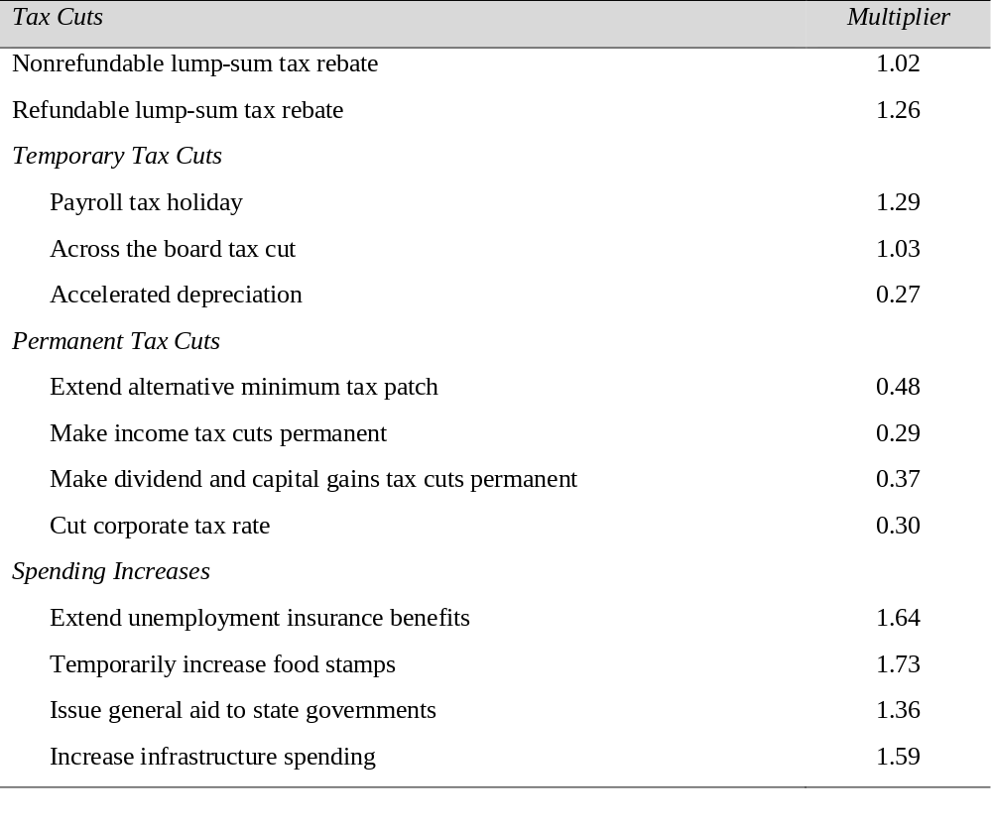
Table 10.1 Different Multiplier Effects
Source: M. Zandi, “The Economic Impact of the American Recovery and Reinvestment Act,” Moody’s Economy.com, 2009.

Slide 8
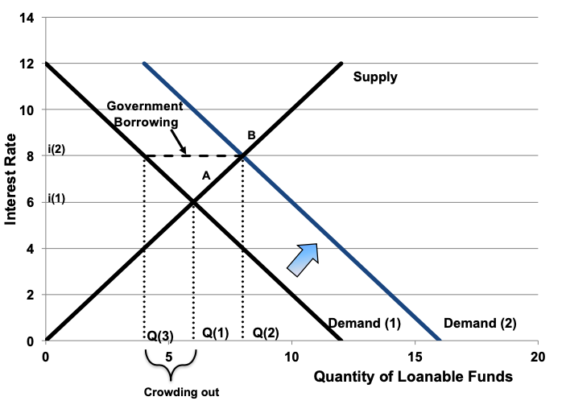
Figure 10.5 Crowding Out in the Loanable Funds Market
Source: St. Louis Federal Reserve Bank

Slide 9
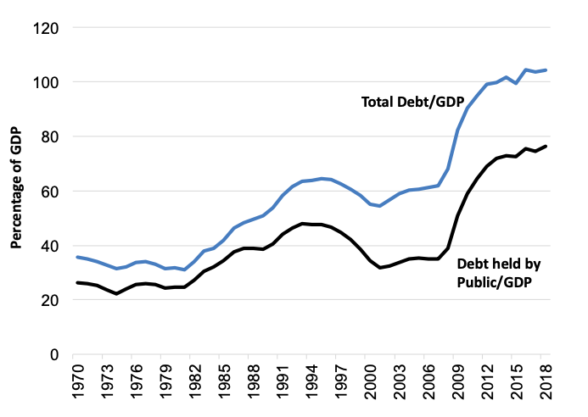
Figure 10.6 U.S. National Debt as a Percentage of GDP, 1970-2018
Source: Treasury Department, 2016, Tables OFS-1; Distribution of Federal Securities by Class of Investors and Type of Issues, Table OFS-2; Estimated Ownership of US Treasury Securities and Table.

Slide 10
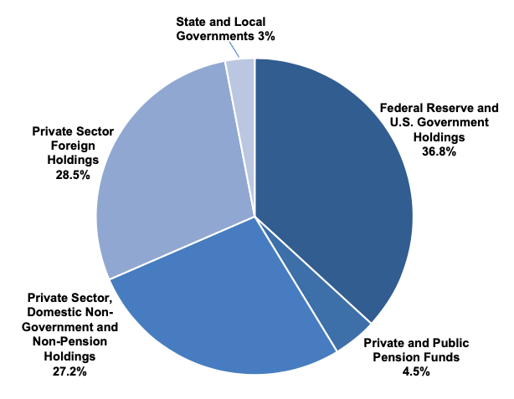
Figure 10.7 Ownership of Gross Federal Debt, 2016
Source: St. Louis Federal Reserve Bank

Slide 11
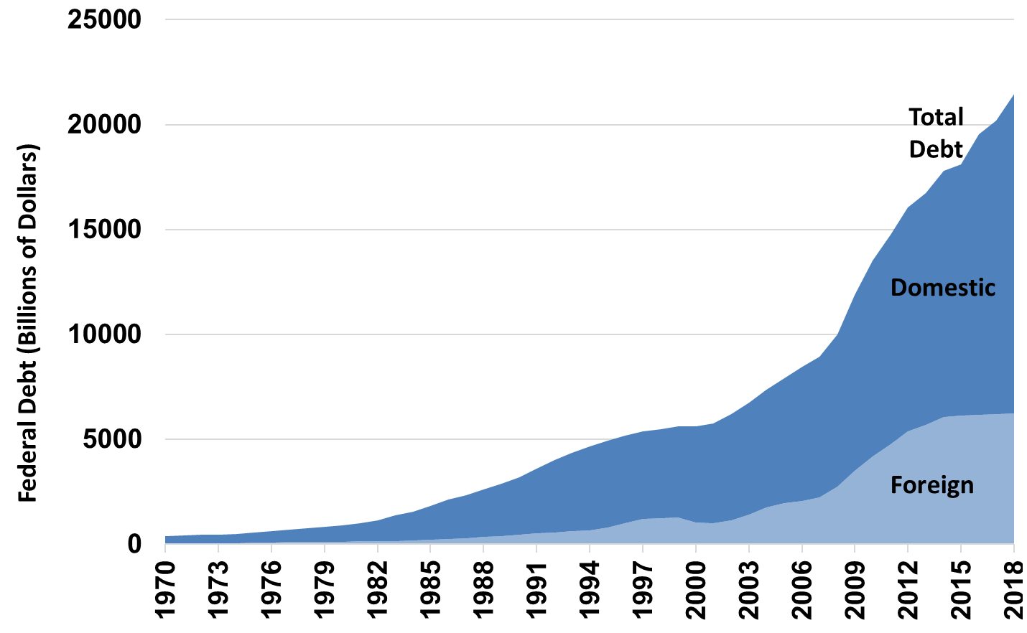
Figure 10.8 Domestic and Foreign Ownership of U.S. Debt (billions of dollars), 1970-2018
Source: St. Louis Federal Reserve Bank

