Slide 1
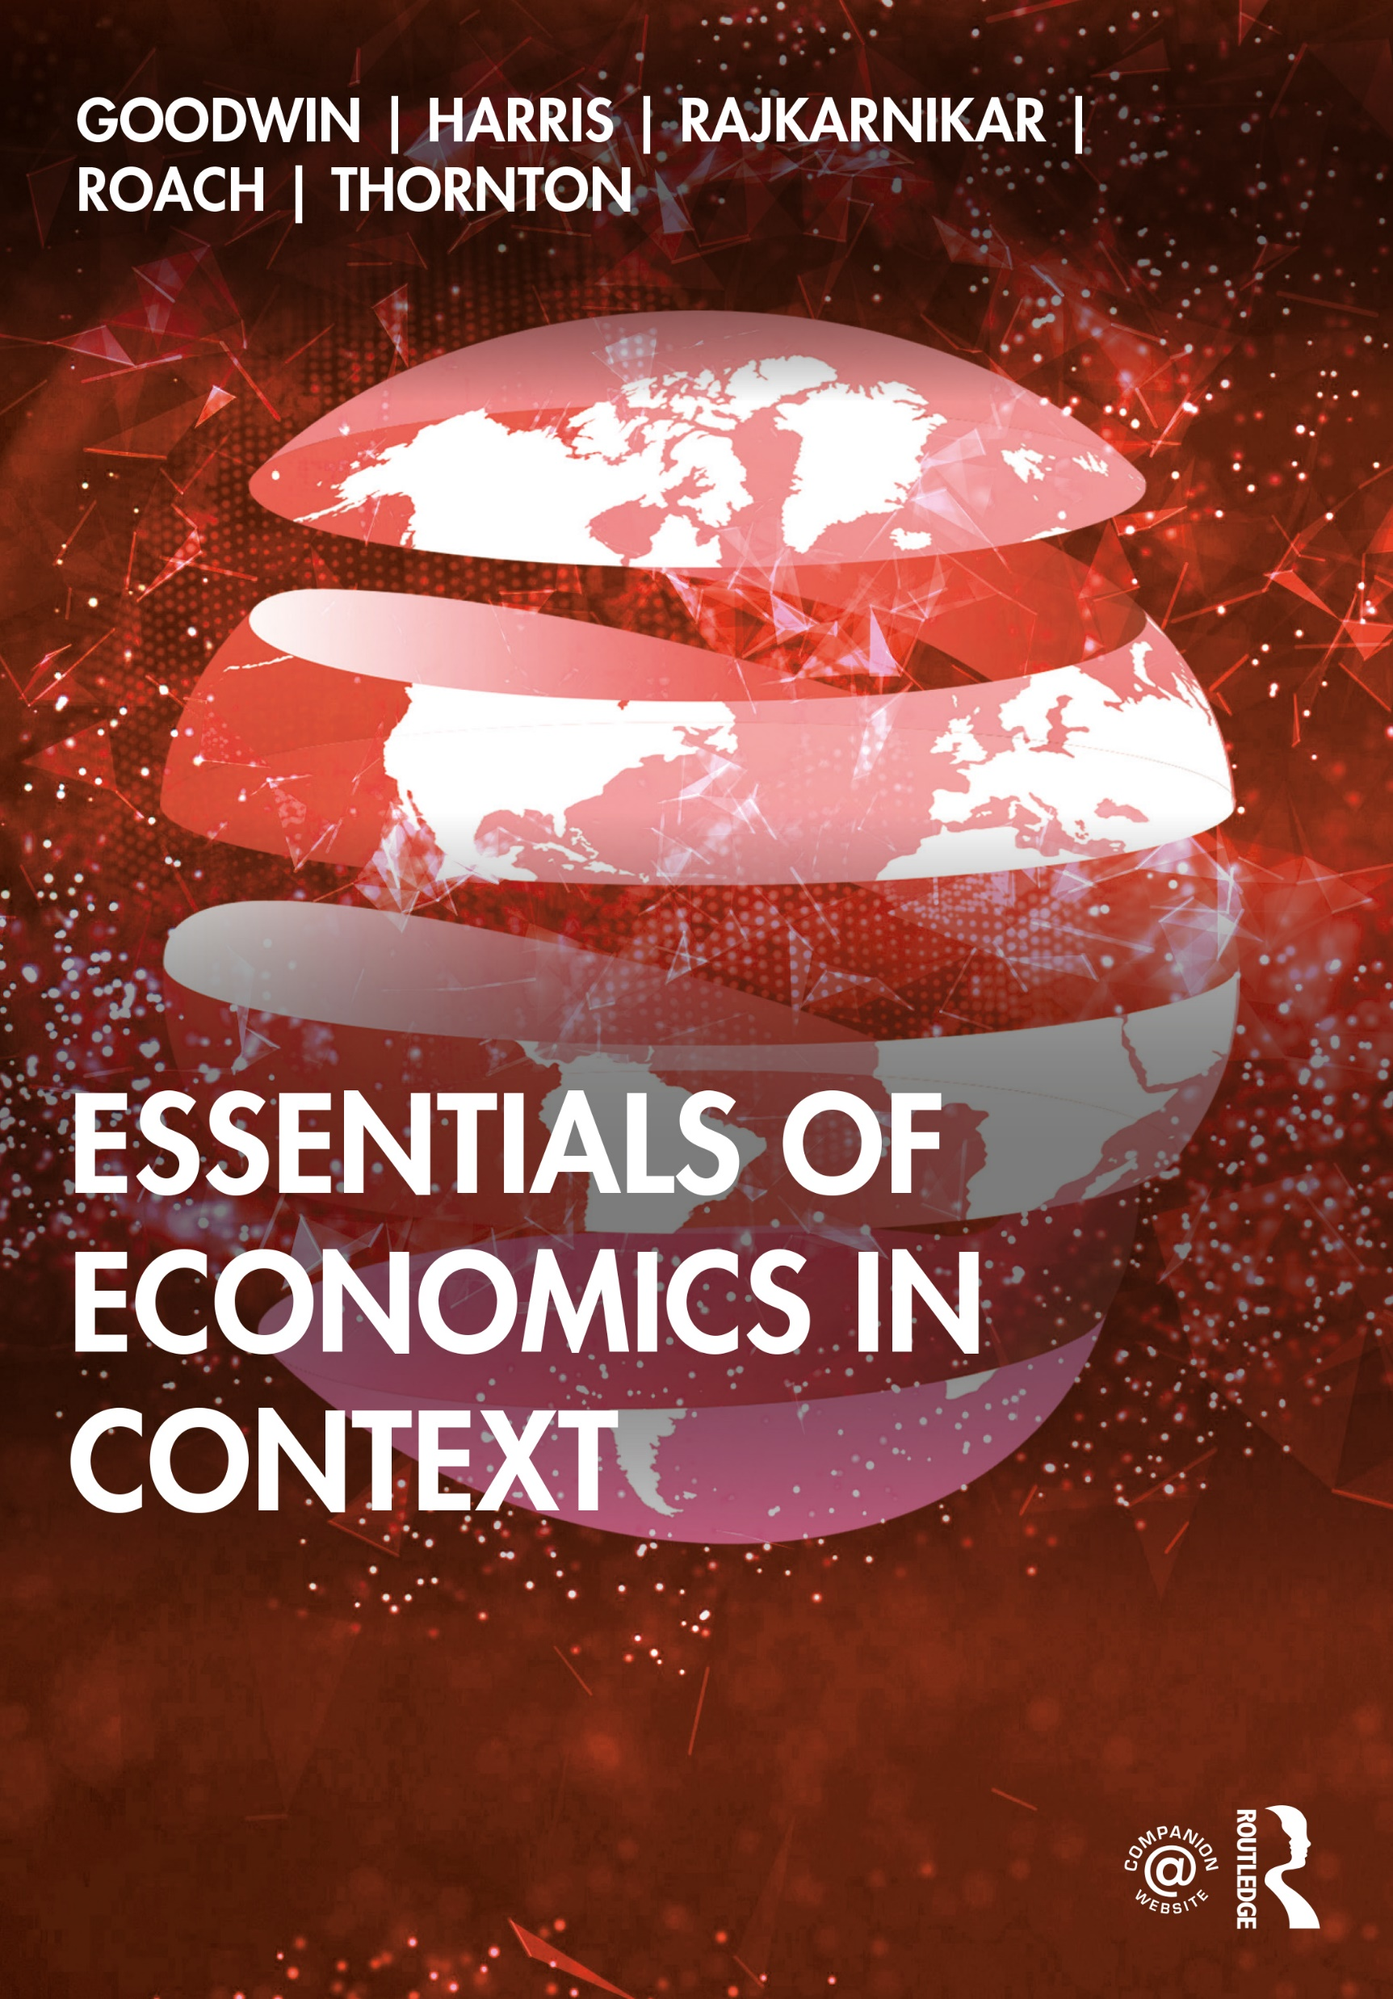
Chapter 1
Economic Activity in Context

Slide 2
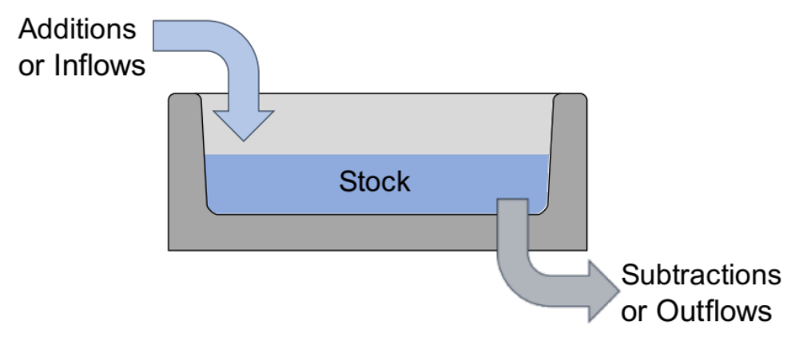
Figure 1.1 “Bathtub”-Style Stock Flow Diagram

Slide 3
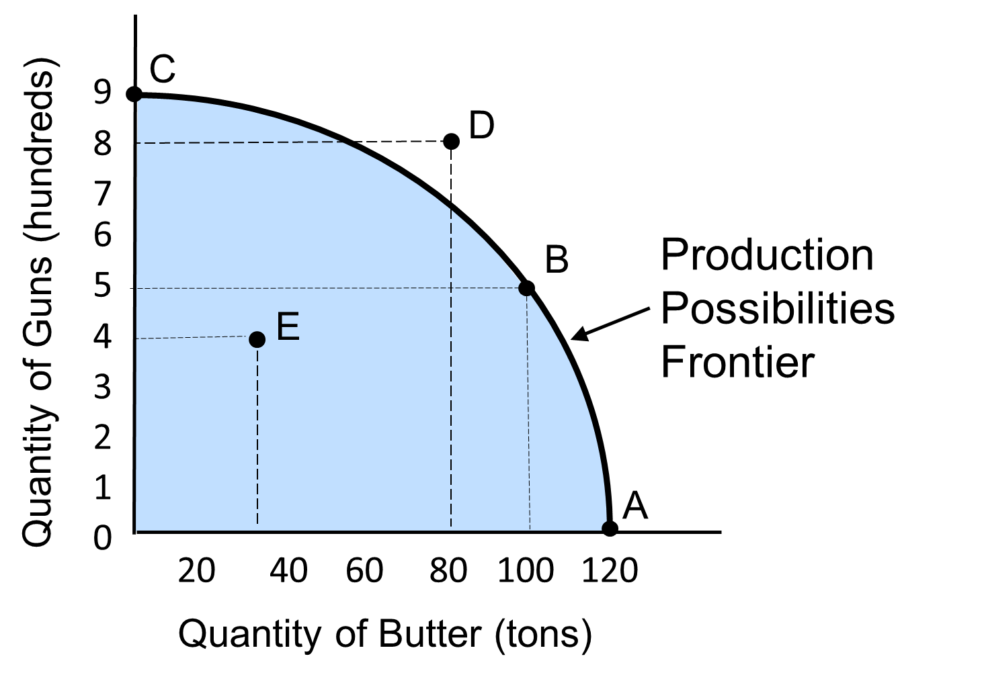
Figure 1.2 Society’s Production Possibilities Frontier

Slide 4
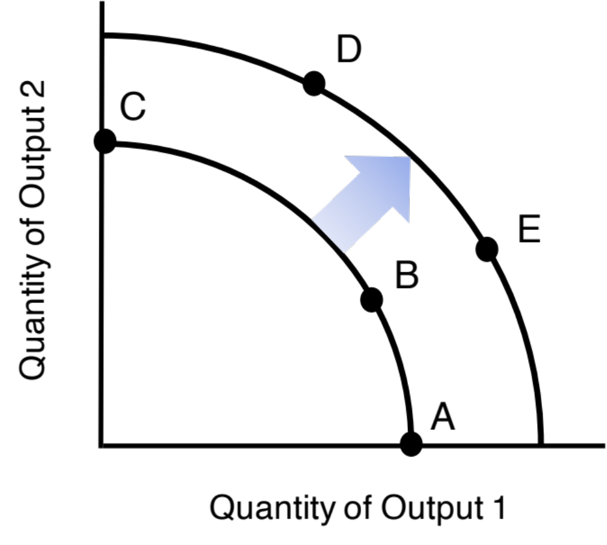
Figure 1.3 An Expanded Production Possibilities Frontier

Slide 5
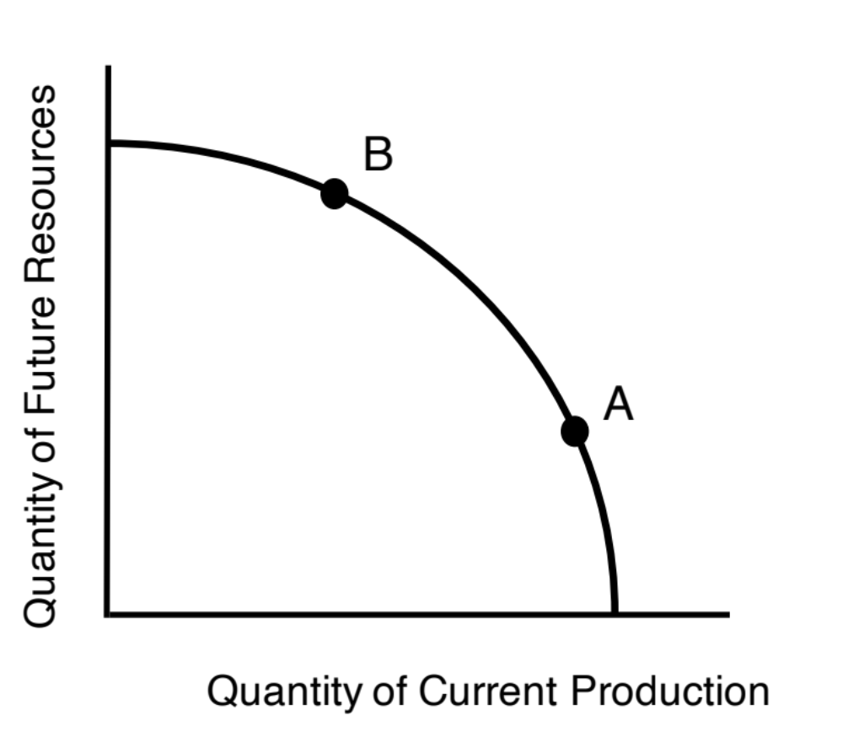
Figure 1.4 Society’s Choice between Current Production and Future Resource Availability

Slide 6
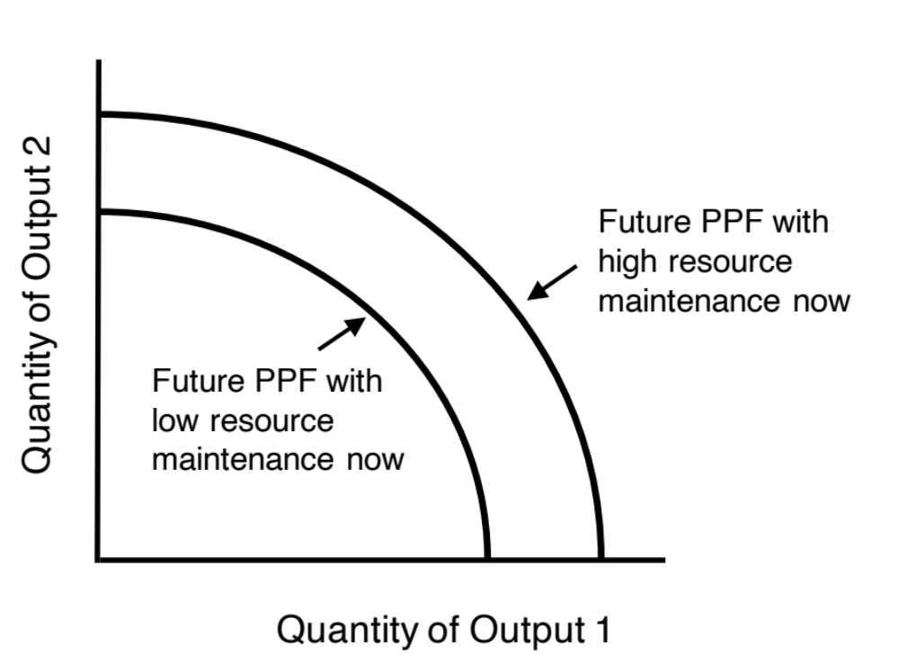
Figure 1.5 Potential Future Production Possibility Frontiers

Slide 7
Table 1.1 One Possible List of Final Goals, as Components of Human Well-Being
1. Satisfaction of basic physical needs: including nutrition and care adequate for survival as well as a comfortable living environment.
2. Security: assurance that one’s basic needs will continue to be met throughout all stages of life, as well as security against aggression or unjust persecution.
3. Happiness: adequate opportunity to experience feelings of contentment, pleasure, enjoyment and peace of mind.
4. Ability to realize one’s potential, including one’s physical, intellectual, social, aesthetic and spiritual potential.
5. A sense of meaning: a purpose to one’s life.
6. Fairness: fair and equal treatment by others and within social institutions.
7. Freedom: the ability to make personal decisions while not infringing on the freedom of others.
8. Participation: opportunity to participate in the processes in which decisions are made that affect one’s society.
9. Good social relations: having satisfying and trustful relations with friends, family, fellow citizens, and business associates, as well as peaceful relations among larger groups (such as nations).
10. Ecological balance: protecting natural resources and where necessary, restoring them to a healthy state

