Slide 1
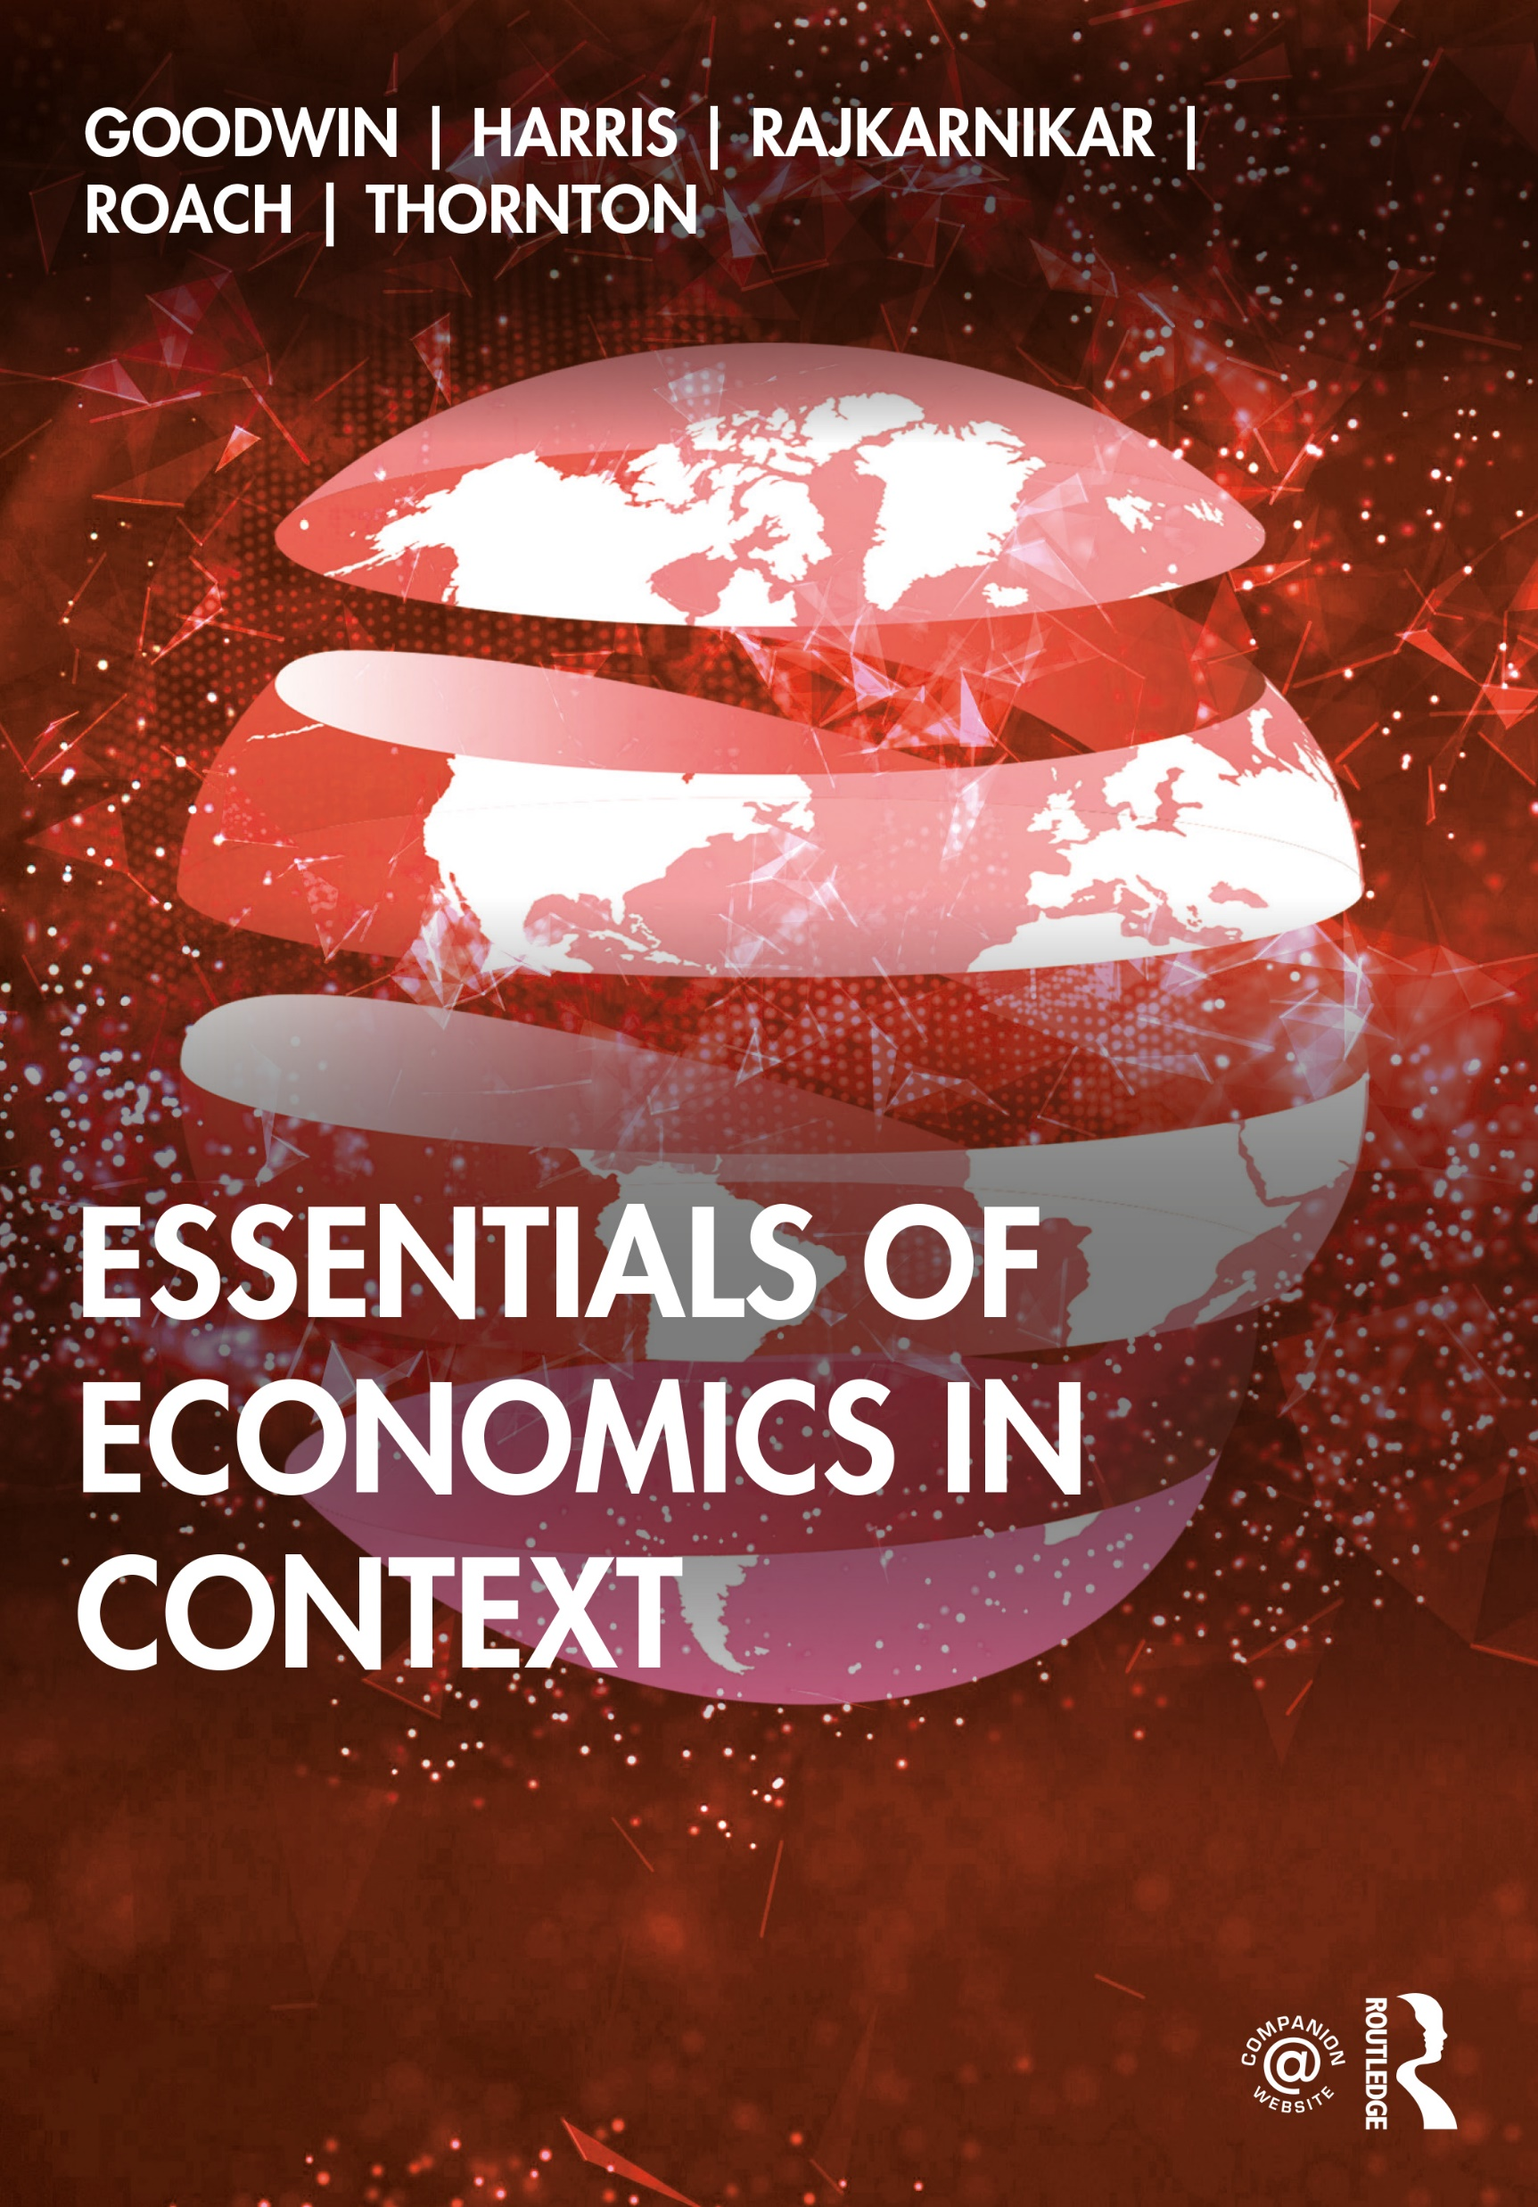
Chapter 0
Economics and Well-Being

Slide 2
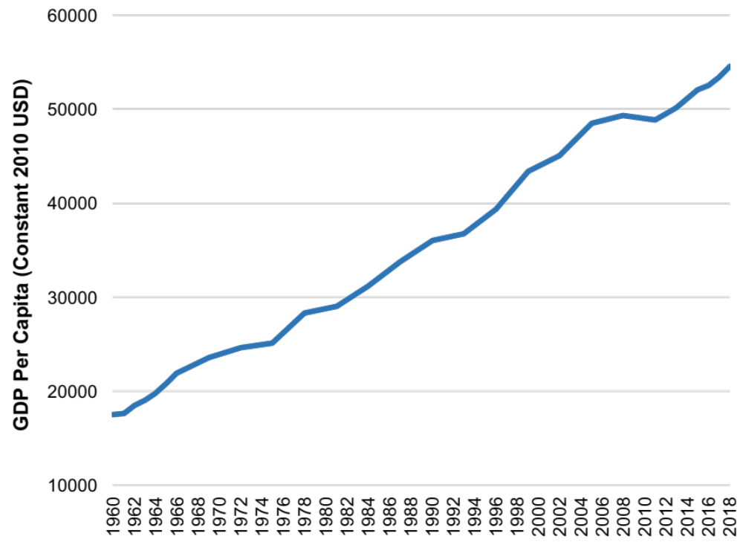
Figure 0.1: GDP per Capita, 1960-2018 (Constant 2010 USD)
Source: World Bank, World Development Indicators database.
Notes:
What it is: GDP, or Gross Domestic Product, is a measure of the total value of goods and services produced in a country. As discussed in Chapter 8, there are controversies about exactly what is covered, or not covered, by GDP, but the measure is used very widely as an index of the status and growth of an economy. GDP can be seen both as a measure of product and of income. GDP per capita, shown here, is GDP divided by the country’s population, and the time trend of GDP per capita shows how average income changes over time.
The results: U.S. GDP per capita has increased more than threefold since 1960. The progression has not been entirely smooth, with pauses and declines especially during periods of economic recession, but the overall trend is upwards. One of the largest breaks in this trend was the recession of 2007–2009, discussed in detail in Chapter 13. As the graph shows, growth of GDP per capita started to recover after 2010. GDP per capita has continued to grow, reaching over $54,000 in 2018.

Slide 3
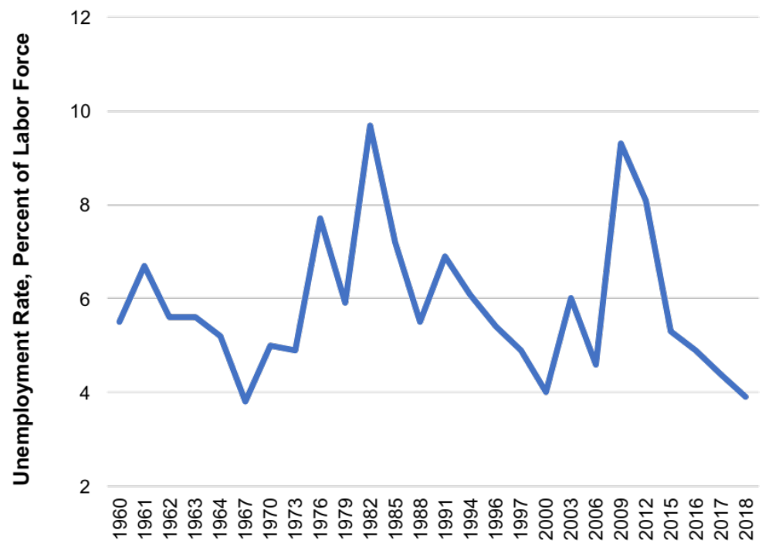
Figure 0.2: Unemployment Rate (Annual average) 1960 – 2018
Source: U.S. Bureau of Labor Statistics, Current Population Survey, 2019.
Notes:
What it is: The unemployment rate is a measure of the proportion of people in the labor force who are seeking jobs but unable to find them (discussed in Chapters 7 and 8). The measure does not include people who have part-time work but would like full-time work, nor does it include “discouraged workers” who have given up looking for work. The unemployment rate typically falls during economic expansions, and rises during and immediately after economic recessions.
The results: U.S. unemployment has varied since 1960 between about 3 and 10 percent. In expansionary periods such as the late 1960s and the late 1990s, it was between 3.5 and 5 percent. In recessions it has typically risen above 6 percent, with peaks of nearly 10 percent in 1982 and 2009, resulting from severe recessions. Since 2016, the unemployment rate has remained below 5 percent, and in 2018 it reached a nearly five-decade low of 3.9 percent, suggesting strong labor market conditions.

Slide 4
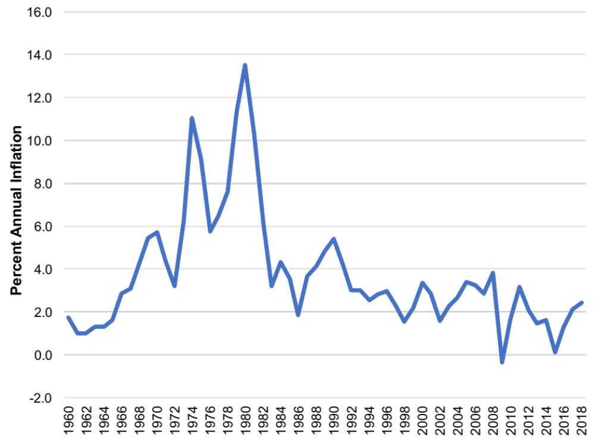
Figure 0.3: Inflation Rate, 1960-2018
Source: U.S. Bureau of Labor Statistics, Consumer Price Index (CPI-U), 2019.
Notes:
What it is: The inflation rate is a measure of the average increase in prices between one year and the next. It is measured by the change in the Consumer Price Index, discussed in Chapter 8. There are various versions of the Consumer Price Index (CPI); the graph below is based on the CPI-U, which measures the cost of living in urban areas.
The results: The U.S. inflation rate has varied considerably since 1960, with noticeable peaks in the late 1970s and early 1980s. At these times, the inflation rate rose above 10 percent (referred to as “double-digit inflation”). This level of inflation is considered significantly harmful to an economy, as discussed in Chapter 9. Since 1992, inflation rates in the United States have generally been fairly low, not rising above 4 percent, and averaging around 2 percent. During the 2007–2009 recession, inflation briefly fell to zero, arousing concern about deflation—negative inflation or generally falling prices. (Although some might think that falling prices would be a good thing, sustained deflation can be very damaging to businesses and reduce employment, as occurred during the Great Depression of the 1930s.)

Slide 5
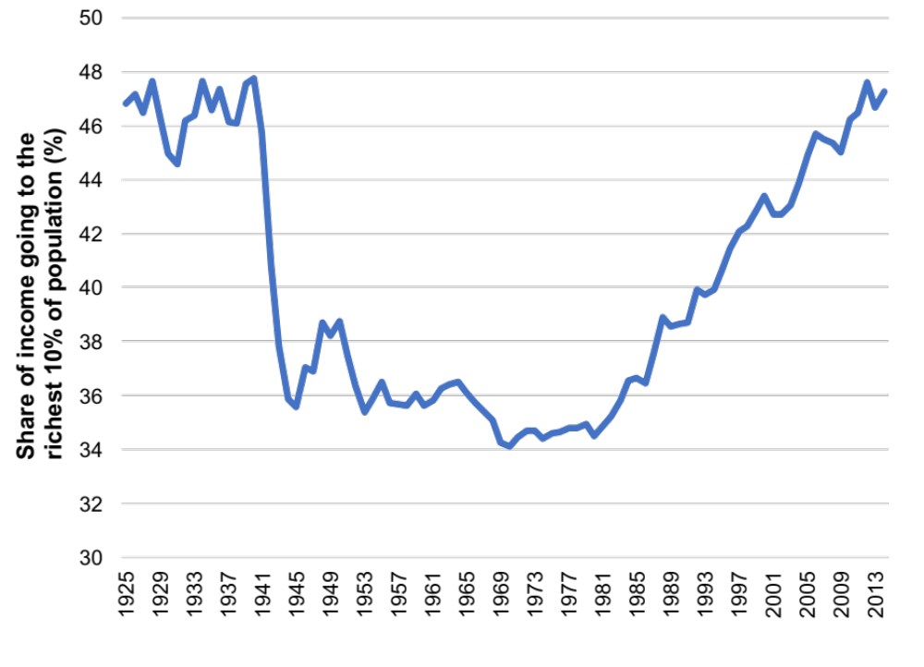
Figure 0.4: Percentage Share of Income Earned by the Richest 10% of Population, 1926-2014
Source: Thomas Piketty, Emmanuel Saez, and Gabriel Zucman. “Distributional National Acccounts: Methods and Estimates for the United States,” Appendix II: Detailed distributional series. http://gabriel-zucman.eu/usdina/
Notes:
What it is: The graph below shows the trend in income inequality in the United States between 1925 and 2014. Percentage share of income going to the richest 10 percent of the population is used as an indicator of inequality. A decline in the value of this indicator implies lower inequality, with a greater share of income going to the bottom 90 percent of the population.
The results: Income inequality in the United States has varied considerably over time. It declined sharply in the early 1940s, with the economic prosperity during and after World War II along with the implementation of New Deal policies. While inequality remained relatively stable until the 1960s, it has been increasing since then, reaching almost as high as the peak inequality levels right before the Great Depression. This trend in inequality can be explained by the changes in tax and labor market policies, among other things, as will be discussed in detail in Chapter 13.

Slide 6
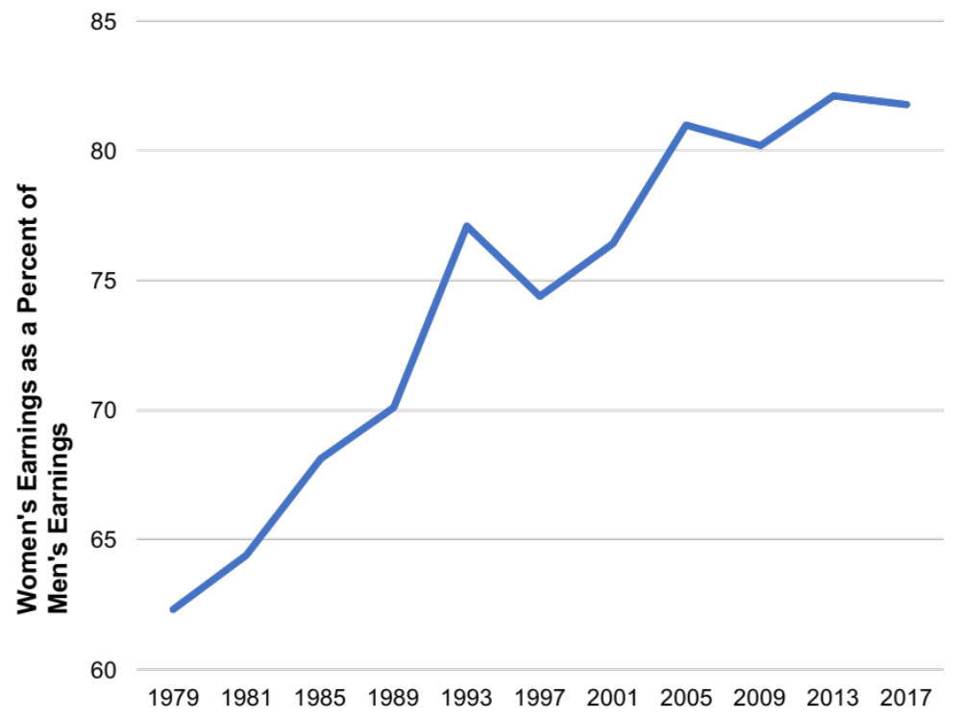
Figure 0.5: Gender-Based Earnings Inequality, 1979-2017
Source: U.S. Bureau of Labor Statistics. 2018. “Highlights of Women’s Earnings in 2017.” Report 1075.
Notes:
What it is: The “gender wage gap” is the difference in median earnings between men and women who work full time. The graph below shows women’s median earnings in the United States as a percentage of men’s median earnings, over the period 1979 to 2017.
The results: In 1979 women working full time in the United States only earned 62 percent of what men earned. During the 1970s and 1980s, the gender wage gap closed considerably. By the early 2000s, women working full time earned about 80 percent of what men earned. Since then, the wage gap has remained relatively constant. In 2017, women earned 81.8 percent of what men earned. Is this clear evidence of gender discrimination? We’ll discuss this topic in more detail in Chapter 7.

Slide 7
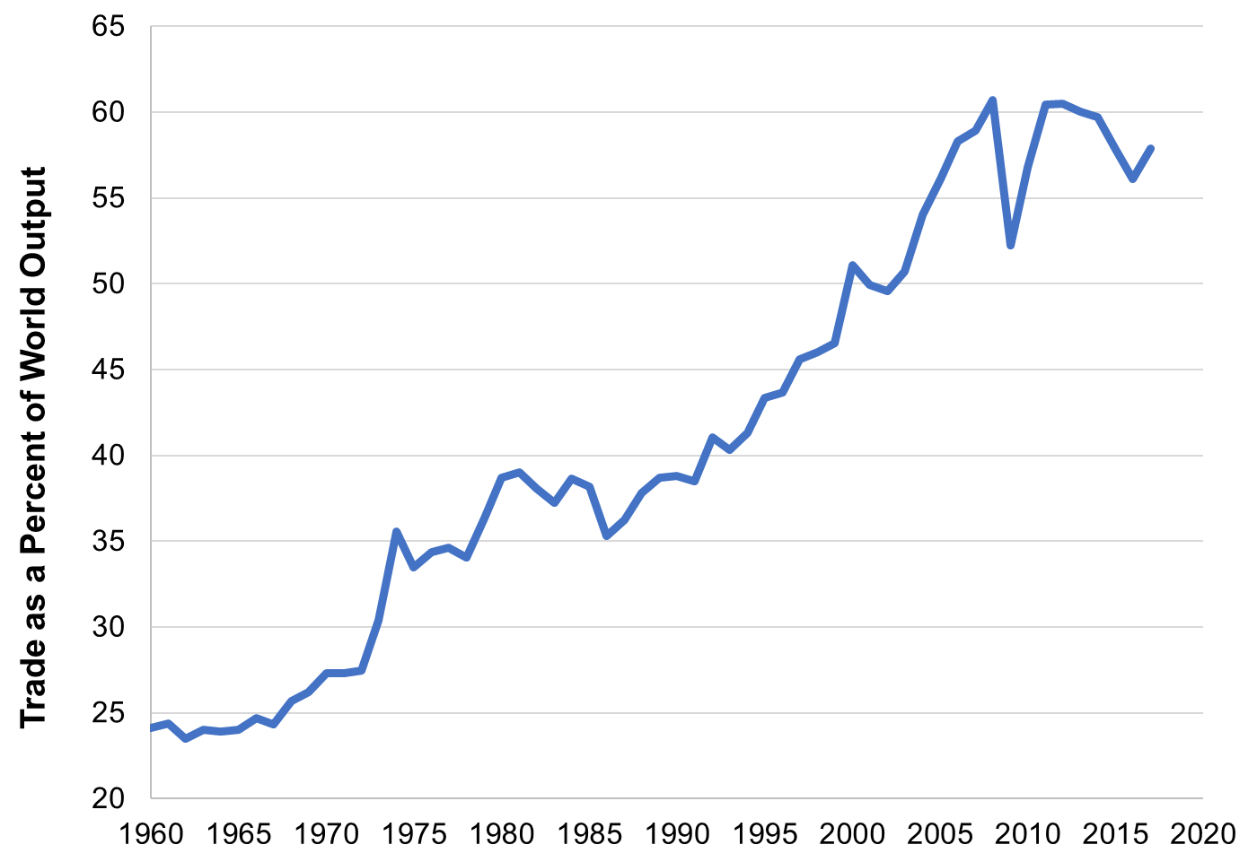
Figure 0.6: Global International Trade, 1960-2017
Source: World Bank, World Development Indicators database.
Notes:
What it is: The graph below shows the volume of international trade (sum of exports and imports) as a percentage of world economic production between 1960 to 2017. This is one way to get a quick, partial snapshot of the degree of “globalization.”
The results: At least as measured by international trade, the world has clearly become more globalized in recent decades. About 24 percent of all goods and services produced in the world were traded in 1960. Currently about 58 percent of world production is traded internationally. We can see that the global financial crisis of 2007–2009 temporarily reduced international trade, but that it has since recovered to previous levels. We will discuss the topic of international trade further in Chapter 14.

Slide 8
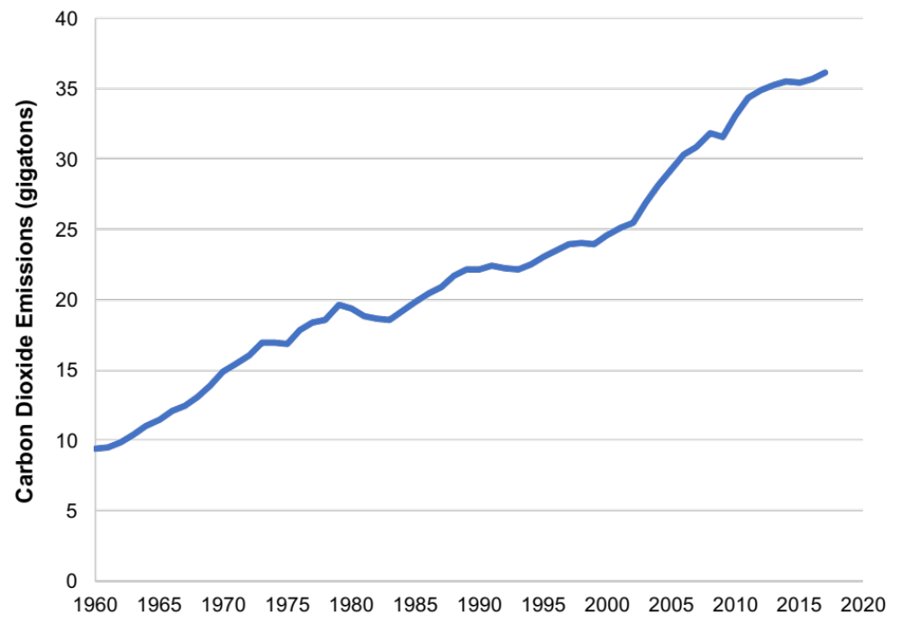
Figure 0.7: Global Carbon Dioxide Emissions, 1960-2017
Source: Global Carbon Project. Global Carbon Atlas. http://www.globalcarbonatlas.org/en/content/welcome-carbon-atlas.
Notes:
What it is: The vast majority of scientists believe that human activities are impacting the global climate. Carbon dioxide emissions, which result when oil, coal, and natural gas are burned, have been identified as the primary cause of global climate change. The graph below shows global carbon dioxide emissions from 1960 to 2017, measured in gigatons (a gigaton is a billion metric tons).
The results: We see that global carbon dioxide emissions increased from about 10 gigatons in 1960 to just over 35 gigatons recently. While most projections indicate that global carbon dioxide emissions will continue to increase in the future, scientists note that emissions will need to decrease substantially in the next few decades to avoid significant negative consequences to the global ecosystem and to human societies. We will discuss global climate change in more detail in Chapter 16.

Slide 9
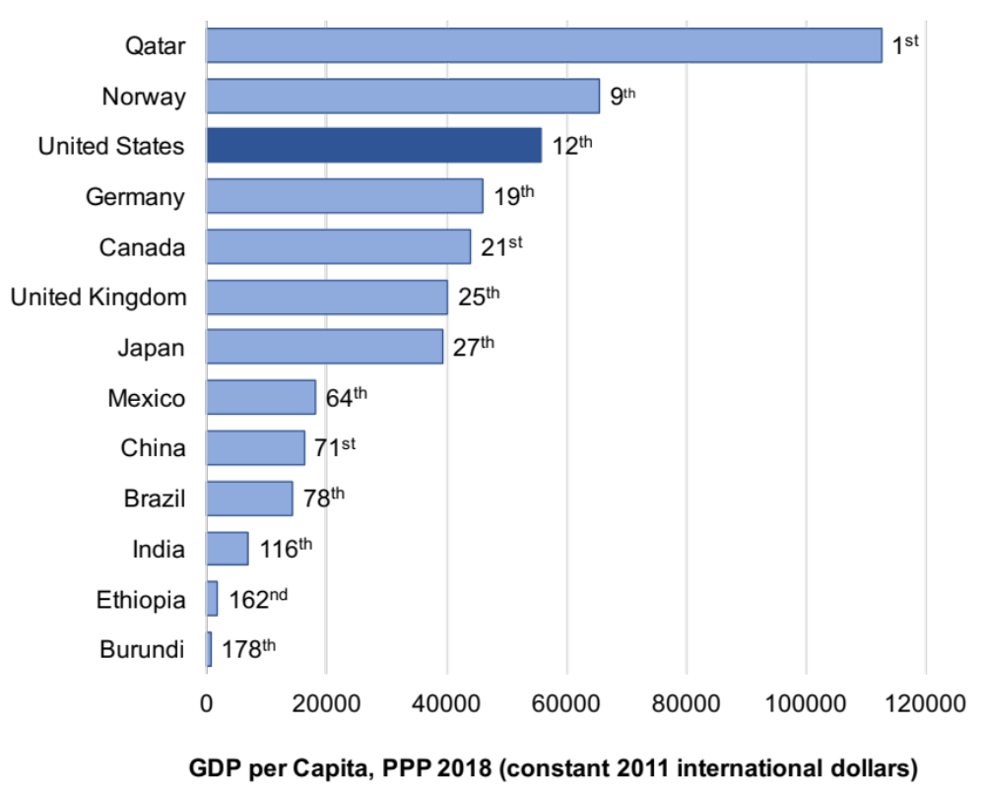
Figure 0.8: GDP per Capita, 2018
Source: World Bank, World Development Indicators database.
Note: Data are adjusted for purchasing power differences across countries (e.g., a dollar in India buys more than a dollar in the United States).
Notes:
What it is: Media stories of economic performance frequently refer to GDP. A country’s GDP per capita measures economic production per person per year, which gives us an idea of the average material living standards in the country. While GDP is perhaps the most commonly used macroeconomic metric, it does not necessarily measure well-being. We discuss how GDP is calculated in Chapter 8 along with a discussion of its limitations, and alternative economic measures.
The results: The United States ranks 12th, with a GDP per capita of $55,681. Qatar has the world’s highest GDP per capita at around $112,531, with the country’s economy driven by its oil and gas sectors. Burundi has the lowest GDP per capita, at only $660.

Slide 10
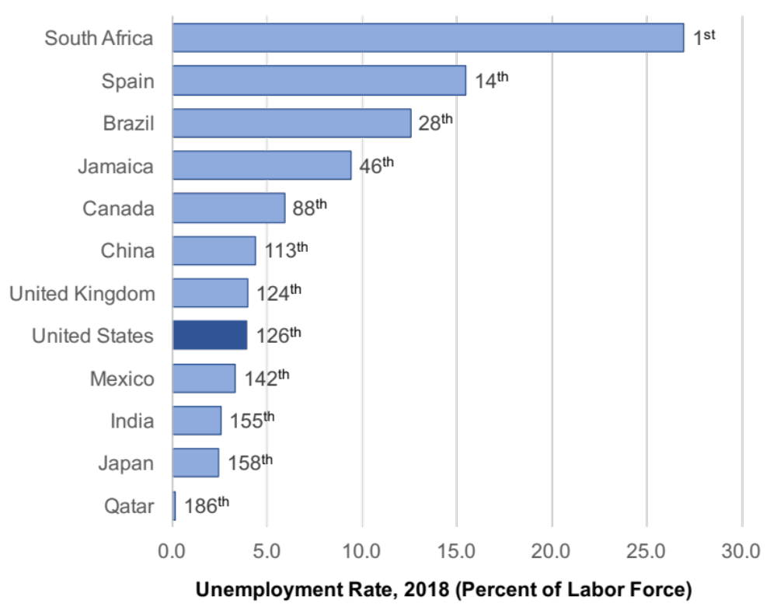
Figure 0.9: Unemployment Rate, 2018 (Percent of Labor Force)
Source: World Bank, World Development Indicators database.
Notes:
What it is: The unemployment rate in a country is an important macroeconomic metric. Not only does having a job provide a source of income, but it also provides a sense of identity and contributes to overall well-being. Estimating the unemployment rate is somewhat complex, and the method used to measure unemployment rate may differ across countries. In Chapters 7 and 8 we discuss issues involved in estimating the unemployment rate including defining what it means to be in the workforce.
The results: Unemployment rates vary tremendously across countries and they also fluctuate a lot over time. In 2018, Qatar had the lowest official unemployment rate at 0.1 percent, and South Africa had the highest unemployment rate at about 27 percent. While many developing countries, such as Lesotho, Botswana, and Libya, have very high unemployment rates (15 percent or more), other developing countries have rather low unemployment rates, at around 3 percent. The unemployment rate in the United States, usually in the range of 4–6 percent, rose considerably in the 2007–2009 recession, but has since declined slowly to about 3.9 percent in 2018.

Slide 11
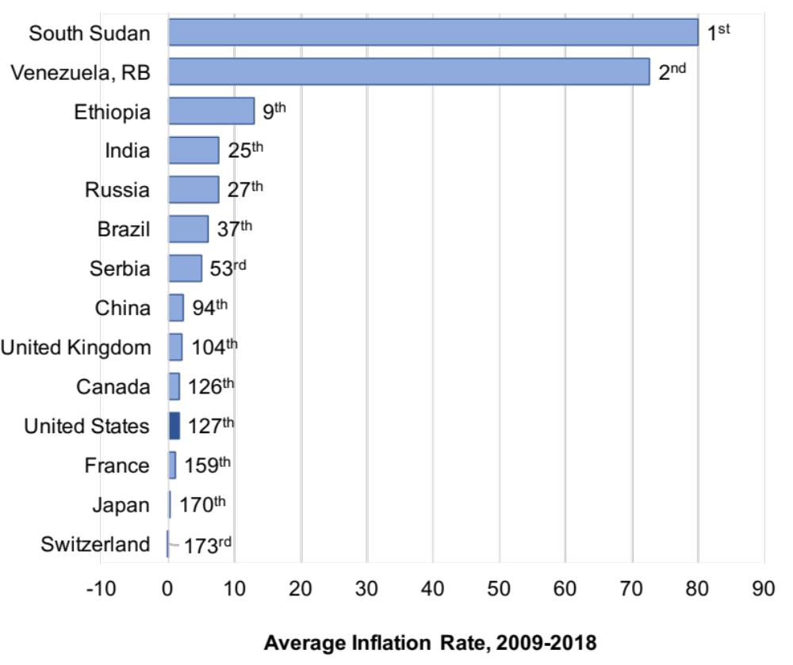
Figure 0.10: Average Annual Inflation Rate, 2009–2018
Source: World Bank, World Development Indicators database.
Note: The average inflation rate is calculated as the average of the inflation rate for each year from 2009 to 2018.
Notes:
What it is: The rate of inflation summarizes how average prices change in a country in one year. For example, an inflation rate of 5 percent means that average prices increased by 5 percent that year. In Chapter 8 we discuss how to adjust data from different years for inflation, and we focus on macroeconomic theories of inflation in Chapters 11 and 12.
The results: Over the period 2009–2018, Switzerland and Japan had the lowest inflation rates in the world, with prices actually declining slightly during some years and hardly increasing overall. However, this is not necessarily a good thing, as we see later in the book. A low and stable—but not negative—inflation rate is generally considered an important macroeconomic policy goal. Most developed countries have generally been successful in controlling inflation in recent years. High and fluctuating inflation rates in a country are a sign of macroeconomic instability. With average inflation rates of over 80 percent between 2009 and 2018, South Sudan had the highest inflation rate over this period. Extremely high inflation rates of over 800 percent in Venezuela and over 24,000 percent in Zimbabwe have been observed in recent years.

Slide 12
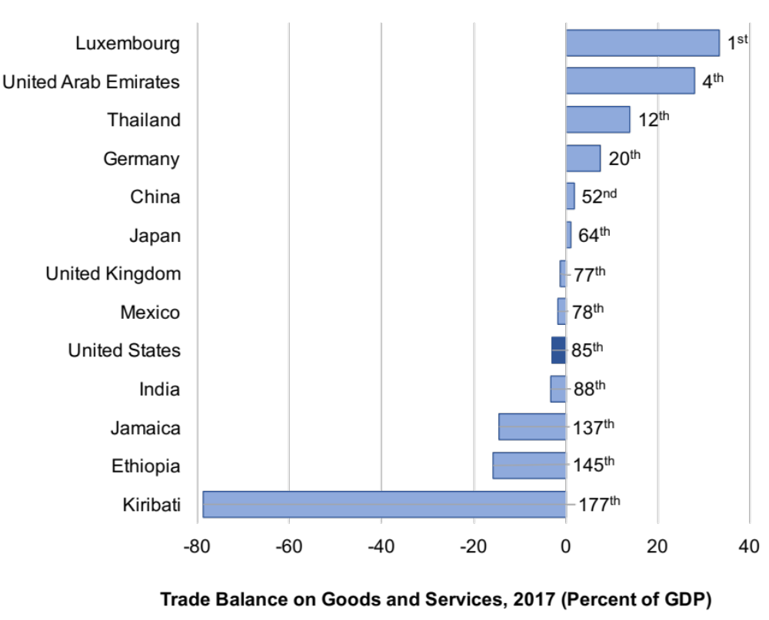
Figure 0.11: Trade Balance, 2017 (Percent of GDP)
Source: World Bank, World Development Indicators database.
Notes:
What it is: Economists refer to a country’s trade balance as the dollar value of its exports minus its imports, normally expressed as a percentage of GDP. Thus, a negative trade balance indicates a trade deficit. A positive trade balance indicates a trade surplus. The trade deficit of the United States is often considered a cause for concern in media stories. We discuss trade balances, and other trade issues, in more detail in Chapter 14.
The results: Of the 178 countries with available data, 71 have a positive trade balance (exports exceed imports) and 107 have a negative trade balance. Those countries with the largest trade surpluses tend to be smaller countries (such as Luxembourg and Singapore) or oil-producing countries (such as Qatar and the United Arab Emirates). The U.S. trade deficit is about 3 percent of GDP, with other countries, such as Canada in a similar range. The countries with the largest trade deficits tend to be poorer countries, although some poor countries do have trade surpluses.

Slide 13
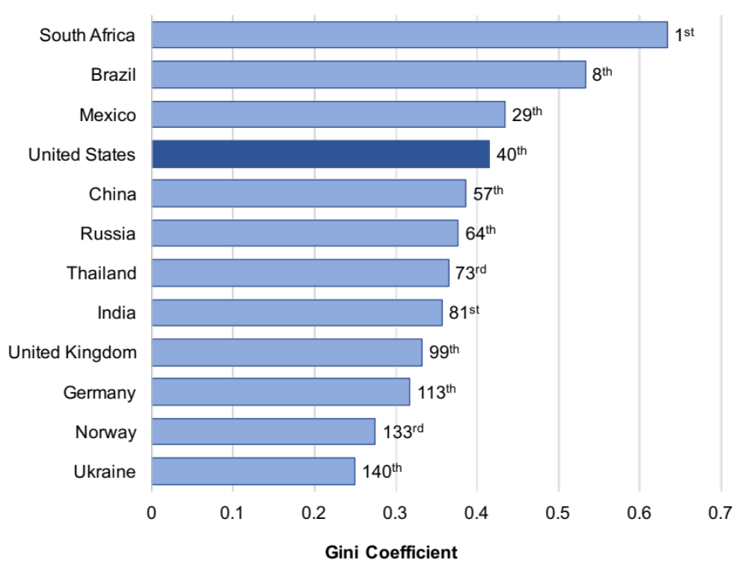
Figure 0.12: Income Inequality (Gini Coefficient - Least Equal to Most Equal)
Source: World Bank, World Development Indicators database.
Note: Data for the most recent year available, between 2010 and 2017.
Notes:
What it is: A Gini coefficient is a measure of economic inequality in a country. It is most commonly calculated according to the distribution of income, but it can also be calculated according to wealth distribution or other variables. It can range from 0 (everyone in the country has the same exact income) to 1 (one person receives all the income in a country). We learn more about Gini coefficients and economic inequality in Chapter 13.
The results: Scandinavian countries such as Sweden, Norway, and Finland tend to be the most equal countries in the world, by income (with the lowest Gini coefficients). Several African countries, including Botswana, Lesotho, Namibia, and South Africa, are the most unequal countries in the world. In general, countries with high GDP per capita have lower inequality than those with low GDP per capita. However, this is not always true. The United States, for example, is among the most economically unequal of the developed countries.

Slide 14
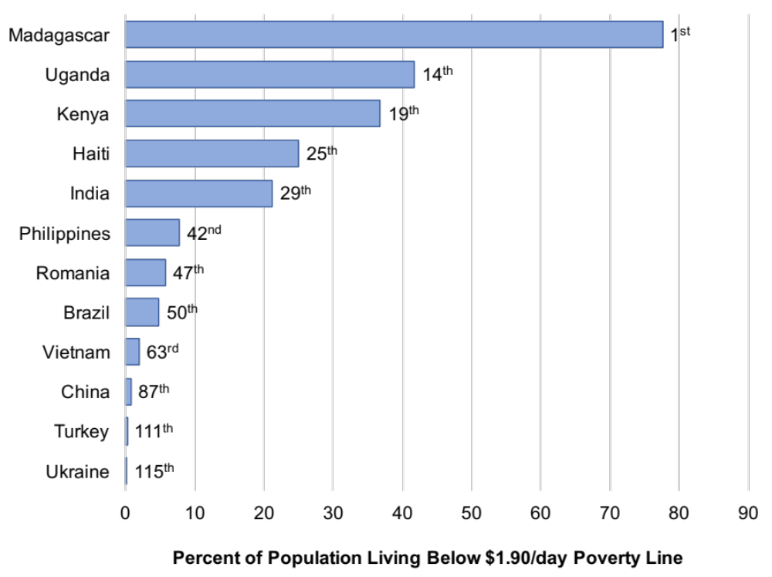
Figure 0.13: Percent of Population Living Below $1.90/day Poverty Line
Source: World Bank, World Development Indicators database. Data for the most recent year available, between 2011 and 2017.
Notes:
What it is: The $1.90-per-day poverty line has been defined by the United Nations as a measure of absolute poverty. One of the Sustainable Development Goals set by the United Nations is to eradicate absolute poverty worldwide. Formerly, under the Millennium Development Goals, the UN had aimed at halving the number of people in the world living in absolute poverty between 1990 and 2015. This goal has already been met, mainly due to progress in China and India. We discuss poverty and economic development in Chapter 15.
The results: Note that the only graph in this chapter that does not include the United States or any other developed countries (few people in developed countries live below the $1.90-a-day poverty line, though homelessness and food insecurity continue to plague many cities in the U.S.). A majority of people do live below that poverty line in countries, such as Madagascar, Democratic Republic of Congo, Rwanda, Zambia, Mozambique, Malawi and Burundi. A small portion of the population lives in absolute poverty in some upper middle-income countries such as Argentina, Costa Rica, and Turkey.

Slide 15
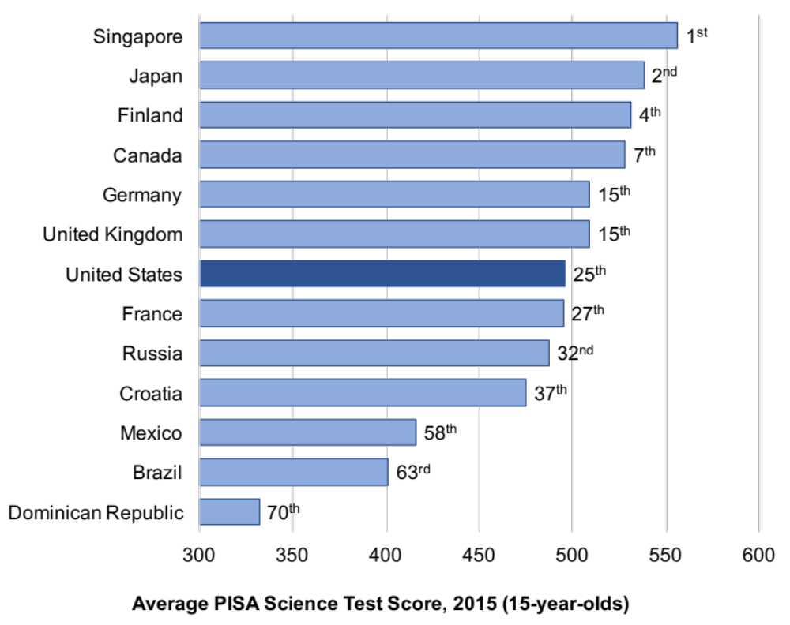
Figure 0.14: Average PISA Science Test Score, 2015 (15-year-olds)
Source: Organisation for Economic Co-operation and Development, Programme for International Student Assessment, PISA 2015 Key Findings.
Notes:
What it is: To compare the educational performance of students in different countries we present data from the Programme for International Student Assessment (PISA), which administers standardized math, science, and reading tests to 15-year-olds in over 60 countries every three years. The graph below provides results from the science test. The country rankings were relatively similar for the math and reading tests, with some variations (e.g., the United States ranked 21st on the reading test and 35th on the math test).
The results: Students in Asian countries tended to achieve the highest test scores, including China, Singapore, Japan, and South Korea. Among European countries, students received high scores in Finland, the Netherlands, and Germany. The scores from the United States were average for developed countries. For less developed countries, scores tended to be lower.

Slide 16
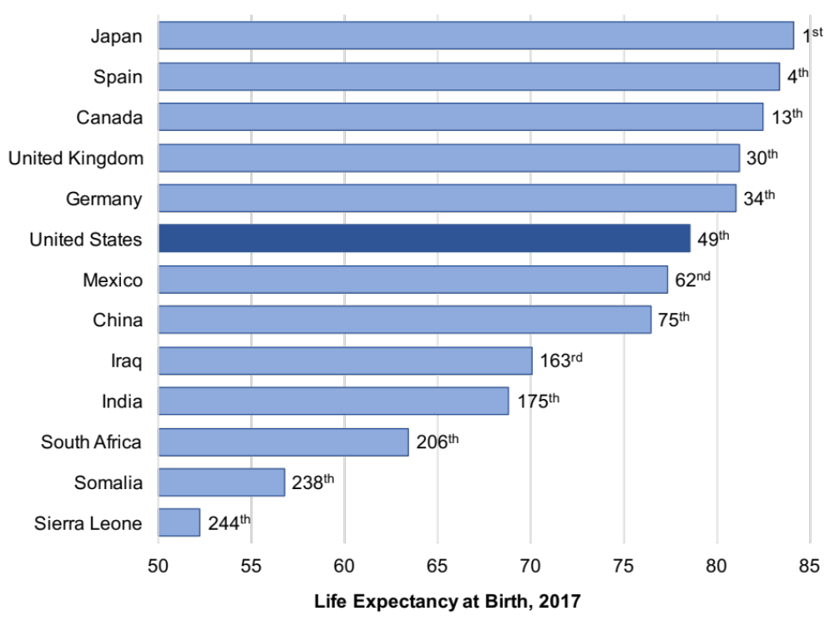
Figure 0.15: Life Expectancy at Birth, 2017
Source: World Bank, World Development Indicators database.
Notes:
What it is: Average life expectancy at birth is a common measure of health outcomes in a country. We discuss health as one component of well-being indices in Chapter 1.
The results: Life expectancy at birth now exceeds 80 years in over 34 countries, including Japan, France, Spain, and Greece. In 2010, only 20 countries had life expectancy at birth that exceeded 80 years. For a developed country, the United States has a comparatively low life expectancy, even lower than some middle-income countries such as Costa Rica and Cuba. Life expectancy is the lowest, below 55 years, in six African countries, including Sierra Leone, Lesotho, and Central African Republic.

Slide 17
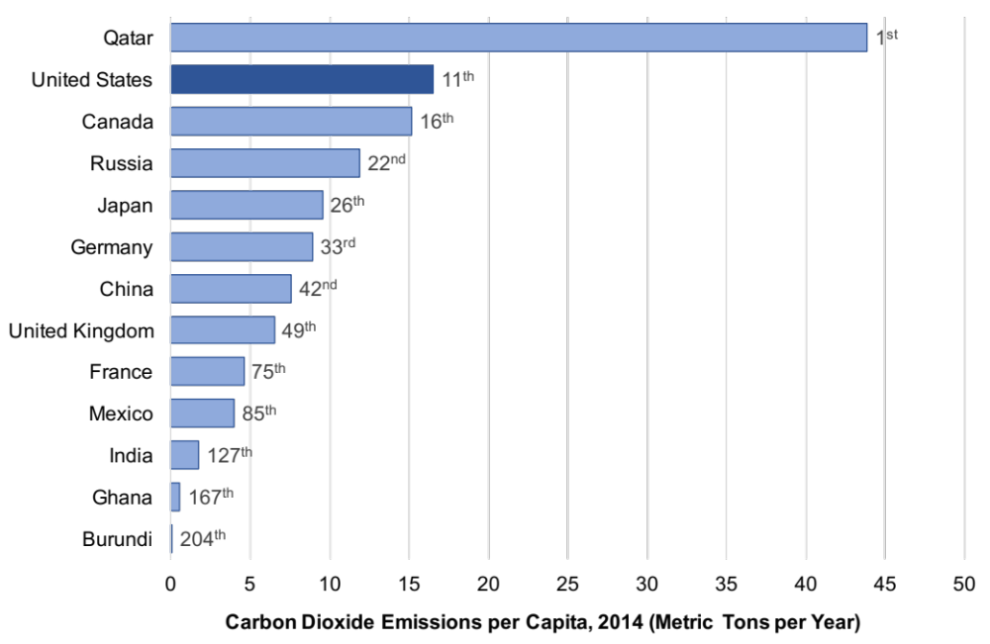
Figure 0.16: Carbon Dioxide Emissions per Capita, 2014 (Metric Tons per Year)
Source: World Bank, World Development Indicators database.
Notes:
What it is: Carbon dioxide (CO₂) is the most important gas responsible for global climate change. CO₂ is emitted whenever fossil fuels are burned. Scientific analysis indicates that the accumulation of CO₂ in the atmosphere is raising global temperatures, leading to serious negative impacts on human societies and ecosystems. CO₂ per capita gives us an idea of how much the average person in a county is affecting the environment. We learn more about CO₂ and climate change in Chapter 16.
The results: The countries with the highest CO₂ emissions per capita are several oil-producing countries, including Qatar (the highest, at over 40 tons per person), Kuwait, and Bahrain. The United States has the eleventh-highest emissions per capita, around 16.5 tons per person. Emissions per person in European countries such as the United Kingdom and Germany are about half of U.S. levels. While China is the world’s largest emitter of CO₂ overall, on a per-capita basis its emissions are less than half of those in the United States. CO₂ emissions per capita are negligible in the world’s poorest countries.

