Slide 1
Chapter 5:
Elasticity

Slide 2
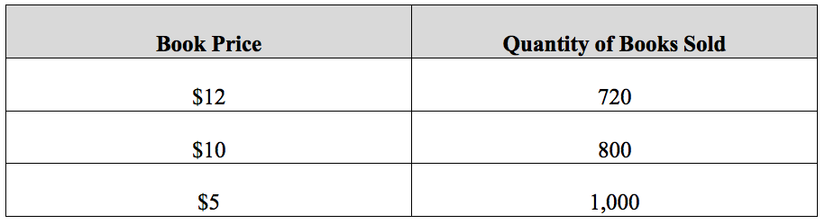
Table 5.1 Relationship Between Price and Quantity Demanded for Braeburn’s Poetry Book

Slide 3
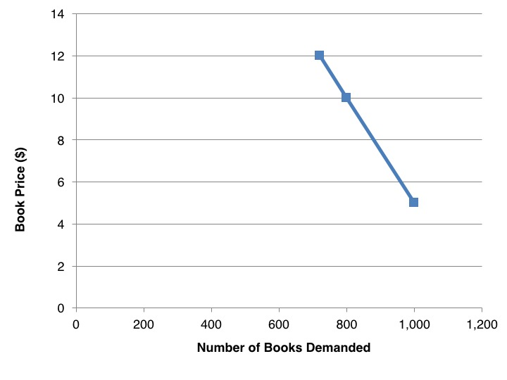
Figure 5.1 Demand Curve for Braeburn’s Poetry Book

Slide 4
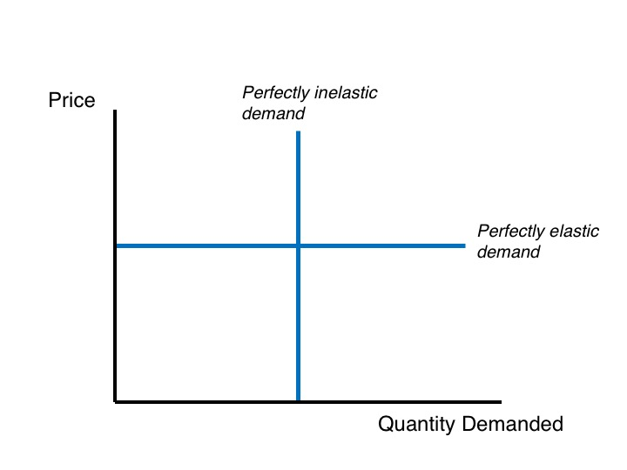
Figure 5.2 Perfectly Inelastic and Perfectly Elastic Demand Curves

Slide 5
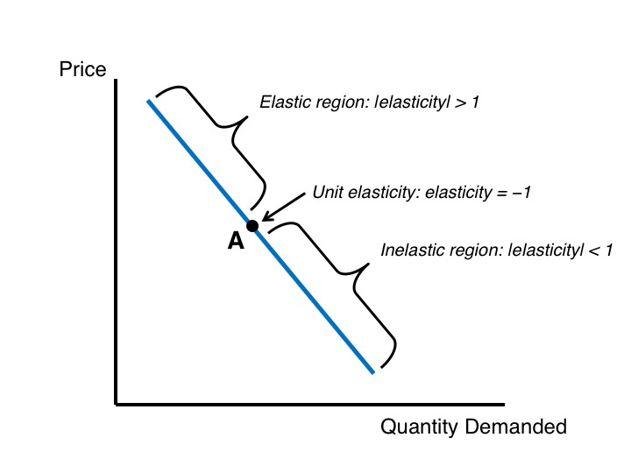
Figure 5.3 Elasticity Varies Along a Straight-Line Demand Curve

Slide 6
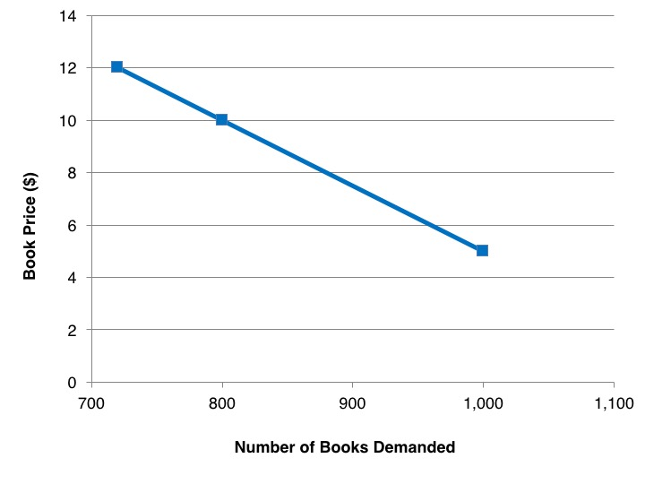
Figure 5.4 Changing the x-Axis Scale of Braeburn’s Demand Curve

Slide 7
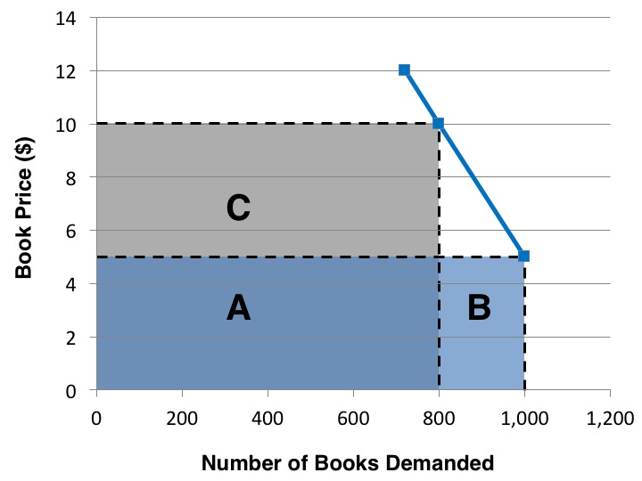
Figure 5.5 Braeburn’s Book Revenues

Slide 8
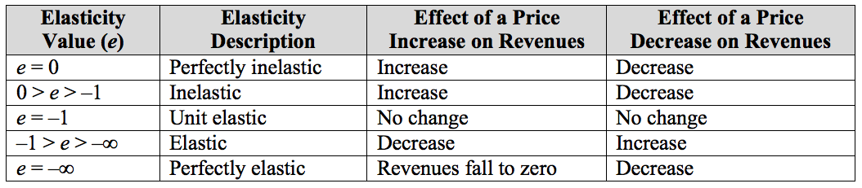
Table 5.2 Effects of Price Changes on Revenues

Slide 9
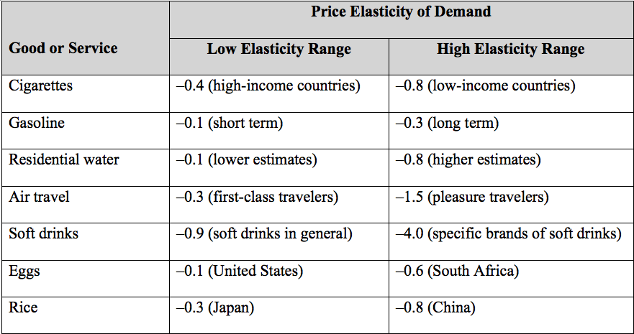
Table 5.3 Some Estimated Price Elasticities of Demand
Sources: Perucic, 2012; Dalhuisen et al., 2003; https://en.wikipedia.org/wiki/Price_elasticity_of_demand.

Slide 10
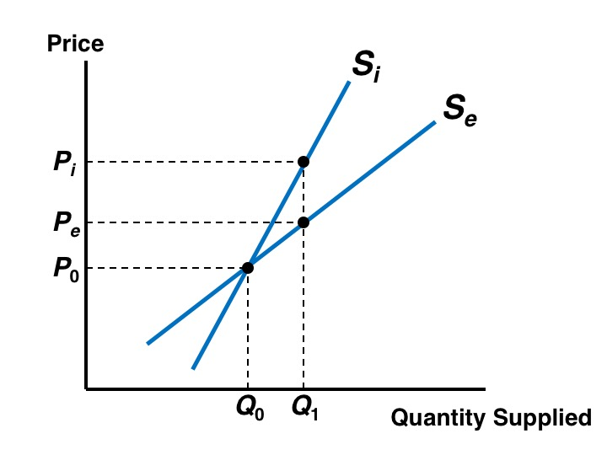
Figure 5.6 The Price Elasticity of Supply

Slide 11
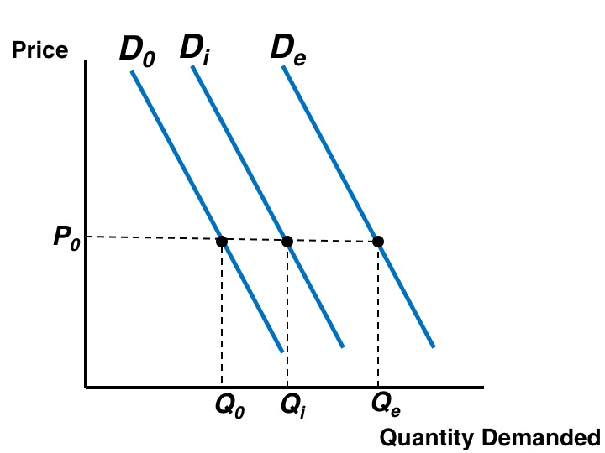
Figure 5.7 The Income Elasticity of Demand

