Slide 1
Chapter 33
Growth and Sustainability in the Twenty-First Century

Slide 2
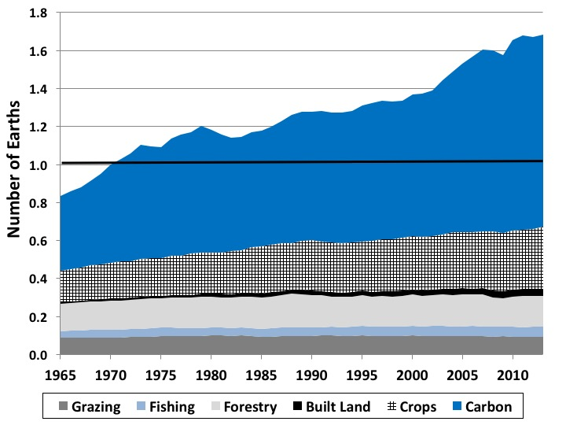
Figure 33.1 Global Ecological Footprint, by Impact Type, 1965-2013
Source: Global Footprint Network Public Data Set, https://www.footprintnetwork.org/resources/data/.

Slide 3
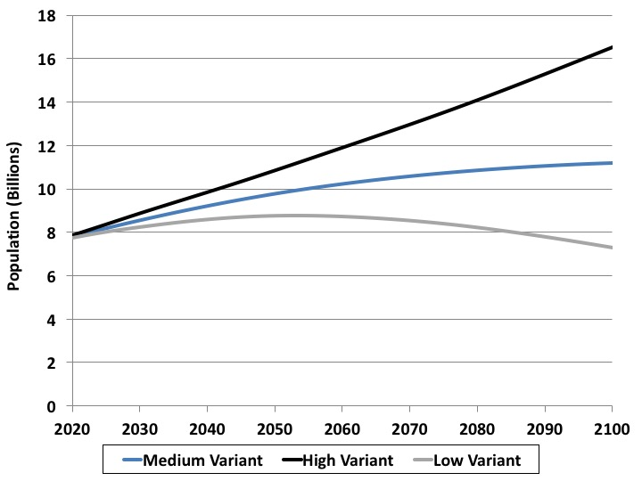
Figure 33.2 United Nations Global Population Projections, 2020-2100
Source: United Nations, World Population Prospects 2017.

Slide 4
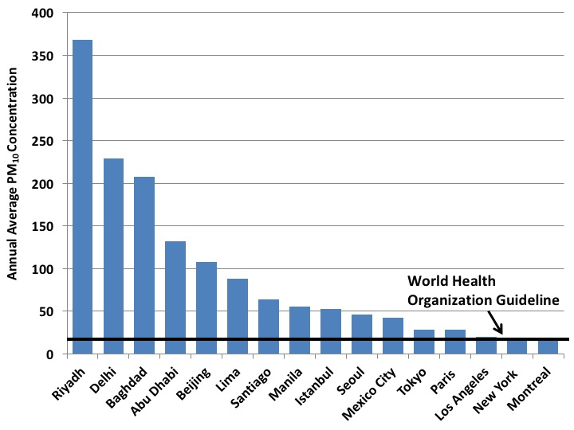
Figure 33.3 Average Particulate Matter Concentration, Selected Major Cities
Source: World Health Organization, Ambient Air Quality Database.
Notes: Particulate matter concentrations in μg/m3; data vary by city, between 2012 and 2015.

Slide 5
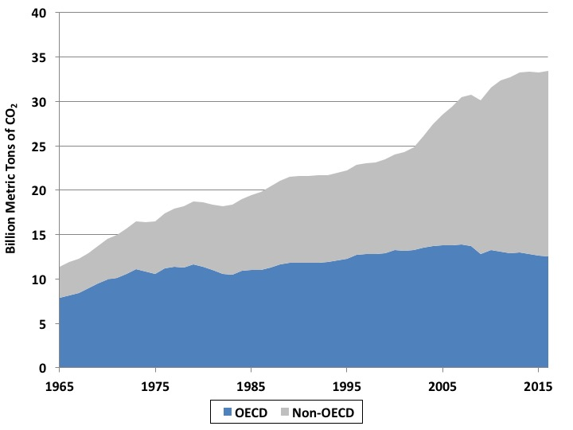
Figure 33.4 Global Carbon Dioxide Emissions, 1965-2016,
OECD and Non-OECD Countries
Source: BP, 2017.

Slide 6
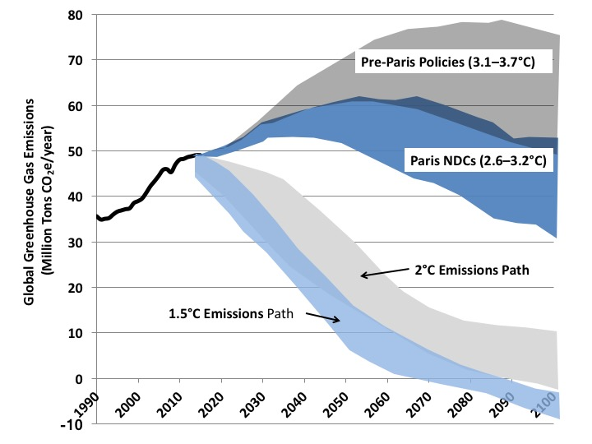
Figure 33.5 Global Greenhouse Gas Emissions Under
Alternative Scenarios
Source: Climate Action Tracker, http://climateactiontracker.org/global.html.
Note: Emissions data include carbon dioxide and other greenhouse gases converted to carbon dioxide equivalents.

Slide 7
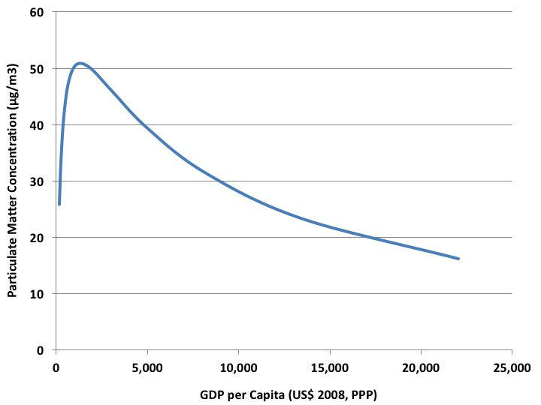
Figure 33.6 Environmental Kuznets Curve for Particulate Matter
Source: Mazurek, 2011.

Slide 8
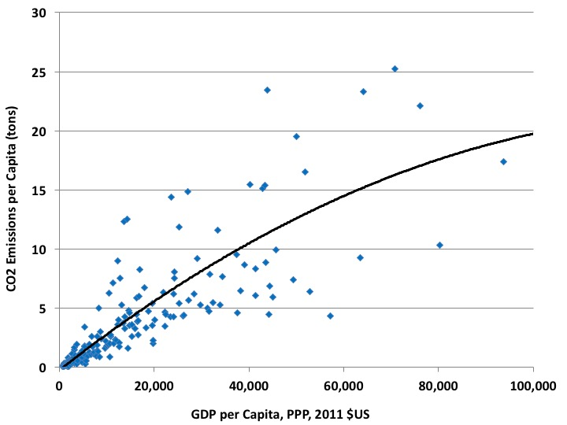
Figure 33.7 Relationship between Carbon Dioxide Emissions and GDP per Capita, 2014
Source: World Bank, World Development Indicators database.

Slide 9
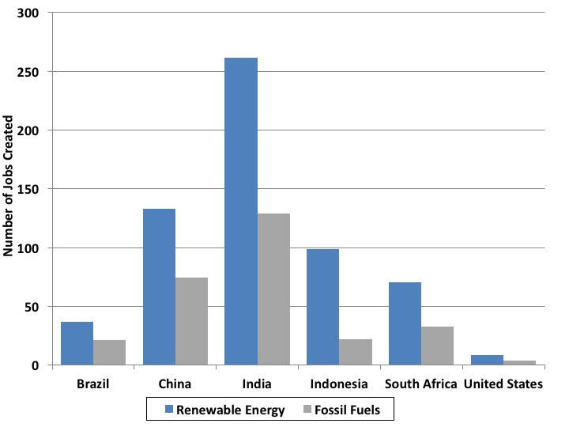
Figure 33.8 Jobs Generated by Investing One Million Dollars in Clean Energy versus Fossil Fuel Production, Select Countries
Source: Pollin, 2015.

Slide 10
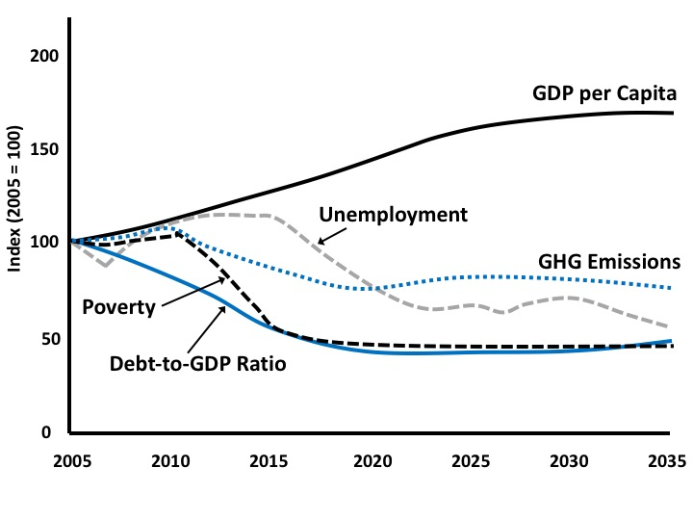
Figure 33.9 A No-Growth Scenario for the Canadian Economy
Source: Adapted from Victor, 2008, p. 182.

Slide 11
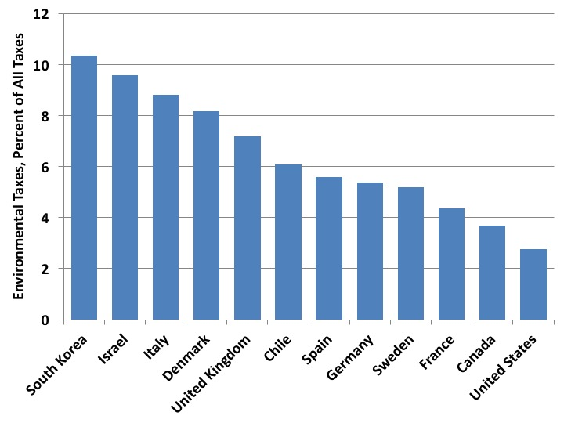
Figure 33.10 Environmental Taxes, as a Percent of Total Tax Revenues, Select Countries, 2015
Source: OECD, OECD.Stat, “Environmentally related tax revenue.”

