Slide 1
Chapter 32
How Economies Grow and Develop

Slide 2
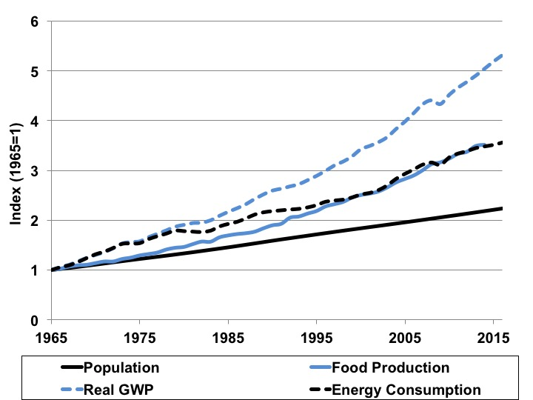
Figure 32.1 Global Growth in Population, Food Production, Economic Production, and Energy Consumption, 1965-2016
Sources: World Bank, World Development Indicators; BP, 2017.
Notes: GWP is gross world product. Global food production index not available for 2015 and 2016.

Slide 3
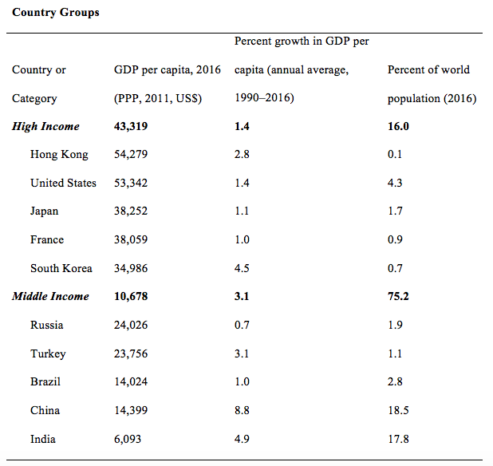
Table 32.1a Income, Growth, and Population Comparisons, Selected Countries and Country Groups

Slide 4
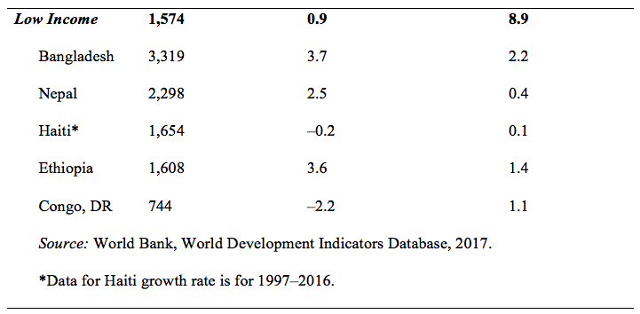
Table 32.1b Income, Growth, and Population Comparisons, Selected Countries and Country Groups
Source: World Bank, World Development Indicators Database, 2017.
*Data for Haiti growth rate is for 1997–2016.

Slide 5
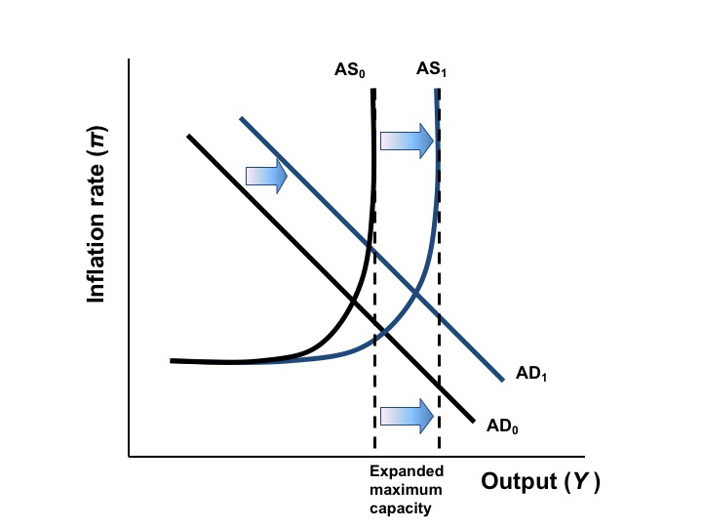
Figure 32.2 Economic Growth in the AS/AD Model

Slide 6
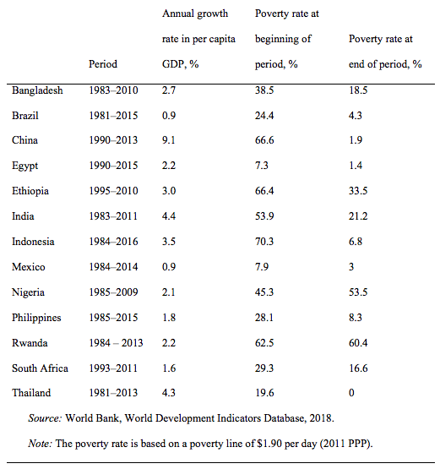
Table 32.2 Growth Rates and Changes in Poverty Rates,
Selected Countries

Slide 7
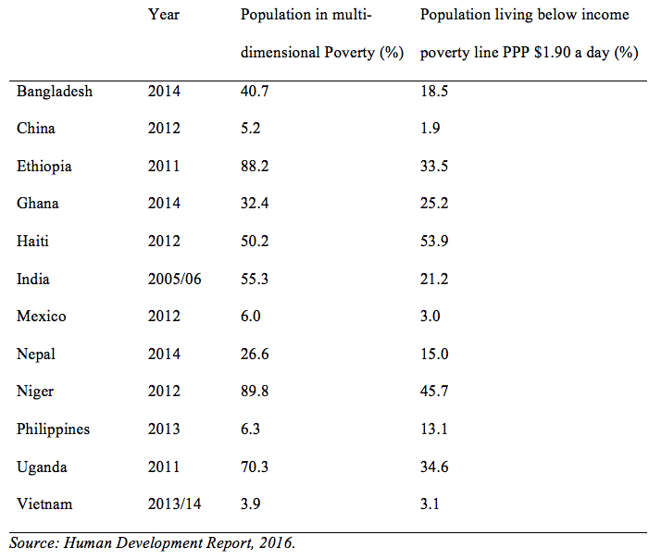
Table 32.3 Population in Multidimensional Poverty and
Income Poverty

Slide 8
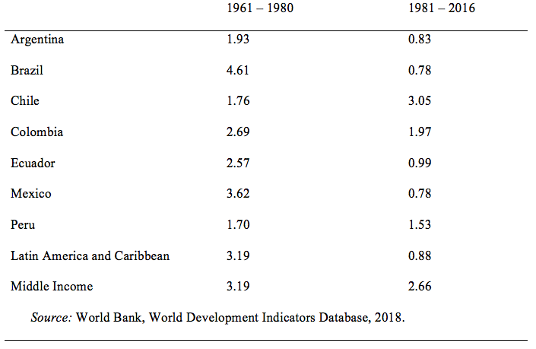
Table 32.4 Average Per Capita Annual Real GDP Growth, Select Latin American Countries, 1961-2016 (%)

Slide 9
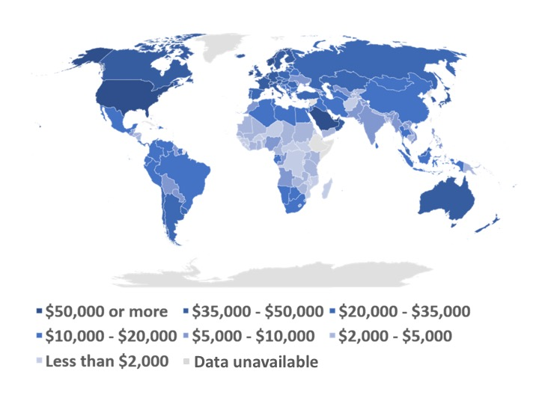
Figure 32.3 GDP per Capita in 2016 (in constant 2011 PPP $ per person)
Source: World Economic Outlook Database 2016, IMF.

Slide 10
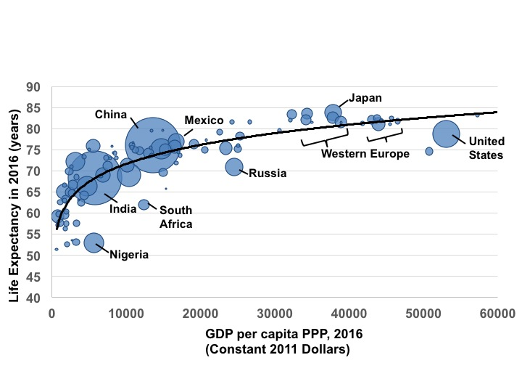
Figure 32.4 The Relation Between Life Expectancy and Income, with Area Proportional to Population, 2016
Source: World Bank, World Development Indicators Database, 2017.

