Slide 1
Chapter 31
Deficits and Debt

Slide 2
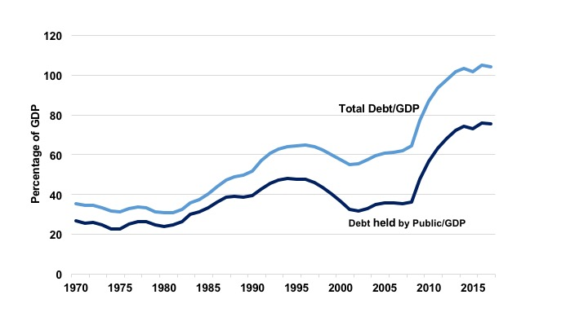
Figure 31.1 U.S. National Debt as a Percentage of GDP
Source: St. Louis Federal Reserve Bank.

Slide 3
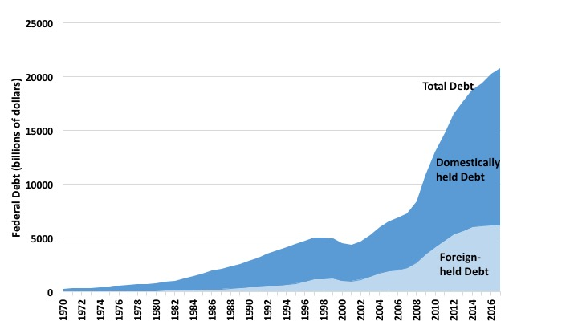
Figure 31.2 Domestic and Foreign Holdings of U.S. Debt (billions of dollars), 1970-2017
Source: St. Louis Federal Reserve Bank.

Slide 4
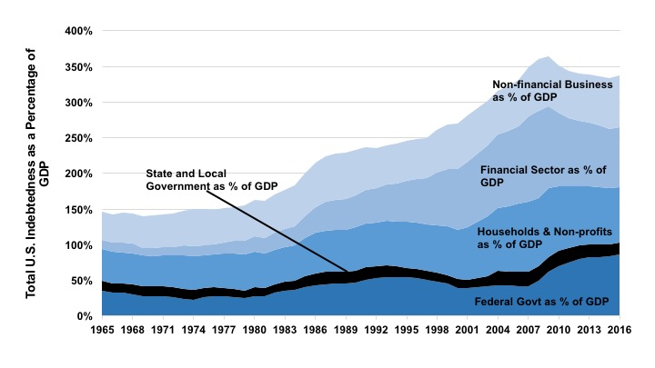
Figure 31.3 Total U.S. Indebtedness as a Percentage of GDP, 1965-2016
Source: Federal Reserve Bank of St. Louis, FRED Economic Database.

Slide 5
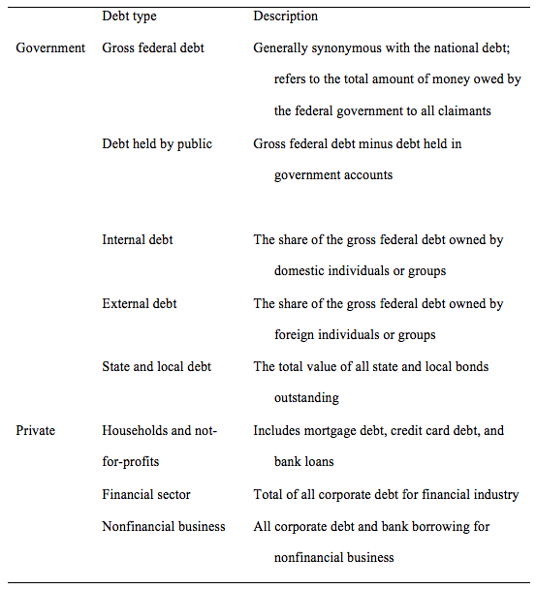
Table 31.1 Debt Taxonomy

Slide 6
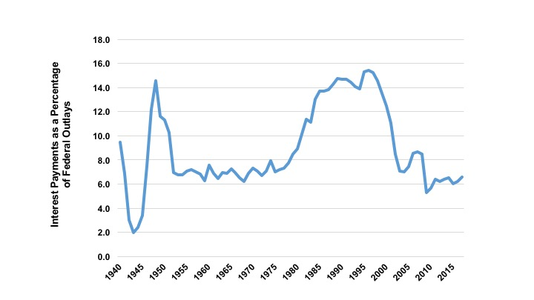
Figure 31.4 Interest Payments as Percentage of Total Federal Outlays, 1940-2017
Source: St. Louis Federal Reserve Bank.

Slide 7
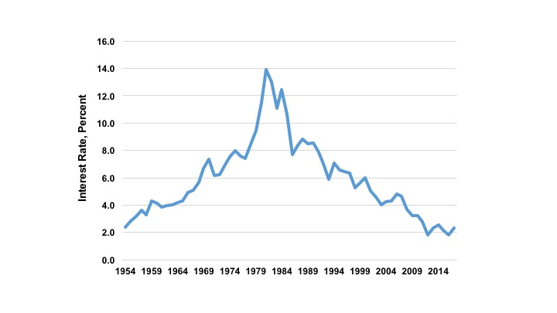
Figure 31.5 The Interest Rate on 10-Year Treasury Bonds, 1954-2017
Source: St. Louis Federal Reserve Bank.

Slide 8
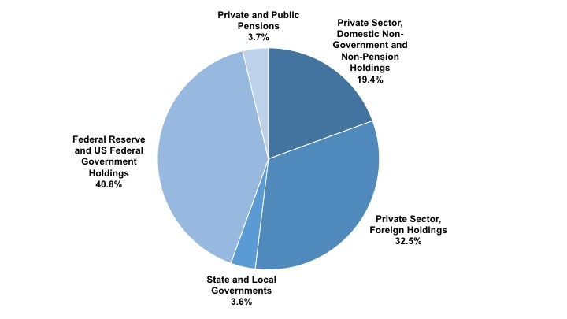
Figure 31.6 Ownership of Gross Federal Debt, 2016
Source: Treasury Department, 2016, Tables OFS-1; Distribution of Federal Securities by Class of Investors and Type of Issues, Table OFS-2; Estimated Ownership of US Treasury Securities and Table.

Slide 9
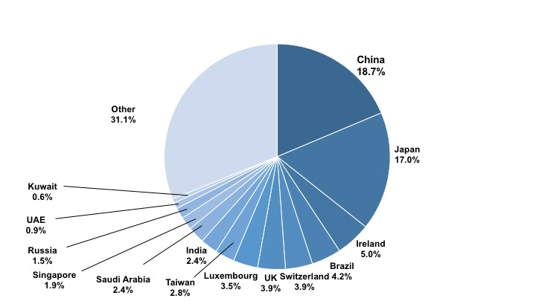
Figure 31.7 Foreign Holders of Gross Federal Debt, 2018
Source: Treasury Department, 2018, Major Foreign Holders of Treasury Securities.

Slide 10
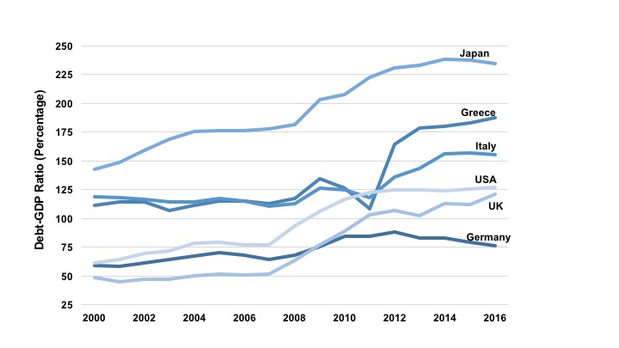
Figure 31.8 Debt-GDP Ratios, an International Comparison, 2000-2016
Source: OECD, General Government Debt, www.oecd.org
Note: U.S. debt figures include Federal, state, and local debt.

Slide 11
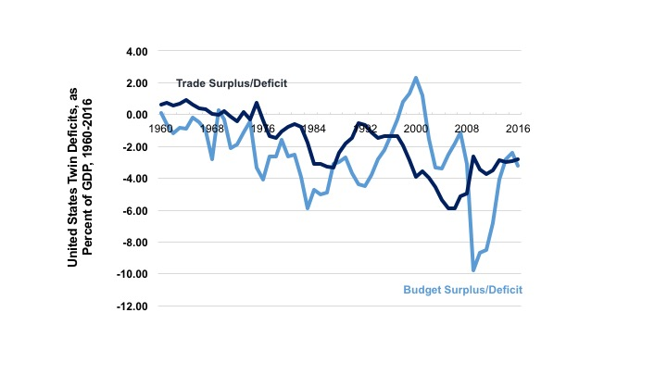
Figure 31.9 United States Twin Deficits as Percentage of GDP, 1960-2016
Sources: CBO and U.S. Census Bureau.

Slide 12
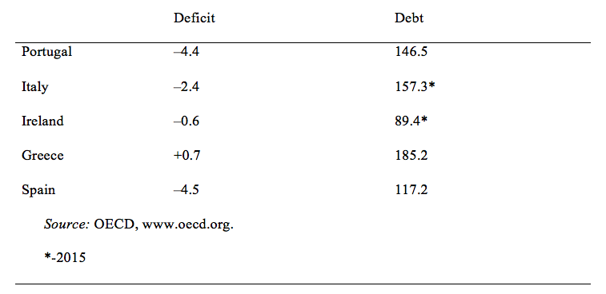
Table 31.2 EU Deficits and Debt Levels in 2016 (percentage of GDP)

Slide 13
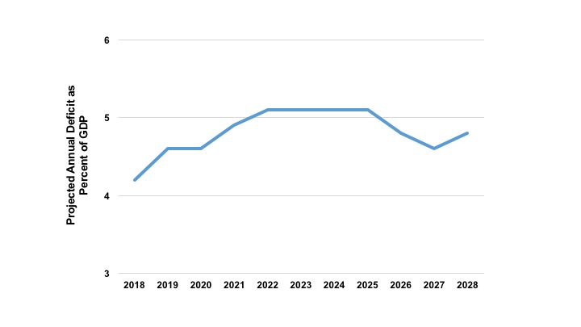
Figure 31.10 Projected Annual Deficit as a Percentage of GDP, 2018-2028
Source: Congressional Budget Office, The Budget and Economic Outlook: 2018 to 2028.

Slide 14
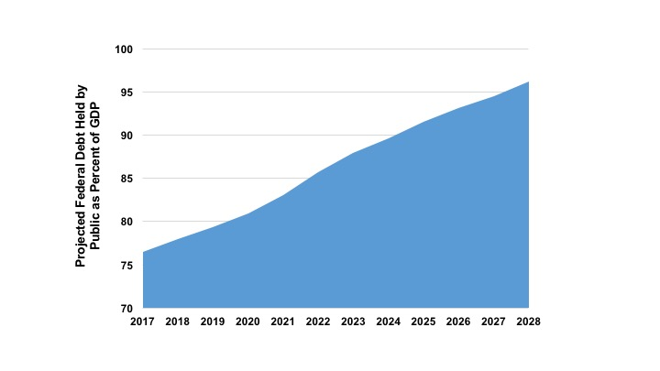
Figure 31.11 Projection for Federal Debt Held by the Public, 2017-2028
Source: Congressional Budget Office, The Budget and Economic Outlook: 2018 to 2028.

Slide 15
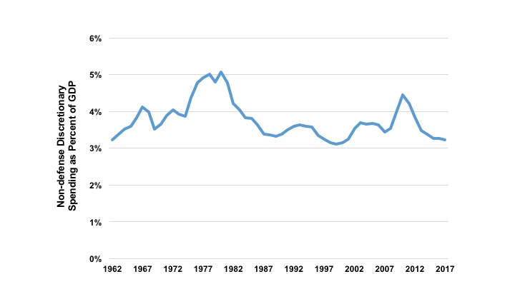
Figure 31.12 Non-Defense Discretionary Spending as Percent of GDP, 1962-2017
Source: Congressional Budget Office; Office of Management and Budget.

