Slide 1
Chapter 29
The Global Economy and Policy

Slide 2
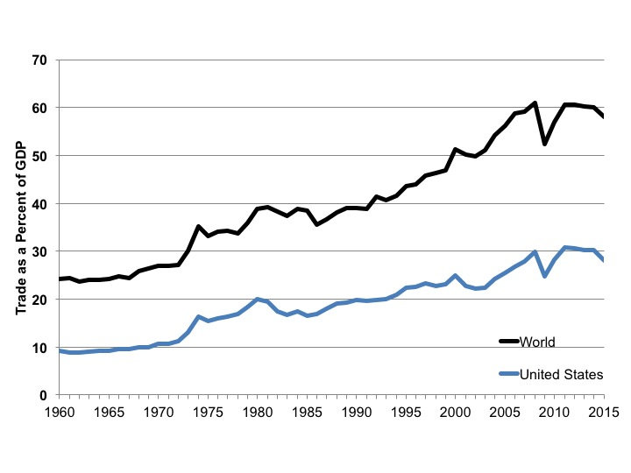
Figure 29.1 Trade Expressed as a Percentage of Production, World and United States, 1960-2015
Source: World Development Indicators, World Bank, 2016.
Note: Since this measure includes both imports and exports, it does not mean that over 50 percent of
all produced goods and services in the world are traded—it counts the same goods both as exports from one country and imports to another.

Slide 3
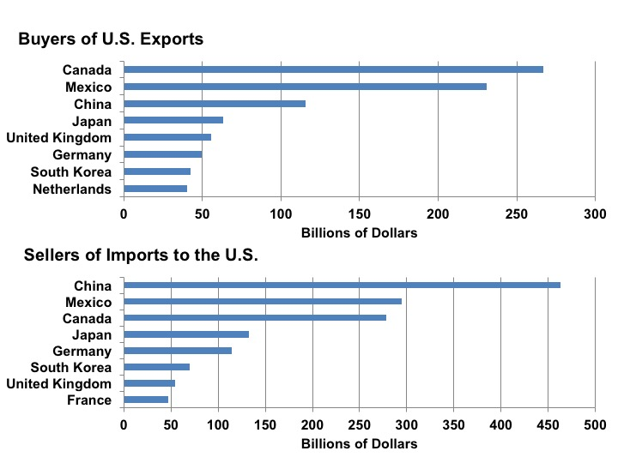
Figure 29.2 Top Purchasers of Goods from the United States and Suppliers of Goods to the United States, 2015
Source: U.S. Census Bureau, Foreign Trade Statistics, Top Trading Partners, 2015.

Slide 4
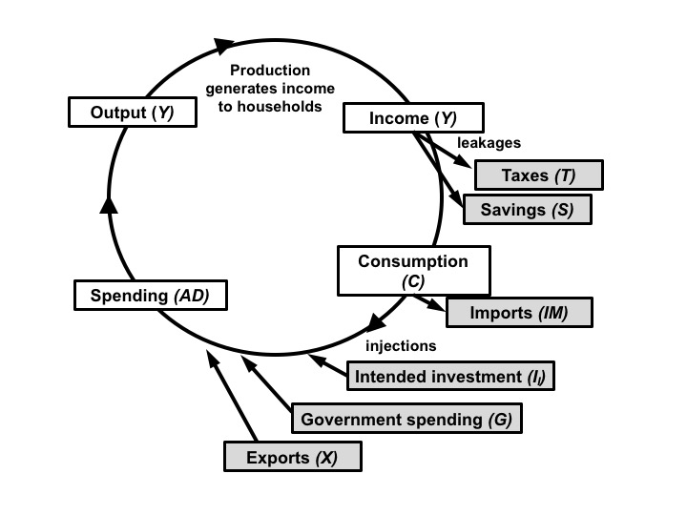
Figure 29.3 Leakages and Injections in a Complete Macroeconomic Model

Slide 5
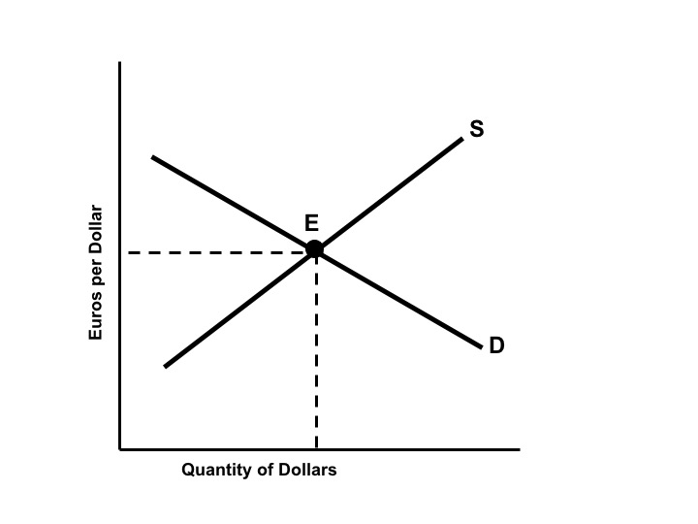
Figure 29.4 A Foreign Exchange Market for Dollars

Slide 6
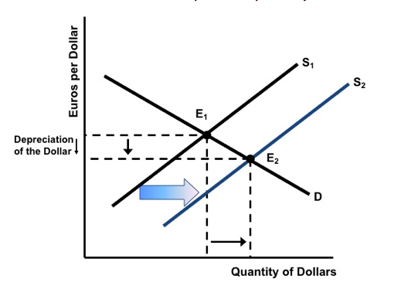
Figure 29.5 A Supply Shift in a Foreign Exchange Market

Slide 7
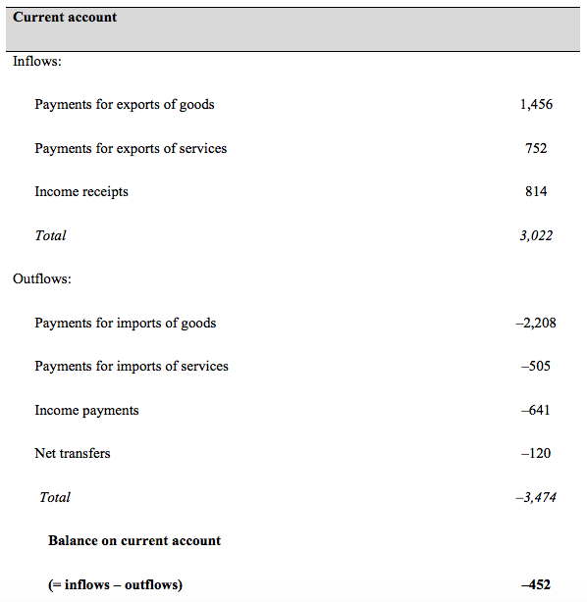
Table 29.1a U.S. Balance of Payments Account, 2016 (billions of dollars)

Slide 8
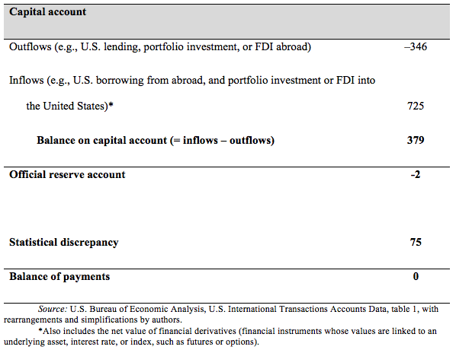
Table 29.1b U.S. Balance of Payments Account, 2016 (billions of dollars)

Slide 9
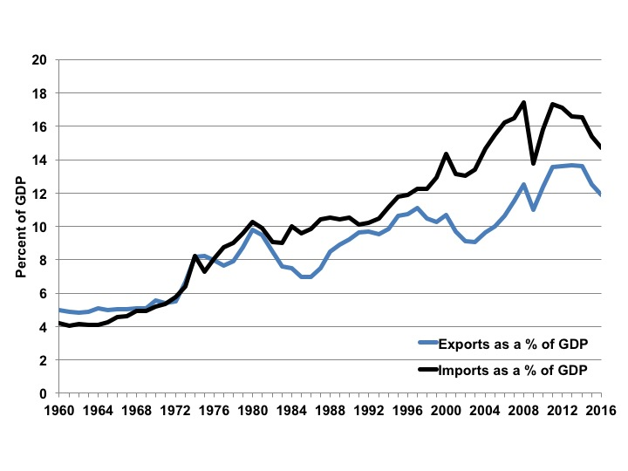
Figure 29.6 U.S. Imports and Exports of Goods and Services, 1960-2016
Source: BEA NIPA Tables 4.1 and 1.1.5.

Slide 10
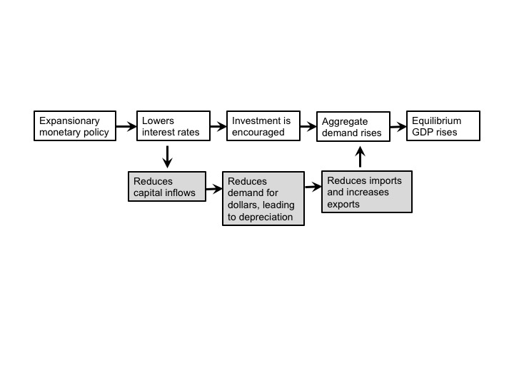

Slide 11
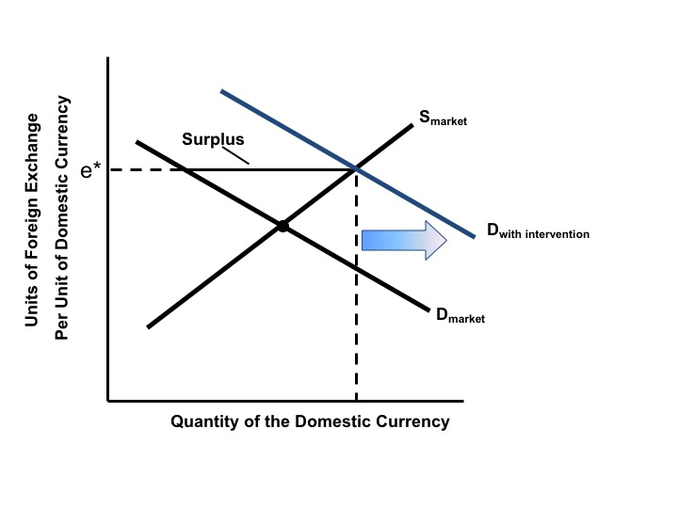
Figure 29.7 Foreign Exchange Intervention

