Slide 1
Chapter 24
Aggregate Demand and Economic Fluctuations

Slide 2
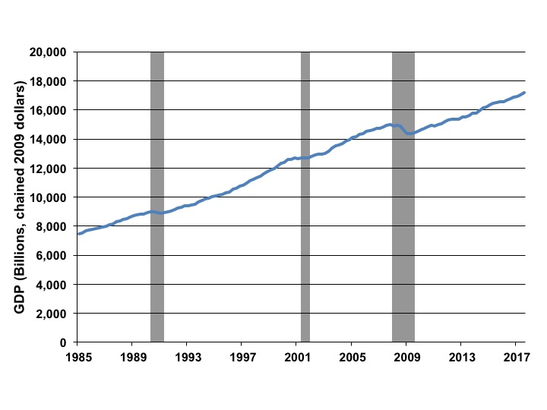
Figure 24.1 U.S. Real GDP and Recessions, 1985-2017
Source: BEA quarterly data 1985–2017, and NBER.

Slide 3
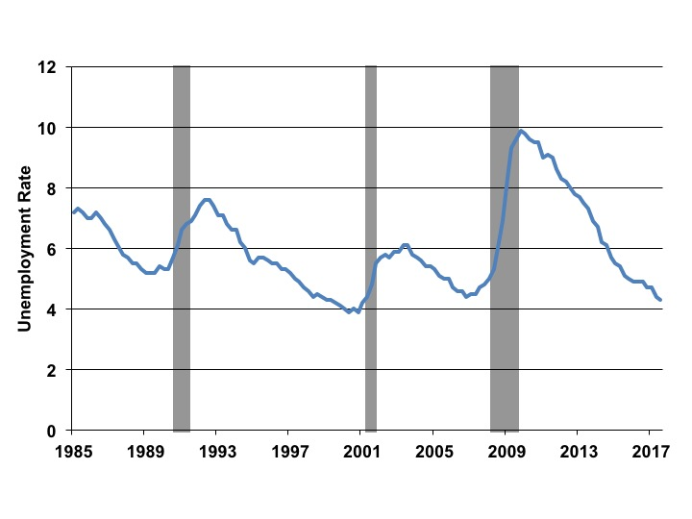
Figure 24.2 U.S. Unemployment Rate and Recessions, 1985-2017
Source: BLS monthly data 1985–2017, and NBER.

Slide 4
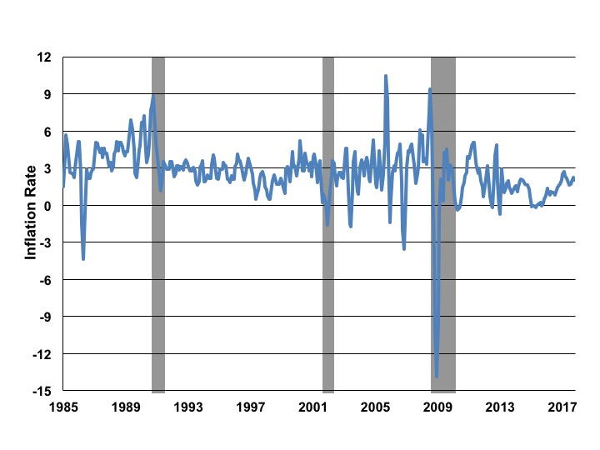
Figure 24.3 U.S. Inflation Rate and Recessions, 1985-2017
Source: “Economic Report of the President” 1985–2017; rate is calculated as a three-month moving average of the CPI; NBER.

Slide 5
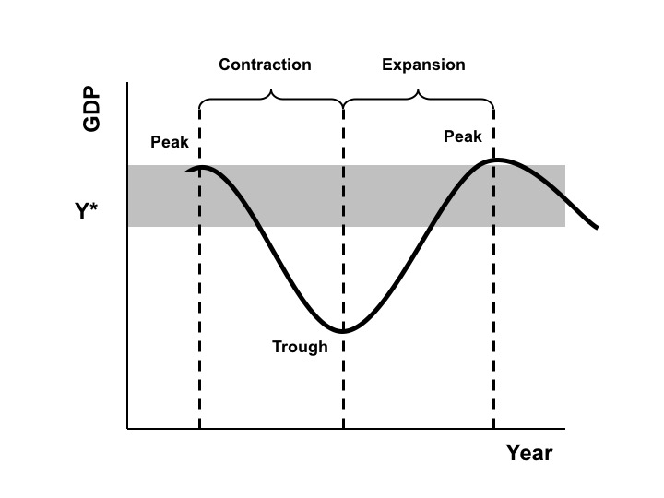
Figure 24.4 A Stylized Business Cycle

Slide 6
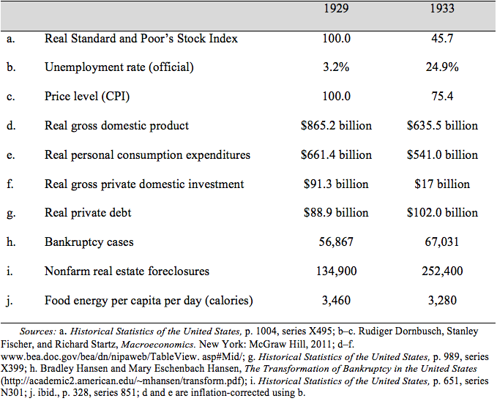
Table 24.1 The Early Years of the Great Depression in the United States

Slide 7
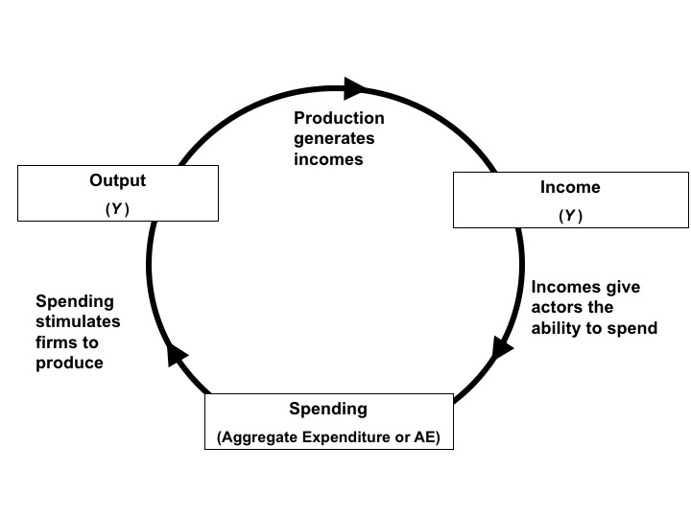
Figure 24.5 The Output-Income-Spending Flow of an Economy in Equilibrium

Slide 8
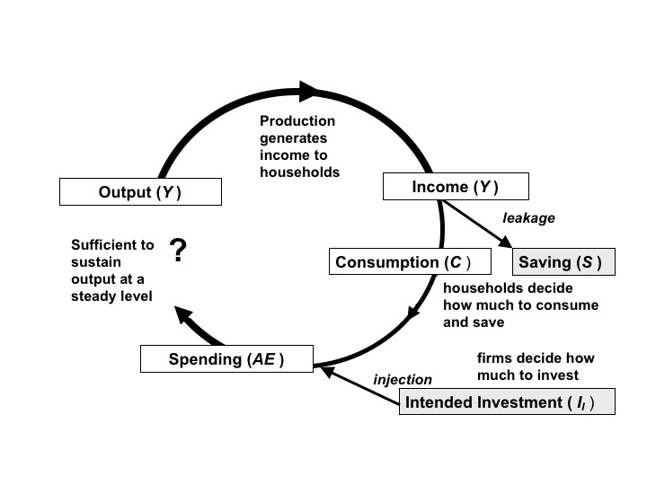
Figure 24.6 The Output-Input-Spending Flow with Leakages and Injections

Slide 9
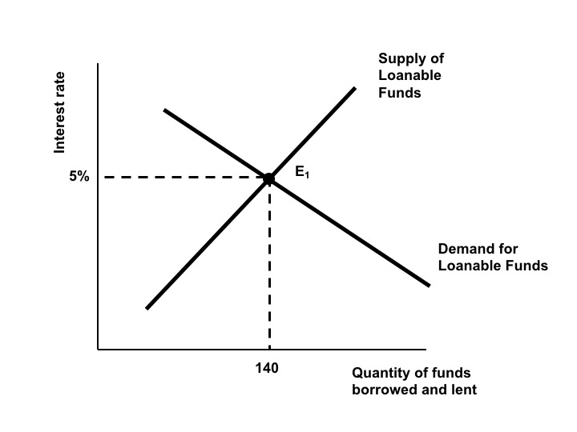
Figure 24.7 The Classical Model of the Market for Loanable Funds

Slide 10
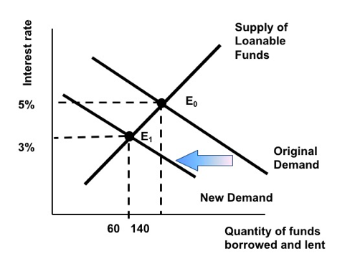
Figure 24.8 Adjustment to a Reduction in Intended Investment in the Classical Model

Slide 11
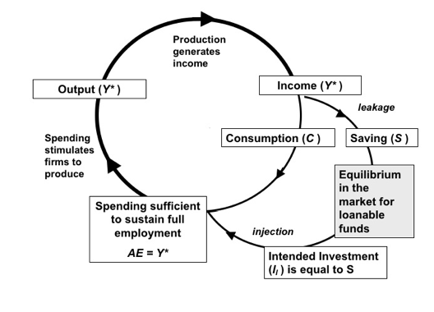
Figure 24.9 Macroeconomic Equilibrium at Full Employment in the Classical Model

Slide 12
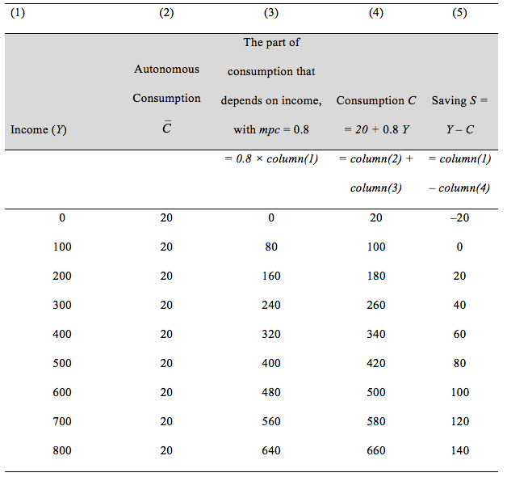
Table 24.2 The Consumption Schedule (and Saving)

Slide 13
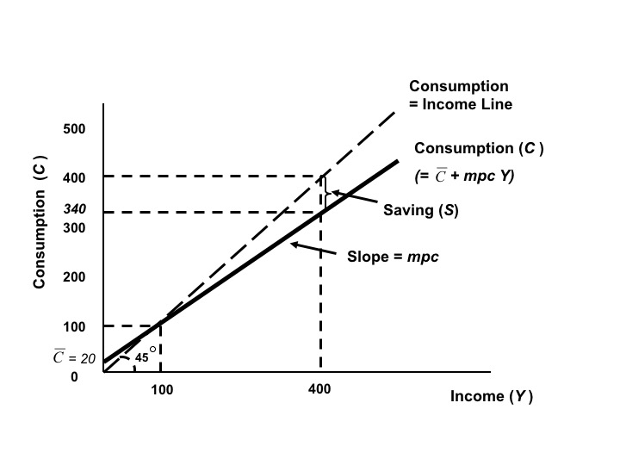
Figure 24.10 The Keynesian Consumption Function

Slide 14
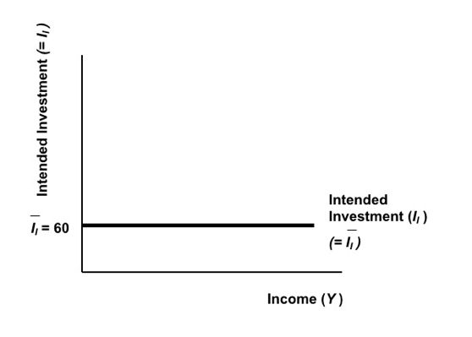
Figure 24.11 The Keynesian Investment Function

Slide 15
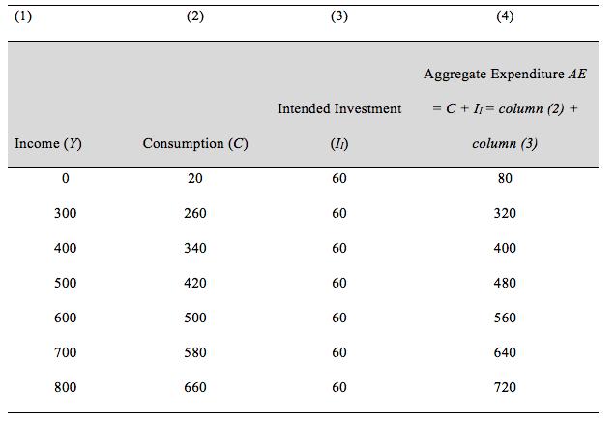
Table 24.3 Deriving Aggregate Expenditure from the Consumption Function and Investment

Slide 16
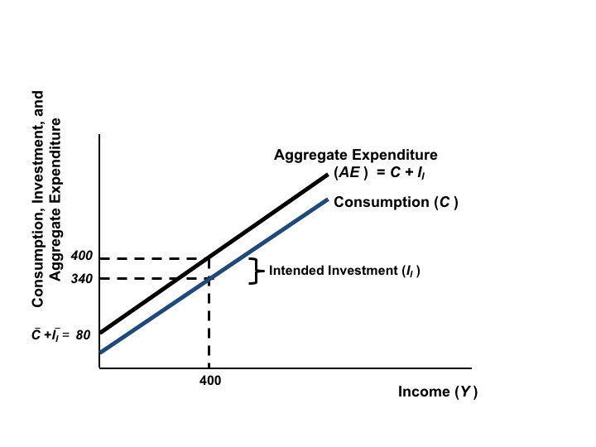
Figure 24.12 Aggregate Expenditure

Slide 17
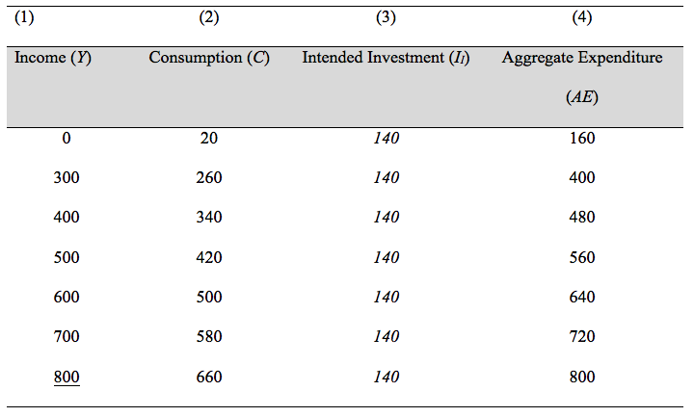
Table 24.4 Aggregate Expenditure with Higher Intended Investment

Slide 18
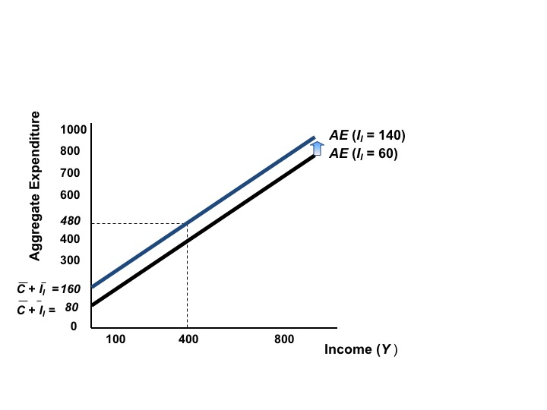
Figure 24.13 Aggregate Expenditure with Higher Intended Investment

Slide 19
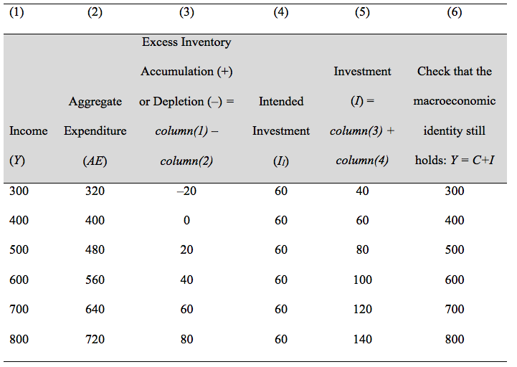
Table 24.5 The Possibility of Excess Inventory Accumulation or Depletion

Slide 20
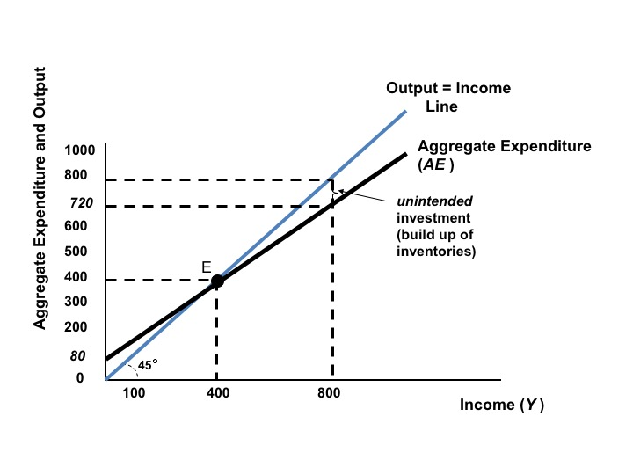
Figure 24.14 Unintended Investment in the Keynesian Model

Slide 21
Figure 24.15 Full Employment Equilibrium with High Intended Investment

Slide 22
Figure 24.16 A Keynesian Unemployment Equilibrium

Slide 23
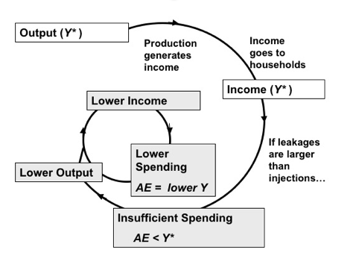
Figure 24.17 Movement to an Unemployment Equilibrium

Slide 24
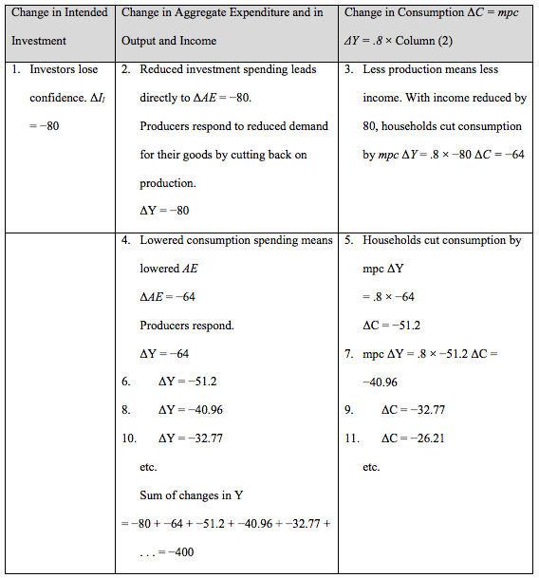
Table 24.6 The Multiplier at Work

