Slide 1
Chapter 22
The Structure of the United States Economy

Slide 2
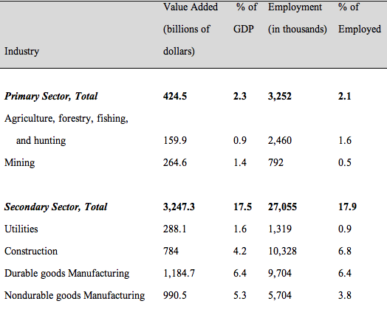
Table 22.1A Value Added and Employment by Output Sector in the United States, 2016

Slide 3
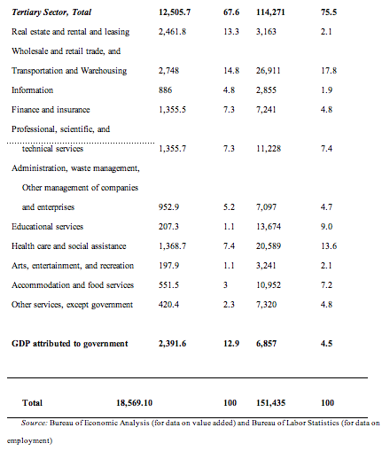
Table 22.1B Value Added and Employment by Output Sector in the United States, 2016

Slide 4
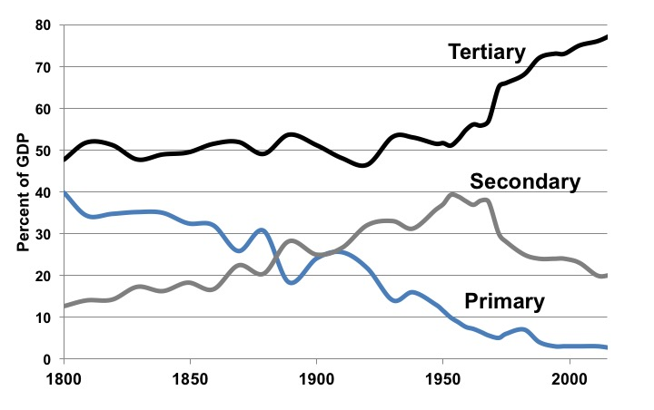
Figure 22.1 Relative Shares of United States Economic Production, by Output Sector, 1800-2016
Sources: Historical Statistics of the United States, 1789–1945, U.S. Census Bureau, 1949 (1800–1938); Historical Statistics of the United States, Bicentennial Edition, Colonial Times to 1970, U.S. Census Bureau, 1975 (1947–1968); various annual editions of the Statistical Abstract of the United States, U.S. Census Bureau (1969–2016).
Note: This graph shows relative, not absolute, magnitudes.

Slide 5
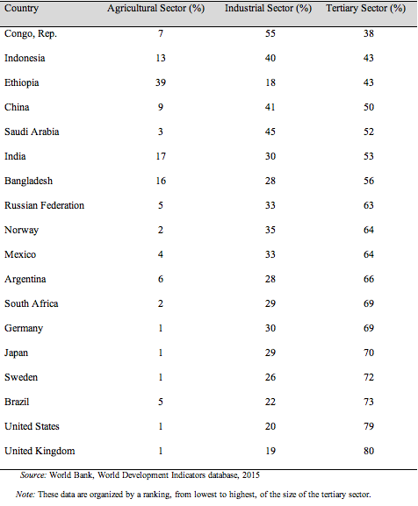
Table 22.2 Division of GDP by Output Sector, Selected Countries, 2015

Slide 6
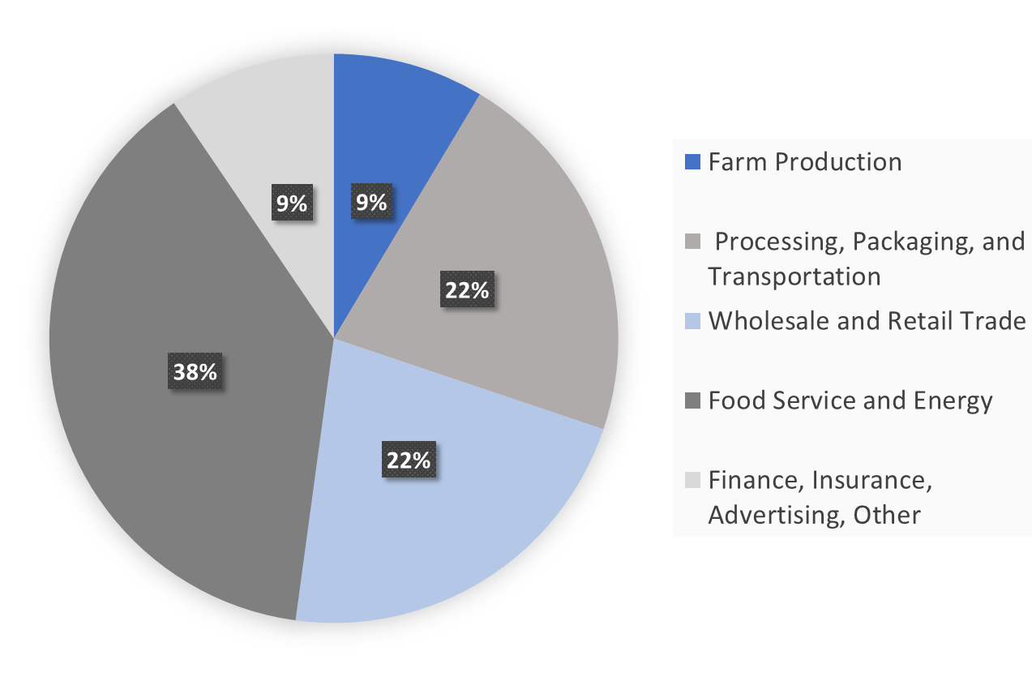
Figure 22.2 The Allocation of a Dollar Spent on Food in the United States, 2015
Source: U.S. Department of Agriculture (USDA), Food Dollar Series, 2015.
Note: “Other” includes two industry groups, Agribusiness plus Legal and Accounting.

Slide 7
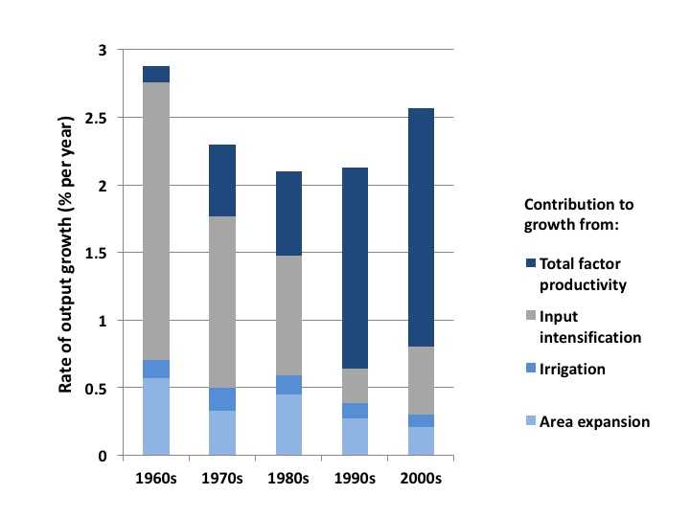
Figure 22.3 Average Annual Growth Rate in Gross Global Agriculture Output (1960s-2000s)
Source: Fuglie and Wang, 2012.

Slide 8
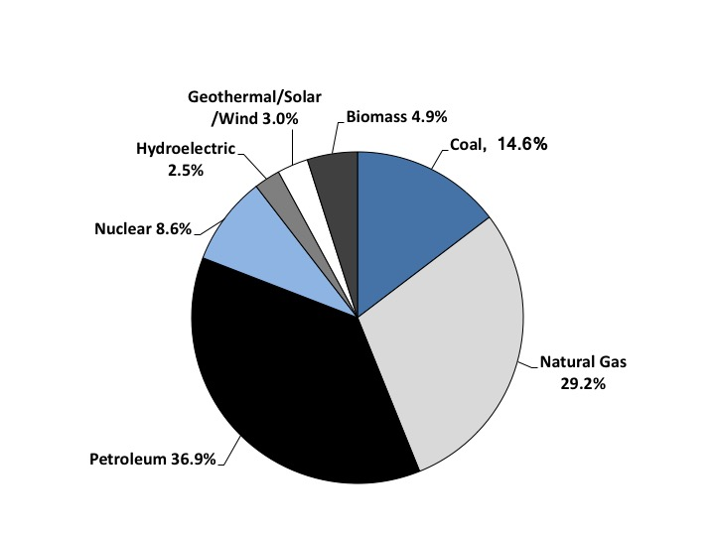
Figure 22.4 Energy Consumption in the United States, by Energy Source, 2016
Source: Monthly Energy Review, United States Energy Information Administration, 2016.

Slide 9
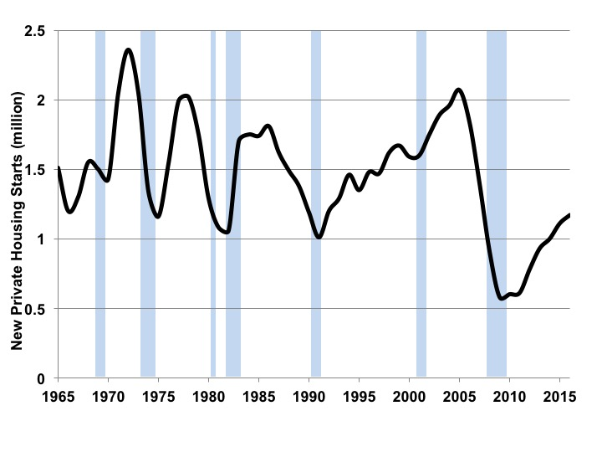
Figure 22.5 Annual Number of Private Housing Starts in the United States, 1965-2015
Sources: Various editions of the Statistical Abstract of the United States.

Slide 10
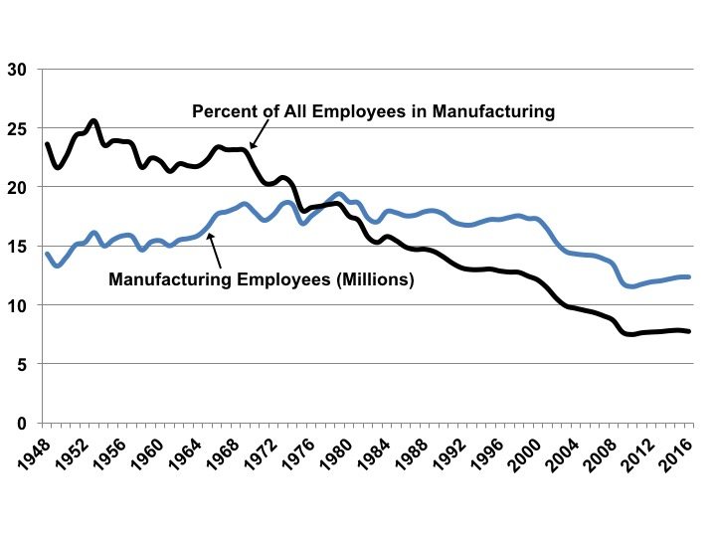
Figure 22.6 Total U.S. Manufacturing Employment and Manufacturing Employment as a Percentage of Total Employment, 1950-2016
Source: Various editions of the Statistical Abstract of the United States.

Slide 11
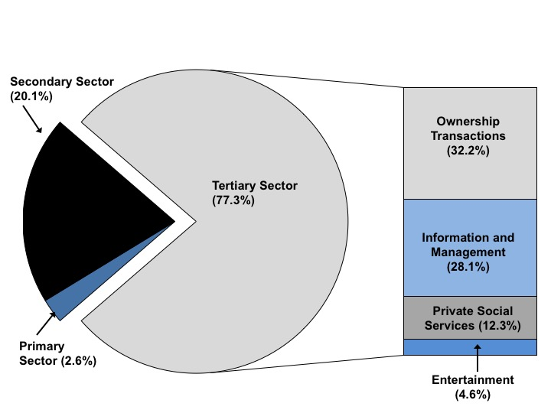
Figure 22.7 Classification of Private GDP in the United States, 2016

Slide 12
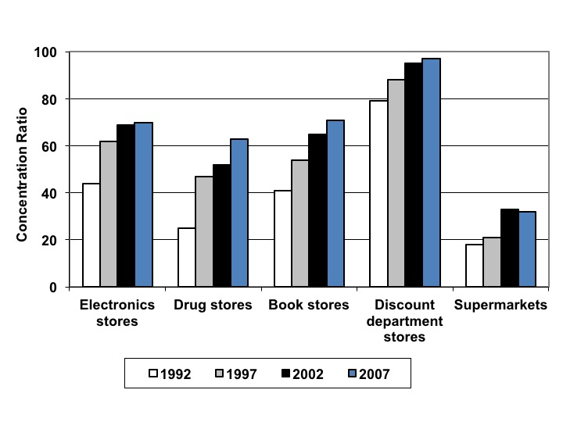
Figure 22.8 Four-Firm Concentration Ratios in Retail Industries, 1992-2007
Source: Economic Census publications, United States Census Bureau.

Slide 13
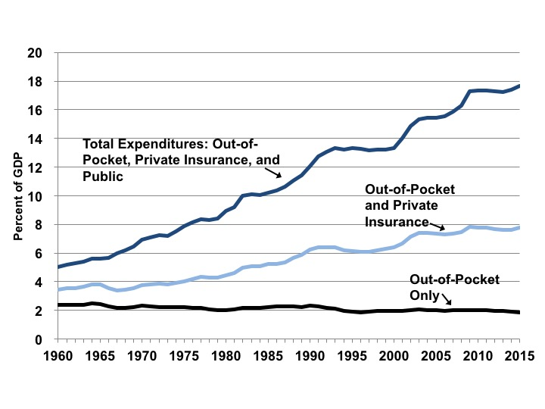
Figure 22.9 Health Care Expenditures in the United States as a Percentage of GDP, 1960-2015
Source: Various editions of the Statistical Abstract of the United States.

