Slide 1
Chapter 21
Macroeconomic Measurement: Environmental and Social Dimensions

Slide 2
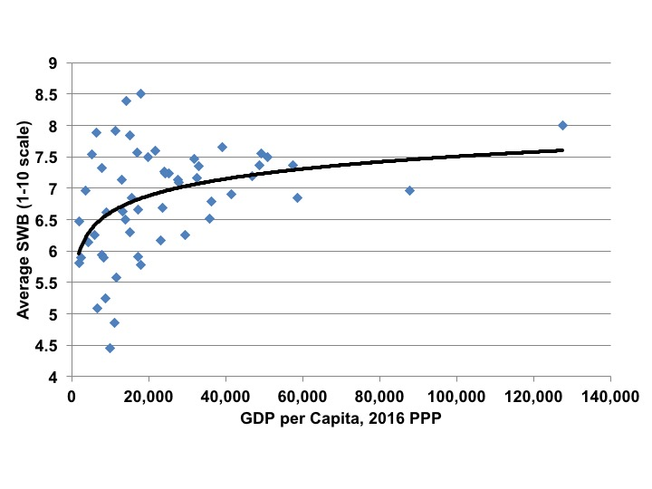
Figure 21.1 Average Subjective Well-Being and GDP Per Capita, 2016 PPP
Sources: SWB from World Values Survey online data analysis, 2005–2008 survey wave; GDP from World Development Indicators online database.
Note: The trendline is a statistically fitted line showing a “best fit” estimate of the relationship between the two variables on the graph, GDP per capita and SWB.

Slide 3
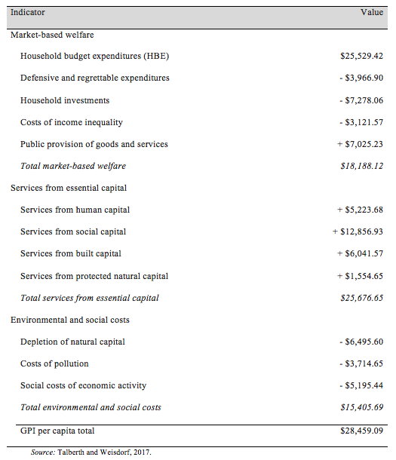
Table 21.1 Genuine Progress Indicator ($2012 per capita), United States 2014

Slide 4
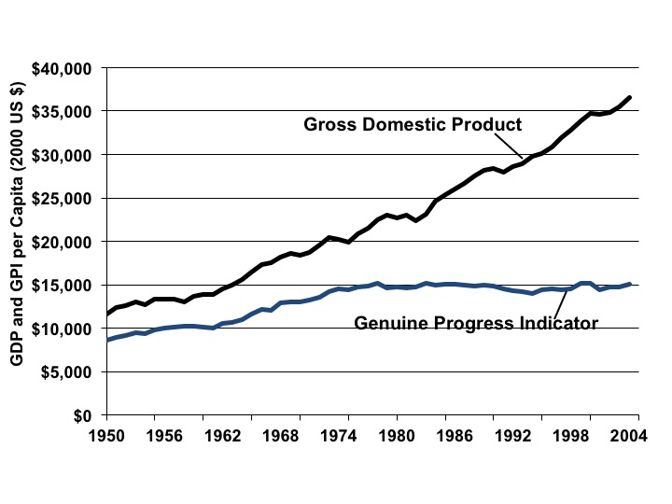
Figure 21.2 GPI vs. GDP Per Capita 1950-2004
Source: Talberth et al., 2007.

Slide 5
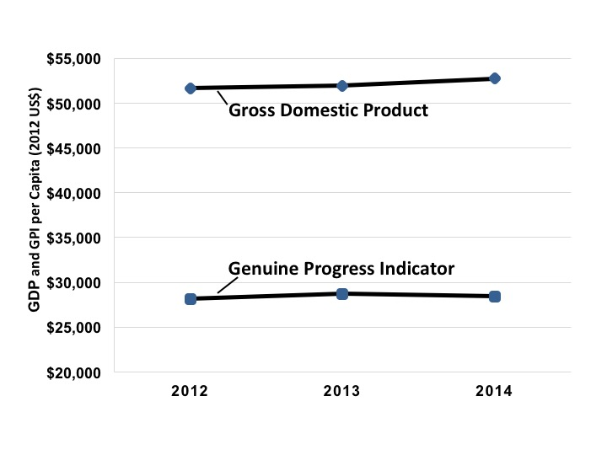
Figure 21.3 GPI vs. GDP Per Capita 2012-2014
Source: Talberth and Weisdorf, 2017.

Slide 6
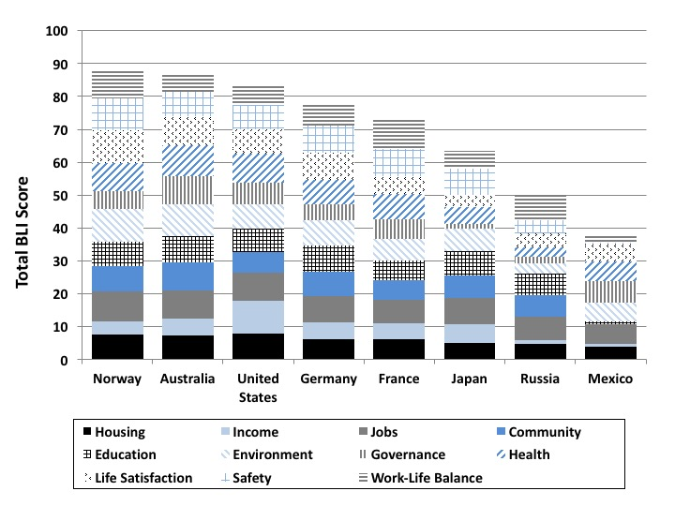
Figure 21.4 BLI for Selected Countries, 2015
Source: OECD, 2015.

Slide 7
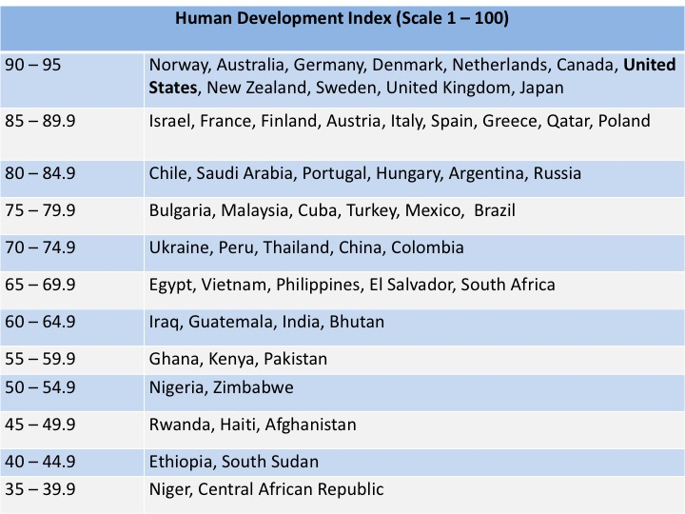
Figure 21.5 Selected Countries as Ranked in the Human Development Index
Source: UNDP, Human Development Report, 2016 data.

Slide 8
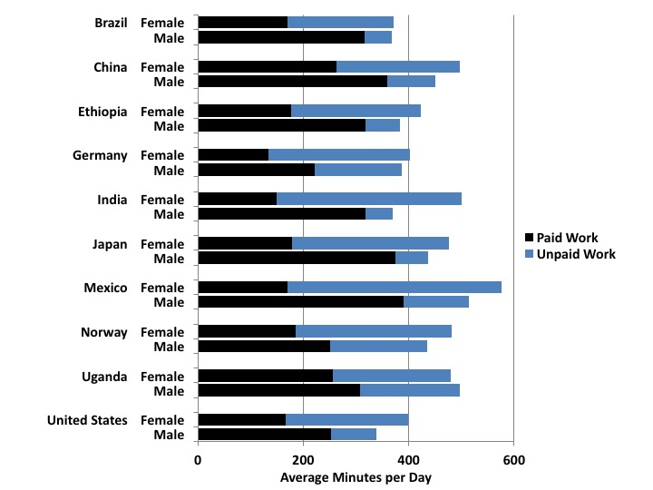
Figure 21.6 Paid and Unpaid Work by Gender, Selected Countries
Source: UN Women, 2015, Annex 3.

Slide 9
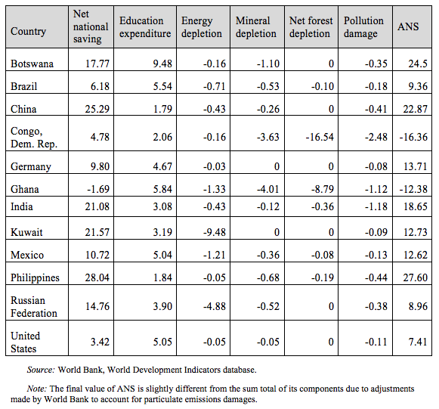
Table 21.2 Adjusted Net Saving (ANS) Rates, Selected Countries, Percent of Gross National Income, 2015

