Slide 1
Chapter 16:
Production Costs

Slide 2
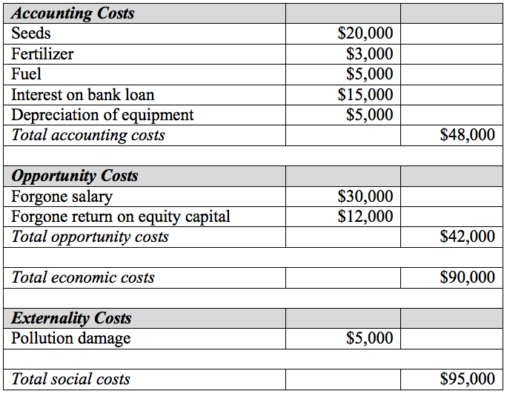
Table 16.1 Gail’s Cost of Farming

Slide 3
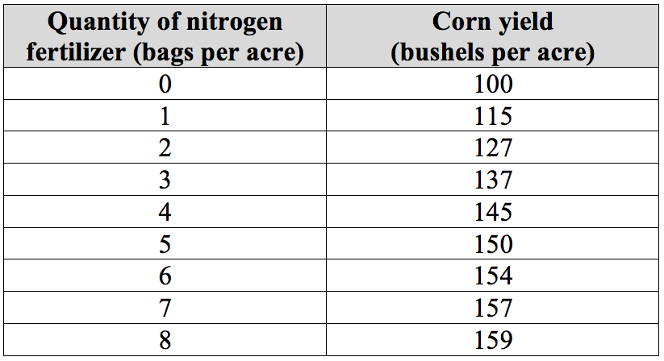
Table 16.2 Corn Production Function

Slide 4
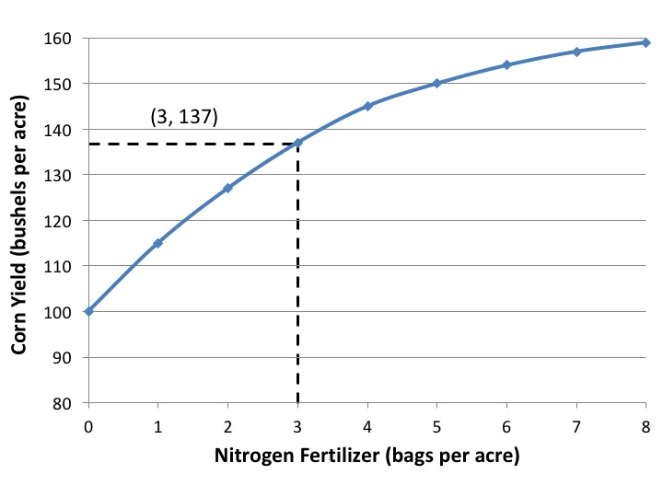
Figure 16.1 Corn Production Function

Slide 5
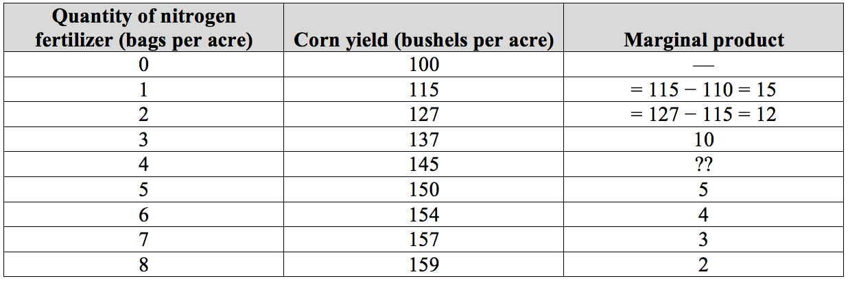
Table 16.3 Calculating Marginal Product

Slide 6
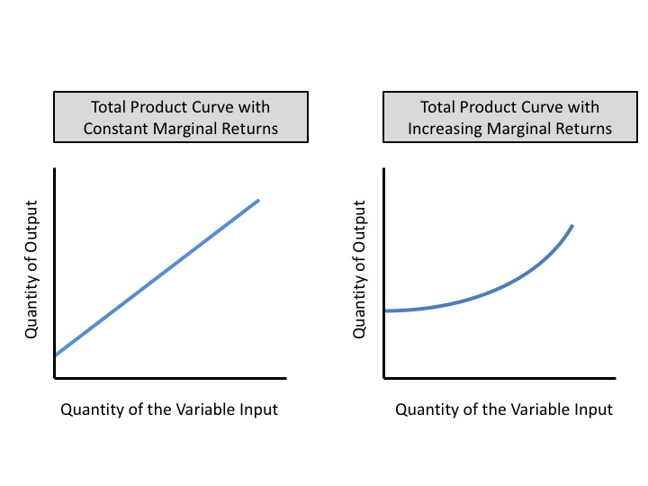
Figure 16.2 Total Product Curves with Constant and Increasing Marginal Returns

Slide 7
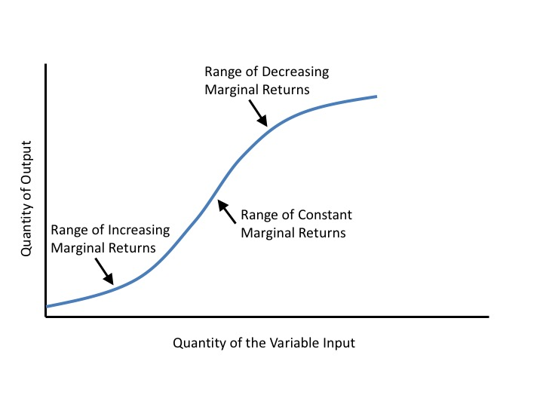
Figure 16.3 A Total Product Curve with Increasing, Constant, and Decreasing Marginal Returns

Slide 8
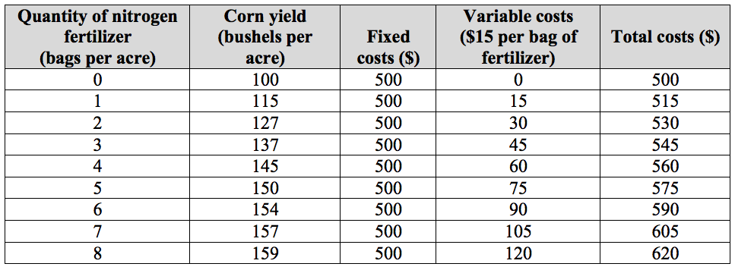
Table 16.4 Cost of Corn Production

Slide 9
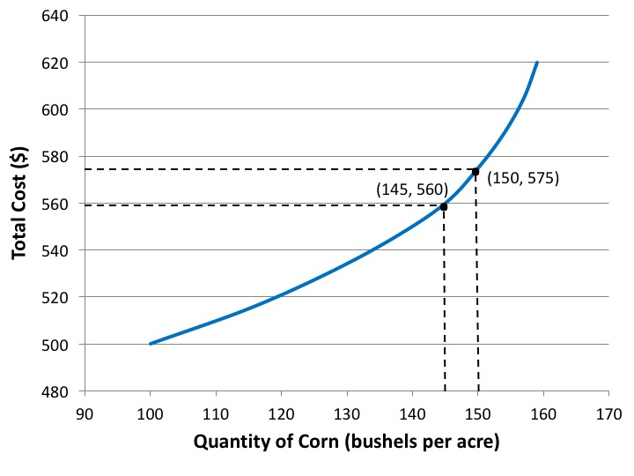
Figure 16.4 Total Cost Curve for Corn Production

Slide 10
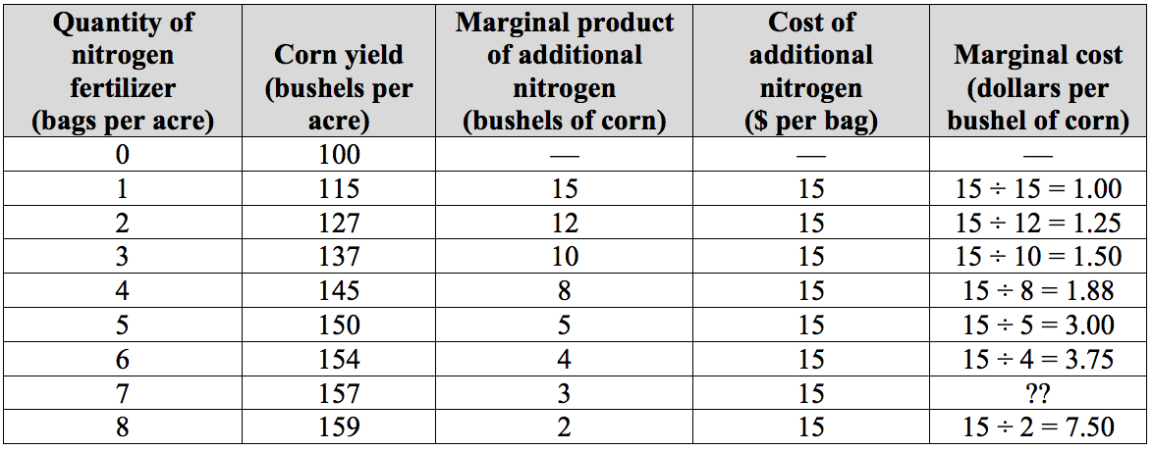
Table 16.5 Marginal Cost of Corn Production

Slide 11
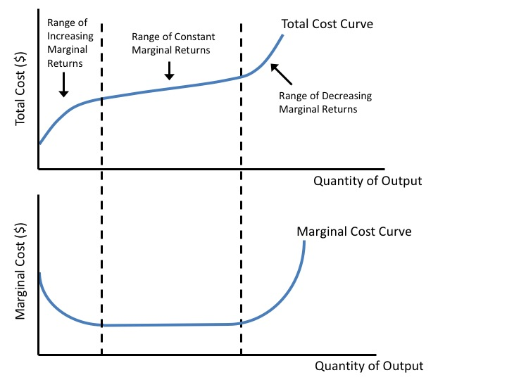
Figure 16.5 Relationship Between Total and Marginal Costs

Slide 12
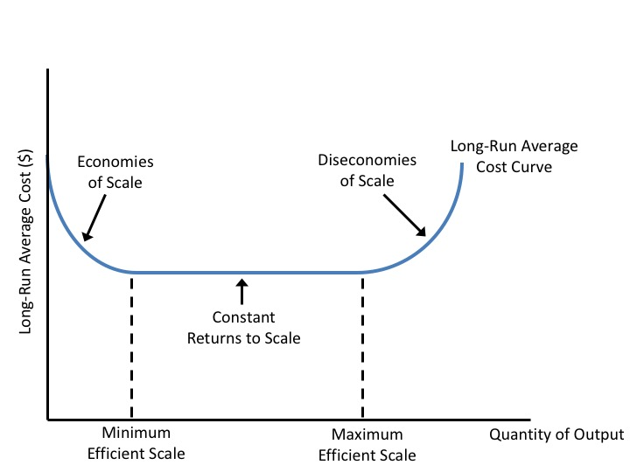
Figure 16.6 Long-Run Average Costs

Slide 13
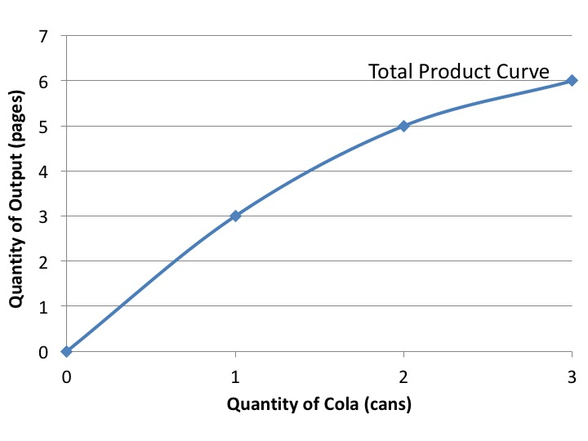
Chapter 16 Exercise 5

Slide 14
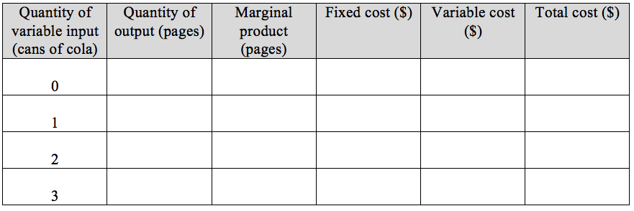
Chapter 16 Exercise 5

