Slide 1
Chapter 14:
Common Property Resources and Public Goods

Slide 2
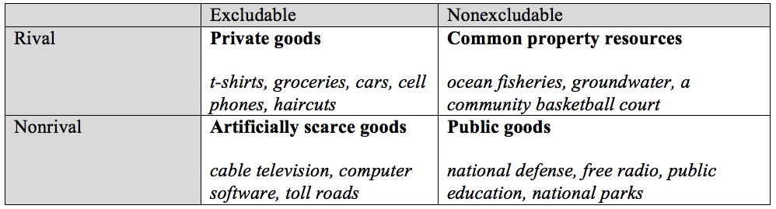
Table 14.1 Classification of Different Types of Goods

Slide 3
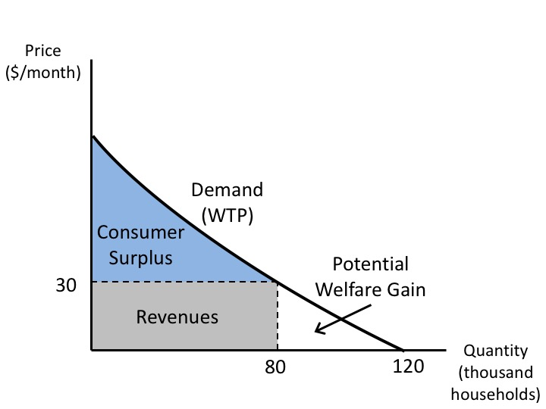
Figure 14.1 The Market for an Artificially Scarce Good (Cable Television)

Slide 4
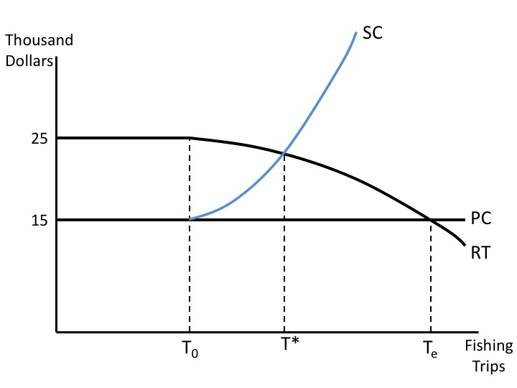
Figure 14.2 Common Property Model of a Fishery

Slide 5
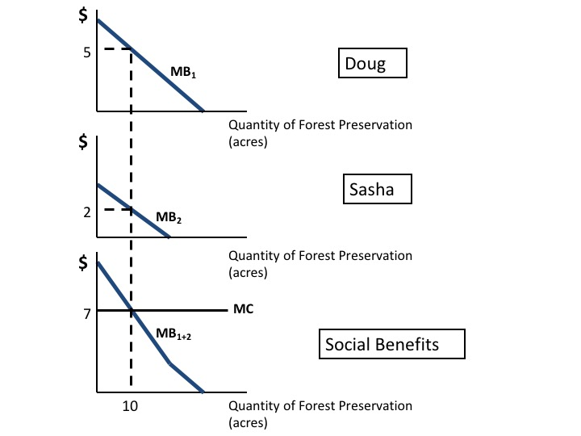
Figure 14.3 The Benefits of Public Goods

Slide 6
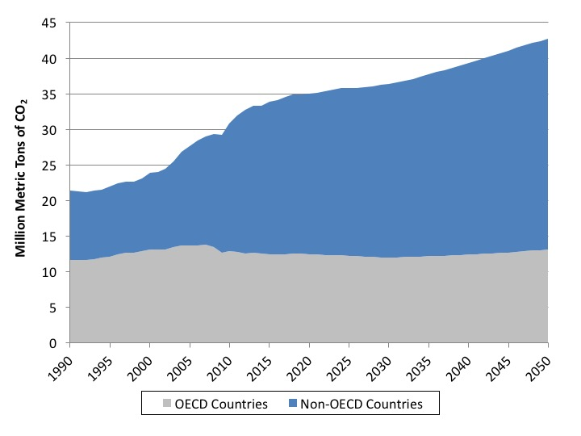
Figure 14.4 Past and Projected Global Emissions of Carbon Dioxide, 1990-2005
Source: United States Energy Information Administration online database.
Note: Projections are for the EIA Reference Scenario.

Slide 7
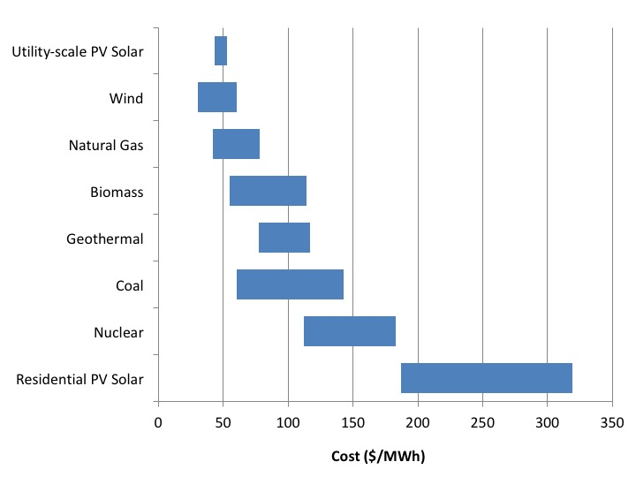
Figure 14.5 Cost Comparison of Electricity Generation from Different Energy Sources, 2017
Source: Lazard, 2017.

