Slide 1
Chapter 11:
Economic and Social Inequality

Slide 2
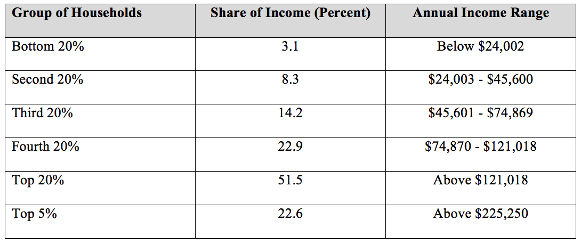
Table 11.1 Household Income Distribution in the United States, 2016
Source: U.S. Census Bureau, Historical Income Tables: Households, Tables H-1 and H-2. See:
https://www.census.gov/data/tables/time-series/demo/income-poverty/historical-income-households.html

Slide 3
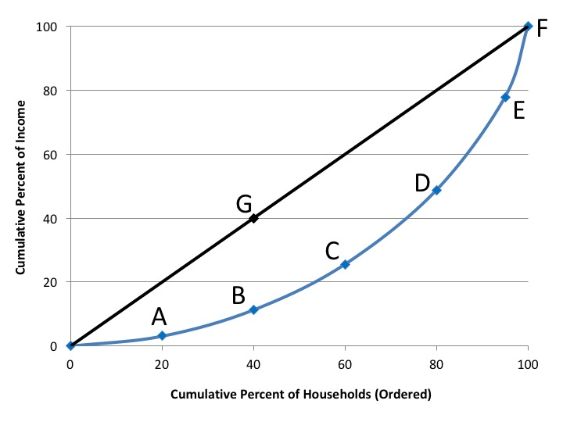
Figure 11.1 Lorenz Curve for the United States, 2016
Source: U.S. Census Bureau, Historical Income Tables: Households, Tables H-1 and H-2. See: https://
www.census.gov/data/tables/time-series/demo/income-poverty/historical-income-households.html

Slide 4
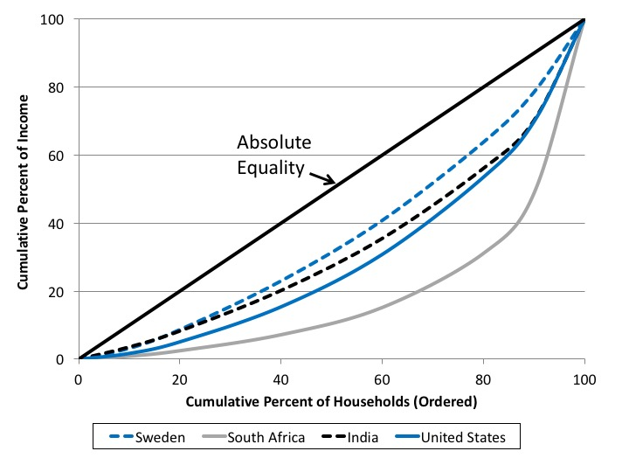
Figure 11.2 Lorenz Curves for Sweden, South Africa, India, and the United States
Source: World Bank, World Development Indicators database. Year of data varies from 2011 to 2013.

Slide 5
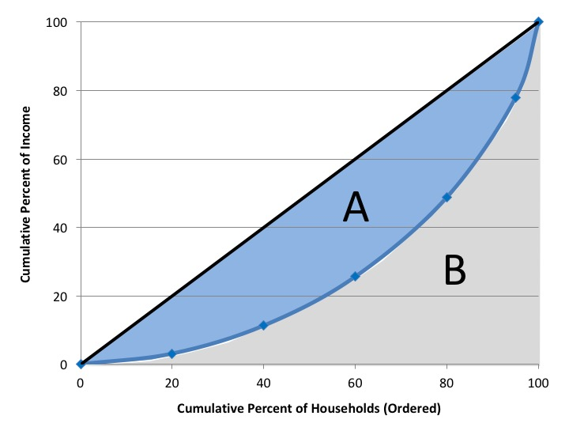
Figure 11.3 The Gini Coefficient: A / (A + B)

Slide 6
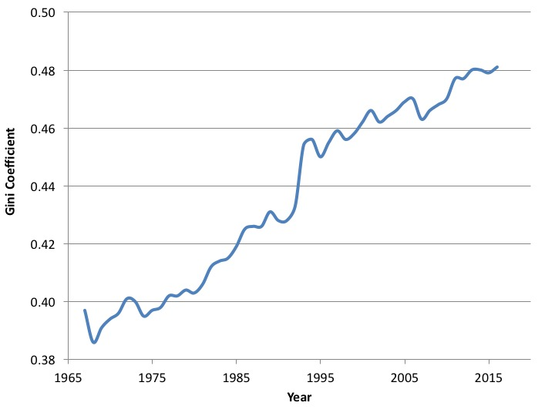
Figure 11.4 Gini Coefficient in the United States, 1967-2016
Source: U.S. Census Bureau, Historical Income Tables: Households, Table H-4. See: https://www.
census.gov/data/tables/time-series/demo/income-poverty/historical-income-households.html

Slide 7
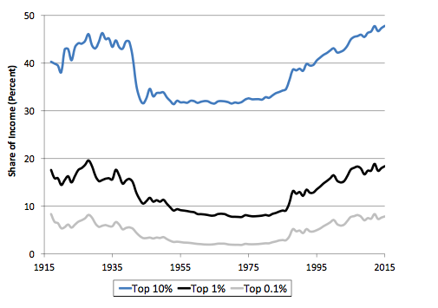
Figure 11.5 Income Shares of Top-Income Groups, United States, 1917-2016
Source: Saez, 2016.
Note: Data exclude capital gains.

Slide 8
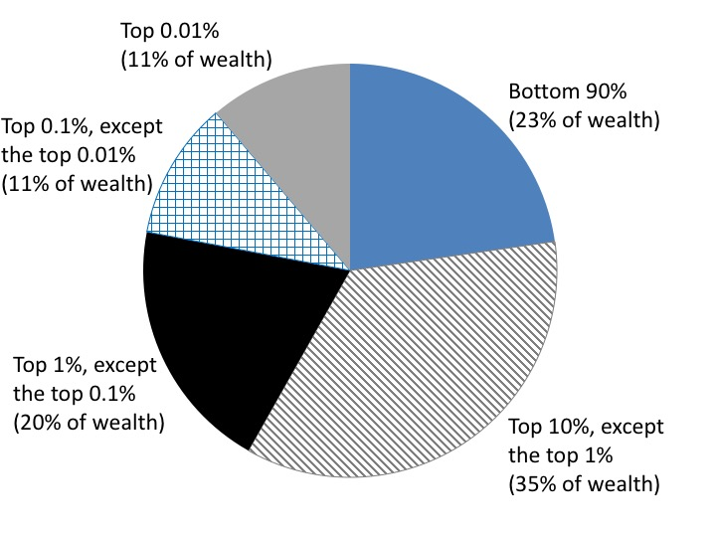
Figure 11.6 The Distribution of Wealth in the United States, 2012
Source: Saez and Zucman, 2016.

Slide 9
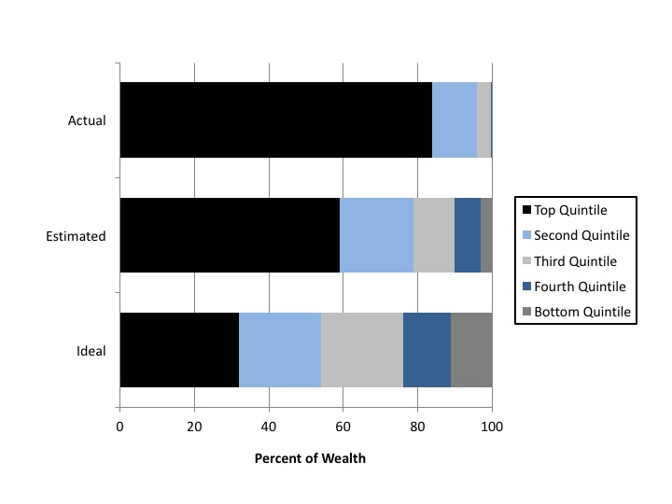
Figure 11.7 Actual, Estimated, and Ideal Distribution of Wealth in the United States
Source: Norton and Ariely, 2011.

Slide 10
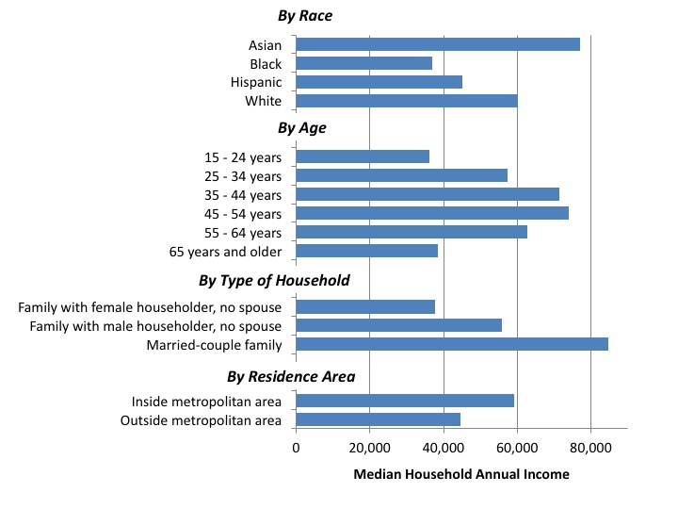
Figure 11.8 Median Household Income in the United States by Select Characteristics, 2015
Source: Proctor et al., 2016, Table 1.

Slide 11
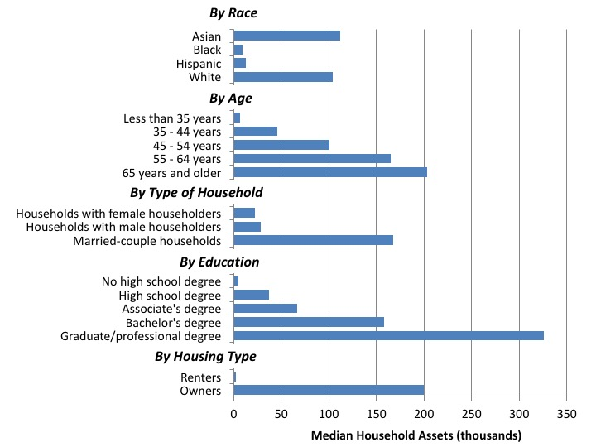
Figure 11.9 Median Value of Household Assets in the United States by Select Characteristics, 2013
Source: U.S. Census Bureau, 2017.

Slide 12
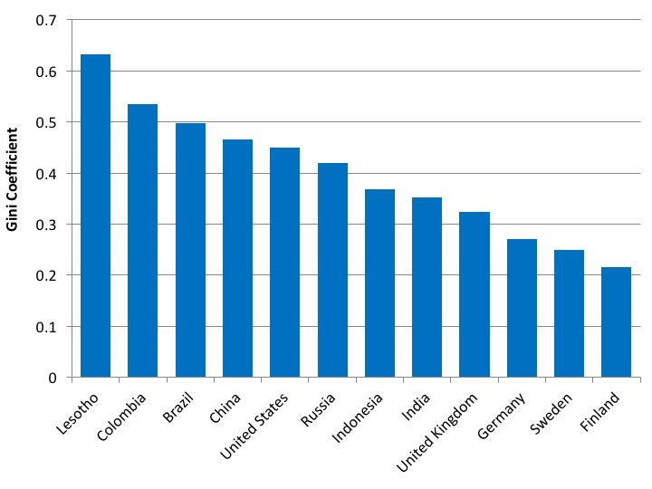
Figure 11.10 Income Gini Coefficient for Select Countries
Source: CIA World Factbook, United States Central Intelligence Agency.
Note: Year of data varies.

Slide 13
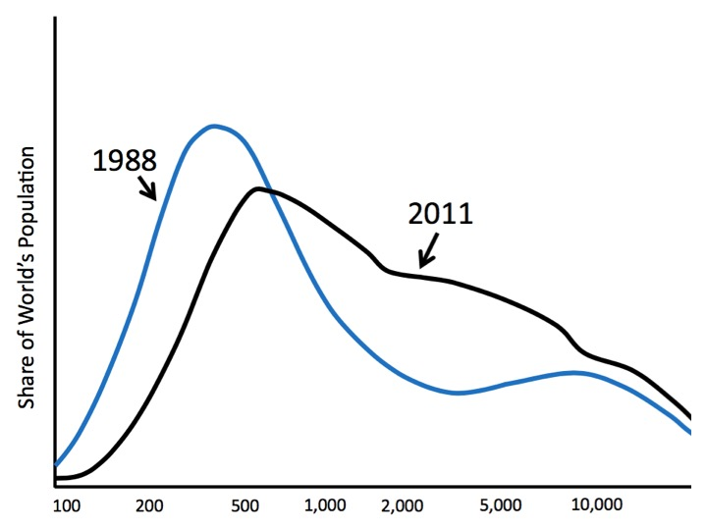
Figure 11.11 Global Income Distribution, 1988 and 2011
Source: Our World in Data website, https://ourworldindata.org/income-inequality/.

Slide 14
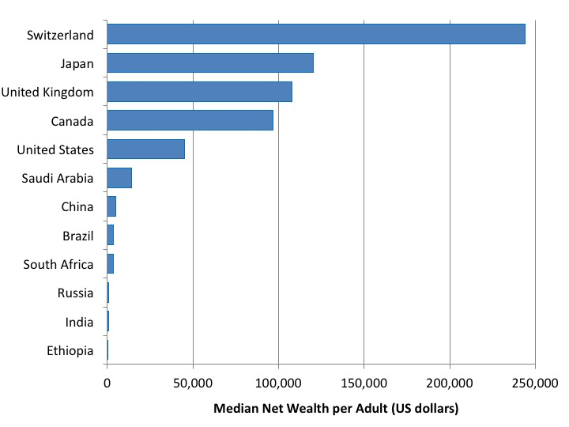
Figure 11.12 Median Net Worth per Adult, Select Countries, 2016
Source: Credit Suisse, 2016b.

Slide 15
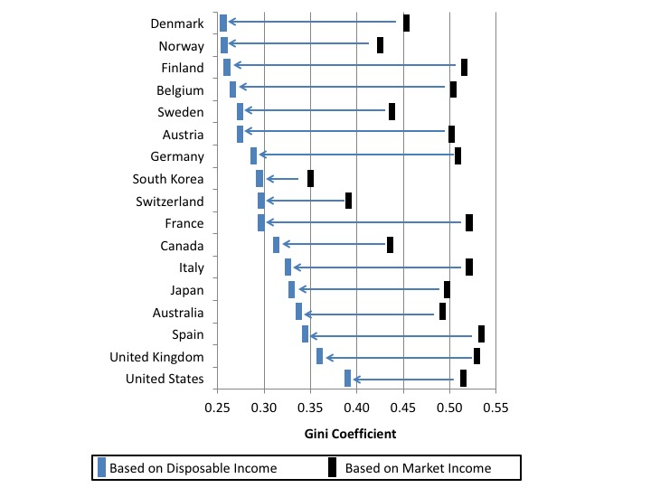
Figure 11.13 Market - and Disposable-Income Gini Coefficients, Select OECD Countries
Source: OECD online statistics database, Income Distribution and Poverty.
Note: Data for most countries are from 2014. Other data are from 2013 or 2015.

