Slide 1
Chapter 10:
Markets for Labor

Slide 2
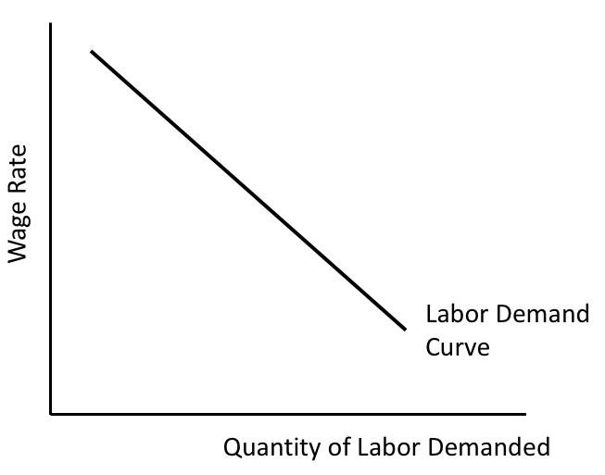
Figure 10.1 An Individual Firm’s Labor
Demand Curve

Slide 3
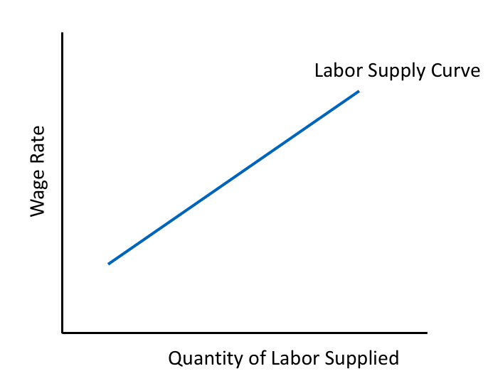
Figure 10.2 Upward-Sloping Labor Supply Curve

Slide 4
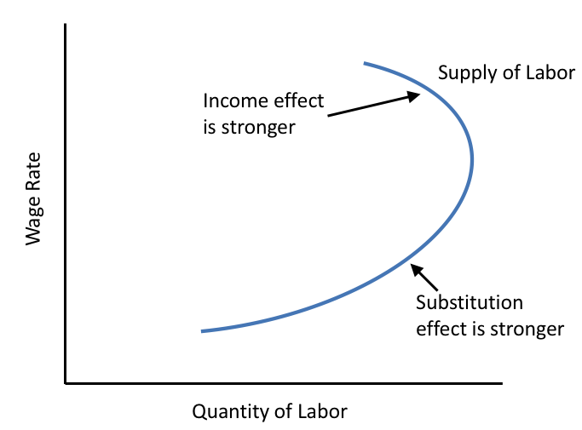
Figure 10.3 Backward-Bending Individual Labor Supply Curve

Slide 5
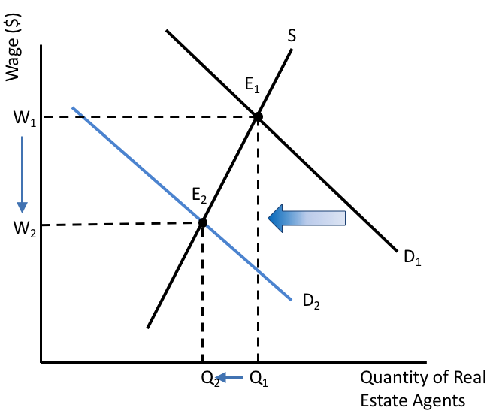
Figure 10.4 The Labor Market for Real Estate Agents

Slide 6
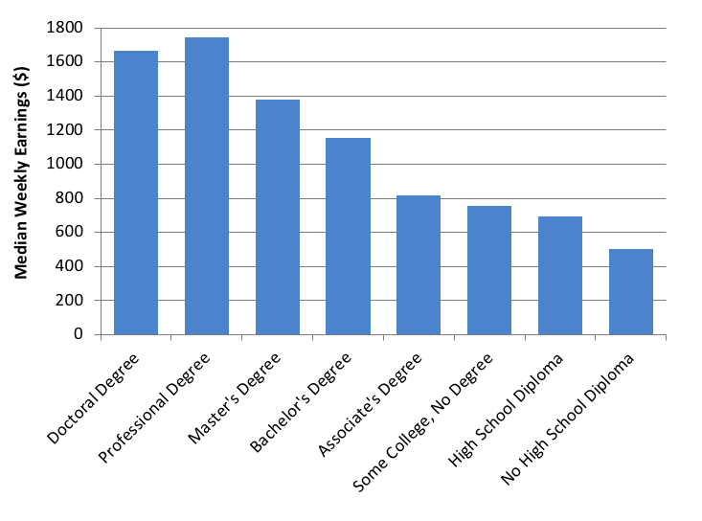
Figure 10.5 Median Weekly Earnings of U.S. Workers, by Educational Attainment, 2016
Source: U.S. Bureau of Labor Statistics, 2017a.

Slide 7
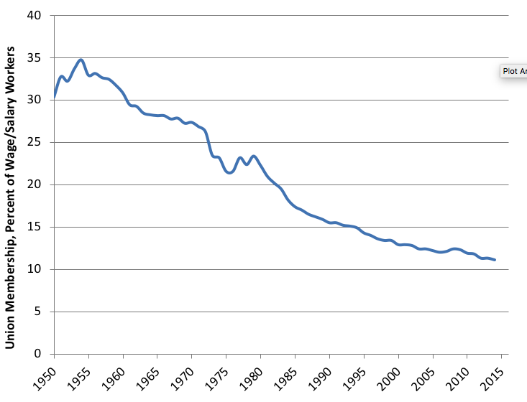
Figure 10.6 Union Membership in the United States,
1950-2016
Source: Mayer, 2004; U.S. Bureau of Labor Statistics, 2017.

Slide 8
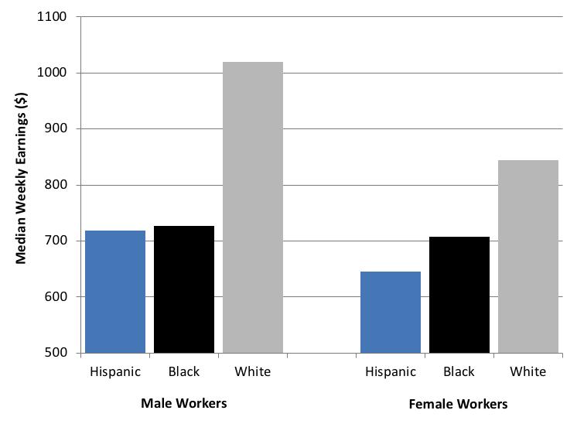
Figure 10.7 Median Weekly Earnings, Select Groups of U.S. Workers, Age 25 and Over, 2017
Source: U.S. Bureau of Labor Statistics, 2017d.

Slide 9
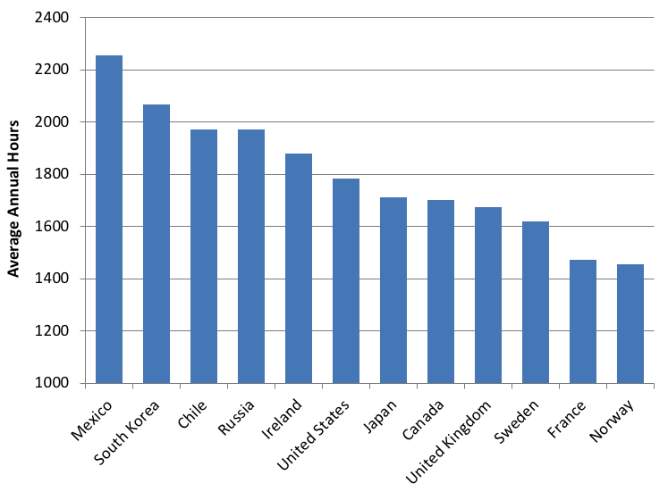
Figure 10.8 Average Annual Hours Worked,
Select Countries, 2016
Source: OECD, OECD. Stat, “Average Annual Hours Actually Worked per Worker.”

Slide 10
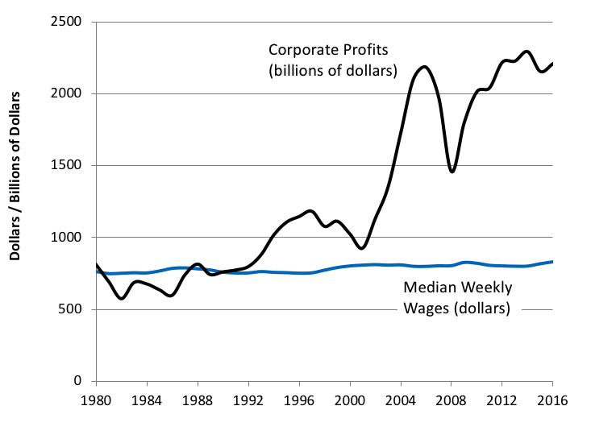
Figure 10.9 Real Median Weekly Wages Versus Real Corporate Profits, United States, 1980-2016
Source: Federal Reserve Bank of St. Louis, National Income: Corporate Profits before Tax; U.S. Bureau of Labor Statistics, Weekly and Hourly Earnings Data from the Current Population Survey.

Slide 11
Table 10.1 Labor Analysis of Hypothetical Razor Firm
Quantity of labor | Quantity of razors | MPP_{L} | MRP_{L} | MFC_{L}
1 | 5 | 5 | 15 | 12
2 | 12 | 7 | 21 | 12
3 | 18 | 6 | 18 | 12
4 | 23 | 5 | 15 | 12
5 | 27 | 4 | 12 | 12
6 | 30 | 3 | 9 | 12
7 | 32 | 2 | 6 | 12
8 | 33 | 1 | 3 | 12

Slide 12
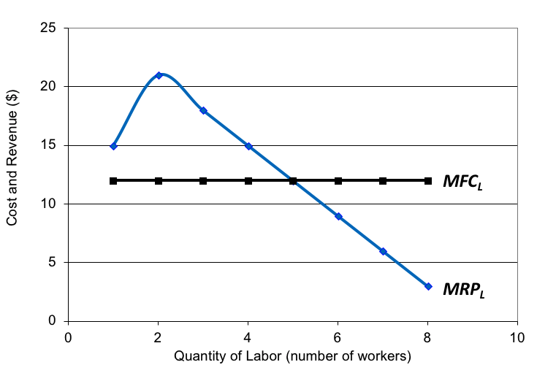
Figure 10.10 Marginal Revenue Product of Labor and Marginal Factor Cost of Labor

