Slide 1
Chapter 0:
Economics and
Well-Being

Slide 2
Figure 0.1: GDP per Capita (Constant 2010 USD)
GDP Per Capita (Constant 2010 USD)
Source: World Bank, World Development Indicators database.
Notes:
What it is: GDP, or Gross Domestic Product, is a measure of the total value of goods and services produced in a country. As discussed in Chapters 20 and 21, there are controversies about exactly what is covered, or not covered, by GDP, but the measure is used very widely as an index of the status and growth of an economy. GDP can be seen both as a measures of product and of income. GDP per capita, shown here, is GDP divided by the country’s population, and the time trend of GDP/capita shows how average income changes over time.
The results: U.S. GDP per capita has increased by more than three times since 1960. The progression has not been entirely smooth, with pauses and declines especially during periods of economic recession, but the overall trend is upwards. One of the largest breaks in this trend was the recession of 2007-9, discussed in detail in Chapters 28 and 30. As the graph shows, GDP/capita started to recover after 2010, but remained below its 2007 peak until 2013. GDP per capita has continued to grow, reaching over $53,000 in 2017.

Slide 3
Figure 0.2: Unemployment Rate (Annual Average),
1960-2017
Unemployment Rate, Percent of Labor Force
Source: U.S. Bureau of Labor Statistics, Current Population Survey, 2018.
Notes:
What it is: The unemployment rate is a measure of the proportion of people in the labor force who are seeking jobs but unable to find them (discussed in detail in Chapter 23). The measure does not include people who have part-time work but would like full-time work, nor does it include “discouraged workers” who have given up looking for work. The unemployment rate typically falls during economic expansions, and rises during and immediately after economic recessions.
The results: U.S. unemployment has varied since 1960 between about 3 and 10 percent. In expansionary periods such as the late 1960s and the late 1990s, it was between 3.5 and 5 percent. In recessions it has typically risen above 6 percent, with peaks of between 8 and 10 percent in 1975, 1982, and 2010, resulting from severe recessions. Since 2016, unemployment rate has remained below 5 percent and in September 2018, it reached a nearly five-decade low of 3.7 percent, suggesting strong labor market conditions.

Slide 4
Figure 0.3: Inflation Rate, 1960-2017
Percent Annual Inflation
Source: U.S. Bureau of Labor Statistics, Consumer Price Index (CPI-U), 2018.
Notes:
What it is: The inflation rate is a measure of the average increase in prices between one year and the next. It is measured by the change in the Consumer Price Index, discussed in Chapter 20. There are various versions of the Consumer Price Index (CPI); the graph below is based on the CPI-U, which measures the cost of living in urban areas.
The results: The U.S. inflation rate has varied considerably since 1960, with noticeable peaks in the late 1970s and early1980s. At these times, the inflation rate rose above 10 percent (referred to as “double-digit inflation). This level of inflation is considered significantly harmful to an economy, as discussed in Chapters 26-28. Since 1992, inflation rates in the United States have generally been fairly low, not rising above 4 percent, and averaging around 2 percent. During the 2007-9 recession, inflation briefly fell to zero, arousing concern about deflation—negative inflation or generally falling prices. (Although some might think that falling prices would be a good thing, sustained deflation can be very damaging to businesses and reduce employment, as occurred during the Great Depression of the 1930s.)

Slide 5
Figure 0.4: Taxes as a Percentage of GDP
Total Taxes
Federal Taxes
State and Local Taxes
Source: U.S. Bureau of Economic Analysis, online database.
Notes:
What it is: The graph below shows tax collections in the United States over the period 1950–2016, measured as a percent of gross domestic product (GDP). Total taxes are divided into federal taxes and state and local taxes.
The results: Total tax collections in the United States gradually increased from about 25 percent of GDP in the 1950s to close to 35 percent of GDP in the late 1990s. Since then, federal tax revenues have fluctuated—falling during recessions and increasing during economic recoveries. While surveys of Americans show that many people believe taxes have gone up in recent years (particularly federal taxes), this is generally not true. We will discuss taxes in more detail in Chapters 12 and 25.

Slide 6
Figure 0.5: Stock Market Performance
Source: Yahoo Finance, https://finance.yahoo.com/quote/%5EGSPC?p=^GSPC
Notes:
What it is: Media stories about the economy often focus on the performance of the stock market. Several common stock indices, such as the Dow Jones Composite, the Nasdaq Composite, and S&P (Standard & Poor’s) 500 Index, provide a broad overview of stock market prices. The graph below shows the value of the S&P 500 Index from 1965 to early 2018. The S&P 500 Index is calculated based on the stock prices of 500 large, mostly American, companies.
The results: From 1965 to 2000 the S&P 500 Index rose from about 100 to over 1,500. Since 2000, there have been two major “crashes” in the American stock market. Recovering from the Great Recession, the S&P 500 increased by about 300 percent between 2009 and 2018. While we won’t discuss the stock market in much detail in this book, we will spend considerable time discussing how markets operate, including the factors that lead to price fluctuations.

Slide 7
Figure 0.6: Median Home Prices
Source: Federal Reserve Bank of St. Louis, Case-Shiller U.S. National Home Price Index.
Notes:
What it is: The “median” price of home sales is the price at which half of homes sell for more than this price, and half sell for less. The graph below shows median home price in the United States over the period 1987 to mid-2018. The prices have not been adjusted for inflation.
The results: The median price of houses in the United States increased by a factor of three between 1987 and 2007. Then the housing bubble burst, and home prices fell by about one-third. Since then home prices have recovered to their previous levels. Our discussion of markets, beginning in Chapter 3 and covering most of the chapters in this book, will help you understand how markets operate.

Slide 8
Figure 0.7: Median Worker Earnings vs. Corporate Profits
Corporate Profits (billions of dollars)
Median Weekly Wages (dollars)
Source: Federal Reserve Bank of St. Louis, National Income: Corporate Profits before Tax; U.S. Bureau of Labor Statistics, Weekly and Hourly Earnings Data from the Current Population Survey.
Notes:
What it is: The graph below shows the change in two variables over the period of 1980 to 2016 in the United States:
1. Total corporate profits, measured in billions of dollars
2. Median weekly earnings for American workers, measured in dollars
The data for both variables have been adjusted for inflation. Note that the vertical axis is measured in dollars for median worker earnings and billions of dollars for corporate profits.
The results: Corporate profits have fluctuated based on the health of the overall economy, but we see that profits have reached record highs recently. Corporate profits in 2016 were about three times the level they were at in 1980. Meanwhile, the median wages of U.S. workers have essentially not changed at all since 1980. We will discuss wages in more detail in Chapters 10 and 23, including the reasons why wages have not risen in proportion to corporate profits.

Slide 9
Figure 0.8: Gender-Based Earnings Inequality
Source: U.S. Bureau of Labor Statistics. 2017. “Highlights of Women’s Earnings in 2016.” Report 1069.
Notes:
What it is: The “gender wage gap” is the difference in median earnings between men and women who work full-time. The graph below shows women’s median earnings in the United States as a percentage of men’s median earnings, over the period 1979 to 2016.
The results: In 1979 women working full-time in the United States only earned 62 percent of what men earned. During the 1970s and 1980s, the gender wage gap closed considerably. By the early 2000s, women working full-time earned about 80 percent of what men earned. Since then, the wage gap has remained relatively constant. In 2016, women earned 82 percent of what men earned. Is this clear evidence of gender discrimination? We’ll discuss this topic in more detail in Chapter 10.

Slide 10
Figure 0.9: Global International Trade
Source: World Bank, World Development Indicators database.
Notes:
What it is: The graph below shows the percentage of world economic production (called “gross world product”) that is traded across international borders, over the period 1960 to 2015. This is one way to get a quick, partial snapshot of the degree of “globalization.”
The results: At least as measured by international trade, the world is clearly becoming more globalized in recent decades. About 12 percent of all goods and services produced in the world were traded in 1960. Currently about 30 percent of world production is traded internationally. We can see that the global financial crisis of 2007–2009 temporarily reduced international trade, but that it has since recovered to previous levels. We will discuss the topic of international trade further in Chapters 7 and 29.

Slide 11
Figure 0.10: Global Carbon Dioxide Emissions
Source: Global Carbon Project. Global Carbon Atlas. http://www.globalcarbonatlas.org/en/content/welcome-carbon-atlas.
Notes:
What it is: The vast majority of scientists believe that human activities are impacting the global climate. Carbon dioxide emissions, which result when oil, coal, and natural gas are burned, have been identified as the primary cause of global climate change. The graph below shows global carbon dioxide emissions from 1960 to 2016, measured in gigatons (a gigaton is a billion metric tons).
The results: We see that global carbon dioxide emissions increased from about 10 gigatons in 1960 to about 35 gigatons recently. While most projections indicate that global carbon dioxide emissions will continue to increase in the future, scientists note that emissions will need to decrease substantially in the next few decades to avoid significant negative consequences to the global ecosystem and to human societies. We will discuss global climate change in more detail in Chapters 14 and 33.

Slide 12
Figure 0.11: Income Inequality
Source: U.S. Census Bureau. 2017. “Historical Income Tables: Households,” Table H-3.
Notes:
What it is: The graph below shows the average household income for different income groups in the United States, based on 2016 data. Each group represents one-fifth of American households, except for the last group which includes only the top 5 percent.
The results: For American households with income in the bottom fifth, average income in 2016 was only about $13,000. For those in the middle fifth, household income averaged nearly $60,000. Those in the top fifth had an average household income of about $210,000. Average household income was over $375,000 for the top 5 percent. Note that these are average values, so some households in each group made less than these income values, while some made more. We will discuss income inequality, including its causes, in more detail in Chapters 11 and 30.

Slide 13
Figure 0.12: Unequal Income Growth
Source: U.S. Census Bureau. 2017. “Historical Income Tables: Households,” Table H-3.
Note: We use 1968 as the starting year in this analysis because it is the year in which income inequality in the United States started to increase, as we will discuss in Chapter 11.
Notes:
What it is: The graph below shows the growth in household income for different income groups in the United States, over the period 1968–2016. Similar to the previous graph, each group represents one-fifth of American households, except for the last group which includes only the top 5 percent. The data have been adjusted for inflation.
The results: You’ve probably heard the saying that “The poor get poorer and the rich get richer.” That’s close, but not quite true. We see that those at the bottom of the income distribution did see small income gains in recent decades. Those in the middle did a little better. But the largest gains, by far, were obtained by those at the top, particularly those in the top 5 percent. The graph tells us that income inequality has increased considerably in recent decades. We will discuss trends in income inequality in more detail in Chapters 11 and 30.

Slide 14
Figure 0.13: Educational Attainment
Sources: U.S. Census Bureau, Educational Attainment, CPS Historical Time Series Tables, Table A-1; U.S. Census Bureau, Educational Attainment in the United States: 2017, Table 1.
Notes:
What it is: Education is an important type of “human capital”—a term economists use to describe the knowledge and skills people possess that allows them to engage in production activities. The graph below shows the maximum educational attainment for Americans age 25 and over in 1960, 1970, 1980, 1990, 2000, 2010, and 2017. Each column adds up to 100%, but the percent falling into each education category varies with changes in educational attainment.
The results: In 1960, about 58 percent of Americans age 25 and over had not graduated high school, and less than 10 percent had a college degree or higher. We see that educational attainment has increased each decade, but still only about 34 percent of adult Americans have a college degree or higher. We will discuss education as a form of human capital in Chapter 15, and the relationship between education and wages in Chapter 10.

Slide 15
Figure 0.14: Industrial Concentration Ratios
Source: U.S. Census Bureau, 2012 Economic Census.
Note: Manufacturing concentration ratios based on value-added. All other concentration ratios based on revenues.
Notes:
What it is: An industrial concentration ratio measures the percentage of all sales in a particular industry that are received by the largest firms in that industry. The figure below shows four-firm and eight-firm concentration ratios—the percentage of all sales received by the largest four and eight firms in each industry. Industrial concentration ratios provide information about the degree of market power held by large firms in a particular industry.
The results: Some industries in the United States are dominated by a few firms, while other industries are more competitive. Examples of industries with a few dominant firms include cell phone services, cereals, and credit cards. Examples of industries where market power is not so concentrated include insurance, gas stations, and lawyers. We will discuss market power in more detail in Chapter 18.

Slide 16
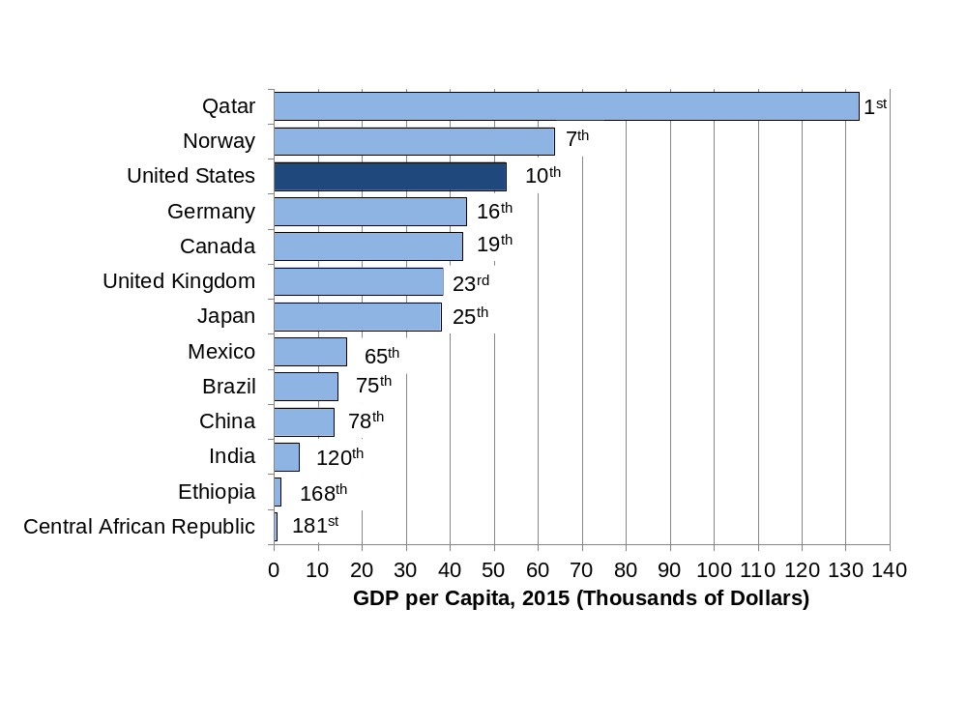
Figure 0.15 GDP per Capita, 2015 (Thousands of dollars)
Source: World Bank, World Development Indicators database.
Data are adjusted for purchasing power differences across countries (e.g., a dollar in India buys more than a dollar in the United States).
Notes:
What it is: Media stories of economic performance frequently refer to gross domestic product (GDP). A country’s GDP per capita measures economic production per person per year, which gives us an idea of the average material living standards in the country. While GDP is perhaps the most commonly used macroeconomic metric, it does not necessarily measure well-being. We discuss how GDP is calculated in Chapter 20 and about the limitations of, and alternatives to, GDP in Chapter 21.
The results: The United States ranks tenth, with a GDP per capita of around US$52,000. Qatar has the world’s highest GDP per capita at around US$133,000, with the country’s economy driven by its oil and gas sectors. The Central African Republic has the lowest GDP per capita, at only US$580.

Slide 17
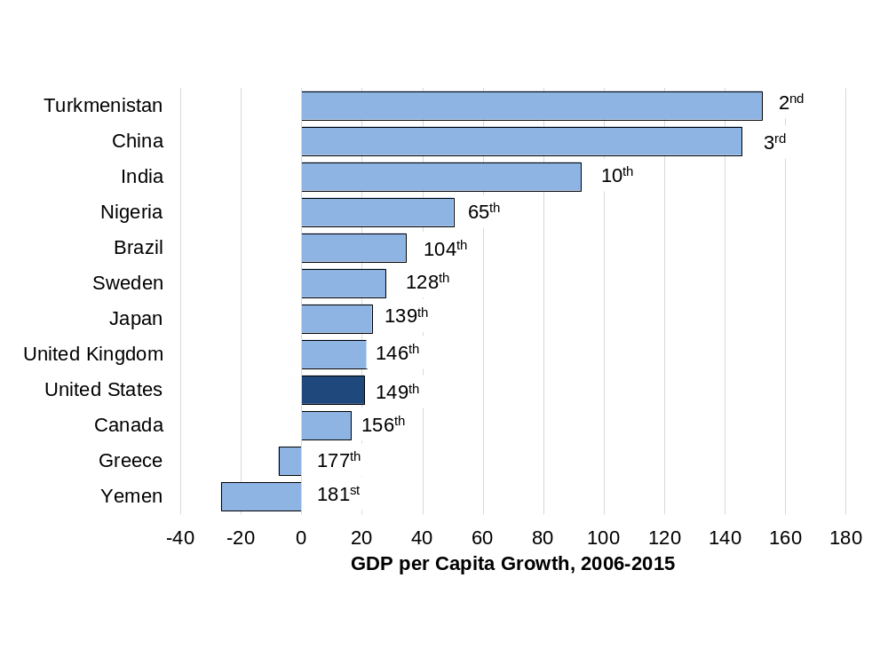
Figure 0.16 Growth in GDP per Capita, 2006 – 2015 (Percent)
Source: World Bank, World Development Indicators database.
Data are adjusted for purchasing power differences.
Notes:
What it is: In macroeconomics, we seek to explain not only why some countries have a higher GDP per capita but also what conditions lead to strong GDP growth rates. In this graph we compare the growth in GDP per capita, after adjusting for inflation, across countries over the ten-year period 2006–2015. We discuss measuring GDP growth rates in Chapter 20 and theories of GDP growth in Chapter 32.
The results: GDP per capita grew rapidly from 2006 to 2015 in some countries, slowly in others, and even declined in several countries. The highest growth in GDP per capita (excluding some tiny countries with exceptional circumstances) occurred in Turkmenistan, primarily from oil and gas development, with high growth also in China, Myanmar, Ethiopia, and India. The fastest growth among developed countries took place in Ireland as it recovered from a severe recession in 2007-8. Countries with declines in GDP per capita include Yemen, Central African Republic, United Arab Emirates, Kuwait, Greece, Brunei, and the Bahamas.

Slide 18
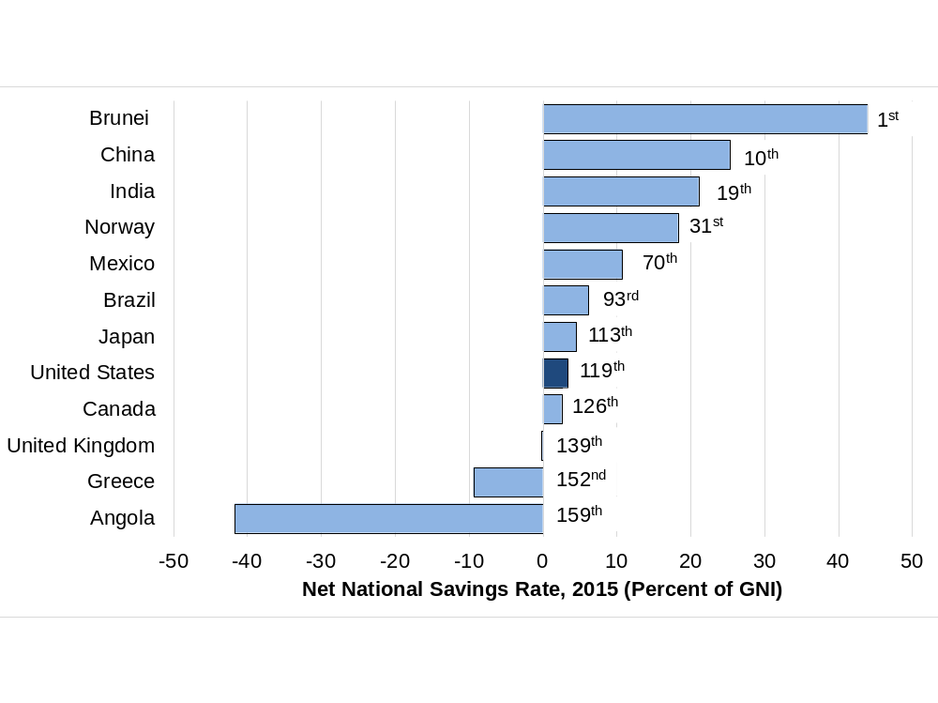
Figure 0.17 Net National Savings Rate, 2015
(Percent of GNI)
Source: World Bank, World Development Indicators database.
Note: GNI is gross national income, a measure similar to gross domestic product, but including income from residents abroad and excluding income earned by foreigners within the country. GNI is also sometimes referred to as Gross National Product (GNP).
Notes:
What it is: How much a country saves and invests is widely considered an important factor in explaining differences in GDP growth rates. Here we present data on net national savings rates, which equal total national savings minus the depreciation of productive capital such as factories and machinery. A negative net national savings rate implies that a country’s productive capacity is declining. We discuss saving, investment, and growth in detail in Chapter 32.
The results: In 2015, Brunei—another country with oil and gas as major sources of national income—had the highest net national saving rate. Other countries with high savings rates include Singapore, Qatar, Philippines, and China. Twenty-one countries (among those with data) had a negative net savings rate in 2015, including the United Kingdom, Portugal, and Greece.

Slide 19
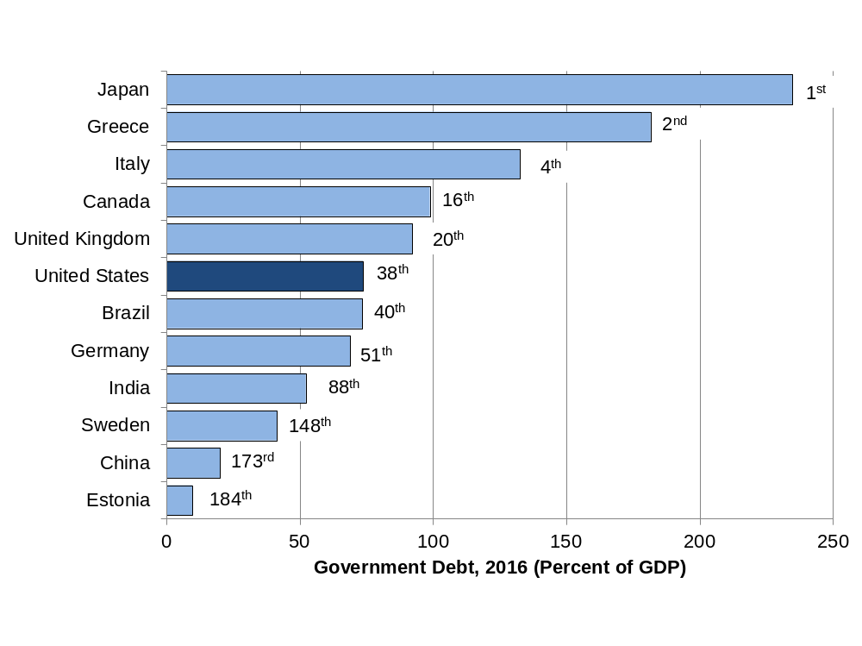
Figure 0.18 Government Debt (Percent of GDP)
Source: United States Central Intelligence Agency, CIA World Factbook.
Note: Data are mostly 2016 estimates.
Notes:
What it is: The level of government debt has been a focus of media stories in recent years. What matters is not so much the size of debt in dollars but government debt relative to a country’s GDP. This variable portrays the amount of debt owed by the governments of different countries, including debts owed to domestic and foreign entities. What level of debt should be considered a problem? This is a topic we discuss in more detail in Chapter 31.
The results: In 2016, Japan had the highest government debt in the world, measured as a percentage of GDP, followed by Greece and Lebanon. The United States had the thirty-eighth-highest debt, but many other developed countries had higher debt, including Singapore, Canada, France, and United Kingdom. Some developing countries, such as Liberia and Tajikistan, have relatively low government debt.

Slide 20
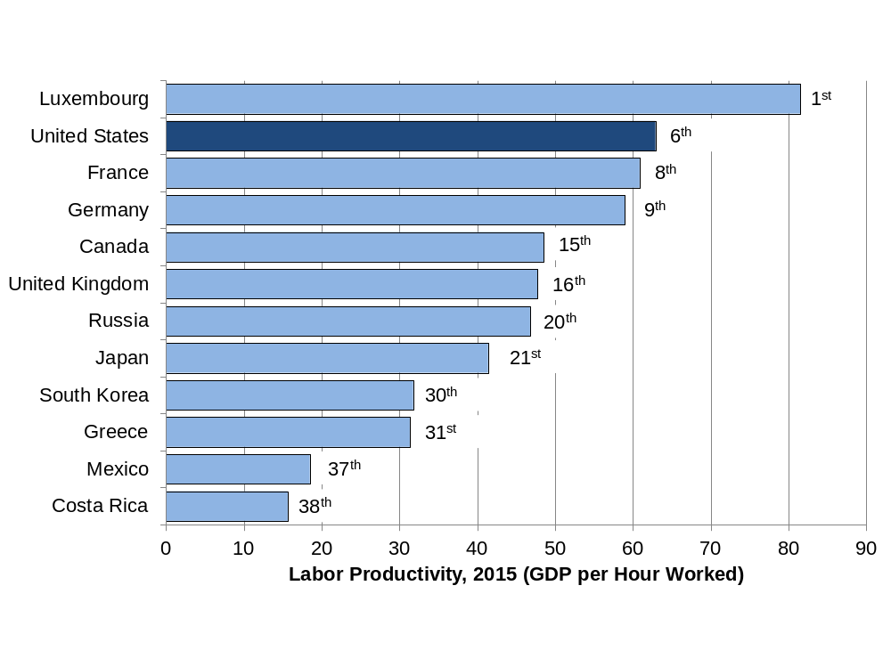
Figure 0.19 Labor Productivity, 2015
(GDP per Hour Worked)
Source: Organisation for Economic Co-operation and Development, OECD online statistical database.
Notes:
What it is: One measure of the economic efficiency of a country is labor productivity. This is calculated by dividing a country’s GDP by an estimate of the total number of hours worked. Thus, labor productivity tells us how many dollars of GDP are generated for each hour worked. We present more about labor productivity in Chapters 22 and 23.
The results: Data on labor productivity are available for only 38 countries. Luxembourg has the highest labor productivity in the world. The United States ranks sixth, behind Norway, Ireland, Belgium and Denmark. Productivity is slightly lower in France and Germany. Less developed countries have lower labor productivity. We see that productivity in Mexico is only about one-third of the U.S. level.

Slide 21
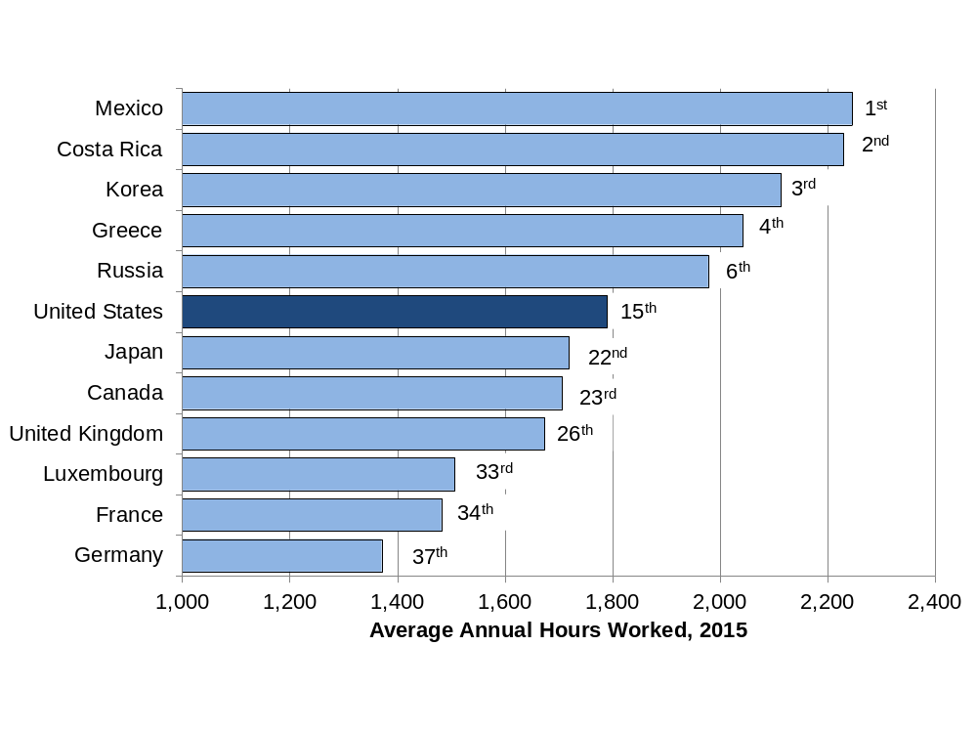
Figure 0.20 Average Annual Hours Worked, 2015
Source: Organisation for Economic Co-operation and Development. OECD online statistical database.
Notes:
What it is: Even if two countries have the same labor productivity, their GDP will differ if the number of hours worked are different. This graph shows the average number of hours worked each year per employee. Note that this includes only hours actually worked; vacations, holidays, and sick days are excluded. Thus, the average annual hours worked in a country may be high if work expectations are more stringent and time off is limited. Work hours may also be high if workers choose to work long hours and there are very few part-time workers. We discuss work hours further in Chapters 10 and 23.
The results: Data on hours worked are available for only 37 countries. The average annual hours worked per employee are lowest in Germany. Other countries with relatively low annual work hours are the Netherlands, Norway, Denmark, and France. One reason for the relatively low work hours in these countries is federal laws that mandate minimum vacation times and paid holidays. In the United States, where such laws do not exist, average work hours are higher. Work hours tend to be highest among countries with lower levels of GDP per capita. In 2015, Mexico had the highest average annual hours worked, followed by Costa Rica and South Korea.

Slide 22
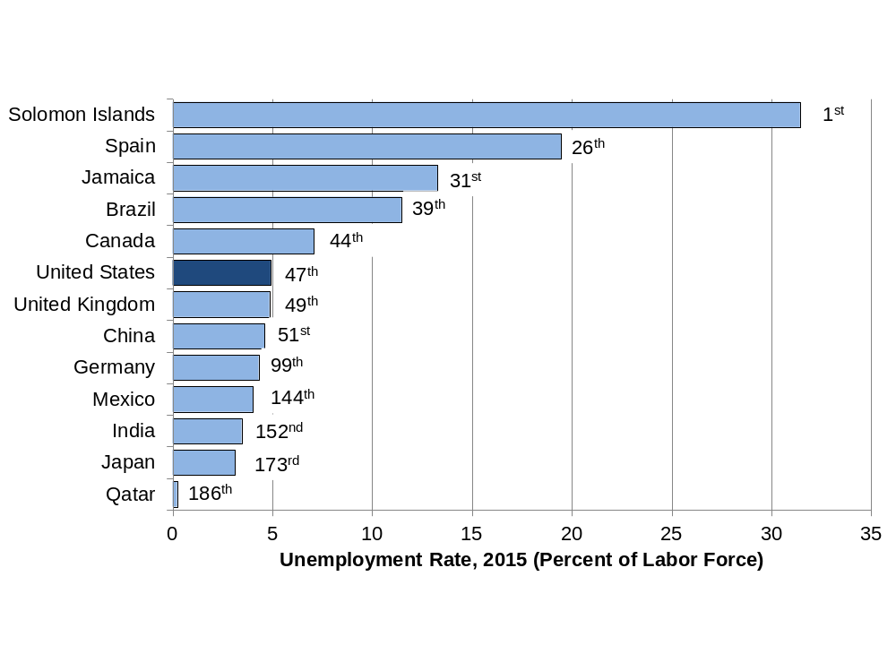
Figure 0.21 Unemployment Rate, 2016
(Percent of Labor Force)
Source: World Bank, World Development Indicators database.
Notes:
What it is: The unemployment rate in a country is an important macroeconomic metric. Not only does having a job provide a source of income, but it also provides a sense of identity and contributes to overall well-being. Estimating the unemployment rate is somewhat complex, and the method used to measure unemployment rate may differ across countries. In Chapter 23 we discuss issues involved in estimating the unemployment rate including defining what it means to be in the workforce.
The results: Unemployment rates vary tremendously across countries and they also fluctuate a lot over time. In 2016, Qatar had the lowest official unemployment rate at 0.2 percent and Solomon Islands—a small nation located in the south Pacific Ocean—had the highest unemployment rate at about 31 percent. While many poor countries, such as Mozambique, Swaziland, and Lesotho, have very high unemployment rates (20 percent or more), other poor countries such as Cuba and Bhutan have rather low unemployment rates, at around 3 percent. The unemployment rate in the United States, usually in the range of 4–6%, rose considerably in the 2007–9 recession, and has since declined slowly to return to the 4-6% range in late 2015.

Slide 23
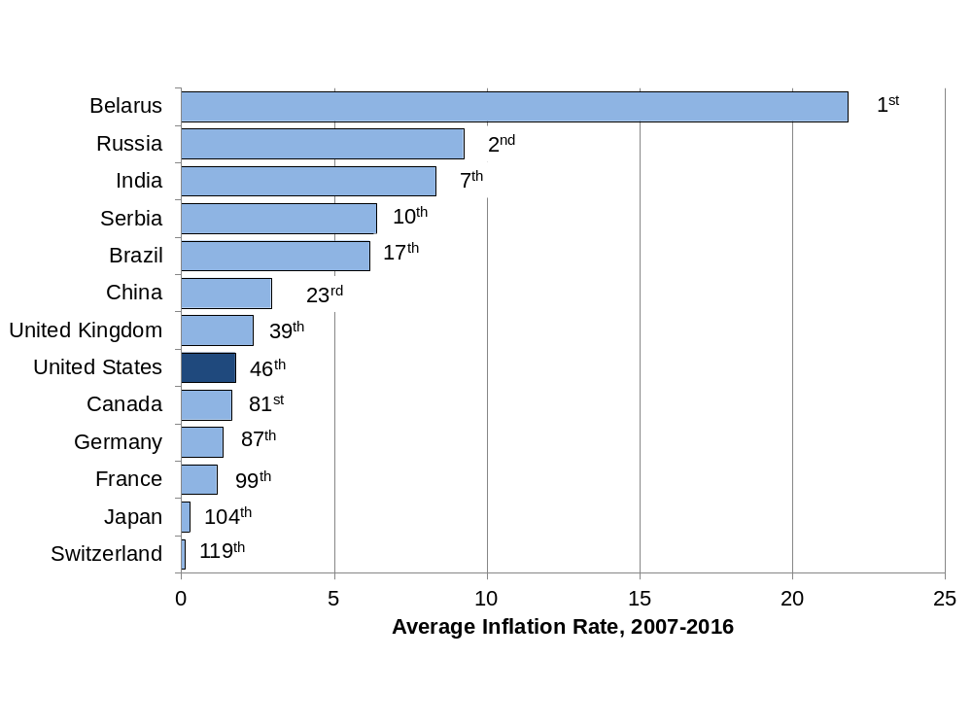
Figure 0.22 Average Annual Inflation Rate, 2007-2016
Source: World Bank, World Development Indicators database.
Note: The average inflation rate is calculated as the average of the inflation rate for each year from 2007 to 2016.
Notes:
What it is: The rate of inflation summarizes how average prices change in a country in one year. For example, an inflation rate of 5 percent means that average prices increased by 5 percent that year. In Chapter 20 we discuss how to adjust data from different years for inflation, and we focus on macroeconomic theories of inflation in Chapters 27 and 28.
The results: Over the period 2007–2016, Switzerland and Japan had the lowest inflation rates in the world, with prices actually declining slightly during some years and hardly increasing overall. However, this is not necessarily a good thing, as we see later in the book. A low and stable—but not negative—inflation rate is generally considered an important macroeconomic policy goal. Most developed countries have generally been successful in controlling inflation in recent years. High and fluctuating inflation rates in a country are a sign of macroeconomic instability. With average inflation rate of over 20 percent between 2007 and 2016, Belarus had the highest inflation rate over this period. Extremely high inflation rates of over 800 percent in Venezuela and over 24,000 percent in Zimbabwe have been observed in recent years.

Slide 24
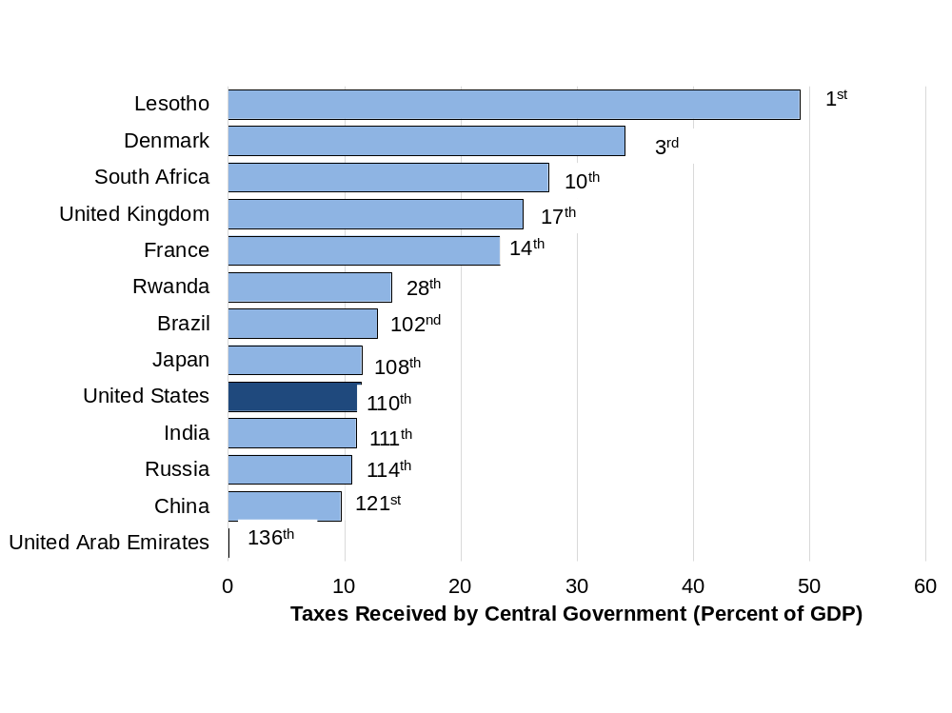
Figure 0.23 Taxes Received by Central Government (Percent of GDP)
Source: World Bank, World Development Indicators database.
Note: Data are mostly 2015 estimates.
Notes:
What it is: Tax policies are among the most significant ways a government can influence the well-being of the citizens, as we discuss in Chapters 12 and 25. Taxes received by the central government, expressed as a percentage of GDP, includes taxes collected at the federal level. Note that some countries also collect significant amount of taxes at the local level.
The results: Overall tax revenues vary significantly across countries. While Western European countries tend to have relatively high taxes, some other countries with surprisingly high taxes (more than 25 percent of GDP) include Jamaica, South Africa, and Botswana. The United States has one of the lowest overall tax rates in the world—by far the lowest of any major industrialized country. The countries with the lowest tax revenues (less than 10 percent of GDP) tend to be relatively poor countries in Africa and Asia.

Slide 25
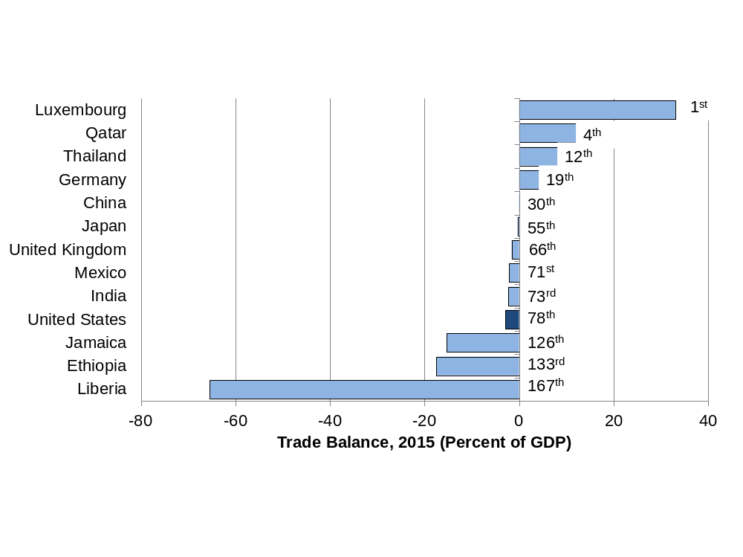
Figure 0.24 Trade Balance, 2015 (Percent of GDP)
Source: World Bank, World Development Indicators database, and authors’ calculations.
Notes:
What it is: The trade deficit of the United States is often considered a cause for concern in media stories. A trade deficit means that a country imports more than it exports. Economists refer to a country’s trade balance as the dollar value of its exports minus its imports, normally expressed as a percentage of GDP. Thus, a negative trade balance indicates a trade deficit. A positive trade balance indicates a trade surplus. We discuss trade balances, and other trade issues, in more detail in Chapters 7 and 29.
The results: Of the 168 countries with available data, 50 have a positive trade balance (exports exceed imports) and 118 have a negative trade balance. Those countries with the largest trade surpluses tend to be smaller countries (such as Luxembourg and Singapore) or oil-producing countries (such as Qatar and United Arab Emirates). The U.S. trade deficit is about 3 percent of GDP, with other countries, such as the Canada, Ecuador, and Turkey, in a similar range. The countries with the largest trade deficits tend to be poorer countries, although some poor countries do have trade surpluses.

Slide 26
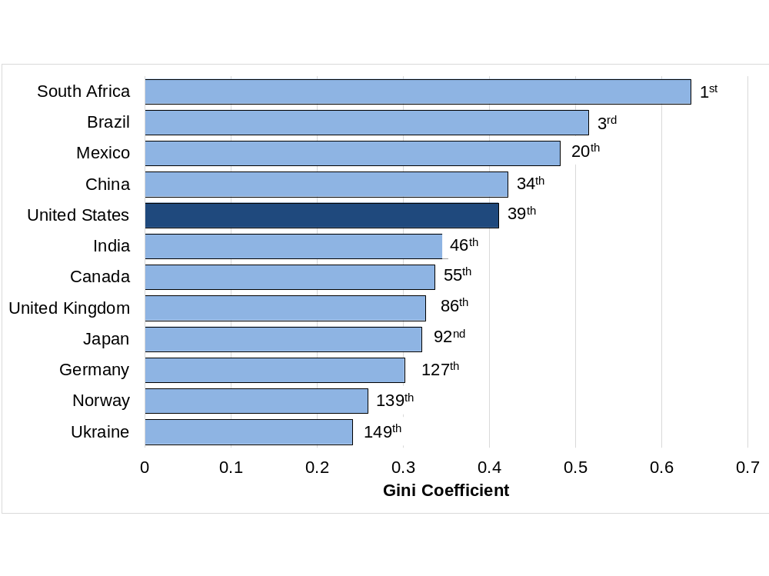
Figure 0.25: Income Inequality (Gini Coefficient - Most Equal to Least Equal)
Source: World Bank, World Development Indicators database.
Note: Data for the most recent year available, between 2008 and 2014.
Notes:
What it is: A Gini coefficient is a measure of economic inequality in a country. It is most commonly calculated according to the distribution of income (as is done in the figure here), but it can also be calculated according to wealth distribution or other variables. It can range from 0 (everyone in the country has the same exact income) to 1 (one person receives all the income in a country). We learn more about Gini coefficients and economic inequality in Chapters 11, 30 and 32.
The results: Scandinavian countries such as Sweden, Norway, and Finland tend to be the most equal countries in the world, by income (with the lowest Gini coefficients). Several African countries, including Botswana, Lesotho, Namibia, and South Africa are the most unequal countries in the world. In general, countries with high GDP per capita have lower inequality than those with low GDP per capita (compare figures 0.15 and 0.25). However, this is not always true. The United States, for example, is among the most economically unequal of the developed countries.

Slide 27
Figure 0.26: CEO Pay to Worker Pay Ratio
Source: Bloomberg, “Executive Pay,” January 2018. https://www.bloomberg.com/quicktake/executive-pay.
Notes:
What it is: In addition to comparing corporate profits to worker pay, we can look at the pay difference between CEOs (chief executive officers) and workers. The graph below shows the ratio of average CEO compensation to the average pay of “rank-and-file” workers, in several countries. The ratios are based on data from 2016 and 2017.
The results: In the United States, average CEO pay is over 250 times higher than average worker pay. In other countries, CEOs still make significantly more than rank-and-file workers, but pay differences are not as pronounced. For example, in Canada CEOs make, on average, 150 times more than workers, while in Japan CEOs make about 60 times worker pay.

Slide 28
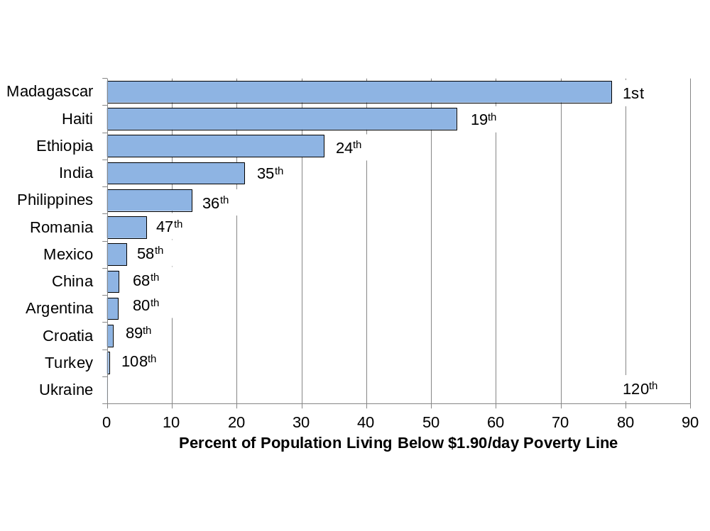
Figure 0.27 Percent of Population Living Below $1.90/day Poverty Line
Source: World Bank, World Development Indicators database. Data are for the most recent year available, between 2010 and 2014.
Notes:
What it is: The US$1.90-per-day poverty line has been defined by the United Nations as a measure of absolute poverty. One of the Sustainable Development Goals set by the United Nations is to eradicate absolute poverty worldwide. Formerly, under the Millennium Development Goals, the UN had aimed at halving the number of people in the world living in absolute poverty between 1990 and 2015. This goal has already been met, mainly due to progress in China and India. We discuss poverty and economic development in Chapter 32.
The results: Note that this is one of the two graphs in this chapter that does not include the United States or any other developed countries (few people in developed countries live below the US$1.90-a-day poverty line, though homelessness and food insecurity continue to plague many cities in the U.S.). A majority of people do live below that poverty line in 17 countries, including Rwanda, Nigeria, Mozambique, and Haiti. A small portion of the population lives in absolute poverty in some upper middle-income countries such as Argentina, Costa Rica, Thailand, and Turkey.

Slide 29
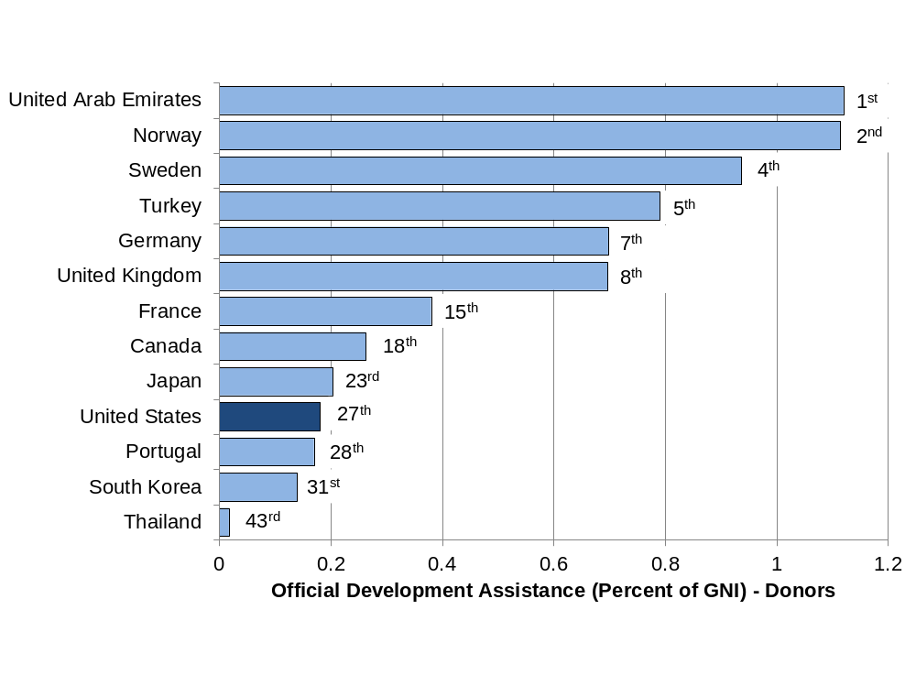
Figure 0.28 Official Development Assistance, 2016 (Percent of GNI)
Source: Organisation for Economic Co-operation and Development, Official Development Assistance—2016 Update.
Notes:
What it is: In 1970, the “economically advanced” countries agreed to a United Nations resolution on foreign aid to developing countries. The resolution set a target for official development assistance (ODA) of 0.7 percent of gross national income (GNI). ODA is defined as government flows to promote economic development and welfare in developing countries. The 0.7 percent target has been reaffirmed at subsequent international meetings. We discuss the role of foreign aid in promoting economic development in Chapter 32.
The results: In 2016 only six countries met the 0.7 percent target: United Arab Emirates, Norway, Luxembourg, Sweden, Turkey, and Denmark. Both U.A.E and Turkey began giving aid recently, mostly to Muslim-majority countries in the Middle-East and Sub-Saharan Africa. Though U.A.E. ranks the highest among aid givers, it has received criticism for the lack of transparency on how the aid is being used. ODA from the United States was 0.18 percent of GNI. Israel and Russia had the lowest ODA percentage, at 0.08 percent. A common criticism of foreign aid is that it is given to gain political and economic influence. This criticism, often leveled at countries like the U.S. and China, has also been directed to new aid donors like Turkey. Note that ODA does not include private charity donations or non-governmental organizations, only official aid given by governments and support given to refugees who come to the donor countries.

Slide 30
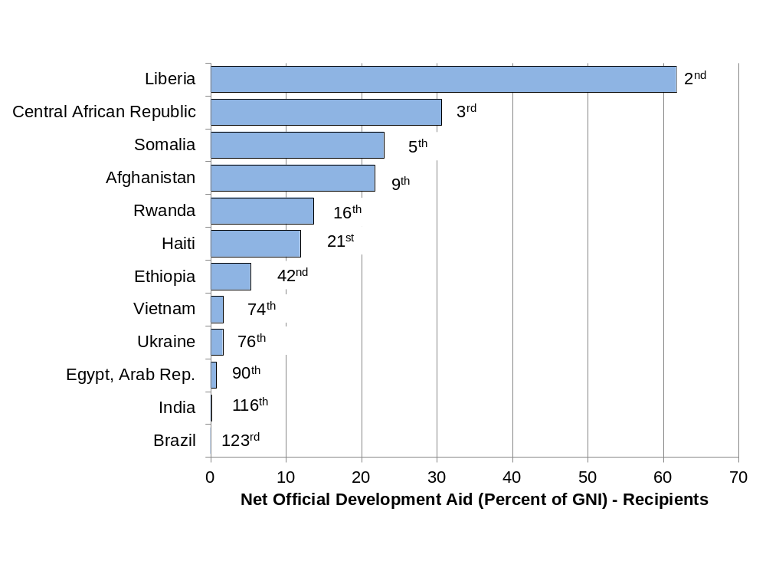
Figure 0.29 Official Development Assistance Received, 2015 (Percent of GNI)
Source: World Bank, World Development Indicators database.
Notes:
What it is: Official Development Aid (ODA) received by a country includes bilateral aid from another country as well as multilateral aid from international organizations. Net ODA as a percentage of GNI (Gross National Income) shows the size of aid received by a country relative to the country’s gross national income. It is an indicator of how dependent a country is on foreign aid. Foreign aid may be an important source of revenue for funding development programs and for providing relief from natural disasters or conflicts in developing countries.
The results: This is one of the graphs in this chapter that does not include any developed country, as developed countries do not usually receive aid. Countries in Sub-Saharan Africa including Central African Republic, Somalia, and Rwanda are highly dependent on foreign aid. A significant amount of foreign aid is directed towards conflict-affected countries such as Afghanistan and Syria. Some middle-income countries such as Brazil and Vietnam also receive small amounts of foreign aid.

Slide 31
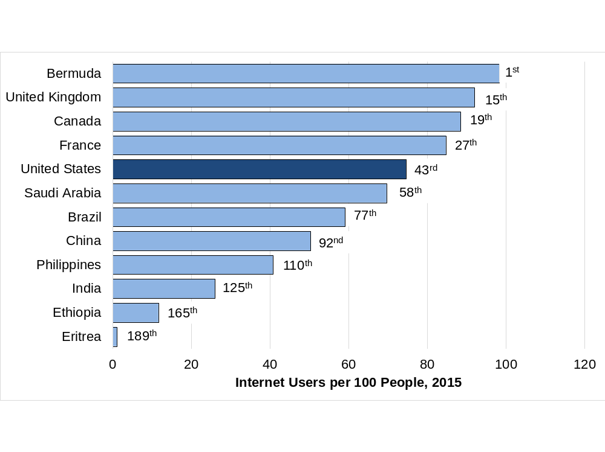
Figure 0.30 Internet Users per 100 People, 2015
Source: World Bank, World Development Indicators database.
Notes:
What it is: The percentage of people who have access to the Internet provides an indication of a country’s level of technological development. As we discuss in Chapter 32, technology has long been recognized as one of the drivers of economic growth.
The results: Access to the Internet may not be as widespread as you think. While near-universal access occurs in a few countries, such as Iceland, Norway, and Denmark, in most developed countries access rates are about 70–85 percent. Middle-income countries generally have access rates around 30–50 percent. Twenty countries, most of them poor African countries, have access rates of less than 10 percent.

Slide 32
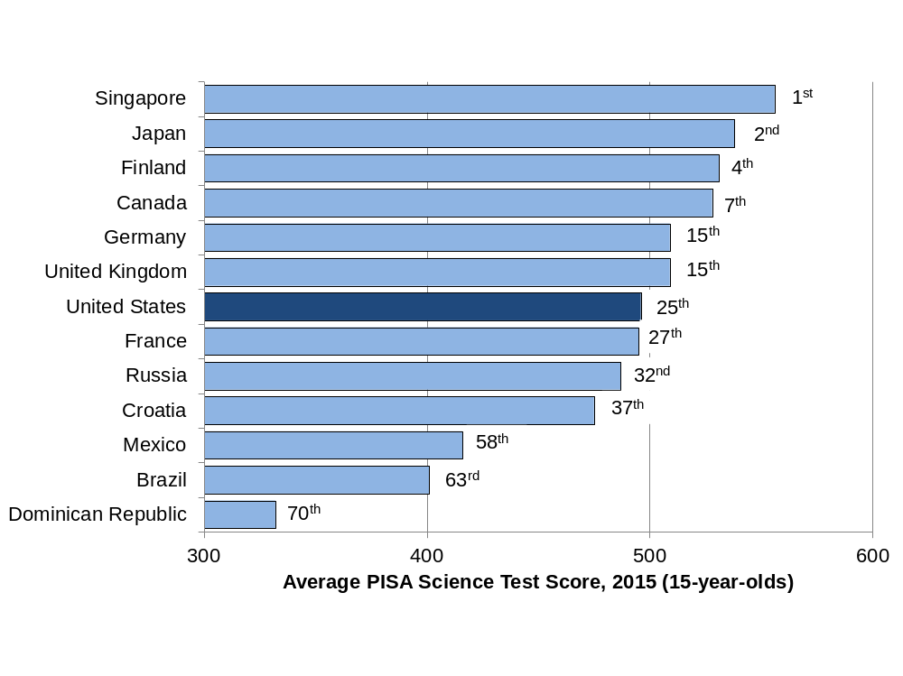
Figure 0.31 Average PISA Science Test Score, 2015 (15-year-olds)
Source: Organisation for Economic Co-operation and Development, Programme for International Student Assessment, PISA 2015 Key Findings.
Notes:
What it is: To compare the educational performance of students in different countries we present data from the Programme for International Student Assessment (PISA), which administers standardized math, science, and reading tests to 15-year-olds in over 60 countries every three years. The graph below provides results from the science test. The country rankings were relatively similar for the math and reading tests, with some variations (e.g., the United States ranked twenty-first on the reading test and thirty-fifth on the math test).
The results: Students in Asian countries tended to achieve the highest test scores, including China, Singapore, Japan, and South Korea. Among European countries, students received high scores in Finland, the Netherlands, and Germany. The scores from the United States were average for developed countries. For less developed countries, scores tended to be lower.

Slide 33
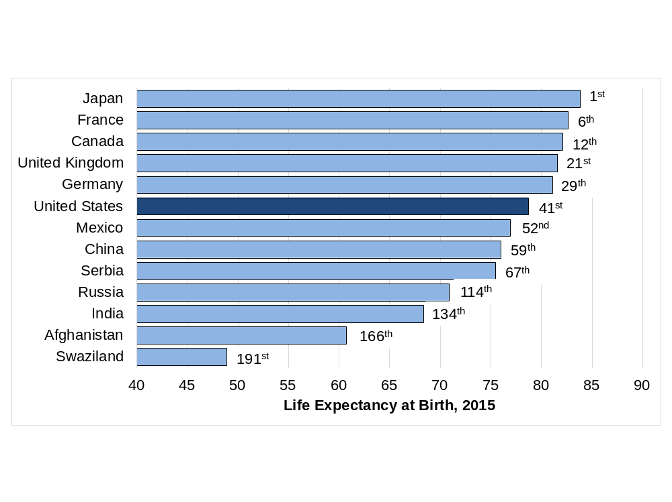
Figure 0.32 Life Expectancy at Birth, 2017
Source: World Bank, World Development Indicators database.
Notes:
What it is: Average life expectancy at birth is a common measure of health outcomes in a country. We discuss health as one component of well- being indices in Chapter 21 and as a topic of economic development in Chapter 32.
The results: Life expectancy at birth now exceeds 80 years in over 30 countries, including Japan, France, Spain, and Greece. In 2010, only 20 countries had life expectancy at birth that exceeded 80 years. For a developed country, the United States has a comparatively low life expectancy, even lower than some middle- income countries such as Costa Rica and Cuba. Life expectancy is the lowest, below 55 years, in several African countries, including Sierra Leone, Lesotho, and Swaziland.

Slide 34
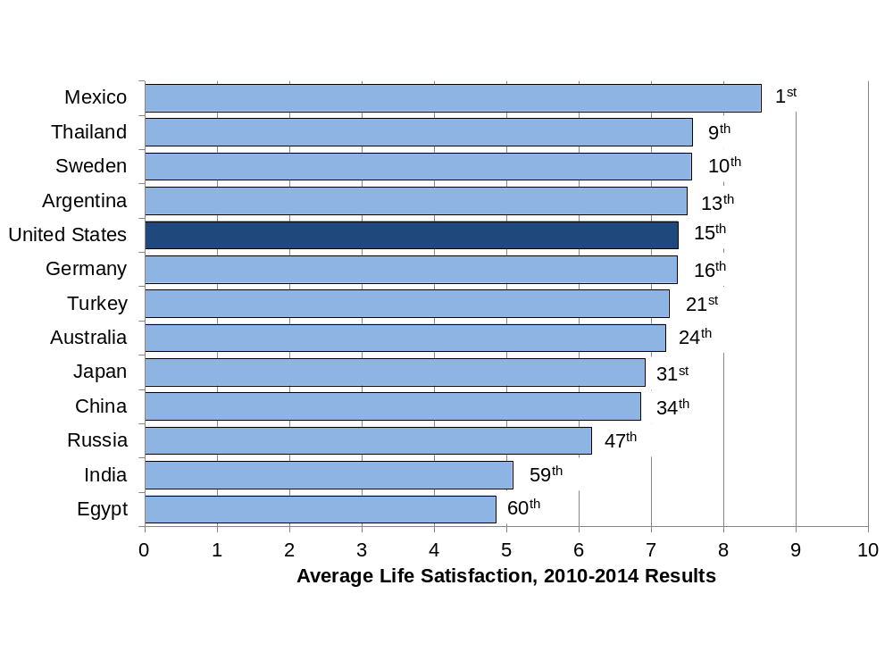
Figure 0.33 Average Life Satisfaction, 2010-2014 Results (1 = Dissatisfied, 10 = Satisfied)
Source: World Values Survey, online database.
Notes:
What it is: Researchers are increasingly using surveys to measure well-being or happiness directly. The most common approach is to ask people to rate their overall satisfaction with their lives, on a scale from 1 (dissatisfied) to 10 (satisfied). The responses are referred to as “subjective well-being.” We discuss subjective well-being in more detail in Chapter 21.
The results: According to the most recent data, which cover 60 countries, Mexico has the highest level of average subjective well-being. Other relatively happy countries include Colombia, Qatar, Ecuador, and Uzbekistan. Happiness levels in the United States are about average for a developed country. Happiness levels are relatively low in countries that have recently experienced conflicts such as Egypt or Iraq, in the poorest countries such as Zimbabwe, as well as in Eastern European countries, such as Georgia and Estonia.

Slide 35
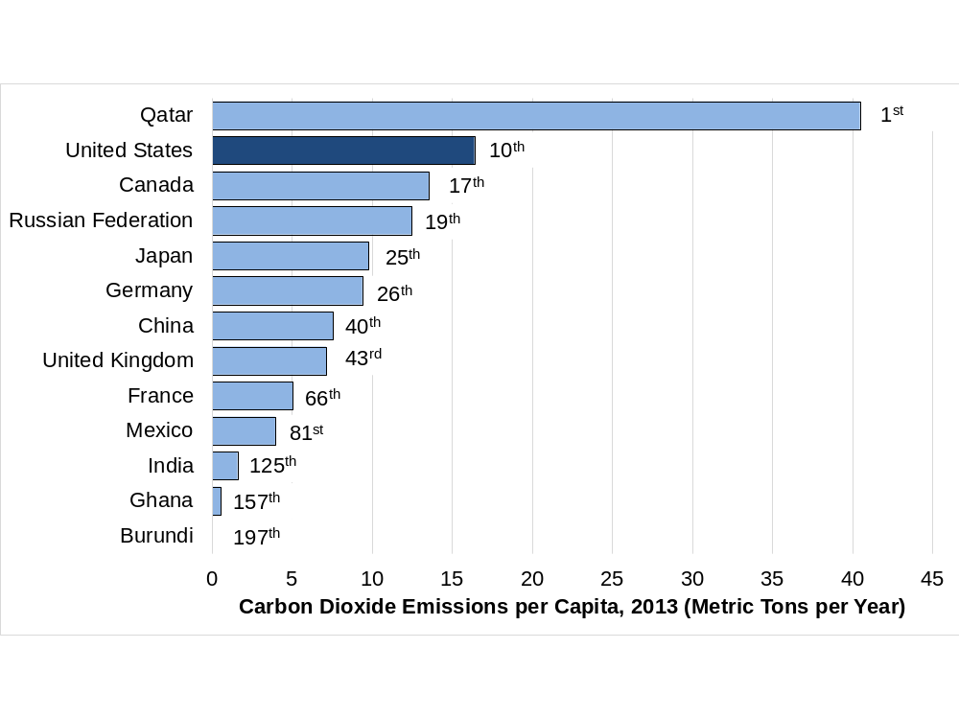
Figure 0.34 Carbon Dioxide Emissions per Capita, 2013 (Metric Tons per Year)
Source: World Bank, World Development Indicators database.
Notes:
What it is: Carbon dioxide (CO₂) is the most important gas responsible for global climate change. CO₂ is emitted whenever fossil fuels are burned. Scientific analysis indicates that the accumulation of CO₂ in the atmosphere is raising global temperatures, leading to serious negative impacts on human societies and ecosystems. CO₂ per capita gives us an idea of how much the average person in a county is affecting the environment. We learn more about CO₂ and climate change in Chapters 14 and 33.
The results: The countries with the highest CO₂ emissions per capita are several oil-producing countries, including Qatar (the highest, at 41 tons per person), Kuwait, and Bahrain. The United States has the tenth-highest emissions per capita, around 17 tons per person. Emissions per person in European countries such as the UK and Germany are about half of U.S. levels. While China is the world’s largest emitter of CO₂ overall, on a per-capita basis its emissions are less than half of those in the United States. CO₂ emissions per capita are negligible in the world’s poorest countries.

Slide 36
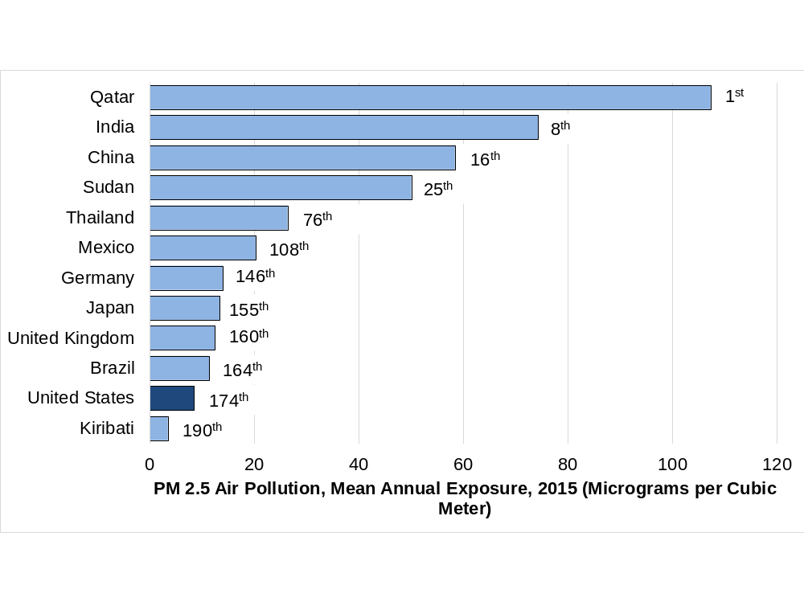
Figure 0.35 Average National Particulate Matter Concentration, 2015 (Micrograms per Cubic Meter)
Source: World Bank, World Development Indicators database.
Note: Data are for particulate matter smaller than 2.5 micrometers, referred to as PM2.5. For reference, the European Union pollution standard for average PM2.5 is 25 micrograms/cubic meter (µg/m3); California has a stricter standard of 12 µg/m3.
Notes:
What it is: While CO₂ emissions contribute to climate change, breathing air with elevated levels of CO₂ does not cause any adverse health effects. Local air pollutants, on the other hand, can cause numerous health effects, including asthma, lung cancer, and heart problems. One of the most important local air pollutants is particulate matter, which is emitted from power plants, industrial factories, motor vehicles, and other sources. Particulate matter pollution can be reduced through effective environmental regulations and technology. We discuss pollution further in Chapters 13, 21, and 33.
The results: A country with high CO₂ emissions does not necessarily have poor local air quality. The United States is a prime example—CO₂ emissions are high, but local air quality is relatively good due to environmental laws and modern technologies. Other developed countries have as good, or better, local air quality. Developing countries can have good or poor local air quality, depending on their level of development, regulations, and technologies. Oil producing countries such as Qatar and Saudi Arabia as well as poor countries in South Asia and Africa have very poor quality of local air. China is almost as well-known for its poor air quality as it is for its high GDP growth rate.

