Slide 1

Chapter Three:
Supply and Demand

Slide 2
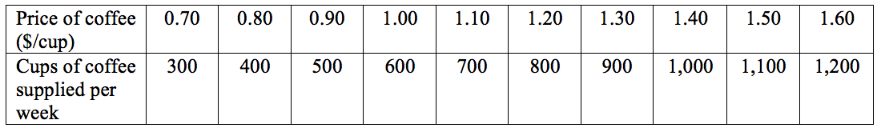
Table 3.1 Supply Schedule for Cups of Coffee

Slide 3
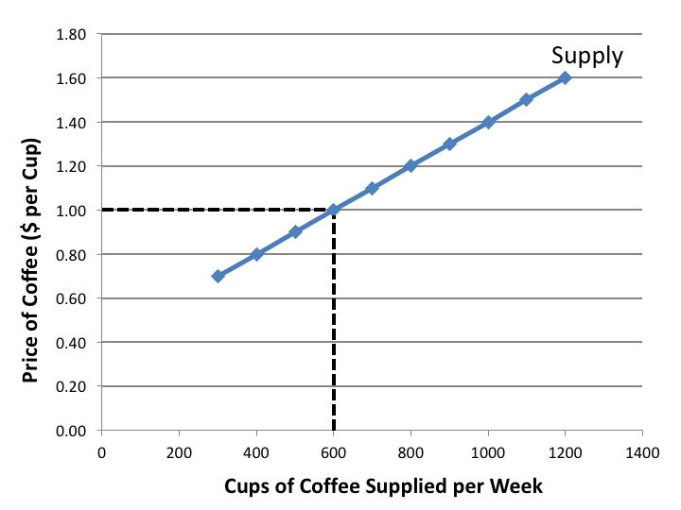
Figure 3.1 Market Supply Curve for Cups of Coffee

Slide 4
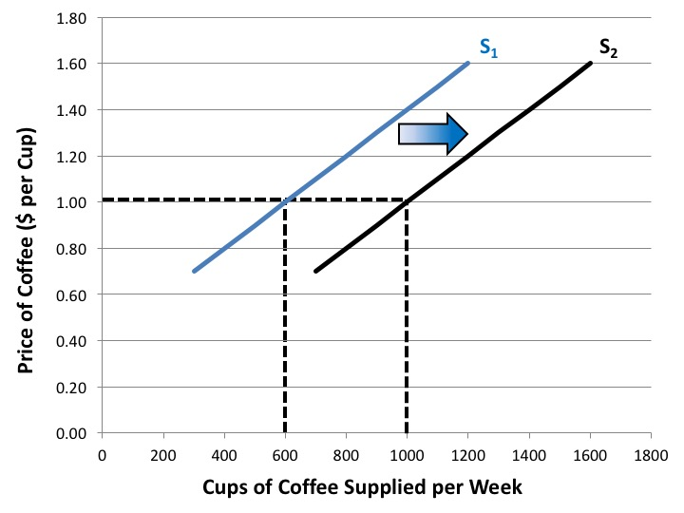
Figure 3.2 An Increase in Supply

Slide 5
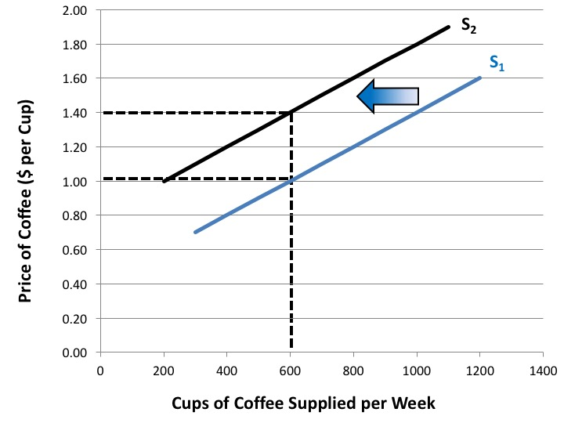
Figure 3.3 A Decrease in Supply

Slide 6
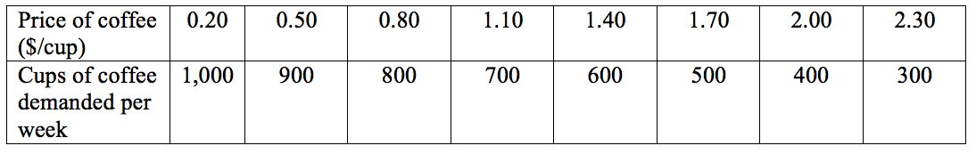
Table 3.2 Demand Schedule for Cups of Coffee

Slide 7
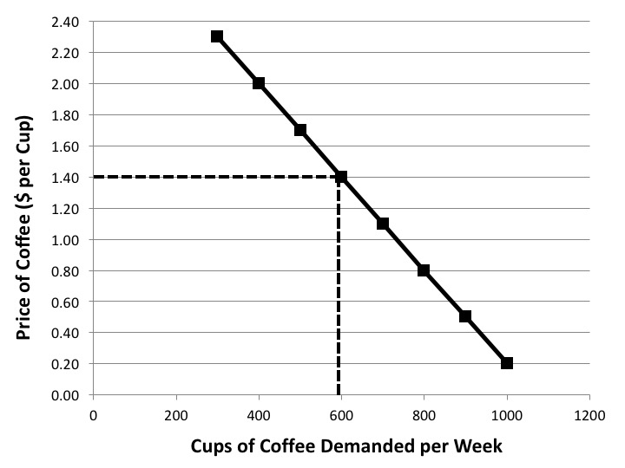
Figure 3.4 Market Demand Curve for Cups of Coffee

Slide 8
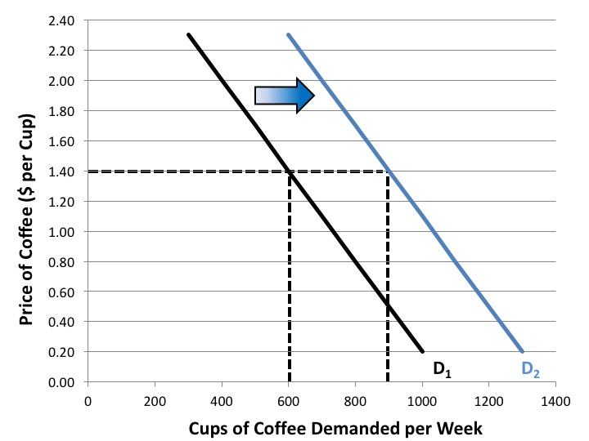
Figure 3.5 An Increase in Demand

Slide 9
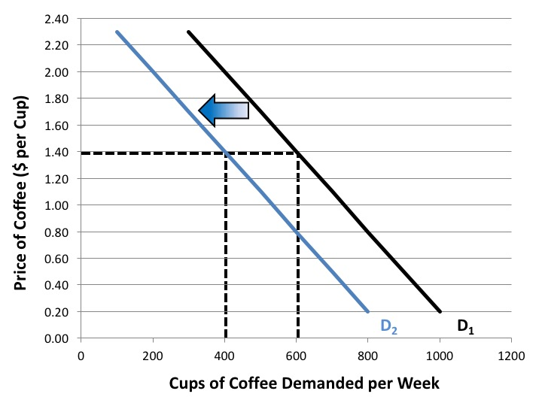
Figure 3.6 A Decrease in Demand

Slide 10
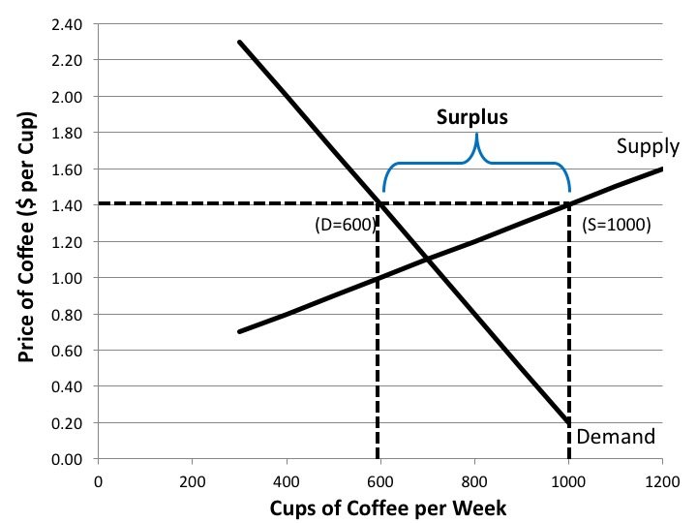
Figure 3.7 A Market Surplus

Slide 11
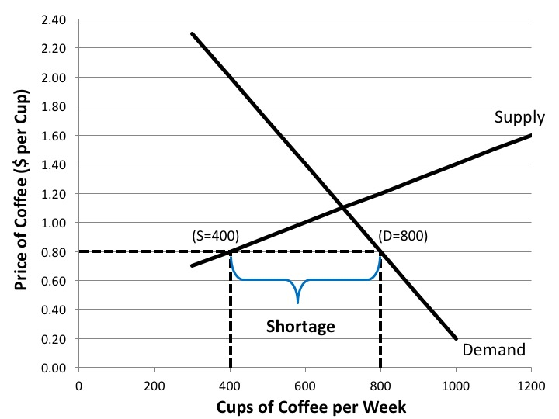
Figure 3.8 A Market Shortage

Slide 12
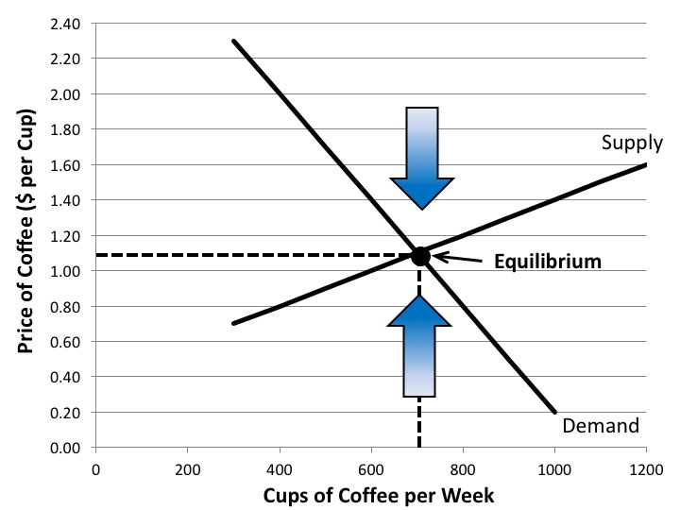
Figure 3.9 Market Equilibrium

Slide 13
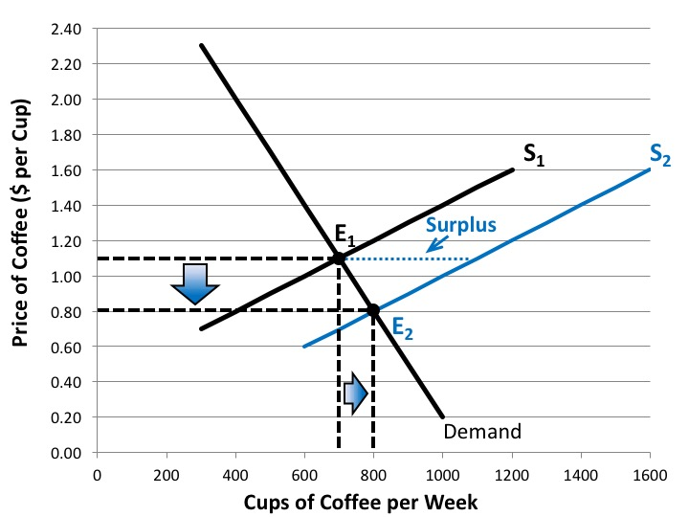
Figure 3.10 Market Adjustment to an Increase in Supply

Slide 14
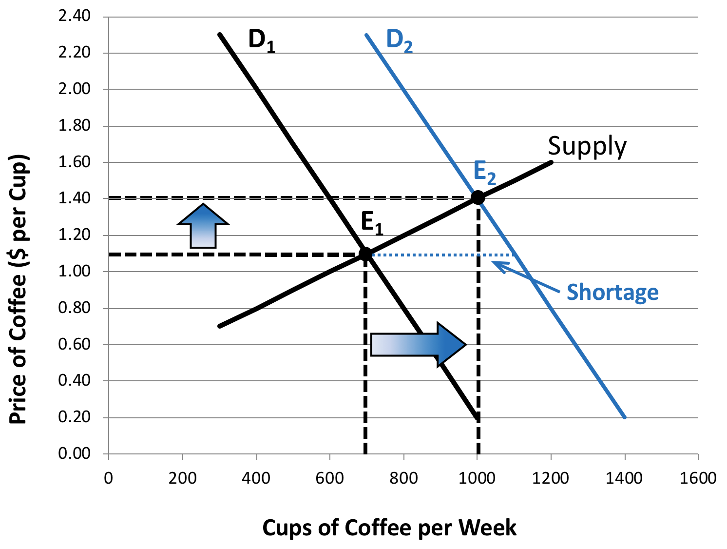
Figure 3.11 Market Adjustment to an Increase in Demand

Slide 15
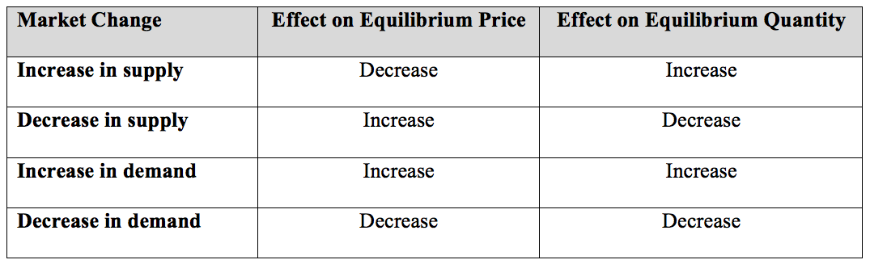
Table 3.3 Summary of the Market Effects of Shifts in Supply or Demand

Slide 16
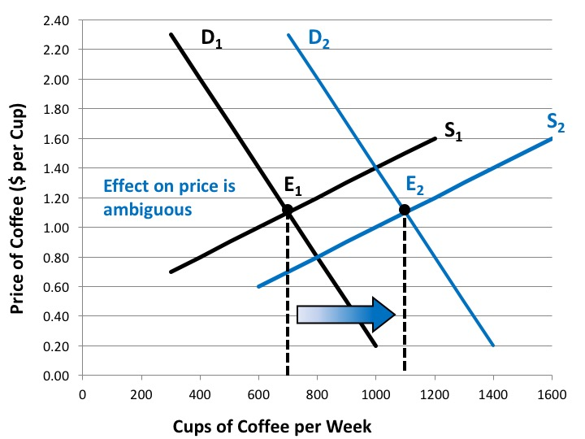
Figure 3.12 Market Adjustment to an Increase in both Supply and Demand

Slide 17
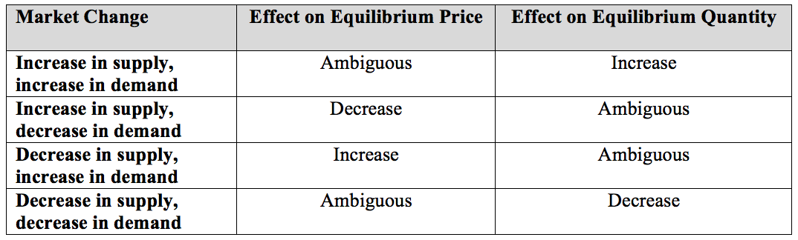
Table 3.4 Summary of the Market Effects When Both Supply and Demand Shift

Slide 18
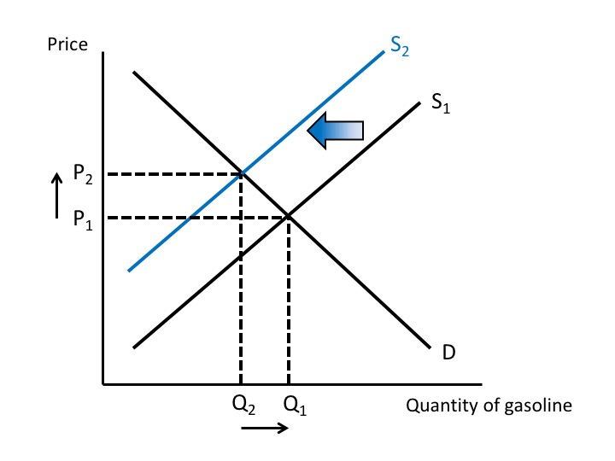
Exercise #5

