Slide 1

Chapter Two:
Markets and Society

Slide 2
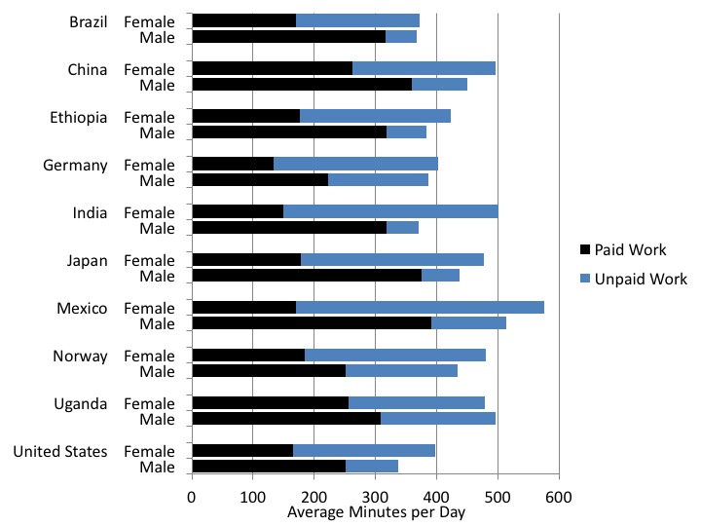
Figure 2.1 Paid and Unpaid Work, Male and Female, Selected Countries
Source: UN Women, 2015, Annex 3.

Slide 3
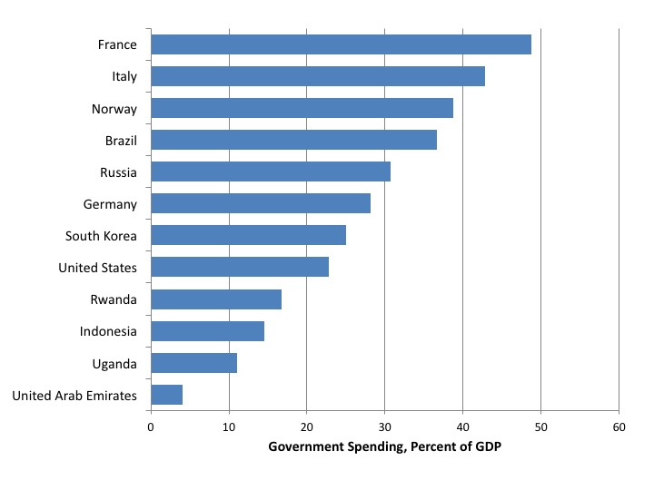
Figure 2.2 Government Spending, Percentage of GDP, Selected Countries, 2015
Source: World Bank, World Development Indicators database.

Slide 4
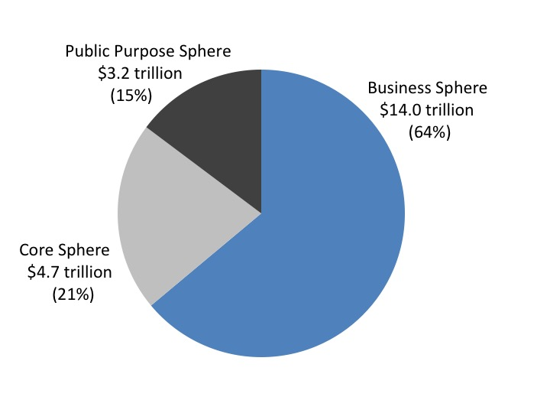
Figure 2.3 Estimated Size of the Three Spheres in the United States, 2016
Sources: U.S. Bureau of Economic Analysis, GDP and Personal Income database, and authors’ calculations.

Slide 5
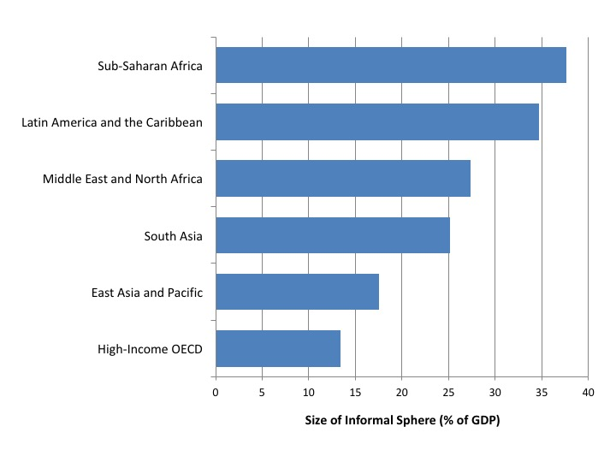
Figure 2.4 The Average Size of the Informal Sphere, Percentage of GDP, by World Region
Source: Schneider and Williams, 2013, Table 7.

