Slide 1

Chapter Sixteen:
Perfectly Competitive Markets

Slide 2
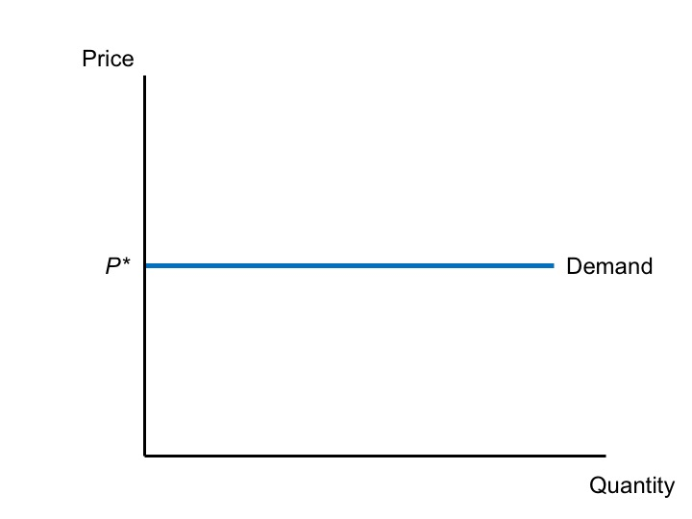
Figure 16.1 The Demand Curve for a Perfectly Competitive Seller

Slide 3
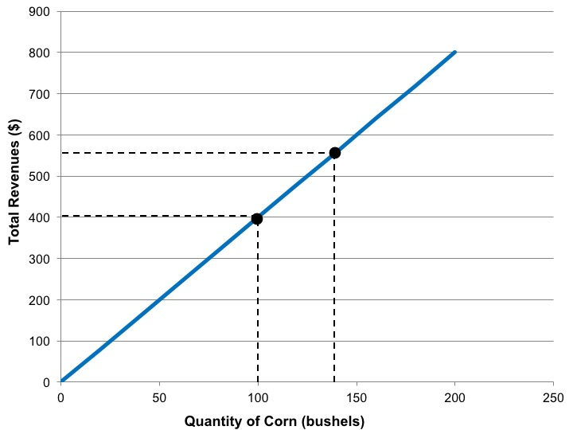
Figure 16.2 Total Revenues

Slide 4
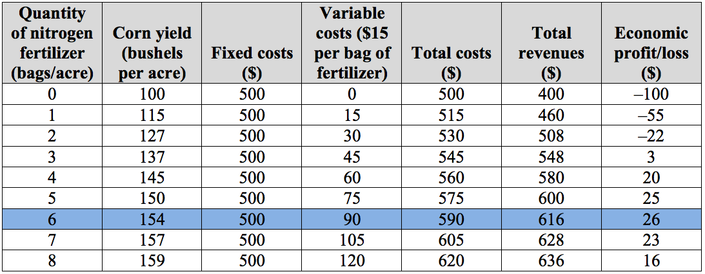
Table 16.1 Profit Maximization, Based on Analysis of Total Costs and Total Revenues

Slide 5
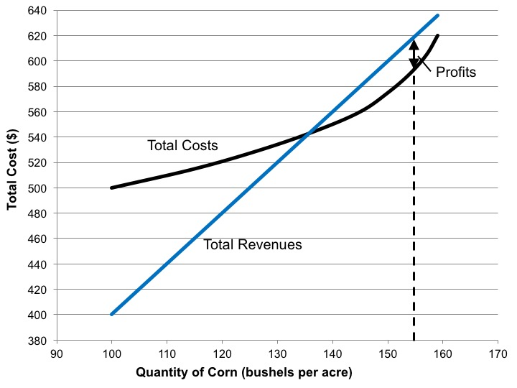
Figure 16.3 Profit Maximization, Based on Analysis of Total Costs and Total Revenues

Slide 6
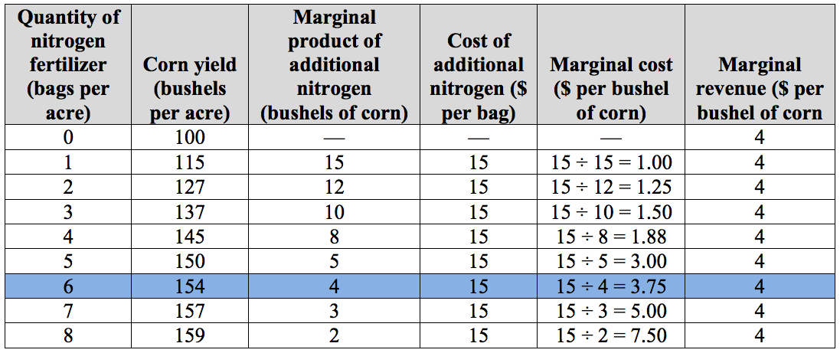
Table 16.2 Profit Maximization, Based on Analysis of Marginal Costs and Marginal Revenues

Slide 7
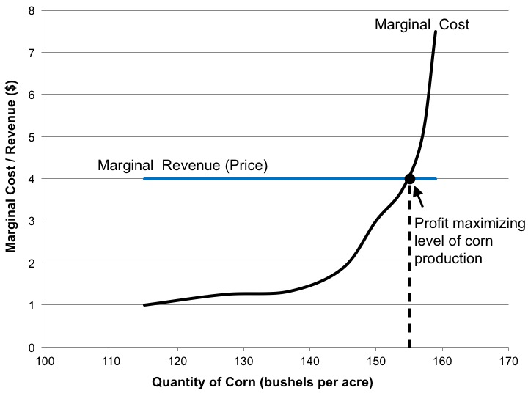
Figure 16.4 Profit Maximization Based on Marginal Analysis

Slide 8
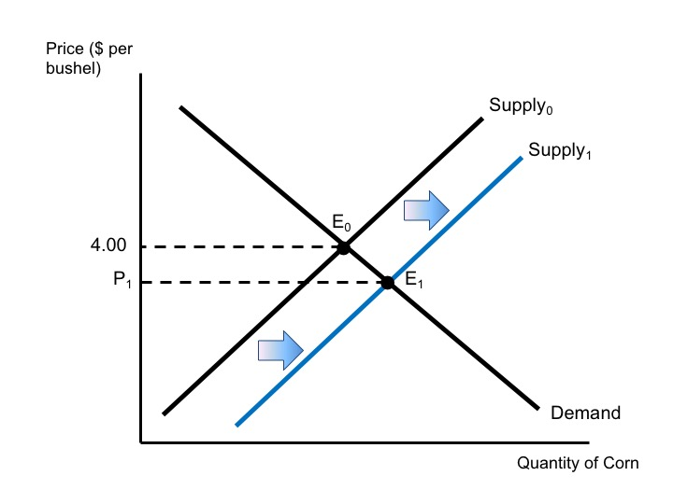
Figure 16.5 An Increase in Supply as More Farmers Enter the Corn Market

Slide 9
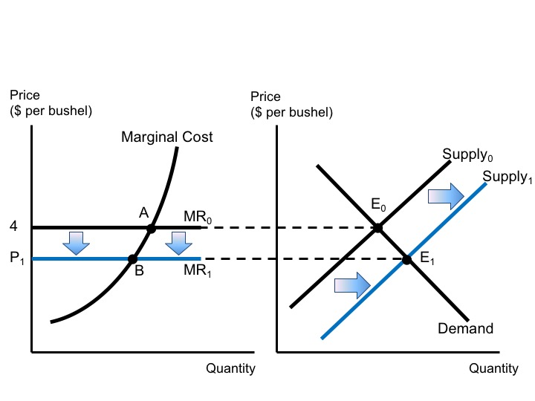
Figure 16.6 The Relationship Between Market Conditions and Individual Production Decisions

Slide 10
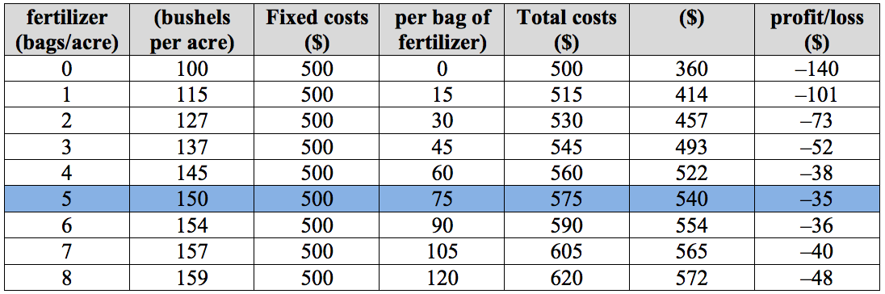
Table 16.3 Impact of a Decrease in Corn Prices

Slide 11
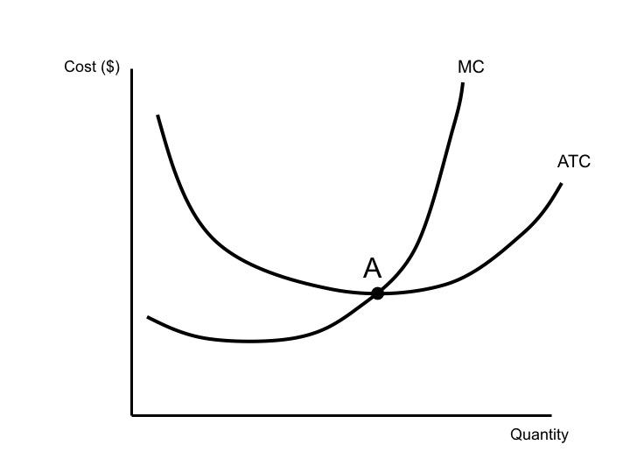
Figure 16.7 The Relationship Between Average Total Costs and Marginal Costs

Slide 12
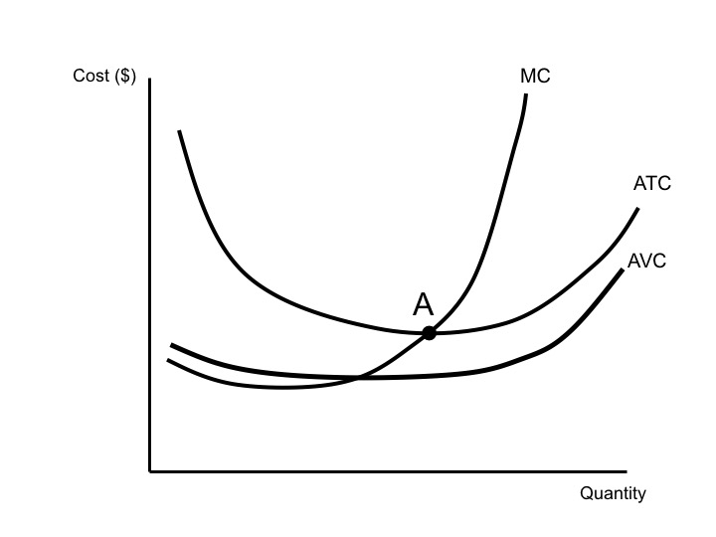
Figure 16.8 The Relationship Between Average Total Costs, Marginal Costs, and Average Variable Costs

Slide 13
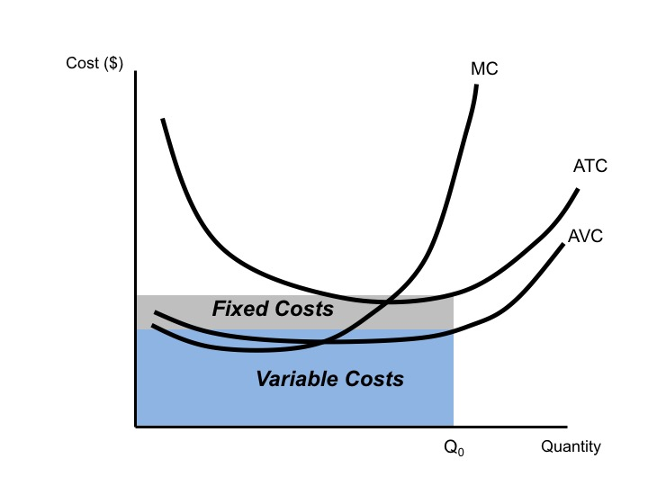
Figure 16.9 The Relationship Between Cost Curves and Areas of Total Costs, Fixed Costs, and Variable Costs

Slide 14
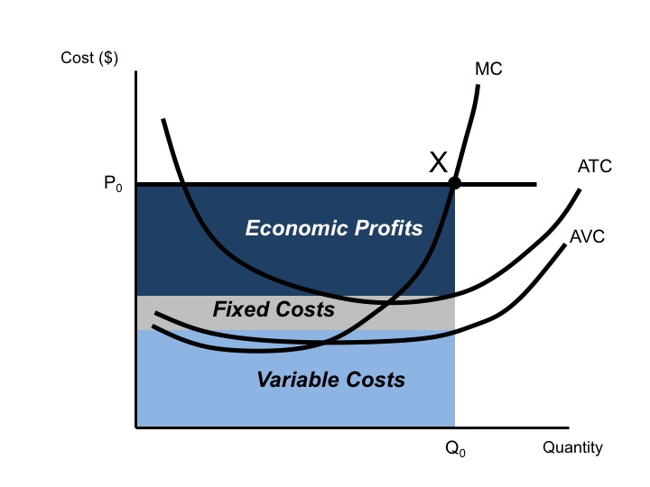
Figure 16.10 Positive Economic Profits

Slide 15
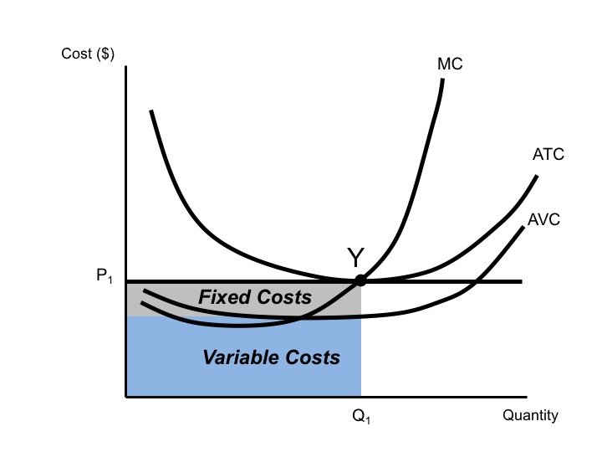
Figure 16.11 Zero Economic Profits – The Perfectly Competitive Market Equilibrium

Slide 16
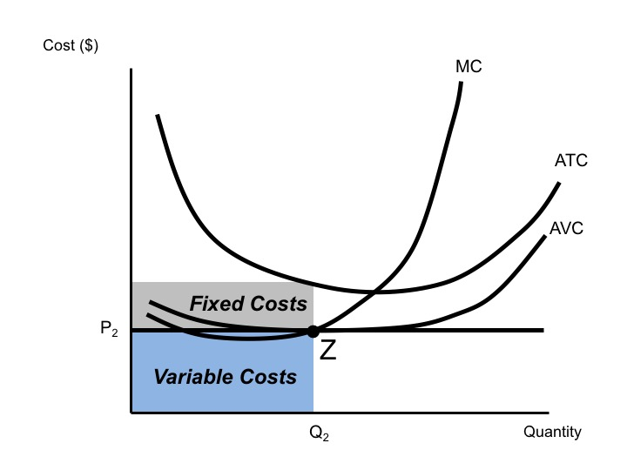
Figure 16.12 The Decision to Produce with Losses

