Slide 1
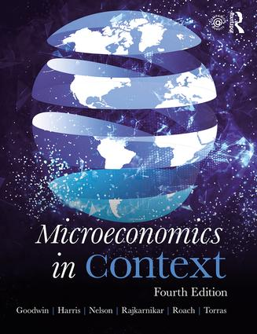
Chapter Fifteen:
Production Costs

Slide 2
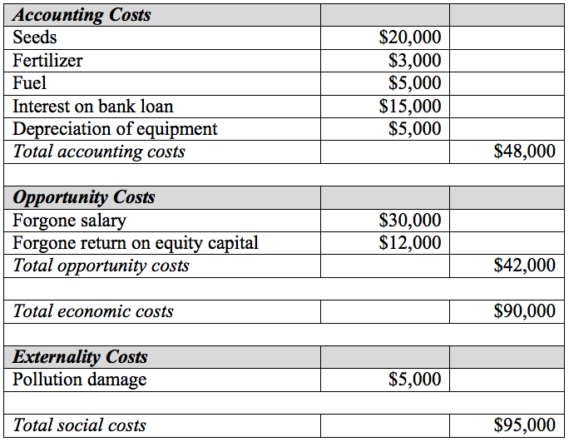
Table 15.1 Gail’s Cost of Farming

Slide 3
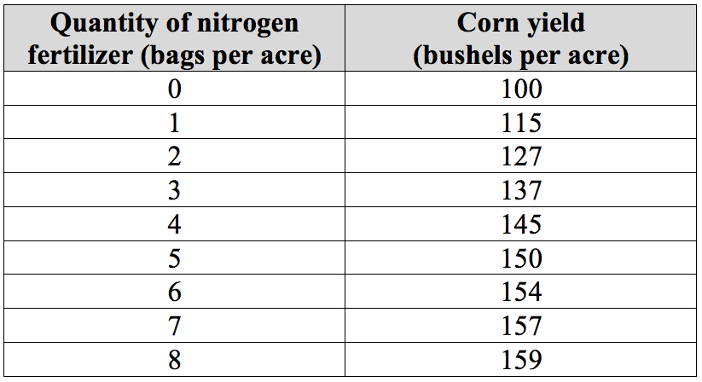
Table 15.2 Corn Production Function

Slide 4
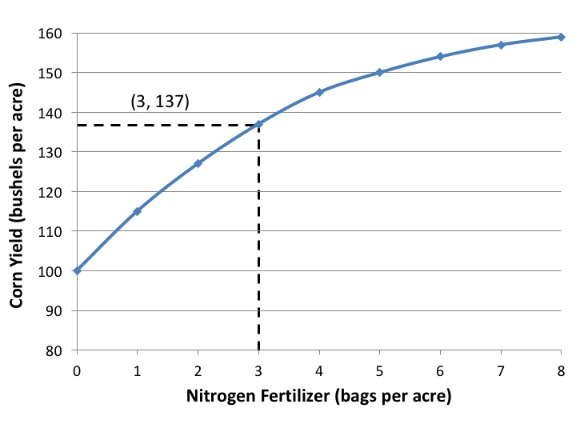
Figure 15.1 Corn Production Function

Slide 5
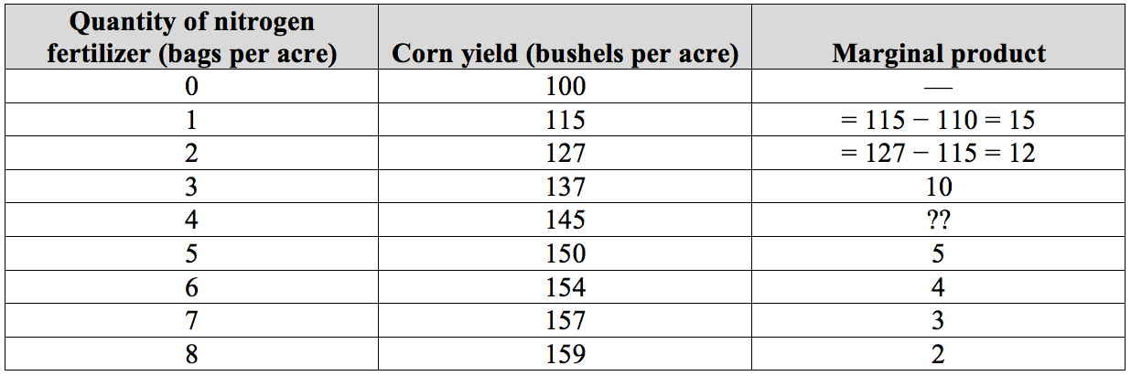
Table 15.3 Calculating Marginal Product

Slide 6
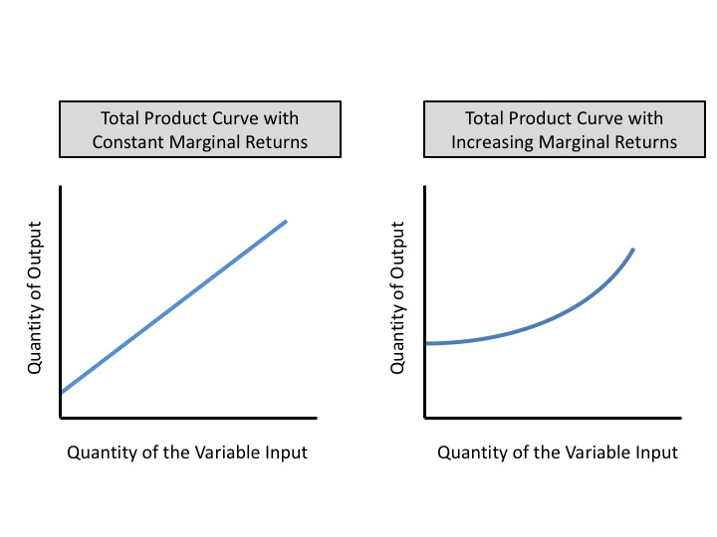
Figure 15.2 Total Product Curves with Constant and Increasing Marginal Returns

Slide 7
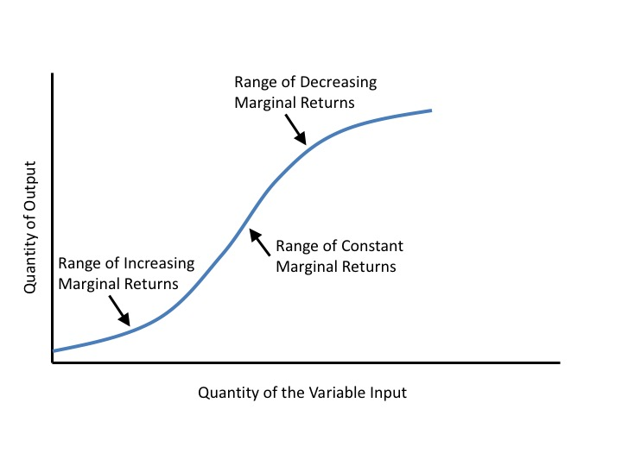
Figure 15.3 A Total Product Curve with Increasing, Constant, and Decreasing Marginal Returns

Slide 8
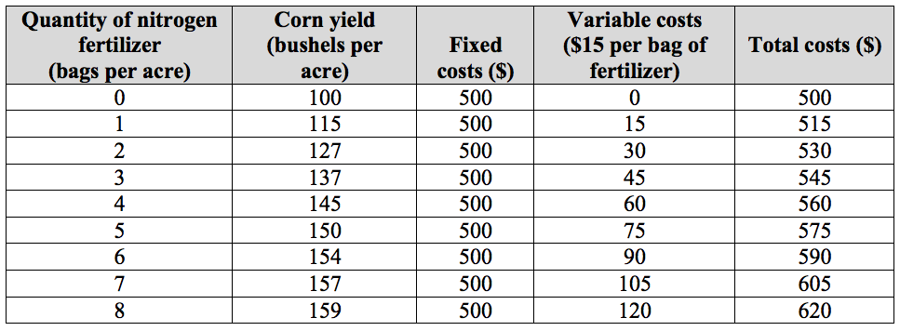
Table 15.4 Cost of Corn Production

Slide 9
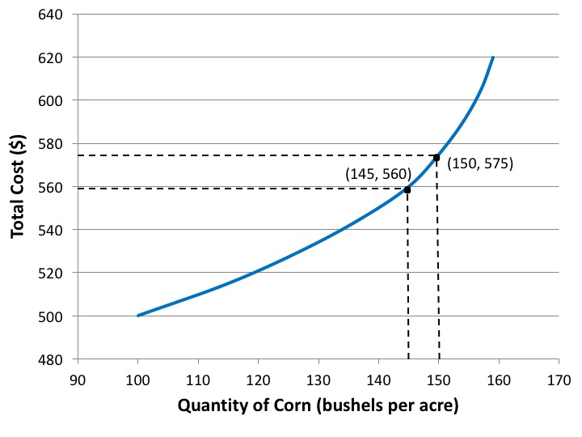
Figure 15.4 Total Cost Curve for Corn Production

Slide 10
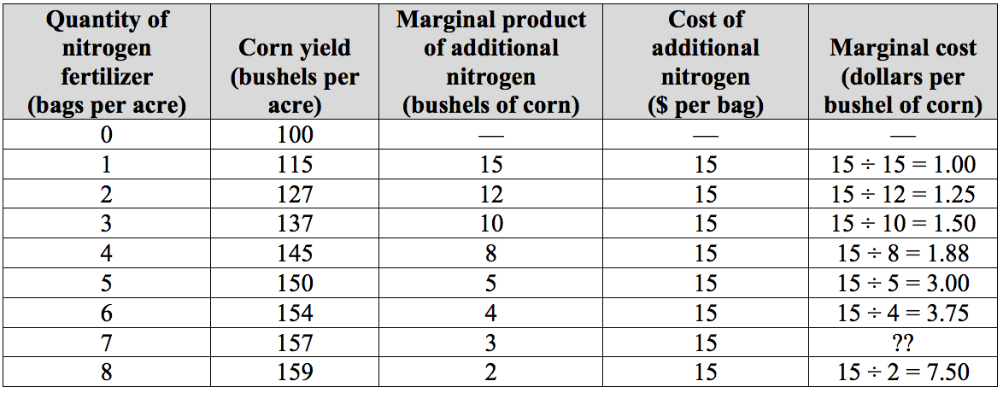
Table 15.5 Marginal Cost of Corn Production

Slide 11
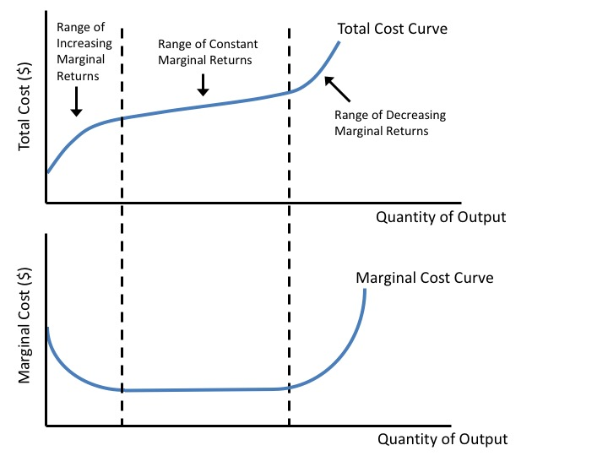
Figure 15.5 Relationship Between Total and Marginal Costs

Slide 12
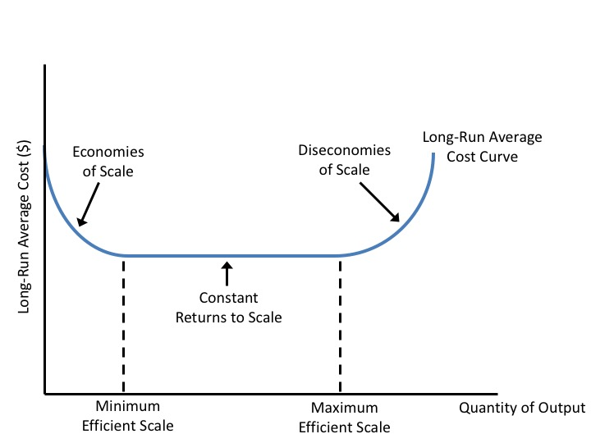
Figure 15.6 Long-Run Average Costs

Slide 13
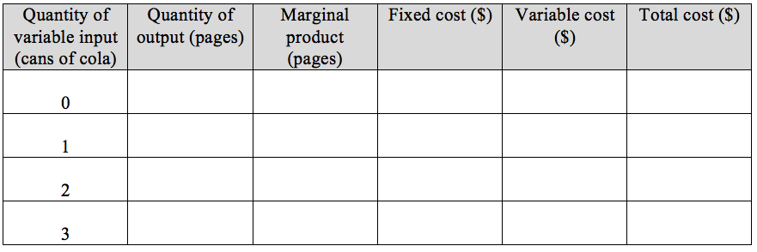
Chapter 15 Exercise 5

Slide 14
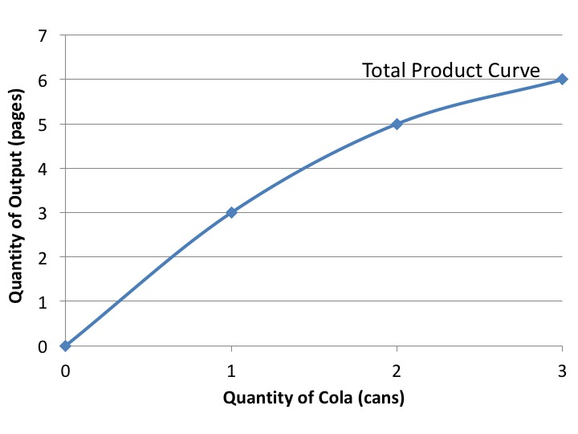
Chapter 15 Exercise 5

