Slide 1

Chapter Fourteen:
Capital Stocks
and Resource Management

Slide 2
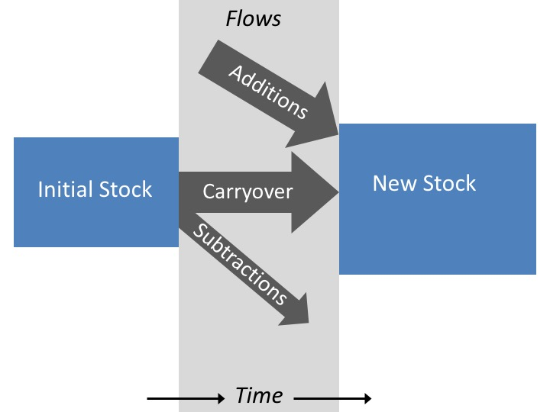
Figure 14.1 A Stock-Flow Diagram

Slide 3
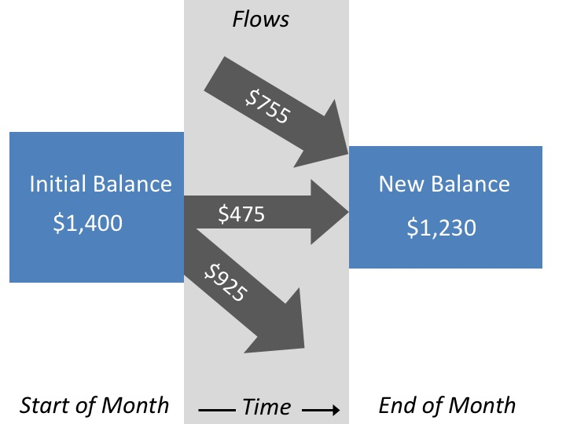
Figure 14.2 A Stock-Flow Diagram for a Checking Account

Slide 4
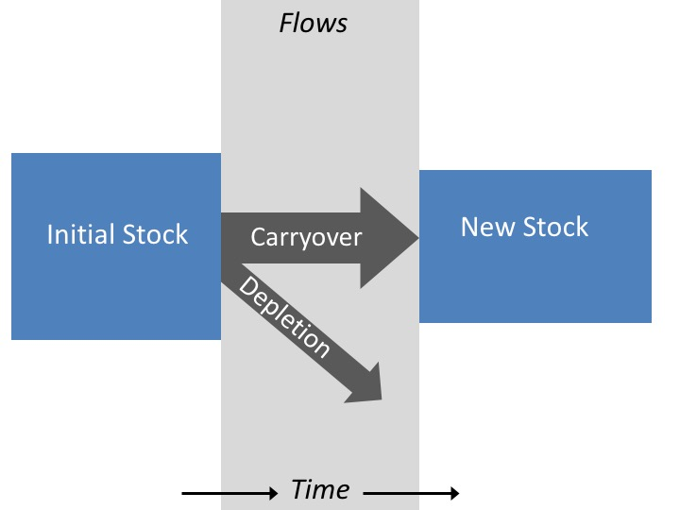
Figure 14.3 Depletion of Nonrenewable Natural Capital Over Time

Slide 5
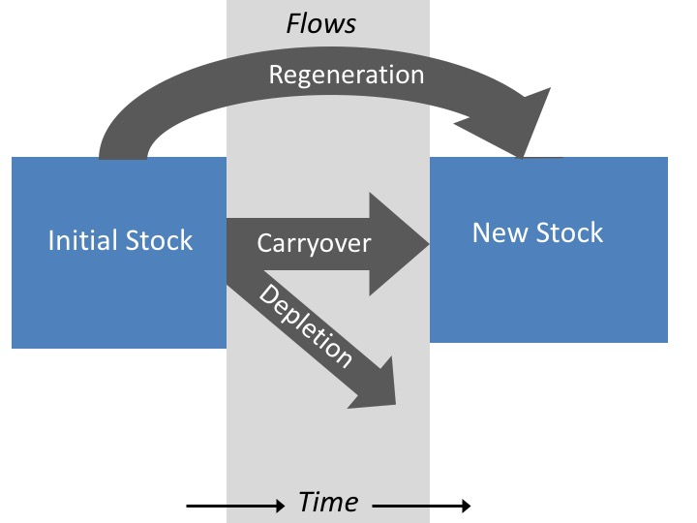
Figure 14.4 Stock Changes for a Renewable Natural Resource

Slide 6
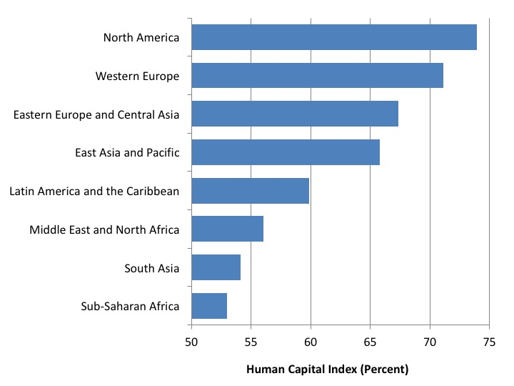
Figure 14.5 Average Human Capital Index, by World Region
Source: World Economic Forum, 2017a.

Slide 7
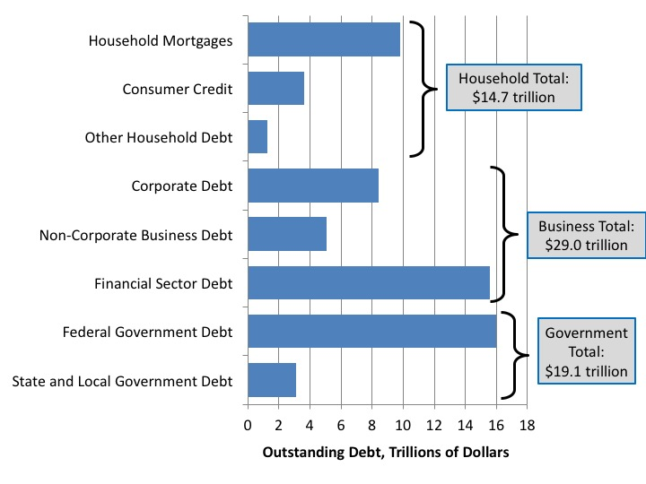
Figure 14.6 Outstanding Debt in the United States, 2016
Source: Board of Governors of the Federal Reserve System, 2017.

