Slide 1

Chapter Eleven:
Taxes and Tax Policy

Slide 2
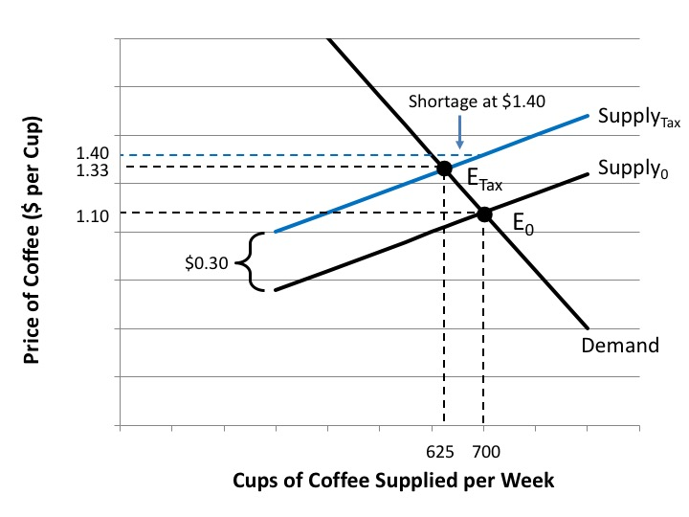
Figure 11.1 The Impact of a Tax on the Market for Cups of Coffee

Slide 3
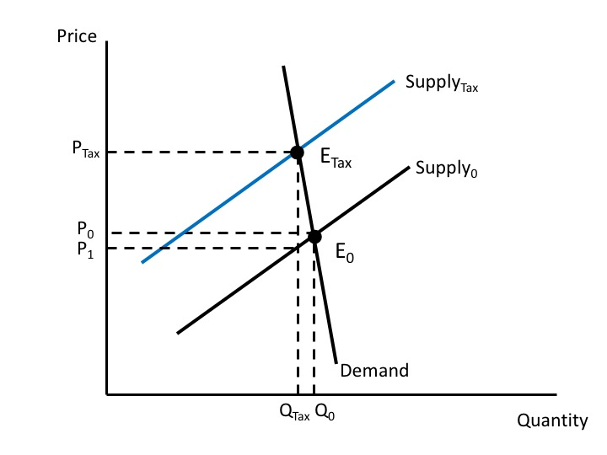
Figure 11.2 The Impact of an Excise Tax with an Inelastic Demand Curve

Slide 4
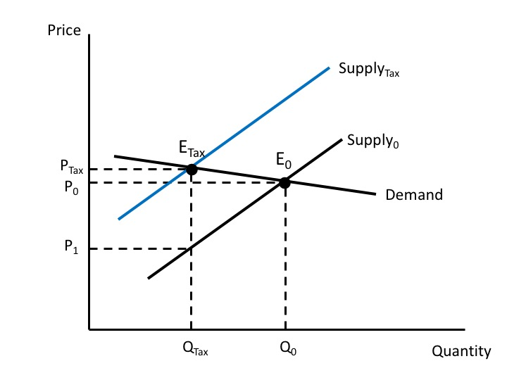
Figure 11.3 The Impact of an Excise Tax with an Elastic Demand Curve

Slide 5
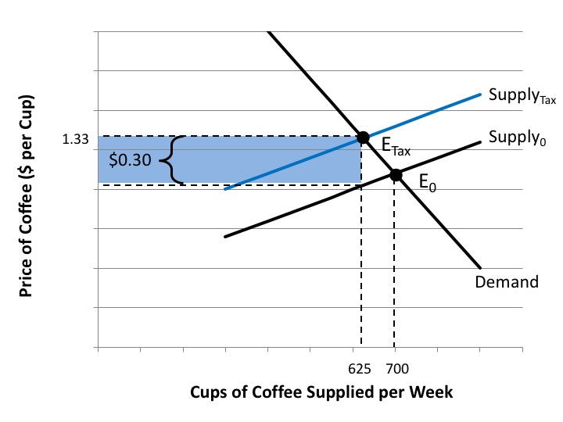
Figure 11.4 Tax Revenue from a Tax on Cups of Coffee

Slide 6
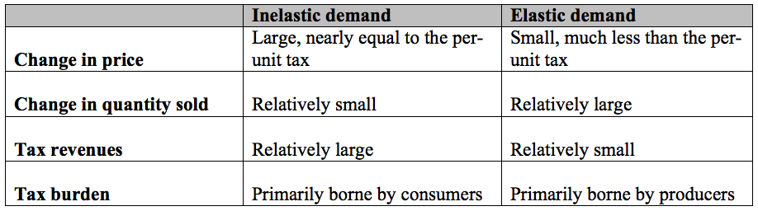
Table 11.1 Summary of Excise Tax Impacts for Products with Elastic and Inelastic Demand Curves

Slide 7
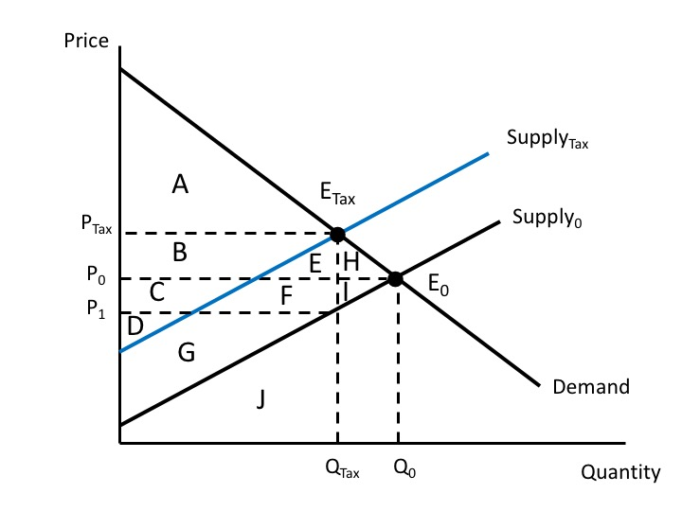
Figure 11.5 Welfare Analysis of an Excise Tax

Slide 8
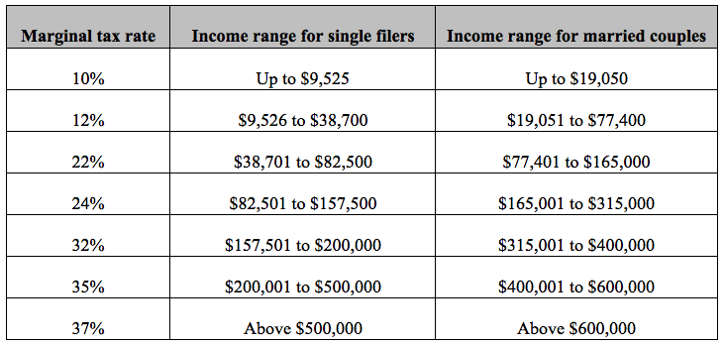
Table 11.2 U.S. Federal Marginal Tax Rates, 2018

Slide 9
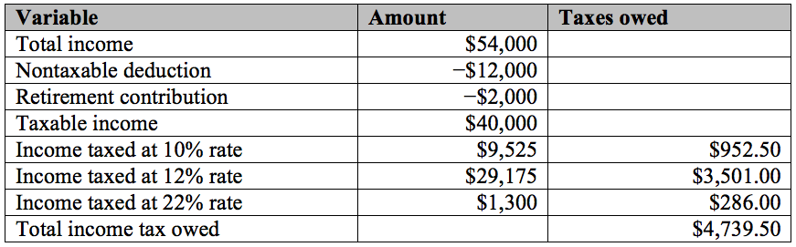
Table 11.3 Susan’s Federal Income Tax Calculations

Slide 10
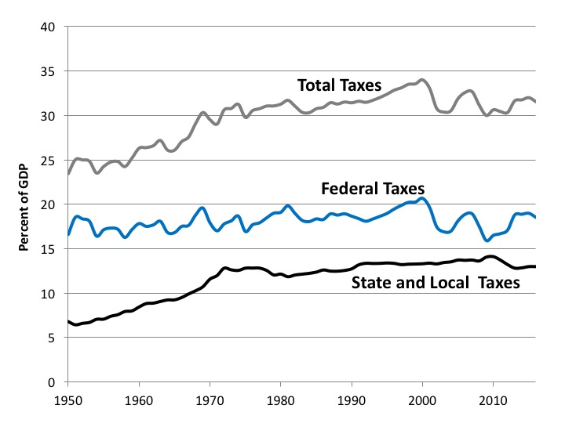
Figure 11.6 Tax Receipts in the United States, as a Percentage of GDP, 1950-2016
Source: U.S. Bureau of Economic Analysis, online database.

Slide 11
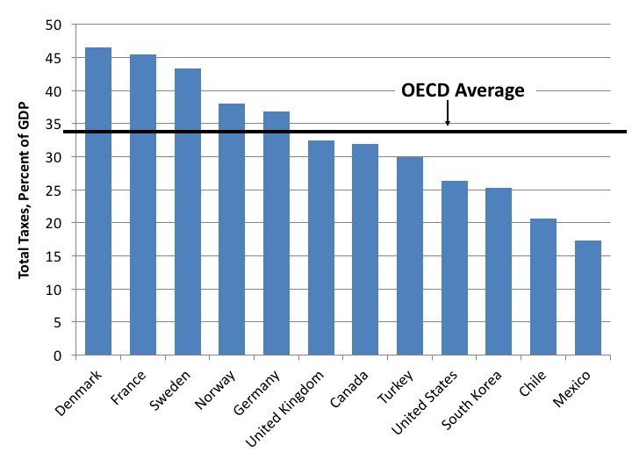
Figure 11.7 International Comparison of Overall Tax Receipts, Select Countries, 2015
Source: OECD, Revenue Statistics.

Slide 12
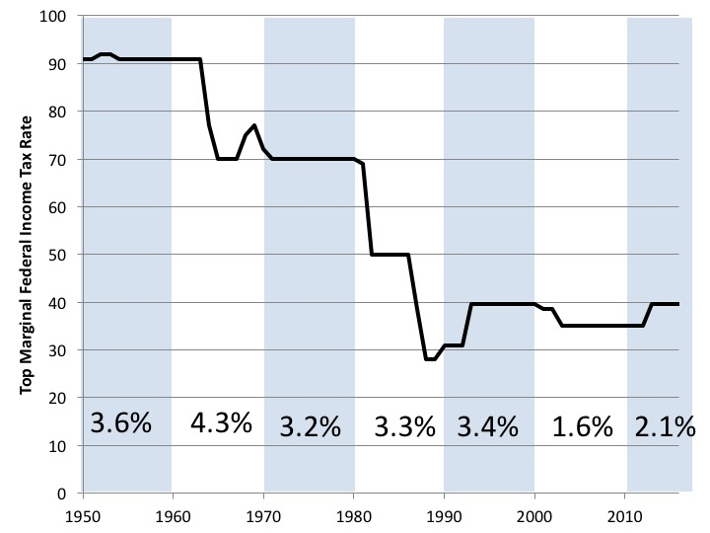
Figure 11.8 The Top Marginal Federal Income Tax Rate and Average Economic Growth, 1950-2016
Sources: U.S. Bureau of Economic Analysis; Tax Policy Center,
http://www.taxpolicycenter.org/sites/default/files/legacy/taxfacts/content/PDF/toprate_historical.pdf.
Note: Percentages are average annual growth rates of real GDP per decade.

Slide 13
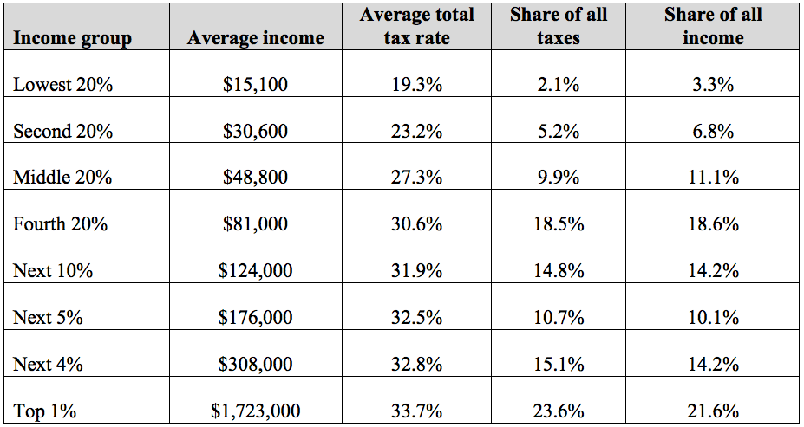
Table 11.4 The Distribution of Taxes in the United States, 2016
Source: Citizens for Tax Justice, 2016.

