Slide 1

Chapter Zero:
Microeconomics and Well-Being

Slide 2
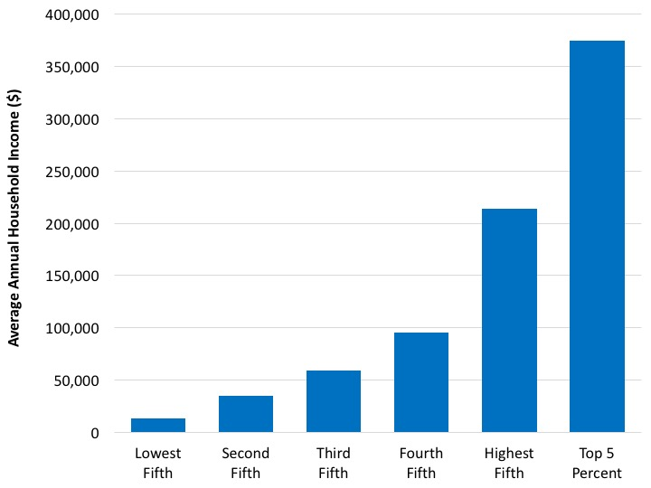
1. Income Inequality
Source: U.S. Census Bureau. 2017. “Historical Income Tables: Households,” Table H-3.
Notes:
What it is: The graph below shows the average household income for different
income groups in the United States, based on 2016 data. Each group
represents one-fifth of American households, except for the last group
which includes only the top 5%.
The results: For American households with income in the bottom fifth, average income
in 2016 was only about $13,000. For those in the middle fifth,
household income averaged nearly $60,000. Those in the top fifth had
an average household income of about $210,000. Average household
income was over $375,000 for the top 5%. Note that these are average
values, so some households in each group made less than these income
values, while some made more. We will discuss income inequality, including
its causes, in more detail in Chapter 10.

Slide 3
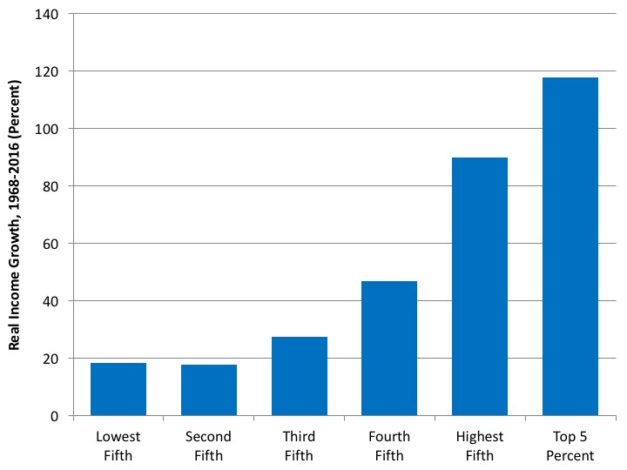
2. Unequal Income Growth
Source: U.S. Census Bureau. 2017. “Historical Income Tables: Households,” Table H-3.
Note: We use 1968 as the starting year in this analysis because it is the year in which income inequality in the United States started to increase, as we will discuss in Chapter 10.
Notes:
What it is: The graph below shows the growth in household income for different
income groups in the United States, over the period 1968–2016. Similar
to the previous graph, each group represents one-fifth of American
households, except for the last group which includes only the top 5%.
The data have been adjusted for inflation.
The results: You’ve probably heard the saying that “The poor get poorer and the
rich get richer.” That’s close, but not quite true. We see that those at the
bottom of the income distribution did see small income gains in recent
decades. Those in the middle did a little better. But the largest gains, by
far, were obtained by those at the top, particularly those in the top 5%.
The graph tells us that income inequality has increased considerably in
recent decades. We will discuss trends in income inequality in more detail
in Chapter 10.

Slide 4
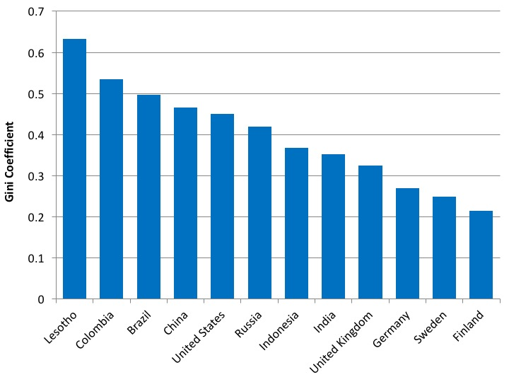
3. Income Inequality – International Comparisons
Source: U.S. Central Intelligence Agency, CIA World Factbook.
Note: Year of data varies.
Notes:
What it is: A Gini coefficient is a measure of economic inequality in a country,
as we will discuss in Chapter 10. It can range from 0 (everyone in the
country has the same income) to 1 (one person receives all the income
in a country).
The results: Scandinavian countries such as Sweden, Norway, and Finland tend to be
the most equal nations in the world, by income. Other countries with
low Gini coefficients include Germany, Hungary, and Ukraine. The
United States is the most economically unequal developed country, and
has a Gini coefficient similar to China’s and Mexico’s. Several African
countries, including Botswana, Lesotho, and South Africa, are the most
unequal countries in the world.

Slide 5
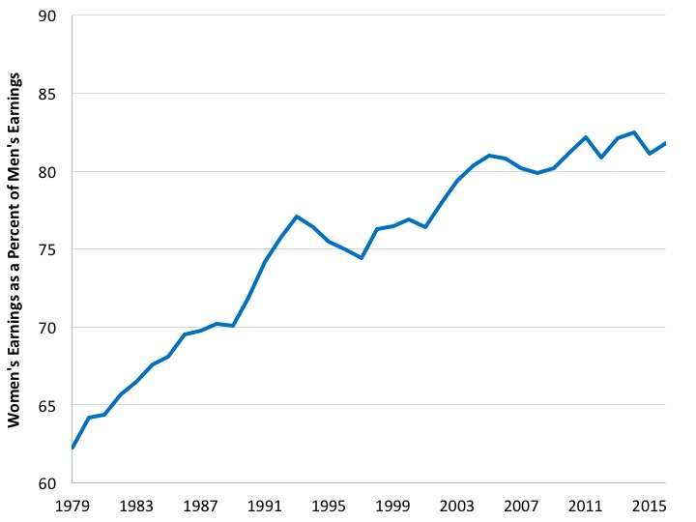
4. Gender-Based Earnings Inequality
Source: U.S. Bureau of Labor Statistics. 2017. “Highlights of Women’s Earnings in 2016.” Report 1069.
Notes:
What it is: The “gender wage gap” is the difference in median earnings between
men and women who work full-time. The graph below shows women’s
median earnings in the United States as a percentage of men’s median
earnings, over the period 1979 to 2016.
The results: In 1979 women working full-time in the United States only earned
62% of what men earned. During the 1970s and 1980s, the gender
wage gap closed considerably. By the early 2000s, women working fulltime
earned about 80% of what men earned. Since then, the wage gap
has remained relatively constant. In 2016, women earned 82% of what
men earned. Is this clear evidence of gender discrimination? We’ll discuss
this topic in more detail in Chapter 9.

Slide 6
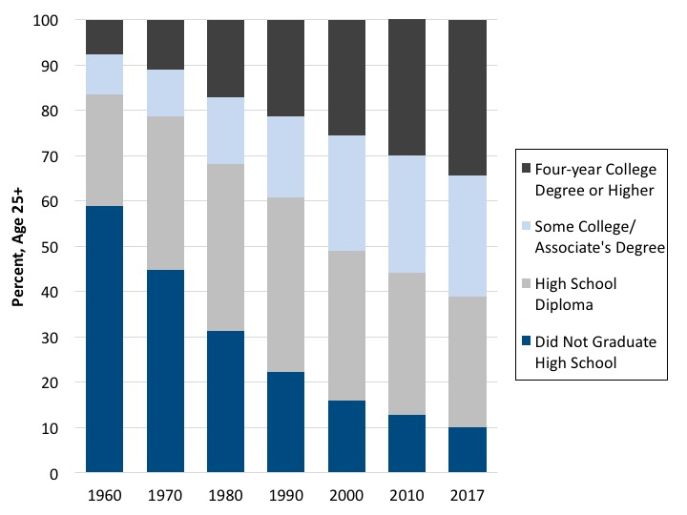
5. Educational Attainment
Sources: U.S. Census Bureau, Educational Attainment, CPS Historical Time Series Tables, Table
A-1; U.S. Census Bureau, Educational Attainment in the United States: 2017, Table 1.
Notes:
What it is: Education is an important type of “human capital”—a term economists
use to describe the knowledge and skills people possess that allows
them to engage in production activities. The graph below shows the
maximum educational attainment for Americans age 25 and over in
1960, 1970, 1980, 1990, 2000, 2010, and 2017. Each column adds up to
100%, but the percent falling into each education category varies with
changes in educational attainment.
The results: In 1960, about 58% of Americans age 25 and over had not graduated
high school, and less than 10% had a college degree or higher. We see
that educational attainment has increased each decade, but still only
about 34% of adult Americans have a college degree or higher. We will
discuss education as a form of human capital in Chapter 14, and the
relationship between education and wages in Chapter 9.

Slide 7
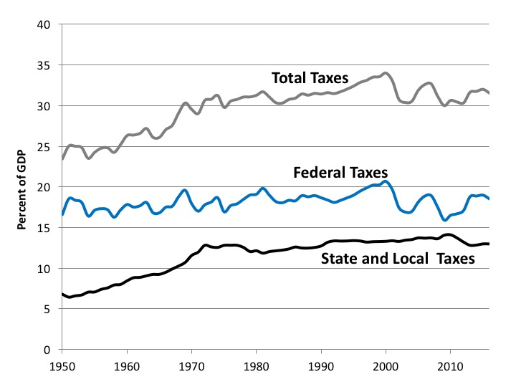
6. Taxes as a Percentage of GDP
Source: U.S. Bureau of Economic Analysis, online database.
Notes:
What it is: The graph below shows tax collections in the United States over the
period 1950–2016, measured as a percent of gross domestic product
(GDP). Total taxes are divided into federal taxes and state and local taxes.
The results: Total tax collections in the United States gradually increased from
about 25% of GDP in the 1950s to close to 35% of GDP in the late
1990s. Since then, federal tax revenues have fluctuated—falling during
recessions and increasing during economic recoveries. While surveys of
Americans show that many people believe taxes have gone up in recent
years (particularly federal taxes), this is generally not true. We will discuss
taxes in more detail in Chapter 11.

Slide 8
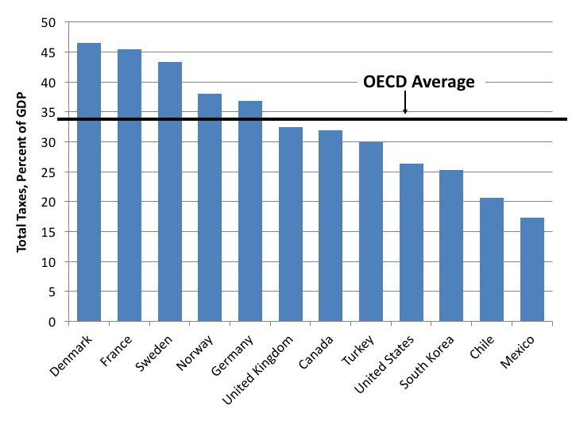
7. Taxes—International Comparisons
Source: Organisation for Economic Co-operation and Development, Revenue Statistics.
Notes:
What it is: The graph below shows total tax collections in 2015, as a percentage of
GDP, for various OECD (Organisation for Economic Co-operation and
Development) countries. The OECD is an organization of 36 countries,
most of them high-income countries, which promotes policies to improve
economic and social well-being.
The results: Tax collections, as a percentage of GDP, vary considerably across countries.
Taxes tend to be relatively high in European countries. Among
high-income countries, the United States has one of the lowest overall
tax rates in the world. This is not necessarily the perception of many
Americans. We will further discuss international comparisons of taxes in
Chapter 11.

Slide 9
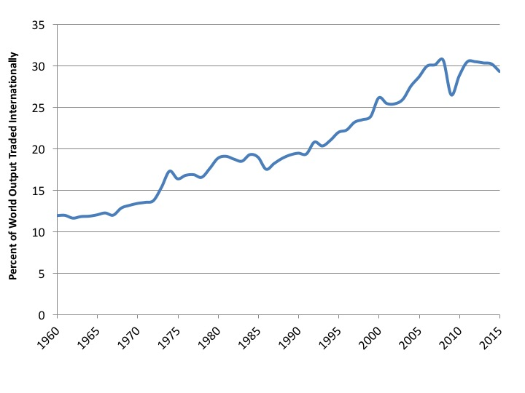
8. Global International Trade
Source: World Bank, World Development Indicators database.
Notes:
What it is: The graph below shows the percentage of world economic production
(called “gross world product”) that is traded across international borders,
over the period 1960 to 2015. This is one way to get a quick, partial
snapshot of the degree of “globalization.”
The results: At least as measured by international trade, the world is clearly becoming
more globalized in recent decades. About 12% of all goods and
services produced in the world were traded in 1960. Currently about
30% of world production is traded internationally. We can see that the
global financial crisis of 2007–2009 temporarily reduced international
trade, but that it has since recovered to previous levels. We will discuss
the topic of international trade further in Chapter 6.

Slide 10
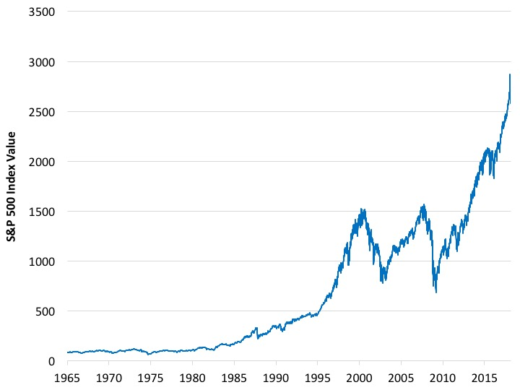
9. Stock Market Performance
Source: Yahoo Finance, https://finance.yahoo.com/quote/%5EGSPC?p=^GSPC.
Notes:
What it is: Media stories about the economy often focus on the performance of
the stock market. Several common stock indices, such as the Dow Jones
Composite, the Nasdaq Composite, and S&P (Standard & Poor’s) 500
Index, provide a broad overview of stock market prices. The graph below
shows the value of the S&P 500 Index from 1965 to early 2018.
The S&P 500 Index is calculated based on the stock prices of 500 large,
mostly American, companies.
The results: From 1965 to 2000 the S&P 500 Index rose from about 100 to over
1,500. Since 2000, there have been two major “crashes” in the American
stock market. Recovering from the Great Recession, the S&P 500
increased by about 300% between 2009 and 2018. While we won’t discuss
the stock market in much detail in this book, we will spend considerable
time discussing how markets operate, including the factors that
lead to price fluctuations.

Slide 11
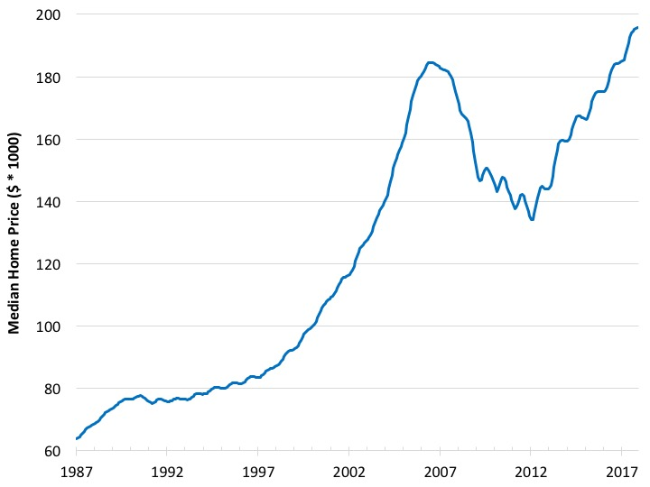
10. Median Home Prices
Source: Federal Reserve Bank of St. Louis, Case-Shiller U.S. National Home Price Index.
Notes:
What it is: The “median” price of home sales is the price at which half of homes
sell for more than this price, and half sell for less. The graph below shows
median home price in the United States over the period 1987 to mid-
2018. The prices have not been adjusted for inflation.
The results: The median price of houses in the United States increased by a factor of
three between 1987 and 2007. Then the housing bubble burst, and home
prices fell by about one-third. Since then home prices have recovered to
their previous levels. Our discussion of markets, beginning in Chapter 2
and covering most of the chapters in this book, will help you understand
how markets operate.
60

Slide 12
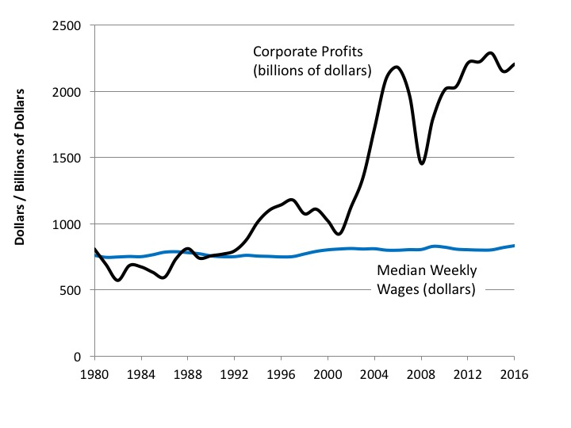
11. Median Worker Earnings vs. Corporate Profits
Sources: Federal Reserve Bank of St. Louis, National Income: Corporate Profits before Tax; U.S.
Bureau of Labor Statistics, Weekly and Hourly Earnings Data from the Current Population Survey.
15034-2054e-Fullbook.indb 15
Notes:
What it is: The graph below shows the change in two variables over the period of
1980 to 2016 in the United States:
1. Total corporate profits, measured in billions of dollars
2. Median weekly earnings for American workers, measured in dollars
The data for both variables have been adjusted for inflation. Note that
the vertical axis is measured in dollars for median worker earnings and
billions of dollars for corporate profits.
The results: Corporate profits have fluctuated based on the health of the overall
economy, but we see that profits have reached record highs recently.
Corporate profits in 2016 were about three times the level they were at
in 1980. Meanwhile, the median wages of U.S. workers have essentially
not changed at all since 1980. We will discuss wages in more detail in
Chapter 9, including the reasons why wages have not risen in proportion
to corporate profits.

Slide 13
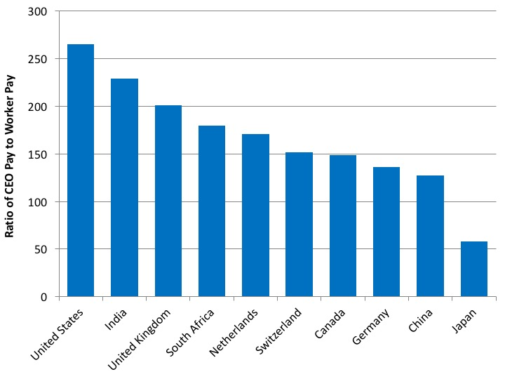
12. CEO Pay vs. Worker Pay – International Comparisons
Source: Bloomberg, “Executive Pay,” January 2018. https://www.bloomberg.com/quicktake/executive-pay.
Notes:
What it is: In addition to comparing corporate profits to worker pay, we can look at
the pay difference between CEOs (chief executive officers) and workers.
The graph below shows the ratio of average CEO compensation to the
average pay of “rank-and-file” workers, in several countries. The ratios
are based on data from 2016 and 2017.
The results: In the United States, average CEO pay is over 250 times higher than average
worker pay. In other countries, CEOs still make significantly more
than rank-and-file workers, but pay differences are not as pronounced.
For example, in Canada CEOs make, on average, 150 times more than
workers, while in Japan CEOs make about 60 times worker pay.

Slide 14
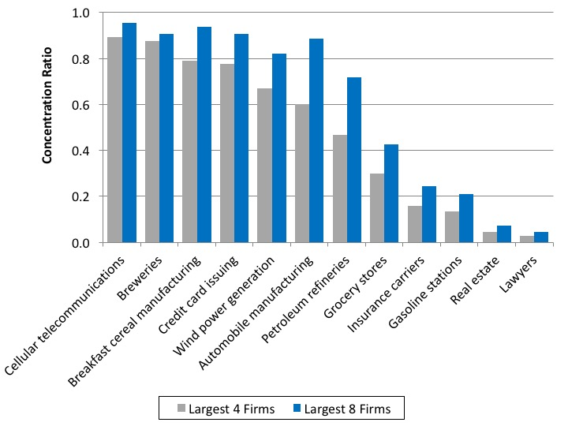
13. Industrial Concentration Ratios
Source: U.S. Census Bureau, 2012 Economic Census.
Note: Manufacturing concentration ratios based on value-added. All other concentration ratios based on revenues.
Notes:
What it is: An industrial concentration ratio measures the percentage of all sales in a
particular industry that are received by the largest firms in that industry.
The figure below shows four-firm and eight-firm concentration ratios—
the percentage of all sales received by the largest four and eight firms in
each industry. Industrial concentration ratios provide information about
the degree of market power held by large firms in a particular industry.
The results: Some industries in the United States are dominated by a few firms, while
other industries are more competitive. Examples of industries with a few
dominant firms include cell phone services, cereals, and credit cards. Examples
of industries where market power is not so concentrated include
insurance, gas stations, and lawyers. We will discuss market power in more
detail in Chapter 17.

Slide 15
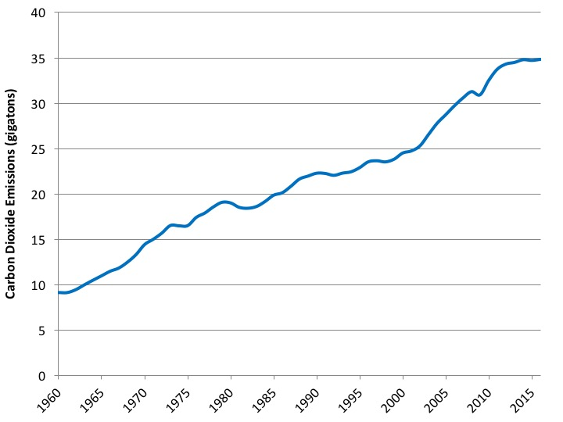
14. Global Carbon Dioxide Emissions
Source: Global Carbon Project. Global Carbon Atlas. http://www.globalcarbonatlas.org/en/content/welcome-carbon-atlas.
Notes:
What it is: The vast majority of scientists believe that human activities are impacting
the global climate. Carbon dioxide emissions, which result when
oil, coal, and natural gas are burned, have been identified as the primary
cause of global climate change. The graph below shows global carbon
dioxide emissions from 1960 to 2016, measured in gigatons (a gigaton is
a billion metric tons).
The results: We see that global carbon dioxide emissions increased from about 10
gigatons in 1960 to about 35 gigatons recently. While most projections
indicate that global carbon dioxide emissions will continue to increase
in the future, scientists note that emissions will need to decrease substantially
in the next few decades to avoid significant negative consequences
to the global ecosystem and to human societies. We will discuss global
climate change in more detail in Chapter 13.

Slide 16
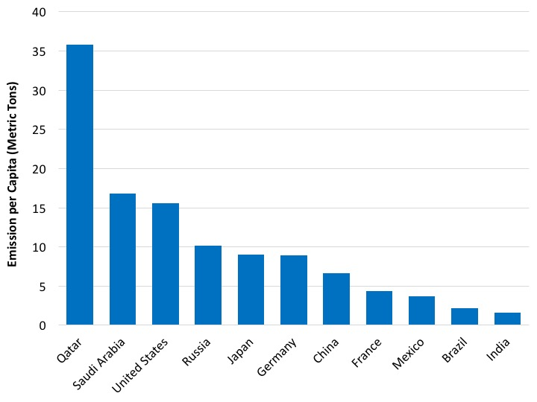
15. Per Capita Carbon Dioxide Emissions –International Comparisons
Source: Statista.com, CO2 Emissions per Person in 2015. Original data from International Energy Agency. https://www.statista.com/statistics/270508/co2-emissions-per-capita-by-country/.
Notes:
What it is: The graph below shows annual per-capita (average per person) carbon dioxide
emissions for several countries, measured in tons. The data are from 2015.
The results: Per-capita carbon dioxide emissions vary significantly across countries. In
general, emissions per capita rise with higher incomes, but this is not always
the case. The highest per-capita emissions are found in oil-producing
countries. Emissions per capita are quite high in the United States, at
around 16 tons. Per-capita emissions are about 9 tons in Germany, 7 tons
in China, and 4 tons in Mexico. Per-capita carbon dioxide emissions are
much lower in the world’s poorest countries. We will discuss carbon dioxide
emissions, and global climate change, in Chapter 13.

