Slide 1

Chapter 9
Aggregate Demand and Economic Fluctuations

Slide 2
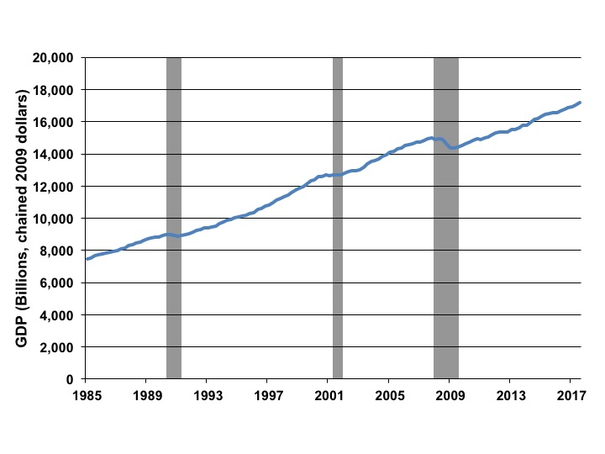
Figure 9.1 U.S. Real GDP and Recessions, 1985-2017
Source: BEA quarterly data 1985–2017, and NBER.

Slide 3
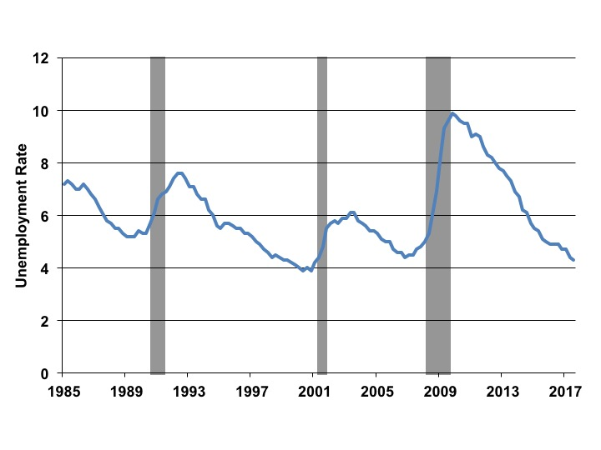
Figure 9.2 U.S. Unemployment Rate and Recessions, 1985-2017
Source: BLS monthly data 1985–2017, and NBER.

Slide 4
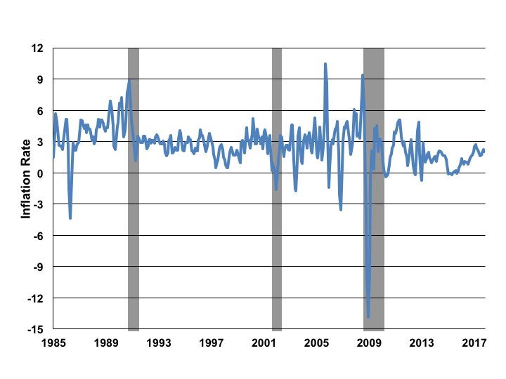
Figure 9.3 U.S. Inflation Rate and Recessions, 1985-2017
Source: “Economic Report of the President” 1985–2017; rate is calculated as a three-month moving average of the CPI; NBER.

Slide 5
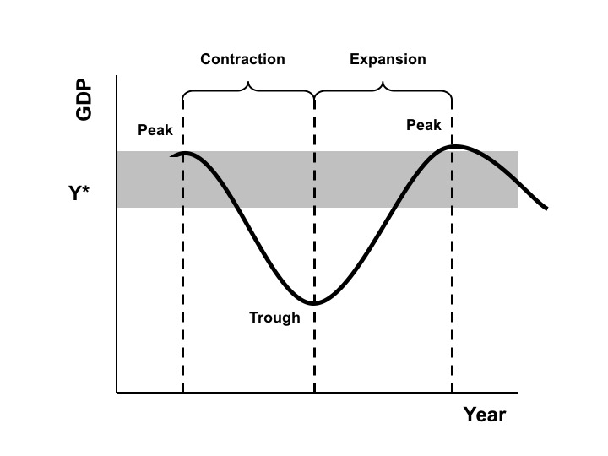
Figure 9.4 A Stylized Business Cycle

Slide 6
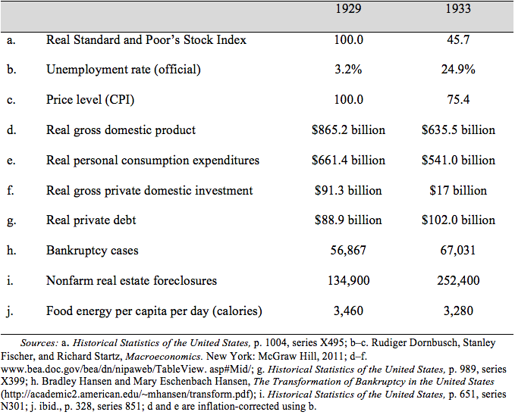
Table 9.1 The Early Years of the Great Depression in the United States

Slide 7
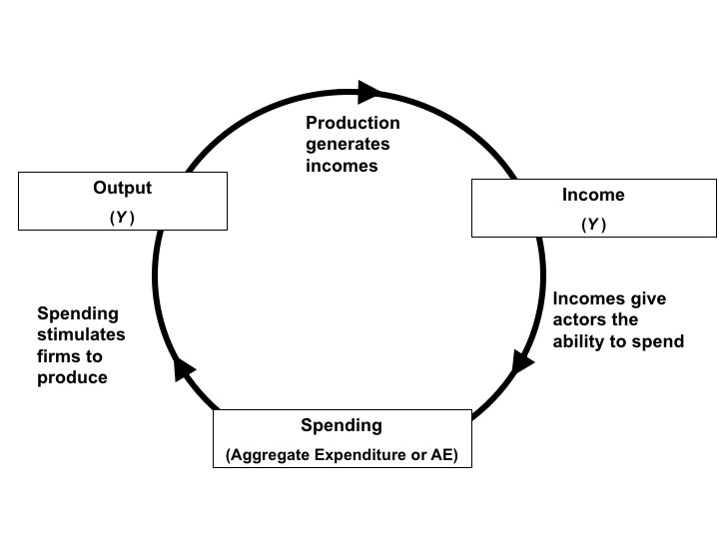
Figure 9.5 The Output-Income-Spending Flow of an Economy in Equilibrium

Slide 8
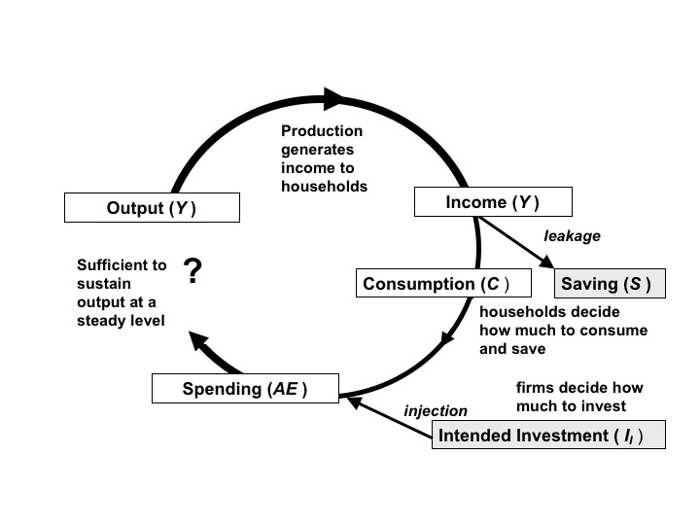
Figure 9.6 The Output-Input-Spending Flow with Leakages and Injections

Slide 9
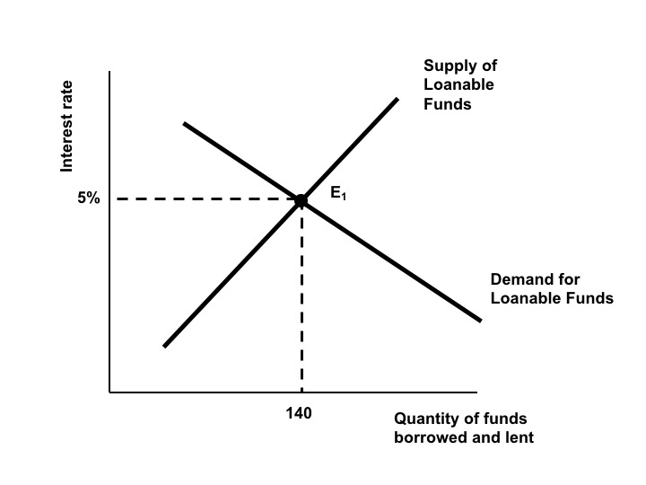
Figure 9.7 The Classical Model of the Market for Loanable Funds

Slide 10
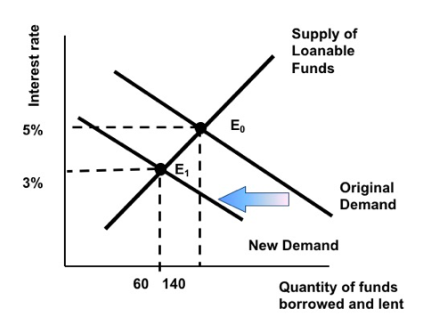
Figure 9.8 Adjustment to a Reduction in Intended Investment in the Classical Model

Slide 11
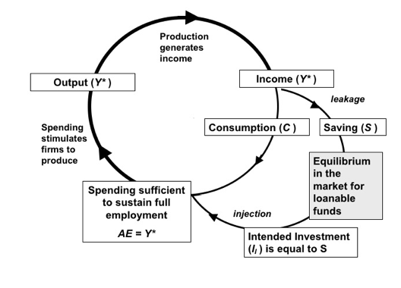
Figure 9.9 Macroeconomic Equilibrium at Full Employment in the Classical Model

Slide 12
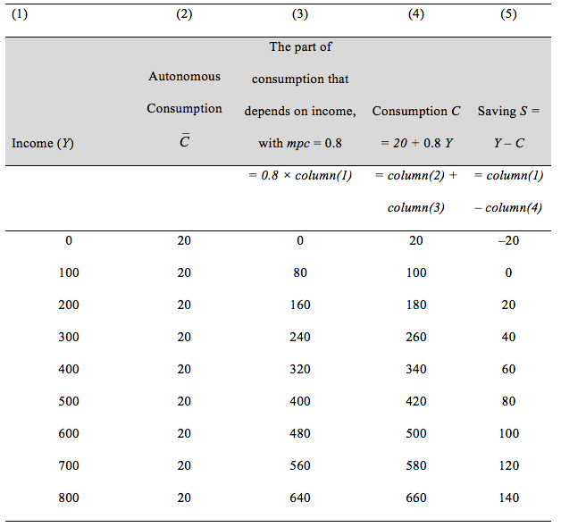
Table 9.2 The Consumption Schedule (and Saving)

Slide 13
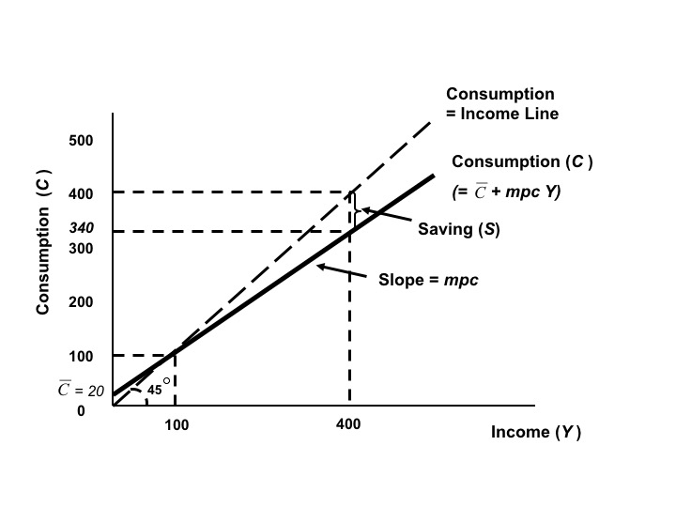
Figure 9.10 The Keynesian Consumption Function

Slide 14
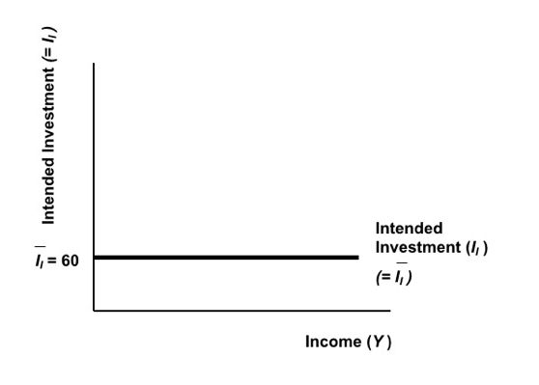
Figure 9.11 The Keynesian Investment Function

Slide 15
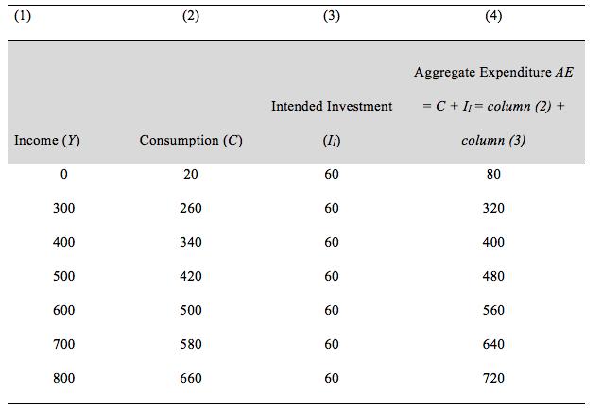
Table 9.3 Deriving Aggregate Expenditure from the Consumption Function and Investment

Slide 16
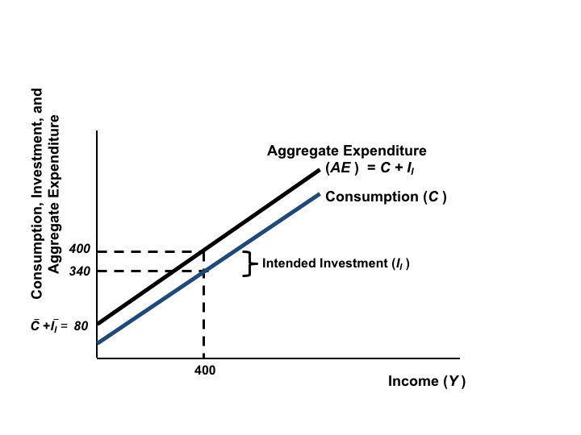
Figure 9.12 Aggregate Expenditure

Slide 17
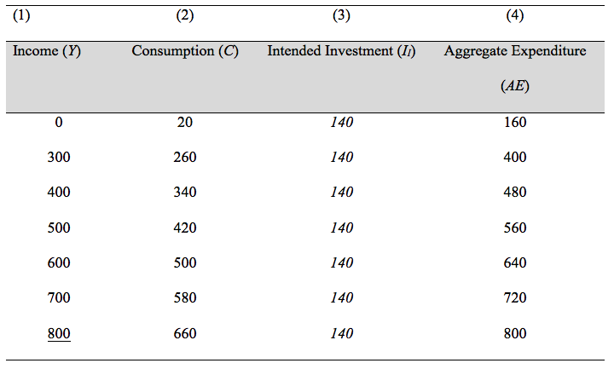
Table 9.4 Aggregate Expenditure with Higher Intended Investment

Slide 18
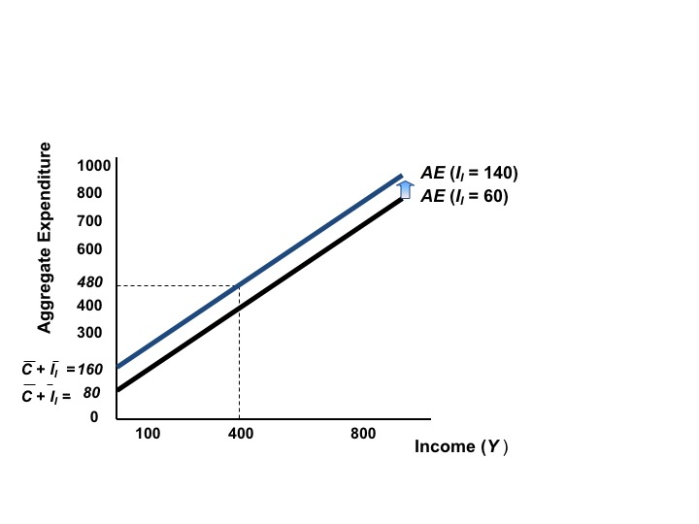
Figure 9.13 Aggregate Expenditure with Higher Intended Investment

Slide 19
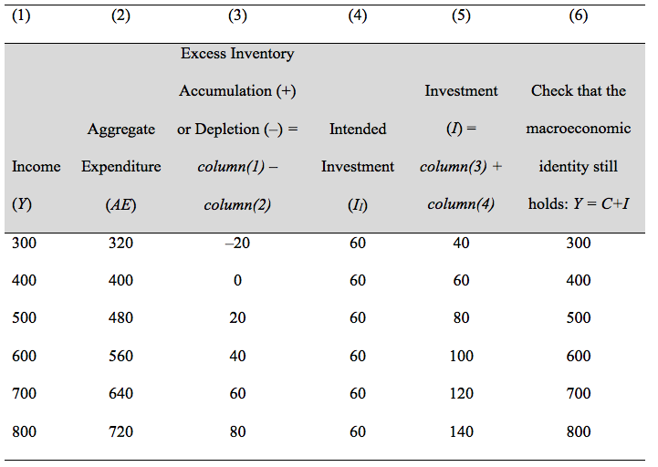
Table 9.5 The Possibility of Excess Inventory Accumulation or Depletion

Slide 20
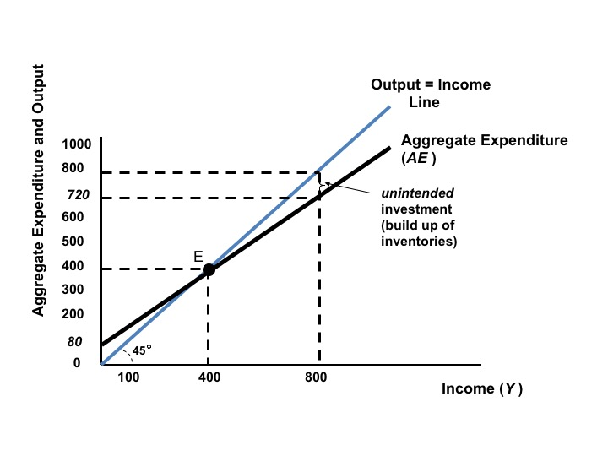
Figure 9.14 Unintended Investment in the Keynesian Model

Slide 21
Figure 9.15 Full Employment Equilibrium with High Intended Investment

Slide 22
Figure 9.16 A Keynesian Unemployment Equilibrium

Slide 23
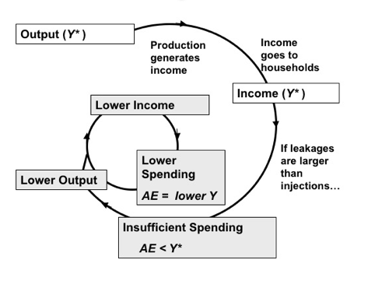
Figure 9.17 Movement to an Unemployment Equilibrium

Slide 24
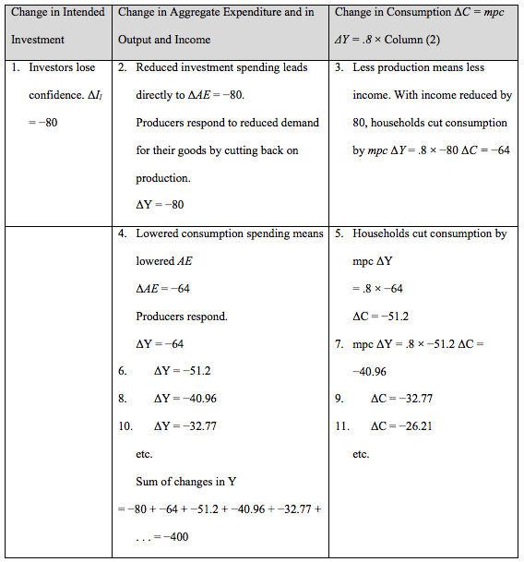
Table 9.6 The Multiplier at Work

