Slide 1

Chapter 8
Employment, Unemployment, and Wages

Slide 2
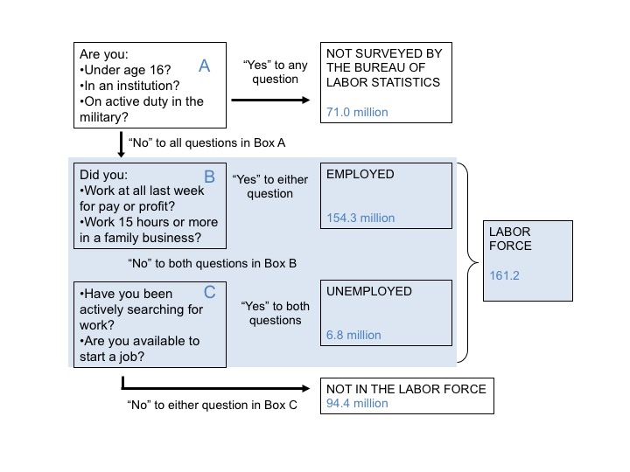
Figure 8.1 Who is in the Labor Force? (September 2017 data)
Source: BLS News Release, “The Employment Situation—September 2017,” October 6, 2017; U.S. Census Bureau Current Population Clock.

Slide 3
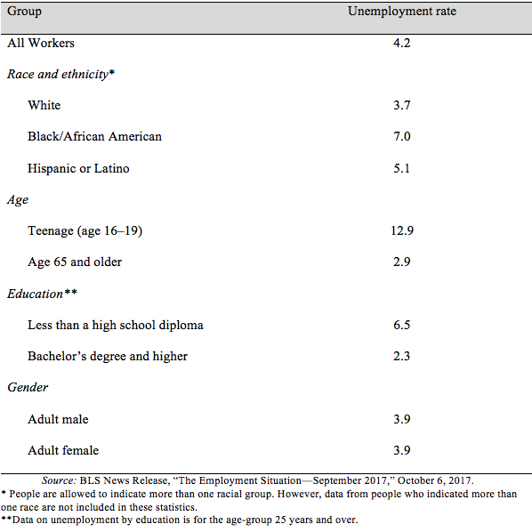
Table 8.1 Unemployment Rates for Different Groups, September 2017

Slide 4
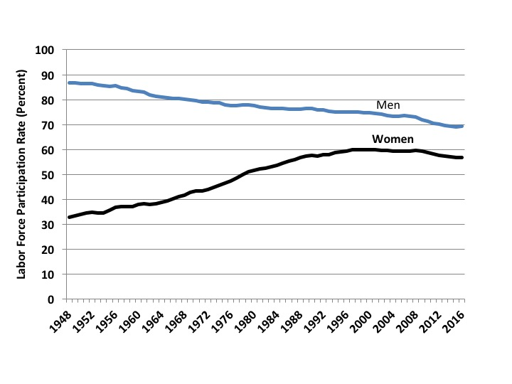
Figure 8.2 Male and Female Labor Force Participation Rates, Aged 24 to 54, 1948-2016
Sources: Abraham Mosisa and Steven Hipple, “Trends in Labor Force Participation in the United States,” BLS Monthly Labor Review, pp. 35–57, October 2006; BLS 2017 Employment and Earnings Online, Household Survey Data; various editions of the Statistical Abstract of the United States.
Source: CEA, 2016b; Krueger, 2017.

Slide 5
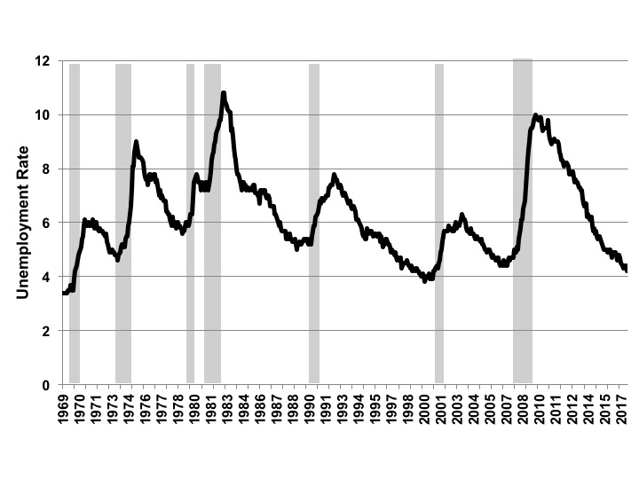
Figure 8.3 The Monthly Unemployment Rate in the United States, 1969-2017
Source: U.S. Bureau of Labor Statistics online database.
Notes: Recessionary periods shaded.

Slide 6
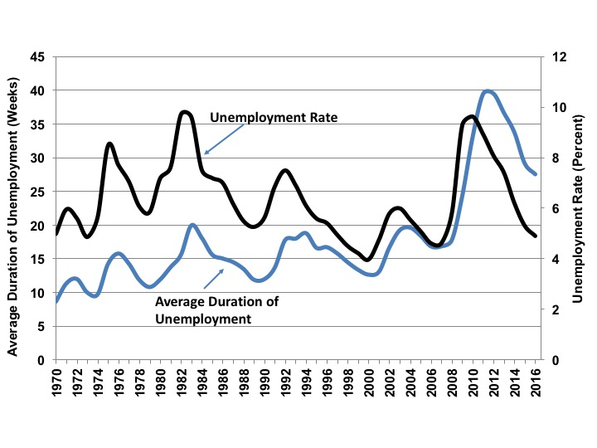
Figure 8.4 Average Duration of Unemployment and Unemployment Rate, 1969-2016
Source: U.S. Bureau of Labor Statistics online database.

Slide 7
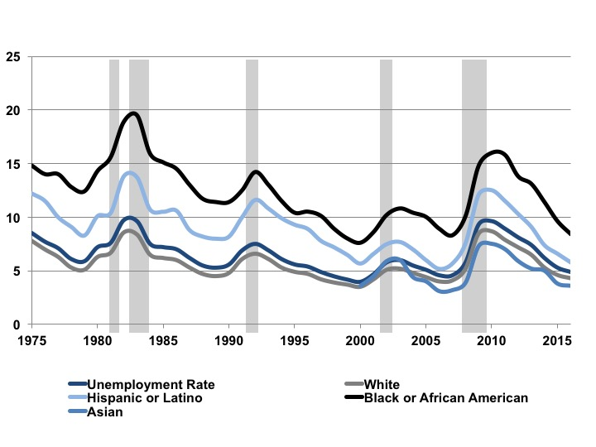
Figure 8.5 Unemployment Rate by Race, 1975-2017
Source: U.S. Bureau of Labor Statistics online database.

Slide 8
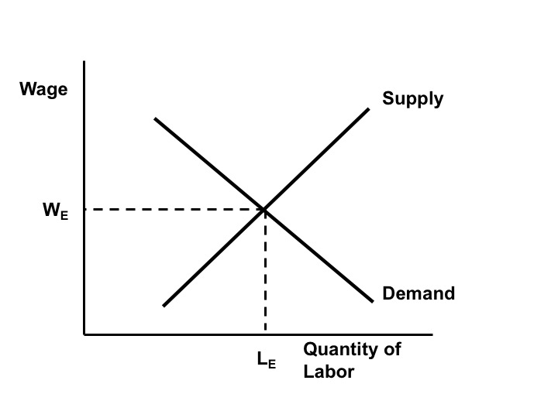
Figure 8.6a The Classical Labor Market Model

Slide 9
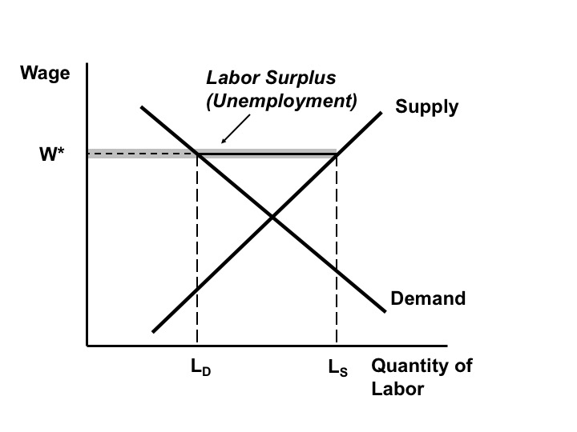
Figure 8.6b Unemployment in the Classical Labor Market Model

Slide 10
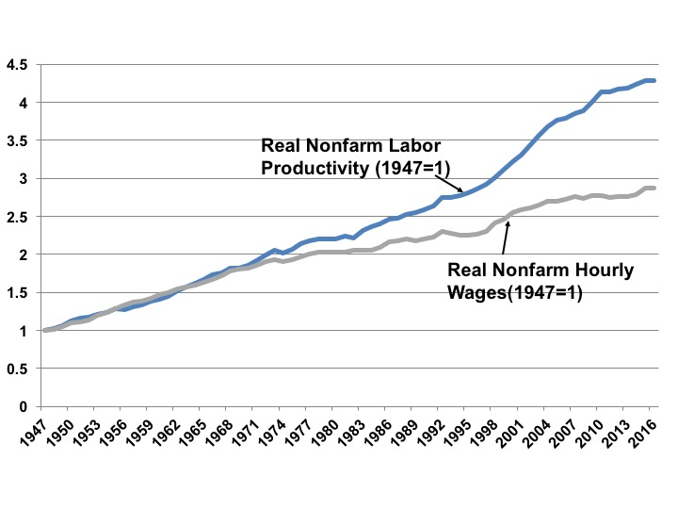
Figure 8.7 Real Nonfarm Median Wages and Labor Productivity, 1947-2016
Source: U.S. Bureau of Labor Statistics, Labor Productivity and Costs online database.

