Slide 1

Chapter 5
Macroeconomic Measurement: The Current Approach

Slide 2
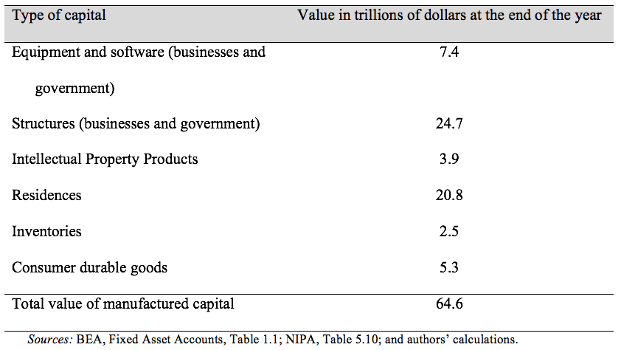
Table 5.1 The Estimated Size of U.S. Manufactured Capital Stock, 2016

Slide 3
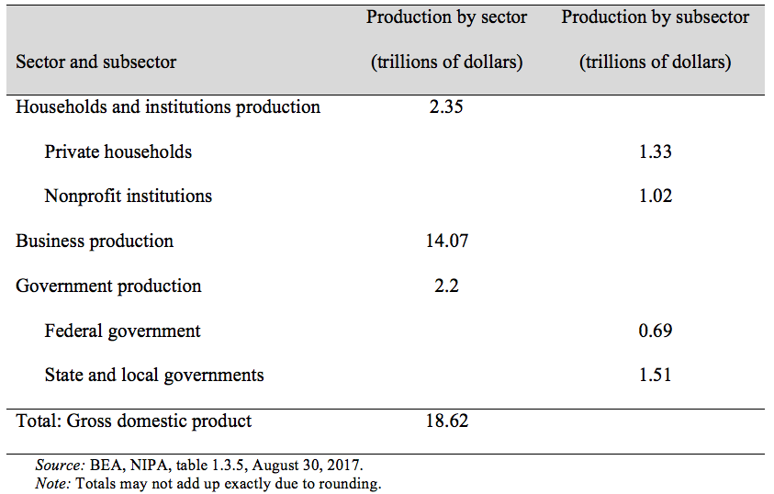
Table 5.2 Gross Domestic Product, Product Approach, 2016

Slide 4
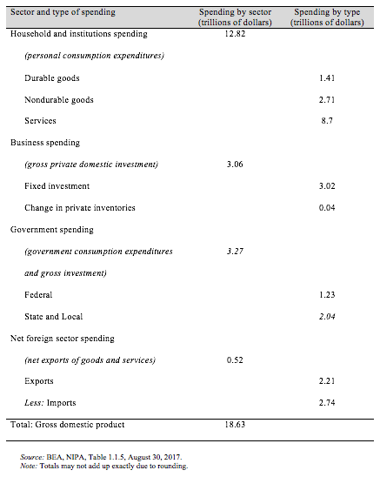
Table 5.3 Gross Domestic Product, Spending Approach, 2016

Slide 5
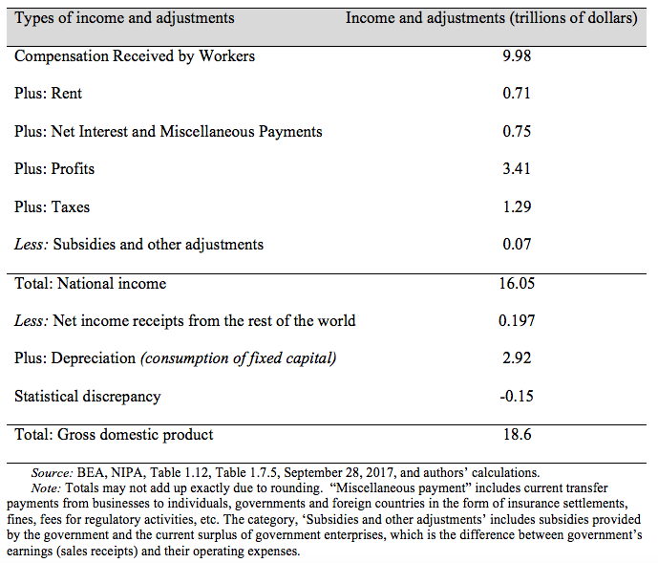
Table 5.4 Gross Domestic Product, Income Approach, 2016

Slide 6
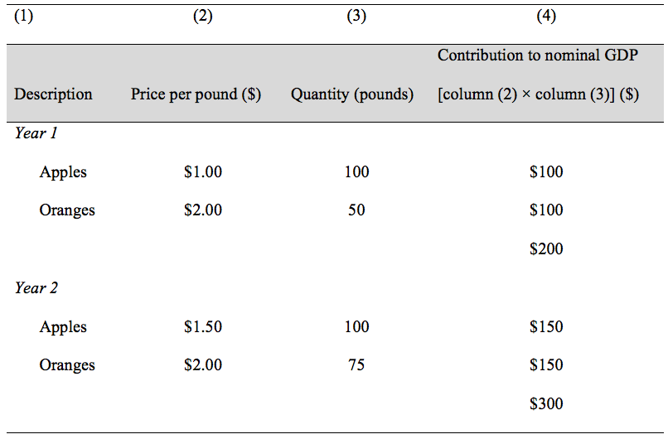
Table 5.5 Calculation of Nominal GDP in an “Apples-and-Oranges” Economy

Slide 7
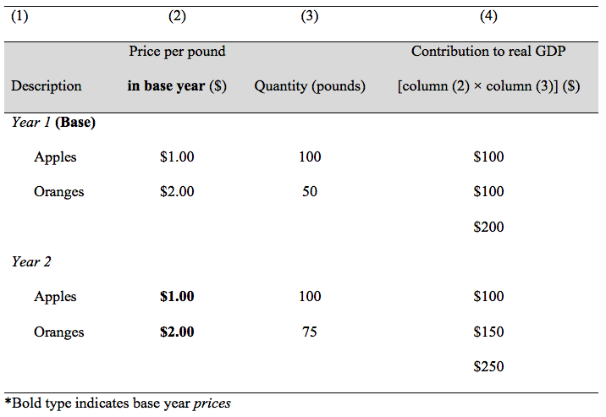
Table 5.6 Calculation of Constant-Dollar Real GDP

Slide 8
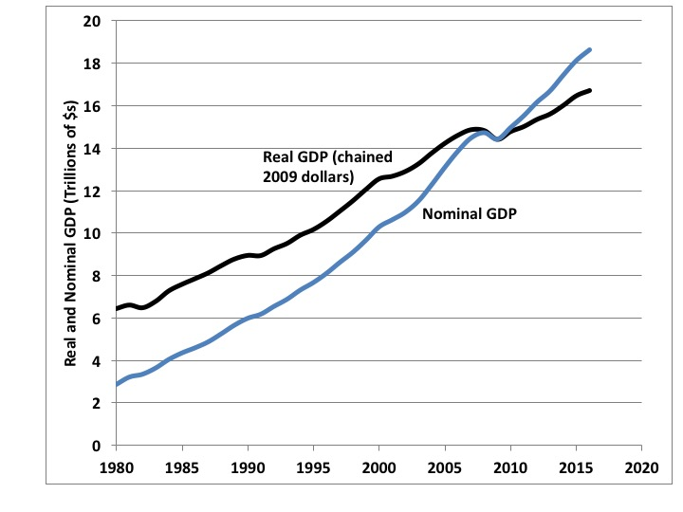
Figure 5.1 Real versus Nominal GDP, Chained 2009 Dollars, 1980-2016
Source: BEA NIPA Tables 1.1.5 and 1.1.6, published 1/30/2017.

Slide 9
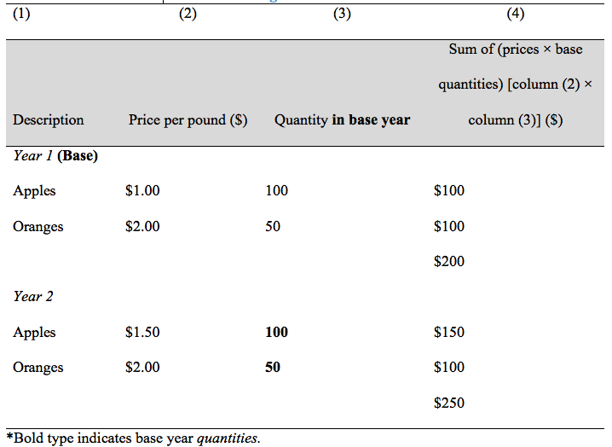
Table 5.7 Calculation of a Constant-Weight Price Index

Slide 10
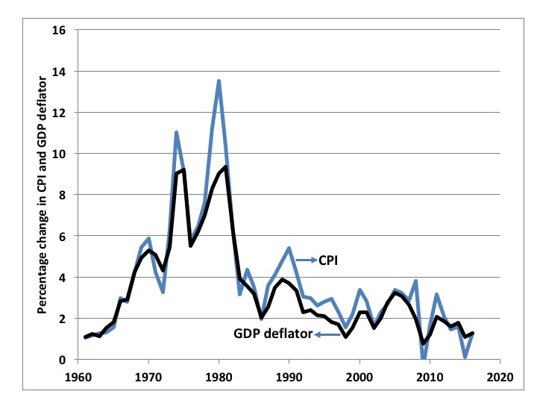
Figure 5.2 Rate of Change in GDP Deflator vs. CPI,
1960-2016
Source: BEA NIPA Tables 1.1.4 and BLS Table on CPI-All urban consumers.

Slide 11
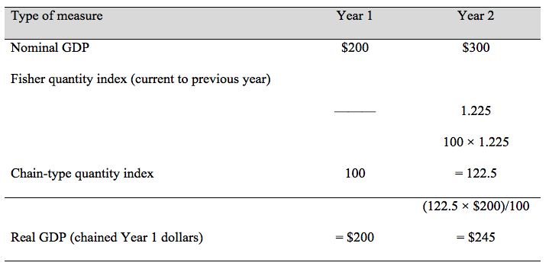
Table 5.8 Deriving Real GDP in Chained (Year 1) Dollars

