Slide 1

Chapter 4
Supply and Demand

Slide 2
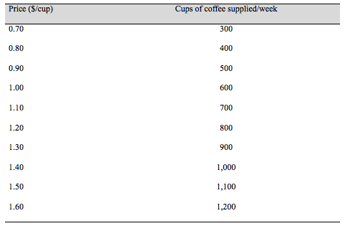
Table 4.1 A Supply Schedule for Coffee

Slide 3
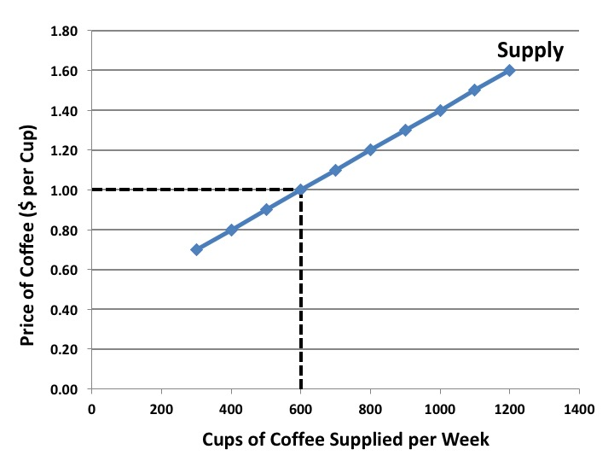
Figure 4.1 The Supply Curve for Cups of Coffee

Slide 4
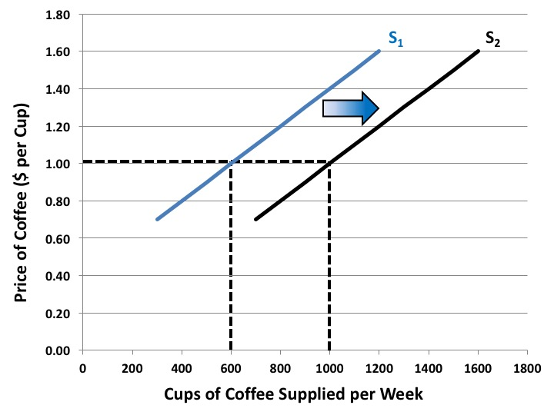
Figure 4.2 An Increase in Supply

Slide 5
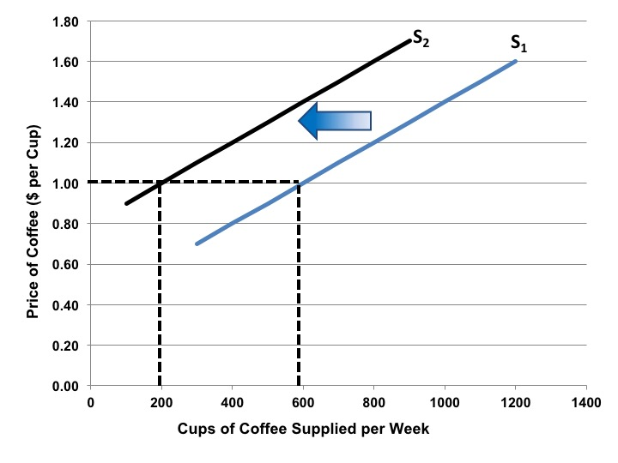
Figure 4.3 A Decrease in Supply

Slide 6
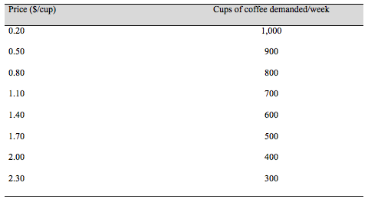
Table 4.2 A Demand Schedule for Coffee

Slide 7
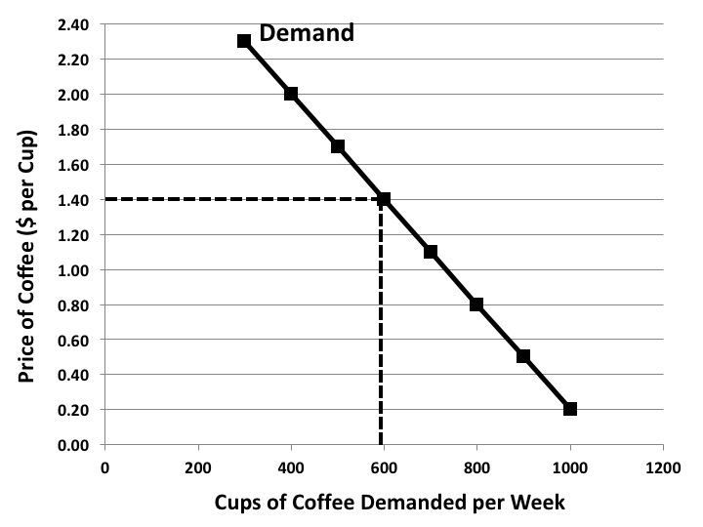
Figure 4.4 The Demand Curve for Cups of Coffee

Slide 8
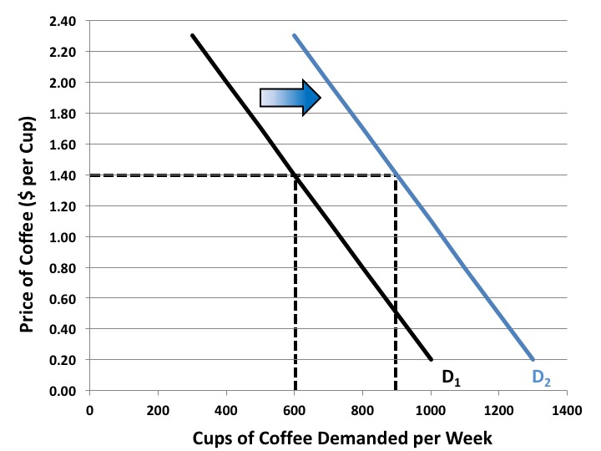
Figure 4.5 An Increase in Demand

Slide 9
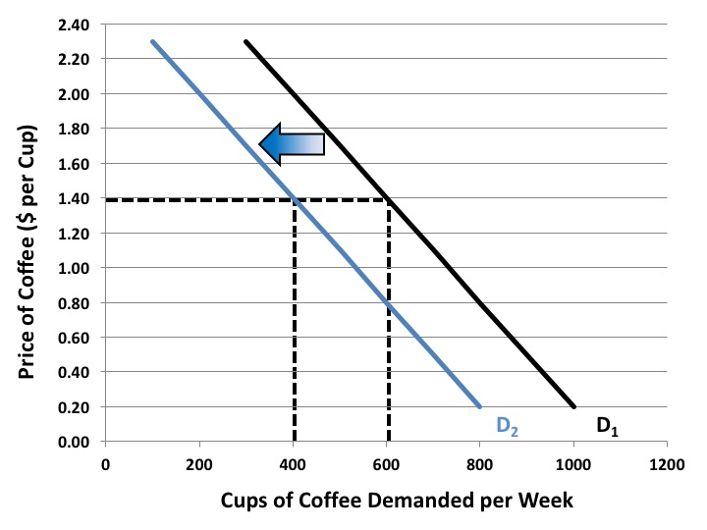
Figure 4.6 A Decrease in Demand

Slide 10
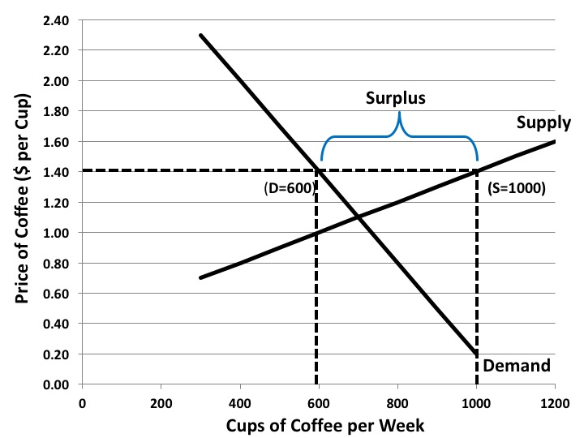
Figure 4.7 A Market Surplus

Slide 11
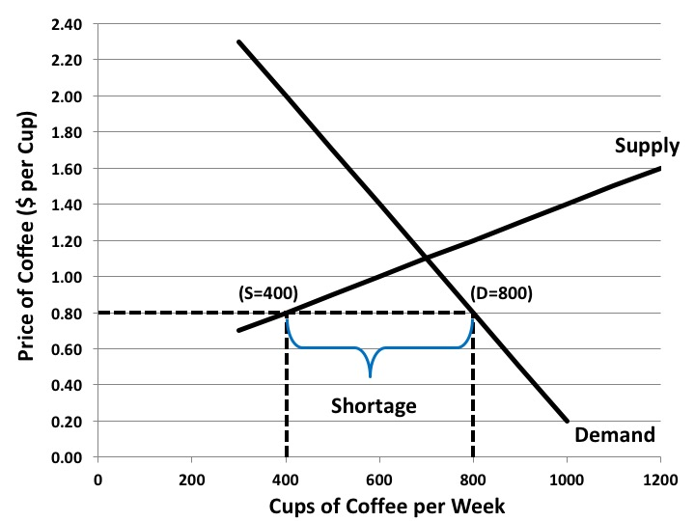
Figure 4.8 A Market Shortage

Slide 12
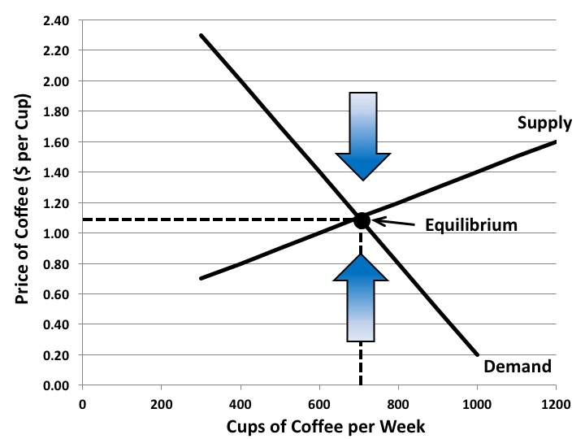
Figure 4.9 Market Equilibrium

Slide 13
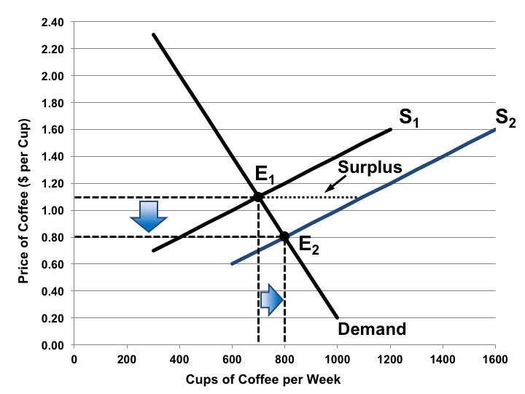
Figure 4.10 Market Adjustment to an Increase in Supply

Slide 14
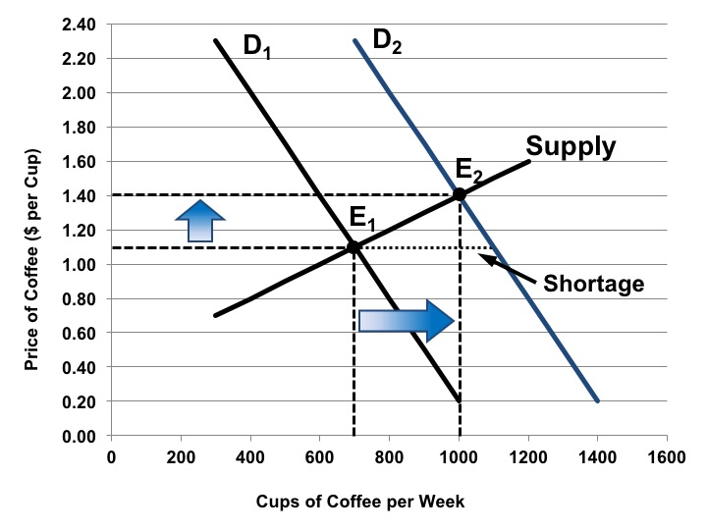
Figure 4.11 Market Adjustment to an Increase in Demand

Slide 15
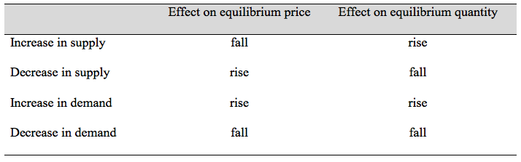
Table 4.3 Effects of Changes in Supply and Demand

Slide 16
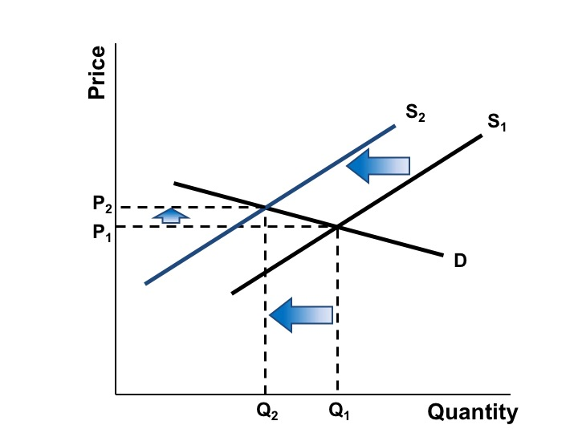
Figure 4.12A Price Elasticity of Demand, Relatively price-elastic demand

Slide 17
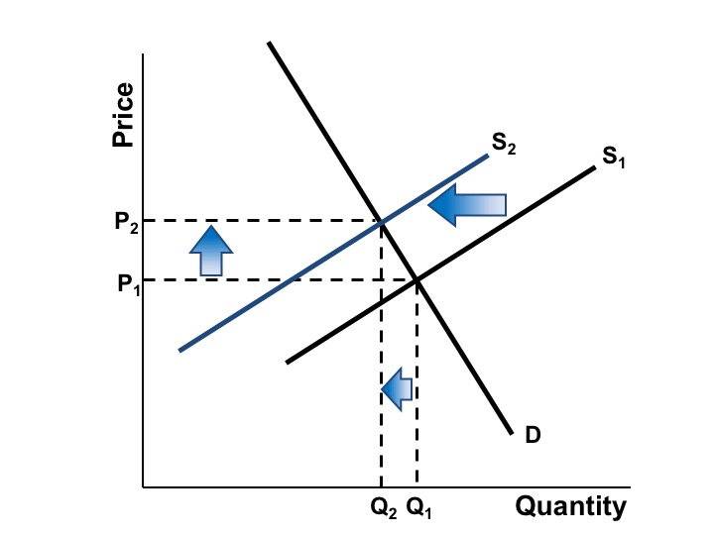
Figure 4.12B Price Elasticity of Demand, Relatively price-inelastic demand

Slide 18
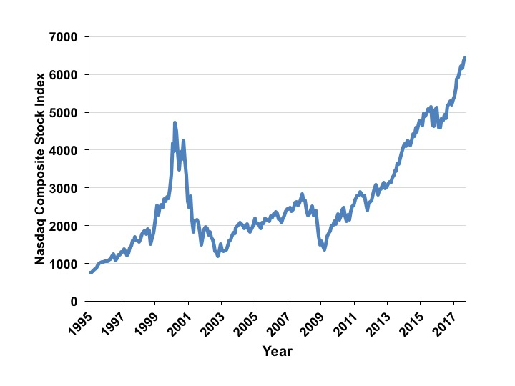
Figure 4.13 The Nasdaq Composite Stock Index, 1995–2017
Source: Yahoo! Finance, Monthly data.

